Slide 1
BAA1113 Statistics, Visualization & Communication
Can Ireland's grid reach 80% renewable electricity by 2030?
Data: Kaggle open datasets on European Energy: Generation, Prices & 2030 Targets
GROUP
PRESENTED BY
9
Shreyas Patil · Sanjana Mahabal · Sayali Chavan · Soham Gode · Aditya Kadam
Notes:
[Member 1 · about 0:20]
Good morning, everyone. Can Ireland's grid reach 80 per cent renewable electricity by 2030? That is the one question we will answer in the next few minutes, using a Power BI dashboard we built on open Ember data.
RUN OF SHOW
Speaking time across all ten slides: about 5:30, plus roughly 25s of handovers, so about 5:55 in total. That leaves a buffer under the 8-minute limit.
Member 1: slides 1 to 3 · Member 2: slide 4 · Member 3: slides 5 to 6 · Member 4: slides 7 to 8 · Member 5: slides 9 to 10.
If you are running long, skip the audience guess on slide 7 and the limits detail on slide 9.

Slide 2
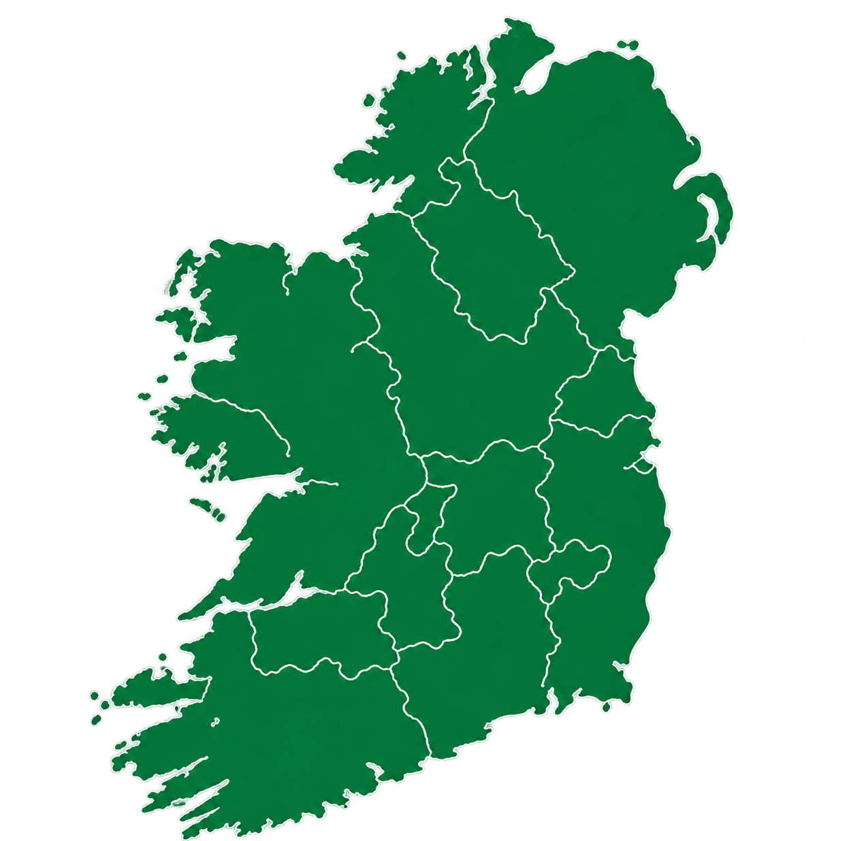
Ireland is just under halfway, with five years left
Summary
48.4% of Ireland's electricity came from renewables in 2025
The official goal is 80% by 2030
That leaves a gap of 31.6 percentage points to close
With 5 years left, Ireland needs 6.3 points a year to get there
Renewable share, 2025
Gap: 31.6 points
0%
Today: 48.4%
2030 goal: 80%
100%
Notes:
[Member 1 · about 0:20]
Ireland is at 48.4 per cent renewable electricity, almost half. The goal is 80 per cent by 2030, so the gap is 31.6 percentage points, with five years to close it. Hold on to that number, because the rest of this talk tests whether it is realistic.

Slide 3




We split one big question into four
OUR APPROACH
Where are we today?
How do we compare?
What does it cost?
What would it take?
Renewable share from 1990 to 2025, and how fast it is moving.
Which fuels lead the 2025 mix.
Ireland ranked against other European countries.
The spread from leaders to laggards, and its link to price.
Wholesale prices against other European countries.
How the Irish premium has moved since 2019.
The pace and fuel mix the 2030 target demands.
How much faster Ireland must build to reach 80%.
Dashboard 1 Ireland overview
Dashboard 2 Europe comparison
Dashboard 3 price
Dashboard 4 recommendation
Notes:
[Member 1 · about 0:35]
We split the question into four: where are we, how do we compare, what does it cost, and what would it take. Each has its own page in the dashboard, built from two Ember datasets, generation by fuel and wholesale prices. Green always means Ireland, and orange flags a gap. [LIVE DEMO, about ten seconds: switch to Power BI, change the Country slicer, show the cards update, then come back.] Member 2 will take it from here.

Slide 4
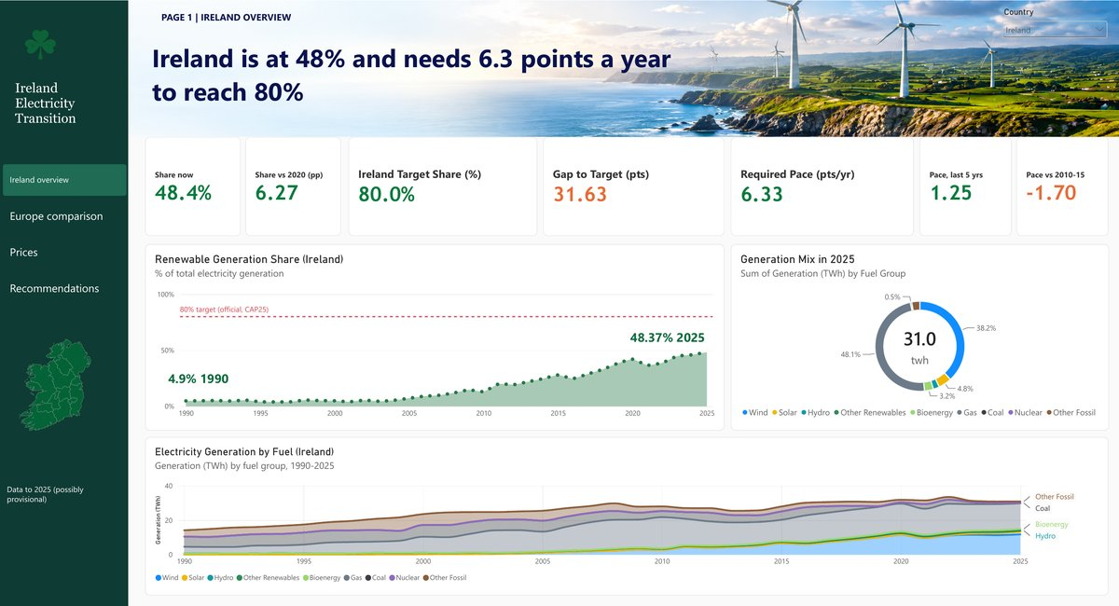
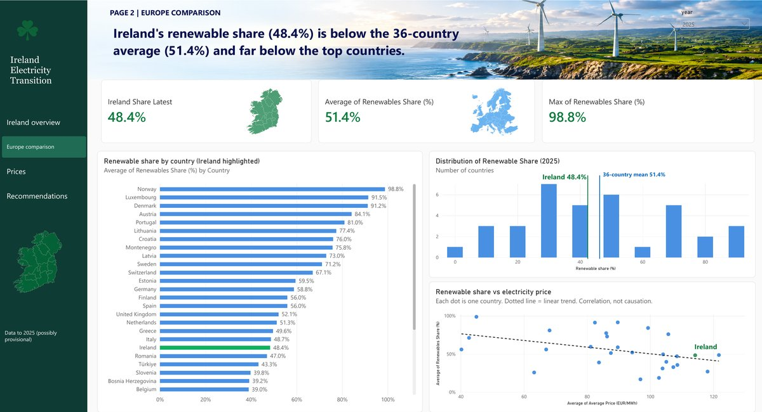
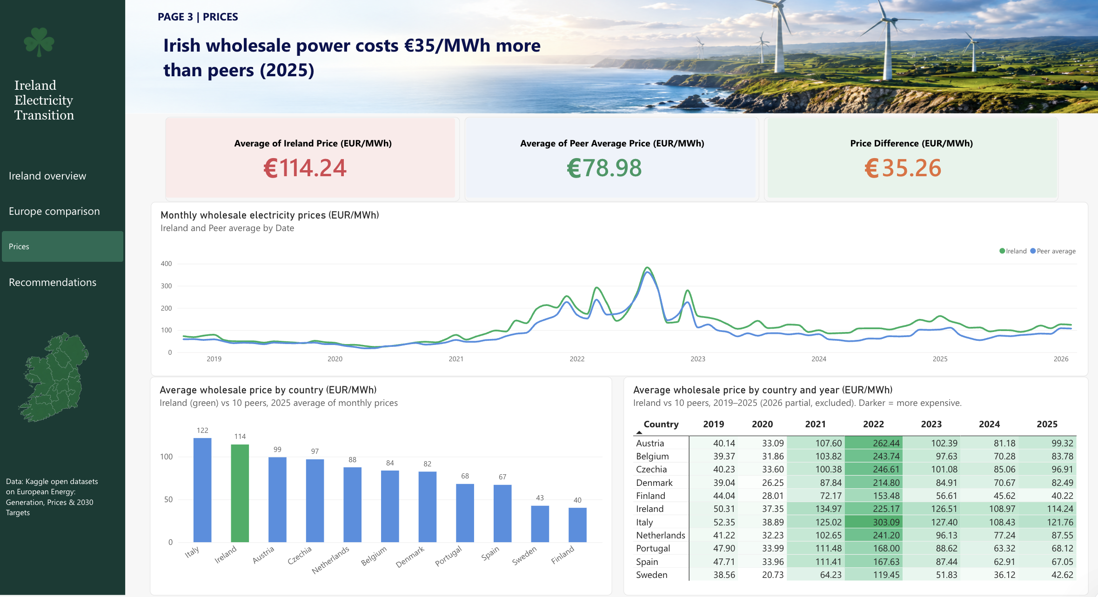
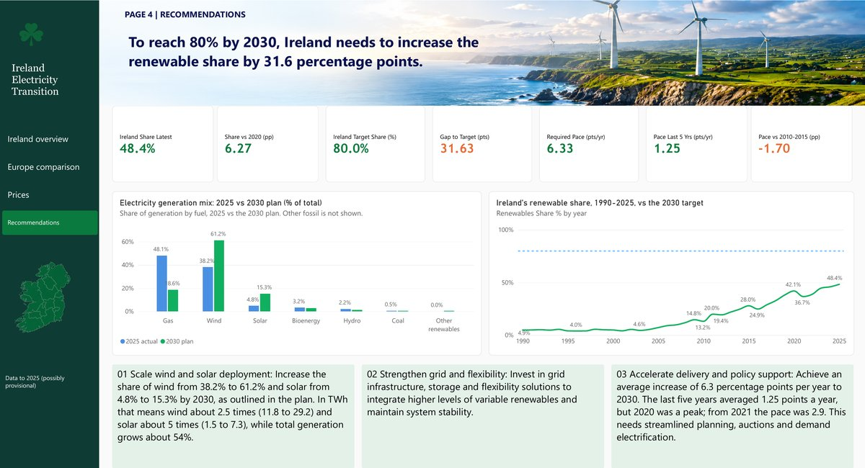
Four pages, one for each question
DASHBOARD
Behind the four pages
1
One linked model
Countries, dates, generation, prices and 2030 targets.
1 · Ireland overview
Trend, fuel mix, KPI cards
2 · Europe comparison
Ranking, spread, price scatter
Three DAX measures
Share, gap to target and required pace.
2
3
A simple color code
Green is always Ireland. Orange flags a gap.
3 · Prices
Premium against ten peers
4 · Recommendations
Required pace and 2030 plan
Notes:
Backup slide for questions. Overview of the four dashboard pages and the model behind them.

Slide 5
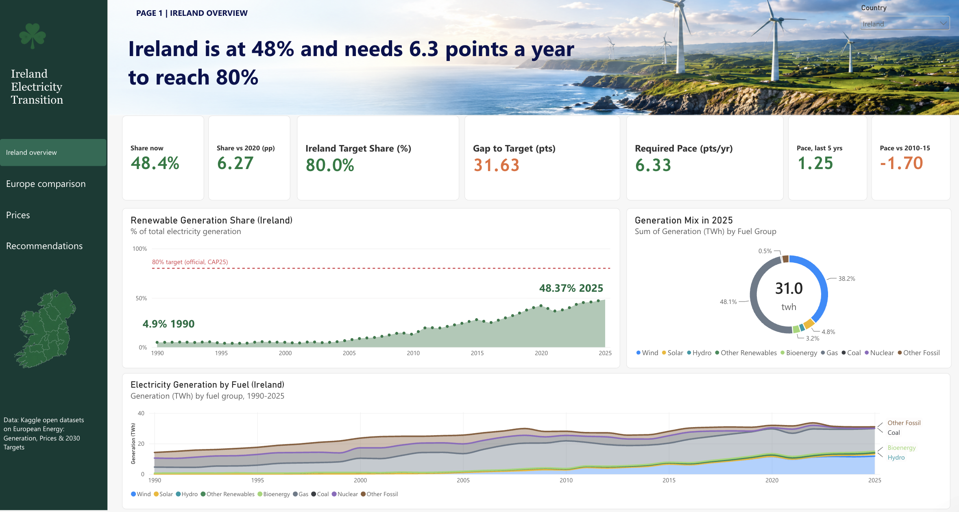
Ireland overview: share, fuel mix and required pace
DASHBOARD PAGE 1
Notes:
Backup slide for questions. The full dashboard page, as built in Power BI.

Slide 6
Progress has slowed, and gas still leads
FINDING · WHERE WE ARE
48.4% renewable in 2025, up from 4.9% in 1990
Share dipped to 36.7% in 2021 before recovering
Growth slowed to 1.25 points a year since 2020
That is 1.70 points a year slower than 2010–2015
Gas still supplies 48.1%, the largest share
Wind gives 38.2% and solar only 4.8%
Renewable required pace to grow is 6.3 points per year
Share of generation by fuel, 2025
Notes:
[Member 2 · about 0:55]
Let's start with where we are. In 1990 only 4.9 per cent of our electricity was renewable. It peaked at 42.1 in 2020, dipped to 36.7 in 2021, and reached 48.4 last year. That is just 1.25 points a year over the last five years, 1.7 slower than 2010 to 2015, so progress is real but not accelerating. The reason is on the right: gas is still 48.1 per cent of generation, wind is 38.2 and solar is under five. The 2030 plan needs wind at 61, solar at 15 and gas down to 19. That means wind about two and a half times larger, solar five times, and total generation up 54 per cent as heat and transport electrify. Over to Member 3.

Slide 7
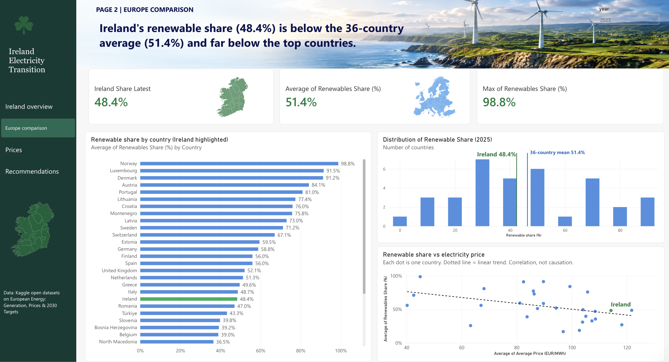
Europe comparison: ranking, spread and price scatter
DASHBOARD PAGE 2
Notes:
Backup slide for questions. The full dashboard page, as built in Power BI.

Slide 8
Ireland ranks 20th of 36, in the crowded middle
FINDING · EUROPE COMPARISON
51.4%
Simple average of the 36 countries in our dashboard
48%
Ireland is the 20th country in renewable weightage against Europe
98.8%
Norway, ranked 1st of 36, about twice Ireland's 48.4%
Notes:
[Member 3 · about 0:25]
How do we compare? Ireland ranks twentieth of thirty-six, at 48.4 per cent, just behind Italy and ahead of Romania. Norway leads with 98.8. Our dashboard average is 51.4, but Ember's generation-weighted figure for the EU is 48. So we trail the typical country, but match Europe as a system.

Slide 9
Prices: Ireland against ten peers, 2019 to 2025
DASHBOARD PAGE 3
Notes:
Backup slide for questions. The full dashboard page, as built in Power BI.

Slide 10
Ireland has been above the peer average every year
FINDING · PRICES OVER TIME
+€7
Irish premium in 2019, before the price spike
+€13
premium at the 2022 spike, when every country was hit
+€35
premium in 2025, after widening to about €37 to €39 in 2023 and 2024
Average wholesale price, € per MWh. Annual averages of monthly prices.
Notes:
Backup slide for questions. Annual averages from the dashboard's price table, with the ten-peer average calculated by us.

Slide 11
Irish wholesale power costs 44.6% more than peers
FINDING · PRICES COMPARISON
Ireland, 2025
Ten peers, 2025
Irish premium
€114.24
€78.98
+€35.26
per MWh
per MWh
only Italy is dearer
Do more renewables mean cheaper power?
Only modestly: r = −0.39 across 31 countries in 2025, and close to zero when all years are pooled.
A likely suspect: gas
Gas price spikes lifted prices in 21 EU countries in 2025, and gas is still 48.1% of Irish generation.
Average wholesale price in 2025, € per MWh. Ireland and ten peers.
Notes:
[Member 3 · about 0:40]
Now cost. Irish wholesale power averaged 114 euros a megawatt-hour in 2025, against 79 for our ten peers: a premium of 35 euros, about 45 per cent, and only Italy was dearer. Do more renewables mean cheaper power? Only modestly: minus 0.39 across thirty-one countries, and about zero pooled across years. Gas is a likely suspect, since gas spikes lifted prices in 21 EU countries and it is still almost half our generation. That is a link to test, not a proven cause. Over to Member 4.

Slide 12
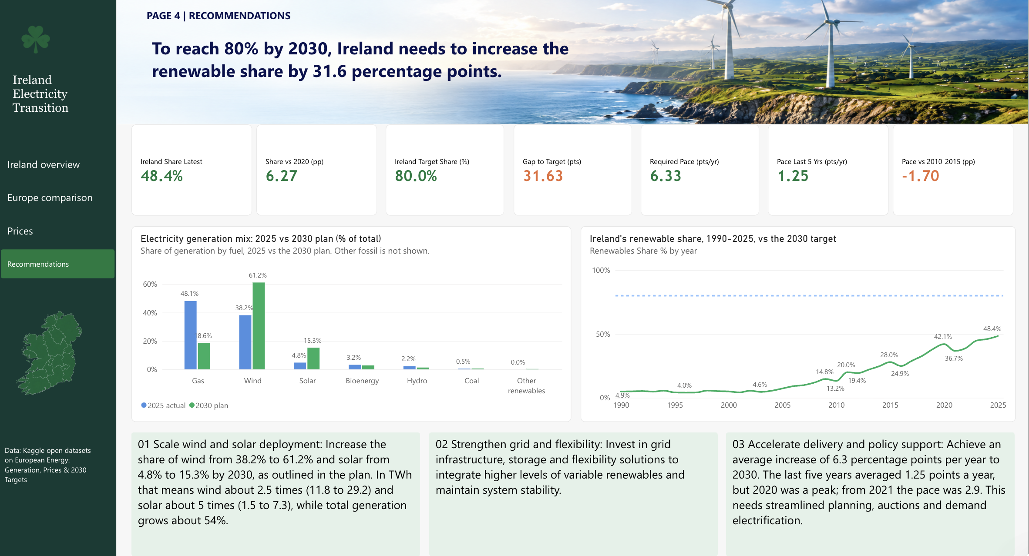
Recommendations: 2025 versus the 2030 plan
DASHBOARD PAGE 4
Notes:
Backup slide for questions. The full dashboard page, as built in Power BI.

Slide 13
Ireland must build 5× faster to reach 80%
FINDING · THE GAP IS PACE, NOT AMBITION
Percentage points of renewable share added per year
5.1×
faster than Ireland has built since 2020
Even the best five years on record managed less than half the pace needed.
Notes:
[Member 4 · about 0:40]
Here is the core issue. Quick guess before you read the number: how many times faster than the last five years do we need to build? [Pause three seconds.] About five times, 5.1. We need 6.3 points a year and have managed 1.25. Even the better pace since the 2021 low, 2.9 a year, only reaches about 63 per cent by 2030, and the last-five-year pace gets us to about 55. So the gap is not ambition. It is speed of delivery.

Slide 14



Four moves to close the gap
RECOMMENDATIONS
Scale up wind and solar
Strengthen the grid
Take wind from 38.2% to 61.2% of generation and solar from 4.8% to 15.3%, as the 2030 plan assumes.
Add storage, interconnection and flexible demand, so gas becomes the backup rather than the backbone.
Wind 2.5× · solar 5×
Less exposure to gas spikes
Speed up delivery
Treat price as its own goal
Faster planning, grid connections and auctions, and a yearly check of required against achieved pace.
Find out what drives the premium before promising lower bills. Renewables alone may not close it.
6.3 needed vs 1.25 achieved
€35.26 per MWh to explain
Notes:
[Member 4 · about 0:30]
Four recommendations. Scale wind and solar to what the plan needs. Strengthen the grid with storage, interconnection and flexible demand, so gas becomes the backup, not the backbone. Speed up delivery, and compare required with achieved pace every year. And treat price as its own goal, because renewables alone may not close a 35 euro premium. Member 5 will close.

Slide 15
CONCLUSION
A delivery problem, not a direction problem
Thank you
80% is reachable only if wind and solar are built at several times the recent rate, on a grid flexible enough to use them.
Questions welcome
5.1×
48.1%
€35
the recent pace needed
of generation is still gas
per MWh premium to explain
Notes:
[Member 5 · about 0:35]
To sum up. Ireland has come a long way, from under 5 per cent to almost half. But the evidence points to a delivery problem, not a direction problem: five times the recent pace, gas near half of generation, and a price premium to explain. Eighty per cent is achievable only if wind and solar are built at several times the recent rate, on a flexible grid. Thank you. We are happy to take questions.

Slide 16
Where our numbers come from
DATA AND SOURCES
Kaggle
Open datasets on European Energy: Generation, Prices & 2030 Targets
IEA (2026)
The 80% by 2030 renewable electricity goal in Ireland's Climate Action Plan 2025.
Petrovich (2026)
The generation-weighted EU renewable share (48%) and the effect of gas price spikes on EU wholesale prices in 2025.
Our calculations
Gap to target, required pace, pace extrapolations, the price correlation (r = −0.39, 31 countries, 2025) and the ten-peer averages.
Notes:
Backup slide for questions. Full APA references are in the submitted report.

