Slide 1
Tabulation Method

Slide 2
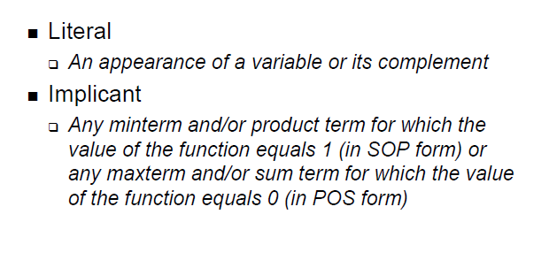
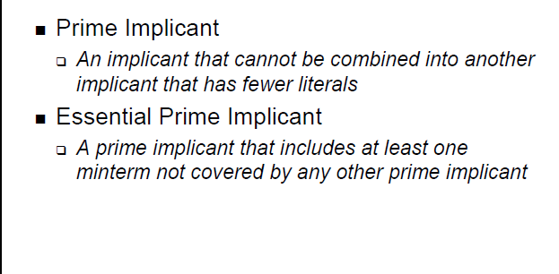
Quine-McCluskey Method
ECE C03 Lecture 3

Slide 3
Common Terms for 2-Level Minimization
Literal – A variable in complemented or uncomplemented form
Product – The disjunction (AND) of a set of literals; also represents a cube
Support Set – Set of all variables that define the domain of a switching function
Minterm – A disjunction (AND) containing an instance of each literal corresponding to a variable in the support set that is in the on-set, f^{on},of a function
Don’t Care – The absence of a supporting variable in a product term
Implicant – A product term that covers one or more minterms in the on-set, f^{on}, of a function
Prime Implicant – An implicant in the on-set, f^{on}, of a function such that it is not a subproduct of any other possible implicant in the set.
Essential Prime Implicant – A prime implicant that covers at least one minterm NOT covered by any other implicant in the on-set, f^{on}.

Slide 4
Quine-McCluskey Method
Tabular method to systematically find all prime implicants
ƒ(A,B,C,D) = Σm(4,5,6,8,9,10,13) + Σd(0,7,15)
Stage 1: Find all prime implicants
Implication Table
Column I
0000 0
0100 4
1000 8
0101 5
0110 6
1001 9
1010 10
0111 7
1101 13
1111 15
Step 1: Fill Column 1 with ON-set and
DC-set minterm indices. Group
by number of 1's.
ECE C03 Lecture 3

Slide 5
Tabular method to systematically find all prime implicants
ƒ(A,B,C,D) = Σ m(4,5,6,8,9,10,13) + Σ d(0,7,15)
Stage 1: Find all prime implicants
Implication Table
Column I Column II Column III
0000 (0) 0-00 (0,4) 01- - (4,5,6,7)
-000 (0,8) -1-1 (5,13,7,15)
0100 (4)
1000 (8) 010- (4,5)
01-0 (4,6)
0101 (5) 100- (8,9)
0110 (6) 10-0 (8,10)
1001 (9)
1010 (10) 01-1 (5,7)
-101 (5,13)
0111 (7) 011- (6,7)
1101 (13) 1-01 (9,13)
1111 (15) -111 (7,15)
11-1 (13,15)
Step 1: Fill Column 1 with ON-set and
DC-set minterm indices. Group
by number of 1's.
Step 2: Apply Uniting Theorem—
Compare elements of group w/
N 1's against those with N+1 1's.
Differ by one bit implies adjacent.
Eliminate variable and place in
next column.
E.g., 0000 vs. 0100 yields 0-00
0000 vs. 1000 yields -000
When used in a combination,
mark with a check. If cannot be
combined, mark with a star. These
are the prime implicants.

Slide 6
Prime Implicants:
0-00 = A' C' D'
100- = A B' C'
1-01 = A C' D
-1-1 = B D
-000 = B' C' D'
10-0 = A B' D'
01-- = A' B
ECE C03 Lecture 3

Slide 7
Prime Implicants:
0-00 = A' C' D'
100- = A B' C'
1-01 = A C' D
-1-1 = B D
-000 = B' C' D'
10-0 = A B' D'
01-- = A' B
Stage 2: find smallest set of prime implicants that cover the ON-set
recall that essential prime implicants must be in all covers
another tabular method– the prime implicant chart
ECE C03 Lecture 3

Slide 8
Finding the Minimum Cover
We have so far found all the prime implicants
The second step of the Q-M procedure is to find the smallest set of prime implicants to cover the complete on-set of the function
This is accomplished through the prime implicant chart
  Columns are labeled with the minterm indices of the onset
  Rows are labeled with the minterms covered by a given prime implicant
  Example a prime implicant (-1-1) becomes minterms 0101, 0111, 1101, 1111, which are indices of minterms m5, m7, m13, m15
ECE C03 Lecture 3

Slide 9






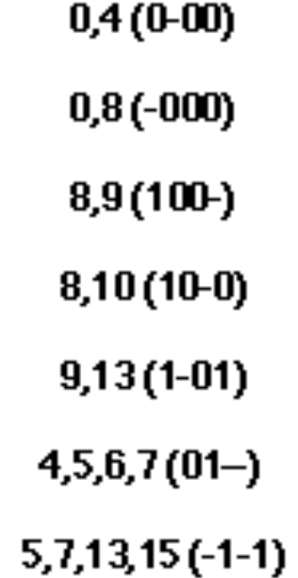

Prime Implicant Chart
4 5 6 8 9 10 13 don’t care terms are not considered
0,4(0-00)
0,8(-000)
8,9(100-)
8,10(10-0)
9,13(1-01)
4,5,6,7(01--)
5,7,13,15(-1-1)
X
X
X X
rows = prime implicants
columns = ON-set elements
place an "X" if ON-set element is
covered by the prime implicant
X X
X X
X X X
X X
ECE C03 Lecture 3

Slide 10
Prime Implicant Chart
4 5 6 8 9 10 13
0,4(0-00)
0,8(-000)
8,9(100-)
8,10(10-0)
9,13(1-01)
4,5,6,7(01--)
5,7,13,15(-1-1)
X
X
X X
X X
X X
X X X
X X
If column has a single X, than the
implicant associated with the row
is essential. It must appear in
minimum cover
ECE C03 Lecture 3

Slide 11
Prime Implicant Chart (Contd)
4 5 6 8 9 10 13
0,4(0-00)
0,8(-000)
8,9(100-)
8,10(10-0)
9,13(1-01)
4,5,6,7(01--)
5,7,13,15(-1-1)
X
X
X X
X X
X X
X X X
X X
Eliminate all columns covered by
essential primes
ECE C03 Lecture 3

Slide 12
Prime Implicant Chart (Contd)
4 5 6 8 9 10 13
0,4(0-00)
0,8(-000)
8,9(100-)
8,10(10-0)
9,13(1-01)
4,5,6,7(01--)
5,7,13,15(-1-1)
X
X
X X
X X
X X
X X X
X X
Find minimum set of rows that
cover the remaining columns
ƒ = A B' D' + A C' D + A' B
ECE C03 Lecture 3

Slide 13
Second Example of Q-M Method
Assume function F(A,B,C,D) = Σ m(0, 1, 4, 5, 7, 12, 14, 15)
Enumerate the minterms in order
of number of uncomplemented variables
Column I lists them
minterms with zero 1’s: 0
minterms with one 1’s : 1,4
minterms with two 1’s : 5,12
minterms with three 1’s : 7,14
minterms with four 1’s : 15
Column II combines minterms that are
adjacent in one variable (that has difference
in one bit position)
example, 0,1 and 0.4 , etc.
Implication Table
Column I Column II Column III
0( 0000) 0,1 (000-) 0,1,4,5 (0-0-)
0,4(0-00) 0,4,1,5(0-0-)
1( 0001) 1,5(0-01)
4( 0100) 4,5(010-)
4,12 (-100)
5( 0101) 5,7(01-1)
12(1100) 12,14(11-0)
7( 0111) 7,15 (-111)
14(1110) 14,15 (111-)
15( 1111)
ECE C03 Lecture 3

Slide 14
Column III tries to combine adjacent
terms in Column II (that has difference
in two bit position)
Example: 0,1 with 4,5 gives 0,1,4,5
0,4 with 1,5 gives 0,1,4,5
No other larger groups
End of procedure
FINAL PRIME IMPLICANTS
(0,1,4,5) representing -0-0 or A C
(4,12)
(5,7)
(12,14)
(7,15)
(14,15)
Implication Table
Column I Column II Column III
0( 0000) 0,1 (000-) 0,1,4,5 (0-0-)
0,4(0-00) 0,4,1,5(0-0-)
1( 0001) 1,5(0-01)
4( 0100) 4,5(010-)
4,12 (-100)
5( 0101) 5,7(01-1)
12(1100) 12,14(11-0)
7( 0111) 7,15 (-111)
14(1110) 14,15 (111-)
15( 1111)
ECE C03 Lecture 3

Slide 15
Prime Implicant Chart for Second Example
0 1 4 5 7 12 14 15
0,1,4,5
5,7
12, 14
7, 15
14, 15
4, 12
X X X X
X X
X X
X X
X X
X X
ECE C03 Lecture 3

Slide 16
Essential Primes for Example
0 1 4 5 7 12 14 15
0,1,4,5
5,7
12, 14
7, 15
14, 15
4, 12
X X X X
X X
X X
X X
X X
X X
ECE C03 Lecture 3

Slide 17
Delete Columns Covered by Essential Primes
0 1 4 5 7 12 14 15
0,1,4,5
5,7
12, 14
7, 15
14, 15
4, 12
X X X X
X X
X X
X X
X X
X X
ECE C03 Lecture 3

Slide 18
Resultant Minimum Cover
0 1 4 5 7 12 14 15
0,1,4,5
5,7
12, 14
7, 15
14, 15
4, 12
X X X X
X X
X X
X X
X X
X X
Several choices
of combinations
of prime implicants.
Resultant minimum function F = 0,1,4,5 + 7,15 + 12, 14
_ _ _
= A C+ B C D + A B D

Slide 19
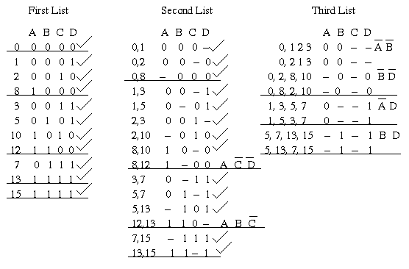
EXAMPLE 3:
Consider the function f(A, B, C, D) = (0,1,2,3,5,7,8,10,12,13,15), note that this is in decimal form.
(0000,0001,0010,0011,0101,0111,1000,1010,1100,1101,1111) in binary form.
ECE C03 Lecture 3

Slide 20
The chart is used to remove redundant prime implicants. A grid is prepared having all the prime implicants listed at the left and all the minterms of the function along the top. Each minterm covered by a given prime implicant is marked in the appropriate position.
_ _ _ _ _ _ _ _
The Prime Implicants are: AB + BD + AD + BC + A CD + ABC
ECE C03 Lecture 3

Slide 21
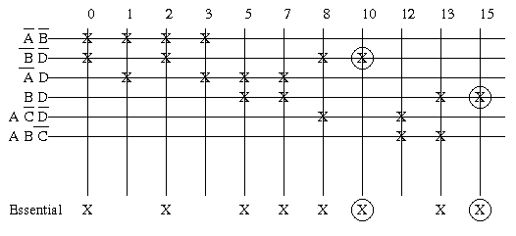
ECE C03 Lecture 3

Slide 22
From the above chart, BD is an essential prime implicant. It is the only prime implicant that covers the Minterm decimal 15 and it also includes 5, 7 and 13.
_ _
BD is also an essential prime implicant. It is the only prime implicant that covers the minterm denoted by decimal 10 and it also includes the terms 0, 2 and 8. The other minterms of the function are 1, 3 and 12. Minterm 1 is present
_ _ _
in AB and AD. Similarly for minterm 3. We can therefore use either of these prime
_ _ _
implicants for these minterms. Minterm 12 is present in A CD and ABC , so again either can be used.
_ _ _ _ _ _
Thus, one minimal solution is: Z=BD+BD+AB+ACD
ECE C03 Lecture 3

Slide 23
Implication Table (1,0,-)
Quine-McCluskey Method
  Tabular method to systematically find all prime implicants
  ƒ(A,B,C,D) = Σ m(4,5,6,8,9, 10,13) + Σ d(0,7,15)
  Part 1: Find all prime implicants
  Step 1: Fill Column 1 with active-set and DC-set minterm indices. Group by number of true variables (# of 1’s).
Implication Table
Column I
0000
0100
1000
0101
0110
1001
1010
0111
1101
1111
NOTE: DCs are included in this step!

Slide 24
Implication Table (cellular)
Quine-McCluskey Method
  Tabular method to systematically find all prime implicants
  ƒ(A,B,C,D) = Σ m(4,5,6,8,9, 10,13) + Σ d(0,7,15)
  Part 1: Find all prime implicants
  Step 1: Fill Column 1 with active-set and DC-set minterm indices. Group by number of true variables (# of 1’s).
Implication Table
Column I
0
4
8
5
6
9
10
7
13
15
NOTE: DCs are included in this step!

Slide 25
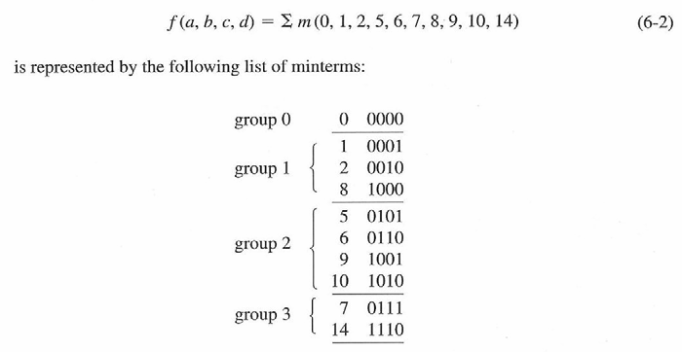
Find f(a,b,c,d)=Σm(0,1,2,5,6,7,8,9,10,14)
ECE C03 Lecture 3

Slide 26
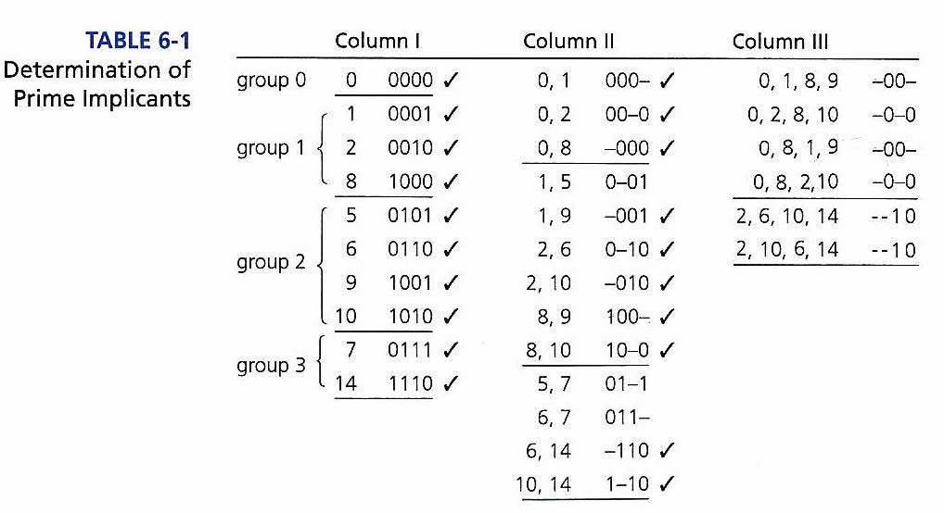
ECE C03 Lecture 3

Slide 27
ECE C03 Lecture 3

Slide 28
ECE C03 Lecture 3

Slide 29

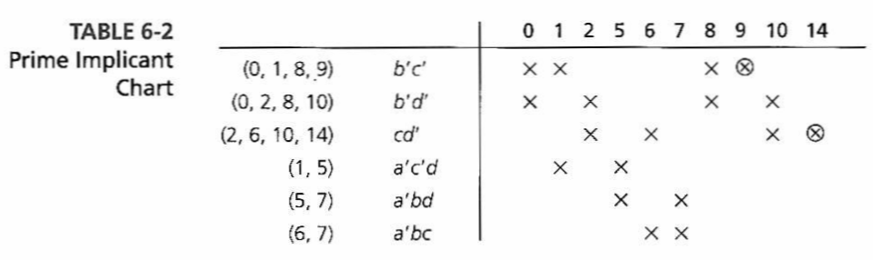
_ _ _ _
Simplified expression is: b c + c d + a b d
ECE C03 Lecture 3

Slide 30
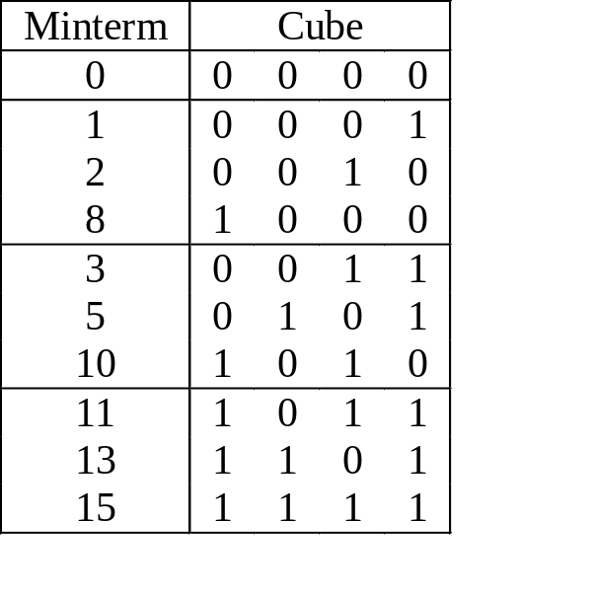
STEP 1 - EXAMPLE
f ^{on} = {m₀, m₁, m₂, m₃, m₅, m₈, m₁₀, m₁₁, m₁₃, m₁₅} = ∑ (0, 1, 2, 3, 5, 8, 10, 11, 13, 15)

Slide 31
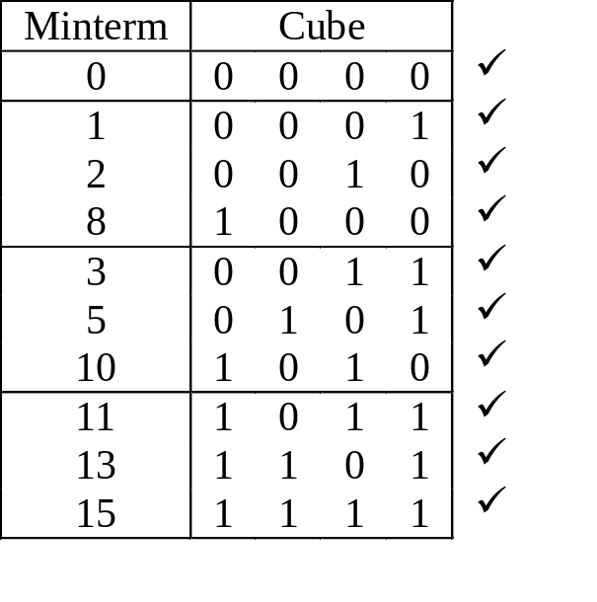
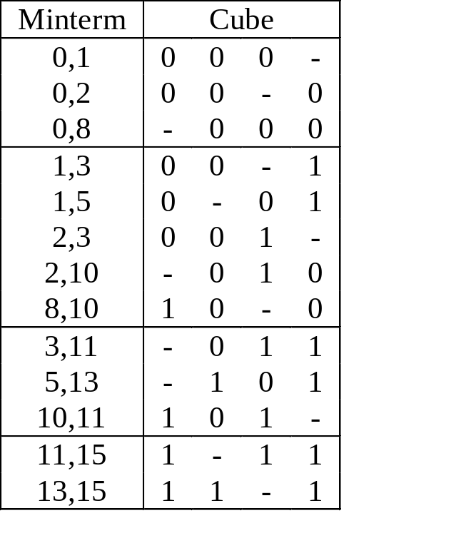
STEP 1 - EXAMPLE
f ^{on} = {m₀, m₁, m₂, m₃, m₅, m₈, m₁₀, m₁₁, m₁₃, m₁₅} = ∑ (0, 1, 2, 3, 5, 8, 10, 11, 13, 15)

Slide 32
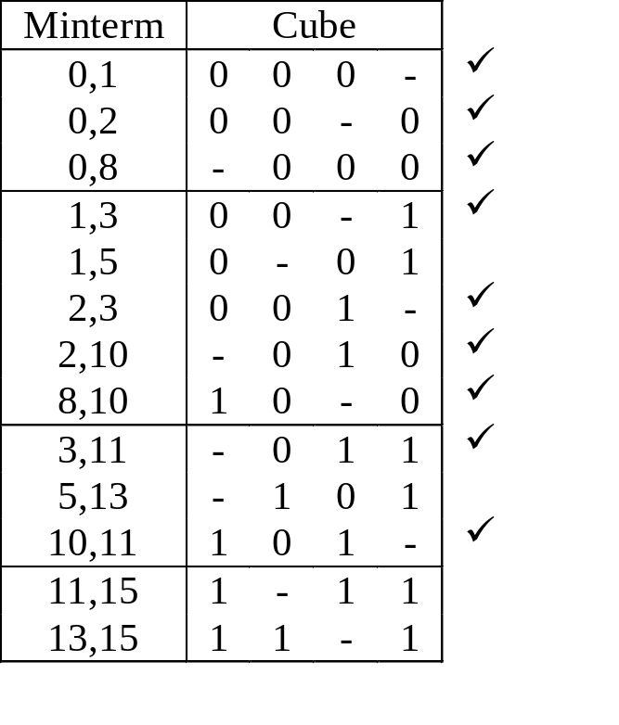
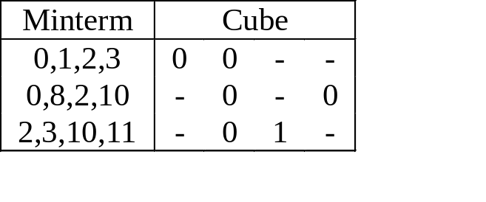
STEP 1 - EXAMPLE
f ^{on} = {m₀, m₁, m₂, m₃, m₅, m₈, m₁₀, m₁₁, m₁₃, m₁₅} = ∑ (0, 1, 2, 3, 5, 8, 10, 11, 13, 15)

Slide 33
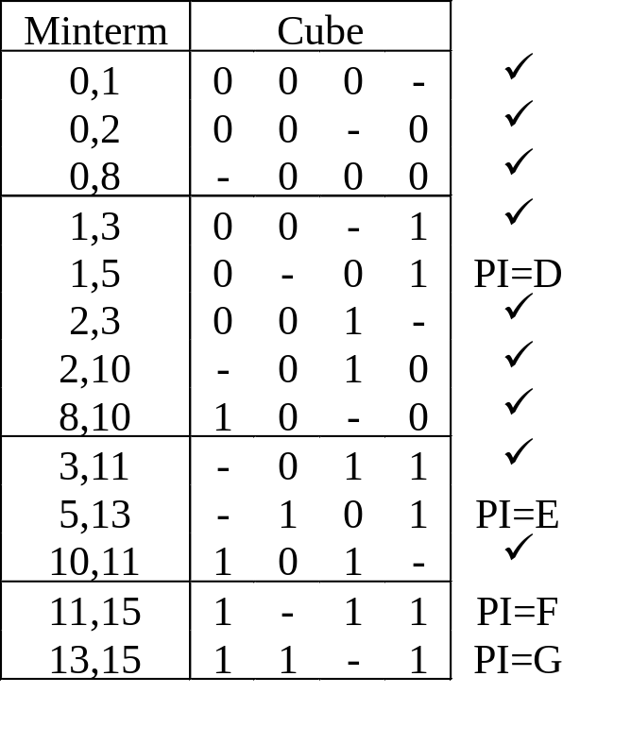
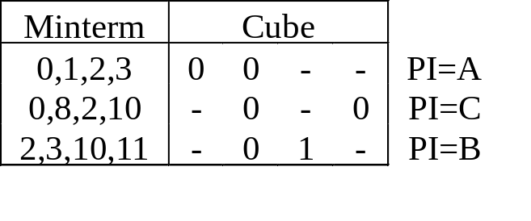
STEP 1 - EXAMPLE
f ^{on} = {m₀, m₁, m₂, m₃, m₅, m₈, m₁₀, m₁₁, m₁₃, m₁₅} = ∑ (0, 1, 2, 3, 5, 8, 10, 11, 13, 15)
Question: Can this be done on a CCM? How modified?
f ^{on} = {A,B,C,D,E,F,G} = {00--, -01-, -0-0, 0-01, -101, 1-11, 11-1}

Slide 34
Prime implicants are:
_ _
AB
_
BC
_ _
BD
_ _
ACD
_
BCD
ACD
ABD
ECE C03 Lecture 3

Slide 35
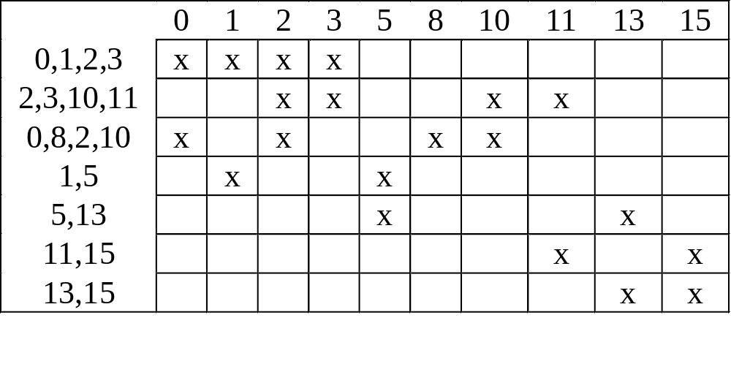
STEP 2 – Construct Cover Table
PIs Along Vertical Axis (in order of # of literals)
Minterms Along Horizontal Axis
NOTE: Table 4.2 in book is incomplete

Slide 36
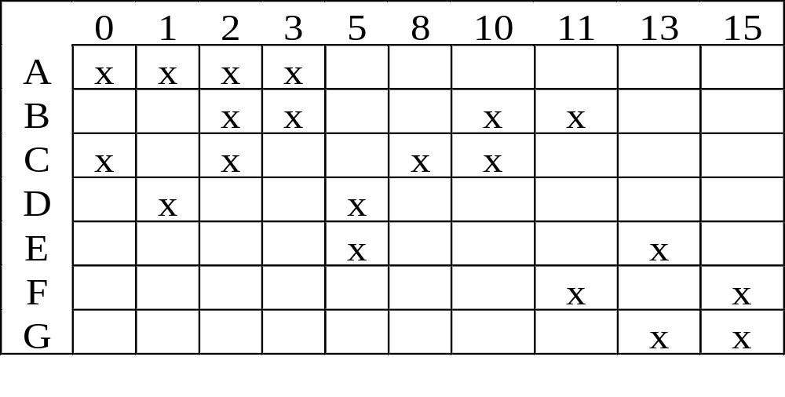
STEP 2 – Finding the Minimum Cover
Extract All Essential Prime Implicants, EPI
EPIs are the PI for which a Single x Appears in a Column
_ _ _ _ _
An EPI is: f ^{on}={C, F,A,E} = BD+ACD+AB+BCD
Row C and Columns 0, 2, 8, and 10 can be Eliminated Giving Reduced Cover Table
Examine Reduced Table for New EPIs

Slide 37
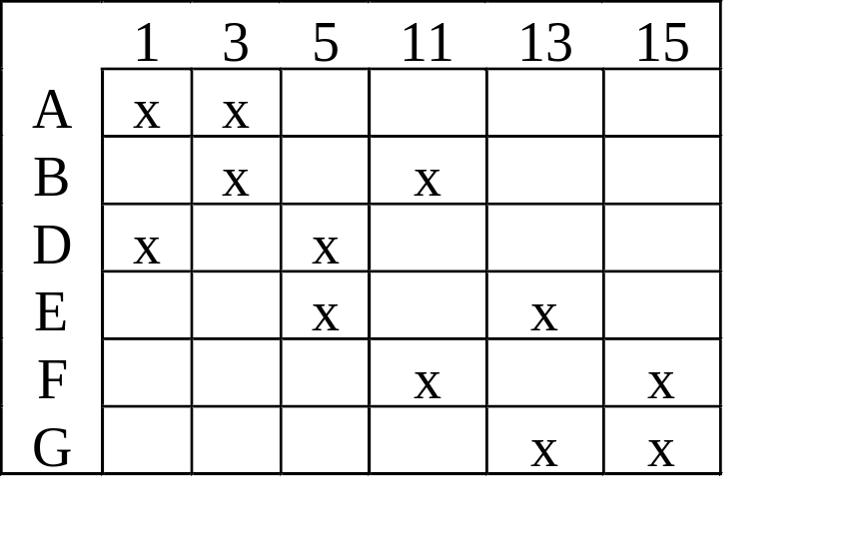
STEP 2 – Reduced Table
Distinguished Column
Essential row
The Row of an EPI is an Essential row
The Column of the Single x in the Essential Row is a Distinguished Column

Slide 38
Row and Column Dominance
If Row P has x’s Everywhere Row Q Does
Then Q Dominates P if P has fewer x’s
If Column i has x’s Everywhere j Does
Then j Dominates i if i has fewer x’s
If Row P is equal to Row Q and Row Q does not cost more than Row P, eliminate Row P, or if Row P is dominated by Row Q and Row Q Does not cost more than Row P, eliminate Row P
If Column i is equal to Column j, eliminate Column i or if Column i dominates Column j, eliminate Column i

Slide 39
STEP 3 – The Reduced Cover Table
Initially, Columns 0, 2, 8 and 10 Removed
No EPIs are Present
No Row Dominance Exists
No Column Dominance Exists
This is Cyclic Cover Table
Must Solve Exactly OR Use a Heuristic

Slide 40
STEP 3 – The Reduced Cover Table
Initially, Columns 0, 2, 8 and 10 Removed
No EPIs are Present
No Row Dominance Exists
No Column Dominance Exists
This is Cyclic Cover Table
Must Solve Exactly OR Use a Heuristic

Slide 41
The Cyclic Cover Table

Slide 42
The Cyclic Cover Table
For now, we Arbitrarily Choose a PI
Later we will Study Exact and Heuristic Methods
Arbitrarily Choose F so: f^{on}={C, F, ...}
This Choice May Lead to a Non-Optimal Result!!!!
Form Reduced Cover and Go To Step 2

Slide 43
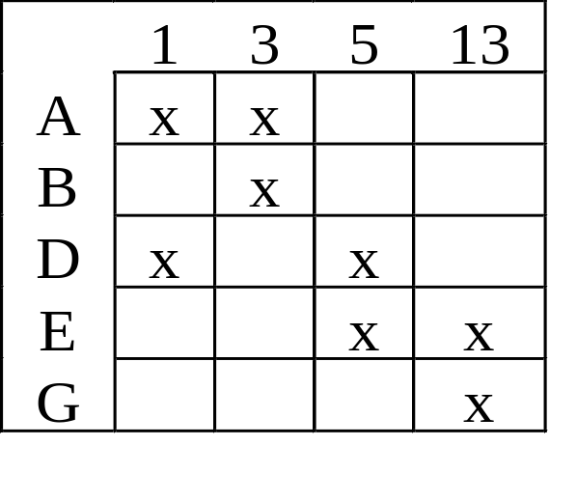
STEP 3 – Dominance
Initially, Reduced Table has Columns 11 and 15 Removed
G is Dominated by E
B is Dominated by A
Form Reduced Cover Table and Go To Step 2

Slide 44
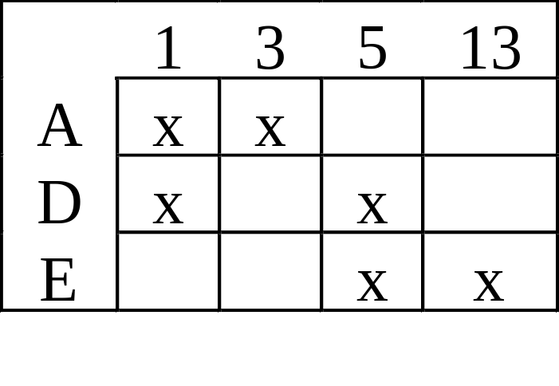
STEP 2 – The Reduced Cover
Initially, Table has Rows G and B Removed
Secondary EPIs – A and E
All Columns Covered
Eliminate D
f^{on}={C, F, A, E}

Slide 45
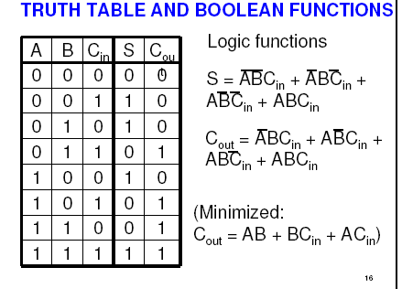
ECE C03 Lecture 3

Slide 46
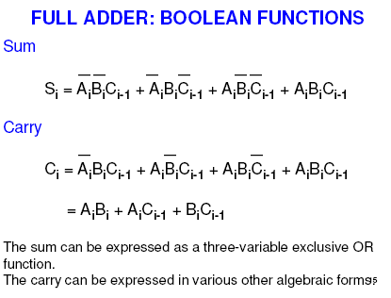
ECE C03 Lecture 3

Slide 47
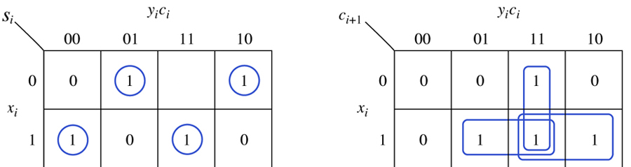
Copyright © The McGraw-Hill Companies, Inc. Permission required for reproduction or display.
Karnaugh maps for the binary full adder.
Figure 5.1
5-<number>

Slide 48
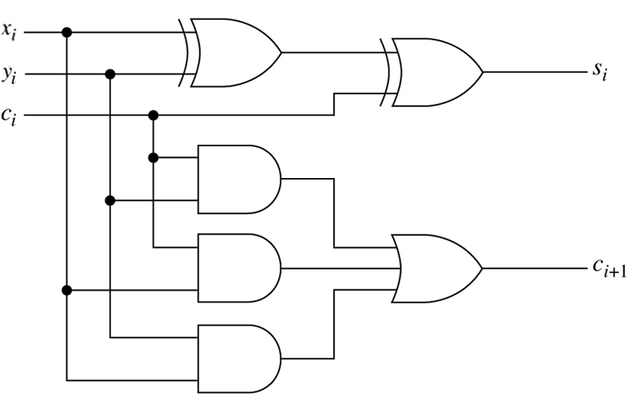
A realization of the binary full adder.
Figure 5.2

Slide 49
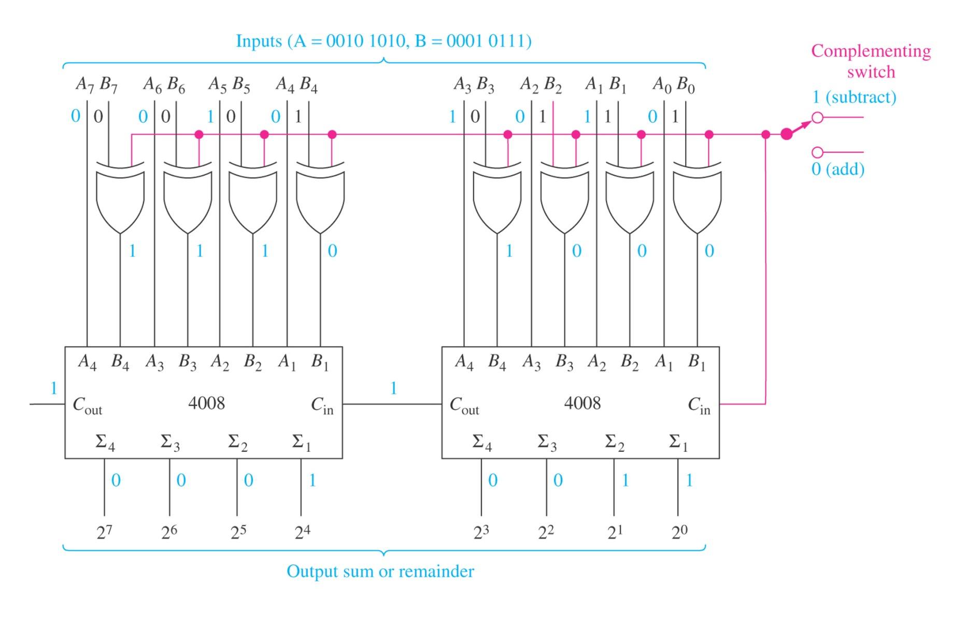
FIGURE 7–16 Eight-bit two’s-complement adder/subtractor illustrating the subtraction 42 - 23 = 19
42 in hex is 2A( 0010 1010 ) 23 in Hex is 17 ( 0001 0111)
William Kleitz
Digital Electronics: A Practical Approach, 7e
Copyright ©2005 by Pearson Education, Inc.
Upper Saddle River, New Jersey 07458
All rights reserved.

Slide 50
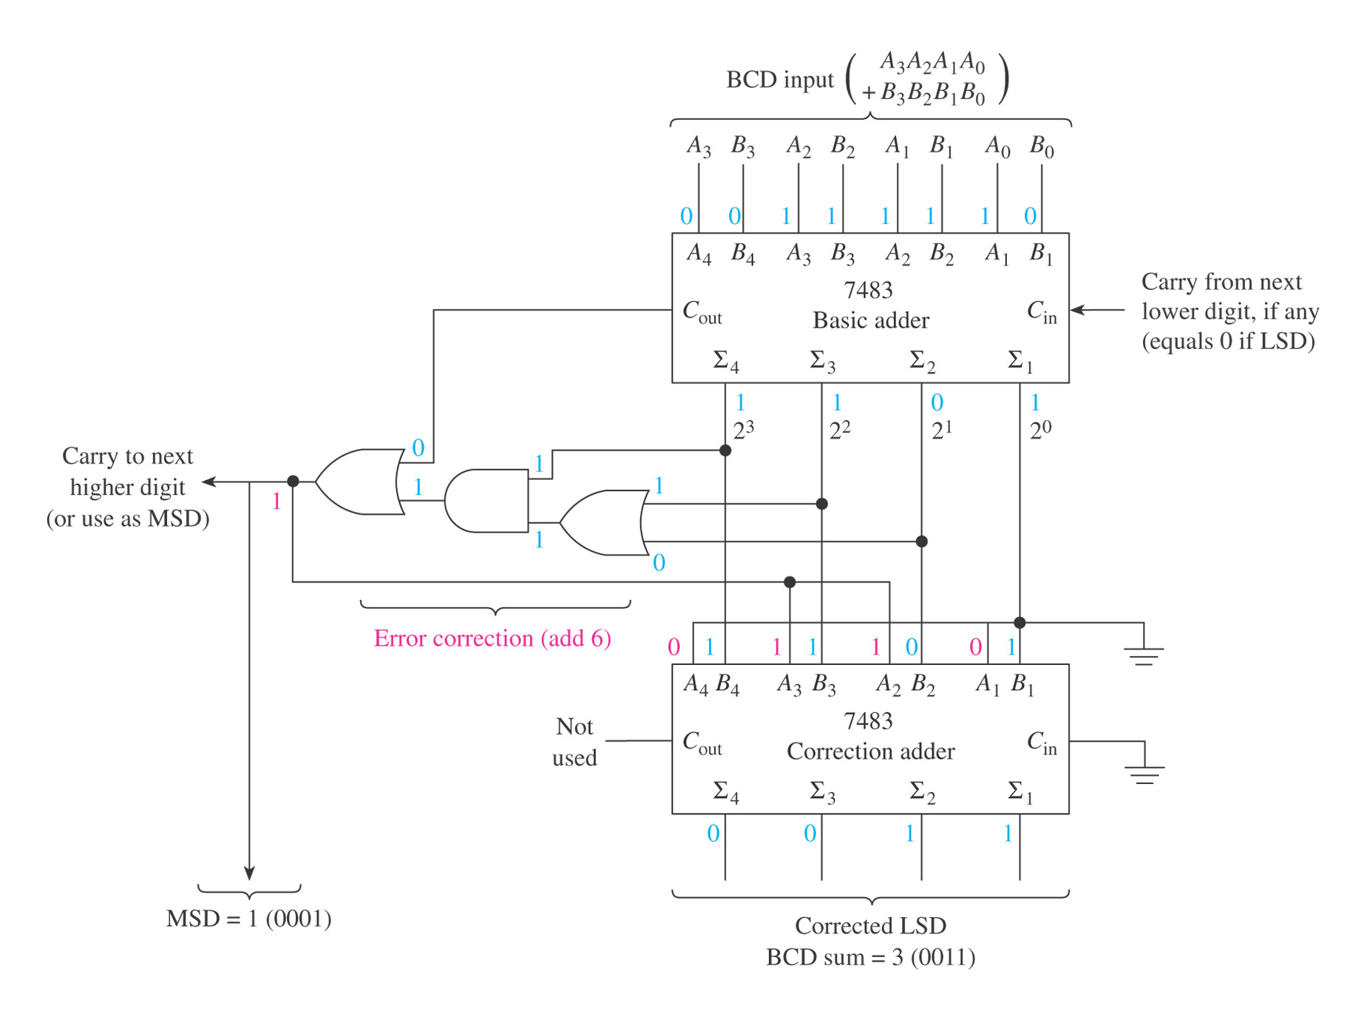
FIGURE 7–17 BCD adder illustrating the addition 7 + 6 = 13 (0111 + 0110 = 0001 0011BCD).
William Kleitz
Digital Electronics: A Practical Approach, 7e
Copyright ©2005 by Pearson Education, Inc.
Upper Saddle River, New Jersey 07458
All rights reserved.

Slide 51
FIGURE 7–17 BCD adder illustrating the addition 7 + 6 = 13 (0111 + 0110 = 0001 0011BCD).
William Kleitz
Digital Electronics: A Practical Approach, 7e
Copyright ©2005 by Pearson Education, Inc.
Upper Saddle River, New Jersey 07458
All rights reserved.

Slide 52
FIGURE 7–17 BCD adder illustrating the addition 7 + 6 = 13 (0111 + 0110 = 0001 0011BCD).
William Kleitz
Digital Electronics: A Practical Approach, 7e
Copyright ©2005 by Pearson Education, Inc.
Upper Saddle River, New Jersey 07458
All rights reserved.

Slide 53
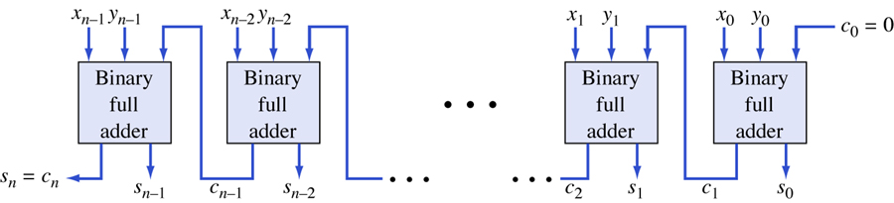
Parallel (ripple) binary adder.
Figure 5.3

Slide 54
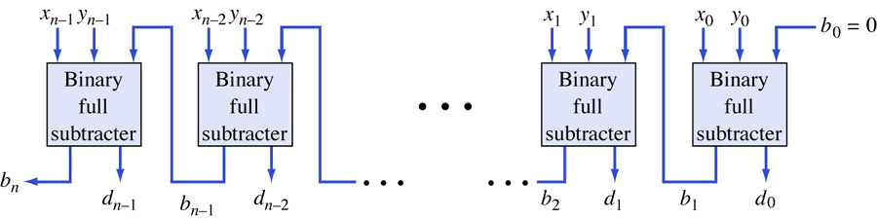
Parallel (ripple) binary subtracter.
Figure 5.4

Slide 55
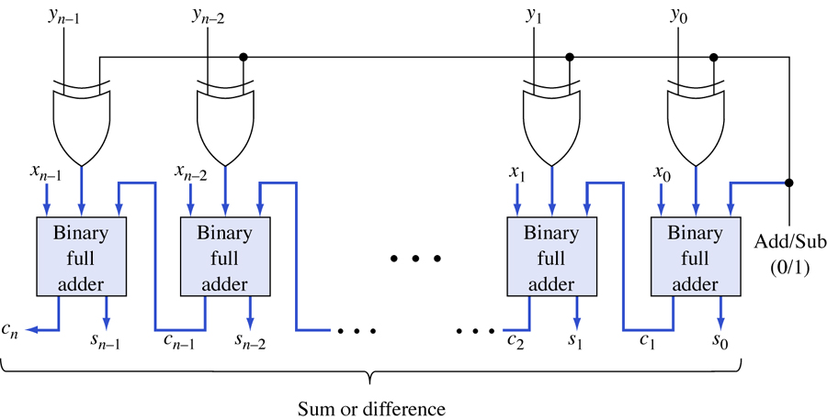
Parallel binary adder/subtracter.
Figure 5.6

Slide 56
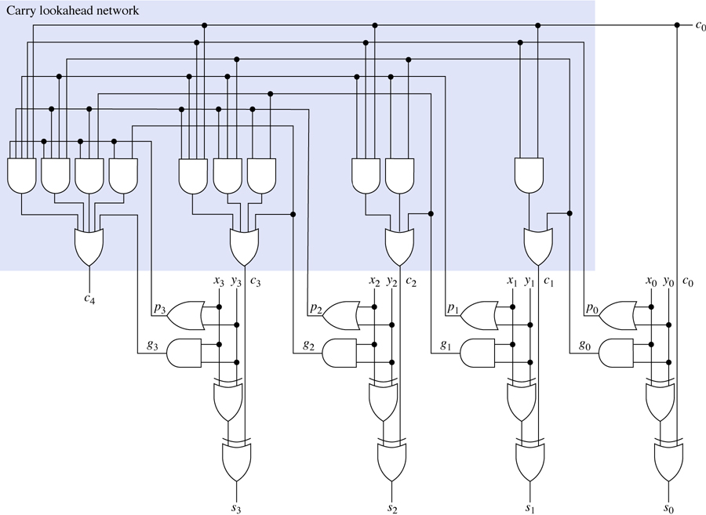
A 4-bit carry lookahead adder.
Figure 5.8

Slide 57
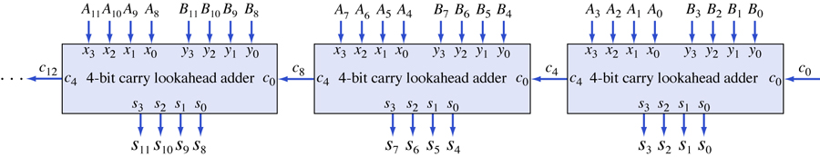
Cascade connection of 4-bit carry lookahead adders.
Figure 5.9

Slide 58
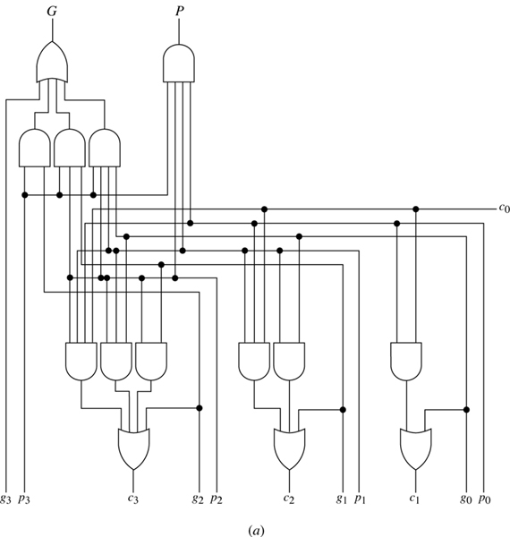
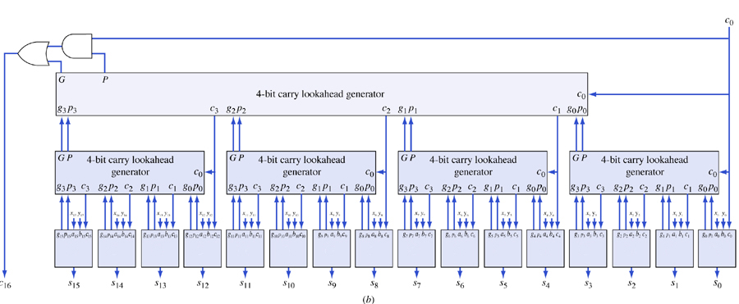
(a) A carry lookahead generator. (b) a 16-bit high-speed adder.
Figure 5.10
Σ
Σ
Σ
Σ
Σ
Σ
Σ
Σ
Σ
Σ
Σ
Σ
Σ
Σ
Σ
Σ

Slide 59
4-Bit Arithmetic Logic Unit
General Description
The DM74LS181 is a 4-bit Arithmetic Logic Unit (ALU)
which can perform all the possible 16 logic operations on
two variables and a variety of arithmetic operations.
Features
n Provides 16 arithmetic operations: add, subtract, compare,
double, plus twelve other arithmetic operations
n Provides all 16 logic operations of two variables:
exclusive-OR, compare, AND, NAND, OR, NOR, plus
ten other logic operations
n Full lookahead for high speed arithmetic operation on
long words
ECE C03 Lecture 3

Slide 60
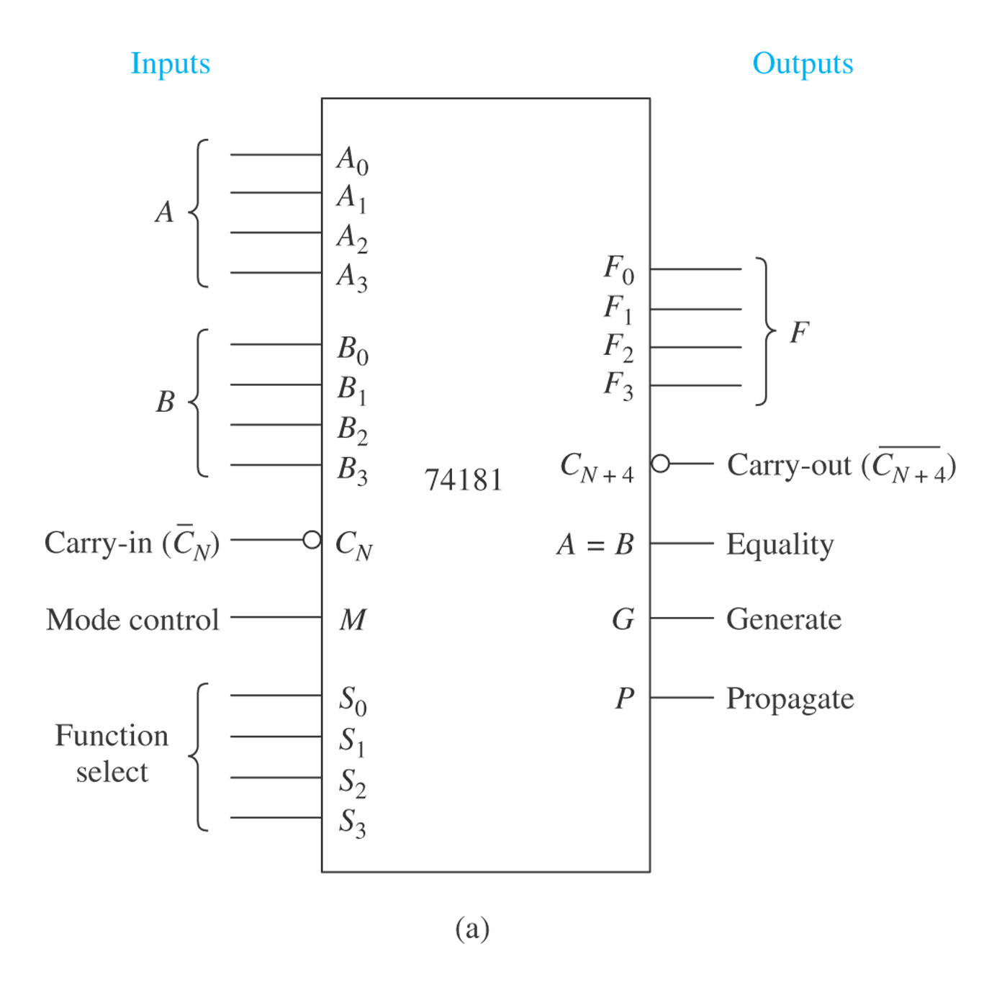
FIGURE 7–19 The 74181 ALU: (a) logic symbol;

Slide 61
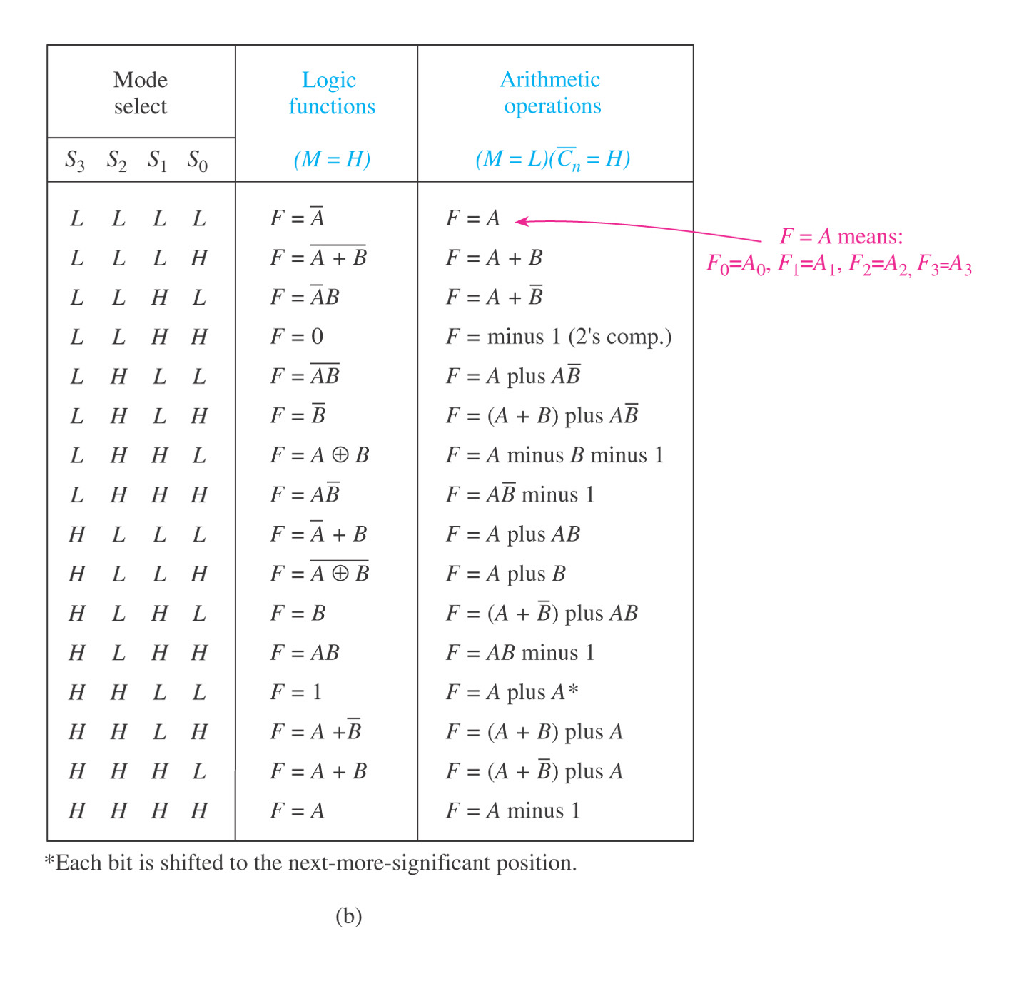
FIGURE 7–19 (continued) The 74181 ALU: (b) function table.

Slide 62
FIGURE 7–19 The 74181 ALU: (a) logic symbol;

Slide 63
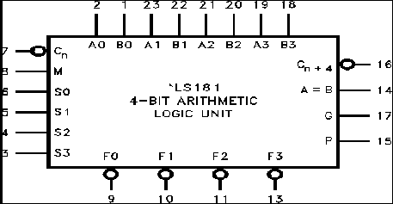
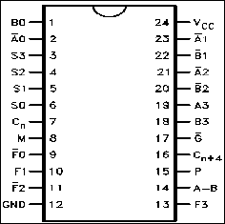
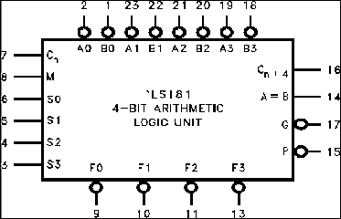
ECE C03 Lecture 3

Slide 64
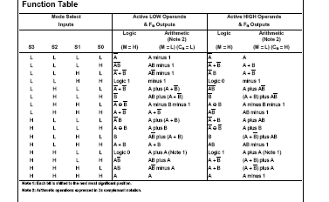
ECE C03 Lecture 3

Slide 65
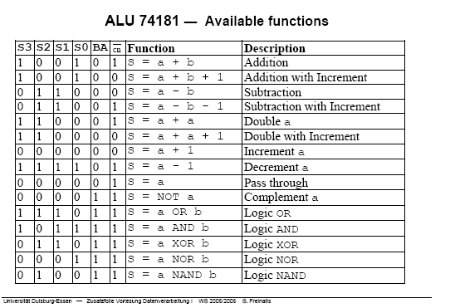
ECE C03 Lecture 3

Slide 66
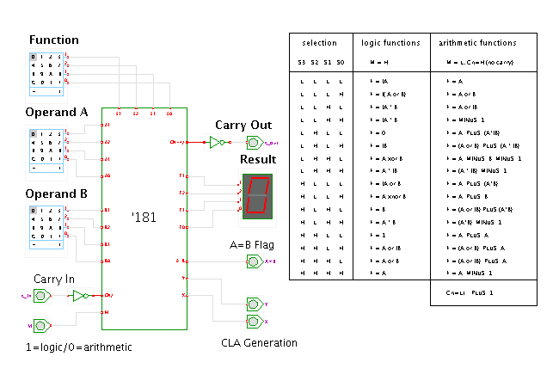
ECE C03 Lecture 3

Slide 67
Multiplexers
A multiplexer is a digital switch
- it connects data from one of n sources to its output.
Multiplexers also known as
Data Selectors

Slide 68
Multiplexers
An n-input and b-bit multiplexer has n soureces of data, each of which b bits wide, and there are b output bits.
A multiplexer is a unidirectional device.
Multiplexers are used in any application in which data must be switched from multiple sources to a destination.
e.g., processor’s registers to ALU

Slide 69
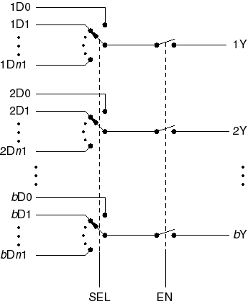
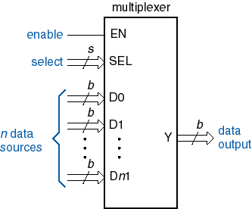
Multiplexers

Slide 70
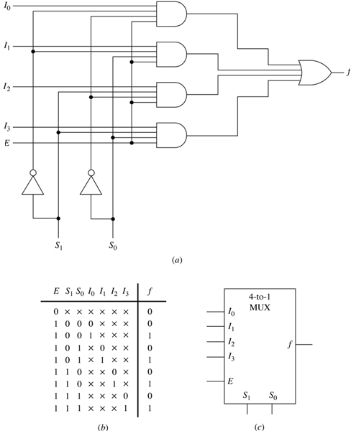
A 4-to-1-line multiplexer. (a) Logic diagram (b) Compressed truth table. (c) Symbol.
Figure 5.33

Slide 71
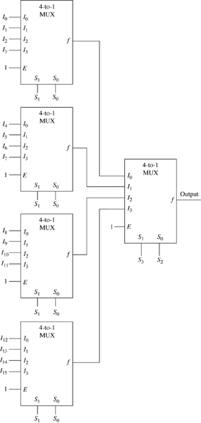
A multiplexer tree to form a 16-to-1-line multiplexer.
Figure 5.34

Slide 72
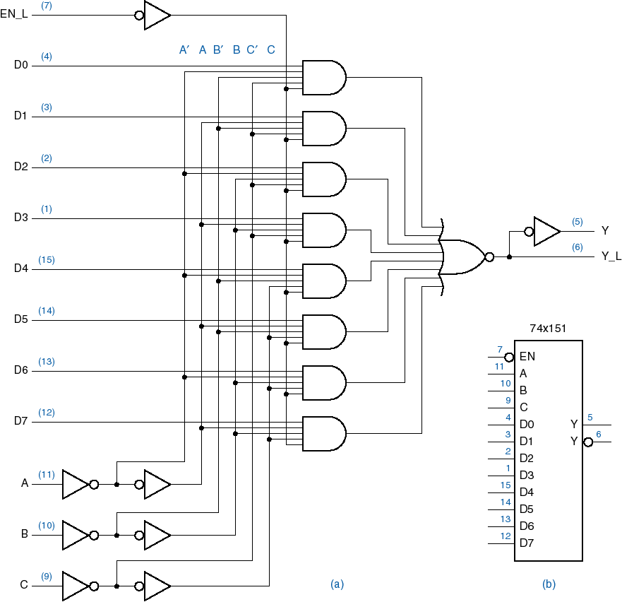
74x151
8-input 1-bit multiplexer

Slide 73
Multiplexers
74x151
    8-input, 1-bit-wide Multiplexer
    8-input, 1-bit Multiplexer
    1-bit, 8-to-1 Multiplexer
    1, 8-to-1 Multiplexer
    1, 1-of-8 Data Selector
    Single, 1-of-8 Data Selector
74x157
    2-input, 4-bit-wide Multiplexer
    2-input, 4-bit Multiplexer
    4-bit, 2-to-1 Multiplexer
    4, 2-to-1 Multiplexer
    Quadruple 2-line to 1-line Data Selector/Multiplexer
    Quad, 1-of-2 Data Selector
74x153
    4-input, 2-bit-wide Multiplexer
    2-bit, 4-to-1 Multiplexer
    2, 1-of-4 Data Selector

Slide 74
Multiplexers, Demultiplexers
A multiplexer is used to select one of n sources of data to transmit on a bus.
A demultiplexer is opposite of a multiplexer.
A 1-bit, n-output demultiplexer has one data input and s inputs to select one of n = 2^{s} data outputs.
A b-bit, n-output demultiplexer has b-data input and s inputs to select one of n = 2^{s} sets of b-data outputs.

Slide 75
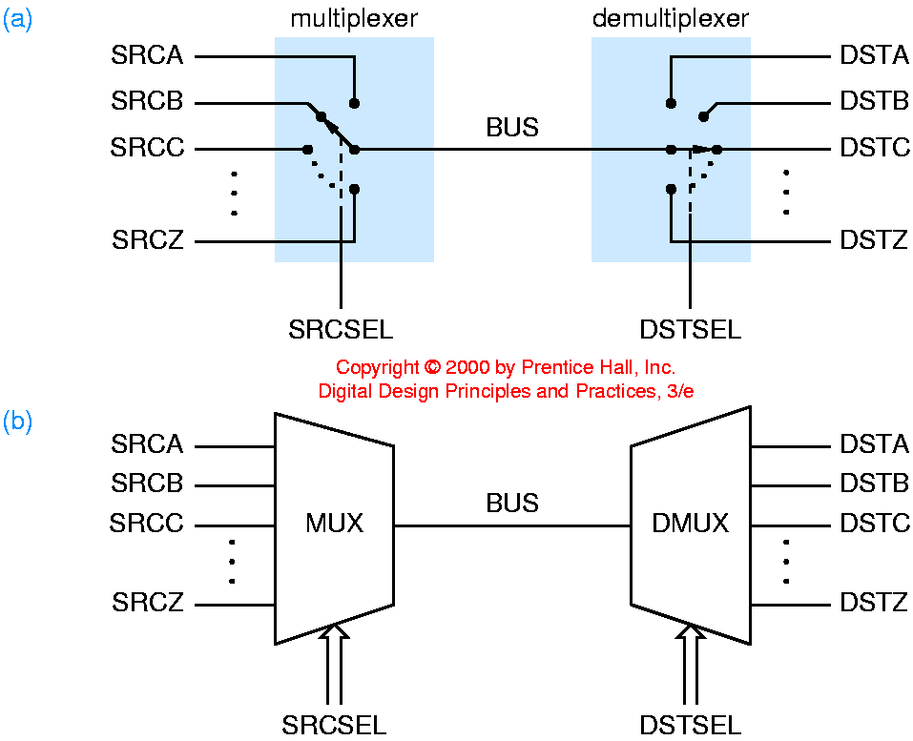
Multiplexers, Demultiplexers, and Buses

Slide 76
Multiplexers, Demultiplexers, and Buses
A multiplexer can be used to select one of n sources of data to transmit on a bus.
A demultiplexer can be used to route the bus data to one of m destinations.

Slide 77
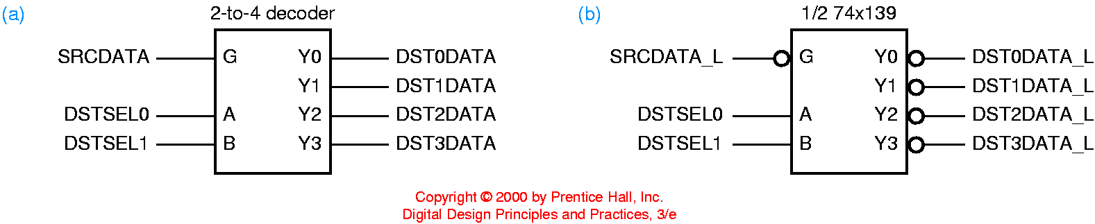
Decoder/Demultiplexers
A binary decoder with an enable input can be used as a demultiplexer.
The decoder’s enable input is connected to the data line, and its select inputs determine which of its output lines is driven with the data bit.

Slide 78
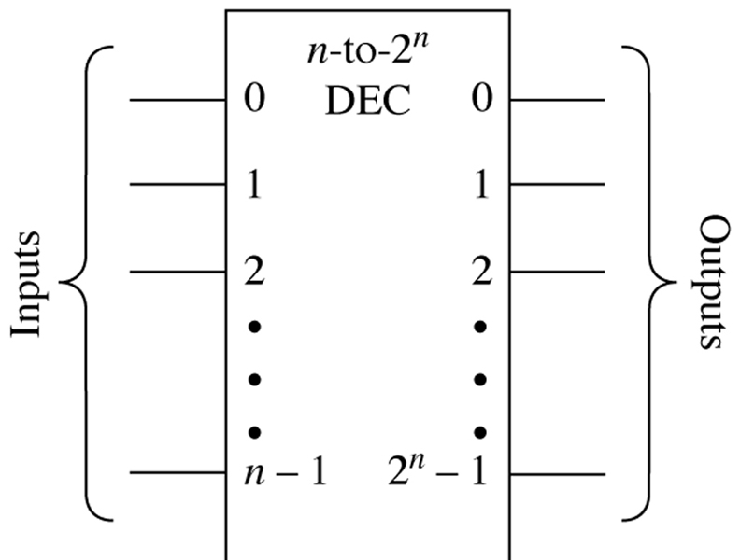
An n-to-2^{n}-line decoder symbol.
Figure 5.17

Slide 79
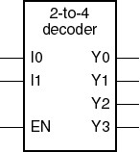

Binary 2-to-4 decoder
Note “x” (don’t care) notation.

Slide 80

A 3-to-8-line decoder. (a) Logic diagram. (b) Truth table.
(c) Symbol.
Figure 5.18

Slide 81

Realization of the Boolean expressions f₁(x₂,x₁,x₀) =
Σm(1,2,4,5) and f₂(x₂,x₁,x₀) = Σm(1,5,7) with a 3-to-8-line decoder and two or-gates.
Figure 5.19

Slide 82

2-input XOR gates
Like an OR gate, but excludes the case where both inputs are 1.
XNOR: complement of XOR
X⊕Y = X’.Y + X.Y’

Slide 83

2-input XOR gates
X⊕Y = X’.Y + X.Y’

