Slide 1
Shift Registers
Serial Communications

Slide 2
Definition
A register is a digital circuit with two basic functions: Data Storage and Data Movement
  A shift register provides the data movement function
  A shift register “shifts” its output once every clock cycle
A shift register is a group of flip-flops set up in a linear fashion with their inputs and outputs connected together in such a way that the data is shifted from one device to another when the circuit is active

Slide 3
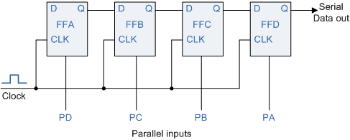
Shift Register Applications
communications
  UART
converting between serial data and parallel data
temporary storage in a processor
  scratch-pad memories
some arithmetic operations
  multiply, divide
some counter applications
  Johnson counter
  ring counter
  LSFR counters
time delay devices
more …

Slide 4
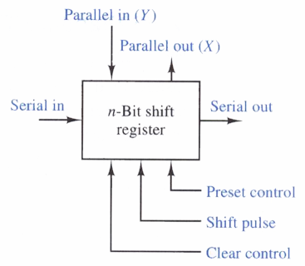
Shift Register Characteristics
Types
  Serial-in, Serial-out
  Serial-in, Parallel-out
  Parallel-in, Serial-out
  Parallel-in, Parallel-out
  Universal
Direction
  Left shift
  Right shift
  Rotate (right or left)
  Bidirectional
n-bit shift register

Slide 5
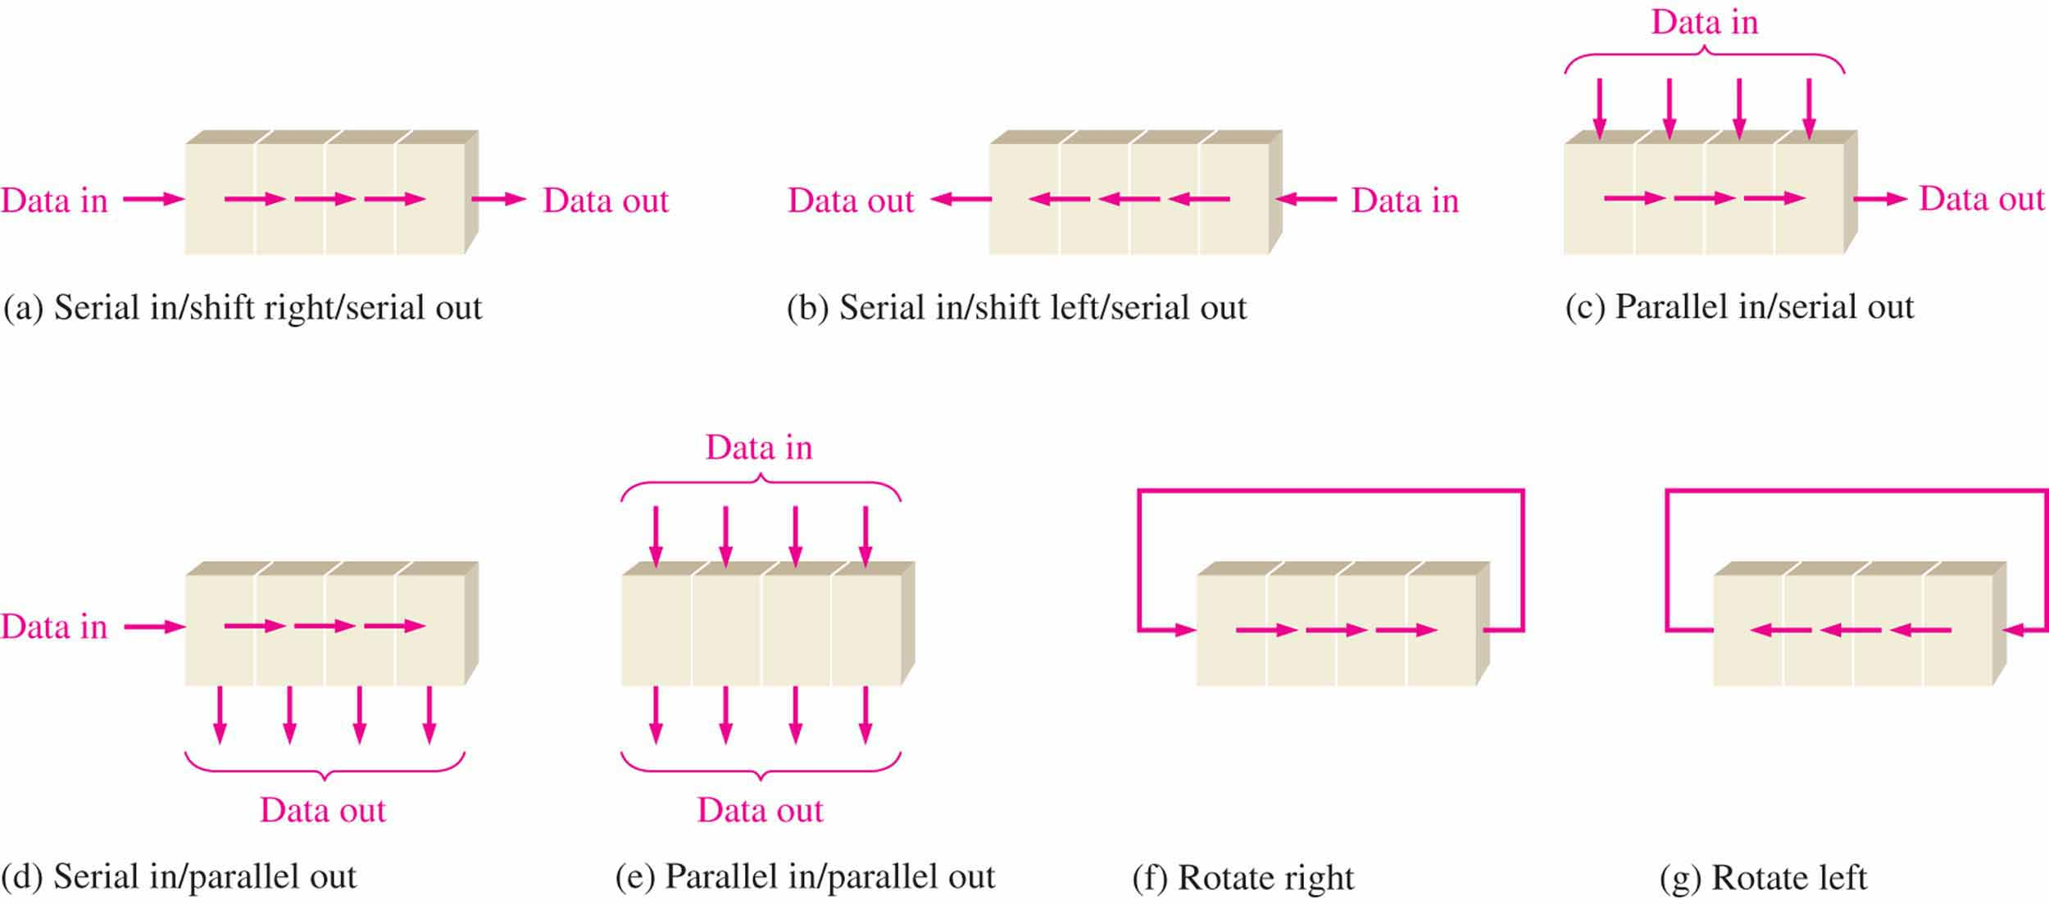
Data Movement
The bits in a shift register can move in any of the following manners

Slide 6
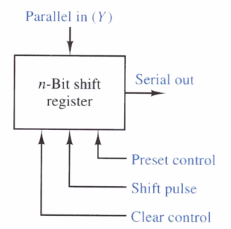
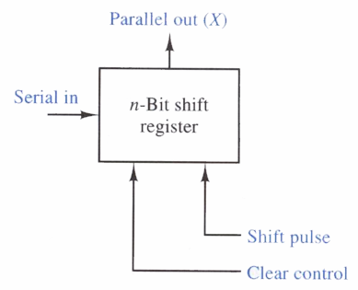
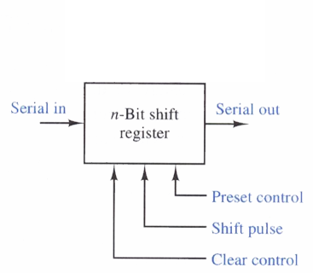
Data Movement
Block diagrams for shift registers with various input/output options:
n-bit shift register
n-bit shift register
n-bit shift register
n-bit shift register

Slide 7
Serial-In Serial-Out

Slide 8
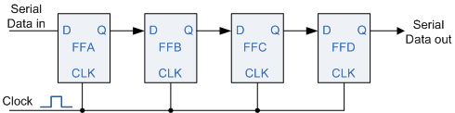
Serial-In Serial-Out
Data bits come in one at a time and leave one at a time
One Flip-Flop for each bit to be handled
Movement can be left or right, but is usually only a single direction in a given register
Asynchronous preset and clear inputs are used to set initial values
Each clock pulse shifts the contents of the register one bit position to the right.
n-bit shift register

Slide 9

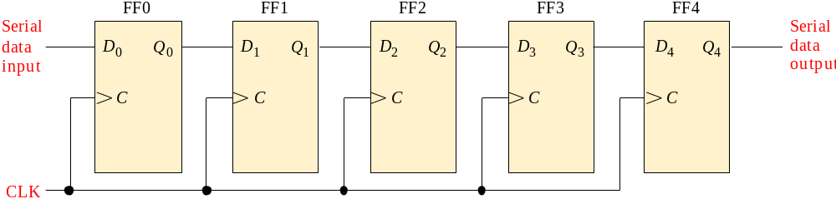

Data movement in Serial-in/Serial out Shift Register
Shift registers are available in IC form or can be constructed from discrete flip-flops as is shown here with a five-bit serial-in serial-out register.
Each clock pulse will move an input bit to the next flip-flop. For example, a 1 is shown as it moves across.
1
1
1
1
1
1
CLK
CLK
CLK
CLK
CLK

Slide 10
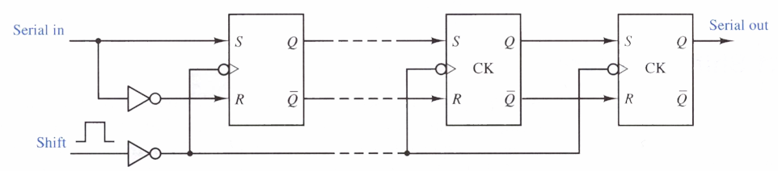
Serial-In Serial-Out
The logic circuit diagram below shows a generalized serial-in serial-out shift register
  SR Flip-Flops are shown
  Connected to behave as D Flip-Flops
  Input values moved to outputs of each Flip-Flop with the clock (shift) pulse
N
1
0
N-Bit Shift Register

Slide 11
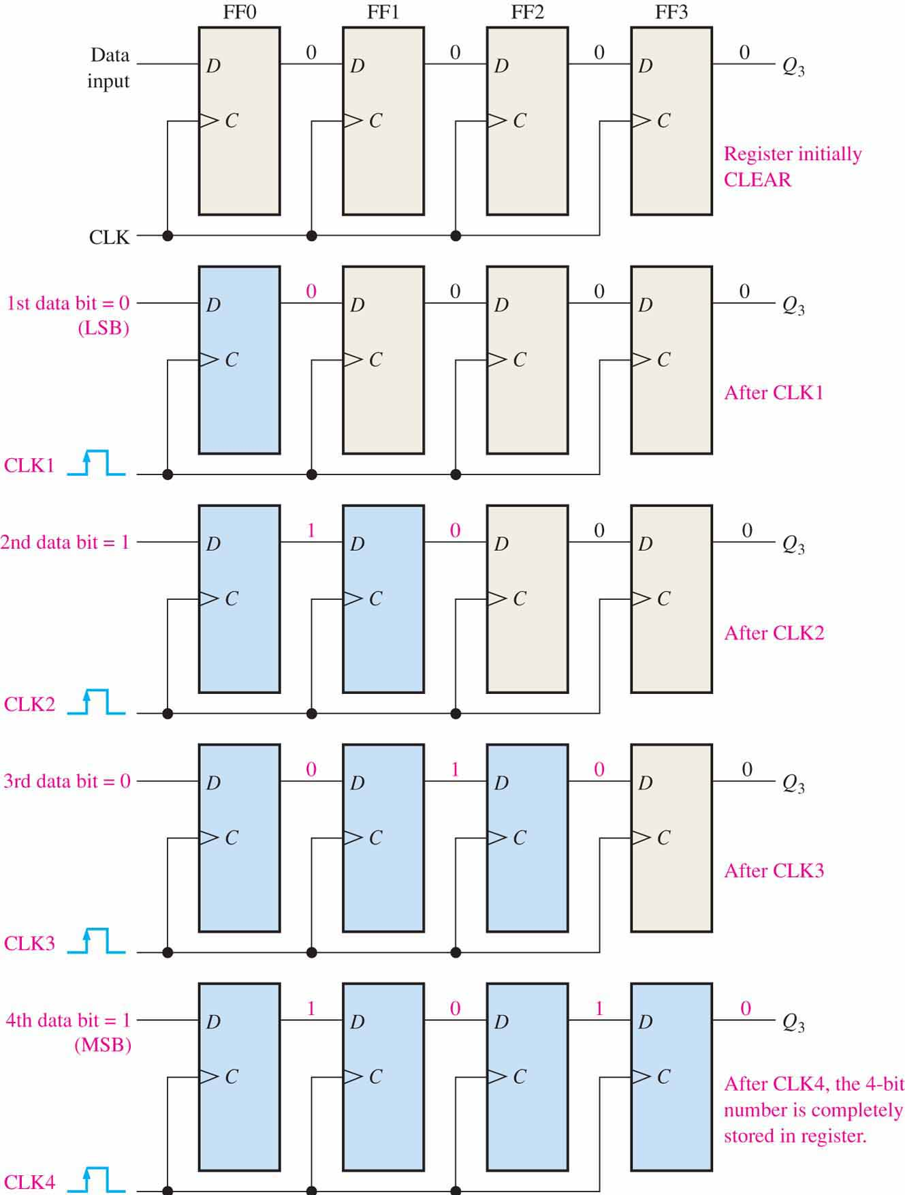
Serial-In Serial-Out
The diagram at right shows the 4-bit sequence “1010” being loaded into the 4-bit serial-in serial-out shift register
Each bit moves one position to the right each time the clock’s leading edge occurs
Four clock pulses loads the register

Slide 12
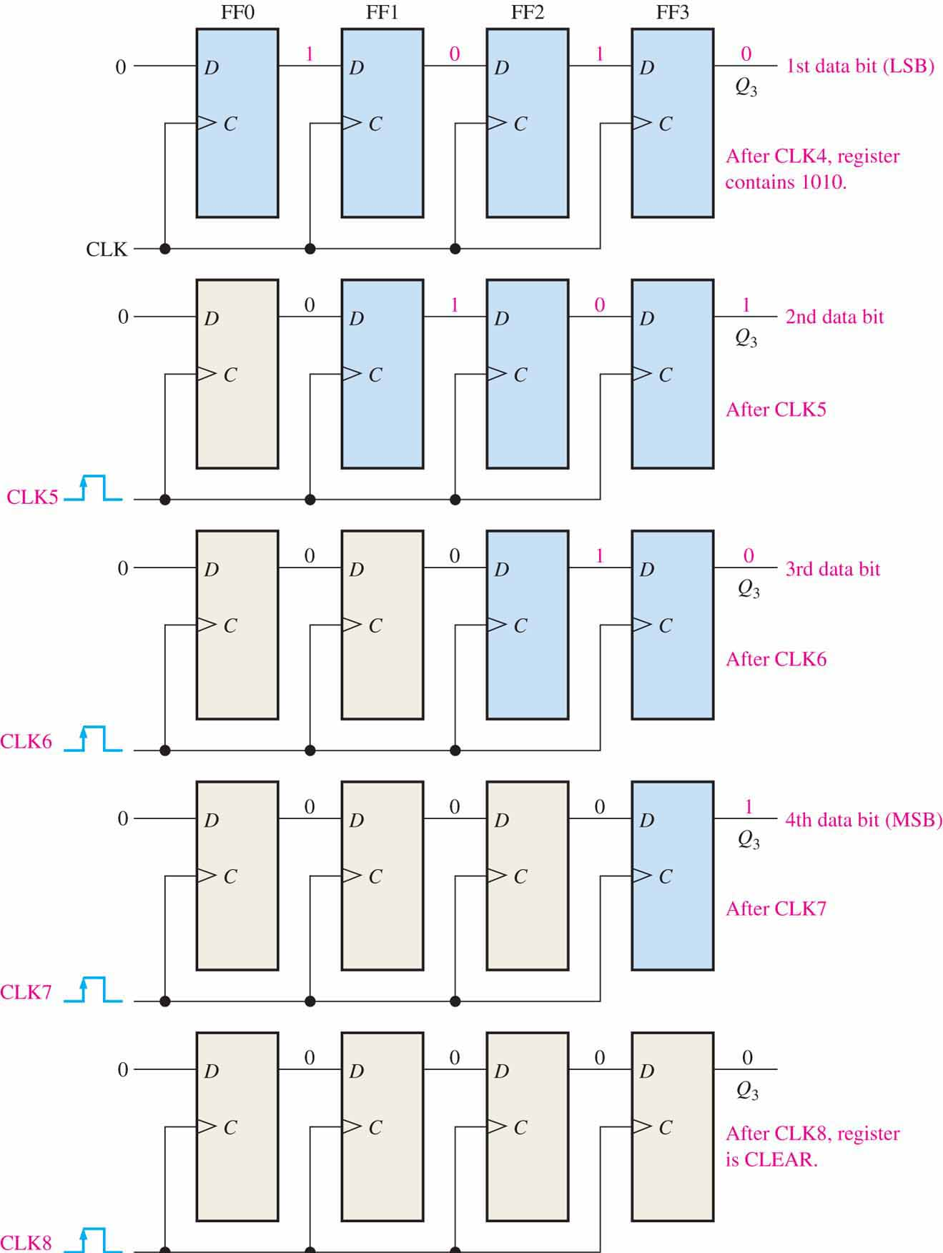
Serial-In Serial-Out
This diagram shows the 4-bit sequence “1010” as it is unloaded from the 4-bit serial-in serial-out shift register
Each bit moves one position to the right each time the clock’s leading edge occurs
Four clock pulses unloads the register

Slide 13
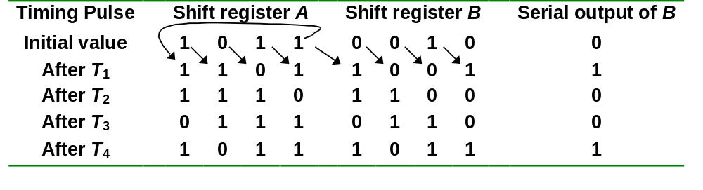
Serial In/Serial Out Shift Registers
Serial-transfer example.
CS1104-13
Serial In/Serial Out Shift Registers

Slide 14
Serial In/Parallel Out Shift Registers

Slide 15
Serial In/Parallel Out Shift Registers
Accepts data serially.
Outputs of all stages are available simultaneously.
n-bit shift register

Slide 16
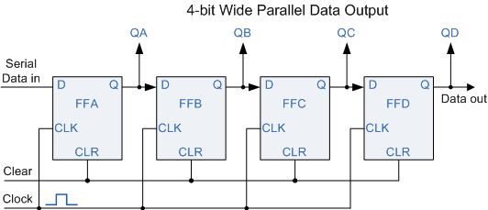
We often need to convert from serial to parallel
  e.g., after receiving a series transmission
The diagrams illustrate a 4-bit serial-in parallel-out shift register
Note that we could also use the Q of the right-most Flip-Flop as a serial-out output

Slide 17
Parallel In/Serial Out Shift Registers

Slide 18
Parallel-to-Serial Conversion
We usa a Parallel-in Serial-out Shift Register
The DATA is applied in parallel form to the parallel input pins PA to PD of the register
It is then read out sequentially from the register one bit at a time from PA to PD on each clock cycle in a serial format
One clock pulse to load
Four pulses to unload
n-bit shift register

Slide 19
Parallel In/Serial Out Shift Registers
Bits are entered simultaneously, but output is serial.
Data input
D₀
D₁
D₂
D₃
SHIFT/LOAD
Serial data out
D
Q
Q₀
D
Q
Q₁
D
Q
Q₂
D
Q
Q₃
C
C
C
C
CLK
SHIFT.Q₀ + SHIFT'.D₁
CS1104-13
Parallel In/Serial Out Shift Registers

Slide 20
Parallel In/Parallel Out Shift Registers

Slide 21
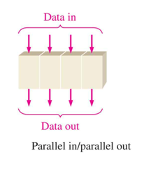
Parallel In/Parallel Out Shift Registers
Simultaneous input and output of all data bits.
Parallel data inputs
D₀
D₁
D₂
D₃
n-bit shift register
D
Q
D
Q
D
Q
D
Q
C
C
C
C
CLK
Q₀
Q₁
Q₂
Q₃
Parallel data outputs
CS1104-13
Parallel In/Parallel Out Shift Registers

Slide 22
Applications of Shift registers

Slide 23
An Application – Serial Addition
Most operations in digital computers are done in parallel. Serial operations are slower but require less equipment.
A serial adder is shown below. A ← A + B.
SI
Shift-right
SO
Shift-register A
X
Y
z
FA
S
C
CP
SI
External input
SO
Shift-register B
Q
D
Clear
CS1104-13
An Application – Serial Addition

Slide 24
An Application – Serial Addition
A = 0100; B = 0111. A + B = 1011 is stored in A after 4 clock pulses.
Initial:
A: 0 1 0 0
B: 0 1 1 1
Q: 0
Step 1: 0 + 1 + 0
S = 1, C = 0
A: 1 0 1 0
B: x 0 1 1
Q: 0
Step 2: 0 + 1 + 0
S = 1, C = 0
A: 1 1 0 1
B: x x 0 1
Q: 0
Step 3: 1 + 1 + 0
S = 0, C = 1
A: 0 1 1 0
B: x x x 0
Q: 1
Step 4: 0 + 0 + 1
S = 1, C = 0
A: 1 0 1 1
B: x x x x
Q: 0
CS1104-13
An Application – Serial Addition

Slide 25
Shift Register Counters
Shift register counter: a shift register with the serial output connected back to the serial input.
They are classified as counters because they give a specified sequence of states.
Two common types: the Johnson counter and the Ring counter.
CS1104-13
Shift Register Counters

Slide 26
Ring Counters
One flip-flop (stage) for each state in the sequence.
The output of the last stage is connected to the D input of the first stage.
An n-bit ring counter cycles through n states.
No decoding gates are required, as there is an output that corresponds to every state the counter is in.
CS1104-13
Ring Counters

Slide 27
Ring Counters
A ring counter is basically a circulating shift register in which the output of the most significant stage is fed back to the input of the least significant stage. The following is a 4-bit ring counter constructed from D flip-flops. The output of each stage is shifted into the next stage on the positive edge of a clock pulse. If the CLEAR signal is high, all the flip-flops except the first one FF0 are reset to 0. FF0 is preset to 1 instead.

Slide 28
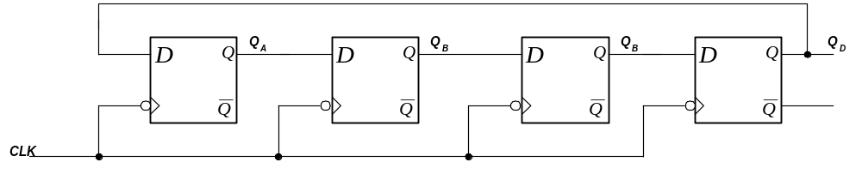
Ring Counter (Synchronous)
Another counter where the output of one flip-flop is connected directly to the input of another to produce a particular pattern.
In this case the data/bit is shifted from one flip-flop to the next on each negative edge of the clock pulse.
i.e. The 1-bit is shifted from one state to the next.

Slide 29
Ring counter Sequence
Clock | QA | QB | QC | QD
1 | 1 | 0 | 0 | 0
2 | 0 | 1 | 0 | 0
3 | 0 | 0 | 1 | 0
4 | 0 | 0 | 0 | 1
5 | 1 | 0 | 0 | 0
6 | 0 | 1 | 0 | 0
7 | 0 | 0 | 1 | 0

Slide 30
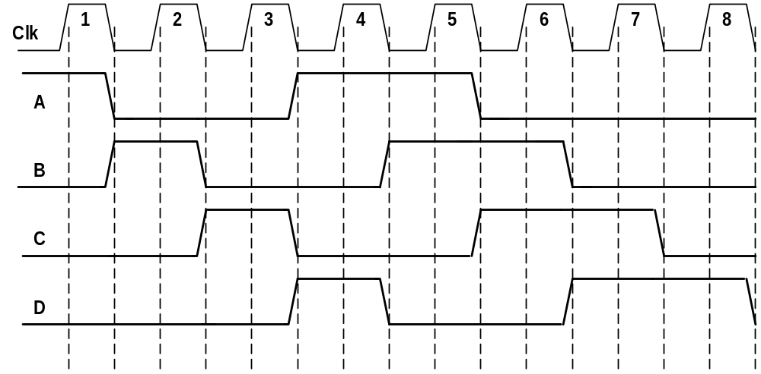
Ring Counter (Synchronous)
• Can be initialised to particular vale e.g. ABCD = 1000
Used to produce a repeating n-bit pattern

Slide 31
Johnson Counters
The complement of the output of the last stage is connected back to the D input of the first stage.
Also called the twisted-ring counter.
Require fewer flip-flops than ring counters but more flip-flops than binary counters.
An n-bit Johnson counter cycles through 2n states.
Require more decoding circuitry than ring counter but less than binary counters.
CS1104-13
Johnson Counters

Slide 32
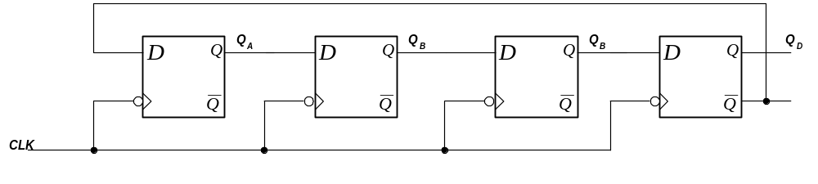
Johnson Counter
NOTE :
• This is a synchronous design as all the clocks are connected to a common synchronising clock.
• state changes for all affected flip-flops occur at the same time.
⇒ 1st negative edge will cause the flip-flop A to set.

Slide 33
Four bit Johnson sequence
Clock | QA | QB | QC | QD
0 | 0 | 0 | 0 | 0
1 | 1 | 0 | 0 | 0
2 | 1 | 1 | 0 | 0
3 | 1 | 1 | 1 | 0
4 | 1 | 1 | 1 | 1
5 | 0 | 1 | 1 | 1
6 | 0 | 0 | 1 | 1
7 | 0 | 0 | 0 | 1

Slide 34
State Diagram
A State Diagram is used to describe the sequence of output states of a circuit.
The state diagram for the previous Johnson counter looks like this:
1000
0000
1100
0001
1110
0011
1111
0111
Registers 1.<number>

Slide 35
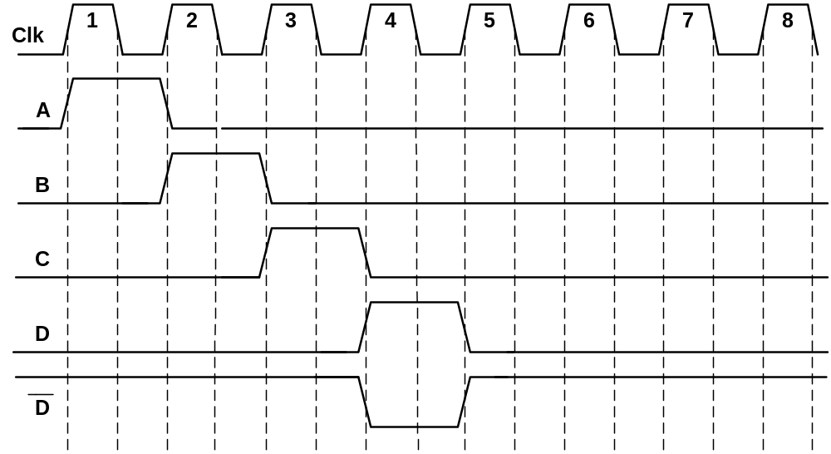
Johnson Counter
Process continues as long as power is applied and clock is present.
The main use of this counter design is the generation of time delays for control applications.

Slide 36
Other Applications
Shift registers can be found in many applications. Here is a list of a few
To produce time delay
The serial in -serial out shift register can be used as a time delay device. The amount of delay can be controlled by:
the number of stages in the register
the clock frequency

Slide 37
Applications
To simplify combinational logic
The ring counter technique can be effectively utilized to implement synchronous sequential circuits. A major problem in the realization of sequential circuits is the assignment of binary codes to the internal states of the circuit in order to reduce the complexity of circuits required. By assigning one flip-flop to one internal state, it is possible to simplify the combinational logic required to realize the complete sequential circuit. When the circuit is in a particular state, the flip-flop corresponding to that state is set to HIGH and all other flip-flops remain LOW.

Slide 38
Applications
To convert serial data to parallel data
A computer or microprocessor-based system commonly requires incoming data to be in parallel format. But frequently, these systems must communicate with external devices that send or receive serial data. So, serial-to-parallel conversion is required. As shown in the previous sections, a serial in - parallel out register can achieve this.

Slide 39
Applications
Sequence detector and generator

Slide 41
An Application – Serial Addition
A = 0100; B = 0111. A + B = 1011 is stored in A after 4 clock pulses.
Initial:
A: 0 1 0 0
B: 0 1 1 1
Q: 0
Step 1: 0 + 1 + 0
S = 1, C = 0
A: 1 0 1 0
B: x 0 1 1
Q: 0
Step 2: 0 + 1 + 0
S = 1, C = 0
A: 1 1 0 1
B: x x 0 1
Q: 0
Step 3: 1 + 1 + 0
S = 0, C = 1
A: 0 1 1 0
B: x x x 0
Q: 1
Step 4: 0 + 0 + 1
S = 1, C = 0
A: 1 0 1 1
B: x x x x
Q: 0
CS1104-13
An Application – Serial Addition

Slide 42
Counters
Counters are sequential circuits which "count" through a specific state sequence. They can count up, count down, or count through other fixed sequences. Two distinct types are in common usage:
Synchronous Counters
  Clock is directly connected to the flip-flop clock inputs
  Logic is used to implement the desired state sequencing
Ripple Counters
  Clock connected to the flip-flop clock input on the LSB bit flip-flop
  For all other bits, a flip-flop output is connected to the clock input, thus circuit is not truly synchronous!
  Output change is delayed more for each bit toward the MSB.
  Resurgent because of low power consumption
Chapter 7 - Part 2 <number>

Slide 43
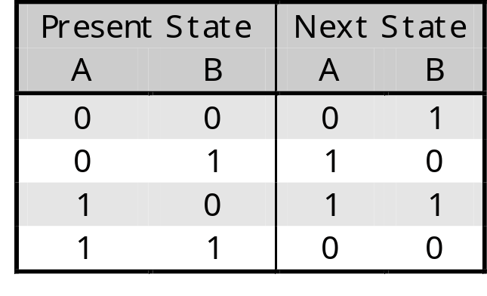
Introducing counters
Counters are a specific type of sequential circuit.
The state, or the flip-flop values themselves, serves as the “output.”
The output value increases by one on each clock cycle.
After the largest value, the output “wraps around” back to 0.
Using two bits, we’d get something like this:
1
00
01
1
1
1
11
10

Slide 44
Counters can act as simple clocks to keep track of “time.”
You may need to record how many times something has happened.
  How many bits have been sent or received?
  How many steps have been performed in some computation?
All processors contain a program counter, or PC.
  Programs consist of a list of instructions that are to be executed one after another (for the most part).
  The PC keeps track of the instruction currently being executed.
  The PC increments once on each clock cycle, and the next program instruction is then executed.

Slide 45
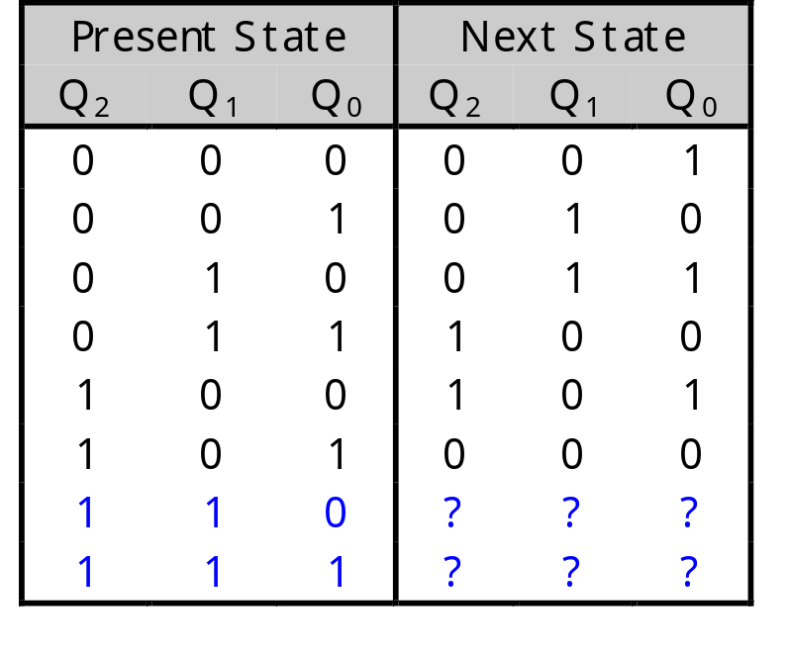
Unused states
The examples shown so far have all had 2^{n} states, and used n flip-flops. But sometimes you may have unused, leftover states.
For example, here is a state table and diagram for a counter that repeatedly counts from 0 (000) to 5 (101).
What should we put in the table for the two unused states?
000
101
001
100
010
011

Slide 46
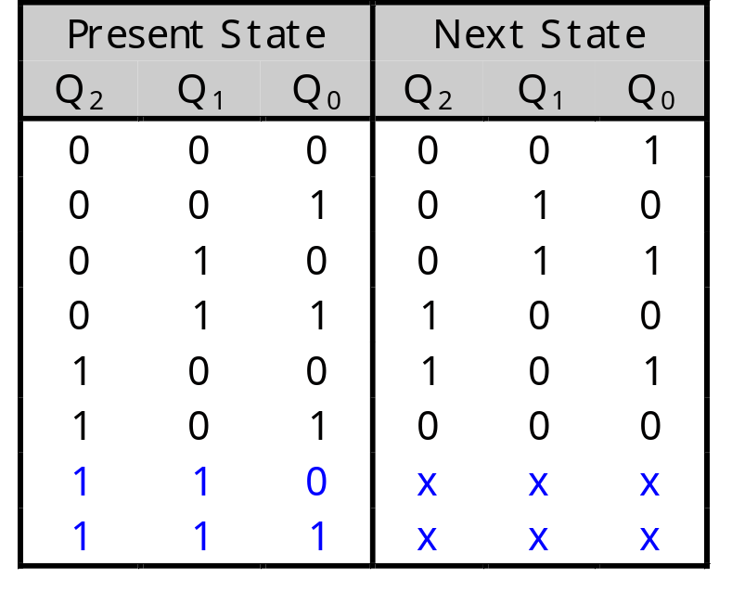
Unused states can be don’t cares…
To get the simplest possible circuit, you can fill in don’t cares for the next states. This will also result in don’t cares for the flip-flop inputs, which can simplify the hardware.
If the circuit somehow ends up in one of the unused states (110 or 111), its behavior will depend on exactly what the don’t cares were filled in with.
000
101
001
100
010
011

Slide 47
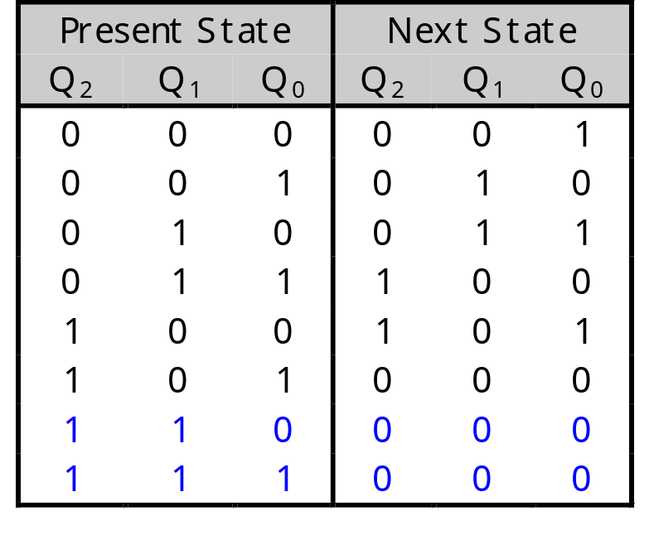
…or maybe you do care
To get the safest possible circuit, you can explicitly fill in next states for the unused states 110 and 111.
This guarantees that even if the circuit somehow enters an unused state, it will eventually end up in a valid state.
This is called a self-starting counter.
110
111
000
101
001
100
010
011

Slide 48
Ripple Counter
How does it work?
  When there is a positive
  edge on the clock input
  of A, A complements
  The clock input for flip-
  flop B is the complemented
  output of flip-flop A
  When flip A changes
  from 1 to 0, there is a
  positive edge on the
  clock input of B
  causing B to
  complement
D
A
Clock
C_{R}
D
B
C_{R}
Reset
CP
A
B
0
1
2
3
0
1
Chapter 7 - Part 2 <number>

Slide 49
Ripple Counter (continued)
The arrows show the
cause-effect relation-
ship from the prior
slide =>
The corresponding
sequence of states =>
(B,A) = (0,0),
Each additional bit, C, D, …behaves like bit B, changing half as frequently as the bit before it.
For 3 bits: (C,B,A) = (0,0,0), (0,0,1), (0,1,0), (0,1,1),
(1,0,0), (1,0,1), (1,1,0), (1,1,1), (0,0,0), …
CP
A
B
0
1
2
3
0
1
(0,1),
(1,0),
(1,1),
(0,0),
(0,1), …
Chapter 7 - Part 2 <number>

Slide 50
Ripple Counter (continued)
These circuits are called ripple counters because each edge sensitive transition (positive in the example) causes a change in the next flip-flop’s state.
The changes “ripple” upward through the chain of flip-flops, i. e., each transition occurs after a clock-to-output delay from the stage before.
Chapter 7 - Part 2 <number>

Slide 51
Synchronous Counters
To eliminate the "ripple" effects, use a common clock for each flip-flop and a combinational circuit to generate the next state.
For an up-counter,
use an incrementer =>
Incre-menter
A3
S3
D3
Q3
A2
S2
D2
Q2
A1
S1
D1
Q1
A0
S0
D0
Q0
Clock
Chapter 7 - Part 2 <number>

Slide 52
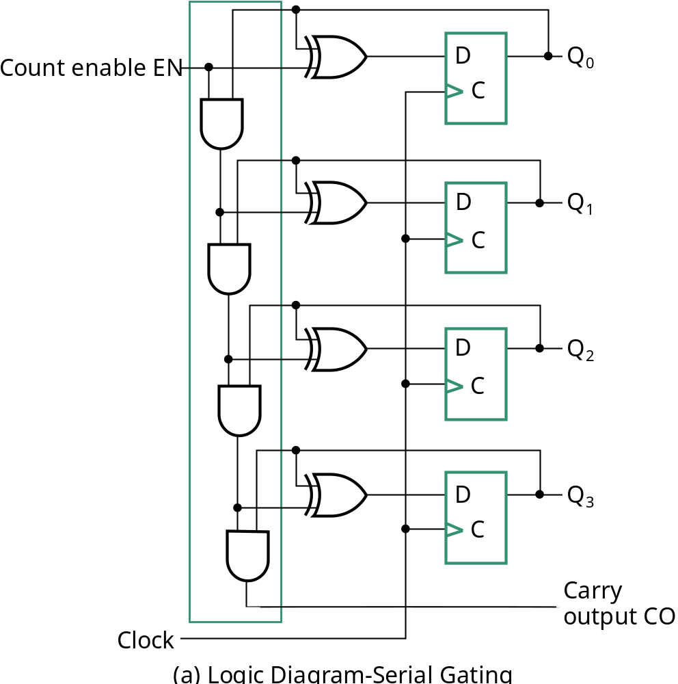
Synchronous Counters (continued)
Internal details =>
Internal Logic
  XOR complements each bit
  AND chain causes complement
  of a bit if all bits toward LSB
  from it equal 1
Count Enable
  Forces all outputs of AND
  chain to 0 to “hold” the state
Carry Out
  Added as part of incrementer
  Connect to Count Enable of
  additional 4-bit counters to
  form larger counters
Incrementer
Chapter 7 - Part 2 <number>

Slide 53
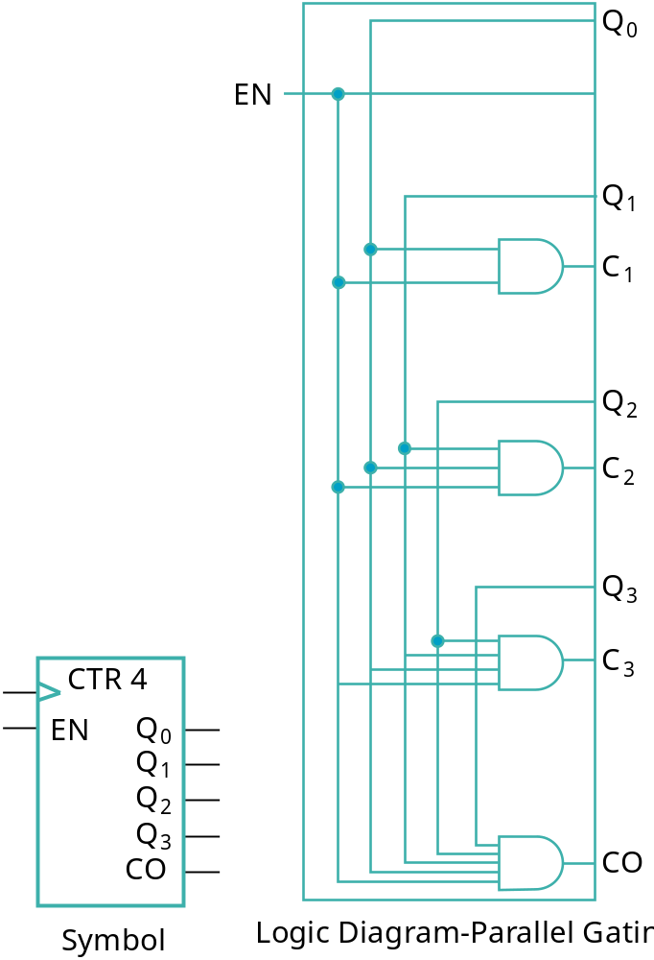
Synchronous Counters (continued)
Carry chain
  series of AND gates through which the
  carry “ripples”
  Yields long path delays
  Called serial gating
Replace AND carry chain with ANDs =>
in parallel
  Reduces path delays
  Called parallel gating
  Like carry lookahead
  Lookahead can be used on COs
  and ENs to prevent long paths in
  large counters
Symbol for Synchronous Counter
Chapter 7 - Part 2 <number>

Slide 54
Other Counters
See text for:
  Down Counter - counts downward instead of upward
  Up-Down Counter - counts up or down depending on value a control input such as Up/Down
  Parallel Load Counter - Has parallel load of values available depending on control input such as Load
Divide-by-n (Modulo n) Counter
  Count is remainder of division by n; n may not be a power of 2 or
  Count is arbitrary sequence of n states specifically designed state-by-state
  Includes modulo 10 which is the BCD counter
Chapter 7 - Part 2 <number>

Slide 55
Counter with Parallel Load
Add path for input data
  enabled for Load = 1
Add logic to:
  disable count logic for Load = 1
  disable feedback from outputs
  for Load = 1
  enable count logic for Load = 0
  and Count = 1
The resulting function table:
Load
Count
D
0
D
Q
0
C
D
1
D
Q
1
C
D
2
D
Q
2
Load | Count | Action
0 | 0 | Hold Stored Value
0 | 1 | Count Up Stored Value
1 | X | Load D
C
D
3
D
Q
3
C
Carry
Chapter 7 - Part 2 <number>
Clock
Output CO

Slide 56
Design Example: Synchronous BCD
Use the sequential logic model to design a synchronous BCD counter with D flip-flops
State Table =>
Input combinations
1010 through 1111
are don’t cares
Current State
Next State
Q8 Q4 Q2 Q1
Q8 Q4 Q2 Q1
0 0 0 0
0 0 0 1
0 0 0 1
0 0 1 0
0 0 1 0
0 0 1 1
0 0 1 1
0
1 0 0
0 1 0 0
0 1 0 1
0 1 0 1
0 1 1 0
0 1 1 0
0 1 1 1
0 1 1 1
1 0 0 0
1 0 0 0
1 0 0 1
1 0 0 1
0 0 0 0
Chapter 7 - Part 2 <number>

Slide 57
Synchronous BCD (continued)
Use K-Maps to two-level optimize the next state equations and manipulate into forms containing XOR gates:
D1 = Q1
D2 = Q2 + Q1Q8
D4 = Q4 + Q1Q2
D8 = Q8 + (Q1Q8 + Q1Q2Q4)
The logic diagram can be draw from these equations
  An asynchronous or synchronous reset should be added
What happens if the counter is perturbed by a power disturbance or other interference and it enters a state other than 0000 through 1001?
Chapter 7 - Part 2 <number>

Slide 58
Synchronous BCD (continued)
Find the actual values of the six next states for the don’t care combinations from the equations
Find the overall state diagram to assess behavior for the don’t care states (states in decimal)
0
Present State | Next State
Q8 Q4 Q2 Q1 | Q8 Q4 Q2 Q1
1 0 1 0 | 1 0 1 1
1 0 1 1 | 0 1 1 0
1 1 0 0 | 1 1 0 1
1 1 0 1 | 0 1 0 0
1 1 1 0 | 1 1 1 1
1 1 1 1 | 0 0 1 0
9
1
14
8
2
15
12
7
11
13
3
6
10
4
5
Chapter 7 - Part 2 <number>

Slide 59
Synchronous BCD (continued)
For the BCD counter design, if an invalid state is entered, return to a valid state occurs within two clock cycles
Is this adequate? If not:
  Is a signal needed that indicates that an invalid state has been entered? What is the equation for such a signal?
  Does the design need to be modified to return from an invalid state to a valid state in one clock cycle?
  Does the design need to be modified to return from a invalid state to a specific state (such as 0)?
The action to be taken depends on:
  the application of the circuit
  design group policy
See pages 244 of the text.
Chapter 7 - Part 2 <number>
Notes:
Error = Q8 Q4 + Q8 Q2

Slide 60
Counting Modulo 7: Synchronously Load on Terminal Count of 6
A synchronous 4-bit binary
counter with a synchronous
load and an asynchronous
clear is used to make a
Modulo 7 counter
Use the Load feature to
detect the count "6" and
load in "zero". This gives
a count of 0, 1, 2, 3, 4, 5, 6,
0, 1, 2, 3, 4, 5, 6, 0, ...
Using don’t cares for states
above 0110, detection of 6 can be done with Load = Q4 Q2
0
D3
Q3
0
D2
Q2
0
D1
Q1
0
D0
Q0
Clock
CP
LOAD
Reset
CLEAR
Chapter 7 - Part 2 <number>

Slide 61
Counting Modulo 6: Synchronously Preset 9 on Reset and Load 9 on Terminal Count 14
A synchronous, 4-bit binary
counter with a synchronous
Load is to be used to make a
Modulo 6 counter.
Use the Load feature to
preset the count to 9 on
Reset and detection of
count 14.
This gives a count of 9, 10, 11, 12, 13, 14, 9, 10, 11, 12, 13, 14, 9, …ie. If 1110 is current i/p next state is set to 1001
If the terminal count is 15 detection is usually built in as Carry Out (CO)
1
D3
Q3
0
D2
Q2
0
D1
Q1
1
D0
Q0
Clock
CP
Reset
LOAD
1
CLEAR

Slide 62
Synchronous Binary Counter
In a binary counter the flip-flop in the lowest -order position is complemented on every clock pulse.
Consider a Modulo-5 Counter
0
0
0
0
0
1
0
1
0
0
1
1
1
0
0
A
B
C

Slide 63
Synchronous Binary Counter
If we wish to implement a design made up of J-K-flop-flops
How Many flip Flops ?
  Have three bits A, B and C.
  3 J-K’s are required, one for each bit,
Why do we need the flip flops ?
• Need the flip-flops to change their outputs so that the counter counts in the correct sequence.

Slide 64
Why do we need the flip-flops to do ?
• Wish clock pulse to change output of flip-flop C every pulse
• Wish clock pulse to change output of flip-flop B every 2nd pulse
• Wish clock pulse to change output of flip-flop A every 4th pulse
0
0
0
0
0
1
0
1
0
0
1
1
1
0
0
A
B
C

Slide 65
Synchronous Binary Counter
Use the excitation table of the J-K flip-flop to observe the required inputs at J and K to achieve this switching procedure.
Q_{t-1}
Q_{t}
J
K
0
0
0
X
0
1
1
X
1
0
X
1
1
1
X
0

Slide 66
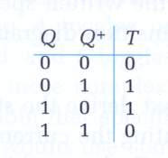
Excitation table for T flip flop

Slide 67
Synchronous Binary Counter
An excitation table for the counter can be constructed
A
B
C
J_{A}
K_{A}
J_{B}
K_{B}
J_{C}
K_{C}
0
0
0
0
X
0
X
1
X
0
0
1
0
X
1
X
X
1
0
1
0
0
X
X
0
1
X
0
1
1
1
X
X
1
X
1
1
0
0
X
1
0
X
0
X

Slide 68
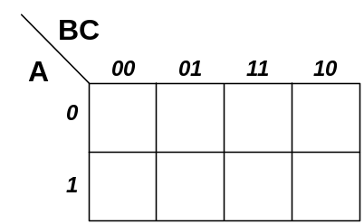
Synchronous Binary Counter
J_{C}
K_{C}

Slide 69
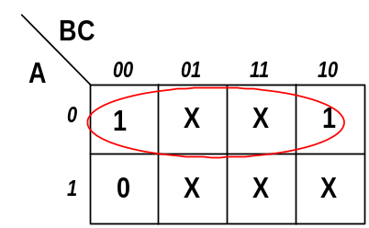
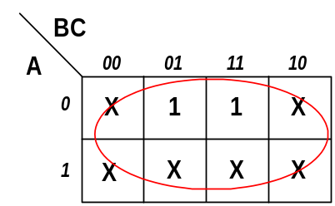


Synchronous Binary Counter
J_{C}
K_{C}

Slide 70
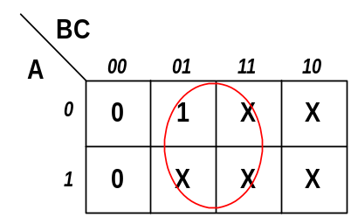
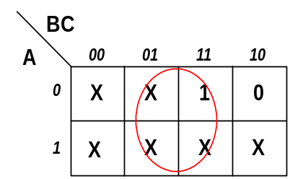


Synchronous Binary Counter
J_{B}
K_{B}

Slide 71
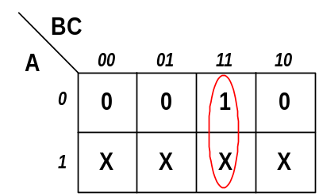
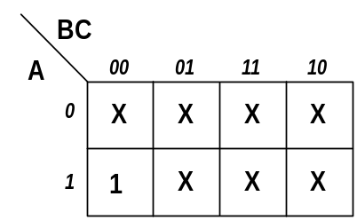


Synchronous Binary Counter
J_{A}
K_{A}

Slide 72
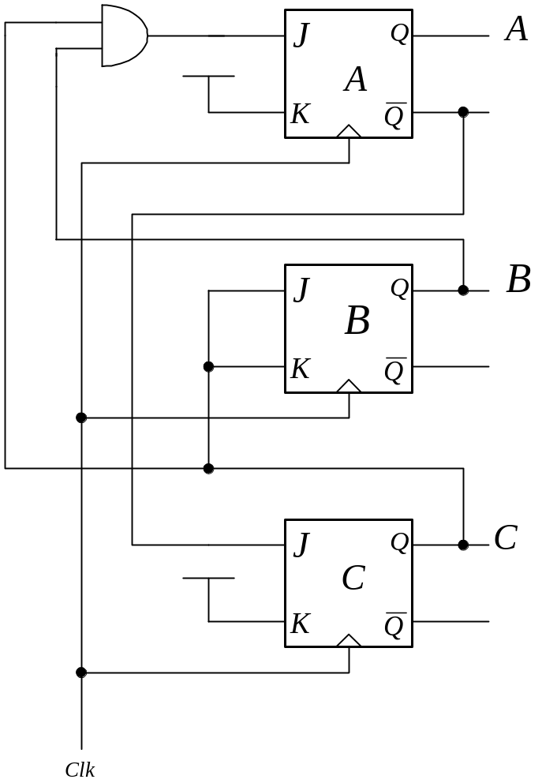
Synchronous Binary Counter
NOTE
Implementation for two of the K inputs requires that they be at logic level
To fulfil the requirement the inputs are connected to the Logic Level 1 reference (normally +5v).
Circuit arrangement can be easily designed to form a down counter.
:

Slide 73
Johnson Counter (synchronous)
As with other designs the output of one flip-flop is fed into the input of the next one.
Did we not do this before….what is different here ?
This time output of the last D flip-flop is fed into the input of the first flip-flop.
In general the complement of the Most Significant Output is connected to the Least Significant input.

Slide 74
Johnson Counter
NOTE :
• This is a synchronous design as all the clocks are connected to a common synchronising clock.
• state changes for all affected flip-flops occur at the same time.
⇒ 1st negative edge will cause the flip-flop A to set.

Slide 75
Four bit Johnson sequence
Clock | QA | QB | QC | QD
0 | 0 | 0 | 0 | 0
1 | 1 | 0 | 0 | 0
2 | 1 | 1 | 0 | 0
3 | 1 | 1 | 1 | 0
4 | 1 | 1 | 1 | 1
5 | 0 | 1 | 1 | 1
6 | 0 | 0 | 1 | 1
7 | 0 | 0 | 0 | 1

Slide 76
Johnson Counter
Process continues as long as power is applied and clock is present.
The main use of this counter design is the generation of time delays for control applications.

Slide 77
Ring Counter (Synchronous)
Another counter where the output of one flip-flop is connected directly to the input of another to produce a particular pattern.
In this case the data/bit is shifted from one flip-flop to the next on each negative edge of the clock pulse.
i.e. The 1-bit is shifted from one state to the next.

Slide 78
Ring counter Sequence
Clock | QA | QB | QC | QD
1 | 1 | 0 | 0 | 0
2 | 0 | 1 | 0 | 0
3 | 0 | 0 | 1 | 0
4 | 0 | 0 | 0 | 1
5 | 1 | 0 | 0 | 0
6 | 0 | 1 | 0 | 0
7 | 0 | 0 | 1 | 0

Slide 79
Ring Counter (Synchronous)
• Can be initialised to particular vale e.g. ABCD = 1000
Used to produce a repeating n-bit pattern

Slide 80
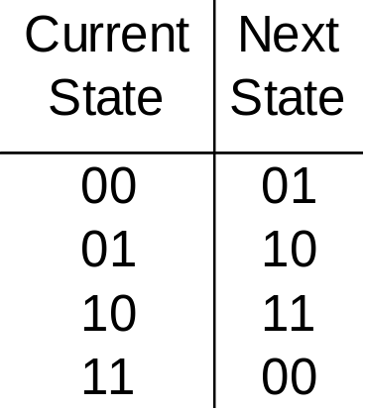
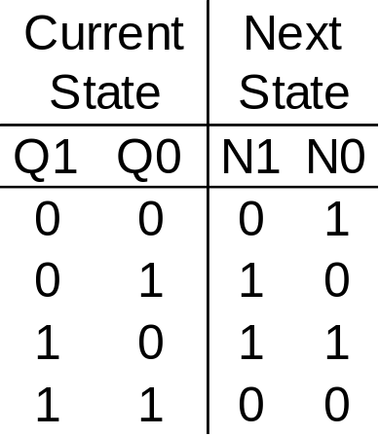
Transition Table for 2-Bit Counter
It is the truth table for the input forming logic…
It describes what the next state values
are as a function of the current state
(clock is assumed)
13 COUNTERS
Page <number>
ECEn 224

Slide 81
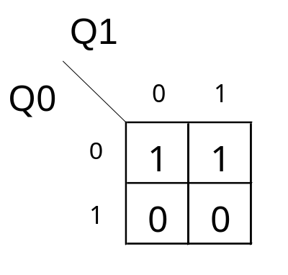
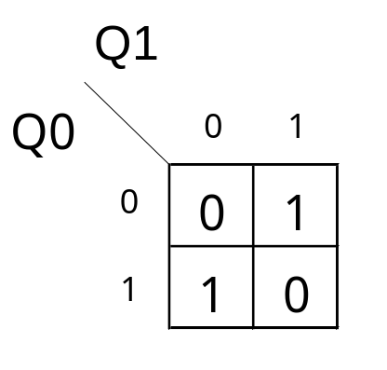
Implementation of 2-Bit Counter
N1
D Q
Q1
N0 = Q0’
CLK
N0
D Q
Q0
CLK
N1 =Q1 ⊕ Q0
13 COUNTERS
Page <number>
ECEn 224

Slide 82
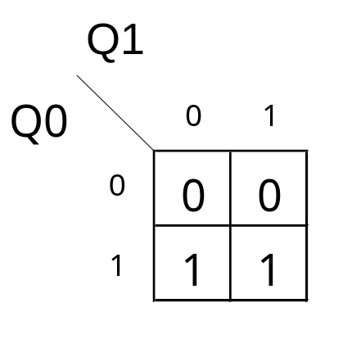
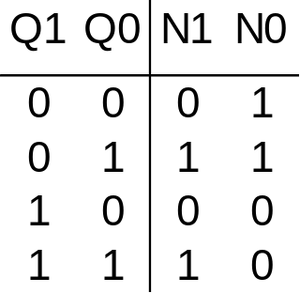
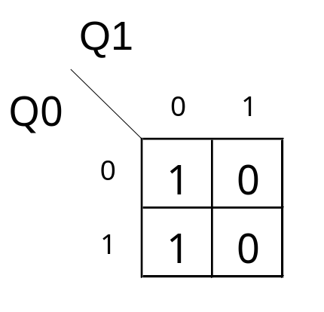
Example 2 – A Gray Code Counter
N1
D Q
Q1
N1= Q0
CLK
N0
D Q
Q0
N0 = Q1’
CLK
13 COUNTERS
Page <number>
ECEn 224

Slide 83
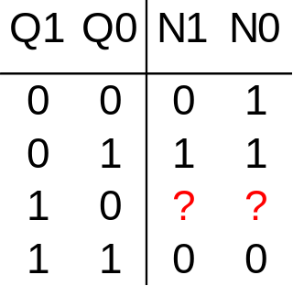
Example 3 – Not All Count Values Used
Desired count sequence = 00 – 01 – 11 - 00 …
What should next state for 10 be?
13 COUNTERS
Page <number>
ECEn 224

Slide 84
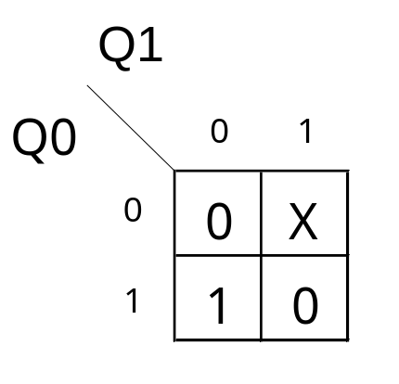
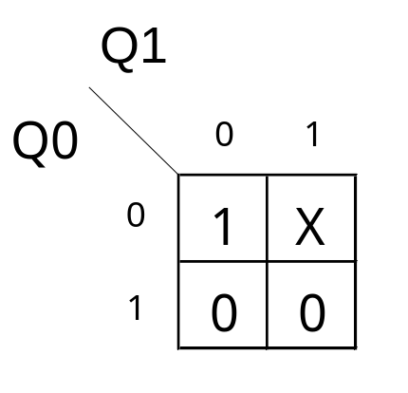
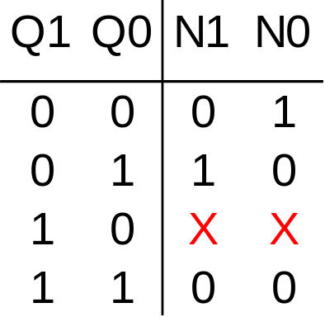
Example 3 – Not All Count Values Used
N1 = Q0•Q1’
N0 = Q0’
Do the normal K-map minimization with don’t cares
13 COUNTERS
Page <number>
ECEn 224

Slide 85
Toggle Excitation
Table

Slide 86
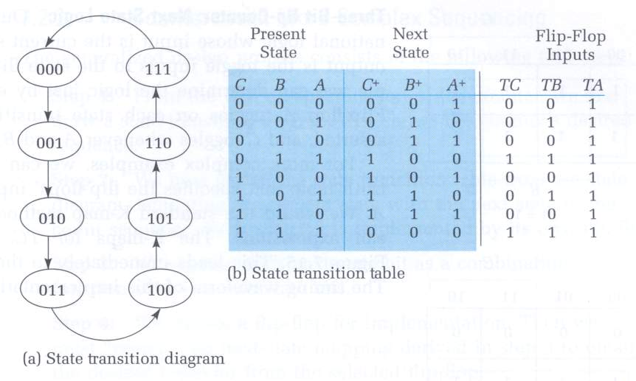
Counter Design Procedure
Introduction
This procedure can be generalized to implement ANY finite state
machine
Counters are a very simple way to start:
no decisions on what state to advance to next
current state is the output
Example:
3-bit Binary Upcounter
Decide to implement with
Toggle Flipflops
What inputs must be
presented to the T FFs
to get them to change
to the desired state bit?
This is called
"Remapping the Next
State Function"

Slide 87
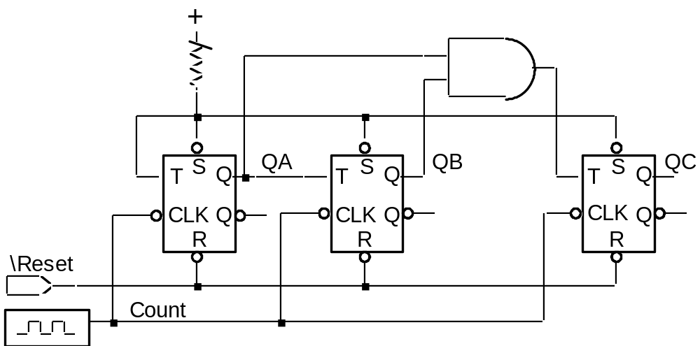
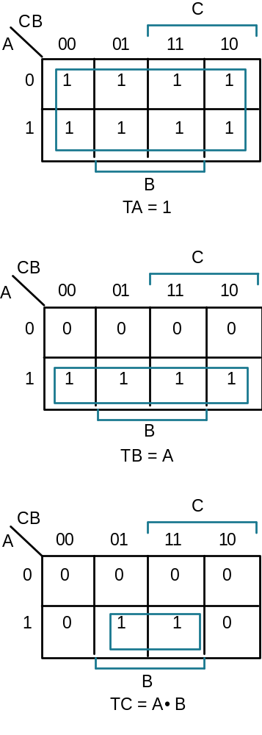
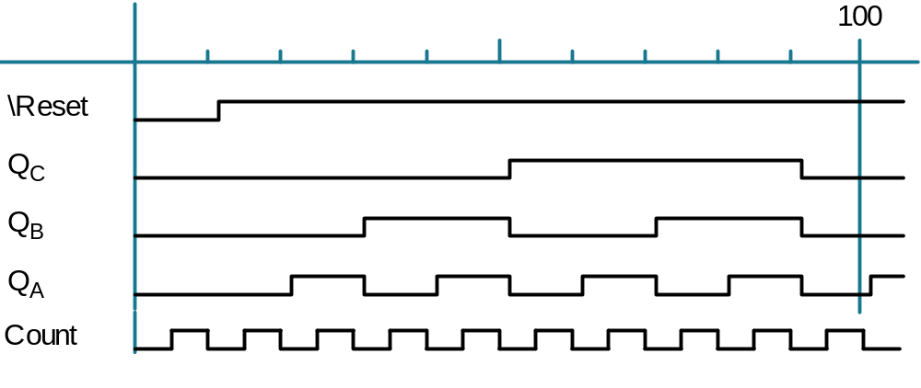
Counter Design Procedure
Example Continued
K-maps for Toggle
Inputs:
Resulting Logic Circuit:
Timing Diagram:

Slide 88
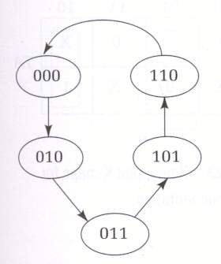
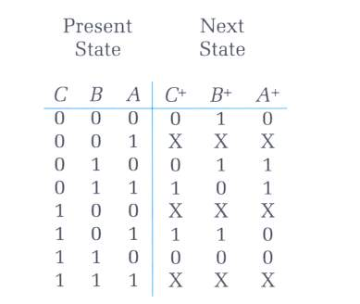
Counter Design Procedure
More Complex Count Sequence
Step 1: Derive the State Transition Diagram
Count sequence: 000, 010, 011, 101, 110
Step 2: State Transition Table
Note the Don't Care conditions

Slide 89



Counter Design Procedure
More Complex Count Sequence
Step 3: K-Maps for Next State Functions

Slide 90



Counter Design Procedure
More Complex Count Sequence
Step 3: K-Maps for Next State Functions

Slide 91

Counter Design Procedure
More Complex Counter Sequencing
Step 4: Choose Flipflop Type for Implementation
Use Excitation Table to Remap Next State Functions
Toggle Excitation
Table
Remapped Next State
Functions

Slide 92
Counter Design Procedure
More Complex Counter Sequencing
Remapped K-Maps
TC = A C + A C = A xor C
TB = A + B + C
TA = A B C + B C

Slide 93


Counter Design Procedure
More Complex Counter Sequencing
Resulting Logic:
5 Gates
10 Literals +
Flipflop connections
Timing Waveform:

Slide 94


Implementation with Different Kinds of FFs
R-S Flipflops
Continuing with the 000, 010, 011, 101, 110, 000, ... counter example
RS Excitation Table
Remapped Next State Functions

Slide 95
Implementation with Different Kinds of FFs
RS FFs Continued
CB
CB
A
00
01
11
10
A
00
01
11
10
0
0
1
1
RC
SC
RC =
SC =
RB =
SB =
RA =
SA =
CB
CB
A
00
01
11
10
A
00
01
11
10
0
0
1
1
RB
SB
CB
CB
A
00
01
11
10
A
00
01
11
10
0
0
1
1
RA
SA

Slide 96

Implementation with Different Kinds of FFs
RS FFs Continued
RC = A
SC = A
RB = A B + B C
SB = B
RA = C
SA = B C

Slide 97

Implementation With Different Kinds of FFs
RS FFs Continued
Resulting Logic Level Implementation:
3 Gates, 9 Literals + Flipflop connections
using RB = B (A + C)
Could be 4 Gates, 10 Literals + FF connections

Slide 98


Implementation with Different FF Types
J-K FFs
J-K Excitation Table
Remapped Next State Functions

Slide 99
Implementation with Different FF Types
J-K FFs Continued
CB
CB
A
00
01
11
10
A
00
01
11
10
0
0
1
1
JC =
KC =
JB =
KB =
JA =
KA =
JC
KC
CB
CB
A
00
01
11
10
A
00
01
11
10
0
0
1
1
JB
KB
CB
CB
A
00
01
11
10
A
00
01
11
10
0
0
1
1
JA
KA

Slide 100

Implementation with Different FF Types
J-K FFs Continued
JC = A
KC = A
JB = 1
KB = A + C
JA = B C
KA = C

Slide 101

Implementation with Different FF Types
J-K FFs Continued
Resulting Logic Level Implementation:
2 Gates, 7 Literals + Flipflop Connections

Slide 102

Implementation with Different FF Types
D FFs
Simplest Design Procedure: No remapping needed!
DC = A
DB = A C + B
DA = B C
Resulting Logic Level Implementation:
3 Gates, 6 Literals + Flipflop connections

Slide 103
Implementation with Different FF Types
Comparison
T FFs well suited for straightforward binary counters
But yielded worst gate and literal count for this example!
No reason to choose R-S over J-K FFs: it is a proper subset of J-K
R-S FFs don't really exist anyway
J-K FFs yielded lowest gate count
Tend to yield best choice for packaged logic where gate count is key
D FFs yield simplest design procedure
Best literal count
D storage devices very transistor efficient in VLSI
Best choice where area/literal count is the key

Slide 104

Counters With Outputs
Z=1 when count={0,3,6}
Z is called a Moore or static output.
It is a function only of the current state.
13 COUNTERS
Page <number>
ECEn 224

Slide 105

Combined Transition Table
Current state
Next state
Output
Z = Q2’•Q1’•Q0’ + Q2’•Q1•Q0 + Q2•Q1•Q0’
(implement OFL with gates)
13 COUNTERS
Page <number>
ECEn 224

Slide 106
Counter With A Moore Output
N2
D Q
Q2
CLK
N1
D Q
Q1
Z
CLK
N0
D Q
Q0
IFL
OFL
CLK
13 COUNTERS
Page <number>
ECEn 224

