Slide 1
Sequential Logic
Counters and Registers
Counters
Introduction: Counters
Asynchronous (Ripple) Counters
Asynchronous Counters with MOD number < 2^{n}
Asynchronous Down Counters
Cascading Asynchronous Counters
CS1104-13
Lecture 13: Sequential Logic: Counters and Registers

Slide 2
Sequential Logic
Counters and Registers
Synchronous (Parallel) Counters
Up/Down Synchronous Counters
Designing Synchronous Counters
Decoding A Counter
Counters with Parallel Load
CS1104-13
Lecture 13: Sequential Logic: Counters and Registers

Slide 3
Sequential Logic
Counters and Registers
Registers
Introduction: Registers
  Simple Registers
  Registers with Parallel Load
Using Registers to implement Sequential Circuits
Shift Registers
  Serial In/Serial Out Shift Registers
  Serial In/Parallel Out Shift Registers
  Parallel In/Serial Out Shift Registers
  Parallel In/Parallel Out Shift Registers
CS1104-13
Lecture 13: Sequential Logic: Counters and Registers

Slide 4
Lecture 13: Sequential Logic
Counters and Registers
Bidirectional Shift Registers
An Application – Serial Addition
Shift Register Counters
  Ring Counters
  Johnson Counters
Random-Access Memory (RAM)
CS1104-13
Lecture 13: Sequential Logic: Counters and Registers

Slide 5
Introduction: Counters
Counters are circuits that cycle through a specified number of states.
Two types of counters:
  synchronous (parallel) counters
  asynchronous (ripple) counters
Ripple counters allow some flip-flop outputs to be used as a source of clock for other flip-flops.
Synchronous counters apply the same clock to all flip-flops.
CS1104-13
Introduction: Counters

Slide 6
Asynchronous (Ripple) Counters
Asynchronous counters: the flip-flops do not change states at exactly the same time as they do not have a common clock pulse.
Also known as ripple counters, as the input clock pulse “ripples” through the counter – cumulative delay is a drawback.
n flip-flops → a MOD (modulus) 2^{n} counter. (Note: A MOD-x counter cycles through x states.)
Output of the last flip-flop (MSB) divides the input clock frequency by the MOD number of the counter, hence a counter is also a frequency divider.
CS1104-13
Asynchronous (Ripple) Counters

Slide 7
Asynchronous (Ripple) Counters
Example: 2-bit ripple binary counter.
Output of one flip-flop is connected to the clock input of the next more-significant flip-flop.
HIGH
J
Q₀
J
Q₁
CLK
C
Q₀
C
K
K
FF0
FF1
CLK
1
2
3
4
Q₀
Timing diagram
00 → 01 → 10 → 11 → 00 ...
Q₀
0
1
0
1
0
Q₁
0
0
1
1
0
CS1104-13
Asynchronous (Ripple) Counters

Slide 8
How does it work?
  When there is a positive edge on the clock input of A, A complements The clock input for flip- flop B is the complemented output of flip-flop A
  When flip A changes from 1 to 0, there is a positive edge on the clock input of B causing B to complement
CS1103

Slide 9
Asynchronous (Ripple) Counters
Example: 3-bit ripple binary counter.
HIGH
J
Q₀
J
Q₁
J
Q₂
CLK
C
Q₀
C
Q₁
C
K
K
K
FF0
FF1
FF2
CLK
1
2
3
4
5
6
7
8
Q₀
0
1
0
1
0
1
0
1
0
Q₁
0
0
1
1
0
0
1
1
0
Q₂
0
0
0
0
1
1
1
1
0
Recycles back to 0
CS1104-13
Asynchronous (Ripple) Counters

Slide 10
Asynchronous (Ripple) Counters
Propagation delays in an asynchronous (ripple-clocked) binary counter.
If the accumulated delay is greater than the clock pulse, some counter states may be misrepresented!
CLK
1
2
3
4
Q₀
Q₁
Q₂
t_{PHL} (CLK to Q₀)
t_{PHL} (CLK to Q₀)
t_{PLH}
(CLK to Q₀)
t_{PLH} (Q₀ to Q₁)
t_{PHL} (Q₀ to Q₁)
t_{PLH} (Q₁ to Q₂)
CS1104-13
Asynchronous (Ripple) Counters

Slide 11
Asynchronous (Ripple) Counters
Example: 4-bit ripple binary counter (negative-edge triggered).
HIGH
J
Q₀
J
Q₁
J
Q₂
J
Q₃
CLK
C
C
C
C
K
K
K
K
FF0
FF1
FF2
FF3
CLK
1
2
3
4
5
6
7
8
9
10
11
12
13
14
15
16
Q₀
Q₁
Q₂
Q₃
CS1104-13
Asynchronous (Ripple) Counters

Slide 12
Up/Down Synchronous Counters
Up/down synchronous counter: a bidirectional counter that is capable of counting either up or down.
An input (control) line Up/Down (or simply Up) specifies the direction of counting.
  Up/Down = 1 → Count upward
  Up/Down = 0 → Count downward
CS1104-13
Up/Down Synchronous Counters

Slide 13
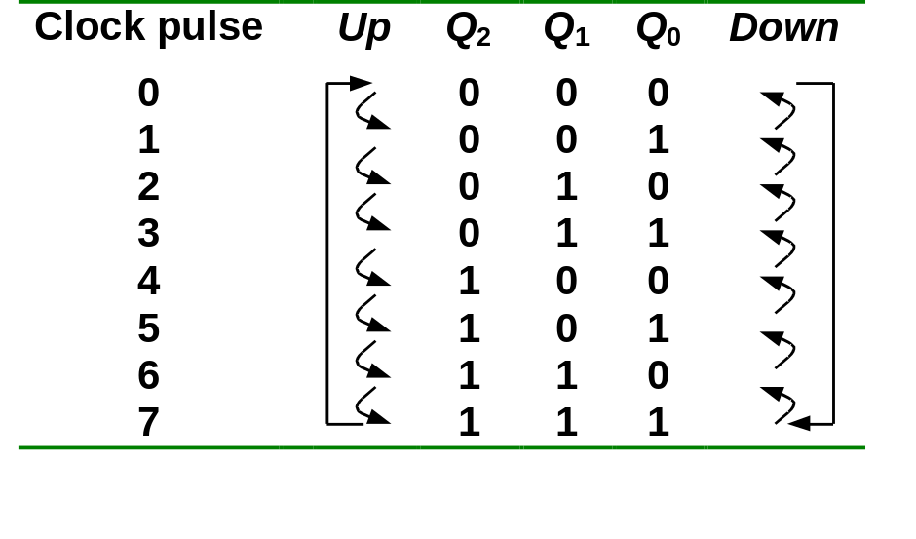
Up/Down Synchronous Counters
Example: A 3-bit up/down synchronous binary counter.
TQ₀ = 1
TQ₁ = (Q₀.Up) + (Q₀'.Up' )
TQ₂ = ( Q₀.Q₁.Up ) + (Q₀'. Q₁'. Up' )
Up counter
TQ₀ = 1
TQ₁ = Q₀
TQ₂ = Q₀.Q₁
Down counter
TQ₀ = 1
TQ₁ = Q₀’
TQ₂ = Q₀’.Q₁’
CS1104-13
Up/Down Synchronous Counters

Slide 14
Up/Down Synchronous Counters
Example: A 3-bit up/down synchronous binary counter (cont’d).
TQ₀ = 1
TQ₁ = (Q₀.Up) + (Q₀'.Up' )
TQ₂ = ( Q₀.Q₁.Up ) + (Q₀'. Q₁'. Up' )
Q₀
Q₁
1
T
Q
T
T
Q₂
Q
Q
Q
Q
Q
Up
C
C
C
Q'
Q'
Q'
Q'
Q'
Q'
CLK
CS1104-13
Up/Down Synchronous Counters

Slide 15
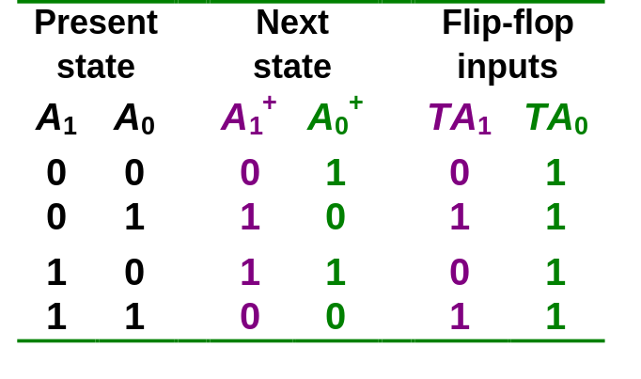
Synchronous (Parallel) Counters
Example: 2-bit synchronous binary counter (using T flip-flops, or JK flip-flops with identical J,K inputs).
TA₁ = A₀
TA₀ = 1
1
J
A₀
J
A₁
Q
Q
Q
C
C
Q'
Q'
K
Q'
K
CLK
CS1104-13
Synchronous (Parallel) Counters

Slide 16
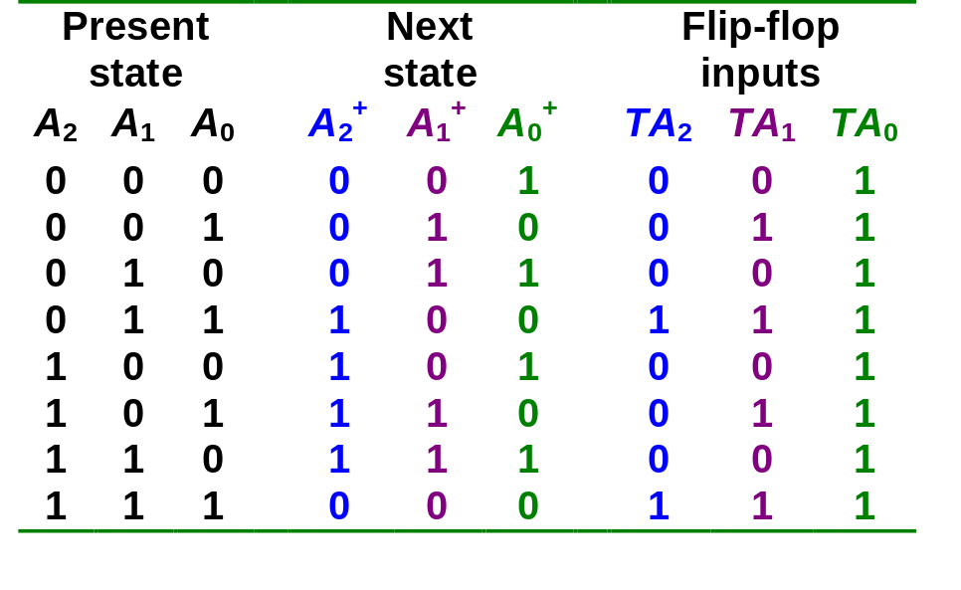
Synchronous (Parallel) Counters
Example: 3-bit synchronous binary counter (using T flip-flops, or JK flip-flops with identical J, K inputs).
A₁
A₁
A₁
1
1
1
1
1
1
1
A₂
1
A₂
1
1
A₂
1
1
1
1
A₀
A₀
A₀
TA₂ = A₁.A₀
TA₁ = A₀
TA₀ = 1
CS1104-13
Synchronous (Parallel) Counters

Slide 17
Asyn. Counters with MOD no. < 2^{n}
States may be skipped resulting in a truncated sequence.
Technique: force counter to recycle before going through all of the states in the binary sequence.
Example: Given the following circuit, determine the counting sequence (and hence the modulus no.)
C
B
A
Q
J
Q
J
Q
J
All J, K inputs are 1 (HIGH).
CLK
CLK
CLK
Q
K
Q
K
Q
K
CLR
CLR
CLR
B
C
CS1104-13
Asynchronous Counters with MOD number < 2^n

Slide 18
Asyn. Counters with MOD no. < 2^{n}
Example (cont’d):
C
B
A
Q
J
Q
J
Q
J
All J, K inputs are 1 (HIGH).
CLK
CLK
CLK
Q
K
Q
K
Q
K
CLR
CLR
CLR
B
C
1
2
3
4
5
6
7
8
9
10
11
12
MOD-6 counter produced by clearing (a MOD-8 binary counter) when count of six (110) occurs.
Clock
A
B
C
NAND
Output
1
0
CS1104-13
Asynchronous Counters with MOD number < 2^n

Slide 19
Asyn. Counters with MOD no. < 2^{n}
Example (cont’d): Counting sequence of circuit (in CBA order).
1
2
3
4
5
6
7
8
9
10
11
12
Clock
A
0
0
0
1
0
0
0
1
0
1
1
0
0
0
1
1
0
1
0
0
0
1
0
0
B
C
NAND
Output
1
0
111
000
Temporary state
001
Counter is a MOD-6 counter.
110
010
101
011
100
CS1104-13
Asynchronous Counters with MOD number < 2^n

Slide 20
Asyn. Counters with MOD no. < 2^{n}
Exercise: How to construct an asynchronous MOD-5 counter? MOD-7 counter? MOD-12 counter?
Question: The following is a MOD-? counter?
F
E
D
C
B
A
Q
J
Q
J
Q
J
Q
J
Q
J
Q
J
Q
K
Q
K
Q
K
Q
K
Q
K
Q
K
CLR
CLR
CLR
CLR
CLR
CLR
C
D
E
F
All J = K = 1.
CS1104-13
Asynchronous Counters with MOD number < 2^n

Slide 21
Asyn. Counters with MOD no. < 2^{n}
Decade counters (or BCD counters) are counters with 10 states (modulus-10) in their sequence. They are commonly used in daily life (e.g.: utility meters, odometers, etc.).
Design an asynchronous decade counter.
(A.C)'
HIGH
J
Q
D
J
Q
C
J
Q
B
J
Q
A
CLK
C
C
C
C
K
K
K
K
CLR
CLR
CLR
CLR
CS1104-13
Asynchronous Counters with MOD number < 2^n

Slide 22
Asyn. Counters with MOD no. < 2^{n}
Asynchronous decade/BCD counter (cont’d).
HIGH
D
C
B
A
J
Q
J
Q
J
Q
J
Q
(A.C)'
CLK
C
C
C
C
K
K
K
K
CLR
CLR
CLR
CLR
1
2
3
4
5
6
7
8
9
10
11
Clock
D
0
0
0
0
1
0
0
0
0
1
0
0
1
1
0
0
0
0
1
0
1
0
1
0
0
1
1
0
1
1
1
0
0
0
0
1
1
0
0
1
0
0
0
0
C
B
A
NAND
output
CS1104-13
Asynchronous Counters with MOD number < 2^n

Slide 23
Asynchronous Down Counters
So far we are dealing with up counters. Down counters, on the other hand, count downward from a maximum value to zero, and repeat.
Example: A 3-bit binary (MOD-2³) down counter.
1
J
Q₀
J
Q₁
J
Q₂
3-bit binary up counter
Q
Q
Q
Q
CLK
C
C
C
Q'
K
Q'
K
Q'
K
Q'
1
J
Q₀
J
Q₁
J
Q₂
3-bit binary down counter
Q
Q
Q
Q
CLK
C
C
C
Q'
Q'
Q'
K
Q'
K
K
CS1104-13
Asynchronous Down Counters

Slide 24
Asynchronous Down Counters
Example: A 3-bit binary (MOD-8) down counter.
000
001
111
1
J
Q₀
J
Q₁
J
Q₂
010
110
Q
Q
Q
Q
CLK
C
C
C
Q'
Q'
Q'
K
Q'
K
K
011
101
100
CLK
1
2
3
4
5
6
7
8
Q₀
0
1
0
1
0
1
0
1
0
Q₁
0
1
1
0
0
1
1
0
0
Q₂
0
1
1
1
1
0
0
0
0
CS1104-13
Asynchronous Down Counters

Slide 25
Cascading Asynchronous Counters
Larger asynchronous (ripple) counter can be constructed by cascading smaller ripple counters.
Connect last-stage output of one counter to the clock input of next counter so as to achieve higher-modulus operation.
Example: A modulus-32 ripple counter constructed from a modulus-4 counter and a modulus-8 counter.
Q₀
Q₁
Q₂
Q₃
Q₄
J
Q
J
J
J
J
Q
Q
Q
Q
Q
Q
CLK
C
C
C
C
C
Q'
Q'
Q'
Q'
K
K
K
Q'
K
Q'
K
Q'
Modulus-4 counter
Modulus-8 counter
CS1104-13
Cascading Asynchronous Counters

Slide 26
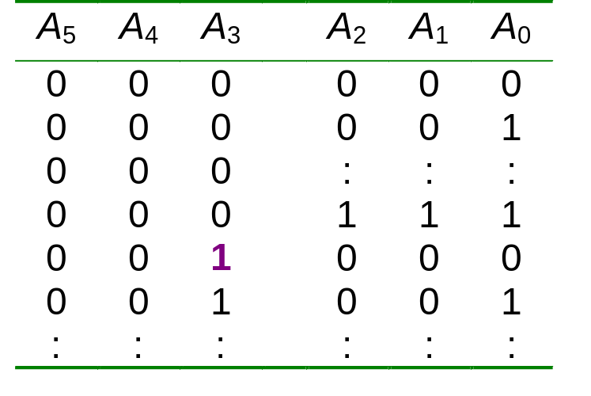
Cascading Asynchronous Counters
Example: A 6-bit binary counter (counts from 0 to 63) constructed from two 3-bit counters.
A₀ A₁ A₂
A₃ A₄ A₅
Count pulse
3-bit
binary counter
3-bit
binary counter
CS1104-13
Cascading Asynchronous Counters

Slide 27
Cascading Asynchronous Counters
If counter is a not a binary counter, requires additional output.
Example: A modulus-100 counter using two decade counters.
freq/10
1
CTEN
Decade counter
CTEN
Decade counter
freq/100
TC
TC
CLK
C
Q₃ Q₂ Q₁ Q₀
C
Q₃ Q₂ Q₁ Q₀
freq
TC = 1 when counter recycles to 0000
CS1104-13
Cascading Asynchronous Counters

Slide 28
Synchronous (Parallel) Counters
Synchronous (parallel) counters: the flip-flops are clocked at the same time by a common clock pulse.
We can design these counters using the sequential logic design process (covered in Lecture #12).
Example: 2-bit synchronous binary counter (using T flip-flops, or JK flip-flops with identical J,K inputs).
00
01
11
10
CS1104-13
Synchronous (Parallel) Counters

Slide 29
Synchronous (Parallel) Counters
Example: 2-bit synchronous binary counter (using T flip-flops, or JK flip-flops with identical J,K inputs).
TA₁ = A₀
TA₀ = 1
1
J
A₀
J
A₁
Q
Q
Q
C
C
Q'
Q'
K
Q'
K
CLK
CS1104-13
Synchronous (Parallel) Counters

Slide 30
Synchronous (Parallel) Counters
Example: 3-bit synchronous binary counter (using T flip-flops, or JK flip-flops with identical J, K inputs).
A₁
A₁
A₁
1
1
1
1
1
1
1
A₂
1
A₂
1
1
A₂
1
1
1
1
A₀
A₀
A₀
TA₂ = A₁.A₀
TA₁ = A₀
TA₀ = 1
CS1104-13
Synchronous (Parallel) Counters

Slide 31
Synchronous (Parallel) Counters
Example: 3-bit synchronous binary counter (cont’d).
  TA₂ = A₁.A₀ TA₁ = A₀ TA₀ = 1
A₂
A₁
A₀
Q
Q
Q
J
K
J
K
J
K
CP
1
CS1104-13
Synchronous (Parallel) Counters

Slide 32
Synchronous (Parallel) Counters
Note that in a binary counter, the n^{th} bit (shown underlined) is always complemented whenever
  011…11 → 100…00
  or 111…11 → 000…00
Hence, X_{n} is complemented whenever X_{n-1}X_{n-2} ... X₁X₀ = 11…11.
As a result, if T flip-flops are used, then TX_{n} = X_{n-1} . X_{n-2} . ... . X₁ . X₀
CS1104-13
Synchronous (Parallel) Counters

Slide 33
Synchronous (Parallel) Counters
Example: 4-bit synchronous binary counter.
  TA₃ = A₂ . A₁ . A₀
  TA₂ = A₁ . A₀
  TA₁ = A₀
  TA₀ = 1
1
A₁.A₀
A₂.A₁.A₀
J
A₀
J
A₁
J
A₂
J
A₃
Q
Q
Q
Q
Q
C
C
C
C
Q'
Q'
Q'
Q'
K
Q'
K
K
K
CLK
CS1104-13
Synchronous (Parallel) Counters

Slide 34
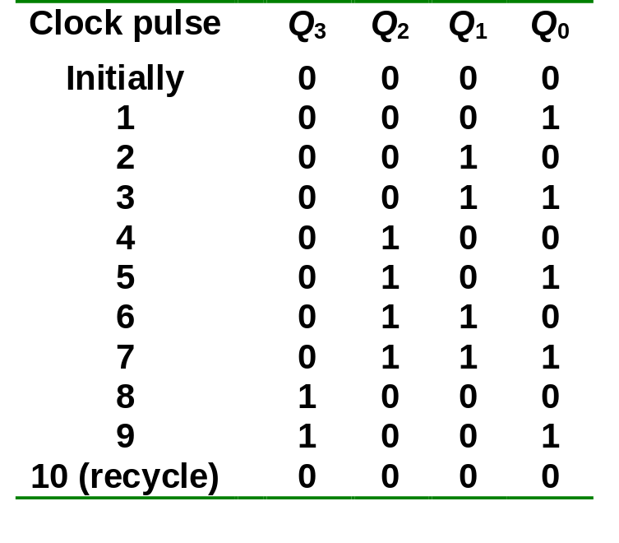
Synchronous (Parallel) Counters
Example: Synchronous decade/BCD counter.
T₀ = 1
T₁ = Q₃'.Q₀
T₂ = Q₁.Q₀
T₃ = Q₂.Q₁.Q₀ + Q₃.Q₀
CS1104-13
Synchronous (Parallel) Counters

Slide 35
Synchronous (Parallel) Counters
Example: Synchronous decade/BCD counter (cont’d).
T₀ = 1
T₁ = Q₃'.Q₀
T₂ = Q₁.Q₀
T₃ = Q₂.Q₁.Q₀ + Q₃.Q₀
Q₀
1
T
Q
T
Q₁
T
Q₂
T
Q₃
Q
Q
Q
Q
Q
Q
Q
C
C
C
C
Q'
Q'
Q'
Q'
Q'
Q'
Q'
Q'
CLK
CS1104-13
Synchronous (Parallel) Counters

Slide 36
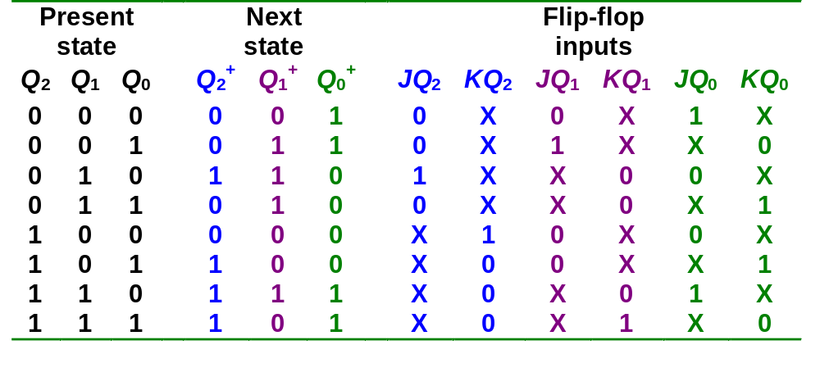
Designing Synchronous Counters
Covered in Lecture #12.
Example: A 3-bit Gray code counter (using JK flip-flops).
000
100
001
101
011
111
010
110
CS1104-13
Designing Synchronous Counters

Slide 37
Designing Synchronous Counters
3-bit Gray code counter: flip-flop inputs.
Q₁Q₀
Q₁Q₀
Q₁Q₀
Q₂
Q₂
00 01 11 10
Q₂
00 01 11 10
00 01 11 10
0
1
1
0
1
1
X
X
0
1
1
X
X
X
X
X
X
X
X
X
X
1
JQ₂ = Q₁.Q₀'
JQ₁ = Q₂'.Q₀
JQ₀ = Q₂.Q₁ + Q₂'.Q₁'
= (Q₂ ⊕ Q₁)'
Q₁Q₀
Q₁Q₀
Q₁Q₀
Q₂
00 01 11 10
Q₂
00 01 11 10
Q₂
00 01 11 10
0
1
X
X
X
X
0
1
X
X
0
1
X
1
X
1
X
X
1
X
1
X
KQ₂ = Q₁'.Q₀'
KQ₁ = Q₂.Q₀
KQ₀ = Q₂.Q₁' + Q₂'.Q₁
= Q₂ ⊕ Q₁
CS1104-13
Designing Synchronous Counters

Slide 38
Designing Synchronous Counters
3-bit Gray code counter: logic diagram.
JQ₂ = Q₁.Q₀' JQ₁ = Q₂'.Q₀ JQ₀ = (Q₂ ⊕ Q₁)'
KQ₂ = Q₁'.Q₀' KQ₁ = Q₂.Q₀ KQ₀ = Q₂ ⊕ Q₁
Q₀
Q₁
Q₂
J
Q
J
Q
J
Q
C
C
C
Q₁'
Q₂'
K
Q'
K
Q'
K
Q'
Q₀'
CLK
CS1104-13
Designing Synchronous Counters

Slide 39
Decoding A Counter
Decoding a counter involves determining which state in the sequence the counter is in.
Differentiate between active-HIGH and active-LOW decoding.
Active-HIGH decoding: output HIGH if the counter is in the state concerned.
Active-LOW decoding: output LOW if the counter is in the state concerned.
CS1104-13
Decoding A Counter

Slide 40
Decoding A Counter
Example: MOD-8 ripple counter (active-HIGH decoding).
0
1
2
3
4
5
6
7
8
9
10
Clock
A'
B'
C'
HIGH only on count of ABC = 000
A'
B'
C
HIGH only on count of ABC = 001
A'
B
C'
HIGH only on count of ABC = 010
.
.
.
A
B
C
HIGH only on count of ABC = 111
CS1104-13
Decoding A Counter

Slide 41
Decoding A Counter
Example: To detect that a MOD-8 counter is in state 0 (000) or state 1 (001).
A'
B'
C'
0
1
2
3
4
5
6
7
8
9
10
Clock
A'
B'
C
A'
B'
HIGH only on count of ABC = 000 or ABC = 001
Example: To detect that a MOD-8 counter is in the odd states (states 1, 3, 5 or 7), simply use C.
0
1
2
3
4
5
6
7
8
9
10
Clock
HIGH only on count of odd states
C
CS1104-13
Decoding A Counter

Slide 42
Counters with Parallel Load
Counters could be augmented with parallel load capability for the following purposes:
  To start at a different state
  To count a different sequence
  As more sophisticated register with increment/decrement functionality.
CS1104-13
Counters with Parallel Load

Slide 43
Counters with Parallel Load
Different ways of getting a MOD-6 counter:
A₄ A₃ A₂ A₁
A₄ A₃ A₂ A₁
Load
Count = 1
Clear = 1
CP
Clear
Count = 1
Load = 0
CP
I₄ I₃ I₂ I₁
I₄ I₃ I₂ I₁
Inputs = 0
Inputs have no effect
(a) Binary states 0,1,2,3,4,5.
(b) Binary states 0,1,2,3,4,5.
A₄ A₃ A₂ A₁
A₄ A₃ A₂ A₁
Carry-out
Count = 1
Clear = 1
CP
Count = 1
Clear = 1
CP
Load
Load
I₄ I₃ I₂ I₁
I₄ I₃ I₂ I₁
1 0 1 0
0 0 1 1
(c) Binary states 10,11,12,13,14,15.
(d) Binary states 3,4,5,6,7,8.
CS1104-13
Counters with Parallel Load

Slide 44
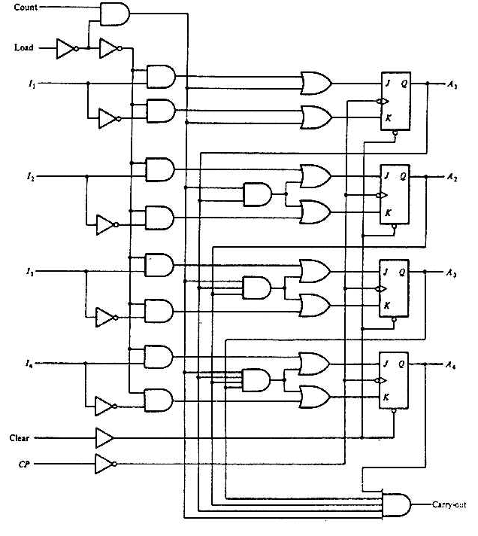
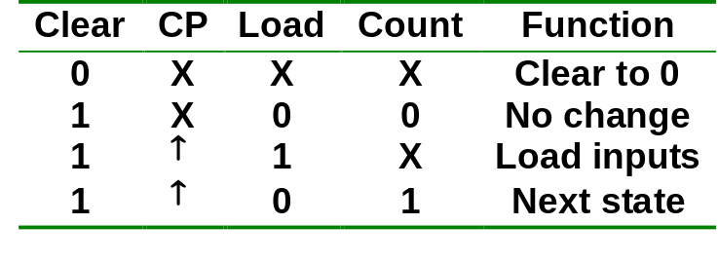
Counters with Parallel Load
4-bit counter with parallel load.
CS1104-13
Counters with Parallel Load

Slide 45
Introduction: Registers
An n-bit register has a group of n flip-flops and some logic gates and is capable of storing n bits of information.
The flip-flops store the information while the gates control when and how new information is transferred into the register.
Some functions of register:
  retrieve data from register
  store/load new data into register (serial or parallel)
  shift the data within register (left or right)
CS1104-13
Introduction: Registers

Slide 46
Simple Registers
No external gates.
Example: A 4-bit register. A new 4-bit data is loaded every clock cycle.
A₃
A₂
A₁
A₀
Q
Q
Q
Q
D
D
D
D
CP
I₃
I₂
I₁
I₀
CS1104-13
Simple Registers

Slide 47
Registers With Parallel Load
Instead of loading the register at every clock pulse, we may want to control when to load.
Loading a register: transfer new information into the register. Requires a load control input.
Parallel loading: all bits are loaded simultaneously.
CS1104-13
Registers With Parallel Load

Slide 48
Registers With Parallel Load
Load'.A₀ + Load. I₀
Load
D
Q
A₀
I₀
D
Q
A₁
I₁
D
Q
A₂
I₂
D
Q
A₃
I₃
CLK
CLEAR
CS1104-13
Registers With Parallel Load

Slide 49
Using Registers to implement Sequential Circuits
A sequential circuit may consist of a register (memory) and a combinational circuit.
Next-state value
Register
Combin-ational circuit
Clock
Inputs
Outputs
The external inputs and present states of the register determine the next states of the register and the external outputs, through the combinational circuit.
The combinational circuit may be implemented by any of the methods covered in MSI components and Programmable Logic Devices.
CS1104-13
Using Registers to implement Sequential Circuits

Slide 50
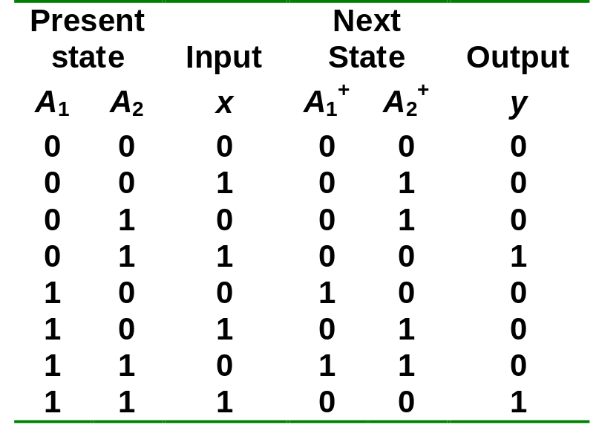
Using Registers to implement Sequential Circuits
Example 1:
  A₁⁺ = Σ m(4,6) = A₁.x'
  A₂⁺ = Σ m(1,2,5,6) = A₂.x' + A₂'.x = A₂ ⊕ x
  y = Σ m(3,7) = A₂.x
A₁.x'
A₁
A₂⊕x
A₂
x
y
CS1104-13
Using Registers to implement Sequential Circuits

Slide 51
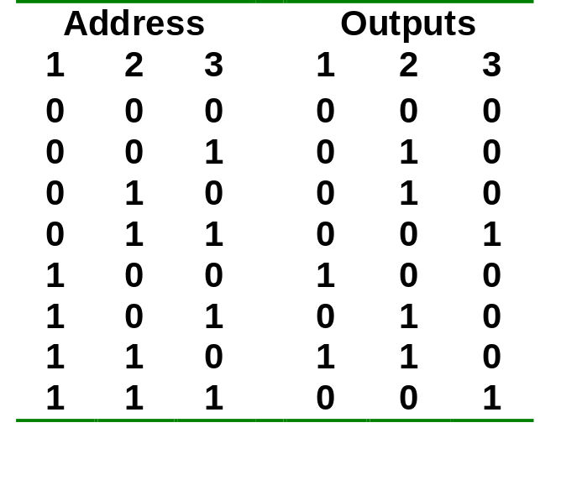
Using Registers to implement Sequential Circuits
Example 2: Repeat example 1, but use a ROM.
A₁
A₂
8 x 3 ROM
x
y
ROM truth table
CS1104-13
Using Registers to implement Sequential Circuits

Slide 52
Shift Registers
Another function of a register, besides storage, is to provide for data movements.
Each stage (flip-flop) in a shift register represents one bit of storage, and the shifting capability of a register permits the movement of data from stage to stage within the register, or into or out of the register upon application of clock pulses.
CS1104-13
Shift Registers

Slide 53
Shift Registers
Basic data movement in shift registers (four bits are used for illustration).
Data in
Data out
Data out
Data in
(a) Serial in/shift right/serial out
(b) Serial in/shift left/serial out
Data in
Data in
Data in
Data out
Data out
(c) Parallel in/serial out
(d) Serial in/parallel out
Data out
(e) Parallel in / parallel out
(f) Rotate right
(g) Rotate left
CS1104-13
Shift Registers

Slide 54
Serial In/Serial Out Shift Registers
Accepts data serially – one bit at a time – and also produces output serially.
Serial data input
Q₀
Q₁
Q₂
Q₃
Serial data output
D
Q
D
Q
D
Q
D
Q
C
C
C
C
CLK
CS1104-13
Serial In/Serial Out Shift Registers

Slide 55
Serial In/Serial Out Shift Registers
Application: Serial transfer of data from one register to another.
SI
SO
SI
SO
Shift register A
Shift register B
Clock
CP
Shift control
Clock
Shift control
Wordtime
CP
T₁
T₂
T₃
T₄
CS1104-13
Serial In/Serial Out Shift Registers

Slide 56
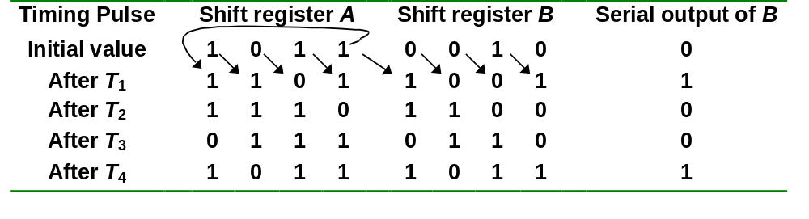
Serial In/Serial Out Shift Registers
Serial-transfer example.
CS1104-13
Serial In/Serial Out Shift Registers

Slide 57
Serial In/Parallel Out Shift Registers
Accepts data serially.
Outputs of all stages are available simultaneously.
Data input
D
Q
D
Q
D
Q
D
Q
C
C
C
C
CLK
Q₀
Q₁
Q₂
Q₃
Data input
D
SRG 4
Logic symbol
CLK
C
Q₀
Q₁
Q₂
Q₃
CS1104-13
Serial In/Parallel Out Shift Registers

Slide 58
Parallel In/Serial Out Shift Registers
Bits are entered simultaneously, but output is serial.
Data input
D₀
D₁
D₂
D₃
SHIFT/LOAD
Serial data out
D
Q
Q₀
D
Q
Q₁
D
Q
Q₂
D
Q
Q₃
C
C
C
C
CLK
SHIFT.Q₀ + SHIFT'.D₁
CS1104-13
Parallel In/Serial Out Shift Registers

Slide 59
Parallel In/Serial Out Shift Registers
Bits are entered simultaneously, but output is serial.
Data in
D₀
D₁
D₂
D₃
SHIFT/LOAD
SRG 4
Serial data out
CLK
C
Logic symbol
CS1104-13
Parallel In/Serial Out Shift Registers

Slide 60
Parallel In/Parallel Out Shift Registers
Simultaneous input and output of all data bits.
Parallel data inputs
D₀
D₁
D₂
D₃
D
Q
D
Q
D
Q
D
Q
C
C
C
C
CLK
Q₀
Q₁
Q₂
Q₃
Parallel data outputs
CS1104-13
Parallel In/Parallel Out Shift Registers

Slide 61
Bidirectional Shift Registers
Data can be shifted either left or right, using a control line RIGHT/LEFT (or simply RIGHT) to indicate the direction.
RIGHT/LEFT
Serial data in
RIGHT.Q₀ + RIGHT'.Q₂
D
Q
D
Q
D
Q
D
Q
Q₃
Q₁
Q₂
C
C
C
C
Q₀
CLK
CS1104-13
Bidirectional Shift Registers

Slide 62
Bidirectional Shift Registers
4-bit bidirectional shift register with parallel load.
Parallel outputs
A₄
A₃
A₂
A₁
Clear
Q
Q
Q
Q
D
D
D
D
CLK
s₁
4x1 MUX
4x1 MUX
4x1 MUX
4x1 MUX
s₀
3 2 1 0
3 2 1 0
3 2 1 0
3 2 1 0
Serial input for shift-right
Serial input for shift-left
I₄
I₃
I₂
I₁
Parallel inputs
CS1104-13
Bidirectional Shift Registers

Slide 63
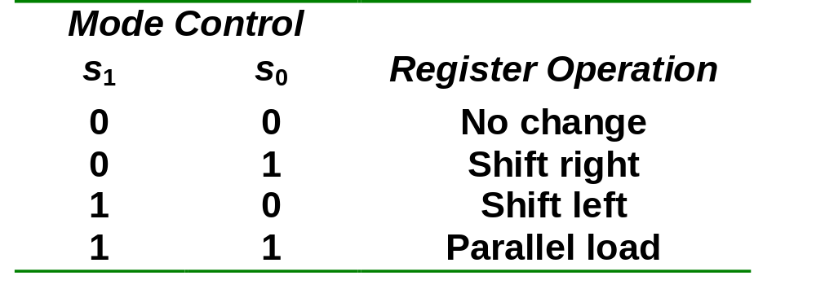
Bidirectional Shift Registers
4-bit bidirectional shift register with parallel load.
CS1104-13
Bidirectional Shift Registers

Slide 64
An Application – Serial Addition
Most operations in digital computers are done in parallel. Serial operations are slower but require less equipment.
A serial adder is shown below. A ← A + B.
SI
Shift-right
SO
Shift-register A
x
y
z
FA
S
C
CP
SI
External input
SO
Shift-register B
Q
D
Clear
CS1104-13
An Application – Serial Addition

Slide 65
An Application – Serial Addition
A = 0100; B = 0111. A + B = 1011 is stored in A after 4 clock pulses.
Initial:
A: 0 1 0 0
B: 0 1 1 1
Q: 0
Step 1: 0 + 1 + 0
S = 1, C = 0
A: 1 0 1 0
B: x 0 1 1
Q: 0
Step 2: 0 + 1 + 0
S = 1, C = 0
A: 1 1 0 1
B: x x 0 1
Q: 0
Step 3: 1 + 1 + 0
S = 0, C = 1
A: 0 1 1 0
B: x x x 0
Q: 1
Step 4: 0 + 0 + 1
S = 1, C = 0
A: 1 0 1 1
B: x x x x
Q: 0
CS1104-13
An Application – Serial Addition

Slide 66
Shift Register Counters
Shift register counter: a shift register with the serial output connected back to the serial input.
They are classified as counters because they give a specified sequence of states.
Two common types: the Johnson counter and the Ring counter.
CS1104-13
Shift Register Counters

Slide 67
Ring Counters
One flip-flop (stage) for each state in the sequence.
The output of the last stage is connected to the D input of the first stage.
An n-bit ring counter cycles through n states.
No decoding gates are required, as there is an output that corresponds to every state the counter is in.
CS1104-13
Ring Counters

Slide 68
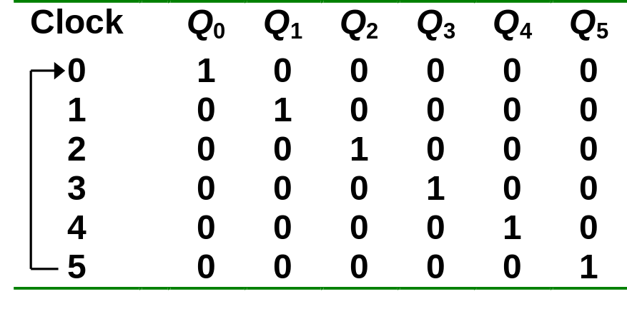
Ring Counters
Example: A 6-bit (MOD-6) ring counter.
PRE
Q₀
Q₁
Q₂
Q₃
Q₄
Q₅
D
Q
D
Q
D
Q
D
Q
D
Q
D
Q
CLR
CLK
100000
000001
010000
000010
001000
000100
CS1104-13
Ring Counters

Slide 69
Johnson Counters
The complement of the output of the last stage is connected back to the D input of the first stage.
Also called the twisted-ring counter.
Require fewer flip-flops than ring counters but more flip-flops than binary counters.
An n-bit Johnson counter cycles through 2n states.
Require more decoding circuitry than ring counter but less than binary counters.
CS1104-13
Johnson Counters

Slide 70
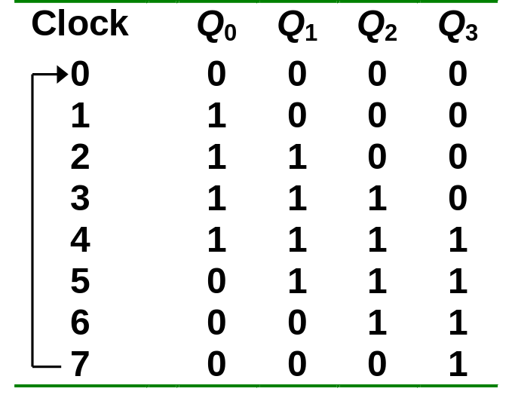
Johnson Counters
Example: A 4-bit (MOD-8) Johnson counter.
Q₀
Q₁
Q₂
D
Q
D
Q
D
Q
D
Q
Q'
Q₃'
CLR
CLK
0000
0001
1000
0011
1100
0111
1110
1111
CS1104-13
Johnson Counters

Slide 71
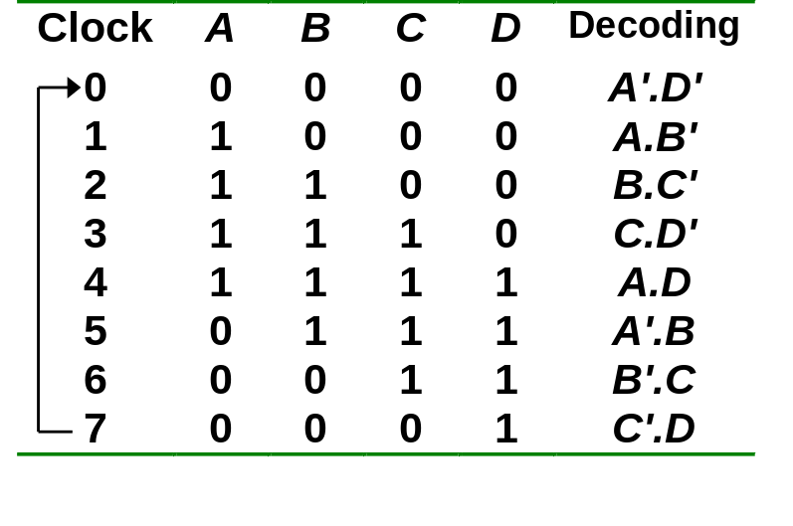
Johnson Counters
Decoding logic for a 4-bit Johnson counter.
A'
D'
State 0
A
B'
State 1
B
C'
State 2
C
D'
State 3
B'
C
A
D
State 6
State 4
C'
D
A'
B
State 7
State 5
CS1104-13
Johnson Counters

Slide 72
Random Access Memory (RAM)
A memory unit stores binary information in groups of bits called words.
The data consists of n lines (for n-bit words). Data input lines provide the information to be stored (written) into the memory, while data output lines carry the information out (read) from the memory.
The address consists of k lines which specify which word (among the 2^{k} words available) to be selected for reading or writing.
The control lines Read and Write (usually combined into a single control line Read/Write) specifies the direction of transfer of the data.
CS1104-13
Random Access Memory (RAM)

Slide 73
Random Access Memory (RAM)
Block diagram of a memory unit:
n data input lines
n
k
Memory unit
2^{k} words
n bits per word
k address lines
Read/Write
n
n data output lines
CS1104-13
Random Access Memory (RAM)

Slide 74
Random Access Memory (RAM)
Content of a 1024 x 16-bit memory:
Memory address
binary
decimal
Memory content
0000000000
0000000001
0000000010
:
:
1111111101
1111111110
1111111111
0
1
2
:
:
1021
1022
1023
1011010111011101
1010000110000110
0010011101110001
:
:
1110010101010010
0011111010101110
1011000110010101
CS1104-13
Random Access Memory (RAM)

Slide 75
Random Access Memory (RAM)
The Write operation:
  Transfers the address of the desired word to the address lines
  Transfers the data bits (the word) to be stored in memory to the data input lines
  Activates the Write control line (set Read/Write to 0)
The Read operation:
  Transfers the address of the desired word to the address lines
  Activates the Read control line (set Read/Write to 1)
CS1104-13
Random Access Memory (RAM)

Slide 76
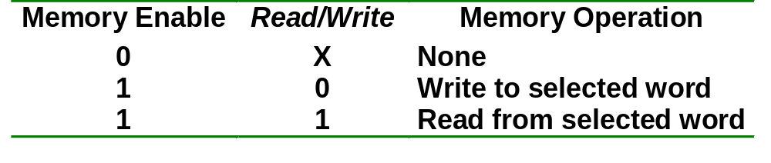
Random Access Memory (RAM)
The Read/Write operation:
Two types of RAM: Static and dynamic.
  Static RAMs use flip-flops as the memory cells.
  Dynamic RAMs use capacitor charges to represent data. Though simpler in circuitry, they have to be constantly refreshed.
CS1104-13
Random Access Memory (RAM)

Slide 77
Random Access Memory (RAM)
A single memory cell of the static RAM has the following logic and block diagrams.
Select
Select
R
S
Input
Q
Output
Input
BC
Output
Read/Write
Read/Write
Logic diagram
Block diagram
CS1104-13
Random Access Memory (RAM)

Slide 78
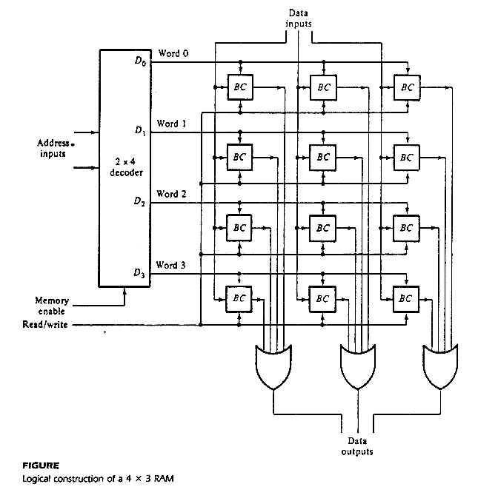
Random Access Memory (RAM)
Logic construction of a 4 x 3 RAM (with decoder and OR gates):
CS1104-13
Random Access Memory (RAM)

Slide 79
Random Access Memory (RAM)
An array of RAM chips: memory chips are combined to form larger memory.
A 1K x 8-bit RAM chip:
RAM 1K x 8
Input data
Address
Chip select
Read/write
8
DATA (8)
ADRS (10)
CS
RW
(8)
8
Output data
10
Block diagram of a 1K x 8 RAM chip
CS1104-13
Random Access Memory (RAM)

Slide 80
Random Access Memory (RAM)
Address
Input data
Lines
Lines
8 lines
11 10
0 – 9
0–1023
DATA (8)
ADRS (10)
CS
RW
(8)
2x4 decoder
1K x 8
S₀
S₁
0
1
2
3
1024 – 2047
DATA (8)
ADRS (10)
CS
RW
(8)
1K x 8
2048 – 3071
Read/write
DATA (8)
ADRS (10)
CS
RW
(8)
1K x 8
3072 – 4095
4K x 8 RAM.
DATA (8)
ADRS (10)
CS
RW
(8)
1K x 8
Output data
CS1104-13
Random Access Memory (RAM)

Slide 81
End of segment

