Slide 1
Chapter 11: File System Implementation
Adapted to COP4610 by Robert van Engelen

Slide 2
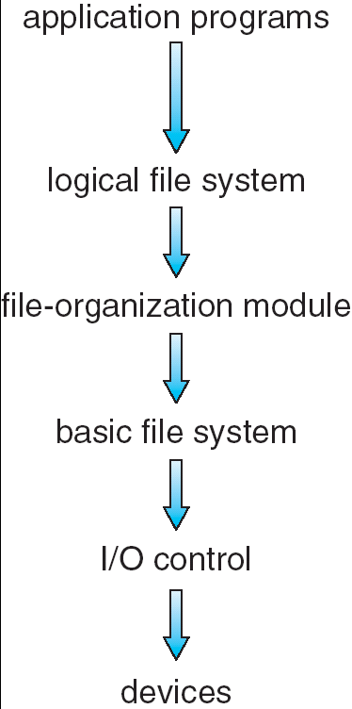
File-System Structure
File structure concept:
  A logical storage unit
  A collection of related information
File system implements file structures
  File system resides on secondary storage (disks)
  File system structure is organized into layers
Layered file system structure

Slide 3
File-System Structure (cont’d)
Logical file system - manages meta-data about the file-system structure in file-control blocks
File organization module - maintains information about files and translates logical block addresses into physical block addresses
Basic file system - issues generic commands to the driver, e.g. read drive1, cylinder 73, track 2, sector 10
Device drivers - lowest level of I/O control with interrupt handlers to transfer data between memory and disk, e.g. read block 123
Layered file system structure

Slide 4
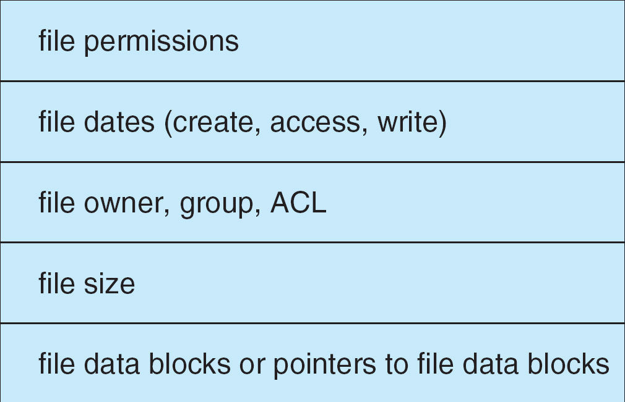
File-Control Blocks
The logical file system maintains structures consisting of information about a file: file-control block (FCB)
Typical FCB

Slide 5

In-Memory File System Structures
Operations performed when opening a file
Operations performed when reading the file after opening

Slide 6

Virtual File Systems
Virtual File Systems (VFS) provide an object-oriented way of implementing file systems
  VFS allows the same system call interface (the API) to be used for different types of file systems
  VFS architecture supports different object types, e.g. file objects, directory objects, whole file system
  The API is to the VFS interface, e.g:
  open()
  read()
  write()
  mmap()

Slide 7
Directory Implementation
How to efficiently implement directory structures?

Slide 8
Directory Implementation (cont’d)
Linear list of file names with pointer to the data blocks
  Simple to program
  Time-consuming to search for file name in (long) lists
Hash Table – linear list with hash data structure
  Decreases directory search time
  Collisions – situations where two file names hash to the same location
    Enlarge the hash table
    Or use fixed size with overflow chains

Slide 9
Allocation Methods
How to efficiently allocate data blocks for files on disk?

Slide 10
Allocation Methods (cont’d)
Three allocation methods:
  Contiguous allocation
  Linked allocation
  Indexed allocation

Slide 12
Contiguous Allocation
A file occupies a set of contiguous blocks on disk
Only starting block (block #) and length (number of blocks) are required in the directory entry (FCB)
Fast -- Minimal seek time and head movement
Random access any block within the file
Similar to dynamic storage-allocation problem
  External fragmentation – may need compaction
Files are difficult to grow
  Find a larger hole and copy the file to the new space

Slide 13

Contiguous Allocation
Each file occupies a set of contiguous blocks on the disk
Pros:
  Simple – only starting location (block #) and length (number of blocks) are required
  Random access
Cons:
  Wasteful of space (dynamic storage-allocation problem)
    External fragmentation: may need to compact space
  Files cannot grow

Slide 14
Contiguous Allocation (cont’d)
Mapping from logical address LA to physical address (B,D) with block number B and displacement D
Suppose block size is 512 bytes:
B = Q + starting address
D = R
Quotient Q
LA/512
Remainder R

Slide 15
Contiguous Allocation: Extent-Based Systems
Some newer file systems (i.e. high-performance Veritas File System) use a modified contiguous allocation scheme
Extent-based file systems allocate disk blocks in extents
An extent is a contiguous chunk of blocks (similar to clusters)
  Extents are allocated when the file grows
  Extents are linked
  A file consists of one or more extents
  Extent size can be set by owner of file

Slide 16
Linked Allocation
Each file is a linked list of disk blocks
  Blocks may be scattered anywhere on the disk
  Directory contains a pointer to the first and last blocks
  Each block contains a pointer to the next block
Advantages
  No external fragmentation
  Easy to grow – Any free block is OK
Disadvantages
  Effectively for only sequential-access file
  Space required for the pointers
  Reliability – What if the pointers are lost

Slide 17

Linked Allocation
Each file is a linked list of disk blocks
Blocks may be scattered anywhere on the disk
Pros:
  Simple – need only starting address
  Free-space management system – no waste of space
Cons:
  No efficient random access
block =
pointer

Slide 18
Linked Allocation (Cont.)
Mapping logical address LA to physical address (B,D) with block number B and displacement D
Suppose block size is 512 bytes and each block contains 4 bytes reserved for pointer to next block:
B = Qth block in the linked chain of blocks
D = R + 4
Quotient Q
LA/508
Remainder R

Slide 19

File-Allocation Table (FAT)
Variation on linked list allocation
FAT is located in contiguous space on disk
Each entry corresponds to disk block number
Each entry contains a pointer to the next block or 0
Used by MS-DOS and OS/2

Slide 20
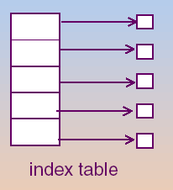
Indexed Allocation
Bring all pointers together into the index block
  An array of disk-block addresses
  The ith entry points to the ith block of the file
  The directory contains the address of the index block
  Similar to the paging scheme for memory management

Slide 21

Indexed Allocation
Brings all pointers together into the index block
Pros:
  Efficient random access
  Dynamic access without external fragmentation
Cons:
  Index table storage overhead

Slide 22
Indexed Allocation (Cont.)
Mapping from logical address LA to physical address (B,D)
Assume block size of 512 bytes
  Need one block for index table with 128 pointers (assuming pointers of 4 bytes each)
  Files have maximum size of 64K bytes
4 x Q = displacement into the index table to obtain B
D = R = displacement into block
Q
LA/512
R

Slide 23
Indexed Allocation – Linked Scheme
Mapping from logical address LA to physical address (B,D) in a file of unbounded length
Linked scheme – link blocks of index table (no limit on size)
Assume block size is 512 bytes and pointer takes 4 bytes:
Q₁
LA / (512 x 127)
R₁
  Q₁ = block of index table in linked chain of index blocks
  R₁ is used as follows:
Q₂
R₁ / 512
R₂
  4 x Q₂ + 4 = displacement into index table (in Q₁) to find B
  R₂ = displacement into block

Slide 24
Indexed Allocation – Two-level Index
Assume block size = 512
Maximum file size is 128x128x512
4 x Q₁ = displacement into outer-index table
R₁ is used as follows:
4 x Q₂ = displacement into block of index table
R₂ displacement into block
Q₁
LA / (512 x 128)
R₁

outer-index
Q₂
index table
file
R₁ / 512
R₂

Slide 25

Combined Scheme: UNIX (4K bytes per block)

Slide 26
Indexed Allocation (Cont.)
Advantage
  Support random access
  Dynamic access without external fragmentation
  No size-declaration problem
  But have overhead of index block. Need index table
Disadvantage
  Wasted space: Worse than the linked allocation for small files
How large the index block should be
  Large index block: waste space for small files
  Small index block: how to handle large files

Slide 27

Free-Space Management
Linked list of free blocks
Pros:
  No waste of space
Cons:
  Difficult to allocate contiguous blocks
Note: FAT free block management is automatic and finding contiguous blocks is easy

Slide 28
Free-Space Management - Bit Vector
Bit vector (for n blocks)
0
1
2
n-1
…
0 ⇒ block[i] free
1 ⇒ block[i] occupied
bit[i] =
Block number calculation:
(number of bits per word) x (number of 0-value words) + offset of first 1 bit

Slide 30
Bit Vector
Simple and efficient to find the first free block, or consecutive free blocks
  By bit-manipulation
Requires extra space
  block size = 2¹² bytes
  disk size = 2³⁰ bytes
  n = 2³⁰/2¹² = 2¹⁸ bits (or 32K bytes)
Efficient only when the entire vector is kept in main memory
  Write back to the disk occasionally for recovery needs
0
1
2
n-1
…
0 ⇒ block[i] free
1 ⇒ block[i] occupied
bit[i] =

001111001111100011000011100…
Question: What’s the block # of the fist free block?

Slide 31
Bit Vector (cont’d)
Pro:
  Easy to find space to allocate contiguous files
Cons:
  Bit map requires extra space, which can be huge
  Example:
block size = 2⁹ bytes
disk size = 2³² bytes (4G bytes)
n = 2³²/2⁹ = 2²³ bits, requiring 2²⁰ bytes (1M bytes)

Slide 32
Linked List
Link together all free blocks
Keep a pointer to the first free block in a special location on the disk and caching it in memory
Cannot get contiguous space easily
No waste of space
Not efficient: have to traverse the disk for free spaces
  Usually, OS needs one free block at a time
FAT incorporate the linked list mechanism

Slide 33
Grouping And Counting
Grouping: store the address of n free blocks in the first free block. The first n-1 are actually free. The final block contains the addresses of another n free blocks…
Counting: Each entry has a disk address and a count
  Several contiguous blocks may be allocated or freed simultaneously

Slide 35
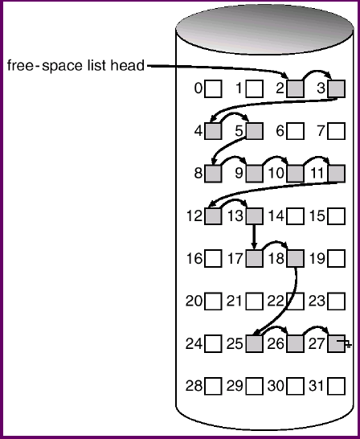
Example Of Free-Space Management
Bit Vector 11000011000000111001111110001111
Grouping
Block 2 → 3, 4, 5
Block 5 → 8, 9, 10
Block 10 → 11, 12, 13
Block 13 → 17, 28, 25
Block 25 → 26, 27
Counting
2 4
8 6
17 2
25 3

Slide 36
Efficiency and Performance
Efficiency dependent on:
  Disk allocation and directory algorithms
  Types of data kept in file’s directory entry
Performance enhancements:
  Disk cache – separate section of main memory for frequently used blocks
  Free-behind and read-ahead – techniques to optimize sequential access
  Improve PC performance by dedicating section of memory as virtual disk, or RAM disk

Slide 37
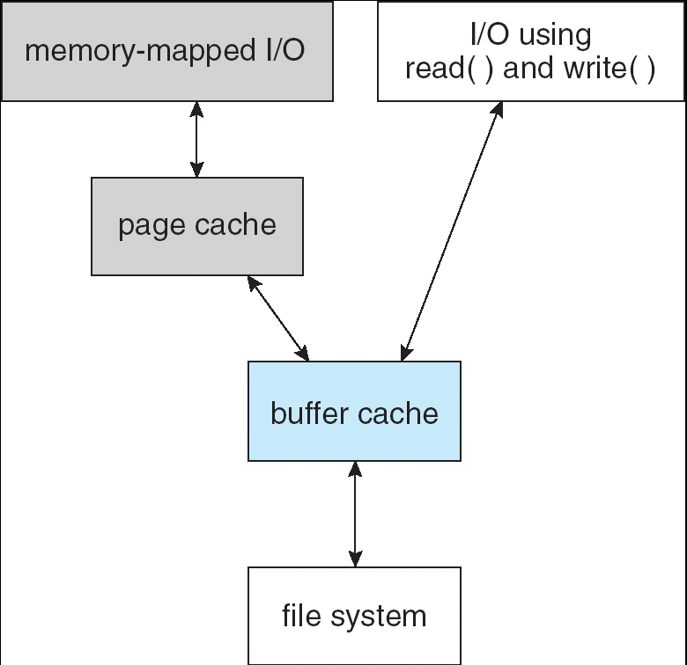
Page Cache
A page cache caches pages rather than disk blocks using virtual memory techniques
Memory-mapped I/O uses a page cache
Routine I/O through the file system uses the buffer (disk) cache
I/O without a unified buffer cache

Slide 38
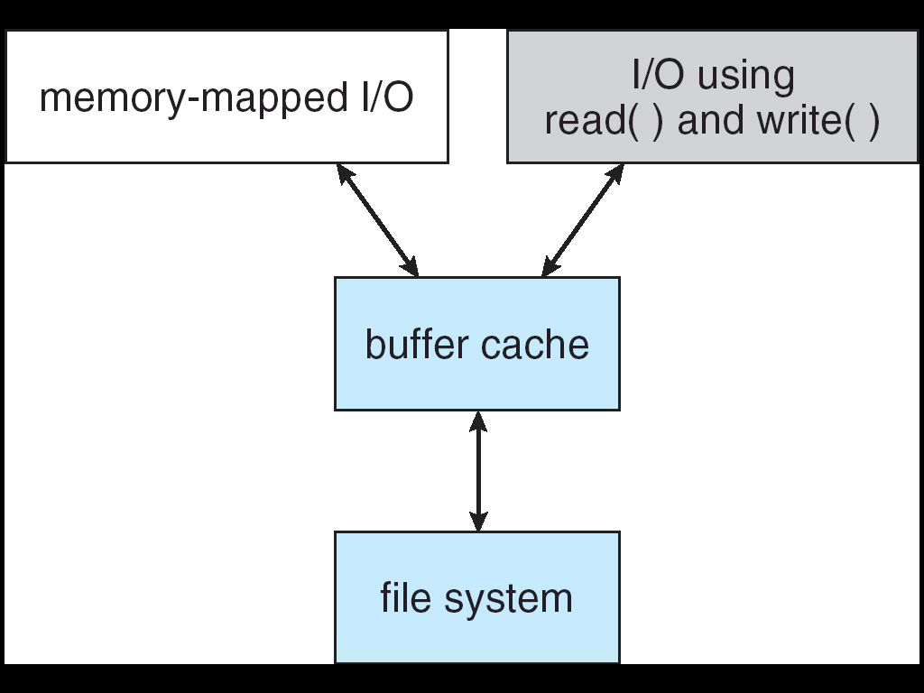
Unified Buffer Cache
A unified buffer cache uses the same page cache to cache both memory-mapped pages and ordinary file system I/O

Slide 39
Recovery
Consistency checking – compares data in directory structure with data blocks on disk, and tries to fix inconsistencies
Use system programs to back up data from disk to another storage device (floppy disk, magnetic tape, other magnetic disk, optical)
Recover lost file or disk by restoring data from backup

Slide 40
Log Structured File Systems
Log structured (or journaling) file systems record each update to the file system as a transaction
All transactions are written to a log
  A transaction is considered committed once it is written to the log
  However, the file system may not yet be updated
The transactions in the log are asynchronously written to the file system
  When the file system is modified, the transaction is removed from the log
If the file system crashes, all remaining transactions in the log must still be performed

Slide 41
The Sun Network File System (NFS)
NFS is an implementation and a specification of a software system for accessing remote files across LANs (or WANs)
The implementation is part of the Solaris and SunOS operating systems running on Sun workstations using an unreliable datagram protocol UDP/IP protocol e.g. over Ethernet
NFS is now widely used

Slide 42
NFS Design
NFS is designed to operate in a heterogeneous environment of different machines, operating systems, and network architectures
  Allows sharing among file systems on different machines in a transparent manner
  NFS specifications are independent of these media
  Independence is achieved through the use of RPC (Remote Procedure Calling) primitives built on top of an External Data Representation (XDR) protocol used between two implementation-independent interfaces
The NFS specification distinguishes between the services provided by a mount mechanism and the actual remote-file-access services

Slide 43
NFS Protocol
Provides RPC for remote file operations
The procedures support the following operations:
  Searching for a file within a directory
  Reading a set of directory entries
  Manipulating links and directories
  Accessing file attributes
  Reading and writing files
NFS servers are stateless; each request has to provide a full set of arguments (NFS V4 is stateful)
Modified data must be committed to the server’s disk before results are returned to the client (lose advantages of caching)
The NFS protocol does not provide concurrency-control mechanisms

Slide 44
NFS Remote Operations
Nearly one-to-one correspondence between regular UNIX system calls and the NFS protocol RPCs (except opening and closing files)
NFS adheres to the remote-service paradigm, but employs buffering and caching techniques for the sake of performance
File-blocks cache – when a file is opened, the kernel checks with the remote server whether to fetch or revalidate the cached attributes
  Cached file blocks are used only if the corresponding cached attributes are up to date
File-attribute cache – the attribute cache is updated whenever new attributes arrive from the server
Clients do not free delayed-write blocks until the server confirms that the data have been written to disk

Slide 45
NFS Mounting
A remote directory is mounted over a local file system directory
  The mounted directory looks like an integral subtree of the local file system, replacing the subtree descending from the local directory
  Specification of the remote directory for the mount operation is nontransparent
    The host name of the remote directory has to be provided
  Subject to access-rights accreditation, potentially any file system (or directory within a file system), can be mounted remotely on top of any local directory

Slide 46

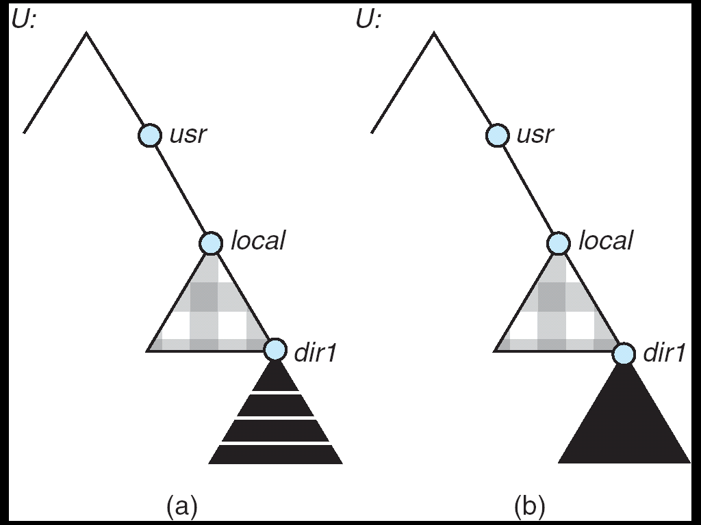
Three Independent File Systems - Mounting
User
Server1
Server2
After
NFS mount
Cascading mounts

Slide 47
NFS Mount Protocol
Establishes initial logical connection between server and client
Mount operation includes name of remote directory to be mounted and name of server machine storing it
  Mount request is mapped to corresponding RPC and forwarded to mount server running on server machine
  Export list – specifies local file systems that server exports for mounting, along with names of machines that are permitted to mount them
Following a mount request that conforms to its export list, the server returns a file handle—a key for further accesses
File handle – a file-system identifier, and an inode number to identify the mounted directory within the exported file system
The mount operation changes only the user’s view and does not affect the server side

Slide 48
Three Major Layers of NFS Architecture
UNIX file-system interface (based on the open, read, write, and close calls, and file descriptors)
Virtual File System (VFS) layer – distinguishes local files from remote ones, and local files are further distinguished according to their file-system types
  The VFS activates file-system-specific operations to handle local requests according to their file-system types
  Calls the NFS protocol procedures for remote requests
NFS service layer – bottom layer of the architecture
  Implements the NFS protocol

Slide 49
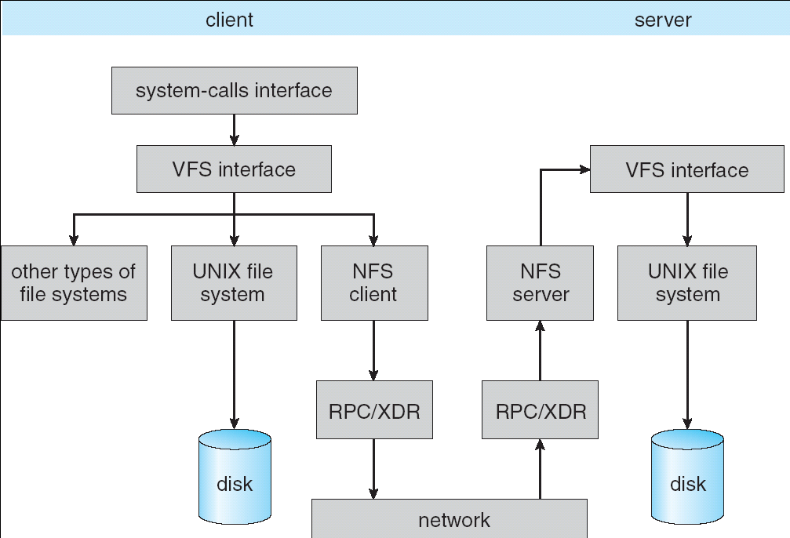
Schematic View of NFS Architecture

Slide 50
NFS Path-Name Translation
Performed by breaking the path into component names and performing a separate NFS lookup call for every pair of component name and directory vnode
To make lookup faster, a directory name lookup cache on the client’s side holds the vnodes for remote directory names

Slide 51
End of Chapter 11

