Slide 1
Chapter 1: Introduction
MINAVATHI
Department of Information Science & Engineering
P E S C E, Mandya

Slide 2
What is an Operating System? (1/2)
A program that acts as an intermediary between a user of a computer and the computer hardware.
Various operating system goals:
  Mainframe operating systems: to optimize utilization of hardware.
  PC operating systems: to support complex games, business applications …
  Handheld computers: to help users easily interface with the computer to execute programs.

Slide 3
What is an Operating System? (2/2)
Some operating systems are designed to be convenient, others to be efficient, and others some combination of the two.

Slide 4

Four Components of a Computer System (1/2)
Computer system can be divided into four components: hardware, the operating system, the application programs, and the users.

Slide 5
Four Components of a Computer System (2/2)
Hardware – provides basic computing resources.
  CPU, memory, I/O devices.
Operating system – controls and coordinates use of hardware among various applications and users
Application programs – define the ways in which the system resources are used to solve the computing problems of the users.
  Word processors, compilers, web browsers, database systems, video games.
Users – people, machines, other computers.
An operation system is similar to a government. It provides an environment
within which other (user) programs can do useful work.

Slide 6
Viewpoints From Users (1/2)
PC: the OS is designed for one user only.
  Resources are monopolized.
  The goal is to maximize the work of the user.
  The OS is generally designed for ease of use, with some attention paid to performance and non paid to resource utilization.
Mainframe: the OS is designed for multiple users – accessing the same computer through terminals.
  These users share resources.
  The OS is designed to maximize resource utilization – to assure that all available CPU time, memory …

Slide 7
Viewpoints From Users (2/2)
Workstation:
  Users sit at workstations connected to networks of other workstations and servers – file, computer, print server.
  The OS is designed to compromise between individual usability and resource utilization.
Handheld computer: are standalone units for individual users.
  The OS is designed mostly for individual usability.
  But performance per amount of battery life is important as well.
Computer with little (or no) user view: embedded home devices.
  The OS is designed to run without user intervention.

Slide 8
Viewpoints From Computers
OS for computer is the program involved with the hardware.
OS is a resource allocator.
  Manages all resources.
  Decides between conflicting requests for efficient and fair resource use.
OS is a control program.
  Controls execution of programs to prevent errors and improper use of the computer.

Slide 9
Operating System Definition (1/3)
What is an operating system?
  No universally accepted definition.
Bare computer (hardware) alone is not easy to use, so application programs are developed.
  These programs require certain common operations, such as those controlling the I/O device.
  These common functions of controlling and allocating resources are then brought together into one piece of software: the operating system.

Slide 10
Operating System Definition (2/3)
OS is …
  “Everything a vendor ships when you order an operating system”
    But varies wildly, for example, text/graphic mode.
A more common definition:
  “The one program running at all times on the computer” is the kernel.
  Everything else is either a system program or an application program.

Slide 11
Operating System Definition (3/3)
The matter of what constitutes an operating system has become increasingly important.
  Antitrust of Microsoft windows.
  Microsoft included too much functionality in its operating systems and thus prevented application vendors from competing.

Slide 12

Computer System Organization (1/2)
Computer-system operation:
  One or more CPUs, device controllers connect through common bus that provides access to shared memory.
  Each device controller is in charge of a specific type of device (disk drives, audio/video devices).

Slide 13
Computer System Organization (2/2)
Each device controller has a local buffer and a set of special-purpose registers.
  E.g., your SATA hard disk may contains 8M buffer.
CPU moves data from/to main memory to/from local buffers.
I/O devices and the CPU can execute concurrently.
Concurrent I/O is from the device to local buffer of controller.

Slide 14
Computer System Operation (1/2)
When a computer is powered up or rebooted …
  A bootstrap program is loaded to Initialize all aspects of system, from CPU registers to device controllers to memory contents.
    Typically stored in ROM (read-only memory) or EEPROM, (erasable programmable read-only memory) generally known as firmware.
    Load into memory the operating-system kernel.
  The operating system then starts executing the first process and waits for some event to occur.
  Events are usually signaled by an interrupt from either the hardware or the software.
    Hardware :I/O operations — disk drive access, keystroke, …
    Software: system calls.

Slide 15
Computer System Operation (2/2)
Why interrupt? — I/O operations without interrupt as an example.
  The handshaking process of a host (a program) reads data through a port (device):
    The controller does the I/O to the device (hardware operations).
    The host repeatedly read the busy bit (of the device) until that bit becomes clear.
    The host reads data from the device controller.
    The I/O is finished.
  In step 2, the host is busy-waiting or polling.
    It is in a loop, reading the busy bit over and over until the bit becomes clear.
    The wait may be long, the host should probably switch to another task.
    Interrupt: the hardware mechanism that enables a device to notify the CPU when it is ready for service.

Slide 16
Interrupt Mechanism (1/3)
The CPU hardware has a wire called the interrupt-request line that the CPU senses after executing every instruction.
When the CPU detects that a controller has asserted a signal on the line, the CPU performs a state save and transfers control to a generic routine.
The generic routine examine the interrupt information and calls the interrupt-specific handler.
  Pooling all the devices to see which one raised the interrupt.
Ideally, interrupts must be handled quickly (data overflow on keyboard controller).
  Fortunately, only a predefined number of interrupts is possible.
  The modern interrupt mechanism accepts an address (index) in accordance with a interrupt vector (table) to provide fast interrupt service.

Slide 17
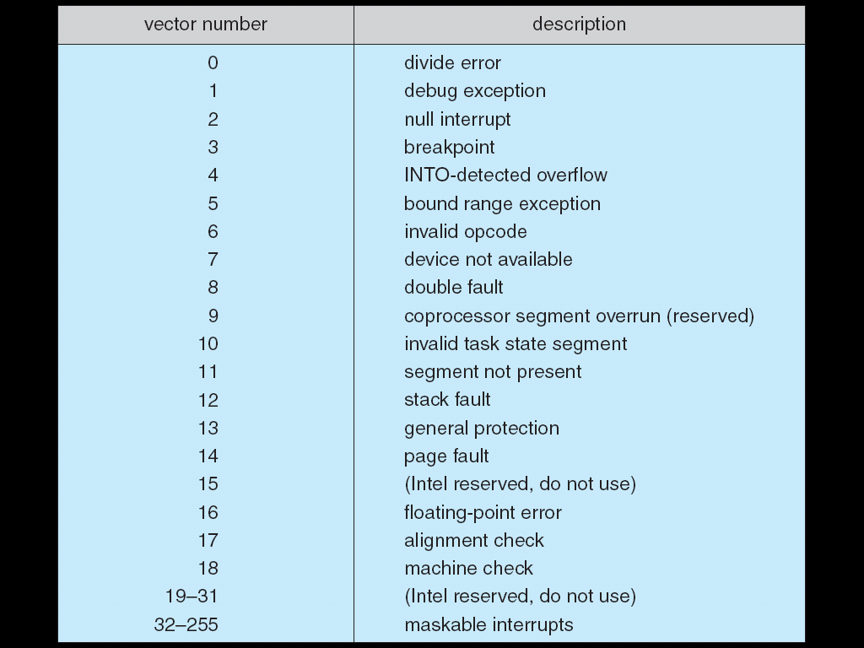
Interrupt Mechanism (2/3)
The interrupt vector contains the addresses of all the specific interrupt handle routines.
The address (index) is an offset in the interrupt vector.
This vectored interrupt mechanism can reduce the need for a single interrupt handler to search all possible sources of interrupts.
Operating systems as different as Windows and Unix dispatch interrupt in this manner.
The design of the interrupt vector
for the Intel Pentium processor.
Used for device-generated
interrupts

Slide 18
Interrupt Mechanism (3/3)
The interrupt mechanism must also save the address of the interrupted instruction.
  It may also save the state (processor register values).
After the interrupt is serviced, the saved address (and saved state) is loaded, and the interrupted computation resumes as though the interrupt had not occurred.
Note:
  Incoming interrupts are disabled while another interrupt is being processed to prevent a lost interrupt.
  A trap is a software-generated interrupt caused either by an error or a user request (system call).

Slide 19

Interrupt Timeline

Slide 20
Example of Interrupt
P₁
I/O devices and the CPU can
execute concurrently
P₂
I/O operations (read)
I/O
device
I/O ready to
transfer data
Point of
interruption
Interrupt
handler
Send an interrupt signal
to CPU to indicate that
it is ready
Resume the
interrupted
process
Time sharing (or multitasking)
time

Slide 21
Storage Structure (1/4)
Main memory and the registers are the only storage that the CPU can access directly.
Registers:
  Are built into the CPU.
  CPU can decode instructions and perform simple operations on register contents.
Main memory:
  Computer programs must be in main memory to be executed.
  Is the only large storage area that the CPU can access directly.

Slide 22
Storage Structure (2/4)
A typical (instruction) execution cycle first fetches an instruction from memory.
  The instruction is stored in the instruction register.
CPU then decodes the instruction.
  May cause operands to be fetched from memory and stored in some internal register.
After the instruction on the operands has been executed, the result may be stored back in memory.
Memory contains information about data and programs.

Slide 23
Storage Structure (3/4)
Ideally, we want the programs and data to reside in main memory permanently.
  Impossible!!
    Main memory is too small to store all needed programs and data.
    Main memory is a volatile storage device that loses its contents when power is turned off.
Secondary storage – extension of main memory that provides large nonvolatile storage capacity.
  Magnetic disks – The most common secondary storage.

Slide 24

Storage Structure (4/4)
Other storage units: CD-ROM, tapes, and so on.
Storage systems organized in hierarchy according to speed and cost.
fast
expensive
nonvolatile
slow
cheap

Slide 25
I/O Structure (1/9)
A large portion of operating system code is dedicated to managing I/O.
  Importance to the reliability and performance of a system.
  The varying nature of the devices.
A general-purpose computer system consists of CPUs and multiple device controllers that are connected through a common bus.
  Each device controller is in charge of a specific type of device (e.g., disk controller and disks).

Slide 26
I/O Structure (2/9)
A device controller maintains some local buffer storage and a set of registers.
  Controller is responsible for moving the data between the devices that it controls and its local buffer storage.
Operating systems have a device driver for each device controller.
  The device driver understands the device controller and presents a uniform interface to the device to the operating system.

Slide 27
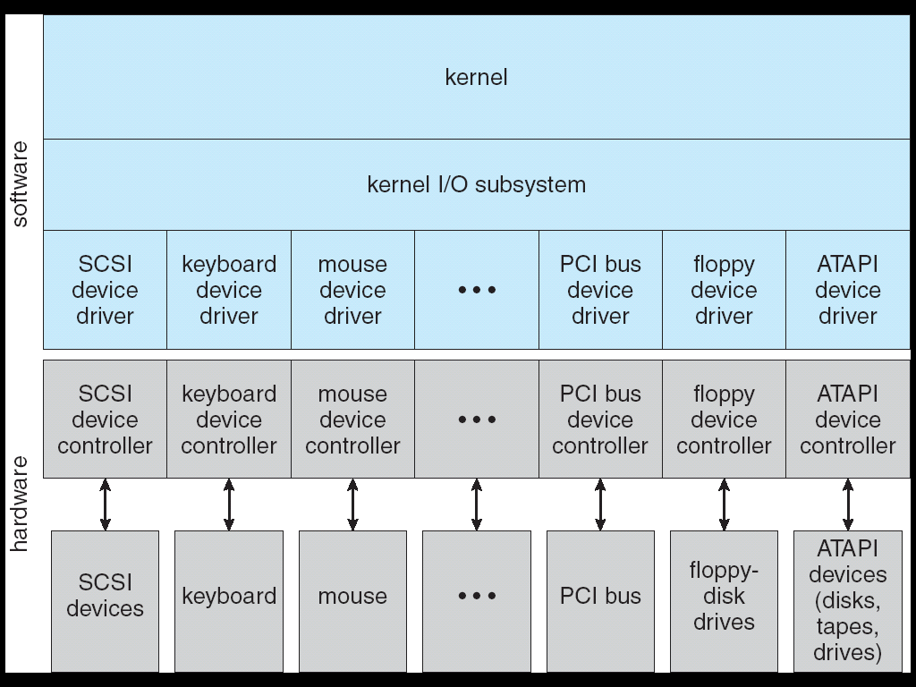
I/O Structure (3/9)

Slide 28
I/O Structure (4/9)
To start an I/O operation (such as “read a character from the keyboard”):
  The device driver loads the appropriate registers with the device controller.
  The device controller, in turn, examines the contents of these registers to determine what action to take.
  The controller starts the transfer the data from the device to its local buffer.
  Once the transfer the data is complete, the device controller informs the device driver via an interrupt.
  The device driver then returns control (the received data) to the operating systems.

Slide 29
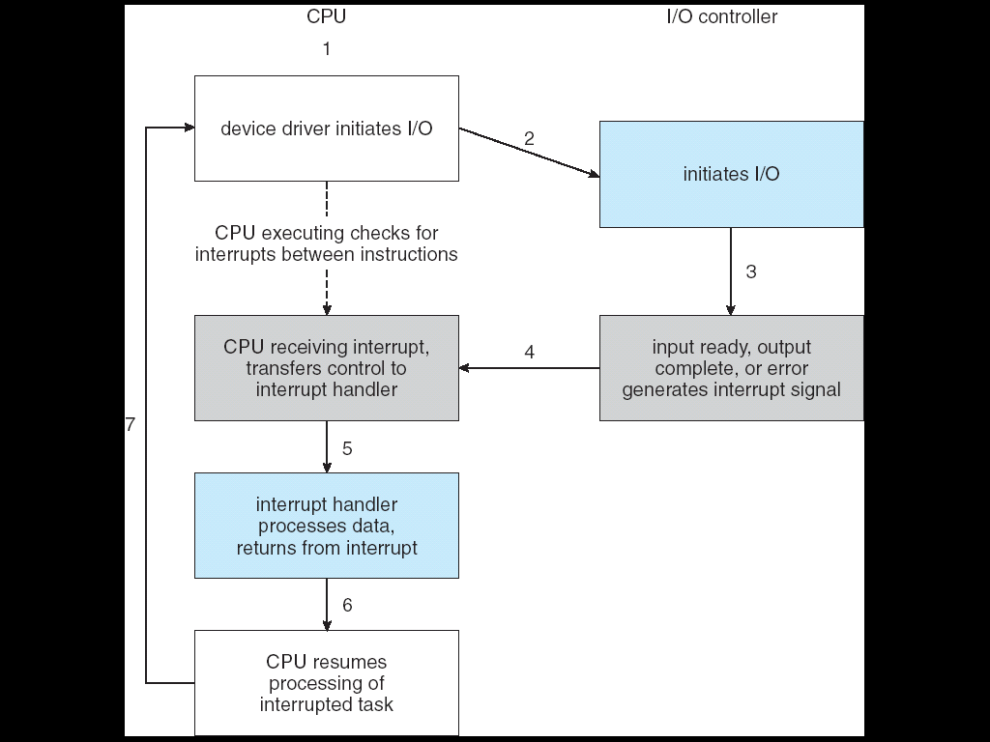
I/O Structure (5/9)

Slide 30
I/O Structure (6/9)
The purpose of device driver is to hide the differences among device controllers from the I/O subsystem of the kernel.
  An I/O read() can read data from SATA, ATA, or SCSI hard disks by using specific device drivers.
Device drivers are internally custom-tailored to each device but export standard interfaces to the I/O subsystem of the kernel.
  Benefit:
    Simplify the job of the operating system developer.
    New devices are easy attached to a computer system without waiting for the operating-system vendor to develop support code.

Slide 31
I/O Structure (7/9)
The interrupt-driven I/O is fine for moving small amounts of data.
  But can produce high overhead when used for bulk data movement (e.g., disk I/O).
Direct memory access (DMA) is used to solve this problem.
  First set up buffers, pointers (to memory block), and counters for the I/O device.
  The device controller transfer the entire block of data directly to/from its buffer to/from memory, with no intervention by the CPU.
  One interrupt for each block access, rather than per byte.

Slide 32

I/O Structure (8/9)

Slide 33
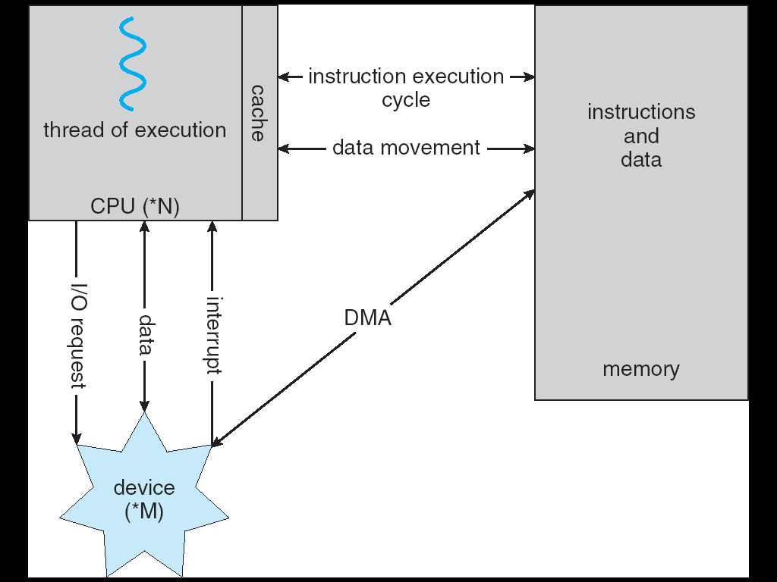
I/O Structure (9/9)

Slide 34
Computer System Architecture (1/7)
Computer systems can be categorized according to the number of general-purpose processors used.
Single-processor systems:
  There is one main CPU capable of executing a general-purpose instruction set.
  Almost all systems have other special-purpose processors as well.
    Device-specific processors (e.g., graphics controllers).
    Do not run user processes and are managed by the operating system.
    Relieve the overhead of the main CPU.

Slide 35
Computer System Architecture (2/7)
Multiprocessor Systems:
  As known as parallel systems.
  Have two or more processors in close communication.
  Share the same computation resources (memory, bus, …).
  Main advantages:
    Increased throughput:
      We expect to get more work done in less time.
      The speed-up ratio with N processors is not N, however; rather, it is less than N.
      A certain amount of overhead is incurred in keeping all the parts working correctly.

Slide 36
Computer System Architecture (3/7)
  Main advantages:
    Economy of scale:
      Cost less than equivalent multiple single-processor systems, because they share computation resources.
        Store data on the same disk vs. many copies of the data.
    Increased reliability:
      If functions can be distributed properly among several processors, then the failure of one processor will not halt the system, only slow it down.

Slide 37
Computer System Architecture (4/7)
The multiple-processor systems in use today are of two types:
  Asymmetric multiprocessing (master-slave relationship):
    Each processor is assigned a specific task.
    A master process controls the system.
    The master processor schedules and allocates work to the slave processors.
  Symmetric multiprocessing (SMP):
    All processors are peers, performs all tasks within the operating system.
    Operating system must be written carefully to avoid unbalanced resource arrangement.
      One processor may be sitting idle while another is overloaded.
    Virtually all modern operating systems (windows, Mac OSX, Linux) now provide support for SMP.

Slide 38
Computer System Architecture (5/7)
A recent trend in CPU design is to include multiple compute core on a single chip.
  In essence, these are multiprocessor chips.
  These multi-core CPUs look to the operating system just as N standard processors.

Slide 39
Computer System Architecture (6/7)
Clustered Systems:
  Clustered computers share storage and are linked via a local-area network (LAN).
  Differ from multiprocessor systems in that they are composed of two or more individual system coupled together.
  Goal: to provide high-availability service.
    Service will continue even if one or more systems in the cluster fail.
    A layer of cluster software runs on the cluster nodes.
      Each node can monitor one or more of the others (over the LAN).
      If the monitored machine fails, the monitoring machine can take over the failed machine.

Slide 40
Computer System Architecture (7/7)
  Clustering can be structured asymmetrically or symmetrically.
  Asymmetric clustering:
    One machine is in hot-standby mode, does nothing but monitor the active nodes.
    If an active fails, the hot-standby host becomes the active node.
  Symmetric mode:
    Host are monitoring each other.
    More efficient as it uses all of the available hardware.

Slide 41
Operating System Structure (1/7)
Operating systems vary greatly in their makeup, since they are organized along many different lines.
  However, there are many commonalities.
One of the most important aspect of operating systems is the ability to multiprogramming.
  User cannot keep CPU and I/O devices busy at all times.
    Jobs have to wait for some task, such as an I/O operation, to complete.
    The CPU would sit idle.
  Multiprogramming organizes jobs so CPU always has one to execute.

Slide 42
Operating System Structure (2/7)
Multiprogramming:
  A subset of total jobs in system is kept in memory.
  One job is selected and run.
  When it has to wait (for I/O for example), OS switches to another job.
  When that job needs to wait, the CPU is switched to another job, and so on.
  Eventually, the first job finishes waiting and gets the CPU back.
  As long as at least one job needs to execute, the CPU is never idle.

Slide 43

Operating System Structure (3/7)

Slide 44
Operating System Structure (4/7)
Time sharing (multitasking):
  Is logical extension of multiprogramming.
  CPU switches jobs frequently.
Time sharing is frequently used in interactive computer system.
  For example, windows systems, which provide direct communication between the user and the system (using keyboard or mouse).
    The response time (of each job) should be short!!
  The operating system must switch rapidly from one job (for one user) to next, such that each user is given the impression that the entire computer system is dedicated to his use.

Slide 45
Operating System Structure (5/7)
Time sharing and multiprogramming require several jobs to be kept simultaneously in memory.
  A program loaded into memory and executing is called a process.
Since main memory is too small to accommodate all jobs, the jobs are kept initially on the disk in the job pool.
  The pool consists of all processes residing on disk awaiting allocation of main memory.
Job scheduling (chapter 5) selects jobs from the pool and loads them into memory for execution.
If several jobs ready to run at the same time CPU scheduling (chapter 5) chooses among them.

Slide 46

Operating System Structure (6/7)
If processes don’t fit in memory, swapping moves them in and out to run (chapter 8).
  Swap to a backing store (e.g., hard disks).
  For example a higher-priority process arrives and wants service, the memory manager can swap out the lower-priority process and then load and execute the higher-priority process.

Slide 47
Operating System Structure (7/7)
Virtual memory allows execution of processes not completely in memory (chapter 9).

Slide 48
Operating-System Operations (1/2)
Modern operating systems are event driven.
  Waiting for something (event) to happen.
Events are signaled by the occurrence of an interrupt or a trap (software interrupt).
  Interrupt driven by hardware.
  Software error or request creates trap.
    E.g., division by zero, request for operating system service.
The operation structure of interrupt (event) driven operating system:
  For each interrupt, separate segments of code in the operating system determine what action should be taken.
  An interrupt service routine (IRS) is provided that is responsible for dealing with the interrupt.

Slide 49
Operating-System Operations (2/2)
Since there are multiple running processes, we (operating system) need to make sure that an error in a program can not affect other programs.
  Infinite loop in one process could prevent the correct operation of many other processes.
  One erroneous (malicious) program might modify another program/data/OS.
  Protection and security are very important!!

Slide 50
Dual-Mode Operation (1/4)
To ensure the proper execution of the operating system, we must be able to distinguish between the execution of operating-system code and user-defined code.
  Computation resources can only be managed by operating-system code.
  User-defined code can not cross the line.
  Supported by hardware mechanism.
Dual-mode: user mode and kernel mode.
  Mode bit provided by hardware, kernel (0) or user (1).
    Recent versions of the Intel CPU do provide dual-mode.
  When a user application requests a service from operating system, it must transition from user to kernel mode to fulfill the request.
  Request only through system call.

Slide 51

Dual-Mode Operation (2/4)
Require a service from the operating system
Passing control to user program
The operating system gains
control of the computer

Slide 52
Dual-Mode Operation (3/4)
The dual mode protects the operating system from errant users.
  We designate some machine instructions that may cause harm as privileged instructions, and only executable in kernel mode.
    I/O control, interrupt management … are examples of privileged instruction.
  Generally, control is switched to the operating system via an interrupt, a trap, or a system call.
Manage computation resources
Ask for services
Prevent errors

Slide 53
Dual-Mode Operation (4/4)
More description of system call:
  When a system call is called, it is treated by the hardware as a software interrupt.
  The mode bit is set to kernel mode.
  Control passes through the interrupt vector to a service routine in the operating system.
    The kernel examines the parameter of the interrupt to determine what type of service the user program is requesting.
  The kernel verifies and executes the request.
  And returns control to the instruction following the system call (user mode).

Slide 54
Operating-System Operations: Timer
Operating system must prevent a user program from running too long.
  E.g., Getting stuck in an infinite loop.
A timer can be set to prevent a user program from running too long.
  Timer can be set to interrupt the computer after a period.
  Before turning over control to the user (program), operating system initializes a counter.
  Every timer interrupt decrements the counter by 1.
  When counter becomes negative, the operating system terminates program.

Slide 55
Process Management (1/2)
Process:
  A program in execution.
    Program is a passive entity, process is an active entity.
  A unit of work within the system.
Process needs resources to accomplish its task.
Process termination requires reclaim of any reusable resources.
  CPU, memory, I/O, files.
Single-threaded process has one program counter specifying location of next instruction to execute.
Multi-threaded process has one program counter per thread.
  Process executes instructions sequentially, one at a time, until completion.

Slide 56
Process Management (2/2)
Typically system has many processes, some user, some operating system running concurrently on one or more CPUs.
The operating system is responsible for the following activities in connection with process management (chapters 3 ~ 6):
  Creating and deleting both user and system processes
  Suspending and resuming processes.
  Providing mechanisms for process synchronization.
  Providing mechanisms for process communication.
  Providing mechanisms for deadlock handling.

Slide 57
Memory Management (1/2)
The main memory is generally the only large storage device that the CPU is able to address and access directly.
  Main memory is a large array of words or bytes, ranging in size from hundreds of thousands to billions.
  Each word or byte has its own (memory) address.
Data must be in memory before and after processing.
  For example, load data from disk into memory.
All instructions must be in memory in order to execute.

Slide 58
Memory Management (2/2)
General-purpose computers must keep several programs in memory to improve the computer performance.
  Creating a need for memory management (chapters 8 and 9).
Memory management activities:
  Keeping track of which parts of memory are currently being used and by whom.
  Deciding which processes (or parts thereof) and data to move into and out of memory.
  Allocating and deallocating memory space as needed.

Slide 59
Storage Management
The operating system provides uniform, logical view of physical storage media.
  Logical storage unit — file.
  Physical storage media — disk, tapes, …
The operating system maps files onto physical media and access these files via the storage devices.

Slide 60
File-System Management
A file is a collection of related information defined by its creator.
  Represent programs and data.
    Data: numeric, alphabetic, or binary. free-form or non-free form.
Files usually organized into directories to make them easier to use.
Multiple user can access to the same file.
  Access control on most operating systems to determine who can access what.
OS activities include (chapters 10 and 11):
  Creating and deleting files and directories.
  Primitives to manipulate files and directories.
  Mapping files onto secondary storage.
  Backup files onto stable (non-volatile) storage media.

Slide 61
Mass-Storage Management (1/2)
Computer system must provide secondary storage to back up main memory.
  Disks are used as the principal storage medium for programs and data.
Disks are frequently used as the source and destination of program processing.
  Proper management is of central importance.
  Speed of computer operation hinges on disk subsystem.
OS activities:
  Free-space management.
  Storage allocation.
  Disk scheduling.

Slide 62
Mass-Storage Management (2/2)
Tertiary storage:
  Storage that is slower and lower in cost than secondary storage.
    Optical storage, magnetic tape.
  Backup disk data.
  Still must be managed.

Slide 63
Caching (1/4)
Important principle of computer systems.
Information is normally kept in some storage system (large, slow, and cheap).
As it is used, it is copied into a faster (small, and expensive) storage system — the cache.
When we need a particular piece of information, we first check faster storage (cache) to determine if information is there.
  If it is, information used directly from the cache (fast).
  If not, data copied to cache and used there.
Because cache is smaller than storage being cached, cache management is an important design problem.
  Careful selection of the cache size and replacement policy (chapter 9).

Slide 64

Caching (2/4)
Performance of Various Levels of Storage:
Movement between levels of storage hierarchy can be explicit or implicit:
  For example, transfer of data from disk to memory is usually controlled by the operating system (explicit).

Slide 65

Caching (3/4)
In a hierarchical storage structure, the same data may appear in different levels of the storage system.
An integer A that is to be incremented by 1 is located in file B on disk.
  Once the increment takes place in the register, the value of A differs in the various storage system!!
In an environment where only one process executes at a time.
  An access to A will always to be the copy at the highest level of the storage hierarchy.

Slide 66
Caching (4/4)
In multitasking environments:
  each process (has its memory space) must obtain the most recently updated value of A.
In multiprocessor environment:
  Each CPU also contains a local cache.
  A copy of A may exist simultaneously in several caches.
  Since CPUs can execute concurrently, an update of A in one cache must be reflected in all other caches where A resides — cache coherency.
Distributed environment situation even more complex.
  Several copies of a datum can exist.
  Various solutions covered in Chapter 17.

Slide 67
I/O Subsystem
The purpose of I/O subsystem of the operating system is to hide peculiarities of hardware devices from the user.
I/O subsystem responsible for
  Memory management of I/O including buffering, caching, spooling.
  General device-driver interface.
  Drivers for specific hardware devices.
Covered in Chapter 13.

Slide 68
Protection and Security (1/2)
A multi-user computer system allows the concurrent execution of multiple processes.
  Computation resources must be operated in a proper and authorized manner.
    For example, a process can execute only within its own address space.
Protection – any mechanism for controlling access of processes or users to resources defined by the operating system.
A system can have adequate protection but still be prone to failure and allow inappropriate access.
  A user’s authentication information is stolen.
Security – defense of the system against internal and external attacks.
  Huge range, including denial-of-service, viruses, …

Slide 69
Protection and Security (2/2)
Protection and security require the operating system to be able to distinguish among all its users.
Most systems maintain a list of user names and associated user identifiers (user IDs, security IDs).
  User ID is then associated with all files, processes of that user to determine access control.
Group identifier (group ID) allows set of users to be defined and managed, then also associated with each process, file.
Privilege escalation allows user to change to effective ID with more rights for an activity.
  For example, on UNIX, the setuid attribute on a program causes that program to run with the user ID of the owner of the file, rather than the current user’s ID.

Slide 70
Distributed Systems
Is a collection of computer systems that are networked to provide the users with access to various resources.
  Access to a shared resource increases computation speed, data availability, …
  For example, NFS (network file system) generalize network access as a form of file access.
Network:
  Protocols: TCP/IP, ATM …
  Distances: LAN (local area network), WAN (wide-area network) …
  Transmission media: copper wires, fiber, wireless …

Slide 71
Special-Purpose Systems (1/2)
Embedded Systems:
  A special-purpose computer system designed to perform one or a few dedicated functions.
    E.g., robotic arms.
  Usually have little or no user interface.
  Almost run real-time operating systems.
    Rigid time requirements have been placed on the operation of a processor or the flow of data.
Multimedia Systems:
  A recent trend in technology is the incorporation of multimedia data into computer system.
  Different from convention data, multimedia data must be delivered according to a certain time restrictions.
  Chapter 20 explores the nature of multimedia data and the design of operating systems that support the multimedia.

Slide 72
Special-Purpose Systems (2/2)
Handheld Systems:
  Such as PDAs, usually have a small amount of memory, slow processors, and small display screens because of their size.
    And can consume less power.
  The operating system and applications must manage memory efficiently.

Slide 73
Computing Environments —
Traditional Computing
The lines separating many of the traditional computing environments are blurring.
Office environment:
  Few years ago:
    PCs connected to a network.
    Rare remote access and portability.
    Terminals attached to mainframe or minicomputers providing batch and timesharing.
  Now:
    Portals allowing networked and remote systems access to same resources.
Home networks:
  Few year ago:
    Used to be single system.
  Now:
    Firewalled, networked.
    Time-sharing technique is used to organize the process owned by the same user.

Slide 74

Computing Environments —
Client-Server Computing (1/2)
As PCs have become faster, powerful and cheaper, designer have shifted away from centralized system architecture.
  Terminals connected to centralized systems are now handled directly by PCs.
  Some tasks, such as user-interface functionality once handled directly by the centralized system, are now being handled by the PCs.

Slide 75
Computing Environments —
Client-Server Computing (2/2)
Now, many systems act as servers to satisfy requests generated by clients.
Server systems can be broadly categorized as:
  Compute-server provides an interface to client to request services (e.g., database and user queries).
  File-server provides interface for clients to store and retrieve files (e.g., web server).

Slide 76
Computing Environments —
Peer-to-Peer Computing
Another model of distributed system — peer-to-peer (P2P).
P2P does not distinguish clients and servers.
  All nodes are considered peers.
  May each act as client, server or both.
In a client-server system, the server is a bottleneck.
But in a P2P system, services can be provided by several nodes distributed through the network.
Node must join P2P network.
  Registers its service (e.g., mp3 files) with central lookup service on network, or
  Broadcast request for service and respond to requests for service via discovery protocol.
Examples include Napster and Gnutella.

Slide 77
Computing Environments —
Web-Based Computing
Web has become ubiquitous.
A wide variety of devices can access the Web.
  PCs: the most prevalent devices.
  Handheld PDAs, cell phones …
Servers should consider various situations and provide appropriate services.

Slide 78
End of Chapter 1

