Slide 1
Chapter 2: Operating-System Structures
Adapted to COP4610 by Robert van Engelen

Slide 2
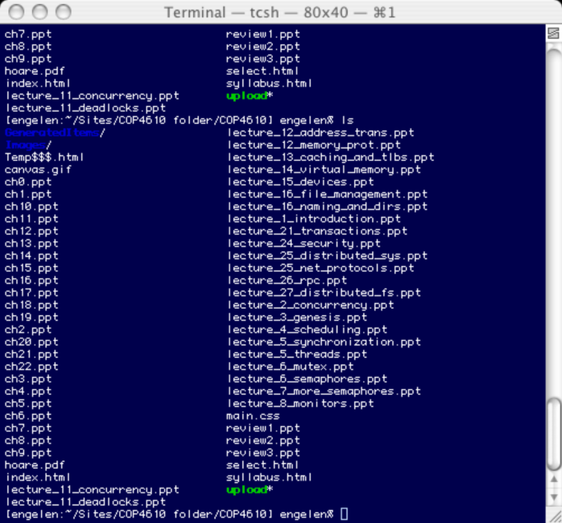
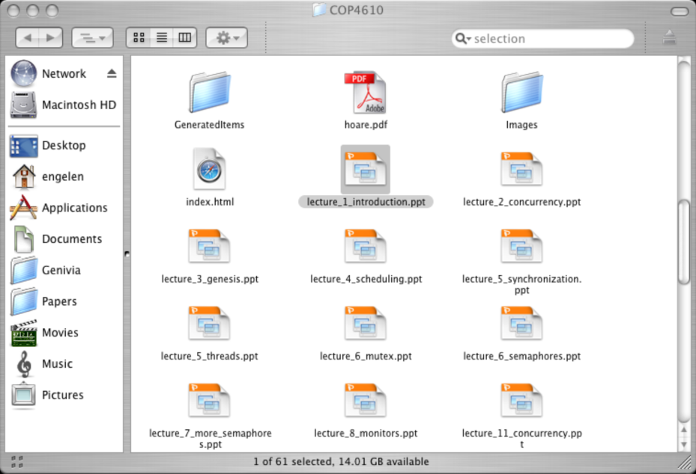
Operating System Services
One set of operating-system services provides functions that are helpful to the user:
  User interface - Almost all operating systems have a user interface (UI)
  Varies between Command-Line Interface (CLI), Graphics User Interface (GUI), and Batch
CLI (shell)
GUI (Mac OS X)

Slide 3
Operating System Services (Cont.)
Functions that are helpful to the user and to processes:
  Program execution - Load a program into memory and run it
  File-system manipulation - Move, copy, and delete files, create directories, change permissions, etc.
  Communications – Processes may exchange information, on the same computer or between computers over a network
    Communications may be via shared memory or through message passing (packets moved by the OS)
  Error detection – OS needs to be constantly aware of possible errors
    May occur in the CPU and memory hardware, in I/O devices, etc.
    For each type of error, OS should take the appropriate action to ensure correct and consistent computing
    Debugging facilities can greatly enhance the user’s and programmer’s abilities to efficiently use the system

Slide 4
Operating System Services (Cont.)
Another set of OS functions exists for ensuring the efficient operation of the system itself via resource sharing
  Resource allocation - When multiple users or multiple jobs running concurrently, resources must be allocated to each of them
    Many types of resources - Some (such as CPU cycles, main memory, and file storage) may have special allocation code, others (such as I/O devices) may have general request and release code.
  Accounting - To keep track of which users use how much and what kinds of computer resources
  Protection and security - The owners of information stored in a multiuser or networked computer system may want to control use of that information, concurrent processes should not interfere with each other
    Protection involves ensuring that all access to system resources is controlled
    Security of the system from outsiders requires user authentication, extends to defending external I/O devices from invalid access attempts
    If a system is to be protected and secure, precautions must be instituted throughout it (a chain is only as strong as its weakest link)

Slide 5

User Operating System Interface - CLI
CLI allows direct command entry
  Sometimes implemented in kernel, sometimes by systems program
  Sometimes multiple flavors implemented – shells
  Primarily fetches a command from user and executes it
    Sometimes commands built-in, sometimes just names of programs
    If the latter, adding new features doesn’t require shell modification

Slide 6

User Operating System Interface - GUI
User-friendly desktop interface
  Icons represent files, programs, actions, etc.
  Various mouse buttons over objects in the interface cause various actions
    provide information, options, execute function, open directory (or folder)
  Invented at Xerox PARC
Many systems now include both CLI and GUI interfaces
  Microsoft Windows is GUI with CLI “command” shell
  Apple Mac OS X as “Aqua” GUI interface with UNIX kernel underneath and shells
  Linux KDE and shells

Slide 7
System Calls
Programming interface to the services provided by the OS:
  Process control, file management, device management, information services, communications
Typically written in a high-level language (C or C++)
Mostly accessed by programs via a high-level Application Program Interface (API) rather than direct system call use
Three most common APIs are
  Win32 API for Windows
  POSIX API for POSIX-based systems (including virtually all versions of UNIX, Linux, and Mac OS X)
  Java API for the Java virtual machine (JVM)
Why use APIs rather than system calls directly?

Slide 8

Example of System Calls
System call sequence to copy the contents of one file to another file

Slide 9
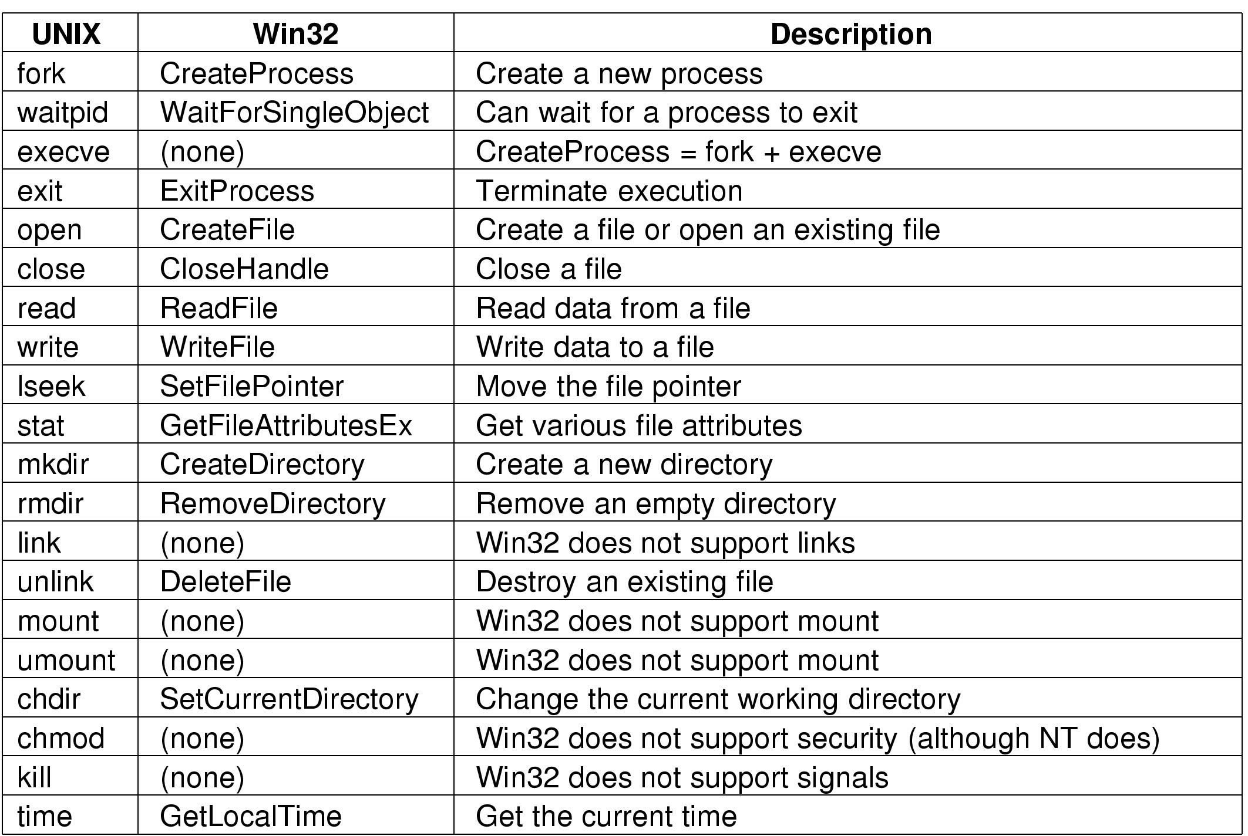
OPERATING SYSTEM STRUCTURES
System Calls
These are examples of various system calls.
2: OS Structures

Slide 10

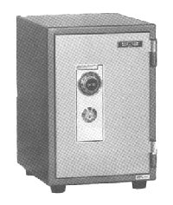
System Call Implementation
Typically using software interrupt (trap)
Register is set to a number associated with the system call
  System-call interface maintains a table indexed according to these numbers (cf. interrupt vector)
The system call interface invokes intended system call in OS kernel and returns status of the system call and any return values
ld R1,#SYSCALL_OPEN
trap
set kernel mode
System call
index table
System call
service routine

Slide 11

Example of Standard API
Consider the ReadFile() function in the
Win32 API—a function for reading from a file
A description of the parameters passed to ReadFile()
  HANDLE file—the file to be read
  LPVOID buffer—a buffer where the data will be read into and written from
  DWORD bytesToRead—the number of bytes to be read into the buffer
  LPDWORD bytesRead—the number of bytes read during the last read
  LPOVERLAPPED ovl—indicates if overlapped I/O is being used

Slide 12

API – System Call – OS Relationship

Slide 13
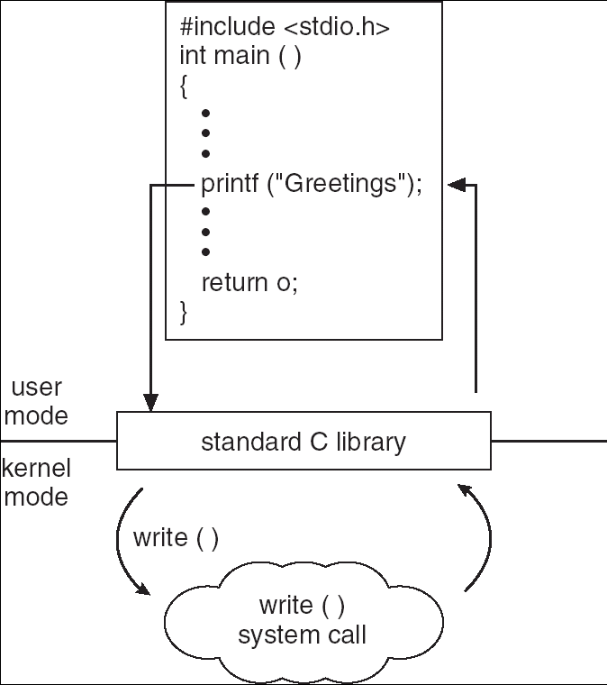
Standard C Library Example
C program invoking printf() library call, which calls write() system call

Slide 14

System Call Parameter Passing
Three general methods used to pass parameters to the OS
  Simplest: pass the parameters in registers
  Parameters stored in a block, or table, in memory, and address of block passed as a parameter in a register
    This approach taken by Linux and Solaris
  Parameters placed, or pushed, onto the stack by the program and popped off the stack by the OS
  Block and stack methods do not limit the number or length of parameters being passed
ld R1,#SYSCALL_OPEN
ld R2,parameter_block
trap

Slide 15
System Programs
System programs provide a convenient environment for program development and execution
Divided into:
  File manipulation
  Status information
  File modification
  Programming language support
  Program loading and execution
  Communications
  Application programs
Most users’ view of the operation system is defined by system programs, not the actual system calls

Slide 16
System Programs (cont’d)
Programs for status information
  Query date/time, amount of available memory, disk space, users
  Some systems implement a registry - used to store and retrieve configuration information
Programs for file modification
  Text editors to create and modify files
  Special commands to search contents of files or perform transformations of the text
Programming-language support - Compilers, assemblers, debuggers and interpreters sometimes provided
Program loading and execution - Absolute loaders, relocatable loaders, linkage editors, and overlay-loaders, debugging systems
Communications - Provide the mechanism for creating virtual connections among processes, users, and computer systems
  Allow users to send messages to one another’s screens, browse web pages, send electronic-mail messages, log in remotely, transfer files from one machine to another

Slide 17
Operating System Design and Implementation
Best design and implementation of OS not “solvable”, but some approaches have proven successful
Internal structure of different Operating Systems can vary widely
Start by defining goals and specifications
Affected by choice of hardware, type of system
User goals and System goals
  User goals – operating system should be convenient to use, easy to learn, reliable, safe, and fast
  System goals – operating system should be easy to design, implement, and maintain, as well as flexible, reliable, error-free, and efficient

Slide 18
Operating System Design and Implementation (Cont.)
Important principle to separate
Policy: What will be done?
Mechanism: How to do it?
Mechanisms determine how to do something, policies decide what will be done
  The separation of policy from mechanism is a very important principle, it allows maximum flexibility if policy decisions are to be changed later

Slide 19

Layered Approach
The operating system is divided into a number of layers (levels), each built on top of lower layers. The bottom layer (layer 0), is the hardware; the highest (layer N) is the user interface.
With modularity, layers are selected such that each uses functions (operations) and services of only lower-level layers

Slide 20

Simple Structure
MS-DOS – written to provide the most functionality in the least space
  Not divided into modules
  Although MS-DOS has some structure, its interfaces and levels of functionality are not well separated
MS-DOS layered structure

Slide 21

MS-DOS execution
(a) At system startup (b) running a program

Slide 22
UNIX
UNIX – limited by hardware functionality, the original UNIX operating system had limited structuring
The UNIX OS consists of two separable parts
  Systems programs
  The kernel
    Consists of everything below the system-call interface and above the physical hardware
    Provides the file system, CPU scheduling, memory management, and other operating-system functions; a large number of functions for one level

Slide 23

UNIX System Structure

Slide 24

FreeBSD Running Multiple Programs

Slide 25

Solaris 10 dtrace Following System Call

Slide 26
Microkernel System Structure
Microkernel design moves as much from the kernel into “user” space
Communication takes place between user modules using message passing
Benefits:
  Easier to extend a microkernel
  Easier to port the operating system to new architectures
  More reliable (less code is running in kernel mode)
  More secure
Detriments:
  Performance overhead of user space to kernel space communication

Slide 27

Mac OS X Structure

Slide 28

Modules
Most modern operating systems implement kernel modules
  Uses object-oriented approach
  Each core component is separate
  Each talks to the others over known interfaces
  Each is loadable as needed within the kernel

Slide 29
Virtual Machines
A virtual machine takes the layered approach to its logical conclusion
It treats hardware and the operating system kernel as though they were all hardware
A virtual machine provides an interface identical to the underlying bare hardware
The operating system creates the illusion of multiple processes, each executing on its own processor with its own (virtual) memory

Slide 30
Virtual Machines (Cont.)
The resources of the physical computer are shared to create the virtual machines
  CPU scheduling can create the appearance that users have their own processor
  Spooling and a file system can provide virtual card readers and virtual line printers
  A normal user time-sharing terminal serves as the virtual machine operator’s console

Slide 31

Virtual Machines (Cont.)
Non-virtual Machine
Virtual Machine
(a) Nonvirtual machine (b) virtual machine

Slide 32
Virtual Machines (Cont.)
The virtual-machine concept provides complete protection of system resources since each virtual machine is isolated from all other virtual machines
This isolation, however, permits no direct sharing of resources
A virtual-machine system is a perfect vehicle for operating-systems research and development
System development is done on the virtual machine, instead of on a physical machine and so does not disrupt normal system operation
The virtual machine concept is difficult to implement due to the effort required to provide an exact duplicate to the underlying machine

Slide 33

VMware Architecture

Slide 34

The Java Virtual Machine

Slide 35
Operating System Generation
Operating systems are designed to run on any of a class of machines; the system must be configured for each specific computer site
SYSGEN program obtains information concerning the specific configuration of the hardware system
Booting – starting a computer by loading the kernel
Bootstrap program – code stored in ROM that is able to locate the kernel, load it into memory, and start its execution

Slide 36
End of Chapter 2

