Slide 1
Chapter 3:
Processes-Concept
MINAVATHI
Department of Information Science & Engineering
P E S C E, Mandya

Slide 2
Outline
Overview.
Process Scheduling.
Operations on Processes.
Interprocess Communication.
Examples of IPC Systems.
Communication in Client-Server Systems.

Slide 3
Process Concept (1/3)
The name of CPU activities varies in different systems:
  Batch system – jobs.
  Time-shared systems – user programs or tasks.
Textbook uses the terms job and process almost interchangeably, but prefers process.
  However, much of operating-system theory and terminology was developed during the batch era.
  Job (such as job scheduling) would be used to avoid misunderstanding.

Slide 4

Process Concept (2/3)
Process:
  A program in execution.
  Execution must progress in sequential fashion.
A process in memory includes:
  Text section: the program code.
  Stack: contains temporary data (local variable, function parameters …).
  Data section: contains global variables.
  Heap: used for dynamical memory allocation.
  Program counter: the address of next instruction.
  Register status.
Process in memory

Slide 5
Process Concept (3/3)
A program is not a process:
  A program is a passive entity; a list of instruction stored on disk.
  A process is an active entry.
    A program becomes a process when an executable file is loaded into memory.
Two (or more) processes may be associated with the same program.
  For example, a user may invoke many copies of the web browser program.
  Each of these is a separate process.
    While the text sections are equivalent, the data, heap, and stack sections vary.

Slide 6
Process State (1/2)
The state of a process is defined by the current activity of that process.
Each process may be in one of the following states:
  New: the process is being created.
  Running: instructions are being executed.
  Waiting: the process is waiting for some event to occur.
    Such as an I/O completion.
  Ready: the process is waiting to be assigned to a process.
  Terminated: the process has finished execution.
Only one process can be running on any processor at any instance.
  Many processes may be ready and waiting.

Slide 7

Process State (2/2)
Diagram of Process State

Slide 8

Process Control Block
Process control block (PCB): a representation of a process in the operating system.
Information associated with each PCB:
  Process state.
  Program counter.
    The address of next instruction.
  CPU registers.
  CPU scheduling information.
    Process priority (chapter 5).
  Memory-management information (chapter 8).
  Accounting information.
    E.g., amount of CPU time.
  I/O status information.
    Allocated devices, files, and so on.
Different processes have different PCB information.

Slide 9
Threads
So far, we focus on single-thread process.
  Only one task can be performed at one time.
  For example, a single-thread word program can not run the spell checker when the user simultaneously type in characters.
Most modern operating system allow multiple-thread execution (chapter 4).
  A process can have multiple threads of execution and thus can perform more than one task at a time.

Slide 10
Process Scheduling
Multiprogramming:
  To have some process running at all time.
  To maximize CPU utilization.
Time sharing:
  To switch the CPU among processes so frequently.
  Users can interact with each program while it is running.
To do so … we need …
  Process scheduler:
    Select an available process for execution on the CPU.
    The rest have to wait until the CPU is free and can be rescheduled.

Slide 11
Scheduling Queues and Schedulers (1/8)
The operating system usually contains a lot of queues (FIFO).
  Contain pointers to the first and final PCBs in the list (queue).
  Each PCB includes a pointer field that points to the next PCB in the queue.
  Job queue:
    Processes are initially spooled to a mass-storage device (e.g., a disk), where they are kept for later execution.
    Job scheduler later selects processes from this pool and load them into memory for execution.
    Often in batch system. On some operating systems, job queue and job scheduler may be absent.
      Such as UNIX and MS Windows.
      Just put every new process in memory for execution.

Slide 12
Scheduling Queues and Schedulers (2/8)
  Ready queue:
    Contain the processes residing in main memory.
    Those processes are ready and waiting to execute.
Operating systems also include other queues.
  Device queue:
    A list of processes waiting for a particular I/O device.
      For instance, there are many processes make requests to a disk.

Slide 13

Scheduling Queues and Schedulers (3/8)
Ready Queue And Various I/O Device Queues

Slide 14

Scheduling Queues and Schedulers (4/8)
A new process is initially put in
the ready queue (ready state).
Eventually, it will be selected
(dispatched) for execution (running state).
The process may issue
an I/O request, and
switches to the waiting state.
The process may create a
new sub-process and wait
for the sub-process’s
termination (waiting state).
The process may be removed
from the CPU by an interrupt,
and be put back in the ready
queue (ready state).
Processes migrate among the various queues.
When the process terminates, it is removed from all
Queues and has its PCB and resources deallocated.

Slide 15
Scheduling Queues and Schedulers (5/8)
A process migrates among the various scheduling queues throughout its lifetime.
  The operating system must select process from these queues in some fashion.
Two main schedulers:
  Job scheduler (or long-term scheduler) – selects which processes should be brought into the ready queue.
  CPU scheduler (or short-term scheduler) – selects which process should be executed next and allocates CPU.
The primary difference between the schedulers: frequency of execution.
  Often, the short-term scheduler executes at leas once every 100 ms.
  The long-term scheduler executes much less frequently.

Slide 16
Scheduling Queues and Schedulers (6/8)
The short-term scheduler must be fast.
  If it takes 10 ms to decide to execute a process for 100 ms, then 10 / (10 + 100) = 9% of the CPU is being wasted for scheduling the work.
However, because of the longer interval between executions, the long-term scheduler can afford to take more time to decision.
The long-term scheduler controls the degree of multiprogramming.
In general, processes can be described as either I/O bound or CPU bound.
  A I/O-bound process spends more of its time doing I/O.
  A CPU-bound process uses more of its time doing computations.
  A good long-term scheduler should select a good process mix of I/O-bound and CPU-bound processes that the system will be balanced.

Slide 17
Scheduling Queues and Schedulers (7/8)
For systems with no long-term schedulers:
  The stability of the systems may depend on the self-adjusting nature of human users.
    If the performance declines to unacceptable levels on a multi-users system, some users will simply quit.
Some operating systems may introduce a medium-term scheduler.
  It removes processes from memory and thus reduce the degree of multi-programming (swap out).
  Later, the processes can be reintroduced into memory for execution (swap in).
  Swapping may improve the process mix.
    Or for better memory management.

Slide 18

Scheduling Queues and Schedulers (8/8)
Addition of medium-term scheduling to the queueing diagram.

Slide 19
Context Switch (1/2)
When CPU switches to another process, the system must save the context of the old process and load the saved context for the new process.
  E.g., interrupts cause the operating system to change a CPU from its current task to run a kernel routine.
Such a switching is known as a context switch.
The context is represented in the PCB of the process.
  The value of the CPU registers.
  The process state.
  Program counter.
  …

Slide 20
Context Switch (2/2)
Context-switch time is overhead; the system does no useful work while switching.
Dependent on hardware support.
  Some processors provide multiple sets of registers.
    A context switch simply requires changing the pointer to the current register set.

Slide 21
Operations on Processes

Slide 22
Process Creation (1/8)
A process may create several new processes, via a create-process system call.
The creating process is called a parent process, and the new processes are called the children of that process.
  New processes may in turn create other processes, forming a tree of processes.
Most operating system (UNIX and MS Windows) identify processes according to a unique process identifier (pid).
  Usually an integer number.

Slide 23

Process Creation (2/8)
A tree of processes on a typical Solaris

Slide 24
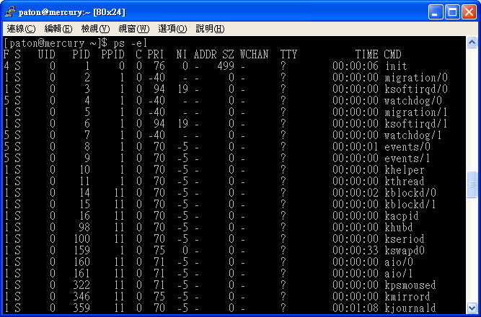
Process Creation (3/8)
On UNIX, the ps command can be used to obtain the information of all process.

Slide 25
Process Creation (4/8)
When parent process holds certain resources (files, I/O devices).
  Parent and children share all resources.
  Children share subset of parent’s resources.
  Parent and child share no resources.
When a process creates a new process, two possibilities exist in terms of execution:
  Parent and children execute concurrently.
  Parent waits until children terminate.
There are also two possibilities in terms of the address space of the new process:
  Child duplicate of parent.
  Child has a program loaded into it.

Slide 26
Process Creation (5/8)
UNIX examples:
  Fork() system call creates new process (POSIX).
  The new process consists of a copy of the address space of the original process.
  Both process continue (concurrently) execution at the instruction after the fork().
  But … how to distinguish?
    The return code for the fork() is zero for the new (child) process.
    The process identifier (PID) of the child is returned to the parent.

Slide 27
Process Creation (6/8)
#include <sys/types.h>
#include <unistd.h>
#include <stdio.h>
#include <stdlib.h>
int main()
{
pid_t pid;
pid = fork(); /* fork another process */
if (pid < 0) { /* error occurred */
printf("Fork Failed\n");
exit(-1);
}
else if (pid == 0) { /* child process */
execlp("/bin/ls", "ls", NULL);
}
else { /* parent process */
/* parent will wait for the child to complete */
wait(NULL);
printf ("Child Complete\n");
exit(0);
}
}
fork_test.c

Slide 28
Process Creation (7/8)
  Typically, the exec() (or its family, such as execlp()) system call (POSIX) is used after a fork() by one of the two processes to replace the process’s memory space with a new program.
    For example, the child process overlays its address space with UNIX command /bin/ls using the execlp() system call.
  The parent can wait for the child process to complete with the wait() system call (POSIX).
    When the child process completes, the parent process resumes from the call to wait.
  exit() system call: cause normal process termination (POSIX).

Slide 29

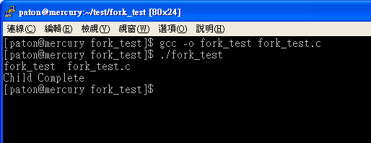
Process Creation (8/8)

Slide 30
Process Termination
Process executes last statement and asks the operating system to delete it by using the exit() system call.
  Can return a status value (typically an integer) to its parent process (via the wait() system call).
  Process’ resources are deallocated by operating system.
Parent may terminate execution of children processes (kill(), POSIX) when:
  Child has exceeded allocated resources.
  Task assigned to child is no longer required.
  If parent is exiting.
    Some operating system do not allow child to continue if its parent terminates.
    All children terminated - cascading termination.

Slide 31
Interprocess Communication

Slide 32
Cooperating Processes (1/4)
Processes may be independent processes or cooperating processes.
  Independent process cannot affect or be affected by the execution of another process.
  Cooperating process can affect or be affected by the execution of another process.
Reasons for process cooperation:
  Information sharing.
  Computation speed-up.
    Can be achieved only if the system have multiple CPUs.
  Modularity.
  Convenience.
    Users may work on many tasks (or sub-tasks) at the same time.

Slide 33
Cooperating Processes (2/4)
Interprocess communication (IPC) is a mechanism that allows cooperating processes to exchange data and information.
Two typical models of IPC:
  Shared memory.
    A region of memory is shared by cooperating processes.
    Processes can exchange information by reading and writing data to the region.
  Message passing.
    Communication takes place by means of messages exchanged between the processes.
  Both of the models are common and implemented in many operating systems.

Slide 34
Cooperating Processes (3/4)
Message passing is useful for exchanging smaller amounts of data.
  Because no conflicts need be avoided.
  Usually slow, because message-passing systems are generally implemented as system calls.
    Require the more time-consuming task of kernel intervention.
Shared memory allows maximum speed and convenience of communication.
  It can be done at memory speeds when within a computer.
  Is faster than message passing.
    Once shared memory is established, all accesses are treated as routine memory access.
    No assistance from the kernel is required.

Slide 35

Cooperating Processes (4/4)
Message passing
Shared memory

Slide 36
Shared-Memory Systems (1/4)
A process creates a shared-memory region residing in its address space.
Other processes that wish to communicate using this shared-memory segment must attach it to their address space.
Then, they can exchange information by reading and writing data in the shared area.
The processes are responsible for ensuring that they are not writing to the same location simultaneously.
  Chapter 6 will discuss synchronization to synchronize concurrent accesses.

Slide 37
Shared-Memory Systems (2/4)
Shared memory as a producer-consumer problem:
  producer process produces information that is consumed by a consumer process.
  A buffer (shared memory) can be filled by the producer and emptied by the consumer.
Two types of buffers:
  unbounded-buffer places no practical limit on the size of the buffer.
    The consumer may have to wait for new items.
    But the producer can always produce new items.
  bounded-buffer assumes that there is a fixed buffer size.
    The consumer may have to wait for new items.
    The producer have to wait if the buffer is full.

Slide 38
Shared-Memory Systems (3/4)
Implementation:
The buffer is implemented as a circular array:
  in=(in++)%BUFFER_SIZE
  out=(out++)%BUFFER_SIZE
At most BUFFER_SIZE-1 items in the buffer at the same time.
Empty: in == out
Full: ((in+1)%BUFFER_SIZE) == out
#define BUFFER_SIZE 10
typedef struct {
. . .
} item;
item buffer[BUFFER_SIZE];
int in = 0;
int out = 0;
in points to the next free position.
out points to the first full position.
buffer
0
1
BUFFER_SIZE-1

Slide 39
Shared-Memory Systems (4/4)
The producer process:
The consumer process
item nextProduced;
while (true) {
/* Produce an item */
while (((in = (in + 1) % BUFFER_SIZE) == out)
; // do nothing
buffer[in] = nextProduced;
in = (in + 1) % BUFFER SIZE;
}
item nextConsumed
while (true) {
while (in == out)
; /* do nothing
nextConsumed = buffer[out];
out = (out + 1) % BUFFER SIZE;
}

Slide 40
POSIX Shared Memory Example (1/5)
A process must first create a shared memory segment using the shmget() system call (Shared Memory GET).
  segment_id = shmget(IPC_PRIVATE, size, S_IRUSR | S_IWUSR);
set to IPC_PRIVATE to create
a new shared-memory segment.
Size in bytes of the
shared memory
Return an integer identifier for
the shared-memory segment.
The permission, S_IRUSR | S_IWUSR
indicates that the owner may read or write.

Slide 41
POSIX Shared Memory Example (2/5)
Processes that wish to access a shared-memory segment must attach it to their address space using the shmat() (Shared Memory Attach) system call.
  shared_memory = (char *) shmat(segment_id, NULL, 0);
A pointer, points to the beginning
location of the attached shared memory.
The integer identifier of the shared-
memory segment being attached.
Cast it as a character string.
Mode flag: 0 allows both reads
and writes to the shared region.
A location where the shared memory will be attached,
if NULL, the system chooses a suitable address at which to
attach the segment.

Slide 42
POSIX Shared Memory Example (3/5)
Then, the process can access the shared memory as a routine memory access using the pointer returned from shmat().
  sprintf(shared_memory, “hello”);
Other processes sharing this segment would see the updates to the shared memory segment.

Slide 43
POSIX Shared Memory Example (4/5)
When a process no longer requires access to the shared-memory segment, it detaches the segment from its address space.
  shmdt(shared_memory);
Finally, a shared-memory segment can be removed from the system with the shmctl() system call.
  Shmctl(segment_id, IPC_RMID, NULL);
Pass the pointer of the shared-
memory region to detach.
The integer identifier of the
shared-memory segment.
Destroy the shared segment

Slide 44
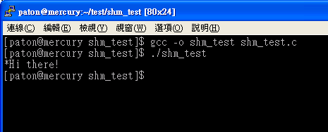
POSIX Shared Memory Example (5/5)
#include <stdio.h> // shm_test.c
#include <sys/shm.h>
#include <sys/stat.h>
int main()
{
/* the identifier for the shared memory segment */
int segment_id;
/* a pointer to the shared memory segment */
char* shared_memory;
/* the size (in bytes) of the shared memory segment */
const int segment_size = 4096;
/* allocate a shared memory segment */
segment_id = shmget(IPC_PRIVATE, segment_size, S_IRUSR | S_IWUSR);
/* attach the shared memory segment */
shared_memory = (char *) shmat(segment_id, NULL, 0);
/* write a message to the shared memory segment */
sprintf(shared_memory, "Hi there!");
/* now print out the string from shared memory */
printf("*%s\n", shared_memory);
/* now detach the shared memory segment */
shmdt(shared_memory);
/* now remove the shared memory segment */
shmctl(segment_id, IPC_RMID, NULL);
return 0;
}

Slide 45
Message-Passing Systems (1/7)
Processes communicate with each other without resorting to shared variables.
The communication actions are synchronized.
Useful in a distributed (network) environment.
A message-passing facility provides at least two operations:
  send(message)
  receive(message)
  message size can be fixed or variable.
    fixed-sized messages are easy to implement, but makes the programming task difficult.
    Variable-sized messages require a more complex system-level implementation, but the programming task becomes simpler.

Slide 46
Message-Passing Systems (2/7)
Processes that want to communicate must have a way to refer to each other.
Direct-symmetry-communication:
  processes that want to communicate must explicitly name the recipient or sender of the communication.
  send(P, message) – send a message to process P.
  receive(Q, message) – receive a message from process Q.
Direct-asymmetry-communication:
  Only the sender names the recipient.
  send(P, message) – send a message to process P.
  receive(id, message) – receive a message from any process; the variable id is set to the name of the sender.

Slide 47
Message-Passing Systems (3/7)
The disadvantage in both of these hard-coding schemes (symmetric and asymmetric).
  Changing the identifier of a process may necessitate examining all other processes.
  All references to the old identifier must be modified to the new identifier.
Indirect communication:
  The messages are sent to and received from mailboxes, or ports.
  Each mailbox has a unique identification.
  A process can communicate with some other process via a number of different mailboxes.
  A mailbox may be owned either by a process of by the operating system.
  send(A, message) – send a message to mailbox A.
  receive(A, message) – receive a message from mailbox A.

Slide 48
Message-Passing Systems (4/7)
In indirect communication scheme, a communication link has the following properties:
  A link is established between a pair of processes only if both members of the pair have a shared mailbox.
  A link may associated with associated with more than two processes.
  Between each pair of communicating processes, there may be a number of different links.

Slide 49
Message-Passing Systems (5/7)
A practical problem of mailbox sharing:
  P₁, P₂, and P₃ share mailbox A.
  P₁, sends; P₂ and P₃ receive.
  Who gets the message?
Solutions
  Allow a link to be associated with at most two processes.
  Allow only one process at a time to execute a receive operation.
  Allow the system to select arbitrarily the receiver. Sender is notified who the receiver was.

Slide 50
Message-Passing Systems (6/7)
There are different design options for implementing the send() and receive() primitives.
  Blocking (synchronous) send: the sending process is blocked until the message is received by the receiving process or by the mail box.
  Nonblocking (asynchronous) send: the sending process sends the message and resumes operation.
  Blocking receive: the receiver blocks until a message is available.
  Nonblocking receive: the receiver retrieves either a valid message or a null.
  Different combinations of send() and receive() are possible.
    E.g., rendezvous: send() and receive() are blocking, a trivial solution to the producer-consumer problem.

Slide 51
Message-Passing Systems (7/7)
Buffering:
  Whether communication is direct or indirect, messages exchanged by communicating processes reside in a temporary queue.
  Queue can be:
    Zero capacity: can not have any messages waiting in it.
      The sender must block until the recipient receives the message.
    Bounded capacity: the queue has finite length n.
      If the queue is full, the sender must block until space is available in the queue.
    Unbounded capacity: the sender never blocks.

Slide 52
Message-Passing Example: Mach (1/4)
Most communication in Mach is carried out by messages.
Messages are sent to and received from mailboxes called ports in Mach.
The port_allocate() system call creates a new mailbox and allocates space for its queue of messages.
The task (process) that creates the mailbox is the owner of the mailbox.
  Only one task (the owner) at a time can receive from a mailbox, but the right can be sent to other tasks (processes) if desired.

Slide 53
Message-Passing Example: Mach (2/4)
The messages consist of a fixed-length header followed by a variable-length data portion.
Header includes:
  The length of the message.
  Two mailbox names.
    The mailbox to which the message is being sent.
    Commonly, we expect a reply, so the mailbox of the sender is passed on to the receiving task, as a “return address”.
The variable part includes:
  a list of typed data items.
    Each entry in the list has a type, size, and value.

Slide 54
Message-Passing Example: Mach (3/4)
When sending a message to a non-full mailbox:
  The message is copied to the mailbox, and the sending task continues.
  Double-copy is the major problem of the message systems because the message is first copied from the sender to the mailbox and then from the mailbox to the receiver.
When sending a message to a full mailbox, the sending task has four options:
  Wait indefinitely until there is room in the mailbox.
  Wait at most n milliseconds.
  Do not wait at all but rather return immediately.
  Temporarily cache a message.

Slide 55
Message-Passing Example: Mach (4/4)
The receive operation must specify the mailbox or mailbox set from which a message is to be received.
  A mailbox set is a collection of mailboxes grouped together for the purposes of the task.
  If no message is waiting to be received, the receiving task can either wait at most n milliseconds or not wait at all.
A port_status() system call returns the number of messages in a given mailbox.

Slide 56
Communication in Client-Server Systems

Slide 57
Sockets (1/2)
A socket is defined as an endpoint for communication.
A socket is identified by an IP address and a port number.
  The socket 161.25.19.8:1625 refers to port 1625 on host 161.25.19.8.
A pair of processes communicating over a network employ a pair of sockets – one for each process.
  The server waits for incoming client requests by listening to a specified port.
  Once a request is received, the server accepts (constructs) a connection from the client socket to complete the connection.
Why port?
  A way to communicate is to know the process ID of the hosts.
  However, IDs change frequently.
  Each port represents a network services.
  All ports below 1024 are considered well known.
    http – 80, telnet – 23, ftp – 21 …

Slide 58

Sockets (2/2)
To initiate a request for a connection,
a client process is assigned a port
by the host computer
This port is an arbitrary
Number greater than 1024.
Packets are delivered to the appropriate
process based on the destination IP
and port number

Slide 59
Java Sockets Example (1/4)
Java provides three different types of sockets:
  Connection-oriented (TCP) sockets – implemented with the Socket class.
  Connectionless (UDP) sockets – implemented with the DatagramSocket class.
  Multicast sockets – implemented with MulticastSocket class.
Example Server:
  Use connection-oriented TCP sockets.
  Listen to port 6013.
  When a client request is received, the server returns the data and time to the client.

Slide 60
Java Sockets Example (2/4)
import java.net.*;
import java.io.*;
public class DateServer
{
public static void main(String[] args) {
try {
ServerSocket sock = new ServerSocket(6013);
// now listen for connections
while (true) {
Socket client = sock.accept();
// we have a connection
PrintWriter pout = new PrintWriter(client.getOutputStream(), true);
// write the Date to the socket
pout.println(new java.util.Date().toString());
// close the socket and resume listening for more connections
client.close();
}
} catch (IOException ioe) {
System.err.println(ioe);
}
}
}
DateServer.java
This class implements server sockets
Listens for (and block till) a connection
to be made to this socket and accepts it.
Return a socket that the server can
use to communicate with the client.
The server closes the socket to the client
and resumes listening for more requests.
http://java.sun.com/j2se/1.4.2/docs/api/java/net/ServerSocket.html

Slide 61
Java Sockets Example (3/4)
import java.net.*;
import java.io.*;
public class DateClient
{
public static void main(String[] args) {
try {
// this could be changed to an IP name
// or address other than the localhost
Socket sock = new Socket("127.0.0.1",6013);
InputStream in = sock.getInputStream();
BufferedReader bin = new BufferedReader(new InputStreamReader(in));
String line;
while( (line = bin.readLine()) != null)
System.out.println(line);
sock.close();
} catch (IOException ioe) {
System.err.println(ioe);
}
}
}
DateClient.java
Create a socket and request a
connection with the server on
port 6013

Slide 62
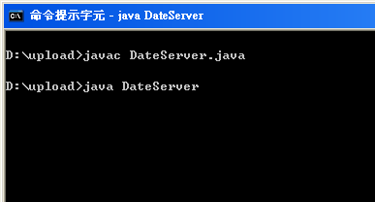
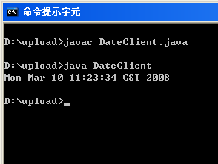
Java Sockets Example (4/4)
The IP address 127.0.0.1 is a special IP address known as the loopback.
  it is referring to itself!!
  The example runs the client and server on the same host to communicate using the TCP/IP protocol.

Slide 63
Remote Procedure Calls (1/6)
The remote procedure call (RPC) was designed as a way to abstract the procedure-call mechanism for use between systems with network connections.
  Allow a client to invoke a procedure on a remote host as it would invoke a procedure locally.
Is a message-based communication because the communicating processes are executing on separate systems.
The message are well structured and are thus no longer just packets of data.

Slide 64
Remote Procedure Calls (2/6)
The RPC takes place by providing a stub on the client side.
  Stub: client-side proxy for the actual procedure on the server.
  A separate stub exists for each separate remote procedure.
RPC operations:
  When the client invokes a remote procedure, the PRC system calls the appropriate stub, passing it the required parameters.
  The stub locates the port on the server and marshals the parameters, and then transmits a message to the server.
  Server has a similar stub that receives this message and invokes the procedure.
  If necessary, return values are passed back to the client using the same technique.

Slide 65
Remote Procedure Calls (3/6)
Parameter marshalling:
  Different systems use different data representation.
    Big/little-endian: use the high/low memory address to store the most signification byte.
  Many RPC systems define a machine-independent representation of data.
    For example, external data representation (XDR).
  Parameter marshalling involves converting the machine-dependent data into XDR before they are sent to the server.
  On the server side, the XDR data are unmarshalled and converted to the machine-dependent representation for the server.

Slide 66
Remote Procedure Calls (4/6)
Problem 1 – RPCs can fail, or be executed more than once, as a result of network errors.
  The operating system have to ensure that messages are acted on exactly once, rather than at most one.
For at most once:
  Each message is attached a timestamp (in the sender side).
  The server keep a large history of all the timestamps of messages it has already processed to detect repeated messages.
For exactly once:
  the server must acknowledge to the client that the RPC call was received and executed.
  The client must resend each RPC call periodically until it receives the ACK for that call.
  Of course, the server must implement the “at most once” protocol.

Slide 67
Remote Procedure Calls (5/6)
Problem 2 – How does a client know the port numbers on the server?
  Approach 1: the information may be predetermined, in the form of fixed port addresses.
    The server can not change the port number of the requested service.
  Approach 2: the operating system provides a matchmaker daemon on a fixed RPC port.
    A client then sends a message containing the name of the RPC to the matchmaker requesting the port address of the RPC it needs to execute.
    More flexible, but requires the extra overhead.

Slide 68
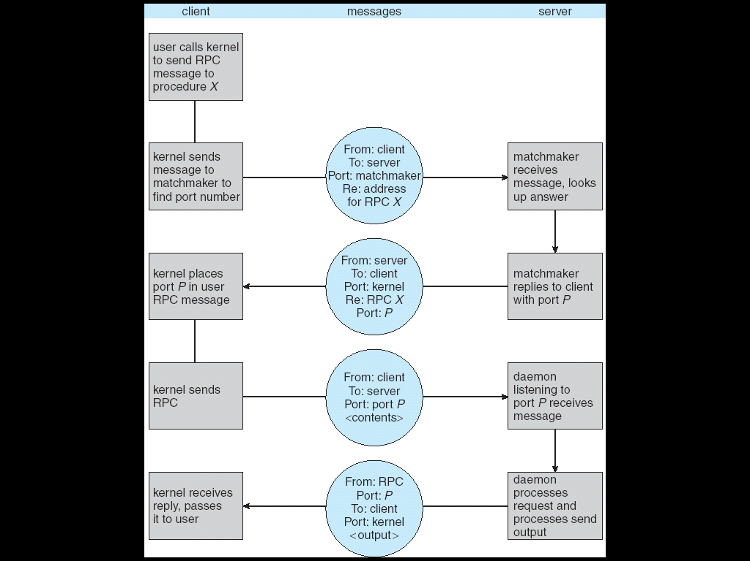
Remote Procedure Calls (6/6)

Slide 69
End of Chapter 3
Homework 1:
Exercises 3.2, 3.5, and 3.8.
Due date:

Slide 70
Appendix – How to use man (1/3)
Typical syntax:
  man [section] command_or_function
Section:
  User commands.
  System calls and error numbers .
  Functions in the C libraries.
  Device drivers.
  File formats.
  Games and other diversions.
  Miscellaneous information.
  System maintenance and operation commands.
  Kernel interface documentation.

Slide 71
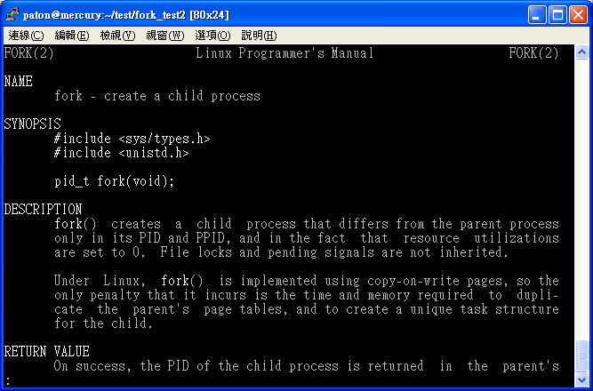
Appendix – How to use man (2/3)
Example: man 2 fork
The headers that you
should include
Explanations of
arguments and
return value.

Slide 72
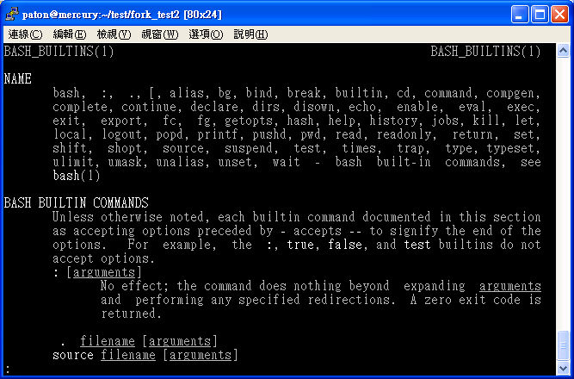
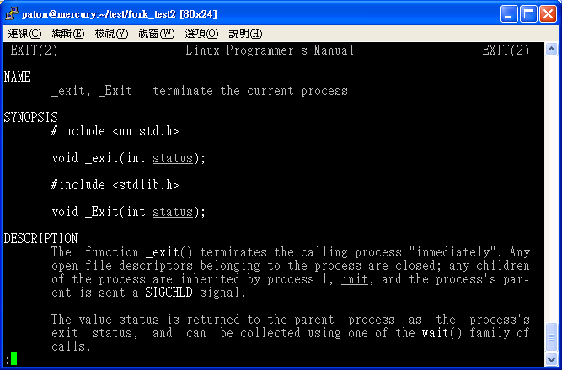
Appendix – How to use man (3/3)
man exit
  The usage of command exit.
man 2 exit
  The usage of system call exit().
No sexual discrimination … but man is very important ^_^

