Slide 1
Chapter 4:
Threads
MINAVATHI
Department of Information Science & Engineering
P E S C E, Mandya

Slide 2
Outline
Overview.
Multithreading Models.
Thread Libraries.
Threading Issues.
Operating-System Examples.

Slide 3
Overview (1/6)
Single-threaded process – multithreaded process:
  A thread is a basic unit of CPU utilization.
  Traditional process has a single thread of control.
  Multithreaded process can perform more than one task at a time.
Many applications are multithreaded.
  A web browser might have one thread display images while another thread retrieves data from the network.
  A word processor may have a thread for responding to keystrokes from the users, and another thread for performing spelling and grammar checking in the background.

Slide 4
Overview (2/6)
In many situations, an application may be required to perform several similar tasks.
  A web server accepts several client requests for web pages.
  If the web server ran as a traditional single-threaded process …
  it would be able to service only one client at a time.
Solution 1:
  When the server receives a request, it creates a separate process to service that request.
    E.g., fork().
  This process-creation method was in common use before threads became popular.
  Process creation is time consuming and resource intensive.
Solution 2:
  It is more efficient to use one process that contains multiple threads.
  When a request was made, the server (a thread) would create another thread to service the request.

Slide 5
Overview (3/6)
A thread comprises:
  A thread ID.
  A program counter.
  A register set.
  A stack.
It shares with other threads belonging to the same process:
  Code section.
  Data section.
  Other operating-system resources, such as open files.

Slide 6

Overview (4/6)

Slide 7
Overview (5/6)
Benefits:
  Responsiveness:
    Application can continue running even if part of it is blocked or is performing a lengthy operation.
    A multithreaded web browser allow user interaction in one thread while an image was being loaded in another thread.
  Resource sharing:
    Threads share the memory and the resources of the process to which they belong.
  Economy:
    Allocating memory and resources for process creation is costly.
    In Solaris, creating a process is about thirty times slower than is creating a thread. Context switching is about five times slower.
  Utilization of multiprocessor architectures:
    Threads may be running in parallel on different processors.
    A single-threaded process can only run on one CPU, no matter how many are available.

Slide 8
Overview (6/6)
Many operating system kernels are now multithreaded.
  Several threads operate in the kernel.
  Each thread performs a specific task.
  For example, Linux uses a kernel thread for managing the amount of free memory in the system.

Slide 9


Slide 10
Process | Thread
Process is called heavy weight process | Thread is called light weight process
Process switching needs interface with OS | Thread switching does not need to call OS & cause an interrupt to the Kernel
In multiple process implementation each process Execs same code but has its own mem & file resources | All threads can share same set of open filed, child processes
If one server process is blocked no other server process can Exec until the first process is unblocked | If one server thread is blocked & waiting second thread in the same task could run
Multiple redundant process uses more resources than multiple threaded | Multiple threaded process uses fewer resources than multiple redundant process
In multiple process each process operates independently of the others | One thread can read , write or even completely wipe out another threads stack

Slide 11
Multithreading Models (1/7)
User threads – kernel threads:
  User threads are supported above the kernel and are managed without kernel support.
  Kernel threads are supported and managed directly by the operating system.
  All contemporary operating systems support kernel threads.
  There must exist a relationship between user threads and kernel threads.

Slide 12
User level threads | Kernel level threads
These are faster to create & manage | slower
Implemented by thread library at user level | OS supports

Slide 13
Multithreading Models (2/7)
Many-to-One model:
  Map many user-level threads to one kernel thread.
  Thread management is done by the thread library in user space.
    The library provides the supports of thread creation, scheduling …
  Is efficient, because there is no kernel intervention.
  But … as the kernel is not aware of user threads …
  The entire process will block if a thread makes a blocking system call.
  Multiple threads are unable to run in parallel on multiprocessors.

Slide 14

Multithreading Models (3/7)
Many-to-One model

Slide 15
Multithreading Models (4/7)
One-to-One model:
  Map each user thread to a kernel thread.
  Allow another thread to run when a thread makes a blocking system call.
  Allow multiple threads to run in parallel on multiprocessors.
  But … creating a user thread requires creating the corresponding kernel thread.
  The creation overhead can burden the performance of an application.
  Most implementations of this model restrict the number of threads supported by the system.
  Supported by Linux and Windows family.

Slide 16

Multithreading Models (5/7)
One-to-One model

Slide 17
Multithreading Models (6/7)
Many-to-Many model:
  Multiplex many user-level threads to a smaller or equal number of kernel threads.
  The number of kernel threads may be specific to either a particular application or a particular machine.
  The many-to-many model does not suffer from the shortcomings of the previous two models.
    Many-to-One: the kernel can schedule only one thread at a time (on a multiprocessor system).
    One-to-One: the number of threads is limited.
    Many-to-many model ^{1.}allows as many user threads as necessary, and ^{2.}the corresponding kernel threads can run in parallel on a multiprocessor. When a thread is blocked, ^{3.}the kernel can schedule another thread for execution.

Slide 18

Multithreading Models (7/7)
Many-to-Many model

Slide 19
Thread Libraries (1/11)
A thread library provides the programmer an API for creating and managing threads.
Two ways of implementing a thread library:
  To provide a library entirely in user space with no kernel support.
    All code and data structures for the library exist in user space.
    All function calls result in local function calls in user space; and no system calls.
  To implement a kernel-level library:
    Supported by the operating system.
    Code and data structures for the library exist in kernel space.
    A function cal in the API for the library results in a system call to the kernel.

Slide 20
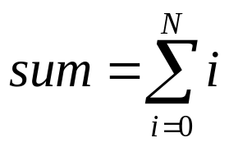
Thread Libraries (2/11)
Three primary thread libraries:
  POSIX Pthreads.
    May be provided as either a user- or kernel-level library.
  Win32 threads.
    Kernel-level library, available on Windows systems.
  Java threads.
    JVM is running on top of a host operating system, the implementation depends on the host system.
    On Windows systems, Java threads are implemented using the Win32 API;
    UNIX-based systems often use Pthreads.
The following multithreaded examples perform the summation of a non-negative integer in a separate thread.
User specified

Slide 21
Thread Libraries – Pthreads (3/11)
Pthreads refers to the POSIX standard, defining an API for thread creation and synchronization.
  Is a specification for thread behavior, not an implementation.
  Operating system designers implement the specification in any way they wish.
  When a program begins, a single thread of control begins in main().
  main() then creates a second thread.
  In a Pthreads program, separate threads begin execution in a specified function – in this example, the runner() function.

Slide 22
Thread Libraries – Pthreads (4/11)
void *runner(void *param)
{
int i, upper = atoi(param);
sum = 0;
if (upper > 0) {
for (i = 1; i <= upper; i++)
sum += i;
}
pthread_exit(0);
}
A global variable shared with main()
Thread termination

Slide 23
Thread Libraries – Pthreads (5/)
#include <pthread.h>
#include <stdio.h>
int sum; /* this data is shared by the thread(s) */
void *runner(void *param); /* the thread */
int main(int argc, char *argv[])
{
pthread_t tid; /* the thread identifier */
pthread_attr_t attr; /* set of attributes for the thread */
if (argc != 2) {
fprintf(stderr,"usage: a.out <integer value>\n");
return -1;
}
if (atoi(argv[1]) < 0) {
fprintf(stderr,"Argument %d must be non-negative\n",atoi(argv[1]));
return -1;
}
/* get the default attributes */
pthread_attr_init(&attr);
/* create the thread */
pthread_create(&tid,&attr,runner,argv[1]);
/* now wait for the thread to exit */
pthread_join(tid,NULL);
printf("sum = %d\n",sum);
}
All Pthreads programs must include this header file.
thrd-posix.c
Use default thread attributes.
Create a separate thread
The parent thread waits for child to complete.

Slide 24
Thread Libraries – Win32 (6/11)
A Win32 multithreaded operation will usually be embedded inside a function which returns a DWORD and takes a LPVOID as a parameter.
  The DWORD data type is an unsigned 32-bit integer.
  LPVOID is a pointer to a void.
Data shared by the separate threads are declared globally.

Slide 25
Thread Libraries – Win32 (7/11)
/* the thread runs in this separate function */
DWORD WINAPI Summation(LPVOID Param)
{
DWORD Upper = *(DWORD *)Param;
for (DWORD i = 0; i <= Upper; i++)
Sum += i;
return 0;
}
Is identical to void *
Unsigned 32-bit
integer
A global variable, shared by the thread(s)

Slide 26
Thread Libraries – Win32 (8/)
#include <stdio.h>
#include <windows.h>
DWORD Sum; /* data is shared by the thread(s) */
int main(int argc, char *argv[])
{
DWORD ThreadId;
HANDLE ThreadHandle;
int Param;
... // do some basic error checking
Param = atoi(argv[1]);
if (Param < 0) {
fprintf(stderr, "an integer >= 0 is required \n");
return -1;
}
// create the thread
ThreadHandle = CreateThread(NULL, 0, Summation, &Param, 0, &ThreadId);
if (ThreadHandle != NULL) {
WaitForSingleObject(ThreadHandle, INFINITE);
CloseHandle(ThreadHandle);
printf("sum = %d\n",Sum);
}
}
Must include this header file
thrd-win32.c
A windows system resources, such as file and thread,
are represented as kernel object.
Objects are accessed in Windows programs by handles
Creation flags, default values
make eligible to be run by
the CPU scheduler
Default security attributes
Default stack size
Thread function
Parameter to thread function

Slide 27
Thread Libraries – Java (9/11)
All Java programs comprise at least a single thread of control.
  E.g., the main() method runs as a single thread in the JVM.
To create Java threads,
  First define a class that implements the Runnable interface.
    The interface has a function run() that the class must implement.
class Summation implements Runnable
{
private int upper;
private Sum sumValue;
public Summation(int upper, Sum sumValue) {
this.upper = upper;
this.sumValue = sumValue;
}
public void run() {
int sum = 0;
for (int i = 0; i <= upper; i++)
sum += i;
sumValue.set(sum);
}
}
class Sum
{
private int sum;
public int get() {
return sum; }
public void set(int sum) {
this.sum = sum; }
}

Slide 28
Thread Libraries – Java (10/11)
  Then, create an object instance of the Thread class and passing the constructor a Runnable object.
  Creating a Thread object does not create the new thread; it is the start() method that actually creates the new thread.
  The join() method in Java provides similar functionality to the pthread_join() and WaitForSingleObject().
public class Driver
{
public static void main(String[] args) {
... // do some basic error checking
Sum sumObject = new Sum();
int upper = Integer.parseInt(args[0]);
Thread worker = new Thread(new Summation(upper, sumObject));
worker.start();
worker.join();
System.out.println("The sum of " + upper + " is " + sumObject.get());
}
}
Driver.java

Slide 29
Thread Libraries – Java (11/11)
Calling the start() method does two things:
  It allocates memory and initializes a new (child) thread in the JVM.
  The child thread begins execution in the run() method.

Slide 30
Threading Issues – fork() and exec() System Calls (1/15)
If one thread in a program call fork() …
  Does the new process duplicate all threads?
  Or is the new process single-threaded?
Some UNIX systems have chosen to have two versions of fork(), one that duplicates all threads and another that duplicates only the thread that invoked the fork() system call.
If a thread invokes the exec() system call, the program specified in the parameter to exec() will replace the entire process – including all threads.

Slide 31
Threading Issues – fork() and exec() System calls (2/15)
For systems with two versions of fork():
  If exec() is called immediately after forking, duplicating only the calling thread is appropriate.
  If the separate process does not call exec() after forking, the separate process should duplicate all threads.

Slide 32
Threading Issues – Cancellation (3/15)
Thread cancellation is the task of terminating a thread before it has completed.
Examples:
  Multithreaded database search:
    When one thread returns the result, the remaining threads might be canceled.
  A user presses a stop button on a web browser:
    A web page is often loaded using several threads.
    When stop, all threads loading the page are canceled.
A thread that is to be canceled is often referred to as the target thread.

Slide 33
Threading Issues – Cancellation (4/15)
Two general approaches:
  Asynchronous cancellation terminates the target thread immediately.
    Canceling a thread asynchronously may not free a system-wide resource.
  Deferred cancellation allows the target thread to periodically check if it should be cancelled.
    One thread indicates that a target thread is to be canceled.
      Probably by setting a flag to the target thread.
    Cancellation occurs only after the target thread has checked a flag to determine if it should be canceled or not.
    This allows a thread to be canceled safely (in an orderly fashion).

Slide 34
Threading Issues – Signal Handling (5/15)
Signals are used in UNIX systems to notify a process that a particular event has occurred.
Procedure of signal handling:
  A signal is generated by the occurrence of a particular event.
  A generated signal is delivered to a process.
  Once delivered, the signal must be handled.
Two types of signals:
  Synchronous signals:
    Signals are delivered to the same process that performed the operation that caused the signal.
    For instance, illegal memory access.
  Asynchronous signals:
    Signals delivered to a process are generated by an event external to the running process.
    For instance, user presses <control><C> to terminate a process.

Slide 35
Threading Issues – Signal Handling (6/15)
Every signal may be handled by one of two possible handlers:
  A default signal handler.
    Run by the kernel when handling signals.
  A user-defined signal handler.
    Default action can be overridden by programmers to call a user-defined handler.
Handling signals in single-threaded programs is straightforward. However, delivering signals is more complicated in multithreaded programs.
  Where should a signal be delivered?

Slide 36
Threading Issues – Signal Handling (7/15)
Options:
  Deliver the signal to the thread to which the signal applies.
  Deliver the signal to every thread in the process.
  Deliver the signal to certain threads in the process.
  Assign a specific thread to receive all signals for the process.
The method for delivering a signal depends on the type of signal generated.
  Synchronous signals need to be delivered to the thread causing the signal and not to other thread in the process.
  For many cases, asynchronous signals (such as <control><C>) should be sent to all threads.

Slide 37
Threading Issues – Signal Handling (8/15)
POSIX Pthreads provides the pthread_kill(pthread_t tid, int signal) to send a signal to a specified thread.
kill(pid_t pid, int signal), a standard UNIX function for delivering a signal to a process.
Signals are defined in <signal.h>
  E.g., SIGKILL – (abnormal) terminate a process or a thread.

Slide 38
Threading Issues – Thread Pools (9/15)
In a multithreaded web server, the server creates a separate thread when it receives a request.
Whereas creating a separate thread is certainly superior to creating a separate process, a multithreaded server nonetheless has potential problems.
  The amount of time required to create the thread prior to servicing the request.
  If we allow all concurrent requests to be serviced in a new thread, unlimited threads could exhaust system resources.
A better way to implement a server is to use a thread pool.

Slide 39
Threading Issues – Thread Pools (10/15)
A process creates a number of threads at process startup.
The threads sit in a pool and wait for work.
When a server receives a request, it awakens a thread from this pool – if one is available – and pass it the request to service.
If the pool contains no available thread, the server waits until one becomes free. (usually line in a queue)
Once the working thread completes its service, it returns to the pool and awaits more work.
Advantages of thread pools:
  Servicing a request with an existing thread is usually faster than waiting to create a thread.
  Pools limit the number of thread. This is important on systems that cannot support a large number of concurrent threads.

Slide 40
Threading Issues – Thread Pools (11/15)
The number of threads in the pool can be set heuristically.
  For example, a pool can have 25 threads/CPU.
Some thread-pool architectures can dynamically adjust the number of threads in the pool according to usage patterns.
  Having a smaller pool when the load on the system is low – to save memory.

Slide 41
Threading Issues – Thread Pools (12/15)
The Win32 Thread Pool API provides several function related to thread pools.
One such member is QueueUserWorkItem() function.
QueueUserWorkItem(PoolFunction, NULL, 0);
Points to a function that is
to run as a separate thread
Pass no parameter
Flag = 0, no special
instructions for creation
DWORD WINAPI PoolFunction(LPVOID Param)
{
/* this function runs as a separate thread */
}

Slide 42
Threading Issues – Thread-Specific Data (13/15)
Threads belonging to a process share the data of the process.
However … in some circumstance, each thread might need its own copy of certain data.
  The data is called thread-specific data.
Most thread libraries provide some form of support for thread-specific data.

Slide 43
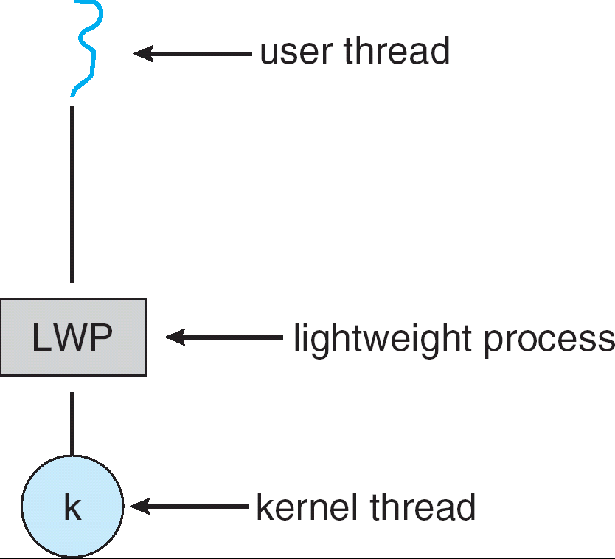
Threading Issues – Scheduler Activations (14/15)
Many systems implementing the many-to-many model place an intermediate data structure between the user and kernel threads.
  Lightweight process (or LWP, virtual processor).
The kernel provides an application with a set of virtual processors.
Each LWP is attached to a kernel thread, and is scheduled by the operating system to run on physical processors.
To the user-thread library, a LWP can be used to schedule a user thread (to run).

Slide 44
Threading Issues – Scheduler Activations (15/15)
When a user thread is blocked (performing I/O), the kernel must notify the library to assign other user threads for running.
Scheduler activation – a scheme for communication between the kernel and the thread library.
  In this scheme, the kernel must inform an application about certain events.
    For example, a user thread is about to block.
    This procedure is known as an upcall.
  Upcalls are handled by the thread library with an upcall handler.
    The kernel first allocates a new virtual processor to the handler.
    The handler saves the state of the blocking thread and relinquishes the virtual processor on which the blocking thread is running.
    The handler then schedules another user thread that is eligible to run on the new processor.

Slide 45
End of Chapter 4
Homework 2:
Exercises 4.5 and 4.8.
Due date:

