Slide 1
Chapter 8: Memory-Management Strategies
MINAVATHI
Department of Information Science & Engineering
P E S C E, Mandya

Slide 2
Outline
Background
Swapping
Contiguous Memory Allocation
Paging
Structure of the Page Table
Segmentation

Slide 3
Background (1/5)
Memory consists of a large array of words or bytes, each with its own address.
It is central to the operation of a modern computer system.
  In a instruction-execution cycle:
    The CPU fetches instructions from memory according to the value of the program counter.
    The instruction is then decoded and may cause operands to be fetch from memory.
    Then, results may be stored back in memory.

Slide 4
Background (2/5)
We must ensure correct operation has to protect the operating system from access by user processes and to protect user processes from one another.
To do this …
  Each process has a range of legal addresses.
  Process can access only these legal addresses.
We can provide this protection by using two registers:
  Base register – hold the smallest legal physical memory address.
  Limit register – specify the size of the range.

Slide 5
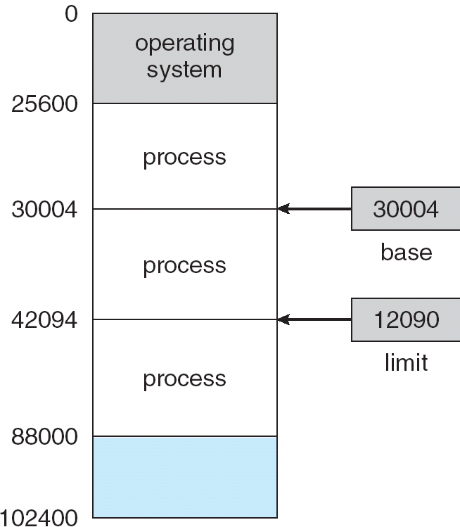
Background (3/5)
30004 + 12090 = 42094!!

Slide 6

Background (4/5)
Then, we compare every address generated in user mode with the registers.
  Any attempt (in user mode) to access operating-system memory or other users’ memory results in a fatal error.
  Therefore, we can prevent a user program from modifying the code or data structures of either the operating system or other users.

Slide 7
Background (5/5)
Note that, the registers can be loaded only by the operating system.
  To prevent user programs from changing the registers’ contents.
The operating system, executing in kernel mode, is given unrestricted access to both operating system and users’ memory.
  Allow the operating system to load users’ program into uers’ memory, to dump out those programs in case of errors …

Slide 8

Address Binding (1/4)
Usually, a program resides on a disk as a binary executable file.
To be executed, the program must be brought into memory and placed within a process.
The process may be moved
between disk and memory
during its execution.
The processes on the disk that
are waiting form the input queue.
Process in memory

Slide 9

Address Binding (2/4)
Before being executed, a user program will go through several steps (some of which may be optional).
Memory addresses may be represented in different ways during these steps.
In the source program, addresses are generally symbolic (such as variable count).
Generally, a compiler will bind these symbolic addresses to re-locatable addresses (such as 14 bytes from the beginning of this module).

Slide 10
Address Binding (3/4)
Typically, the loader (or linkage editor) will bind the re-locatable addresses to absolute addresses (such as 74014).
  Binding is a mapping from one address space to another.
Classically, the binding can be done at any step along the way:
  Compile time:
    If you know at compile time where the process will reside in memory, then absolute code (address) can be generated.
    If, at some later time, the starting location changes, then it will be necessary to recompile this code.

Slide 11
Address Binding (4/4)
  Load time:
    If it is not known at compile time where the process will reside in memory, then the compiler must generate re-locatable code.
    Binding is then delayed until load time.
    If the starting address changes, we need only reload the code to incorporate this changed value.
  Execution time:
    If the process can be moved during its execution from one memory segment to another, then binding must be delayed until run (execution) time.
    Most general-purpose operating systems use this method.

Slide 12
Logical vs. Physical Address Space
(1/2)
Logical address - an address generated by the CPU (or a program).
  The set of all logical addresses generated by a program is a logical address space.
Physical address – an address seen by the memory unit.
  The set of all physical addresses corresponding to the logical addresses is a physical address space.
For compile-time and load-time address-binding methods, logical and physical addresses are identical.
However, the execution-time address-binding scheme results in differing logical (virtual) and physical addresses.
  Process only runs in logical locations 0 to max.
  Logical addresses must be mapped to physical addresses before access.

Slide 13

Logical vs. Physical Address Space
(2/2)
Memory-management unit (MMU) – a hardware device that maps from virtual to physical addresses run-time.
  There are many different methods to accomplish such mapping.
A simple MMU scheme:
  A register-based scheme.
Another name of the base register.
The value in the relocation register is
added to every address generated
by a user process at the time
it is send to memory.

Slide 14
Dynamic Loading
With dynamic loading, a routine (of a program) is not loaded until it is called.
  Routines are kept on disk in a re-locatable load format.
  The main program is loaded into memory and is executed.
  When we need (call) a routine, the caller first checks to see whether the routine has been loaded.
    If not …
      The loader is called to load the desired routine into memory.
      Update the program’s address space to reflect this change.
      Pass control to the newly loaded routine.
Benefits of dynamic loading:
  Unused routines, usually error-handling routines, are never loaded.
  Better memory-space utilization.

Slide 15
Dynamic Linking (1/4)
Some operating systems support only static linking.
  Complied object modules are combined by the loader (or linker) into the binary program image.
Dynamic linking – linking is postponed until execution time.
  Usually used with system libraries.
Without this facility …
  Each program (using system libraries) must include a copy of the library in the executable image.
  Waste both disk space and main memory.

Slide 16
Dynamic Linking (2/4)
A stub is included in the image for each library routine reference.
When the stub is executed …
  It checks to see whether the needed library routine is already in memory.
  If not, the routine is loaded into memory.
  Either way, the stub replaces itself with the address of the routine and executes the routine.
Under this scheme, all processes that use a library execute only one copy of the library code!!

Slide 17
Dynamic Linking (3/4)
This scheme can be extended to library updates (such as bug fixes).
  A library may be replaced by a new version.
  All programs that reference the library will automatically use the new version.
Usually version information is included in both the program and the library, so that programs will not accidentally execute new, incompatible versions of libraries.
More than one version of a library may be loaded into memory.
  Only programs that are compiled with new library version are affected by the changes.
  Other programs linked before the new library was installed will continue using the older library.
  This system is known as shared libraries.

Slide 18
Dynamic Linking (4/4)
Dynamic linking generally requires help from the operating system.
  The operating system is the only entity that can check to see whether the needed routine is in another process’s memory space.
  And allow multiple processes to access the same memory addresses.

Slide 19

Swapping (1/6)
If there is no free memory …
  A process can be swapped temporarily out of memory to a backing store and then brought back into memory for continued execution.
    The backing store is commonly a fast disk.

Slide 20
Swapping (2/6)
Examples:
  In a round-robin system …
    When a quantum expires, the memory manager will swap out the process that just finished
    And swap in another memory for execution.
  In a priority-based system …
    If a higher-priority process arrives, the memory manager can swap out a lower-priority process.
    Then load and execute the higher-priority process.
    This scheme is sometimes called roll out, roll in.

Slide 21
Swapping (3/6)
If address binding is done at compile or load time ..
  A process that is swapped out will be swapped back into the same memory space it occupied previously.
  Because the physical addresses are determined.
If execution-time binding is being used …
  A process can be swapped into a different memory space.
  Because the physical addresses are computed during execution time.

Slide 22
Swapping (4/6)
Normally, the system maintains a ready queue consisting of all processes.
  The memory images of the processes are on the backing store or in memory.
  Whenever the CPU scheduler decides to execute a process, it call the dispatcher.
  The dispatcher checks to see whether the next process is in memory.
  If not, and if there is no free memory region, the dispatcher swaps out a process currently in memory and swap in the desired process.
    Then it reloads registers and transfers control to the selected process.

Slide 23
Swapping (5/6)
The swapping time:
  Assume that:
    The user process is 10 MB.
    The backing store is a standard hard disk with a transfer rate of 40MB/sec.
    No head seeks.
    Average latency is 8 ms.
  The transfer of the 10-MB process to or from memory takes
    10000 KB / 40000 = ¼ second = 250 ms.
  The swap time = (head seeks) + (latency) + (transfer) = 258.
    We must both swap out and in, so the total swap time is 516 ms.
For efficiency, we want the execution time for each process to be long relative to the swap time.
  In this example, the time quantum should be larger than 0.516 seconds.

Slide 24
Swapping (6/6)
Currently, standard swapping is used in few systems.
  It requires too much swapping time to be a reasonable memory-management solution.
However, modified versions of swapping are found on many systems.
  In many versions of UNIX, swapping is normally disabled, but will start if many processes are running and are using a threshold amount of memory.

Slide 25
Contiguous Memory Allocation (1/6)
The memory is usually divided into two partitions:
  One for operating system.
    The operating system can be placed in either low memory or high memory.
    Due to the interrupt vector (which is often in low memory), operating system is usually placed in low memory.
  One for the user processes.
    We want several user processes to reside in memory.
    In contiguous memory allocation, each process is contained in a single contiguous section of memory.

Slide 26
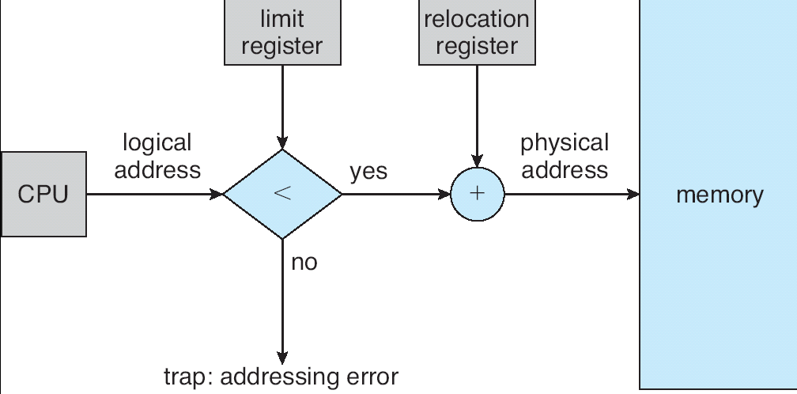
Contiguous Memory Allocation (2/6)
Before discussing memory allocation, we talk about memory mapping and protection.
  The MMU consists of a re-location register and a limit register.

Slide 27
Contiguous Memory Allocation (3/6)
One of the simplest methods for allocating memory is to divide memory into several fixed-sized partitions.
  Each partition can contain exactly one process.
  The degree of multiprogramming is bound by the number of partitions.
When a partition is free, a process is selected from the input queue and is loaded into the free partition.
When the process terminates, the partition becomes available for another process.
This method was used by IBM OS/360 operating system (called MFT).
  The method is out-of-date and no longer in use!!

Slide 28
Contiguous Memory Allocation (4/6)
A generalization of the fixed-partition scheme (called MVT, or dynamic partitions):
  Initially, all memory is available for user processes.
    It is considered on large block of available memory, a hole.
  When a process arrives and needs memory, we (OS) search for a hole large enough for this process.
  If available, we allocate only as much as memory as is needed.
    Keeping the rest to satisfy future requests.

Slide 29
Contiguous Memory Allocation (5/6)
At any given time, we have the input queue (list of waiting processes) and a set of holes of various sizes scattered throughout memory.
To load a waiting process …
  The system searches the set for a hold that is large enough for this process.
    If the hole is too large, it is split into two parts.
      One for the process, the other is returned to the set of holes.
When a process terminates …
  It releases its block of memory, which is placed back in the set of holes.
  If the new hold is adjacent to other holes, these adjacent holes are merged to form one larger hole.

Slide 30
Contiguous Memory Allocation (6/6)
Dynamic storage-allocation problem – how to satisfy a request of size n from a list of free holes?
  First-fit: Allocate the first hole that is big enough.
  Best-fit: Allocate the smallest hole that is big enough.
    Must search entire list, unless ordered by size.
    Produces the smallest leftover hole.
  Worst-fit: Allocate the largest hole.
    Must also search entire list.
    Produces the largest leftover hole, which may be more useful than the smaller left from a best-fit approach.
  Simulations have shown that both first-fit and best-fit are better than worst-fit in terms of decreasing time and storage utilization.
  First-fit is generally faster than best-fit and has similar storage utilization.

Slide 31
Fragmentation (1/2)
As processes are loaded and removed from memory, the free memory space is broken into little pieces.
External fragmentation:
  There is enough total memory space to satisfy a request.
  But the available spaces are not contiguous, and fragmented into a large number of small holes.
  The first-fit and best-fit strategies usually suffer from this fragmentation.
50-percent rule: statistical analysis of first-ft reveals that, given N allocated blocks, another 0.5 N blocks will be lost to fragmentation.
  One-third of memory may be unusable!!

Slide 32
Fragmentation (2/2)
Compaction - a solution to external fragmentation.
  To place all free memory together in one large block.
  Is possible only if binding is dynamic and is done at execution time.
  The simplest compaction algorithm is to move all processes toward one end of memory.
    All holes will move in the other direction.
Internal fragmentation:
  In the fixed-sized partition scheme, the memory allocated to a process (i.e., a partition) may be slightly larger than the requested memory.

Slide 33

Paging – Basic Method (1/9)
Paging is a memory-management scheme that permits the physical address space of a process to be noncontiguous.
  It is commonly used in most operating systems.
Paging breaks …
  Physical memory into fixed-sized blocks called frames.
  Logical memory into blocks of the same size called pages.
Noncontiguous mapping

Slide 34
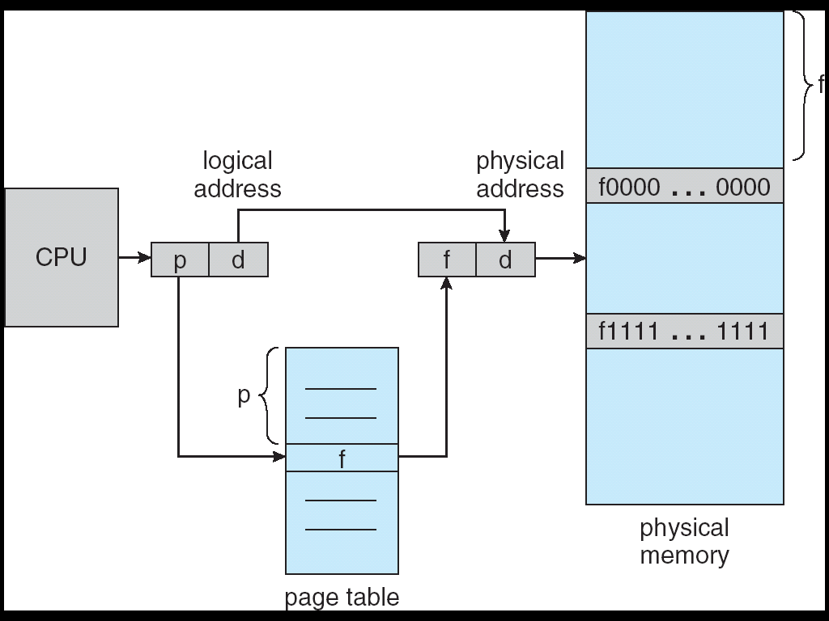
Paging – Basic Method (2/9)
How ?? … every logical address is divided into two parts:
  Page number (p).
    Used as an index into a page table.
    The page table contains the base address of each page in physical memory.
  Page offset (d).
    Page offset is combined with the base address to define the physical memory address.

Slide 35
Paging – Basic Method (3/9)

Slide 36
Paging – Basic Method (4/9)
The page size is typically a power of 2, varying between 512 bytes and 16MB per page.
  Power of 2 makes the translation of a logical address into a page number and page offset particular easy.
If the size of logical address space is 2^{m} and a page size is 2^{n} addressing units (e.g., bytes) …
  The high-order m – n bits of a logical address designate the page number.
  The n low-order bits designate the page offset.
page number | page offset
p | d
m – n | n

Slide 37

Paging – Basic Method (5/9)
Example:
  Page size 4 bytes.
    n = 2.
  A physical memory of 32 bytes (8 pages).
What is the physical address of logical address 13 ??
  13 → 1101(binary).
  Page number = 11(binary) = 3.
  Page offset = 01(binary).
physical address
1001(binary) = 9!!

Slide 38
Paging – Basic Method (6/9)
For a page table with 32-bit (4 bytes) entry length …
  The table can point to 2³² physical page frames.
  If frame size is 4 KB (12 bits), then the system can address 2⁴⁴ bytes (or 16 TB) of physical memory.
page table
0 | A 32-bit page number
1 | A 32-bit page number
…

Slide 39

Paging – Basic Method (7/9)

Slide 40
Paging – Basic Method (8/9)
Paging itself is a form of dynamic relocation.
  Every logical address is bound by the paging hardware to some physical address.
When using paging, we have no external fragmentation!!
  Any free frame can be allocated to a process that needs it.
However, we may have some internal fragmentation.
  The last frame allocated may not be complete full.
  In worst case, a process need n pages plus 1 byte. It would be allocated n+1 frames.
    Resulting in an internal fragmentation of almost an entire frame.

Slide 41
Paging – Basic Method (9/9)
We can expect internal fragmentation to average one-half page per process.
  This consideration suggests that small page sizes are desirable.
However …
  Overhead is involved in each page-table entry.
  Also, disk I/O is more efficient when the number of data being transferred is larger.
To know the status of physical memory, the operating system generally has a data structure call a frame table.
  The frame table has one entry for each physical page frame.
  Indicating whether the frame is free or allocated.
  If allocated, to which page of which process.

Slide 42
Paging – Hardware Support (1/6)
How to implement paging?
In the simplest case, the page table is implemented as a set of dedicated registers.
Most operating systems allocate a page table for each process.
  So, the CPU dispatcher reloads these registers during context switching.
Example – DEC PDP-11.
  The address consists of 16 bits.
  Page size is 8 KB (13 bits).
  The page table thus consists of 8 entries (2³) that are kept in registers.

Slide 43
Paging – Hardware Support (2/6)
The use of fast registers is not feasible!!
  Most contemporary computers allow the page table to be very large.
Rather, the page table is kept in main memory, and a page-table base register (PTBR) points to the page table.
  Problem – two memory accesses are needed!!
  If we want to access location i, we must first index into the page table and combine the frame address with the page offset to produce the actual address.
A solution to this problem is to use a special hardware cache, called a translation look-aside buffer (TLB).

Slide 44

Paging – Hardware Support (3/6)
Each entry in the TLB consists of two parts: a key (page number) and a value (frame number).
  Typically, the number of entries in a TLB is small (64 to 1024), because the hardware is expensive.
When a logical address is generated …
Its page number is
presented to TLB.
If the page number
Is not in the TLB.

Slide 45
Paging – Hardware Support (4/6)
We will add the page number and frame number of a TLB miss to the TLB.
  They will be found quickly on the next reference.
  If the TLB is full, the operating system must select one for replacement.
    Replacement policies range from least recently used (LRU) to random (chapter 9 for more details).
Hit ratio – the percentage of times that a page number is found in TLB.
  If it takes 20 ns to search the TBL, and 100 ns to access memory.
  A TLB hit takes 120 ns to access physical memory.
  If we fail to find the page number in the TLB (20 ns), then we must first access memory for page table and frame number (100 ns) and then access the desired byte in memory (100 ns).
    A total of 220 ns

Slide 46
Paging – Hardware Support (5/6)
To find the effective memory-access time, we weight each case by its probability.
  For a 80-percent hit ratio:
  effective access time = 0.80 x 120 + 0.20 x 220
  = 140 ns.

Slide 47
Paging – Hardware Support (6/6)
The TBL contains entries for several different processes simultaneously.
To ensure address-space protection …
  Some TLBs store address-space identifier (ASIDs) in each TLB entry.
  The ASID for the currently running process must match the ASID associated with the virtual page.

Slide 48
Paging – Protection (1/3)
We can provide separate protection bits for each page.
  When the physical address is being computed, the protection bits can be checked.
  Bits define read-only, read-write, execute-only, …
One general bit is valid-invalid bit.
  When the bit is set to invalid, the page is not in the process’s logical address space.

Slide 49

Paging – Protection (2/3)
Suppose, a system with 14-bit (logical) address space.
Page size is 2 KB (11 bits).
For 1kb: 10 bits
For 2kb: 11 bits
Page table has 2⁽¹⁴⁻¹¹⁾ =8 pages.
A program uses addresses 0 to 10468.
  Require 10468 / 2¹¹ = 5.11 → 6 frames.
The internal fragmentation problem.
  Not all references to page 5 are valid!!
Any attempt to generate an
address in pages 6 or 7 will
be invalid.

Slide 50
Paging – Protection (3/3)
Rarely does a process use all its (logical) address range.
  Previous example: 32-bit entry length with 4 KB frame size results in 16 TB of physical memory.
It would be wasteful to create a page table with entries for every page in the address range.
Some systems provide hardware, in the form of a page-table length register (PTLR), to indicate the size of the page table.
  The value is checked against ever logical address to verify that the address is in the valid range.

Slide 51
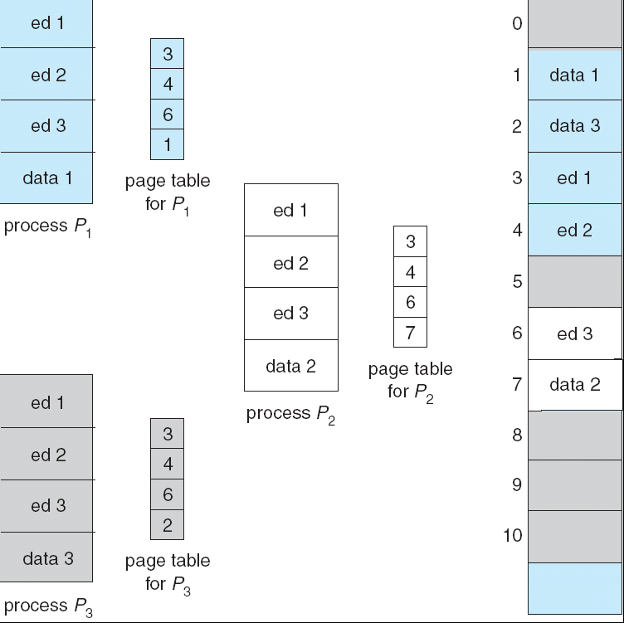
Paging – Shared Pages (1/2)
Consider a system where 40 users execute a text editor.
  If he text editor consists of 150 KB of code and 50 KB of data space, we need (40 x 200) 8,000 KB to support the 40 users.
Paging makes the common code sharing easier.
  If the code is reentrant (pure) code, its pages can be shared.

Slide 52
Paging – Shared Pages (2/2)
Each user’s page table maps onto the same physical copy of the editor, but data pages are mapped onto different frames.
  To support 40 users, the total space required is 2150 KB – a significant savings.
In addition to code sharing …
  In Chapter 4, we discussed the sharing of the address space of a task by thread.
  In Chapter 3, we described shared memory.
  Some operating systems implement the sharing using shared pages.

Slide 53
Hierarchical Paging (1/4)
Most systems support a large logical address space (2³² to 2⁶⁴).
  The page table itself becomes excessively large.
A system with a 32-bit logical address space.
  The page size is 4 KB (2¹²).
  Then, a page table consists of 2³²⁻¹² (million) entries.
  If each entry consists of 4 bytes, each process may need up to 4 MB of physical address for the page table.
It is inappropriate to allocate the large page table contiguously in main memory.

Slide 54

Hierarchical Paging (2/4)
Two-level paging (also know as a forward-mapped page table)
  The page table itself is also paged.
  we can further divide the page number into two parts:
    p₁ is an index into the outer page table.
    p₂ is the displacement within the page of the outer page table.
page number |  | page offset
p₁ | p₂ | d
10 | 10 | 12

Slide 55

Hierarchical Paging (3/4)
p₁=1
phy_addr₁
p₂=1023
} d

Slide 56
Hierarchical Paging (4/4)
For a system with a 64-bit logical-address space, a two-level paging scheme is not appropriate!!
  Suppose that the page size is 4 KB (2¹²).
  Let the inner page tables be one page long (or contain 2¹⁰ 4-byte entries).
  The outer page table consists of 2⁽⁶⁴⁻¹²⁻¹⁰⁾ 4-byte entries, or 2⁴⁴ bytes.
  We can page the outer page table, giving us a three-level paging scheme.
    But the out page table is still 2³⁴ bytes in size.
Hierarchical page tables are generally inappropriate for 64-bit architecture.
  For example, the 64-bit UltraSPARC would require seven levels of paging.
    Result in a prohibitive number of memory access to translate each logical address.

Slide 57

Hashed Page Tables
A common approach for handling address spaces larger than 32 bits.
The virtual page number is hashed into the hash table.
Each entry in the has table contains a linked list of elements that has to the same location (to handle collisions).

Slide 58
Inverted Page Tables (1/3)
Usually, each process has an associated page table.
  The table has one entry for each page that the process is using (or one slot for each page, regardless of validity).
  Each page table may consist of millions of entries!!
  So … the tables of all processes may consume large amount of physical memory.
The scheme of inverted page table uses only one page table in the system.
  The table has one entry for each page of physical memory.
  Each entry consists of:
    The process that owns that page.
    The virtual address of the page stored in that real memory location.

Slide 59

Inverted Page Tables (2/3)
A logical address consists of
<process-id, page-number, offset>
Part of the address is
searched for a match
If a match if found at entry i, then
the physical address <i, offset>
is generated.

Slide 60
Inverted Page Tables (3/3)
Although this scheme decreases the amount of memory requirements …
  It increases the amount of time needed to search the table.
    The whole table might need to be searched for a match.
The scheme also has difficulty implementing shared memory.
  There is only one virtual page entry for every physical page.

Slide 61
Segmentation (1/5)
Do users think of memory as a linear array of bytes??
  No …
We think of a program as:
  A main program,
  A set of methods, procedure, or functions.
  Various data structures: objects, arrays, stacks.
Each of these modules or data elements is referred to by name.
  You talk about them (the stack, the main program, …) without caring what addresses in memory these elements occupy.

Slide 62

Segmentation (2/5)
Segmentation supports this user view of memory.
A logical address space is a collection of segments.
  Each segment has a name and a length.
  The (logical) addresses specify both the segment name (usually a number) and the offset within the segment.
  A two-tuple representation of a logical address:
  <segment-number, offset>

Slide 63
Segmentation (3/5)
In this memory-management scheme, a C compiler might create separate segments for the following:
  The code.
  Global variables.
  The heap, from which memory is allocated.
  The stacks used by each thread.
  The standard C library.

Slide 64

Segmentation (4/5)
Segmentation table – map two-dimensional logical addresses into one-dimensional physical addresses.
  Each entry has:
    a segment base – the starting physical address of the segment.
    a segment limit – the length of the segment.
  The table is thus essentially an array of base-limit register pairs.

Slide 65

Segmentation (5/5)

Slide 66
End of Chapter 8

