Slide 1
Chapter 9: Virtual Memory Management
MINAVATHI
Department of Information Science & Engineering
P E S C E, Mandya

Slide 2
Background (1/5)
Methods in Chapter 8 require that an entire process be in memory before it can execute.
  The requirement is reasonable, but limits the size of a program to the size of physical memory.
In many cases, the entire program is not needed!!
  Programs handling unusual error conditions are rarely executed.
  Arrays, lists, and tables are often allocated more memory than they actually need.

Slide 3
Background (2/5)
Benefits of executing a program that is partially in memory:
  A program would no longer be constrained by the amount of physical memory that is available.
  More programs could be run at the same time.
    Increase CPU utilization and throughput.
  Less I/O would be needed to load or swap each user program into memory, so user programs would run faster.
Virtual memory is a technique that allows the execution of processes that are not completely in memory.

Slide 4
Background (3/5)
Virtual memory separates of user logical memory from physical memory.
  Only part of the program needs to be in memory for execution.
Logical address space can therefore be much larger than physical address space.
  Make programming easier, programmers no longer need to worry about the amount of physical memory.

Slide 5

Background (4/5)
Virtual address space:
  The logical (or virtual) view of how a process is stored in memory.
  Logically, a process begins at a certain logical address – say, address 0 – and exists in contiguous memory.
Virtual address spaces that include holes are known as sparse address space.
  Is beneficial because the holes can be filled during program execution.
  For example, the large blank space between the heap and stack.

Slide 6

Background (5/5)
Other benefits of virtual memory:
  System libraries can be shared by several processes.
  Enable processes to share memory.
  Speeding up process creation – the fork() system call.

Slide 7
Demand Paging – Basic Concepts (1/7)
Demand paging is a technique commonly used in virtual memory systems.
Pages are only loaded when they are demanded during program execution.
  Pages that are never accessed are thus never loaded into physical memory.
Initially, a process resides in secondary memory (usually a disk).
Then we swap it into memory.
  Rather than swapping the entire process into memory, we use a lazy swapper (pager).
  Lazy swapper never swaps a page into memory unless that page will be needed.

Slide 8
Demand Paging – Basic Concepts (2/7)
We need hardware support to distinguish between the pages that are in memory and the pages that are on the disk.
The valid-invalid bit scheme (Chapter 8) can be used for this purpose.
  When valid, the associated page is both legal and in memory.
  When invalid, the associated page either is not valid or is valid but is currently on the disk.

Slide 9

Demand Paging – Basic Concepts (3/7)
on the disk
invalid

Slide 10
Demand Paging – Basic Concepts (4/7)
Access to a page marked invalid causes a page-fault trap.
The procedure for handling a page fault:
  We check an internal table for this process to determine whether the reference was a valid or an invalid memory access.
    page-table length register (PTLR, Chapter 8).
  If invalid, we terminate the process.
  If valid, but we have not yet brought in that page, we now page it in.
  We find a free frame.
    Frame table (Chapter 8).
  We schedule a disk operation to read the desired page into the newly allocated frame.
  When the disk read is complete, we modify the internal table and page table to indicate that the page is now in memory.
  We re-start the instruction that was interrupted by the trap.

Slide 11

Demand Paging – Basic Concepts (5/7)

Slide 12
Demand Paging – Basic Concepts (6/7)
If a page fault occurs on the instruction fetch …
  We can re-start by fetching the instruction again.
If a page fault occurs while we are fetching an operand …
  We must fetch and decode the instruction again.
  And then fetch the operand.
  Example – ADD the content of A to B, placing the result in C.
    Fetch and decode the instruction (ADD)
    Fetch A.
    Fetch B.
    Add A and B.
    Store the sum in C.
We must repeat steps 1 to 4
after bringing the desire page,
If we fault when storing C.
If you are unlucky, you may have faults in step 1, 2, 3, and 5, respectively!!

Slide 13
Demand Paging – Basic Concepts (7/7)
Pure demand paging scheme:
  Execute a process with no pages in memory intially.
  The process immediately faults for the page of the first instruction.
  After this page is brought into memory, the process continues to execute.
    Faulting as necessary until every page that it needs is in memory.

Slide 14
Demand Paging – Performance (1/3)
The effective access time for a demand-paged memory.
effective access time = (1 – p ) x ma + p x page fault time
Three major components of the page-fault service time:
  Service the page-fault interrupt.
  Read in the page.
  Re-start the process.
  The first and third tasks may take from 1 to 100 microseconds each.
  The second task will probably be close to 8 milliseconds.
    3 milliseconds for an average hard disk latency.
    5 milliseconds for a hard disk seek.
    0.05 milliseconds for a page transfer.
  Thus, the total paging time is about 8 milliseconds, including hardware and software time.
Probability of a page fault
Memory-access time

Slide 15
Demand Paging – Performance (2/3)
The page time can be even longer is we have to queue the disk I/O request (when other process are using the disk).
If we take an average page-fault service time of 8 milliseconds and a memory-access time of 200 nano-seconds, then the effective access time (nanoseconds) is :
effective access time = (1 – p) x 200 + p x 8,000,000
= 200 + 7,999,800 x p
Proportional to page-fault rate.

Slide 16
Demand Paging – Performance (3/3)
If p = 1/1000, then effective access time is 8.199 microseconds.
  The computer will be slowed down by a factor of 40.99 because of demand paging!!
If we want degradation to be less than 10 percent, we need
220 > 200 + 7,999,800p or p < 0.0000025.
  That is, fewer than one memory access out of 399,990 to page-fault … that is impossible in a demand-paging system.

Slide 17
Copy-on-Write (1/2)
Traditionally, fork() worked by creating a copy of parent’s address space for the child.
  Duplicating the pages belonging to the parent.
Many child processes invoke the exec() system call immediately after creation.
  The copying of the parent’s address space may be unnecessary.
Copy-on-write is a technique that allows the parent and child processes initially to share the same page!!
  Provide for rapid process creation.
  Minimize the number of allocated pages.

Slide 18
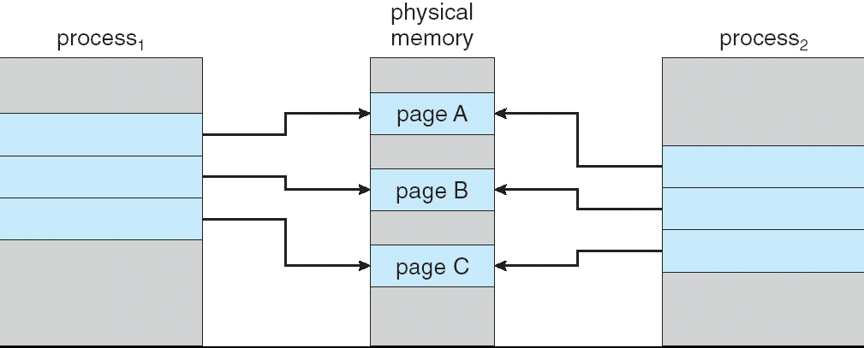
Copy-on-Write (2/2)
The shared pages are marked as copy-on-write pages.
  Meaning that if either process writes to a shared page, a copy of the shared page is created.
Copy-on-write is a common technique used by several operating system, including Windows XP, Linux, and Solaris.
If process1 tries to
modify page C …
Copy of C
Then modify its copied page.

Slide 19
Page Replacement – Basic (1/8)
With demand paging, we can over allocate memory!!
  To increase the degree of multiprogramming.
Assuming a process of ten pages generally uses half of them.
  Five pages are rarely used (loaded).
For a system with forty frames, we could run six processes (rather than four) with ten frames to spare.
However, it is possible that each of these process may suddenly try to use all ten of its pages.
  Resulting in a need for sixty frames when only forty are available.

Slide 20

Page Replacement – Basic (2/8)
Access M generate
a page fault
But .. over-allocated memory cannot
allocate free frame for the fault.

Slide 21
Page Replacement – Basic (3/8)
To solve the page fault:
  The operating system could terminate the process.
    A very bad idea. Paging should be logically transparent to the user.
  The operating system could swap out a process, freeing all its frames.
    Costly, and reduce the level of multiprogramming.
  The most common solution – page replacement.

Slide 22
Page Replacement – Basic (4/8)
Page-fault service routine including page replacement:
  Find the location of the desired page on the disk.
  Find a free frame:
    If there is a free frame, use it.
    If not, use a page-replacement algorithm to select a victim frame.
    Write the victim frame to the disk; change the page and frame tables accordingly.
  Read the desired page into the newly free frame; change he page and frame tables.
  Re-start the user process.

Slide 23

Page Replacement – Basic (5/8)

Slide 24
Page Replacement – Basic (6/8)
If no frames are free, two page transfer (one out and one in) are required.
  Double the page-fault service time!!
We can reduce the overhead by using a modify bit (or dirty bit).
  The modify bit for a page is set whenever any word or byte in the page is written into, since it was read in from the disk.
When we select a page for replacement, we examine its modify bit.
  If set, we must write that page to the disk.
  If not set, we need not write the page to the disk.

Slide 25
Page Replacement – Basic (7/8)
There are many page-replacement algorithms. How do we select a particular replacement algorithm?
  In general, we wan the one with the lowest page-fault rate.
We compute the number of page faults of an algorithm by running it on a string of memory references – reference string.
  The string can be generated artificially, or by tracing a given system.
We only consider the page number, rather than the specific address.
  If page p is valid, any reference to p will never cause a fault.
  So the following address sequence:
  0100, 0432, …, 0609, 0102.
  is reduced to the following reference string, at 100 bytes per page:
  1, 4, …, 6, 1

Slide 26

Page Replacement – Basic (8/8)
To calculate the number of page faults, we need to know the number of frames available.
Ideally, as the number of frames available increases, the number of page faults decreases.
  However, the assumption is not always true!!

Slide 27

FIFO Page Replacement (1/2)
A FIFO replacement algorithm (first-in, first-out) associates with each page the time when it was brought into memory.
When a page must be replaced, the oldest page is chosen.
Example – for a memory with three frames:
Three are 15 faults together.

Slide 28

FIFO Page Replacement (2/2)
The FIFO page-replacement algorithm is easy to understand and program.
However, its performance is not always good.
  The (oldest) page replaced may contain a variable that was initialized early and is in constant use.
Belady’s anomaly – for some page-replacement algorithms, the page-fault rate may increase as the number of allocated frames increases.
  Consider the following
  reference string:
  1,2,3,4,1,2,5,1,2,3,4,5

Slide 29

Optimal Page Replacement (1/2)
The optimal page-replacement algorithm (also known as OPT or MIN) replaces the page that will not be used for the longest period of time.
  It guarantees the lowest possible page-fault rate for a fixed number of frames.
Example:
To replace a page, we check the
next reference time of each page
Page 7 is replaced because
it will be referenced last.
Three are 9 faults together.

Slide 30
Optimal Page Replacement (2/2)
Unfortunately, the optimal page-replacement algorithm is difficult (impossible) to implement.
  It requires future knowledge of the reference string.
As a result, the algorithm is used mainly for comparison studies.

Slide 31
LRU Page Replacement (1/4)
Least-recently-used algorithm (LRU) - an approximation of the optimal algorithm.
If the recent past can be used as an approximation of the near future, we can replace the page that has not been used for the longest period of time.
The algorithm associates with each page the time of that page’s last use.
When a page must be replaced, LRU chooses the page that has not been used for the longest period of time.

Slide 32

LRU Page Replacement (2/4)
Example:
The LRU policy is often used as a page-replacement algorithm, and is considered to be good.
Three are 12 faults together.

Slide 33
LRU Page Replacement (3/4)
How to implement LRU replacement?
  Counter approach:
    Each page-table entry has a time-of-use field.
    CPU has a clock or counter (register).
      The clock is incremented for every memory reference.
    Whenever a reference to a page is made, the contents of the clock register are copied to the time-of-use field in the page-table entry for that page.
    In this way, we always have the time of the last reference to each page.
    We replace the page with the smallest time value.

Slide 34
LRU Page Replacement (4/4)
  Stack approach:
    Whenever a page is referenced, it is removed from the stack and put on the top.
    In this way, the least recently used page is always at the bottom of the stack.
    To remove entries from the middle of the stack, it is best to implement this approach by using a double linked list.
      The tail pointer points to the bottom of the stack.
LRU and optimal replacements do not suffer from Belady’s anomaly.
  They belong to a class of page-replacement algorithms, called stack algorithm.

Slide 35
LRU-Approximation Page Replacement (1/8)
Implementations of LRU require hardware support.
  If every memory reference calls a software to update the data structures (time-of-use field or stack), the reference will be very slow.
However, few computer systems provide sufficient hardware support to true LRU replacement.
Many systems provide help in the form of a reference bit.
  Which is the basis for many page-replacement algorithms that approximate LRU replacement.

Slide 36
LRU-Approximation Page Replacement (2/8)
Each entry in the page table has a reference bit.
Initially, all bits are cleared.
The reference bit is set whenever that page is referenced.
After some time, we can determine which pages have been used by examining the reference bits.
  Although we do not know the order of use.

Slide 37
LRU-Approximation Page Replacement (3/8)
Additional-reference-bits Algorithm:
  We can keep an 8-bit byte for each page in a table in memory.
  At regular intervals (e.g., 100 milliseconds), the operating system shifts the reference bit for each page into the high-order bit of its 8-bit byte.
  The 8-bit byte thus contains the history of page use for the least eight time periods.
reference bit
1 |  | 0 | 0 | 1 | 0 | 1 | 0 | 0 | 1
reset
0 |  | 1 | 0 | 0 | 1 | 0 | 1 | 0 | 0
discard

Slide 38
LRU-Approximation Page Replacement (4/8)
  If we interpret these 8-bit bytes as unsigned integers, the page with the lowest number is the LRU page.
  When there are more than one LRU page, we can either
    Replace all pages with the smallest value
    Use the FIFO method to choose among them.

Slide 39
LRU-Approximation Page Replacement (5/8)
Second-chance algorithm:
  Sometimes referred to as the clock algorithm.
  Is a variation of the FIFO replacement algorithm.
  When a page has been selected, we inspect its reference bit.
  If the value is 0, we proceed to replace this page.
  If the bit is set to 1, we give the page a second chance.
    And move on to select the next FIFO page.
    The reference bit of the second-chance page is cleared.
    And its arrival time is reset to the current time.
      That is, added to the end of the FIFO queue.
  So, if a page is used often enough, it will never be replaced!!

Slide 40

LRU-Approximation Page Replacement (6/8)
  A circular queue implementation of the second-chance algorithm.
When a frame is needed,
the pointer advances until
it finds a page with a 0
reference bit.
As it advances, it
clears the
reference bits.

Slide 41
LRU-Approximation Page Replacement (7/8)
  In the worst case, when all bits are set …
    The pointer cycles through the whole queue.
    It also clears all the reference bits.
    Then, the algorithm is identical to FIFO replacement.
Enhanced Second-Chance Algorithm:
  Consider one additional bit – the modify bit.
  With these two bits (reference bit and modify bit), each page is one of the following four possible classes:
    (0,0) neither recently used nor modified – best page to replace.
    (0,1) not recently used but modified – not quite as good, because the page will need to be written out before replacement.
    (1,0) recent used but clean – probably will be used again soon.
    (1,1) recently used and modified probably will be used again soon, and the page will be need to written out to disk before it can be replaced.

Slide 42
LRU-Approximation Page Replacement (8/8)
  When page replacement is called for, we examine the class to which that page belongs.
  We then replace the first page encountered in the lowest nonempty class.
  The major difference to the simpler clock algorithm:
    We give preference to those page that have been modified.
    To reduce the number of I/Os required.

Slide 43
Counting-Based Page Replacement (1/2)
We can keep a counter of the number of references that have been made to each page.
Least frequently used algorithm (LFU):
  The page with the smallest count will be replaced.
  However, if a page is used heavily during the initial phase but is never used again … it will remain in memory even though it is no longer needed.
    One solution is to shift the counters right by 1 bit at regular intervals.

Slide 44
Counting-Based Page Replacement (2/2)
Most frequent used algorithm (MFU):
  Assume that the page with the smallest count was probably just brought in.
  And has yet to be used.
Generally, MFU and LFU do not approximate OPT replacement well.

Slide 45
Page-Buffering Algorithms (1/3)
Also know as free-frame-buffering algorithms.
Usually conjunct with other replacement algorithms.
Systems commonly keep a pool of free frames.
When a page fault occurs, a victim frame is chosen (by using a replacement algorithm).
Before the victim is written out, the desired page is read into a free frame from the pool.
  Without waiting the victim page to be written out.
  We can re-start the process as soon as possible.
  The victim page is later written out and its frame is added to the free-frame pool.

Slide 46
Page-Buffering Algorithms (2/3)
An expansion is to maintain a list of modified pages.
Whenever the paging device is idle, a modified page is selected as is written to the disk.
  Its modify bit is then reset.
Can increase the probability that a page will be clean when it is selected for replacement.
  No written out.

Slide 47
Page-Buffering Algorithms (3/3)
Keep a pool of free frames but to remember which page was in each frame.
When a page fault occurs, we first check whether the desired page is in the free-frame pool.
  If it is, the old page can be reused directly from the pool.
    No I/O is needed.
In some versions of UNIX system, this method is conjunct with the second-chance algorithm.
  To reduce the penalty incurred if the wrong victim page is selected.

Slide 48
Allocation of Frames (1/6)
If we have multiple processes in memory, we must decide how many frames to allocate to each process.
The simplest case – the single-user system:
  A system with 128 frames.
  The operating system may take 35 frames.
  Leaving 93 frames for the user process.
  Initially, all 93 frames would be put on the free-frame list.
  The first 93 page faults would all get free frames from the free-frame list.
  When the free-frame list was exhausted, a page-replacement would be functioned.
  When the process terminated, the 93 frames would be placed on the free-frame list.

Slide 49
Allocation of Frames (2/6)
There are many variations on the simple allocation strategy.
Many strategies require the knowledge of minimum number of frames.
  The number of frames that a single instruction can reference.
  This minimum number is defined by the computer architecture.
  For example – a system in which all memory-reference instructions have only one memory address.
    We need one frame for the instruction and one frame for the memory reference.
    Moreover, if one-level indirect addressing is allowed (e.g., pointers), then paging requires at least three frames per process.
    What might happen if a process had only two frames? (thrashing)

Slide 50
Allocation of Frames – Algorithms (3/6)
Equal allocation scheme:
  The easiest way to split m frames among n processes is to give everyone an equal share, m / n frames.
  For example – there are 93 frames and five processes.
    Each process will get 18 frames.
    The leftover three frames can be used as a free-frame buffer pool.
  However … various processes will need differing amount of memory.
    If a small student process only requires 2 frames, the other 16 frames are wasted!!

Slide 51
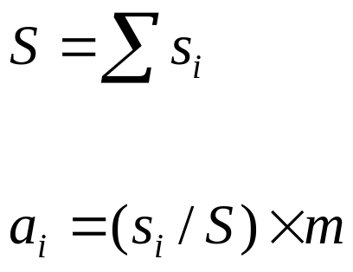
Allocation of Frames – Algorithms (4/6)
Proportional allocation scheme:
  We allocate available memory to each process according to its size.
  We must adjust each a_{i} to be an integer that is greater than the minimum number of frames required by the instruction set.
The size of virtual memory for process p_{i}.
The total number of frames
The frames to p_{i}

Slide 52
Allocation of Frames – Algorithms (5/6)
In both schemes, the allocation may vary according to the multiprogramming level.
  The frames that were allocated to the departed process can be spread over the remaining process.
The priority of process can be a factor of frame allocation.
  We may give the high-priority process more memory to speed its execution.
  One solution is to use a proportional allocation scheme wherein the ratio of frames depends on the a combination of size and priority.

Slide 53
Allocation of Frames – Global vs Local Replacement (6/6)
Frame allocation is related to the way of page replacement.
We can classify page-replacement algorithm into two categories:
  Global replacement:
    Allow a process to select a replacement frame from the frames currently allocated to some other process.
    For example – high-priority processes to select from low-priority processes for replacement.
    The number of frames allocated to a process can change.
    More adaptive, thus generally result in greater system performance.
  Local replacement:
    Each process selects from only its own set of allocated frame for replacement.
    The number of frames allocated to a process does not change.

Slide 54
Thrashing (1/12)
Thrashing – a process is spending more time paging than executing.
For example:
  If a process does not have the number of frames it needs, it will quickly page-fault.
  It must replace some page. however … all its pages are in active use.
  The replaced page will be needed again right away.
  Consequently, it quickly faults again, and aging, and again …

Slide 55
Thrashing (2/12)
Another thrashing example – a global page-replacement system:
  Suppose that a process enters a new phase in its execution and needs more frames.
  It starts faulting and taking frames away from other processes.
  However, these processes need those page. So, they also fault and take frames from other processes.
  As a result, the paging device (disk) will queue a lot of paging requests.
  And the ready queue would be empty.
  The system sees the decreasing CPU utilization and increase the degree of multiprogramming.
  Not enough memory for the new processes will cause more page faults and a longer queue for the paging device.
  CPU utilization drops even further!!!!!
    And the system tries to increase the degree of multiprogramming even more …

Slide 56

Thrashing (3/12)
At this point, we must decrease
the degree of multiprogramming.

Slide 57
Thrashing (4/12)
We can limit the effects of thrashing by using a local replacement algorithm.
  If one process starts thrashing, it cannot steal frames from another process can cause the later to thrash as well.
  However … the queue of the paging device will contain a lot of requests (from the thrashing processes).
  The service time for a page fault of a non-thrashing process will also increase.
To prevent thrashing, we must provide a process with as many frames as it needs.

Slide 58
Thrashing (5/12)
But …how do we know how many frames a process needs?
Process’s memory references generally exhibit locality patterns, or locality model.
A locality is a set of pages that are actively used together.
  For example, the locality of a function call consists of the memory references of the function instructions, its local variables, and a subset of the global variables.
The locality model states that, as a process executes, it moves from locality to locality.

Slide 59

Thrashing (6/12)

Slide 60
Thrashing – Working-Set Model (7/12)
If we allocate fewer frames than the size of the current locality …
  The process will thrash!!
Based on the locality model, the working-set strategy tries to identify how many frames a process is actually using.
The method uses a parameter, ∆, to define the working-set window.
  The idea is to examine the most recent page references.
  The set of page in the most recent ∆ page references is the working set.

Slide 61

Thrashing – Working-Set Model (8/12)
Examples of working set:
  If a page (e.g., page 1) is no longer being used, it will drop from the working set.
  Thus, the working set is an approximation of the program’s locality!!

Slide 62
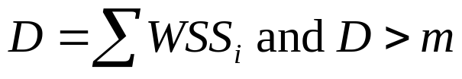
Thrashing – Working-Set Model (9/12)
The working-set model:
  Select the value of ∆.
  Monitor the working set of each process and allocate to that working set enough frames.
  If there are enough extra frames, another process can be initiated.
  If the sum of the working-set sizes exceeds the total number of frames … that is,
    The operating system selects a process to suspend.
    The process’s pages are swapped and reallocated to other processes.
The size of working set i
The total number of frames

Slide 63
Thrashing – Working-Set Model (10/12)
The working-set model prevents thrashing while keeping the degree of multiprogramming as high as possible.
  It thus optimizes CPU utilization!!
The difficulties of the model:
  Accurately keep track the current working set.
    The selection of ∆.
      Too large → overlap several localities.
      Too small → can not encompass the entire locality.

Slide 64

Thrashing – Page-Fault Frequency (11/12)
A thrashing process has a high page-fault rate.
To prevent it, we want to control the page-fault rate.
  When it is too high, we know that the process needs more frames.
  If the rate is too low, then the process may have too many frames.
We can establish upper and
lower bounds on the page-fault rate.

Slide 65
Thrashing – Page-Fault Frequency (12/12)
As with the working-set strategy, we may have to suspend a process.
  When the page-fault rate of the process increases and no free frames are available.
  The freed frames from the suspended process are then distributed to processes with high page-fault rates.

Slide 66
Memory-Mapped Files (1/4)
File accesses require system call (open(), read(), and write()) and disk operations.
The mechanism of memory-mapped files allow a port of the virtual address space to be logically associated with a file.
It maps a disk block to a page (or pages) in memory.
Initial access to the file would result in a page fault.
  A page-sized portion of the file is read into a physical page.
Subsequent reads and writes to the file are handled as memory accesses.
  Thus can decrease the overhead of using the read() and write() system calls.

Slide 67
Memory-Mapped Files (2/4)
Writes to the file mapped in memory are not necessarily immediate writes to the file on disk.
  The operating system periodically checks whether the page in memory has been modified to update physical file.
When the file is closed …
  All the memory-mapped data are written back to disk.
  And removed from the virtual memory of the process.
Some operating systems provide memory mapping only through a specific system call.
Some systems, e.g., Solaris, treat all file I/O as memory-mapped, allowing file access to take place via the efficient memory subsystem.

Slide 68

Memory-Mapped Files (3/4)
Multiple processes may be allowed to map the same file concurrently.
Each sharing process points
to the same page of physical
memory – the page that holds
a copy of the disk block.

Slide 69
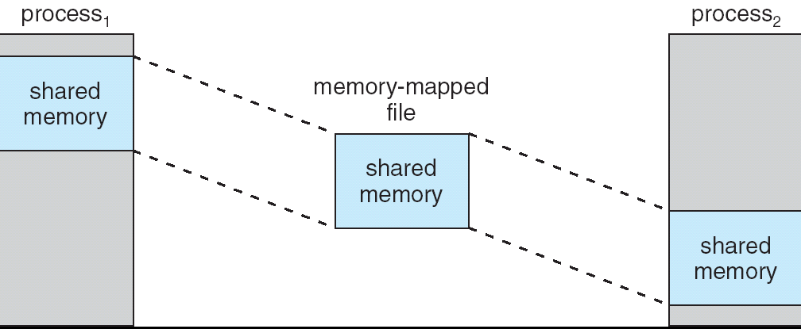
Memory-Mapped Files (4/4)
On Windows NT, 2000, and XP systems, shared memory (IPC) is accomplished by memory mapping files.
The memory-mapped file serves as the
region of shared memory between the
communicating processes.

Slide 70
Shared Memory in the Win32 API (1/8)
To establish a memory-mapped file, a process (producer) first opens the file to be mapped with the CreateFile() function.
#include <windows.h>
#include <stdio.h>
int main(int argc, char *argv[])
{
HANDLE hFile, hMapFile;
LPVOID mapAddress;
// first create/open the file
hFile = CreateFile("temp.txt",
GENERIC_READ | GENERIC_WRITE,
0,
NULL,
OPEN_ALWAYS,
FILE_ATTRIBUTE_NORMAL,
NULL);
if (hFile == INVALID_HANDLE_VALUE) {
fprintf(stderr,"Could not open file temp.txt (%d).\n",GetLastError());
return -1;
}
Producer
file name
no sharing
read/write access
default
security
open new or existing file

Slide 71
Shared Memory in the Win32 API (2/8)
Producer then creates a mapping of this file (HANDLE) using the CreateFileMapping() function.
// now obtain a mapping for it
hMapFile = CreateFileMapping(hFile,
NULL,
PAGE_READWRITE,
0,
0,
TEXT("SharedObject"));
if (hMapFile == NULL) {
fprintf(stderr,"Could not create mapping (%d).\n", GetLastError());
return -1;
}
file handle
default
security
read/write access to mapped pages
map entire
file
named shared memory object,
used by other communicating processes

Slide 72
Shared Memory in the Win32 API (3/8)
The process then establishes a view of the mapped file in its virtual address space with the MapViewOfFile() function.
// now establish a mapped viewing of the file
mapAddress = MapViewOfFile(hMapFile,
FILE_MAP_ALL_ACCESS,
0,
0,
0);
if(mapAddress == NULL) {
printf("Could not map view of file (%d).\n", GetLastError());
return -1;
}
mapped object handle
read/write access
mapped view of entire file
Return a pointer to the starting address of the mapped view

Slide 73
Shared Memory in the Win32 API (4/8)
The producer process writes the message “Shared memory message” to shared memory.
Finally, the process removes the view of the mapped file and the handles.
// write to shared memory
sprintf(mapAddress,"%s","Shared memory message");
while (1);
// remove the file mapping
UnmapViewOfFile(mapAddress);
// close all handles
CloseHandle(hMapFile);
CloseHandle(hFile);
}

Slide 74
Shared Memory in the Win32 API (5/8)
The consumer process first creates (opens) a mapping to the existing named shared-memory object.
#include <stdio.h>
#include <windows.h>
int main(int argc, char *argv[]) {
HANDLE hMapFile;
LPVOID lpMapAddress;
hMapFile = OpenFileMapping(FILE_MAP_ALL_ACCESS,
FALSE,
TEXT("SharedObject"));
if (hMapFile == NULL) {
printf("Could not open file mapping object (%d).\n",
GetLastError());
return -1;
}
Consumer
R/W access
no
inheritance
name of mapped file object

Slide 75
Shared Memory in the Win32 API (6/8)
The consumer process must also create a view of the mapped file.
lpMapAddress = MapViewOfFile(hMapFile,
FILE_MAP_ALL_ACCESS,
0,
0,
0);
if (lpMapAddress == NULL) {
printf("Could not map view of file (%d).\n", GetLastError());
return -1;
}

Slide 76
Shared Memory in the Win32 API (7/8)
The process then reads from shared memory the message “Shared memory message” that was written by the producer process.
Finally, close the mapping and handle.
printf("%s\n",lpMapAddress);
UnmapViewOfFile(lpMapAddress);
CloseHandle(hMapFile);
}

Slide 77
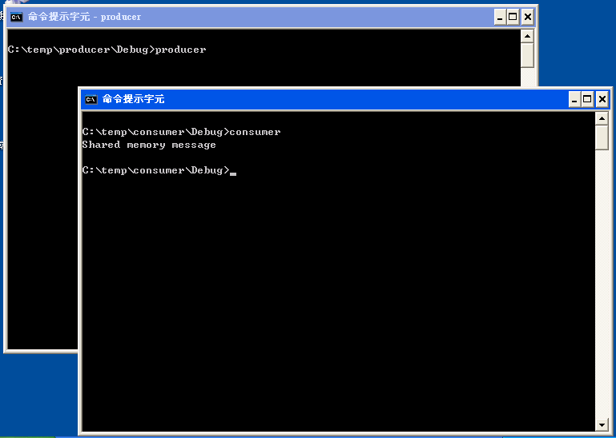
Shared Memory in the Win32 API (8/8)

Slide 78
Other Issues and Considerations
Allocating kernel memory.
Pre-paging.
Page size.
…

Slide 79
End of Chapter 9

