Slide 1
JSUB READ
…
READ LDX ZERO
RLOOP TD INDEV
JEQ RLOOP
RD INDEV
STCH RECORD,X
TIX K100
JLT RLOOP
RSUB
INDEV BYTE X’F1’
RECORD RESB 100
ZERO WORD 0
K100 WORD 100

Slide 2
JSUB READ
………
READ LDX #0
LDT #100
RLOOP TD INDEV
JEQ RLOOP
RD INDEV
STCH RECORD,X
TIXR T
JLT RLOOP
RSUB
INDEV BYTE X’F’
RECORD RESB 100
Chap 2

Slide 3
Assemblers
System Software
by Leland L. Beck
Chapter 2

Slide 4
Role of Assembler
Assembler
Object
Code
Linker
Source
Program
Executable
Code
Loader
Chap 2

Slide 5
Chapter 2 -- Outline
Basic Assembler Functions
Machine-dependent Assembler Features
Machine-independent Assembler Features
Assembler Design Options
Chap 2

Slide 6
Introduction to Assemblers
Fundamental functions
  translating mnemonic operation codes to their machine language equivalents
  assigning machine addresses to symbolic labels
Machine dependency
  different machine instruction formats and codes
Chap 2

Slide 7
BASIC ASSEMBLER FUNCTIONS
Line numbers are for reference only and are not part of the program
Lines beginning with . Are comment lines
Index addressing→x
Along with mnemonic machine instructions,we use assembler directives.
Chap 2

Slide 8
Copy start 1000
First STL RETADR
CLOOP JSUB RDREC
LDA LENGTH
COMP ZERO
JEQ ENDFIL
JSUB WRREC
J CLOOP
ENDFIL LDA EOF
STA BUFFER
LDA THREE
STA LENGTH
JSUB WRREC
LDL RETADR
RSUB
EOF BYTE C’EOF’
THREE WORD 3
ZERO WORD 0
Chap 2

Slide 9
RETADR RESW 1
LENGTH RESW 1
BUFFER RESB 4096
SUBROUTINE TO READ RECORD INTO BUFFER
RDREC LDX ZERO
LDA ZERO
RLOOP TD INPUT
JEQ RLOOP
RD INPUT
COMP ZERO
JEQ EXIT
STCH BUFFER,X
TIX MAXLEN
JLT RLOOP
EXIT STX LENGTH
RSUB
INPUT BYTE X’F1’
MAXLEN WORD 4096
Chap 2

Slide 10
SUBROUTINE TO WRITE RECORD FROM BUFFER
WRREC LDX ZERO
WLOOP TD OUTPUT
JEQ WLOOP
LDCH BUFFER,X
WD OUTPUT
TIX LENGTH
JLT WLOOP
RSUB
OUTPUT BYTE X’05’
END FIRST
Chap 2

Slide 11
Example Program
Purpose
  reads records from input device (code F1)
  copies them to output device (code 05)
  at the end of the file, writes EOF on the output device, then RSUB to the operating system
  program
Chap 2

Slide 12
Example Program (Fig. 2.1)
Data transfer (RD, WD)
  a buffer is used to store record
  buffering is necessary for different I/O rates
  the end of each record is marked with a null character (00₁₆)
  the end of the file is indicated by a zero-length record
Subroutines (JSUB, RSUB)
  RDREC, WRREC
  save link register first before nested jump
Chap 2

Slide 13
Assembler Directives
Pseudo-Instructions
  Not translated into machine instructions
  Providing information to the assembler
Basic assembler directives
  START: SPECIFY NAME AND STARTING address for the program
  END: end of the program & specify first executable instruction
  BYTE: generate character or hexadecimal constant
  WORD: generate one word integer constant
  RESB : reserve indicated no of bytes
  RESW : reserve indicated no of words
Chap 2

Slide 14
1000 copy start 1000
1000 First STL RETADR 141033
1003 CLOOP JSUB RDREC 482039
1006 LDA LENGTH 001036
1009 COMP ZERO 281030
100C JEQ ENDFIL 301015
100F JSUB WRREC 482061
1012 J CLOOP 3C1003
1015 ENDFIL LDA EOF 00102A
1018 STA BUFFER 0C1039
101B LDA THREE 00102D
101E STA LENGTH 0C1036
1021 JSUB WRREC 482061
1024 LDL RETADR 081033
1027 RSUB 4C0000
102A EOF BYTE C’EOF’ 454F46
102D THREE WORD 3 000003
1030 ZERO WORD 0 000000
Chap 2

Slide 15
1033 RETADR RESW 1
1036 LENGTH RESW 1
1039 BUFFER RESB 4096
SUBROUTINE TO READ RECORD INTO BUFFER
2039 RDREC LDX ZERO 041030
203C LDA ZERO 001030
203F RLOOP TD INPUT E0205D
2042 JEQ RLOOP 30203F
2045 RD INPUT D8205D
2048 COMP ZERO 281030
204B JEQ EXIT 302057
204E STCH BUFFER,X 549039
2051 TIX MAXLEN 2C205E
2054 JLT RLOOP 38203F
2057 EXIT STX LENGTH 101036
205A RSUB 4C0000
205D INPUT BYTE X’F1’ F1
205E MAXLEN WORD 4096 001000
Chap 2

Slide 16
SUBROUTINE TO WRITE RECORD FROM BUFFER
2061 WRREC LDX ZERO 041030
2064 WLOOP TD OUTPUT E02079
2067 JEQ WLOOP 302064
206A LDCH BUFFER,X 509039
206D WD OUTPUT DC2079
2070 TIX LENGTH 2C1036
2073 JLT WLOOP 382064
2076 RSUB 4C0000
2079 OUTPUT BYTE X’05’ 05
END FIRST
Chap 2

Slide 17
Object Program
Header
  Col. 1 H
  Col. 2~7 Program name
  Col. 8~13 Starting address (hex)
  Col. 14-19 Length of object program in bytes (hex)
Text
  Col.1 T
  Col.2~7 Starting address in this record (hex)
  Col. 8~9 Length of object code in this record in bytes (hex)
  Col. 10~69 Object code (69-10+1)/6=10 instructions
End
  Col.1 E
  Col.2~7 Address of first executable instruction (hex)
  (END program_name)
Chap 2

Slide 18
Fig. 2.3
H COPY 001000 00107A
T 001000 1E 141033 482039 001036 281030 301015 482061 ...
T 00101E 15 0C1036 482061 081044 4C0000 454F46 000003 000000
T 002039 1E 041030 001030 E0205D 30203F D8205D 281030 …
T 002057 1C 101036 4C0000 F1 001000 041030 E02079 302064 …
T 002073 07 382064 4C0000 05
E 001000
Chap 2

Slide 19
Assembler’s functions
Convert mnemonic operation codes to their machine language equivalents
Convert symbolic operands to their equivalent machine addresses ✓
Build the machine instructions in the proper format
Convert the data constants to internal machine representations
Write the object program and the assembly listing
Break...
Chap 2

Slide 20
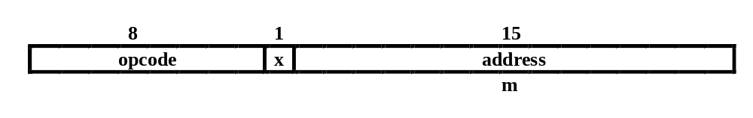
Example of Instruction Assemble
STCH BUFFER,X
549039
Forward reference
(54)₁₆ 1 (001)₂ (039)₁₆
Chap 2

Slide 21
Difficulties: Forward Reference
Forward reference: reference to a label that is defined later in the program.
Loc Label Operator Operand
1000 FIRST STL RETADR
1003 CLOOP JSUB RDREC
… … … … …
1012 J CLOOP
… … … … …
1033 RETADR RESW 1
Chap 2

Slide 22
Two Pass Assembler
Pass 1
  Assign addresses to all statements in the program
  Save the values assigned to all labels for use in Pass 2
  Perform some processing of assembler directives
Pass 2
  Assemble instructions
  Generate data values defined by BYTE, WORD
  Perform processing of assembler directives not done in Pass 1
  Write the object program and the assembly listing
Chap 2

Slide 23
Two Pass Assembler
Read from input line
  LABEL, OPCODE, OPERAND
Source
program
Intermediate
file
Object
codes
Pass 1
Pass 2
OPTAB
SYMTAB
SYMTAB
Chap 2

Slide 24
Data Structures
Operation Code Table (OPTAB)
Symbol Table (SYMTAB)
Location Counter(LOCCTR)
Chap 2

Slide 25
OPTAB (operation code table)
Content
  menmonic, machine code (instruction format, length) etc.
Characteristic
  static table
Implementation
  array or hash table, easy for search
Chap 2

Slide 26
SYMTAB (symbol table)
Content
  label name, value, flag, (type, length) etc.
Characteristic
  dynamic table (insert, delete, search)
Implementation
  hash table, non-random keys, hashing function
COPY 1000
FIRST 1000
CLOOP 1003
ENDFIL 1015
EOF 1024
THREE 102D
ZERO 1030
RETADR 1033
LENGTH 1036
BUFFER 1039
RDREC 2039
Chap 2

Slide 27
Homework #3
SUM START 4000
FIRST LDX ZERO
LDA ZERO
LOOP ADD TABLE,X
TIX COUNT
JLT LOOP
STA TOTAL
RSUB
TABLE RESW 2000
COUNT RESW 1
ZERO WORD 0
TOTAL RESW 1
END FIRST
End of Sec 2-1
Chap 2

Slide 28
PASS 1:
Begin
read first input line
if opcode=‘START’ then
begin
save #[OPERAND] as starting address
initialize LOCCTR to starting address
write line to intermediate file
read next input line
end{if start}
else
initialize LOCCTR to 0
While OPCODE ≠ ‘END’ do
begin
if this is not a comment line then
begin
if there is a symbol in the LABEL field then
Chap 2

Slide 29
begin
search SYMTAB for label
if found then
set error flag (duplicate symbol)
else
insert (LABEL,LOCCTR) into SYMTAB
end { if symbol}
search OPTAB for opcode
If found then
add 3 to LOCCTR
Else if opcode=‘WORD’ then
add 3 to LOCCTR
Else if opcode=‘RESW’then
add 3* #[OPERAND] to LOCCTR
Else if opcode=‘RESB’then
add #[OPERAND] to LOCCTR
Else if opcode=‘BYTE’then
Chap 2

Slide 30
Begin
find length of constant in bytes
Add length to LOCCTR
End {if byte}
Else
Set error flag (invalid operation code)
End{ if not a comment}
Write line to intermediate file
Read next input line
End( While not end)
Write last line to intermediate file
Save(LOCCTR-STARTING ADDRESS) as program length
End {PASS 1}
Chap 2

Slide 31
Pass 2
Begin
read first input line { from intermediate file}
if OPCODE=“START’ then
begin
write listing line
read next input line
end {if start}
Write header record to object program
Initialize first text record
While OPCODE≠ ‘END’ do
begin
if this is not a comment line then
begin
search OPTAB for opcode
if found then
begin
if there is a symbol in OPERAND field then
Chap 2

Slide 32
Begin
search symtab for OPERAND
if found then
store symbol value as operand address
else
begin
store 0 as operand address
set error flag {undefined symbol}
end
End { if symbol}
Else
store 0 as operand address
assemble the object code instruction
End { if opcode found}
Else if OPCODE=‘byte’or ‘word’ then
convert the constant to object code
Chap 2

Slide 33
If object code does not fit in the current text record then
Begin
write text record to object program
initialize new text record
End
Add object code to text record
End { if not comment}
Write listing line
Read next input line
End {while not end}
Write last text record to object program
Write end record to object program
Write last listing line
End {pass 2}
Chap 2

Slide 34
Assembler Design
Machine Dependent Assembler Features
  instruction formats and addressing modes
  program relocation
Machine Independent Assembler Features
  literals
  symbol-defining statements
  expressions
  program blocks
  control sections and program linking
Chap 2

Slide 35
0000 COPY START 0
0000 FIRST STL RETADR 17202D
0003 LDB #LENGTH 69202D
BASE LENGTH
0006 CLOOP +JSUB RDREC 4B101036
000A LDA LENGTH 032026
000D COMP #0 290000
0010 JEQ ENDFIL 332007
0013 +JSUB WRREC 4B10105D
0017 J CLOOP 3F2FEC
001A ENDFIL LDA EOF 032010
001D STA BUFFER 0F2016
0020 LDA #3 010003
0023 STA LENGTH 0F200D
0026 +JSUB WRREC 4B10105D
002A J @RETADR 3E2003
002D EOF BYTE C’EOF’ 454F46
Chap 2

Slide 36
0030 RETADR RESW 1
0033 LENGTH RESW 1
0036 BUFFER RESB 4096
1036 RDREC CLEAR X B410
1038 CLEAR A B400
103A CLEAR S B440
103C +LDT #4096 75101000
1040 RLOOP TD INPUT E32019
1043 JEQ RLOOP 332FFA
1046 RD INPUT DB2013
1049 COMPR A,S A004
104B JEQ EXIT 332008
104E STCH BUFFER,X 57C003
1051 TIXR T B850
1053 JLT RLOOP 3B2FEA
1056 EXIT STX LENGTH 134000
Chap 2

Slide 37
1059 RSUB 4F0000
105C INPUT BYTE X’F1’ F1
105D WRREC CLEAR X B410
105F LDT LENGTH 774000
1062 WLOOP TD OUTPUT E32011
1065 JEQ WLOOP 332FFA
1068 LDCH BUFFER,X 53C003
106B WD OUTPUT DF2008
106E TIXR T B850
1070 JLT WLOOP 3B2FEF
1073 RSUB 4F0000
1076 OUTPUTBYTE X’05’ 05
END FIRST
Chap 2

Slide 38
Machine-dependent
Assembler Features
Sec. 2-2
Instruction formats and addressing modes
Program relocation

Slide 39
Instruction Format and Addressing Mode
SIC/XE
  PC-relative or Base-relative addressing: op m
  Indirect addressing: op @m
  Immediate addressing: op #c
  Extended format: +op m
  Index addressing: op m,x
  register-to-register instructions
Example program
Chap 2

Slide 40
Translation
Register translation
  register name (A, X, L, B, S, T, F, PC, SW) and their values (0,1, 2, 3, 4, 5, 6, 8, 9)
  preloaded in SYMTAB
Address translation
  Most register-memory instructions use program counter relative or base relative addressing
  Format 3: 12-bit address field
    base-relative: 0~4095
    pc-relative: -2048~2047
  Format 4: 20-bit address field
Chap 2

Slide 41
PC-Relative Addressing Modes
PC-relative
  10 0000 FIRST STL RETADR 17202D
  (14)₁₆ 1 1 0 0 1 0 (02D) ₁₆
    displacement= RETADR - PC = 30-3 = 2D
  40 0017 J CLOOP 3F2FEC
    (3C)₁₆ 1 1 0 0 1 0 (FEC) ₁₆
    displacement= CLOOP-PC= 6 - 1A= -14= FEC
Chap 2

Slide 42
Base-Relative Addressing Modes
Base-relative
  base register is under the control of the programmer
  12 LDB #LENGTH
  13 BASE LENGTH
  160 104E STCH BUFFER, X 57C003
  ( 54 )₁₆ 1 1 1 1 0 0 ( 003 ) ₁₆
  (54) 1 1 1 0 1 0 0036-1051= -101B₁₆
    displacement= BUFFER - B = 0036 - 0033 = 3
  NOBASE is used to inform the assembler that the contents of the base register no longer be relied upon for addressing
Chap 2

Slide 43
Immediate Address Translation
Immediate addressing
  55 0020 LDA #3 010003
  ( 00 )₁₆ 0 1 0 0 0 0 ( 003 ) ₁₆
  133 103C +LDT #4096 75101000
  ( 74 )₁₆ 0 1 0 0 0 1 ( 01000 ) ₁₆
Chap 2

Slide 44
Immediate Address Translation (Cont.)
Immediate addressing
  12 0003 LDB #LENGTH 69202D
  ( 68)₁₆ 0 1 0 0 1 0 ( 02D ) ₁₆
  ( 68)₁₆ 0 1 0 0 0 0 ( 033)₁₆ 690033
    the immediate operand is the symbol LENGTH
    the address of this symbol LENGTH is loaded into register B
    LENGTH=0033=PC+displacement=0006+02D
    if immediate mode is specified, the target address becomes the operand
Chap 2

Slide 45
Indirect Address Translation
Indirect addressing
  target addressing is computed as usual (PC-relative or BASE-relative)
  only the n bit is set to 1
  70 002A J @RETADR 3E2003
  ( 3C )₁₆ 1 0 0 0 1 0 ( 003 ) ₁₆
    TA=RETADR=0030
    TA=(PC)+disp=002D+0003
Chap 2

Slide 46
Program Relocation
Example Fig. 2.1
  Absolute program, starting address 1000
  e.g. 55 101B LDA THREE 00102D
  Relocate the program to 2000
  e.g. 55 101B LDA THREE 00202D
  Each Absolute address should be modified
Example Fig. 2.5:
  Except for absolute address, the rest of the instructions need not be modified
    not a memory address (immediate addressing)
    PC-relative, Base-relative
  The only parts of the program that require modification at load time are those that specify direct addresses
Chap 2

Slide 47
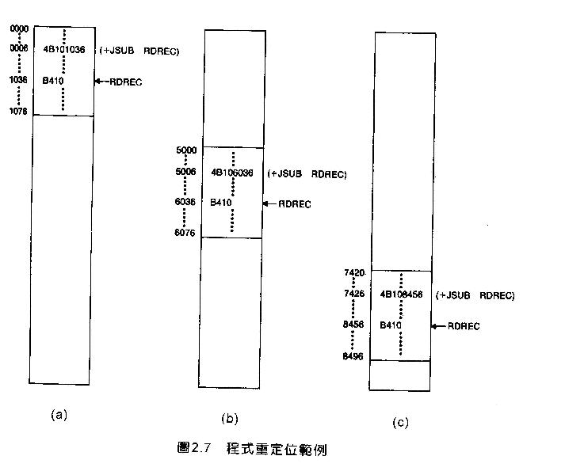
Example
Chap 2

Slide 48
Relocatable Program
Modification record
  Col 1 M
  Col 2-7 Starting location of the address field to be
  modified, relative to the beginning of the program
  Col 8-9 length of the address field to be modified, in half-
  bytes
Chap 2

Slide 49
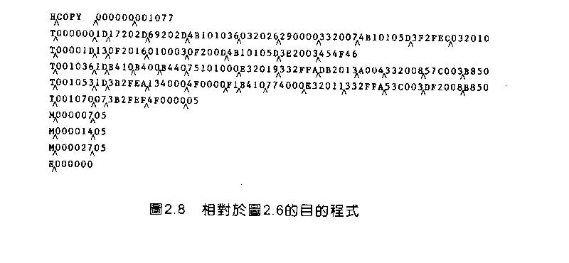
Object Code
End of Sec 2-2
Chap 2

Slide 50
Relocation problem can be solved in the following way
When the assembler generates the object code for the JSUB instruction,it will insert the address relative to the start of the program
the assembler will also produce a command for the loader,instructing it to add the beginning address of the program to the address field in the JSUB instruction at load time
Chap 2

Slide 51
Machine-Independent Assembler Features
Literals
Symbol Defining Statement
Expressions
Program Blocks
Control Sections and Program Linking

Slide 52
Literals
Design idea
  Let programmers to be able to write the value of a constant operand as a part of the instruction that uses it.
  This avoids having to define the constant elsewhere in the program and make up a label for it.
Example
  e.g. 45 001A ENDFIL LDA =C’EOF’ 032010
  93 LTORG
  002D * =C’EOF’ 454F46
  e.g. 215 1062 WLOOP TD =X’05’ E32011
Chap 2

Slide 53
0000 COPY START 0
0000 FIRST STL RETADR 17202D
0003 LDB #LENGTH 69202D
BASE LENGTH
0006 CLOOP +JSUB RDREC 4B101036
000A LDA LENGTH 032026
000D COMP #0 290000
0010 JEQ ENDFIL 332007
0013 +JSUB WRREC 4B10105D
0017 J CLOOP 3F2FEC
001A ENDFIL LDA =C’EOF’ 032010
001D STA BUFFER 0F2016
0020 LDA #3 010003
0023 STA LENGTH 0F200D
0026 +JSUB WRREC 4B10105D
002A J @RETADR 3E2003
LTORG
002D * =C’EOF’ 454F46
Chap 2

Slide 54
0030 RETADR RESW 1
0033 LENGTH RESW 1
0036 BUFFER RESB 4096
1036 BUFEND EQU *
1000 MAXLEN EQU BUFEND-BUFFER
1036 RDREC CLEAR X B410
1038 CLEAR A B400
103A CLEAR S B440
103C +LDT #MAXLEN 75101000
1040 RLOOP TD INPUT E32019
1043 JEQ RLOOP 332FFA
1046 RD INPUT DB2013
1049 COMPR A,S A004
104B JEQ EXIT 332008
104E STCH BUFFER,X 57C003
1051 TIXR T B850
1053 JLT RLOOP 3B2FEA
1056 EXIT STX LENGTH 134000
Chap 2

Slide 55
1059 RSUB 4F0000
105C INPUT BYTE X’F1’ F1
105D WRREC CLEAR X B410
105F LDT LENGTH 774000
1062 WLOOP TD =X’05’ E32011
1065 JEQ WLOOP 332FFA
1068 LDCH BUFFER,X 53C003
106B WD =X’05’ DF2008
106E TIXR T B850
1070 JLT WLOOP 3B2FEF
1073 RSUB 4F0000
END FIRST
1076 * =X’05’ 05
Chap 2

Slide 56
Literals vs. Immediate Operands
Immediate Operands
  The operand value is assembled as part of the machine instruction
  e.g. 55 0020 LDA #3 010003
Literals
  The assembler generates the specified value as a constant at some other memory location
  e.g. 45 001A ENDFIL LDA =C’EOF’ 032010
Compare (Fig. 2.6)
  e.g. 45 001A ENDFIL LDA EOF 032010
  80 002D EOF BYTE C’EOF’ 454F46
Chap 2

Slide 57
Literal - Implementation (1/3)
Literal pools
  Normally literals are placed into a pool at the end of the program
    see Fig. 2.10 (END statement)
  In some cases, it is desirable to place literals into a pool at some other location in the object program
    assembler directive LTORG
    reason: keep the literal operand close to the instruction
Chap 2

Slide 58
Literal - Implementation (2/3)
Duplicate literals
  e.g. 215 1062 WLOOP TD =X’05’
  e.g. 230 106B WD =X’05’
  The assemblers should recognize duplicate literals and store only one copy of the specified data value
    Comparison of the defining expression
      Same literal name with different value, e.g. LOCCTR=*
    Comparison of the generated data value
      The benefits of using generate data value are usually not great enough to justify the additional complexity in the assembler
Chap 2

Slide 59
Literal - Implementation (3/3)
LITTAB
  literal name, the operand value and length, the address assigned to the operand
Pass 1
  build LITTAB with literal name, operand value and length, leaving the address unassigned
  when LTORG statement is encountered, assign an address to each literal not yet assigned an address
Pass 2
  search LITTAB for each literal operand encountered
  generate data values using BYTE or WORD statements
  generate modification record for literals that represent an address in the program
Chap 2

Slide 60
Symbol-Defining Statements
Labels on instructions or data areas
  the value of such a label is the address assigned to the statement
Defining symbols
  symbol EQU value
  value can be:  constant,  other symbol,  expression
  making the source program easier to understand
  no forward reference
Chap 2

Slide 61
Symbol-Defining Statements
Example 1
  MAXLEN EQU 4096
  +LDT #MAXLEN
Example 2 (Many general purpose registers)
  BASE EQU R1
  COUNT EQU R2
  INDEX EQU R3
Example 3
  MAXLEN EQU BUFEND-BUFFER
  +LDT #4096
Chap 2

Slide 62
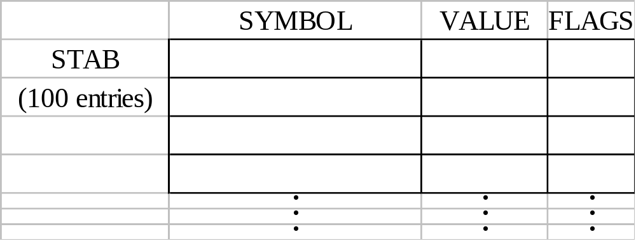
ORG (origin)
Indirectly assign values to symbols
Reset the location counter to the specified value
    ORG value
Value can be:  constant,  other symbol,  expression
No forward reference
Example
  SYMBOL: 6bytes
  VALUE: 1word
  FLAGS: 2bytes
  LDA VALUE, X
Chap 2

Slide 63
ORG Example
Using EQU statements
  STAB RESB 1100
  SYMBOL EQU STAB
  VALUE EQU STAB+6
  FLAG EQU STAB+9
Using ORG statements
  STAB RESB 1100
  ORG STAB
  SYMBOL RESB 6
  VALUE RESW 1
  FLAGS RESB 2
  ORG STAB+1100
Chap 2

Slide 64
Expressions
Expressions can be classified as absolute expressions or relative expressions
  MAXLEN EQU BUFEND-BUFFER
  BUFEND and BUFFER both are relative terms, representing addresses within the program
  However the expression BUFEND-BUFFER represents an absolute value
When relative terms are paired with opposite signs, the dependency on the program starting address is canceled out; the result is an absolute value
Chap 2

Slide 65
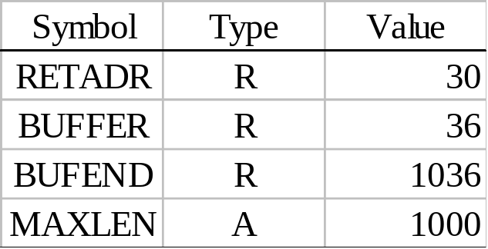
SYMTAB
None of the relative terms may enter into a multiplication or division operation
Errors:
  BUFEND+BUFFER
  100-BUFFER
  3*BUFFER
The type of an expression
  keep track of the types of all symbols defined in the program
Chap 2

Slide 66
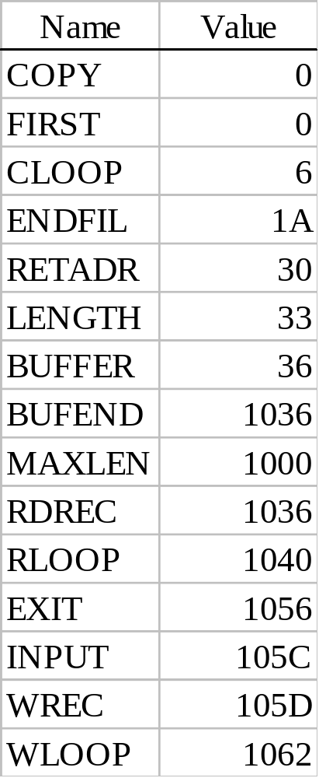
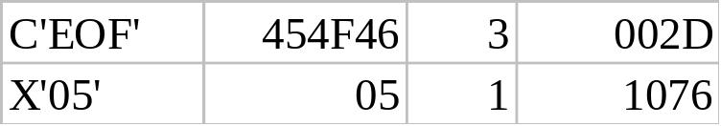
Example 2.9
SYMTAB LITTAB
Chap 2

Slide 67
Program Blocks
Program blocks
  refer to segments of code that are rearranged within a single object program unit
  USE [blockname]
  Default block
  Example: Figure 2.11
  Each program block may actually contain several separate segments of the source program
Chap 2

Slide 68
0000/0 COPY START 0
0000/0 FIRST STL RETADR 172063
0003/0 CLOOP JSUB RDREC 4B2021
0006/0 LDA LENGTH 032060
0009/0 COMP #0 290000
000C/0 JEQ ENDFIL 332006
000F/0 JSUB WRREC 4B203B
0012/0 J CLOOP 3F2FEE
0015/0 ENDFIL LDA =C’EOF’ 032055
0018/0 STA BUFFER 0F2056
001B/0 LDA #3 010003
001E/0 STA LENGTH 0F2048
0021/0 JSUB WRREC 4B2029
0024/0 J @RETADR 3E203F
0000/1 USE CDATA
0000/1 RETADR RESW 1
0003/1 LENGTH RESW 1
0000/2 USE CBLKS
0000/2 BUFFER RESB 4096
Chap 2

Slide 69
1000/2 BUFEND EQU *
1000/2 MAXLEN EQU BUFEND-BUFFER
0027/0 USE
0027/0 RDREC CLEAR X B410
0029/0 CLEAR A B400
002B/0 CLEAR S B440
002D/0 +LDT #MAXLEN 75101000
0031/0 RLOOP TD INPUT E32038
0034/0 JEQ RLOOP 332FFA
0037/0 RD INPUT DB2032
003A/0 COMPR A,S A004
003C/0 JEQ EXIT 332008
003F/0 STCH BUFFER,X 57A02F
0042/0 TIXR T B850
0044/0 JLT RLOOP 3B2FEA
0047/0 EXIT STX LENGTH 13201F
004A/0 RSUB 4F0000
0006/1 USE
0006/1 INPUT BYTE X’F1’ F1
Chap 2

Slide 70
004D/0 USE
004D/0 WRREC CLEAR X B410
004F/0 LDT LENGTH 772017
0052/0 WLOOP TD =X’05’ E3201B
0055/0 JEQ WLOOP 332FFA
0058/0 LDCH BUFFER,X 53A016
005B/0 WD =X’05’ DF2012
005E/0 TIXR T B850
0060/0 JLT WLOOP 3B2FEF
0063/0 RSUB 4F0000
0007/1 USE CDATA
LTORG
0007/1 * =C’EOF’ 454F46
000A/1 * =X’05’ 05
END FIRST
Chap 2

Slide 71
Program Blocks - Implementation
Pass 1
  each program block has a separate location counter
  each label is assigned an address that is relative to the start of the block that contains it
  at the end of Pass 1, the latest value of the location counter for each block indicates the length of that block
  the assembler can then assign to each block a starting address in the object program
Pass 2
  The address of each symbol can be computed by adding the assigned block starting address and the relative address of the symbol to that block
Chap 2

Slide 72
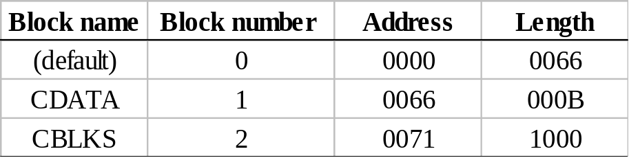
Figure 2.12
Each source line is given a relative address assigned and a block number
For absolute symbol, there is no block number
  line 107
Example
  20 0006 0 LDA LENGTH 032060
  LENGTH=(Block 1)+0003= 0066+0003= 0069
  LOCCTR=(Block 0)+0009= 0009
Chap 2

Slide 73
Program Readability
Program readability
  No extended format instructions on lines 15, 35, 65
  No needs for base relative addressing (line 13, 14)
  LTORG is used to make sure the literals are placed ahead of any large data areas (line 253)
Object code
  It is not necessary to physically rearrange the generated code in the object program
  see Fig. 2.13, Fig. 2.14
Chap 2

Slide 74
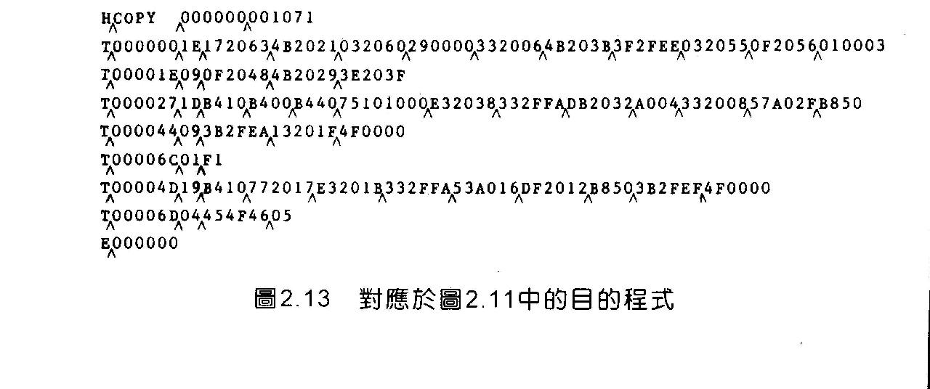
Chap 2

Slide 75
BEGIN
BLOCK NUMBER=0 LOCCTR[I]=0 FOR ALL I
READ THE FIRST INPUT LINE
IF OPCODE=‘START’ THEN
BEGIN
WRITE LINE TO INTERMEDIATE FILE
READ NEXT INPUT LINE
END{ IF START}
WHILE OPCODE ≠ ‘END’ DO
IF OPCODE=‘USE’
BEGIN
IF THERE IS NO OPERAND NAME THEN
SET BLOCK NAME AS DEFAULT
ELSE BLOCK NAME AS OPERAND NAME
IF THERE IS NO ENTRY FOR BLOCK NAME THEN
INSERT(BLOCK NAME,BLOCK NUMBER++) IN BLOCK TABLE
I = BLOCK NUMBER FOR BLOCK NAME
IF THIS IS NOT A COMMENT LINE THEN
BEGIN
Chap 2

Slide 76
IF THERE IS A SYMBOL IN THE LABEL FIELD THEN
BEGIN
SEARCH SYMTAB FOR LABEL
IF FOUND THEN
SET ERROR FLAG( DUPLICATE SYMBOL)
ELSE
INSERT (LABEL,LOCCTR[I]) INTO SYMTAB
END {IF SYMBOL}
SEARCH OPTAB FOR OPCODE
IF FOUND THEN
ADD 3 INSTRUCTION LENGTH TO LOCCTR[I]
ELSE IF OPCODE=‘WORD’ THEN
ADD 3 TO LOCCTR[I]
ELSE IF OPCODE=‘RESW’ THEN
ADD 3 * #[OPERAND] TO LOCCTR[I]
ELSE IF OPCODE=‘RESB’ THEN
ADD #[OPERAND] TO LOCCTR[I]
ELSE IF OPCODE=‘BYTE’ THEN
Chap 2

Slide 77
BEGIN
FIND LENGTH OF CONSTANT IN BYTES
ADD LENGTH TO LOCCTR[I]
END{IF BYTE}
ELSE
SET ERROR FLAG
END {IF NOT A COMMENT}
WRITE LINE TO INTERMEDIATE FILE
READ TEXT INPUT LINE
END {WHILE NOT END}
WRITE LAST LINE TO INTERMEDIATE FILE
SAVE LENGTH[I] AS LOCCTR[I] FOR ALL I
ADDRESS[0]=STARTING ADDRESS
ADDRESS[I]=ADDRESS[I-1] +LENGTH[I-1]{FOR I =1 TO MAX(BLOCK NUMBER)}
INSERT(ADDRESS[I],LENGTH[I]) IN BLOCK TABLE FOR ALL I
END{PASS1}
Chap 2

Slide 78
IF OPCODE=‘USE THEN
SET BLOCK NUMBER FOR BLOCK NAME WITH OPERAND FIELD
SEARCH SYMTAB FOR OPERAND
STORE SYMBOL VALUE +ADDRESS[BLOCK NUMBER] AS OPERAND ADDRESS
END {PASS2}
Chap 2

Slide 79
Control Sections and Program Linking
Control Sections
  are most often used for subroutines or other logical subdivisions of a program
  the programmer can assemble, load, and manipulate each of these control sections separately
  instruction in one control section may need to refer to instructions or data located in another section
  because of this, there should be some means for linking control sections together
  Fig. 2.15, 2.16
Chap 2

Slide 80
0000 COPY START 0
EXTDEF BUFFER,BUFEND,LENGTH
EXTREF RDREC,WRREC
0000 FIRST STL RETADR 172027
0003 CLOOP +JSUB RDREC 4B100000
0007 LDA LENGTH 032023
000A COMP #0 290000
000D JEQ ENDFIL 332007
0010 +JSUB WRREC 4B100000
0014 J CLOOP 3F2FEC
0017 ENDFIL LDA =C’EOF’ 032016
001A STA BUFFER 0F2016
001D LDA #3 010003
0020 STA LENGTH 0F200A
0023 +JSUB WRREC 4B100000
0027 J @RETADR 3E2000
002A RETADR RESW 1
0002D LENGTH RESW 1
LTORG
Chap 2

Slide 81
0030 * =C’EOF’ 454F46
0033 BUFFER RESB 4096
1033 BUFEND EQU *
1000 MAXLEN EQU BUFEND-BUFFER
0000 RDREC CSECT
EXTREF BUFFER,LENGTH,BUFEND
0000 CLEAR X B410
0002 CLEAR A B400
0004 CLEAR S B440
0006 LDT MAXLEN 75201F
0009 RLOOP TD INPUT E3201B
000C JEQ RLOOP 332FFA
000F RD INPUT DB2015
0012 COMPR A,S A004
0014 JEQ EXIT 332009
0017 +STCH BUFFER,X 57900000
001B TIXR T B850
001D JLT RLOOP 3B2FE9
Chap 2

Slide 82
0020 EXIT +STX LENGTH 13100000
0024 RSUB 4F0000
0027 INPUT BYTE X’F1’ F1
0028 MAXLEN WORD BUFEND-BUFFER 000000
0000 WRREC CSECT
EXTREF LENGTH,BUFFER
0000 CLEAR X B410
0002 +LDT LENGTH 77100000
0006 WLOOP TD =X’05’ E32012
0009 JEQ WLOOP 332FFA
000C +LDCH BUFFER,X 53900000
0010 WD =X’05’ DF2008
0013 TIXR T B850
0015 JLT WLOOP 3B2FEE
0018 RSUB 4F0000
END FIRST
001B * =X’05’ 05
END FIRST
Chap 2

Slide 83
External Definition and References
External definition
  EXTDEF name [, name]
  EXTDEF names symbols that are defined in this control section and may be used by other sections
External reference
  EXTREF name [,name]
  EXTREF names symbols that are used in this control section and are defined elsewhere
Example
  15 0003 CLOOP +JSUB RDREC 4B100000
  160 0017 +STCH BUFFER,X 57900000
  190 0028 MAXLEN WORD BUFEND-BUFFER 000000
Chap 2

Slide 84
Implementation
The assembler must include information in the object program that will cause the loader to insert proper values where they are required
Define record
  Col. 1 D
  Col. 2-7 Name of external symbol defined in this control section
  Col. 8-13 Relative address within this control section (hexadeccimal)
  Col.14-73 Repeat information in Col. 2-13 for other external symbols
Refer record
  Col. 1 D
  Col. 2-7 Name of external symbol referred to in this control section
  Col. 8-73 Name of other external reference symbols
Chap 2

Slide 85
Modification Record
Modification record
  Col. 1 M
  Col. 2-7 Starting address of the field to be modified (hexiadecimal)
  Col. 8-9 Length of the field to be modified, in half-bytes (hexadeccimal)
  Col.11-16 External symbol whose value is to be added to or subtracted from the indicated field
  Note: control section name is automatically an external symbol, i.e. it is available for use in Modification records.
Example
  Figure 2.17
  M00000405+RDREC
  M00000705+COPY
Chap 2

Slide 86
External References in Expression
Earlier definitions
  required all of the relative terms be paired in an expression (an absolute expression), or that all except one be paired (a relative expression)
New restriction
  Both terms in each pair must be relative within the same control section
  Ex: BUFEND-BUFFER
  Ex: RDREC-COPY
In general, the assembler cannot determine whether or not the expression is legal at assembly time. This work will be handled by a linking loader.
Chap 2

Slide 87
Assembler Design Options
One-pass assemblers
Multi-pass assemblers

Slide 88
One-Pass Assemblers
Main problem
  forward references
    data items
    labels on instructions
Solution
  data items: require all such areas be defined before they are referenced
  labels on instructions: no good solution
Chap 2

Slide 89
One-Pass Assemblers
Main Problem
  forward reference
    data items
    labels on instructions
Two types of one-pass assembler
  load-and-go
    produces object code directly in memory for immediate execution
  the other
    produces usual kind of object code for later execution
Chap 2

Slide 90
Load-and-go Assembler
Characteristics
  Useful for program development and testing
  Avoids the overhead of writing the object program out and reading it back
  Both one-pass and two-pass assemblers can be designed as load-and-go.
  However one-pass also avoids the over head of an additional pass over the source program
  For a load-and-go assembler, the actual address must be known at assembly time, we can use an absolute program
Chap 2

Slide 91
Forward Reference in One-pass Assembler
For any symbol that has not yet been defined
  1. omit the address translation
  2. insert the symbol into SYMTAB, and mark this symbol undefined
  3. the address that refers to the undefined symbol is added to a list of forward references associated with the symbol table entry
  4. when the definition for a symbol is encountered, the proper address for the symbol is then inserted into any instructions previous generated according to the forward reference list
Chap 2

Slide 92
Load-and-go Assembler (Cont.)
At the end of the program
  any SYMTAB entries that are still marked with * indicate undefined symbols
  search SYMTAB for the symbol named in the END statement and jump to this location to begin execution
The actual starting address must be specified at assembly time
Example
  Figure 2.18, 2.19
Chap 2

Slide 93
memory address contents
1000 454F4600 00030000 00xxxxxx xxxxxxxx
1010 xxxxxxxx xxxxxxxxx xxxxxxxx xxxxxxxx
2000 Xxxxxxxx xxxxxxxx xxxxxxxx xxxxxx14
2010 100948-- --00100C 28100630 ----48—
2020 --3C2012
LENGTH | 100C
RDREC | *
THREE | 1003
ZERO | 1006
WRREC | *
EOF | 1000
ENDFIL | *
RETADR | 1009
2013 NULL
201FNULL
201C NULL
BUFFER | 100F
CLOOP | 2012
FIRST | 200F
Chap 2

Slide 94
1000 copy start 1000
1000 EOF BYTE C’EOF’ 454F46
1003 THREE WORD 3 000003
1006 ZERO WORD 0 000000
1009 RETADR RESW 1
100C LENGTH RESW 1
100F BUFFER RESB 4096
200F First STL RETADR 141009
2012 CLOOP JSUB RDREC 48203D
2015 LDA LENGTH 00100C
2018 COMP ZERO 281006
201B JEQ ENDFIL 302024
201E JSUB WRREC 482062
2021 J CLOOP 3C2012
2024 ENDFIL LDA EOF 001000
2027 STA BUFFER 0C100F
202A LDA THREE 001003
202D STA LENGTH 0C100C
Chap 2

Slide 95
2030 JSUB WRREC 482062
2033 LDL RETADR 081009
2036 RSUB 4C0000
SUBROUTINE TO READ RECORD INTO BUFFER
2039 INPUT BYTE X’F1’ F1
203A MAXLEN WORD 4096 001000
203D RDREC LDX ZERO 041006
2040 LDA ZERO 001030
2043 RLOOP TD INPUT E02039
2046 JEQ RLOOP 302043
2049 RD INPUT D82039
204C COMP ZERO 281006
204F JEQ EXIT 30205B
2052 STCH BUFFER,X 54900F
2055 TIX MAXLEN 2C203A
2058 JLT RLOOP 382043
205B EXIT STX LENGTH 10100C
205E RSUB 4C0000
Chap 2

Slide 96
SUBROUTINE TO WRITE RECORD FROM BUFFER
2061 OUTPUT BYTE X’05’ 05
2062 WRREC LDX ZERO 041006
2065 WLOOP TD OUTPUT E02061
2068 JEQ WLOOP 302065
206B LDCH BUFFER,X 50900F
206E WD OUTPUT DC2061
2071 TIX LENGTH 2C100C
2074 JLT WLOOP 382065
2077 RSUB 4C0000
END FIRST
Chap 2

Slide 97

Chap 2

Slide 98
Chap 2

Slide 99
Chap 2

Slide 100
Chap 2

Slide 101
Chap 2

Slide 102
Chap 2

Slide 103
Chap 2

Slide 104
Chap 2

Slide 105
Chap 2

Slide 106
Chap 2

Slide 107
Chap 2

Slide 108
Chap 2

Slide 109
Chap 2

Slide 110
Algorithm for one pass assembler
BEGIN
READ FIRST INPUT LINE
IF OPCODE=‘START’ THEN
BEGIN
SAVE #[OPERAND] AS STARTING ADDRESS
INITIALIZE LOCCTR AS STARTING ADDRESS
READ NEXT INPUT LINE
END(IF START)
ELSE
INITIALIZE LOCCTR TO 0
WHILE OPCODE ≠ ‘END’ DO
BEGIN
IF THERE IS NOT A COMMENT LINE THEN
BEGIN
IF THERE IS A SYMBOL IN LABEL FIELD THEN
BEGIN
Chap 2

Slide 111
BEGIN
SEARCH SYMTAB FOR LABEL
IF FOUND THEN
BEGIN
IF SYMBOL VALUE AS NULL
SET SYMBOL VALUE AS LOCCTR AND SEARCH THE LINKED LIST WITH THE CORRESPONDING OPERAND
PTR ADDRESSES AND GENERATE OPERAND ADDRESSES AS CORRESPONDING SYMBOL VALUES
SET SYMBOL VALUE AS LOCCTR IN SYMBOL TABLE AND DELETE THE LINKED LIST
END
ELSE
INSERT (LABEL,LOCCTR) INTO SYMTAB
END
SEARCH OPTAB FOR OPCODE
IF FOUND THEN
Chap 2

Slide 112
BEGIN
SEARCH SYMTAB FOR OPERAND ADDRESS
IF FOUND THEN
IF SYMBOL VALUE NOT EQUAL TO NULL THEN STORE SYMBOL VALUE AS OPERAND ADDRESS
ELSE
INSERT AT THE END OF THE LINKED LIST WITH A NODE WITH ADDRESS AS LOCCTR
ELSE
INSERT(SYMBOL NAME,NULL)
ADD 3 TO LOCCTR
END
ELSE IF OPCODE=“WORD” THEN
ADD 3 TO LOCCTR & CONVERT COMMENT TO OBJECT CODE
ELSE IF OPCODE=“RESW” THEN
ADD 3* #[OPERAND] TO LOCCTR
ELSE IF OPCODE=“RESB” THEN
ADD #[OPERAND] TO LOCCTR
Chap 2

Slide 113
ELSE IF OPCODE=“BYTE”THEN
BEGIN
FIND LENGTH OF CONSTANT IN BYTES
ADD LENGTH TO LOCCTR
CONVERT CONSTANT TO OBJECT CODE
END
IF OBJECT CODE WILL NOT FIT INTO CURRENT TEXT RECORD THEN
BEGIN
WRITE TEXT RECORD TO OBJECT PROGRAM
INITIALIZE NEW TEXT RECORD
END
ADD OBJECT CODE TO TEXT RECORD
END
WRITE LISTING LINE
READ NEXT INPUT LINE
END
WRITE LAST TEXT RECORD TO OBJECT PROGRAM
WRITE END RECORD TO OBJECT PROGRAM
WRITE LAST LISTING LINE
END
Chap 2

Slide 114
Producing Object Code
When external working-storage devices are not available or too slow (for the intermediate file between the two passes
Solution:
  When definition of a symbol is encountered, the assembler must generate another Tex record with the correct operand address
  The loader is used to complete forward references that could not be handled by the assembler
  The object program records must be kept in their original order when they are presented to the loader
Example: Figure 2.20
Chap 2

Slide 115
H,COPY ,OO1000,00107A
T,001000,09,454F46,000003,000000
T,00200F,15,141009,480000,00100C,281006,300000,480000,3C2012
T,00201C,02,2024
T,002024,19,001000,0C100F,001003,0C100C,480000,081009,4C0000,F1,001000
T,002013,02,203D
T,00203D,1E,041006,001006,E02039,302043,D82039,281006,300000,54900F,2C203A,382043
T,002050,02,205B
T,00205B,07,10100C,4C0000,05
T,00201F,02,2062
T,002031,02,2062
T,002062,18,041006,E02061,302065,50900F,DC2061,2C100C,382065,4C0000
E,00200F
Chap 2

Slide 116
Multi-Pass Assemblers
Restriction on EQU and ORG
  no forward reference, since symbols’ value can’t be defined during the first pass
EQU & ORG ,any symbol used on RHS be previously defined in the program
Example: ALPHA EQU BETA
BETA EQU DELTA
DELTA RESW 1
example
  Use link list to keep track of whose value depend on an undefined symbol
Figure 2.21
Chap 2

Slide 117
HALFSZ EQU MAXLEN/2
MAXLEN EQU BUFEND-BUFFER
PREVBT EQU BUFFER-1
BUFFER RESB 4096
BUFEND EQU *
Chap 2

Slide 118
HALFSZ &1 MAXLEN/2 NULL
MAXLEN *
HALFSZ NULL
Chap 2

Slide 119
BUFEND *
HALFSZ &1 MAXLEN/2 NULL
MAXLEN &2 BUFEND-BUFFER
BUFFER *
MAXLEN NULL
HALFSZ NULL
MAXLEN NULL
Chap 2

Slide 120
BUFEND *
HALFSZ &1 MAXLEN/2 NULL
PREVBT &1 BUFFER-1 NULL
MAXLEN &2 BUFEND-BUFFER
BUFFER *
MAXLEN NULL
HALFSZ NULL
MAXLEN
PREVBT NULL
Chap 2

Slide 121
BUFEND *
HALFSZ &1 MAXLEN/2 NULL
PREVBT 1033 NULL
MAXLEN &1 BUFEND-BUFFER
BUFFER 1034 NULL
MAXLEN NULL
HALFSZ NULL
Chap 2

Slide 122
BUFEND 2034 NULL
HALFSZ 800 NULL
PREVBT 1033 NULL
MAXLEN 1000 NULL
BUFFER 1034 NULL
Chap 2

Slide 123
Implementation examples
MASM assembler
Discuss some of the features of microsoft MASM assembler for pentium and other x86 systems
An MASM assembler language pgm is written as a collection of segments
Each segments is defined as belonging to a particular class corresponding to its contents
Commonly used classes are CODE,DATA,CONST,STACK
During pgm execution ,segments are addressed via segment registers
Cs→code segment,ss→stack segment,ds,es,fs,gs→data segment
The segment registers are automatically set by the system loader when the pgm is loaded for execution
Chap 2

Slide 124
Register CS is set to indicate the segment that contains the starting label specified in the END statement
Register SS is set to indicate the last stack segment processed by the loader
The segment registers to be used are explicitly specified by programmer,it not selected by the assembler
DS used by default,we can also change the assumption by
ASSUME ES:DATASEG2
Registers DS,ES,FS,GS must be loaded by the pgm before they can be used to address data segments
Mov AX,DATASEG2
Mov ES,AX
BASE==ASSUME→contents of segment register
Chap 2

Slide 125
Jump instructions are assembled in 2 different ways,depending on whether the target of the jump is the same cs as the jump instruction
Near jump
Far jump
Jump to a target in the same cs—jump to a target in
different cs
2.It is assembled using current cs register– it is assembled
using different segment register
specified in instruction prefix
3.The assembled m/c instruction
Occupies 2 or 3 bytes --it occupies 5 bytes
Chap 2

Slide 126
Problem in jump
Jmp target → if the target is forward reference the assembler does not know how many bytes to reserve
By default MASM assumes near jump
If it is far jump ,it is specified as
Jmp far ptr target
If the jump instruction is within 128 bytes of the current instruction the programmer can specify shorter(2-byte) near jump
Jmp short target
Segments in a source pgm can be written in more than one place using SEGMENT directive
PUBLIC==EXTDEF,EXTRN==EXTREF
The object pgm in MASM may be in several different formats
Chap 2

