Slide 1
Loaders and Linkers
Chapter 3
System Software
An introduction to systems programming
Leland L. Beck

Slide 2
Introduction
To execute an object program, we needs
  Relocation, which modifies the object program so that it can be loaded at an address different from the location originally specified
  Linking, which combines two or more separate object programs and supplies the information needed to allow references between them
  Loading and Allocation, which allocates memory location and brings the object program into memory for execution

Slide 3
Overview of Chapter 3
Type of loaders
  assemble-and-go loader
  absolute loader (bootstrap loader)
  relocating loader (relative loader)
  direct linking loader
Design options
  linkage editors
  dynamic linking
  bootstrap loaders

Slide 4
Assemble-and-go Loader
Characteristic
  the object code is stored in memory after assembly
  single JUMP instruction
Advantage
  simple, developing environment
Disadvantage
  whenever the assembly program is to be executed, it has to be assembled again
  programs have to be coded in the same language

Slide 5
Design of an Absolute Loader
Absolute Program
  Advantage
    Simple and efficient
  Disadvantage
    the need for programmer to specify the actual address
    difficult to use subroutine libraries
Program Logic

Slide 6
Fig. 3.2 Algorithm for an absolute loader
Begin
read Header record
verify program name and length
read first Text record
while record type is not ‘E’ do
begin
{if object code is in character form, convert into internal representation}
move object code to specified location in memory
read next object program record
end
jump to address specified in End record
end

Slide 7
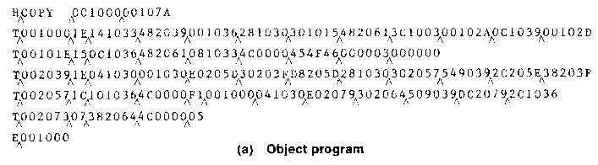

Slide 8
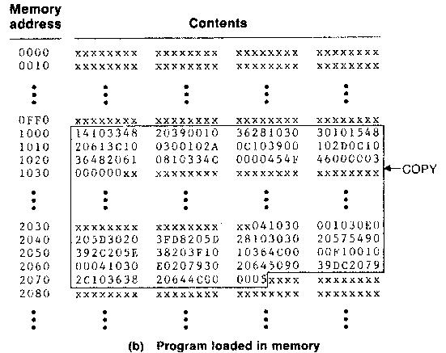

Slide 9
Object Code Representation
Figure 3.1 (a)
  each byte of assembled code is given using its hexadecimal representation in character form
  easy to read by human beings
In general
  each byte of object code is stored as a single byte
  most machine store object programs in a binary form
  we must be sure that our file and device conventions do not cause some of the program bytes to be interpreted as control characters
Break...

Slide 10
A Simple Bootstrap Loader
Bootstrap Loader
  When a computer is first tuned on or restarted, a special type of absolute loader, called bootstrap loader is executed
  This bootstrap loads the first program to be run by the computer -- usually an operating system
Example (SIC bootstrap loader)
  The bootstrap itself begins at address 0
  It loads the OS starting address 0x80
  No header record or control information, the object code is consecutive bytes of memory

Slide 11
The subroutine reads one character from F1 and converts it from the ASCII character code to the value of hexadecimal digit
Eg: ascii code for character “0” (hexa=30)→ value 0
1 through 9(31 to 39)→1 to 9
A through f (41 to 46)→10 to 15
Sub 48(hexa 30)→0 to 9
Sub 55(hexa 37)→a to f
Eof =04

Slide 12
Fig. 3.3 SIC Bootstrap Loader
BOOT START 0
CLEAR A
LDX #128
LOOP JSUB GETC
RMO A,S
SHIFTL S,4
JSUB GETC
ADDR S,A
STCH 0,X
TIXR X,X
J LOOP
0~9 : 30~39
A~F : 41~46
Break...

Slide 13
GETC TD INPUT
JEQ GETC
RD INPUT
COMP #4
JEQ 80
COMP #48
JLT GETC
SUB #48
COMP #10
JLT RETURN
SUB #7
RETURN RSUB
INPUT BYTE X’F1’
END LOOP

Slide 14
Machine dependent loader features:
1.Relocating Loaders
Motivation
  efficient sharing of the machine with larger memory and when several independent programs are to be run together
  support the use of subroutine libraries efficiently

Slide 15
Two methods for specifying relocation
  modification record (Fig. 3.4, 3.5)
  relocation bit (Fig. 3.6, 3.7)
    each instruction is associated with one relocation bit
    these relocation bits in a Text record is gathered into bit masks
    Loaders that allow for program relocation are called relocating loaders or relative loaders

Slide 16
Modification Record
For complex machines
Also called RLD specification
  Relocation and Linkage Directory
Modification record
  col 1: M
  col 2-7: relocation address
  col 8-9: length (halfbyte)
  col 10: flag (+/-)
  col 11-17: segment name

Slide 17
Fig. 3.5
H_{Λ}COPY _{Λ}000000 001077
T_{Λ}000000 _{Λ}1D_{Λ}17202D_{Λ}69202D_{Λ}48101036_{Λ}032026_{Λ}..._{Λ}3F2FEC_{Λ}032010
T_{Λ}00001D_{Λ}13_{Λ}0F2016_{Λ}010003_{Λ}0F200D_{Λ}4B10105D_{Λ}3E2003_{Λ}454F46
T_{Λ}001035 _{Λ}1D_{Λ}B410_{Λ}B400_{Λ}B440_{Λ}75101000_{Λ}E32019_{Λ}..._{Λ}57C003_{Λ}B850
T_{Λ}001053_{Λ}1D_{Λ}3B2FEA_{Λ}134000_{Λ}4F0000_{Λ}F1_{Λ}B410_{Λ}..._{Λ}DF2008_{Λ}B850
T_{Λ}00070_{Λ}07_{Λ}3B2FEF_{Λ}4F0000_{Λ}05
M_{Λ}000007_{Λ}05+COPY
M_{Λ}000014_{Λ}05+COPY
M_{Λ}000027_{Λ}05+COPY
E_{Λ}000000

Slide 18
Relocation Bit
For simple machines
Relocation bit
  0: no modification is necessary
  1: modification is needed
Twelve-bit mask is used in each Text record
  since each text record contains less than 12 words
  unused words are set to 0
  any value that is to be modified during relocation must coincide with one of these 3-byte segments
    e.g. line 210
Text record
  col 1: T
  col 2-7: starting address
  col 8-9: length (byte)
  col 10-12: relocation bits
  col 13-72: object code
Break...

Slide 19
0000 copy start 0000
0000 First STL RETADR 140033
0003 CLOOP JSUB RDREC 481039
0006 LDA LENGTH 000036
0009 COMP ZERO 280030
000C JEQ ENDFIL 300015
000F JSUB WRREC 481061
0012 J CLOOP 3C0003
0015 ENDFIL LDA EOF 00002A
0018 STA BUFFER 0C0039
001B LDA THREE 00002D
001E STA LENGTH 0C0036
0021 JSUB WRREC 481061
0024 LDL RETADR 080033
0027 RSUB 4C0000
002A EOF BYTE C’EOF’ 454F46
002D THREE WORD 3 000003
0030 ZERO WORD 0 000000

Slide 20
0033 RETADR RESW 1
0036 LENGTH RESW 1
0039 BUFFER RESB 4096
SUBROUTINE TO READ RECORD INTO BUFFER
1039 RDREC LDX ZERO 040030
103C LDA ZERO 000030
103F RLOOP TD INPUT E0105D
1042 JEQ RLOOP 30103F
1045 RD INPUT D8105D
1048 COMP ZERO 280030
104B JEQ EXIT 301057
104E STCH BUFFER,X 548039
1051 TIX MAXLEN 2C105E
1054 JLT RLOOP 38103F
1057 EXIT STX LENGTH 100036
105A RSUB 4C0000
105D INPUT BYTE X’F1’ F1
105E MAXLEN WORD 4096 001000

Slide 21
SUBROUTINE TO WRITE RECORD FROM BUFFER
1061 WRREC LDX ZERO 040030
1064 WLOOP TD OUTPUT E01079
1067 JEQ WLOOP 301064
106A LDCH BUFFER,X 508039
106D WD OUTPUT DC1079
1070 TIX LENGTH 2C0036
1073 JLT WLOOP 381064
1076 RSUB 4C0000
1079 OUTPUT BYTE X’05’ 05
END FIRST

Slide 22
Fig. 3-7
H_{Λ}COPY _{Λ}000000 00107A
T_{Λ}000000_{Λ}1E_{Λ}FFC_{Λ}140033_{Λ}481039_{Λ}000036_{Λ}280030_{Λ}300015_{Λ}481061_{Λ}…
T_{Λ}00001E_{Λ}15_{Λ}E00_{Λ}0C0036_{Λ}481061_{Λ}080033_{Λ}4C0000_{Λ}454F46_{Λ}000003_{Λ}000000
T_{Λ}001039_{Λ}1E_{Λ}FFC_{Λ}040030_{Λ}000030_{Λ}E0105D_{Λ}30103F_{Λ}D8105D_{Λ}280030_{Λ}...
T_{Λ}001057_{Λ}0A_{Λ} 800_{Λ}100036_{Λ}4C0000_{Λ}F1_{Λ}001000
T_{Λ}001061_{Λ}19_{Λ}FE0_{Λ}040030_{Λ}E01079_{Λ}301064_{Λ}508039_{Λ}DC1079_{Λ}2C0036_{Λ}...
E_{Λ}000000
Break...

Slide 23
2. Program Linking
Goal
  Resolve the problems with EXTREF and EXTDEF from different control sections (sec 2.3.5)
Example
  Program in Fig. 3.8 and object code in Fig. 3.9
  Use modification records for both relocation and linking
    address constant
    external reference

Slide 24
0000 PROGA START 0
EXTDEF LISTA, ENDA
EXTREF LISTB, ENDB, LISTC, ENDC
.
.
0020 REF1 LDA LISTA 03201D
0023 REF2 +LDT LISTB+4 77100004
0027 REF3 LDX #ENDA-LISTA 050014
.
.
0040 LISTA EQU *
0054 ENDA EQU *
0054 REF4 WORD ENDA-LISTA+LISTC 000014
0057 REF5 WORD ENDC-LISTC-10 FFFFF6
005A REF6 WORD ENDC-LISTC+LISTA-1 00003F
005D REF7 WORD ENDA-LISTA-(ENDB-LISTB) 000014
0060 REF8 WORD LISTB-LISTA FFFFC0
END REF1

Slide 25
0000 PROGB START 0
EXTDEF LISTB, ENDB
EXTREF LISTA, ENDA, LISTC, ENDC
.
.
0036 REF1 +LDA LISTA 03100000
003A REF2 LDT LISTB+4 772027
003D REF3 +LDX #ENDA-LISTA 05100000
.
.
0060 LISTB EQU *
0070 ENDB EQU *
0070 REF4 WORD ENDA-LISTA+LISTC 000000
0073 REF5 WORD ENDC-LISTC-10 FFFFF6
0076 REF6 WORD ENDC-LISTC+LISTA-1 FFFFFF
0079 REF7 WORD ENDA-LISTA-(ENDB-LISTB) FFFFF0
007C REF8 WORD LISTB-LISTA 000060
END

Slide 26
0000 PROGC START 0
EXTDEF LISTC, ENDC
EXTREF LISTA, ENDA, LISTB, ENDB
.
.
0018 REF1 +LDA LISTA 03100000
001C REF2 +LDT LISTB+4 77100004
0020 REF3 +LDX #ENDA-LISTA 05100000
.
.
0030 LISTC EQU *
0042 ENDC EQU *
0042 REF4 WORD ENDA-LISTA+LISTC 000030
0045 REF5 WORD ENDC-LISTC-10 000008
0045 REF6 WORD ENDC-LISTC+LISTA-1 000011
004B REF7 WORD ENDA-LISTA-(ENDB-LISTB) 000000
004E REF8 WORD LISTB-LISTA 000000
END

Slide 27
H PROGA 000000 000063
D LISTA 000040 ENDA 000054
R LISTB ENDB LISTC ENDC
.
.
T 000020 0A 03201D 77100004 050014
.
.
T 000054 0F 000014 FFFF6 00003F 000014 FFFFC0
M000024 05+LISTB
M000054 06+LISTC
M000057 06+ENDC
M000057 06 -LISTC
M00005A06+ENDC
M00005A06 -LISTC
M00005A06+PROGA
M00005D06-ENDB
M00005D06+LISTB
M00006006+LISTB
M00006006-PROGA
E000020

Slide 28
H PROGB 000000 00007F
D LISTB 000060 ENDB 000070
R LISTA ENDA LISTC ENDC
.
.
T 000036 0B 03100000 772027 05100000
.
.
T 000007 0F 000000 FFFFF6 FFFFFF FFFFF0 000060
M000037 05+LISTA
M00003E 06+ENDA
M00003E 06 -LISTA
M000070 06 +ENDA
M000070 06 -LISTA
M000070 06 +LISTC
M000073 06 +ENDC
M000073 06 -LISTC
M000073 06 +ENDC
M000076 06 -LISTC
M000076 06+LISTA
M000079 06+ENDA
M000079 06 -LISTA
M00007C 06+PROGB
M00007C 06-LISTA
E

Slide 29
H PROGC 000000 000051
D LISTC 000030 ENDC 000042
R LISTA ENDA LISTB ENDB
.
T 000018 0C 03100000 77100004 05100000
.
T 000042 0F 000030 000008 000011 000000 000000
M000019 05+LISTA
M00001D 06+LISTB
M000021 06+ENDA
M000021 06 -LISTA
M000042 06+ENDA
M000042 06 -LISTA
M000042 06+PROGC
M000048 06+LISTA
M00004B 06+ENDA
M00004B 006-LISTA
M00004B 06-ENDB
M00004B 06+LISTB
M00004E 06+LISTB
M00004E 06-LISTA
E

Slide 30
Program Linking Example
Fig. 3.10
Load address for control sections
  PROGA 004000 63
  PROGB 004063 7F
  PROGC 0040E2 51
Load address for symbols
  LISTA: PROGA+0040=4040
  LISTB: PROGB+0060=40C3
  LISTC: PROGC+0030=4112
REF4 in PROGA
  ENDA-LISTA+LISTC=14+4112=4126
  T0000540F000014FFFFF600003F000014FFFFC0
  M00005406+LISTC

Slide 31
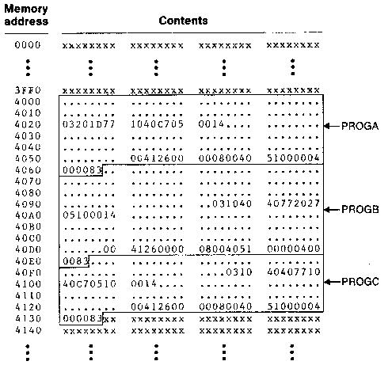

Slide 32
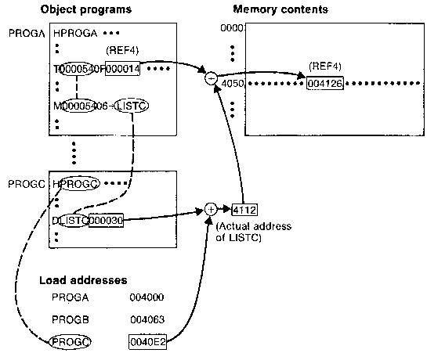

Slide 33
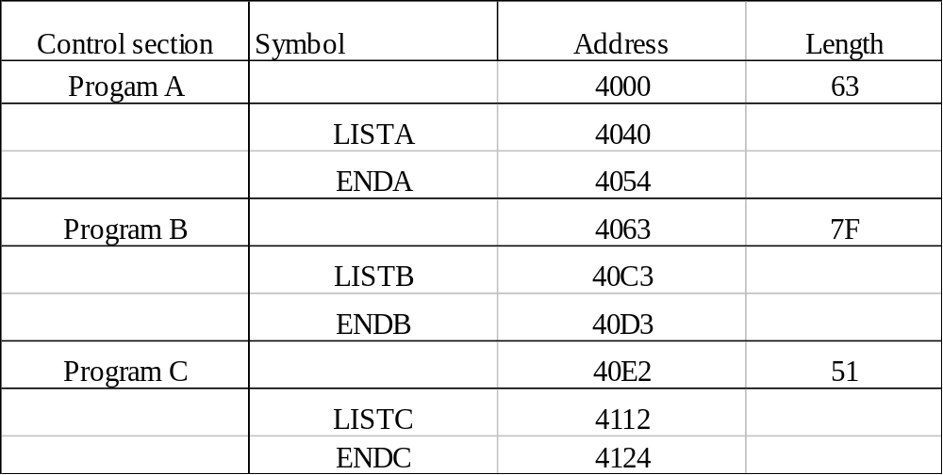
3.Algorithm and Data Structure for a linking loader
Two Passes
  Pass 1: assign addresses to all external symbols
  Pass 2: perform the actual loading, relocation, and linking
ESTAB (external symbol table)

Slide 34
Pass 1 Program Logic
Pass 1:
  assign addresses to all external symbols
Variables & Data structures
  PROGADDR (program load address) from OS
  CSADDR (control section address)
  CSLTH (control section length)
  ESTAB
Fig. 3.11(a)
  Process Define Record

Slide 35
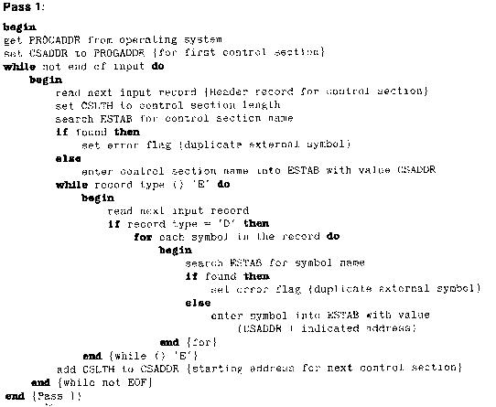

Slide 36
Pass 2 Program Logic
Pass 2:
  perform the actual loading, relocation, and linking
Modification record
  lookup the symbol in ESTAB
End record for a main program
  transfer address
Fig. 3.11(b)
  Process Text record and Modification record

Slide 37
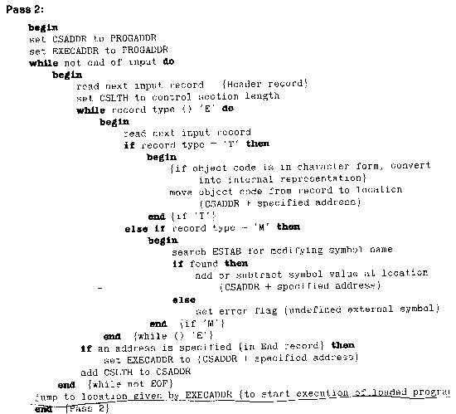

Slide 38
Improve Efficiency
Use local searching instead of multiple searches of ESTAB for the same symbol
  assign a reference number to each external symbol
  the reference number is used in Modification records
Implementation
  01: control section name
  other: external reference symbols
Example
  Fig. 3.12

Slide 39
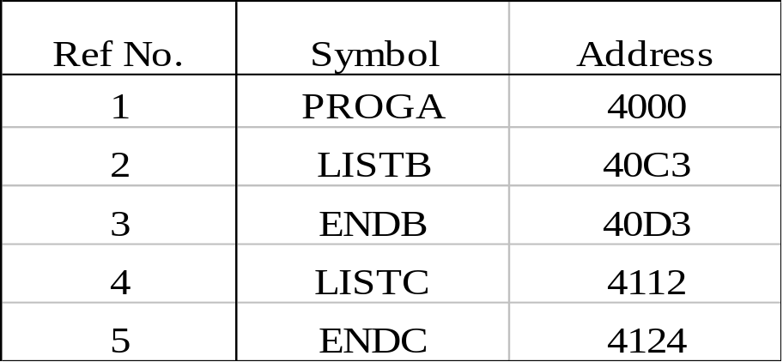
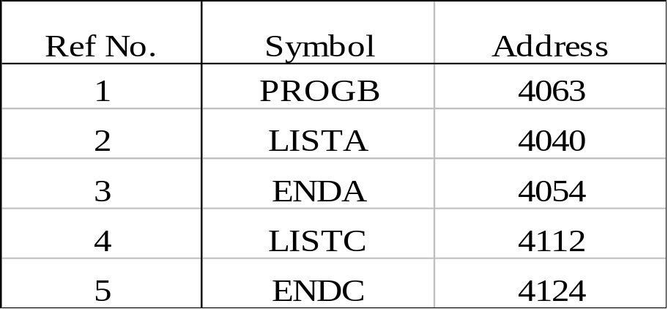
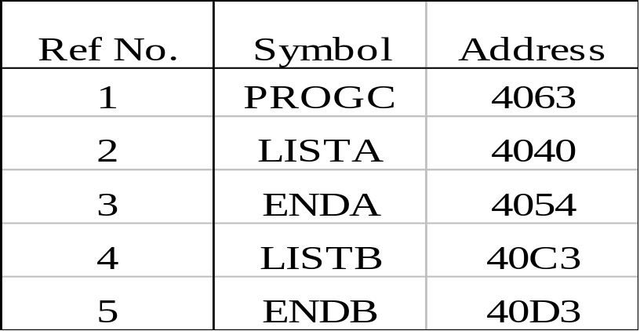
Figure 3.12
PROGA
PROGB PROGC

Slide 40
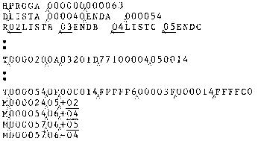
Fig. 3-12 (a)

Slide 41
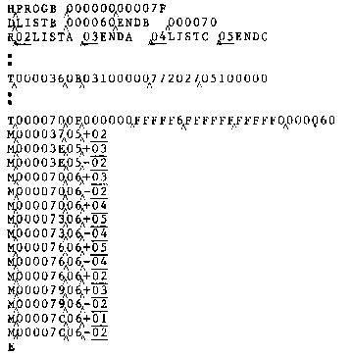
Fig. 3-12 (b)

Slide 42
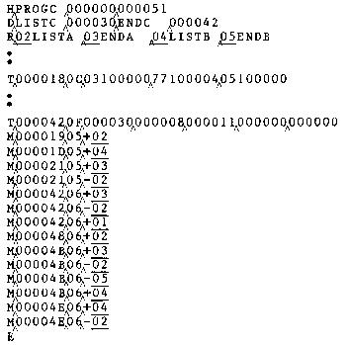

Slide 43
Machine independent loader features
1.Automatic library search
Linking loaders can automatically incorporate routines from libraries into the program being loaded.
There are standard system libraries,other libraries may be specified by control statements or parameters to the loader
The subroutine called by the pgm being loaded are automatically fetched from the library,linked with the main pgm & loaded
The programmer need not specify subroutine name as external references in the source pgm
This is also called as automatic library call

Slide 44
Linking loaders must keep track of external symbols that are referred but not defined.this is stored in ESTAB
These entries are marked to indicate those are not defined
At the end of pass1,the symbols of ESTAB that remain undefined represent unresolved external references.
The programmer can override the standard subroutines in the library by supplying his subroutine
The libraries to be searched by the loader contain assembled or compiled version(object pgm)
Searching these libraries by scanning the define records for all the object pgm-→ inefficient
Therefore special file structure is used for libraries
The structure consists of directory that gives the name of the routine & a pointer to the address within the file.
If the subroutine is callable in more than one name ,both names are specified in the directory

Slide 45
2. Loader options
Loaders allow the user to specify options to modify the standard processing.
Many loaders have a special command language used to specify options
There is a separate input file to the loader that contains control statements
The control statements are embedded in the primary input stream between object program
The programmer can include loader control statements in the source program,and the assembler or compiler retains these commands as part of object pgm
Eg: INCLUDE pgm-name(library-name) →direct the loader to read the designated object pgm from the library and treat it as if it were part of the primary loader input
DELETE csect-name -→delete entire control section

Slide 46
CHANGE name1,name2 →cause the external symbol name1 to be changed to name2,whereever it appears in the object pgm.
INCLUDE READ(UTLIB)
INCLUDE WRITE(UTLIB)
DELETE RDREC,WRREC
CHANGE RDREC,READ
CHANGE WRREC,WRITE
LIBRARY MYLIB →allow the user to specify alternate libraries
User defined libraries are searched first than standard libraries.

Slide 47
Loader Design Options
Lin king loaders: perform all linking and relocation at load time
Linkage editors:perform linking prior to load time
Dynamic linking : linking function is performed at execution time.

Slide 48
Linking loaders
Object pgm
library
Linking loader
memory

Slide 49
The source pgm is first assembled or compiled ,producing an object pgm(may contain several different control section)
It performs all linking & relocation operations including automatic library search if specified,and loads the linked pgm directly into memory for execution
More overhead compared to linkage editor
Linking loader searches library & resolve external references every time the pgm is executed
Linking loader is used in program development and testing environment(student programs)
It is also used when the pgm is used so infrequently that it is not worthwhile to store the assembled version in the library (avoids writing & reading the linked pgm)

Slide 50
Linkage editor
Object pgm
library
Linkage editor
Linked pgm
Relocating loader
memory

Slide 51
Produces the linked version of the pgm written to a file or library for later execution.
When linked pgm is ready to run ,a simple relocating loader loads the pgm to memory
The only object code modification is addition of actual load address
The linkage editor performs relocation relative to the start of linked pgm
Loading can be done in one pass with no external symbol table required.
This involves less overhead than linking loader
If the pgm is to be executed many times without reassembled,the uasage of linkage editor substantially reduces the overhead required
Resolution of external references and library searching is performed once
Linkage editor can perform useful function other than preparing object pgm

Slide 52
Program PLANNER that uses the large number of subroutines
One subroutine PROJECT is changed to correct an error or to improve efficiency
New version of PROJECT is assembled or compiled,the linkage editor can be used to replace this subroutine in the linked version of PLANNER
INCLUDE PLANNER(PROGLIB)
DELETE PROJECT
INCLUDE PROJECT(NEWLIB)
REPLACE PLANNER(PROGLIB)

Slide 53
Dynamic linking or dynamic loading or load on call
Dynamic linking is often used to allow several executing programs to share one copy of the subroutine or library
A single copy of the routine is loaded into memory
All programs currently in execution could be linked to one copy,instead of linking a separate copy into each object pgm
Adv:1.that the pgm contains subroutine that correct or diagnose errors in the input data during execution(these errors are rare ,it provides an ability to load the routines only when they are needed
2.pgm execution uses only a few out of a large number of routines ,but the exact number needed cannot be predicted until the pgm examines input

Slide 54
There are different mechanisms that are used to accomplished the actual loading & linking of a called subroutine
Method in which routines that are dynamically loaded must be called via an operating system sevice request
This method thought of as a request to a part of a loader that is kept in memory during execution of the pgm
Dynamic loader (part of OS)
Load and call ERRHANDL
User pgm

Slide 55
library
Dynamic loader
b
User pgm
ERRHANDL

Slide 56
Dynamic loader
c
User pgm
ERRHANDL

Slide 57
Dynamic loader
d
User pgm
ERRHANDL

Slide 58
Dynamic loader
Load and call
ERRHANDL
e
User pgm
ERRHANDL

Slide 59
Implementation examples
MS DOS linker
Discuss some of the features of microsoft MS-DOS linker for pentium & other x86 systems
Most MS-DOS compilers & assemblers produce object modules not executable code
These modules have extensions .OBJ
MS-DOS link is a linkage editor that combines one or more object modules to produce complete executable pgm
The executable code has the extension .EXE
Box below gives the description of MS-DOS object module which consists of following

Slide 60
THEADR translator header
TYPEDEF
PUBDEF external symbols & references
EXTDEF
LNAMES
SEGDEF segment definition & grouping
GRPDEF
LEDATA
LIDATA translated instruction & data
FIXUPP relocation & linking information
MODEND end of object module

Slide 61
The THEADR record specifies the name of the object module
The MODEND record marks the end of the module,& can contain a reference to the entry point of the program
These 2 records correspond to header & end records of SIC/XE.
The PUBDEF record contains a list of the external symbols that are defined in this object module
The EXTDEF record contains a list of the external symbols that are referred to in the object module
These 2 records are similar to define & refer record in SIC/XE
PUBDEF & EXTDEF can contain information about the data type designated by an external name.these types are defined in the TYPEDEF record
SEGDEF record describes the segments in the object module,including their name,length,& alignment
GRPDEF record specify how these segments are combined into groups

Slide 62
LNAMES record contains a list of all the segment and class names used in the programs
SEGDEF & GRPDEF records refer to the segment by giving the position of its name in the LNAMES record
LEDATA records contain the translated instruction & data from the source pgm similar to text record
LIDATA specify the translated instruction & data that occur in a repeating pattern
FIXUPP records are used to resolve external references,& to carry out address modifications that are associated with relocation & grouping of segments within the pgm.
This is similar to modification record
FIXUPP record must immediately follow LEDATA or LIDATA

Slide 63
LINK performs 2 pass
Pass1
Computes the starting address for each segment in the pgm
Order of segments is same in the executable pgm and the order of SEGDEF records are processed
In some cases segments from different object modules that have the same segment name & class are combined
Segments with same class,but different names are concatenated
The starting address initially associated with the segment is updated during pass1 as these combination & concatenation takes place
Pass 1 constructs a symbol table that associates an address with each segment and each external symbol
If unresolved symbol remain after all object modules ,LINK searches libraries

Slide 64
Pass 2
During pass 2 LINK extracts the translated instruction & data from the object modules,and build an image of the executable pgm in memory
Pass2 processes each LEDATA & LIDATA record along with the corresponding FIXUPP record
It places the binary data from LEDATA & LIDATA records into the memory image at locations that reflect the segment address computed during pass1
……………………………………………………………….

