Slide 1
Macro Processors
Chapter 4
System Software
An introduction to systems programming
Leland L. Beck

Slide 2
Introduction
Concept
  A macro instruction is a notational convenience for the programmer
  It allows the programmer to write shorthand version of a program (module programming)
  The macro processor replaces each macro invocation with the corresponding sequence of statements (expanding)

Slide 3
Macro Processor
Recognize macro definitions
Save the macro definition
Recognize macro calls
Expand macro calls
Source Code
(with macro)
Macro Processor
Expanded Code
Compiler or Assembler
obj

Slide 4
Basic macro processor functions
1.Macro Definition and expansion
copy code
parameter substitution
conditional macro expansion
macro instruction defining macros

Slide 5
Copy code -- Example
Source
STRG MACRO
STA DATA1
STB DATA2
STX DATA3
MEND
.
STRG
.
STRG
.
.
Expanded source
.
.
.
STA DATA1
STB DATA2
STX DATA3
.
STA DATA1
STB DATA2
STX DATA3
.
{
{

Slide 6
Macro vs. Subroutine
Macro
  the statement of expansion are generated each time the macro are invoked
Subroutine
  the statement in a subroutine appears only once

Slide 7
Macro | Subroutine
Macro call is an instruction to replace the macro name with its body | Subroutine call is an instruction to transfer the programs control to the subroutine definition with all parameters if required.
Macro call results in macro expansion | Subroutine call results in execution
Macro expansion increases the size of the program | Subroutine execution does not affect the size of the program
Macro expansion does not affect the execution speed of the program | Subroutine affect the execution speed of the program

Slide 8
Parameter Substitution -- Example
Source
STRG MACRO &a1, &a2, &a3
STA &a1
STB &a2
STX &a3
MEND
.
STRG DATA1, DATA2, DATA3
.
STRG DATA4, DATA5, DATA6
.
.
Expanded souce
.
.
.
STA DATA1
STB DATA2
STX DATA3
.
STA DATA4
STB DATA5
STX DATA6
.
{
{

Slide 9
The pgm defines and uses 2 macro instructions RDBUFF & WRBUFF.
New assembler directives(MACRO & MEND) are used in macro definitions.
The symbol in the label field is the name of the macro,& the entries in the operand field is parameters(starting with &)
Macro name,parameters →macro prototype
Following the macro is macro body
Mend → end of macro
The macro invocation statement is referred as macro call(macro name,arguments)
First pgm is i/p to macroprocessor ,second is o/p of macroprocessor

Slide 10
Copy start 0
RDBUFF MACRO &indev,&bufadr,&reclth
clear x
clear a
clear s
+LDT #4096
TD =X’&INDEV’
JEQ *-3
RD =X’&INDEV’
COMPR A,S
JEQ *+11
STCH &BUFADR,X
TIXR T
JLT *-19
STX &RECLTH
MEND
WRBUFF MACRO &OUTDEV,&BUFADR,&RECLTH
CLEAR X
LDT &RECLTH
LDCH &BUFADR,X

Slide 11
TD =X’&OUTDEV’
JEQ *-3
WD =X’&OUTDEV’
TIXR T
JLT *-14
MEND
FIRST STL RETADR
CLOOP RDBUFF F1,BUFFER,LENGTH
LDA LENGTH
COMP #0
JEQ ENDFIL
WRBUFF 05,BUFFER,LENGTH
J CLOOP
ENDFIL WRBUFF 05,EOF,THREE
J @RETADR
EOF BYTE C’EOF’
THREE WORD 3
RETADR RESW 1
LENGTH RESW 1
BUFFER RESB 4096
END FIRST

Slide 12
COPY START 0
FIRST STL RETADR
.CLOOP RDBUFF F1,BUFFER,LENGTH
CLOOP clear x
clear a
clear s
+LDT #4096
TD =X’F1’
JEQ *-3
RD =X’F1’
COMPR A,S
JEQ *+11
STCH BUFFER,X
TIXR T
JLT *-19
STX LENGTH
LDA LENGTH
COMP #0
JEQ ENDFIL
. WRBUFF 05,BUFFER,LENGTH

Slide 13
CLEAR X
LDT LENGTH
LDCH BUFFER,X
TD =X’05’
JEQ *-3
WD =X’05’
TIXR T
JLT *-14
J CLOOP
.ENDFIL WRBUFF 05,EOF,THREE
ENDFIL CLEAR X
LDT THREE
LDCH EOF,X
TD =X’05’
JEQ *-3
WD =X’05’
TIXR T
JLT *-14
J @RETADR

Slide 14
EOF BYTE C’EOF’
THREE WORD 3
RETADR RESW 1
LENGTH RESW 1
BUFFER RESB 4096
END FIRST

Slide 15
2 PASS MACRO PROCESSOR
In first pass all macro definitions are processed
In second pass all macro invocation statements are expanded
Drawback
Would not allow the body of one macro instruction to contain definitions of other

Slide 16
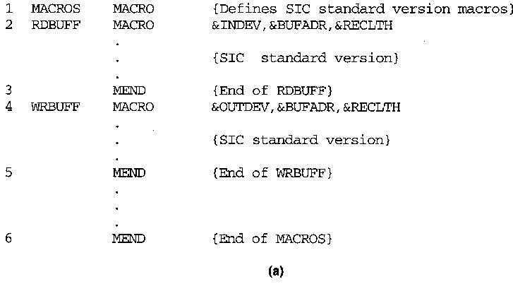
Nested Macros Definition
Macro definition within macros
  process macro definition during expansion time
Example 4.3

Slide 17
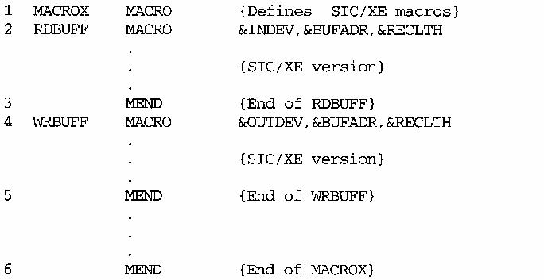
Figure 4.3 (b)

Slide 18
One-Pass Macro Processor
Prerequisite
  every macro must be defined before it is called
Sub-procedures
  macro definition: DEFINE
  macro invocation: EXPAND
NAMTAB
MACRO
DEFINE
DEFTAB
PROCESSLINE
ARGTAB
CALL
EXPAND

Slide 19
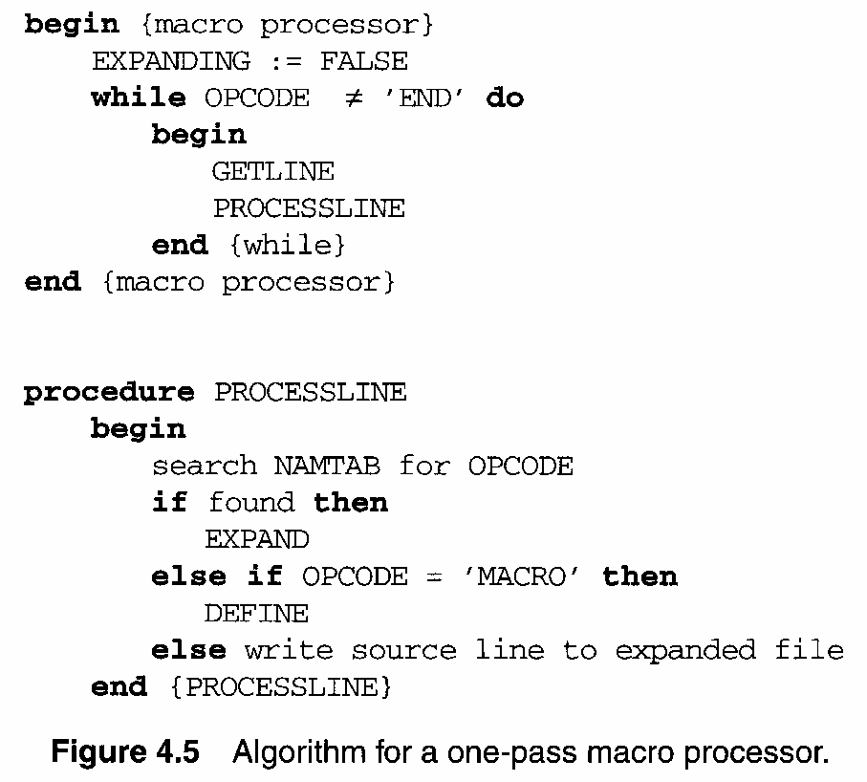

Slide 20
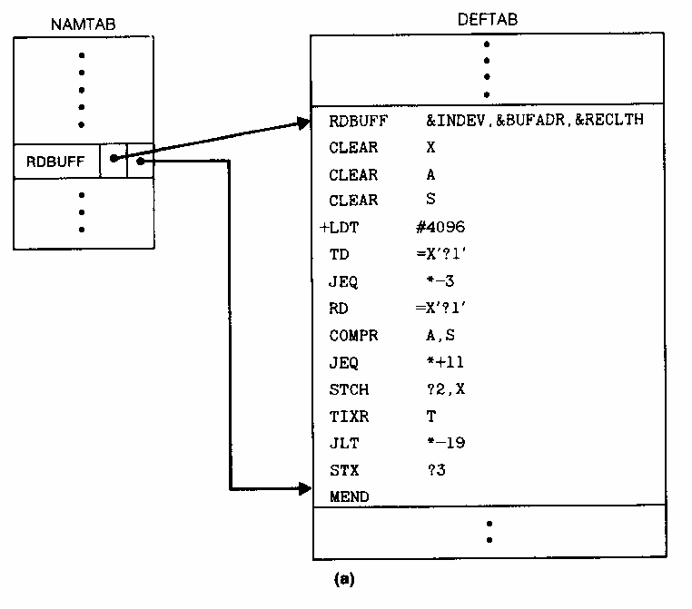
Data Structures -- Global Variables
DEFTAB
NAMTAB
ARGTAB
EXPANDING

Slide 21
Deftab: the macro prototype with macro body
No comment lines
References to macro parameters are converted to positional notations for efficiency
Namtab:the macro name is entered into namtab,which serves as an index to deftab
Contains pointer to starting & ending of definition table
Argtab: is used to store the arguments

Slide 22
One-Pass Macro Processor That Allows Nested Macro Definition
Sub-procedures
  macro definition: DEFINE
  macro invocation: EXPAND
EXPAND may invoke DEFINE when encounter macro definition
NAMTAB
DEFINE
MACRO
DEFTAB
PROCESSLINE
CALL
EXPAND
ARGTAB
Expanding
MACRO Definition

Slide 23
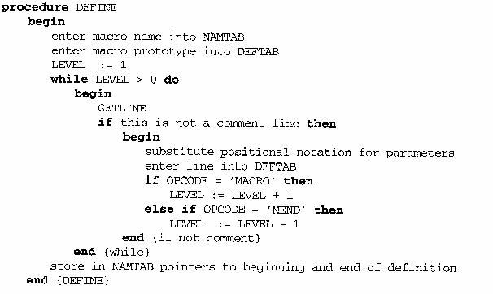

Slide 24
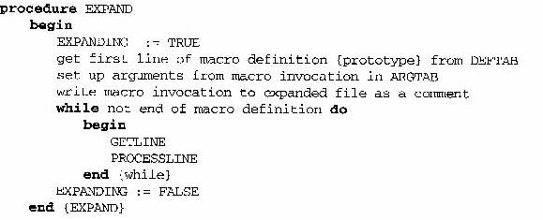
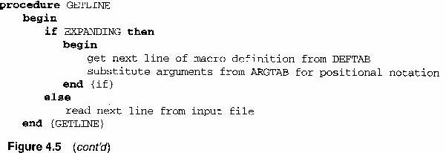

Slide 25
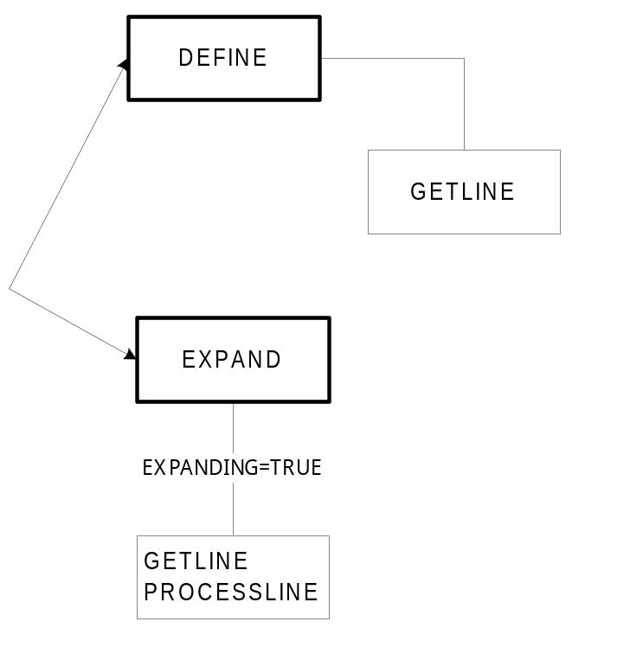
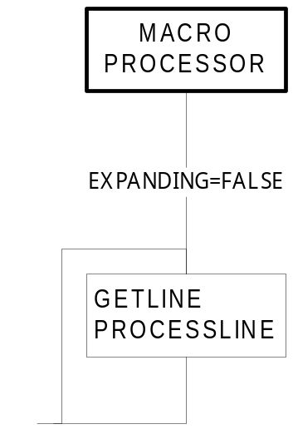
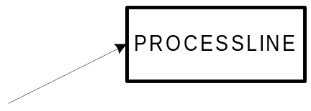
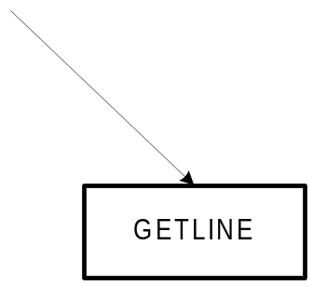
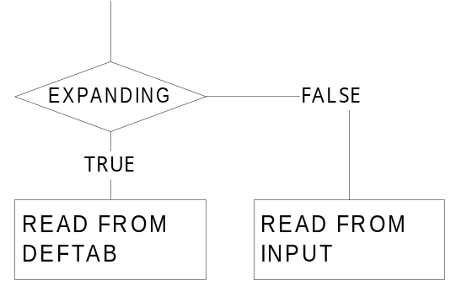
1-Pass Macro Processor

Slide 26
Comparison of Macro Processors Design
Single pass
  every macro must be defined before it is called
  one-pass processor can alternate between macro definition and macro expansion
  nested macro definitions may be allowed but nested calls are not
Two pass algorithm
  Pass1: Recognize macro definitions
  Pass2: Recognize macro calls
  nested macro definitions are not allowed

Slide 27
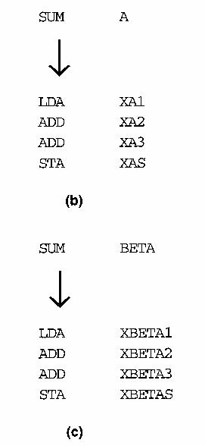
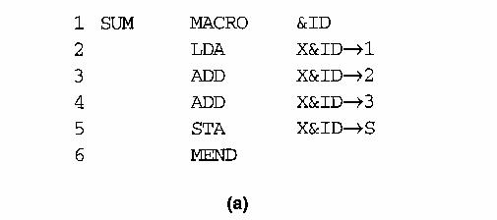
Machine independent macro processor features
1,Concatenation of Macro Parameters
  LDA X&ID→1
Example: Figure 4.6

Slide 28
2.Generation of Unique Labels
Example
  JEQ *-3
  inconvenient, error-prone, difficult to read
Example Figure 4.7
    $LOOP TD =X’&INDEV’
  1st call:
    $AALOOP TD =X’F1’
  2nd call:
    $ABLOOP TD =X’F1’

Slide 29
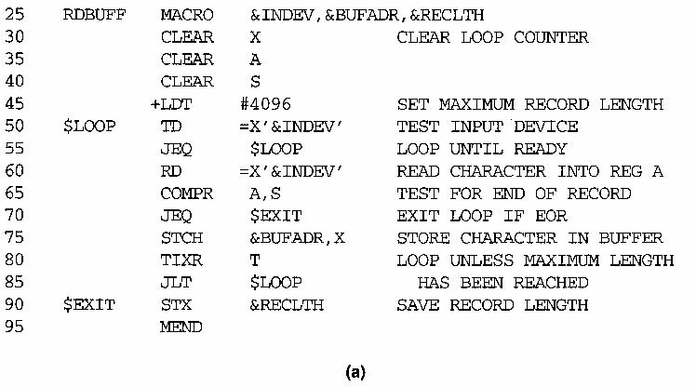

Slide 30
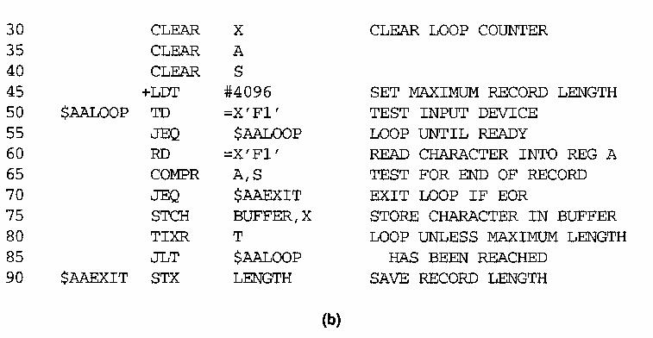
RDBUFF F1, BUFFER, LENGTH

Slide 31
3.Conditional Macro Expansion
Macro-time conditional statements
  Example: Figure 4.8
  IF-ELSE-ENDIF
Macro-time variables
  any symbol that begins with the character & and that is not a macro parameter
  macro-time variables are initialized to 0
  macro-time variables can be changed with their values using SET
    &EORCK SET 1

Slide 32
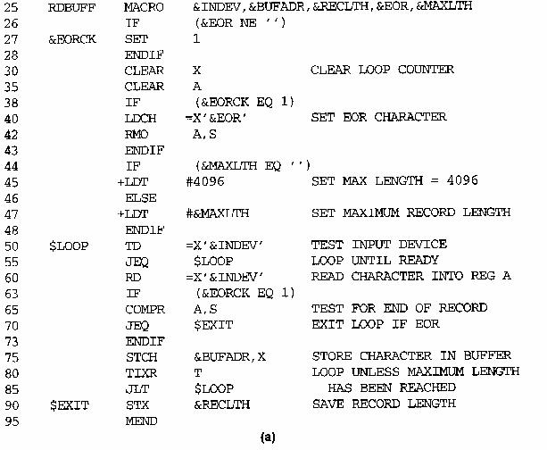

Slide 33
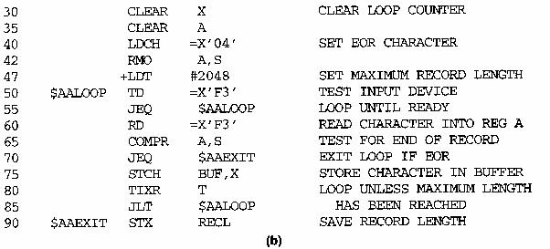
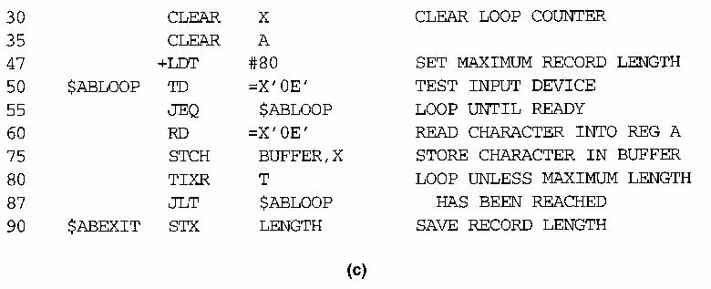
RDBUFF F3, BUF, RECL, 04, 2048
RDBUFF 0E, BUFFER, LENGTH, , 80

Slide 34
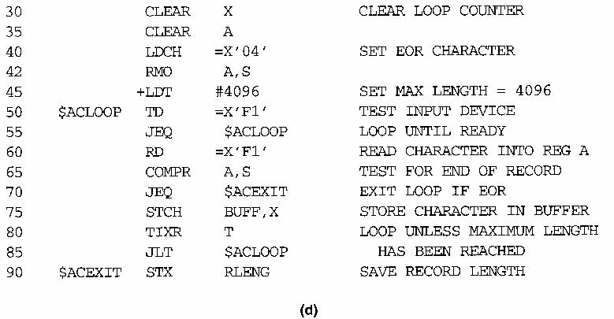
RDBUFF F1, BUFF, RLENG, 04

Slide 35
Conditional Macro Expansion (Cont.)
Macro-time looping statement
  Example: Figure 4.9
  WHILE-ENDW
Macro processor function
  %NITEMS: THE NUMBER OF MEMBERS IN AN ARGUMENT LIST

Slide 36
RDBUFF MACRO &INDEV,&BUFADR,&RECLTH,&EOR
&EORCT SET %NITEMS(&EOR)
CLEAR X
CLEAR A
+LDT #4096
$LOOP TD =X’&INDEV’
JEQ $LOOP
RD =X’&INDEV’
&CTR SET 1
WHILE(&CTR LE &EORCT)
COMP =X’0000&EOR[&CTR]’
JEQ $EXIT
&CTR SET &CTR+1
ENDW
STCH &BUFADR,X
TIXR T
JLT $LOOP
$EXIT STX &RECLTH
MEND

Slide 37
RDBUFF F2,BUFFER,LENGTH,(00,03,04)
CLEAR X
CLEAR A
+LDT #4096
$AALOOP TD =X’F2’
JEQ $AALOOP
RD =X’F2’
COMP =X’000000’
JEQ $AAEXIT
COMP =X’000003’
JEQ $AAEXIT
COMP =X’000004’
JEQ $AAEXIT
STCH BUFFER,X
TIXR T
JLT $AALOOP
$AAEXIT STX LENGTH

Slide 38
4.Keyword macro parameters
Parameters and arguments are associated with each other according to their positions in the macro prototype & macro invocation statement
Positional parameters are quite suitable when less number of parametrs
But it is difficult if more parameter,thus we move on to keyword macro parameters
Eg:GENER ,,DIRECT,,,,,,3
GENER TYPE=DIRECT,CHANNEL=3

Slide 39
RDBUFF MACRO &INDEV=F1,&BUFADR=,&RECLTH=,&EOR=04,&MAXLTH=4096
IF (&EOR NE ‘’)
&EORCK SET 1
ENDIF
CLEAR X
CLEAR A
IF (&EORCK EQ 1)
LDCH =X’&EOR’
RMO A,S
ENDIF
+LDT #&MAXLTH
$LOOP TD =X’&INDEV’
JEQ $LOOP
RD =X’&INDEV’
IF (&EORCK EQ 1)
COMPR A,S
JEQ $EXIT
ENDIF
STCH &BUFADR,X
TIXR T
JLT $LOOP
$EXIT STX &RECLTH
MEND

Slide 40
RDBUFF BUFADR=BUFFER,RECLTH=LENGTH
  CLEAR X
CLEAR A
LDCH =X’04’
RMO A,S
+LDT #4096
$AALOOP TD =X’F1’
JEQ $AALOOP
RD =X’F1’
COMPR A,S
JEQ $AAEXIT
STCH &BUFFER,X
TIXR T
JLT $AALOOP
$AAEXIT STX LENGTH

Slide 41
RDBUFF RECLTH=LENGTH,BUFADR=BUFFER,EOR=,INDEV=F3
CLEAR X
CLEAR A
+LDT #4096
$ABLOOP TD =X’F3’
JEQ $ABLOOP
RD =X’F3’
STCH BUFFER,X
TIXR T
JLT $ABLOOP
$ABEXIT STX LENGTH

Slide 42
Macro processor design options
1.Recursive macro expansion
RDCHAR is to read one character from a specified device into register A
RDCHAR MACRO &IN
TD =X’&IN’
JEQ *-3
RD =X’&IN’
MEND
NESTED INVOCATION PGM

Slide 43
RDBUFF MACRO &BUFADR,&RECLTH,&INDEV
CLEAR X
CLEAR A
CLEAR S
+LDT #4096
$LOOP RDCHAR &INDEV
COMPR A,S
JEQ $EXIT
STCH &BUFADR,X
TIXR T
JLT LOOP
$EXIT STX &RECLTH
MEND
RDBUFF BUFFER,LENGTH,F1
The procedure EXPAND would be called when the macro is recognized
The argtab consists of

Slide 44
BUFFER
LENGTH
F1
(UNUSED)
The boolean variable EXPANDING =TRUE,and the expansion of macro invocation statement would begin
The processing proceed normally till invocation line
At that point PROCESSLINE call EXPAND again
The ARGTAB is now
The expansion of RDCHAR takes place,at the end of RDCHAR expansion EXPANDING=FALSE
The macro procrosser forget that it was in the middle of the routine and causes a problem,this problem is due to recursive call of function EXPAND
This is resolved by writing the macro processor in the programming language which supports recursion
F1
(UNUSED)

Slide 45
2. General purpose macro processor
Macro processor are combined with or closely related to assembler
Macro processors are developed to some high-level programming languages
The general purpose macro processor is not dependent on any programming languages
Adv
1.The programmer does not need to learn about a different macro facility to each compiler
2.Time & expense involved in training are eliminated
3.The costs involved for producing general purpose macroprocessor is high compared to language specific processor,but the overall cost is low
4.Software development & maintenance is low
Disadv
Large number of details that must be included(eg: { } .begin end)
Complex
It has varying syntax for macro definition & invocation statements

Slide 46
3.Macro processing within language translators
Previous macro processors are called as preprocessors,because they process macro definitions & expand macro invocations ,producing an expanded version of the source pgm.
Alternate to preprocessor is combining the macro processing functions with the language translator itself
This is done by line-by-line macro processor method ,where macro processor reads the source pgm statements & performs all the functions ,the output lines are passed to language translator as they are generated( one at a time),instead of being written to an expanded source file.
Advantages:
1. it avoids making extra pass over the source pgm,so it is more efficient than macro preprocessor
2. Data structures required for macro processor & language translator can be combined( NAMTAB & optab)
3. Many utility subroutines & functions can be used by both language translator & macro processor

Slide 47
4.It is easier to give diagnostic messages that are related to the source statement containing the error
The utility routines in line to line macroprocessors are used by both,but they are still independent
The way of communication is by passing source statements b/w 2 functions.
Such a scheme is called the language translator with a integrated macro processor
Disadvantages:
Cost is high
Size is high
Complexity is more

