Slide 1
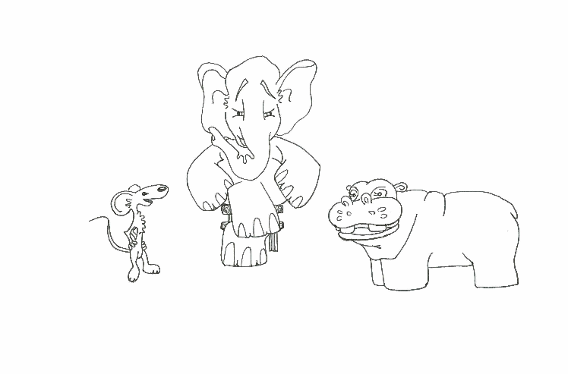
Foundations of Software Testing
Chapter 4: Test Generation: Combinatorial Designs
Aditya P. Mathur
Purdue University
These slides are copyrighted. They are for use with the Foundations of Software Testing book by Aditya Mathur. Please use the slides but do not remove the copyright notice.
Last update: September 3, 2007

Slide 2
Learning Objectives
What are test configurations? How do they differ from test sets?
Why combinatorial design?
What are Latin squares and mutually orthogonal Latin squares (MOLS)?
How does one generate test configurations from MOLS?
What are orthogonal arrays, covering arrays and mixed-level covering arrays?
How to generate mixed-level covering arrays and test configurations from them?

Slide 3
Test configuration
Software applications are often designed to work in a variety of environments. Combinations of factors such as the operating system, network connection, and hardware platform, lead to a variety of environments.
An environment is characterized by combination of hardware and software.
Each environment corresponds to a given set of values for each factor, known as a test configuration.

Slide 4
Test configuration: Example
Windows XP, Dial-up connection, and a PC with 512MB of main memory, is one possible configuration.
Different versions of operating systems and printer drivers, can be combined to create several test configurations for a printer.
To ensure high reliability across the intended environments, the application must be tested under as many test configurations, or environments, as possible.
The number of such test configurations could be exorbitantly large making it impossible to test the application exhaustively.

Slide 5
Test configuration and test set
While a test configuration is a combination of factors corresponding to hardware and software within which an application is to operate, a test set is a collection of test cases. Each test case consists of input values and expected output.
Techniques we shall learn are useful in deriving test configurations as well as test sets.

Slide 6
Motivation
While testing a program with one or more input variables, each test run of a program often requires at least one value for each variable.
For example, a program to find the greatest common divisor of two integers x and y requires two values, one corresponding to x and the other to y.

Slide 7
Motivation [2]
While equivalence partitioning discussed earlier offers a set of guidelines to design test cases, it suffers from two shortcomings:
(a) It raises the possibility of a large number of sub-domains in the partition.
(b) It lacks guidelines on how to select inputs from various sub-domains in the partition.

Slide 8
Motivation [3]
The number of sub-domains in a partition of the input domain increases in direct proportion to the number and type of input variables, and especially so when multidimensional partitioning is used.
Once a partition is determined, one selects at random a value from each of the sub-domains. Such a selection procedure, especially when using uni-dimensional equivalence partitioning, does not account for the possibility of faults in the program under test that arise due to specific interactions amongst values of different input variables.

Slide 9
Motivation [4]
While boundary values analysis leads to the selection of test cases that test a program at the boundaries of the input domain, other interactions in the input domain might remain untested.
We will learn several techniques for generating test configurations or test sets that are small even when the set of possible configurations or the input domain and the number of sub-domains in its partition, is large and complex.

Slide 10
Modeling: Input and configuration space [1]
The input space of a program P consists of k-tuples of values that could be input to P during execution.
The configuration space of P consists of all possible settings of the environment variables under which P could be used.
Consider program P that takes two integers x>0 and y>0 as inputs. The input space of P is the set of all pairs of positive non-zero integers.

Slide 11
Modeling: Input and configuration space [2]
Now suppose that this program is intended to be executed under the Windows and the MacOS operating system, through the Netscape or Safari browsers, and must be able to print to a local or a networked printer.
The configuration space of P consists of triples (X, Y, Z) where X represents an operating system, Y a browser, and Z a local or a networked printer.

Slide 12
Factors and levels
Consider a program P that takes n inputs corresponding to variables X₁, X₂, ..X_{n}. We refer to the inputs as factors. The inputs are also referred to as test parameters or as values.
Let us assume that each factor may be set at any one from a total of c_{i}, 1≤ i ≤ n values. Each value assignable to a factor is known as a level. |F| refers to the number of levels for factor F.

Slide 13
Factor combinations
A set of values, one for each factor, is known as a factor combination.
For example, suppose that program P has two input variables X and Y. Let us say that during an execution of P, X and Y may each assume a value from the set {a, b, c} and {d, e, f}, respectively.
Thus we have 2 factors and 3 levels for each factor. This leads to a total of 3²=9 factor combinations, namely (a, d), (a, e), (a, f), (b, d), (b, e), (b, f), (c, d), (c, e), and (c, f).

Slide 14
Factor combinations: Too large?
In general, for k factors with each factor assuming a value from a set of n values, the total number of factor combinations is n^{k}.
Suppose now that each factor combination yields one test case. For many programs, the number of tests generated for exhaustive testing could be exorbitantly large.
For example, if a program has 15 factors with 4 levels each, the total number of tests is 4¹⁵ ~10⁹. Executing a billion tests might be impractical for many software applications.

Slide 15
Example: Pizza Delivery Service (PDS) [1]
A PDS takes orders online, checks for their validity, and schedules Pizza for delivery.
A customer is required to specify the following four items as part of the online order: Pizza size, Toppings list, Delivery address and a home phone number. Let us denote these four factors by S, T, A, and P, respectively.

Slide 16
Pizza Delivery Service (PDS): Specs
Suppose now that there are three varieties for size: Large, Medium, and Small.
There is a list of 6 toppings from which to select. In addition, the customer can customize the toppings.
The delivery address consists of customer name, one line of address, city, and the zip code. The phone number is a numeric string possibly containing the dash (``--") separator.

Slide 17
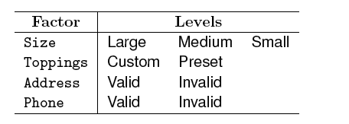
PDS: Input space model
The total number of factor combinations is 2⁴+2³=24.
Suppose we consider 6+1=7 levels for Toppings. Number of combinations= 2⁴+5x2³+2³+5x2²=84.
Different types of values for Address and Phone number will further increase the combinations

Slide 18
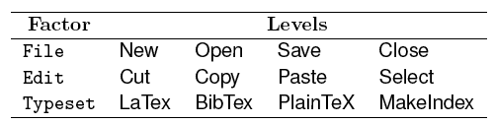
Example: Testing a GUI
The Graphical User Interface of application T consists of three menus labeled File, Edit, and Format.
We have three factors in T. Each of these three factors can be set to any of four levels. Thus we have a total 4³=64 factor combinations.

Slide 19
Example: The UNIX sort utility
The sort utility has several options and makes an interesting example for the identification of factors and levels. The command line for sort is given below.
sort [-cmu] [-ooutput] [-Tdirectory] [-y [ kmem]] [-zrecsz] [-dfiMnr] [-b] [ tchar] [-kkeydef] [+pos1[-pos2]] [file...]
We have identified a total of 20 factors for the sort command. The levels listed in Table 11.1 of the book lead to a total of approximately 1.9x10⁹ combinations.

Slide 20
Example: Compatibility testing
There is often a need to test a web application on different platforms to ensure that any claim such as ``Application X can be used under Windows and Mac OS X” are valid.
Here we consider a combination of hardware, operating system, and a browser as a platform. Let X denote a Web application to be tested for compatibility.
Given that we want X to work on a variety of hardware, OS, and browser combinations, it is easy to obtain three factors, i.e. hardware, OS, and browser.

Slide 21
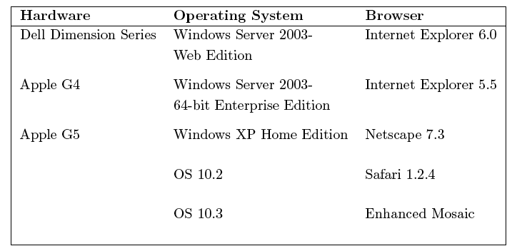
Compatibility testing: Factor levels

Slide 22
Compatibility testing: Combinations
There are 75 factor combinations. However, some of these combinations are infeasible.
For example, Mac OS10.2 is an OS for the Apple computers and not for the Dell Dimension series PCs. Similarly, the Safari browser is used on Apple computers and not on the PC in the Dell Series.
While various editions of the Windows OS can be used on an Apple computer using an OS bridge such as the Virtual PC, we assume that this is not the case for testing application X.

Slide 23
Compatibility testing: Reduced combinations
The discussion above leads to a total of 40 infeasible factor combinations corresponding to the hardware-OS combination and the hardware-browser combination. Thus in all we are left with 35 platforms on which to test X.
Note that there is a large number of hardware configurations under the Dell Dimension Series. These configurations are obtained by selecting from a variety of processor types, e.g., Pentium versus Athlon, processor speeds, memory sizes, and several others.

Slide 24
Compatibility testing: Reduced combinations-2
While testing against all configurations will lead to more thorough testing of application X, it will also increase the number of factor combinations, and hence the time to test.

Slide 25
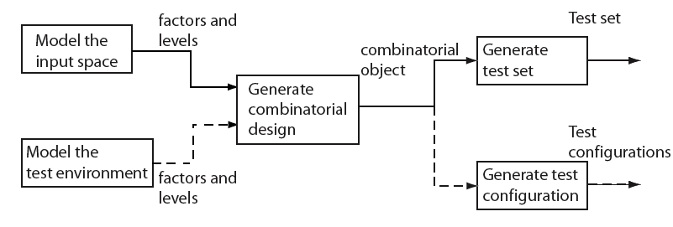
Combinatorial test design process
Modeling of input space or the environment is not exclusive and one might apply either one or both depending on the application under test.

Slide 26
Combinatorial test design process: steps
Step 1: Model the input space and/or the configuration space. The model is expressed in terms of factors and their respective levels.
Step 2: The model is input to a combinatorial design procedure to generate a combinatorial object which is simply an array of factors and levels. Such an object is also known as a factor covering design.
Step 3: The combinatorial object generated is used to design a test set or a test configuration as the requirement might be.
Steps 2 and 3 can be automated.

Slide 27
Combinatorial test design process: test inputs
Each combination obtained from the levels listed in Table 4.1 can be used to generate many test inputs.
For example, consider the combination in which all factors are set to ``Unused" except the -o option which is set to ``Valid File" and the file option that is set to ``Exists.” Two sample test cases are:
t₁: sort -o afile bfile
t₂: sort -o cfile dfile
Is one of the above tests sufficient?

Slide 28
Combinatorial test design process: summary
Combination of factor levels is used to generate one or more test cases. For each test case, the sequence in which inputs are to be applied to the program under test must be determined by the tester.
Further, the factor combinations do not indicate in any way the sequence in which the generated tests are to be applied to the program under test. This sequence too must be determined by the tester.
The sequencing of tests generated by most test generation techniques must be determined by the tester and is not a unique characteristic of test generated in combinatorial testing.

Slide 29
Fault model
Faults aimed at by the combinatorial design techniques are known as interaction faults.
We say that an interaction fault is triggered when a certain combination of t≥1 input values causes the program containing the fault to enter an invalid state.
Of course, this invalid state must propagate to a point in the program execution where it is observable and hence is said to reveal the fault.

Slide 30
t-way interaction faults
Faults triggered by some value of an input variable, i.e. t=1, regardless of the values of other input variables, are known as simple faults.
For t=2, the faults are known as pairwise interaction faults.
In general, for any arbitrary value of t, the faults are known as t--way interaction faults.

Slide 31
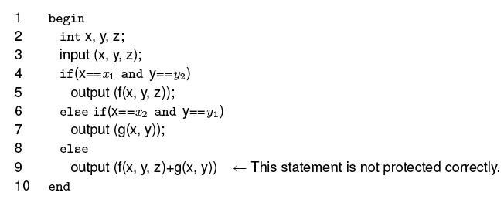
Pairwise interaction fault: Example
Correct output: f(x, y, z)-g(x, y) when X=x1 and Y=y1.
This is a pairwise interaction fault due to the interaction between factors X and Y.

Slide 32

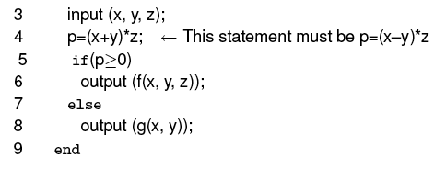
3-way interaction fault: Example
This fault is triggered by all inputs such that x+y≠x-y and z ≠ 0. However, the fault is revealed only by the following two of the eight possible input combinations: x=-1, y=1, z=1 and x=-1, y=-1, z=1.

Slide 33
Fault vectors
Given a set of k factors f1, f2,.., fk, each at qi, 1≤ i ≤ k levels, a vector V of factor levels is (l1, l2,.., lk), where li, 1 ≤ i ≤ k is a specific level for the corresponding factor. V is also known as a run.
A run V is a fault vector for program P if the execution of P against a test case derived from V triggers a fault in P. V is considered as a t-fault vector if any t ≤ k elements in V are needed to trigger a fault in P. Note that a t-way fault vector for P triggers a t-way fault in P.

Slide 34
Fault vectors: Example
The input domain consists of three factors x, y, and z each having two levels. There is a total of eight runs. For example, (1,1, 1) and (-1, -1, 0) are two runs.
Of these eight runs, (-1, 1, 1) and (-1, -1, 1) are three fault vectors that trigger the 3-way fault. (x1, y1, *) is a 2-way fault vector given that the values x1 and y1 trigger the two-way fault.

Slide 35
Goal reviewed
The goal of the test generation techniques described in this chapter is to generate a sufficient number of runs such that tests generated from these runs reveal all t-way faults in the program under test.

Slide 36
Goal reviewed
The number of such runs increases with the value of t. In many situations, t is set to 2 and hence the tests generated are expected to reveal pairwise interaction faults.
Of course, while generating t-way runs, one automatically generates some t+1, t+2, .., t+k-1, and k-way runs also. Hence, there is always a chance that runs generated with t=2 reveal some higher level interaction faults.

Slide 37


Latin Squares
Let S be a finite set of n symbols. A Latin square of order n is an n x n matrix such that no symbol appears more than once in a row and column. The term ``Latin square" arises from the fact that the early versions used letters from the Latin alphabet A, B, C, etc. in a square arrangement.
S={A, B}. Latin squares of order 2.
S={1, 2, 3}. Latin squares of order 3.

Slide 38
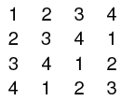
Larger Latin Squares
Larger Latin squares of order n can be constructed by creating a row of n distinct symbols. Additional rows can be created by permuting the first row.
For example, here is a Latin square M of order 4 constructed by cyclically rotating the first row and placing successive rotations in subsequent rows.

Slide 39
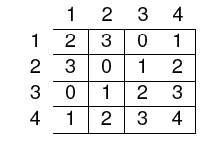
Modulo arithmetic and Latin Squares
A Latin square of order n>2 can also be constructed easily by doing modulo arithmetic. For example, the Latin square M of order 4 given below is constructed such that M(i, j)=i+j (mod 4), 1≤ (i, j) ≤ 4.
A Latin square based on integers 0, 1… n is said to be in standard form if the elements in the top row and the leftmost column are arranged in order.
0

Slide 40
Mutually Orthogonal Latin Squares (MOLS)
Let M1 and M2 be two Latin squares, each of order n. Let M1(i, j) and M2(i, j) denote, respectively, the elements in the ith row and jth column of M1 and M2.
We now create an n x n matrix M from M1 and M2 such that the L(i, j) is M1(i, j)M2(i, j), i.e. we simply juxtapose the corresponding elements of M1 and M2.
If each element of M is unique, i.e. it appears exactly once in M, then M1 and M2 are said to be mutually orthogonal Latin squares of order n.

Slide 41


MOLS: Example
There are no MOLS of order 2. MOLS of order 3 follow.
Juxtaposing the corresponding elements gives us L. Its elements are unique and hence M1 and M2 are MOLS.

Slide 42
MOLS: How many of a given order?
MOLS(n) is the set of MOLS of order n. When n is prime, or a power of prime, MOLS(n) contains n-1 mutually orthogonal Latin squares. Such a set of MOLS is a complete set.
MOLS do not exist for n=2 and n=6 but they do exist for all other values of n>2. Numbers 2 and 6 are known as Eulerian numbers after the famous mathematician Leonhard Euler (1707-1783). The number of MOLS of order n is denoted by N(n). When n is prime or a power of prime, N(n)=n-1.

Slide 43
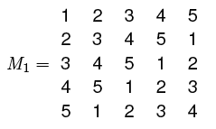
MOLS: Construction [1]
Example: We begin by constructing a Latin square of order 5 given the symbol set S={1, 2, 3, 4, 5}.

Slide 44
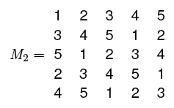
MOLS: Construction [2]
Next, we obtain M2 by rotating rows 2 through 5 of M1 by two positions to the left.

Slide 45
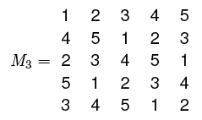
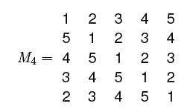
MOLS: Construction [3]
M3 and M4 are obtained similarly but by rotating the first row of M1 by 3 and 4 positions, respectively.
Thus we get MOLS(5)={M1, M2, M3, M4}. It is easy to check that indeed the elements of MOLS(5) are mutually orthogonal by superimposing them pairwise.

Slide 46
MOLS: Construction, limitation
The method illustrated in the previous example is guaranteed to work only when constructing MOLS(n) for n that is prime or a power of prime. For other values of n, the maximum size of MOLS(n) is n-1.
There is no general method available to construct the largest possible MOLS(n) for n that is not a prime or a power of prime. The CRC Handbook of Combinatorial Designs gives a large table of MOLS.

Slide 47

Pairwise designs: Two-valued factors

Slide 48
Pairwise designs
We will now look at a simple technique to generate a subset of factor combinations from the complete set. Each combination selected generates at least one test input or test configuration for the program under test.
Only 2-valued, or binary, factors are considered. Each factor can be at one of two levels. This assumption will be relaxed later.

Slide 49
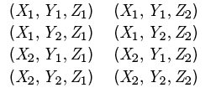
Pairwise designs: Example
Suppose that a program to be tested requires 3 inputs, one corresponding to each input variable. Each variable can take only one of two distinct values.
Considering each input variable as a factor, the total number of factor combinations is 2³. Let X, Y, and Z denote the three input variables and {X1, X2}, {Y1, Y2}, {Z1, Z2} their respective sets of values. All possible combinations of these three factors follow.

Slide 50

Pairwise designs: Reducing the combinations
Now suppose we want to generate tests such that each pair appears in at least one test. There are 12 such pairs: (X1, Y1), (X1, Y2), (X1, Z1), (X1, Z2), (X2, Y1), (X2, Y2), (X2, Z1), (X2, Z2), (Y1, Z1), (Y1, Z2), (Y2, Z1), and (Y2, Z2). The following four combinations cover all pairs:
The above design is also known as a pairwise design. It is a balanced design because each value occurs exactly the same number of times. There are several sets of four combinations that cover all 12 pairs.

Slide 51
Example: ChemFun applet
A Java applet ChemFun allows its user to create an in-memory database of chemical elements and search for an element. The applet has 5 inputs listed after the next slide with their possible values.
We refer to the inputs as factors. For simplicity we assume that each input has exactly two possible values.

Slide 52
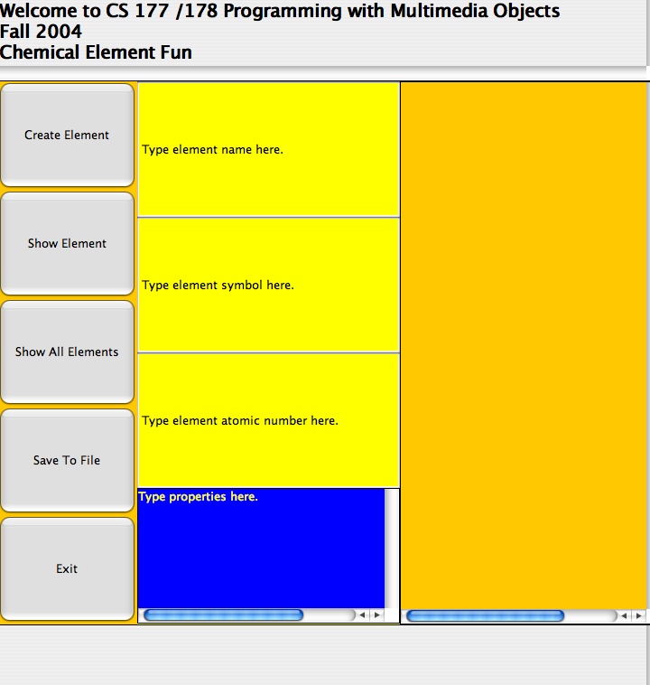
Example: ChemFun applet

Slide 53
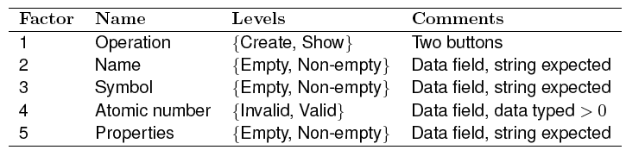
Example: ChemFun applet: Factor identification

Slide 54
ChemFun applet: Input/Output
Input: n=5 factors
Output: A set of factor combinations such that all pairs of input values are covered.

Slide 55


ChemFun applet: Step 1
Compute the smallest integer k such that n≤ |S_{2k-1}|
S_{2k-1}: Set of all binary strings of length 2k-1, k>0.
S_{2k-1}=
For k=3 we have S₅= 10 and for k=2, S₃= 3.
Hence the desired integer is k=3.

Slide 56
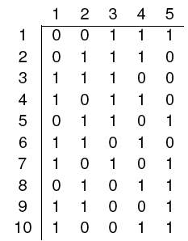
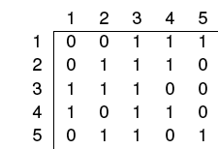
ChemFun applet: Step 2
Select any subset of n strings from S_{2k-1}. We have, k=3 and we have the following strings in the set S₅.
We select first five of the 10 strings in S₅.

Slide 57
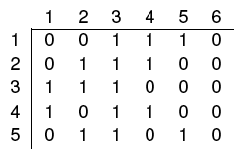
ChemFun applet: Step 3
Append 0's to the end of each selected string. This will increase the size of each string from 2k-1 to 2k.

Slide 58
ChemFun applet: Step 4
Each combination is of the kind (X₁, X₂,…, X_{n}), where the value of each variable is selected depending on whether the bit in column i, 1≤ i ≤ n, is a 0 or a 1.

Slide 59
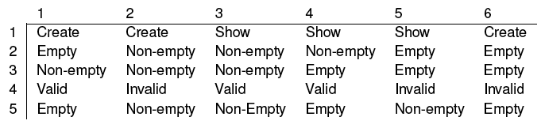
ChemFun applet: Step 4 (contd.)
The following factor combinations by replacing the 0s and 1s in each column by the corresponding values of each factor.

Slide 60

ChemFun applet: tests

Slide 61
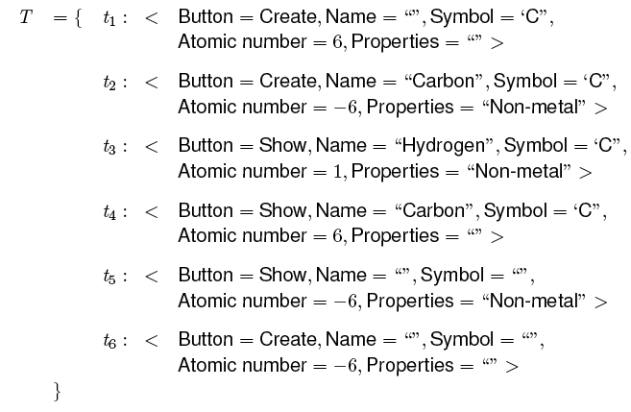
ChemFun applet: All tests
Recall that the total number of combinations is 32. Requiring only pairwise coverage reduces the tests to 6.

Slide 62
Pairwise designs: Multi-valued factors

Slide 63
Pairwise designs: Multi-valued factors
Next we will learn how to use MOLS to construct test configurations when:
The number of factors is two or more,
The number of levels for each factor is more than two,
All factors have the same number of levels.

Slide 64
Multi-valued factors: Sample problem
DNA sequencing is a common activity amongst biologists and other researchers. Several genomics facilities are available that allow a DNA sample to be submitted for sequencing.
One such facility is offered by The Applied Genomics Technology Center (AGTC) at the School of Medicine in Wayne State University.
The submission of the sample itself is done using a software application available from AGTC. We refer to this software as AGTCS.

Slide 65
Sample problem (contd.)
AGTCS is supposed to work on a variety of platforms that differ in their hardware and software configurations. Thus the hardware platform and the operating system are two factors to be considered while developing a test plan for AGTCS.
In addition, the user of AGTCS, referred to as PI, must either have a profile already created with AGTCS or create a new one prior to submitting a sample. AGTCS supports only a limited set of browsers.
For simplicity we consider a total of four factors with their respective levels given next.

Slide 66
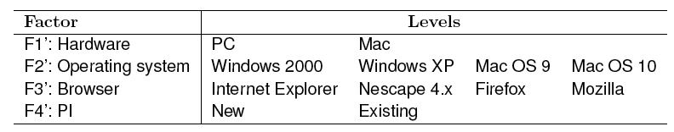
DNA sequencing: factors and levels
There are 64 combinations of the factors listed. As PCs and Macs run their dedicated operating systems, the number of combinations reduces to 32.
We want to test under enough configurations so that all possible pairs of factor levels are covered.

Slide 67
DNA sequencing: Approach to test design
We can now proceed to design test configurations in at least two ways. One way is to treat the testing on PC and Mac as two distinct problems and design the test configurations independently.
Exercise 11.12 asks you to take this approach and explore its advantages over the second approach used in this example.
The approach used in this example is to arrive at a common set of test configurations that obey the constraint related to the operating systems.

Slide 68
DNA sequencing: Test design algorithm
Input: n=4 factors.
|F1’|=2, |F2’|=4, |F3’|=4, |F4’|=2, where F1’, F2’, F3’, and F4’ denote, respectively, hardware, OS, browser, and PI.
Output: A set of factor combinations such that all pairwise combinations are covered.

Slide 69
Test design algorithm: Step 1
Relabel the factors as F1, F2, F3, F4 such that
|F1|≥|F2| ≥ |F3| ≥ |F4|.
Doing so gives us F1=F2', F2=F3', F3=F1', F4=F4’.
A different assignment is possible since |F1|=|F4| and |F2|=|F3|.
Let b=|F1|=4 and k=|F2|=4

Slide 70
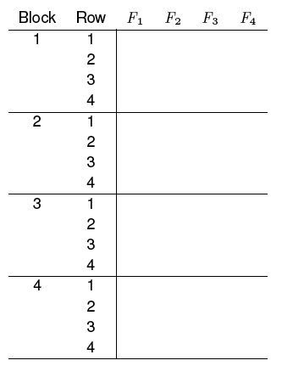
Test design algorithm: Step 2
Prepare a table containing n=4 columns and b x k=16 rows divided into b=4 blocks.
Label the columns F1, F2,…, Fn.
Each block contains k=4 rows.

Slide 71
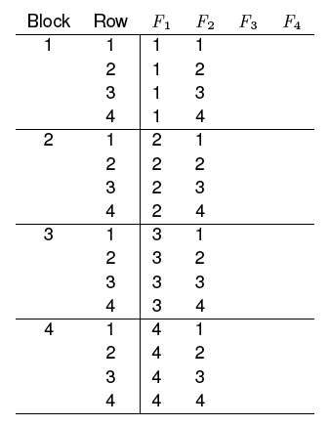
Test design algorithm: Step 3 (contd.)
Fill column F1 with
1's in Block 1,
2's in Block 2,
and so on.
Fill each block of column F2 with the sequence 1, 2,..., k
in rows 1 through k (k=4).

Slide 72
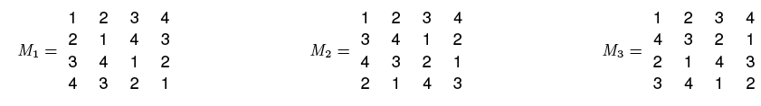
Test design algorithm: Step 4
Find MOLS of order 4. As 4 is not a prime, we cannot use the procedure described earlier.
We choose the following set of MOLS of order 4.

Slide 73
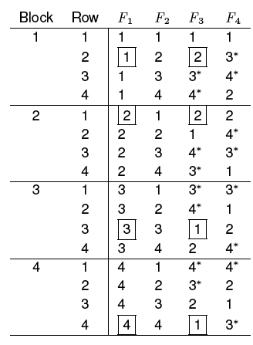
Test design algorithm: Step 5
From M1
From M2
Fill the remaining two columns of the table constructed earlier using columns of M1 for F3 and columns of M2 for F4.
A boxed entry in a row indicates a pair that does not satisfy the operating system constraint.
An entry marked with an asterisk (*) indicates an invalid level.

Slide 74
Test design algorithm: Step 6 [1]
Using the 16 entries in the table above, we can obtain 16 distinct test configurations for AGTCS. However, we need to resolve two problems before we get to the design of test configurations.
Problem 1: Factors F3 and F4 can only assume values 1 and 2 whereas the table above contains other infeasible values for these two factors. These infeasible values are marked with an asterisk.
Solution: One simple way to get rid of the infeasible values is to replace them by an arbitrarily selected feasible value for the corresponding factor.

Slide 75

Test design algorithm: Step 6 [2]
Problem 2: Some configurations do not satisfy the operating system constraint. Four such configurations are highlighted in the design by enclosing the corresponding numbers in rectangles.
Here is an example:
F1: Operating system=1(Win 2000) F3: Hardware=2 (Mac) is infeasible.
W are assume that one is not using Virtual PC on the Mac.

Slide 76
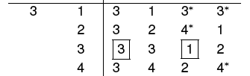
Test design algorithm: Step 6 [3]
Delete rows with conflicts?: Obviously we cannot just delete these rows as that would leave some pairs uncovered. Consider block 3.
Removing Row 3 of block 3 will leave the following five pairs uncovered: (F1=3, F2=3), (F1=3, F4=2), (F2=3, F3=1),
(F2=3, F4=2), and (F3=1, F4=2).

Slide 77
Test design algorithm: Step 6 [4]
Proposed solution: We follow a two step procedure to remove the highlighted configurations and retain complete pairwise coverage.
Step 1: Modify the four highlighted rows so they do not violate the constraint.
Step 2: Add new configurations that cover the pairs left uncovered when we replace the highlighted rows.

Slide 78
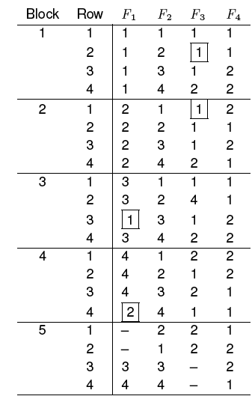
Test design algorithm: Step 6 [5]
F1: OS
F2: Browser
F3: Hardware
F4: PI

Slide 79
Test design algorithm:Design configurations
We can easily construct 20 test configurations from the design obtained. This is in contrast to 32 configurations obtained using a brute force method.
Can we remove some rows from the design without affecting pairwise coverage?

Slide 80
Shortcomings of using MOLS
A sufficient number of MOLS might not exist for the problem at hand.
While the MOLS approach assists with the generation of a balanced design in that all interaction pairs are covered an equal number of times, the number of test configurations is often larger than what can be achieved using other methods.

Slide 81
Orthogonal Arrays

Slide 82
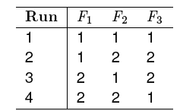
Orthogonal arrays
Examine this matrix and extract as many properties as you can:
An orthogonal array, such as the one above, is an N x k matrix in which the entries are from a finite set S of s symbols such that any N x t subarray contains each t-tuple exactly the same number of times. Such an orthogonal array is denoted by OA(N, k, s, t).

Slide 83
Orthogonal arrays: Example
The following orthogonal array has 4 runs and has a strength of 2. It uses symbols from the set {1, 2}.
This array is denoted as OA(4, 3, 2, 2).
The value of parameter k is 3, hence we have labeled the columns as F1, F2, and F3 to indicate the three factors.

Slide 84
Orthogonal arrays: Index
The index of an orthogonal array is denoted by λ and is equal to N/s^{t}.
N is the number of runs and t is the strength of the orthogonal array.
=4/2²=1 implying that each pair (t=2) appears exactly once (λ=1) in any 4x2 subarray.
There are s^{t}=2²=4 pairs:
(1, 1), (1, 2), (2, 1), and (2, 2).
It is easy to verify that each of the four pairs appears exactly once in each 4x2 subarrays.

Slide 85
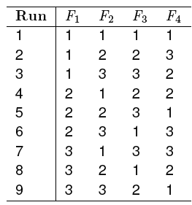
Orthogonal arrays: Another example
What kind of an OA is this?
It has 9 runs and a strength of 2.
Each of the four factors can be at any one of 3 levels.
This array is denoted OA(9, 4, 3, 2) and has index 1.

Slide 86

Orthogonal arrays: Alternate notations
Orthogonal array of N runs where k factors take on any value from a set of s symbols.
Arrays shown earlier are
L_{N} denotes an orthogonal array of 9 runs. T, k, s are determined from the context, i.e., by examining the array itself.

Slide 87
Mixed-level Orthogonal Arrays

Slide 88
Mixed level Orthogonal arrays
So far we have seen fixed level orthogonal arrays:
The design of such arrays assumes that all factors assume values from the same set of s values.
In many practical applications, different factors may take different set of values.
Mixed orthogonal arrays are useful in designing test configurations for such applications.

Slide 89

Mixed level Orthogonal arrays: Notation
Strength=t. Runs=N.
k1 factors at s1 levels,
k2 at s2 levels,
and so on.
Total factors:

Slide 90
Mixed level Orthogonal arrays: Index and balance
The formula used for computing the index λ of an orthogonal array does not apply to the mixed level orthogonal array as the count of values for each factor is a variable.
The balance property of orthogonal arrays remains intact for mixed level orthogonal arrays in that any N x t subarray contains each t-tuple corresponding to the t columns, exactly the same number of times, λ.

Slide 91
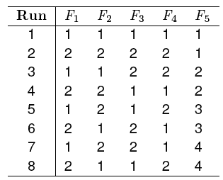

Mixed level Orthogonal arrays: Example
This array can be used to design test configurations for an application that contains 4 factors, each at 2 levels, and 1 factor, at 4 levels.
Can you identify some properties?
Balance: In any subarray of size 8 x 2, each possible pair occurs exactly the same number of times. In the two leftmost columns, each pair occurs exactly twice. In columns 1 and 3, each pair also occurs exactly twice. In columns 1 and 5, each pair occurs exactly once.

Slide 92
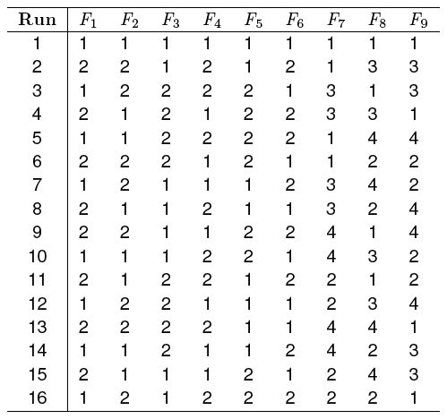
Mixed level Orthogonal arrays: Example
This array can be used to generate test configurations when there are six binary factors, labeled F1 through F6 and three factors each with four possible levels, labeled F7 through F9.

Slide 93
Mixed level Orthogonal arrays: Test generation: Pizza delivery
We have 3 binary factors and one factor at 3 levels. Hence we can use the following array to generate test configurations:

Slide 94
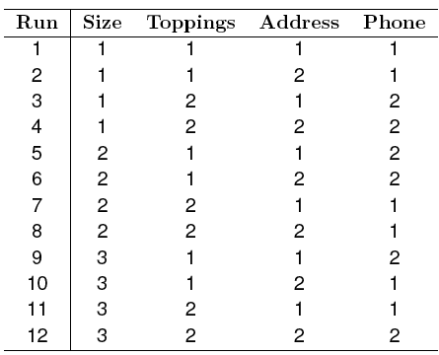
Test generation: Pizza delivery: Array
Check that all possible pairs of factor combinations are covered in the design above. What kind of errors will likely be revealed when testing using these 12 configurations?

Slide 95
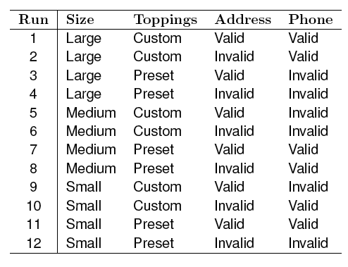
Test generation: Pizza delivery: test configurations

Slide 96
Covering and mixed-level covering arrays

Slide 97
The “Balance” requirement
Observation [Dalal and Mallows, 1998]: The balance requirement is often essential in statistical experiments, but it is not always so in software testing.
For example, if a software application has been tested once for a given pair of factor levels, there is generally no need for testing it again for the same pair, unless the application is known to behave non-deterministically.
For deterministic applications, and when repeatability is not the focus, we can relax the balance requirement and use covering arrays, or mixed level covering arrays for combinatorial designs.

Slide 98
Covering array
A covering array CA(N, k, s, t) is an N x k matrix in which entries are from a finite set S of s symbols such that each N x t subarray contains each possible t-tuple at least λ times.
N denotes the number of runs, k the number factors, s, the number of levels for each factor, t the strength, and λ the index
While generating test cases or test configurations for a software application, we use λ=1.

Slide 99
Covering array and orthogonal array
While an orthogonal array OA(N, k, s, t) covers each possible
t-tuple λ times in any N x t subarray, a covering array
CA(N, k, s, t) covers each possible t-tuple at least λ times
in any N x t subarray.
Thus covering arrays do not meet the balance requirement that is met by orthogonal arrays. This difference leads to combinatorial designs that are often smaller in size than orthogonal arrays.
Covering arrays are also referred to as unbalanced designs.
We are interested in minimal covering arrays.

Slide 100
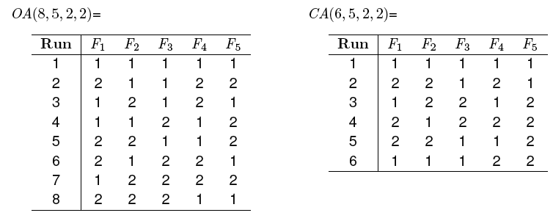
Covering array: Example
A balanced design of strength 2 for 5 binary factors, requires
8 runs and is denoted by OA(8, 5, 2, 2). However, a covering design with the same parameters requires only 6 runs.

Slide 101

Mixed level covering arrays
A mixed-level covering array is denoted as
and refers to an N x Q matrix of entries such that, Q= and each N x t subarray contains at least one occurrence of each t-tuple corresponding to the t columns. s1, s2, … denote the number of levels of each the corresponding factor.
Mixed-level covering arrays are generally smaller than
mixed-level orthogonal arrays and more appropriate for use in software testing.

Slide 102
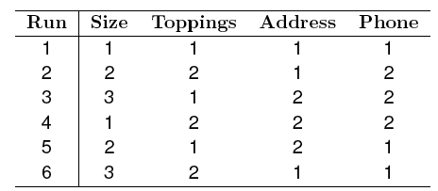

Mixed level covering array: Example
Comparing this with we notice a reduction of 6 configurations.
Is the above array balanced?

Slide 103
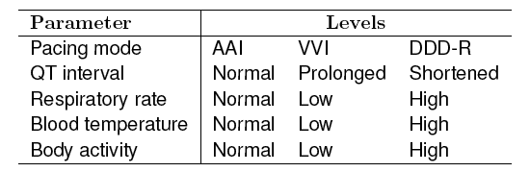
Arrays of strength >2
Designs with strengths higher than 2 are sometimes needed to achieve higher confidence in the correctness of software. Consider the following factors in a pacemaker.

Slide 104
Pacemaker example
Due to the high reliability requirement of the pacemaker, we would like to test it to ensure that there are no pairwise or 3-way interaction errors.
Thus we need a suitable combinatorial object with strength 3. We could use an orthogonal array OA(54, 5, 3, 3) that has 54 runs for 5 factors each at 3 levels and is of strength 3.
A total of 54 tests will be required to test for all 3-way interactions of the 5 pacemaker parameters
Could a design of strength 2 cover some triples and higher order tuples?

Slide 105
Generating mixed level covering arrays
We will now study a procedure due to Lei and Tai for the generation of mixed level covering arrays. The procedure is known as In-parameter Order (IPO) procedure.
Inputs: (a) n ≥2: Number of parameters (factors).
(b) Number of values (levels) for each parameter.
Output: MCA

Slide 106
IPO procedure
Consists of three steps:
Step 1: Main procedure.
Step 2: Horizontal growth.
Step 3: Vertical growth.

Slide 107
IPO procedure: Example
Consider a program with three factors: A, B, and C.
A assumes values from the set {a1, a2, a3},
B from the set {b1, b2},
and C from the set {c1, c2, c3}.
We want to generate a mixed level covering array for these three factors.
We begin by applying the Main procedure which is the first step in the generation of an MCA using the IPO procedure.

Slide 108
IPO procedure: main procedure
Main: Step 1: Construct all runs that consist of pairs of values of the first two parameters. We obtain the following set.
Let us denote the elements of as t1, t2,…,t6.
The entire IPO procedure would terminate at this point if the number of parameters n=2.
In our case n=3, hence we continue with horizontal growth.

Slide 109

IPO procedure: Horizontal growth
HG: Step 1: Compute the set of all pairs AP between parameters A and C, and parameters B and C. This leads us to the following set of nine pairs.
HG: Step 2: AP is the set of pairs yet to be covered.
Let T’ denote the set of runs obtained by extending the runs in T. At this point T’ is empty as we have not extended any run in T.

Slide 110
Horizontal growth: Extend
HG: Steps 3, 4: Expand t1, t2, t3 by appending c1, c2, c3.
This gives us:
t1’=(a1, b1, c1), t2’=(a1, b2, c2), and t3’=(a2, b1, c3)
Update T’ which becomes {(a1, b1, c1), (a1, b2, c2), (a2, b1, c3)}
Update pairs remaining to be covered AP={(a1, c3), (a2, c1), (a2, c2), (a3, c1), (a3, c2), (a3, c3), (b1, c2), (b2, c1), (b2, c3)}

Slide 111
Horizontal growth: Optimal extension
HG. Step 5: We have not extended t4, t5, t6 as the set of possible values for C does not have enough elements.
We find the best way to extend these in the next step.
HG: Step 6: Expand t4, t5, t6 by suitably selected values of C.
If we extend t4=(a2, b2) by c1 then we cover two of the uncovered pairs from AP, namely, (a2, c1) and (b2, c1).
If we extend it by c2 then we cover one pair from AP.
If we extend it by c3 then we cover one pairs in AP.
Thus we choose to extend t4 by c1.

Slide 112
Horizontal growth: Update and extend remaining
T’={(a1, b1, c1), (a1, b2, c2), (a2, b1, c3), (a2, b2, c1)}
AP= {(a1, c3), (a2, c2), (a3, c1), (a3, c2), (a3, c3), (b1, c2), (b2, c3)}_x0003__x0016_
HG: Step 6: Similarly we extend t5 and t6 by the best possible values of parameter C. This leads to:
t5’=(a3, b1, c3) and t6’=(a3, b2, c1)
T’={(a1, b1, c1), (a1, b2, c2), (a2, b1, c3), (a2, b2, c1),
(a3, b1, c3), (a3, b2, c1)}
AP= {(a1, c3), (a2, c2), (a3, c2), (b1, c2), (b2, c3)}_x0003__x0016_

Slide 113
Horizontal growth: Done
We have completed the horizontal growth step.
However, we have five pairs remaining to be covered:
AP= {(a1, c3), (a2, c2), (a3, c2), (b1, c2), (b2, c3)}
Also, we have generated six complete runs namely:
T’={(a1, b1, c1), (a1, b2, c2), (a2, b1, c3), (a2, b2, c1),
(a3, b1, c3), (a3, b2, c1)}
We now move to the vertical growth step of the main IPO procedure to cover the remaining pairs.

Slide 114
Vertical growth
For each missing pair p from AP, we will add a new run to T’ such that p is covered. Let us begin with the pair p= (a1, c3).
The run t= (a1, *, c3) covers pair p. Note that the value of parameter B does not matter , hence is indicated as *, which denotes a don’t care value.
Next, consider p=(a2, c2). This is covered by the run (a2, *, c2)
Next, consider p=(a3, c2). This is covered by the run (a3, *, c2)

Slide 115
Vertical growth (contd.)
Next, consider p=(b2, c3). We already have (a1, *, c3), hence we can modify it to get the run (a1, b2, c3).
Thus p is covered without any new run added.
Finally, consider p=(b1, c2). We already have (a3, *, c2), hence we can modify it to get the run (a3, b1, c2).
Thus p is covered without any new run added.
We replace the don’t care entries by an arbitrary value of the corresponding factor and get:
T={(a1, b1, c1), (a1, b2, c2), (a1, b1, c3), (a2, b1, c2), (a2, b2, c1),
(a2, b2, c3), (a3, b1, c3), (a3, b2, c1), (a3, b1, c2)}

Slide 116
Final covering array
Run | F1(X) | F2(Y) | F3(Z)
1 | 1 | 1 | 1
2 | 1 | 2 | 2
3 | 1 | 2 | 3
4 | 2 | 1 | 2
5 | 2 | 1 | 3
6 | 2 | 2 | 1
7 | 3 | 1 | 2
8 | 3 | 1 | 3
9 | 3 | 2 | 1
MCA(9, 2¹ 3², 2)

Slide 117
Practicalities
That completes our presentation of an algorithm to generate covering arrays. A detailed analysis of the algorithm has been given by Lei and Tai.
Lei and Tai offer several other algorithms for horizontal and vertical growth that are faster than the algorithm mentioned here.
Lei and Tai found that the IPO algorithm performs almost as well as AETG in the size of the generated arrays.

Slide 118
Tools
AETG from Telcordia is a commercial tool to generate covering arrays. It allows users to specify constraints across parameters. For example, parameter A might not assume a value a2 when parameter B assumes value b3.
AETG is covered by US patent 5,542,043.
Other tools: CATS by Sherwood, TCG by Tung and Aldiwan.

Slide 119
Summary
Combinatorial design techniques assist with the design of test configurations and test cases. By requiring only pair-wise coverage and relaxing the “balance requirement,” combinatorial designs offer a significant reduction in the number of test configurations/test cases.
MOLS, Orthogonal arrays, covering arrays, and mixed-level covering arrays are used as combinatorial objects to generate test configurations/test cases. For software testing, most useful amongst these are mixed level covering arrays.
Handbooks offer a number covering and mixed level covering arrays. We introduced one algorithm for generating covering arrays.
This continues to be a research topic of considerable interest.

