Slide 1
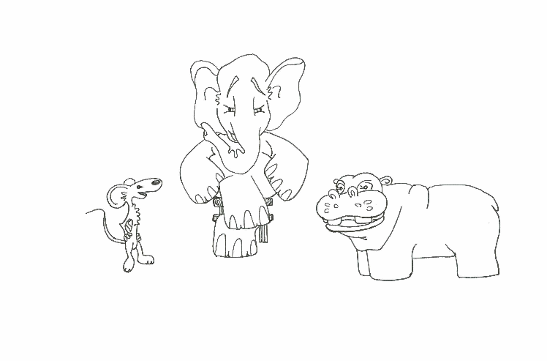
Foundations of Software Testing
Chapter 5: Test Selection, Minimization, and Prioritization for Regression Testing
Aditya P. Mathur
Purdue University
These slides are copyrighted. They are for use with the Foundations of Software Testing book by Aditya Mathur. Please use the slides but do not remove the copyright notice.
Last update: September 3, 2007

Slide 2
Learning Objectives
What is regression testing?
How to select a subset of tests for regression testing?
  How to select or minimize a set of tests for regression testing?
  How to prioritize a set of tests for regression testing?
© Aditya P. Mathur 2007

Slide 3
What is regression testing?

Slide 4
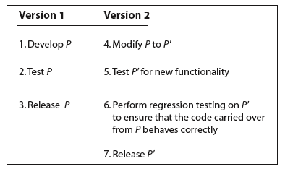
Regression testing
© Aditya P. Mathur 2007

Slide 5
What tests to use?
Idea 1:
All valid tests from the previous version and new tests created to test any added functionality.
[This is the TEST-ALL approach.]
What are the strengths and shortcomings of this approach?
© Aditya P. Mathur 2007

Slide 6
The test-all approach
The TEST-ALL approach is best when you want to be certain that the new version works on all tests developed for the previous version and any new tests.
But what if you have limited resources to run tests and have to meet a deadline?
What if running all tests as well as meeting the deadline is simply not possible?
© Aditya P. Mathur 2007

Slide 7
Test selection
Idea 2:
Select a subset Tr of the original test set T such that successful execution of the modified code P’ against Tr implies that all the functionality carried over from the original code P to P’ is intact.
Tr can be found using several methods.
We will discuss two of these known as test minimization and test prioritization.
© Aditya P. Mathur 2007

Slide 8
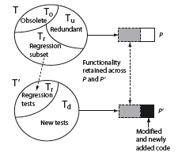
Regression Test Selection problem
Given test set T, our goal is to determine Tr such that successful execution of P’ against Tr implies that modified or newly added code in P’ has not broken the code carried over from P.
Some tests might become obsolete when P is modified to P’.
Such tests are not included in the regression subset Tr.
The task of identifying such obsolete tests is known as test revalidation.
© Aditya P. Mathur 2007

Slide 9
Test selection using execution trace and execution slice

Slide 10
Overview of a test selection method
Step 1: Given P and test set T, find the execution trace of P for each test in T.
Step 2: Extract the test vector test(n) from the execution traces for each node n in the CFG of P.
Step 3: Build syntax trees for each node in the CFGs of P and P’. This step can be executed while building the CFGs of P and P’.
Step 4: Traverse the CFGs and determine a subset of T appropriate for regression testing of P’.
© Aditya P. Mathur 2007

Slide 11
Execution Trace
Let G=(N, E) denote the CFG of program P.
N is a finite set of nodes and E a finite set of edges.
Suppose that nodes in N are numbered 1, 2, and so on, and that Start and End are two special nodes as discussed in Chapter 1.
Let Tno be the set of all valid tests for P’.
Tno is obtained by discarding all tests that have become obsolete.
© Aditya P. Mathur 2007

Slide 12
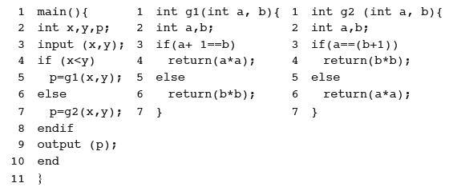
Execution Trace
An execution trace of program P for some test t in Tno is the sequence of nodes in G traversed when P is executed against t. As an example, consider the following program.
© Aditya P. Mathur 2007

Slide 13
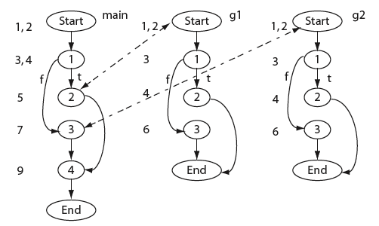
Execution Trace
Here is a CFG for our example program.
© Aditya P. Mathur 2007

Slide 14

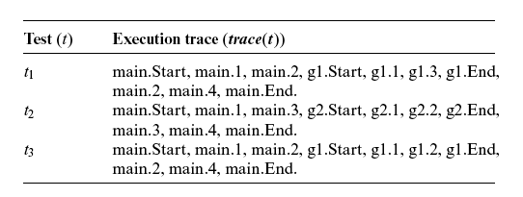
Execution Trace
Now consider the following set of three tests and the corresponding trace.
© Aditya P. Mathur 2007

Slide 15
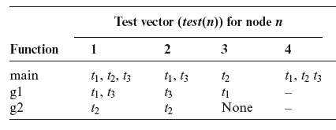
Test vector
A test vector for node n, denoted by test(n), is the set of tests that traverse node n in the CFG. For program P we obtain the following test vectors.
© Aditya P. Mathur 2007

Slide 16
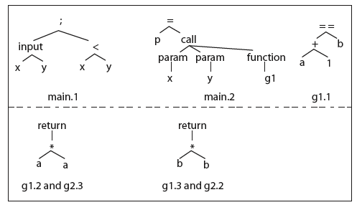
Syntax trees
A syntax tree is built for each node of CFG(P) and CFG(P’).
Recall that each node represents a basic block.
Here are sample syntax trees for the example program.
© Aditya P. Mathur 2007

Slide 17
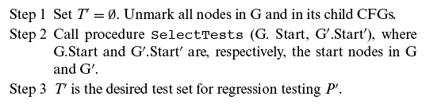
Test selection
Given the execution traces and the CFGs for P and P’, the following three steps are executed to obtain a subset T’ of T for regression testing of P’.
© Aditya P. Mathur 2007

Slide 18
Test selection
The idea underlying procedure SelectTests is to traverse the two CFGs from their respective START nodes using a recursive descent procedure.
The descent proceeds in parallel and corresponding nodes are compared.
If two corresponding nodes n in CFG(P) and n’ in CFG( P’) are found to be syntactically different, all tests in test(n) are added to T’.
© Aditya P. Mathur 2007

Slide 19
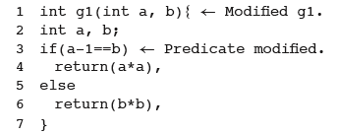
Test selection example
Suppose that function g1 in P is modified as follows.
Try the SelectTests algorithm and check if you get T’={t1, t3}.
© Aditya P. Mathur 2007

Slide 20
Test selection using dynamic slicing

Slide 21
Dynamic slice
Let L be a location in program P and v a variable used at location L.
Let trace(t) be the execution trace of P when executed against test t.
The dynamic slice of program P with respect to test t, variable v, and location L, denoted as DS(t, v, L), is the set of statements in P that lie in trace(t) and affect the value of v at location L.
Question: What is the dynamic slice of P with respect to v, t, and L, if L is not in trace(t)?
© Aditya P. Mathur 2007

Slide 22
Dynamic dependence graph (DDG)
The DDG is needed to obtain a dynamic slice.
Here is how a DDG G is built.
Step 1: Initialize G with a node for each declaration.
There are no edges among these nodes.
Step 2: Add to G the first node in trace(t).
Step 3: For each successive statement in trace(t), add to G a new node n. Then add control and data dependence edges from n to the existing nodes in G.
[Recall from Chapter 1 the definitions of control and data dependence edges.]
© Aditya P. Mathur 2007

Slide 23
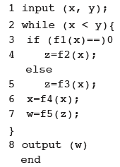
Construction of a DDG: Example [1]
t: <x=2, y=4>
Assume successive values of x to be 2, 0, and 5 and for these f1(x) is 0, 2, and 3 respectively.
trace(t)={1, 2, 3, 4, 6, 7, 2’, 3’, 5, 6’, 7’, 2’’, 8}
0)
For simplicity, we ignore declarations.
Add a node to G corresponding to statement 1.
1
© Aditya P. Mathur 2007

Slide 24
Construction of a DDG: Example [2]
trace(t)={1, 2, 3, 4, 6, 7, 2, 3, 5, 6, 7, 2, 8}
Add another node corresponding to statement 2 in trace(t). Also add a data dependence edge from 2 to 1 as statement 2 is data dependent on statement 1.
0)
1
2
Add yet another node corresponding to statement 3 in trace(t). Also add a data dependence edge from node 3 to node 1 as statement 3 is data dependent on statement 1 and a control edge from node 3 to 2.
1
2
3
© Aditya P. Mathur 2007

Slide 25
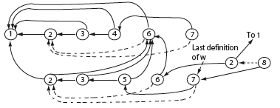
Construction of a DDG: Example [3]
trace(t)={1, 2, 3, 4, 6, 7, 2, 3, 5, 6, 7, 2, 8}
Continuing this way we obtain the following DDG for program P and trace(t).
0)
© Aditya P. Mathur 2007

Slide 26
Obtaining dynamic slice (DS)
Step 1: Execute P against test t and obtain trace(t).
Step 2: Build the dynamic dependence graph G from P and trace(t).
Step 3: Identify in G node n labeled L that contains the last assignment to v. If no such node exists then the dynamic slice is empty, otherwise execute Step 4.
Step 4: Find in G the set DS(t, v, n) of all nodes reachable from n, including n itself. DS(t, v, n) is the dynamic slice of P with respect to v at location L and test t.
© Aditya P. Mathur 2007

Slide 27
Obtaining dynamic slice: Example
Suppose we want to compute the dynamic slice of P with respect to variable w at line 8 and test t shown earlier.
We already have the DDG of P for t.
First, identify the last definition of w in the DDG.
This occurs at line 7 as marked.
Traverse the DDG backwards from node 7 and collect all nodes reachable from 7.
This gives us the following dynamic slice: {1, 2, 3, 5, 6, 7}.
© Aditya P. Mathur 2007

Slide 28
Test selection using dynamic slice
Let T be the test set used to test P. Let P’ be the modified program.
Let n1, n2, …,nk be the nodes in the CFG of P modified to obtain P’.
Which tests from T should be used to obtain a regression test T’ for P’?
Find DS(t) for P.
If any of the modified nodes is in DS(t), then add t to T’.
© Aditya P. Mathur 2007

Slide 29
Exercise
Suppose line 4 in the example program P shown earlier is modified to obtain P’.
Should t be included in T’?
Will t be included in T’ if we were to use the execution slice instead of the dynamic slice to make our decision?
© Aditya P. Mathur 2007

Slide 30
Questions
You may have noticed that a DDG could be huge, especially for large programs. How can one reduce the size of the DDG and still obtain the correct DS?
The DS contains all statements in trace(t) that had an effect on w, the variable of interest.
However, there could be a statement s in trace(t) that did not have an effect but could affect w if changed.
How can such statements be identified?
[Hint: Read about potential dependence.]
© Aditya P. Mathur 2007

Slide 31
Questions
Suppose statement s in P is deleted to obtain P’.
How would you find the tests that should be included in the regression test suite?
Suppose statement s is added to P to obtain P’.
How would you find the tests that should be included in the regression test suite?
In our example, we used variable w to compute the dynamic slice.
While selecting regression tests, how would you select the variable for which to obtain the dynamic slice?
© Aditya P. Mathur 2007

Slide 32
Test selection using test minimization

Slide 33
Test minimization
Test minimization is yet another method for selecting tests for regression testing.
To illustrate test minimization, suppose that P contains two functions: main and f.
Now suppose that P is tested using test cases t1 and t2.
During testing it was observed that t1 causes the execution of main but not of f while t2 causes the execution of both main and f.
© Aditya P. Mathur 2007

Slide 34
Test minimization
Now suppose that P’ is obtained from P by making some modification to f.
Which of the two test cases should be included in the regression test suite?
Obviously there is no need to execute P’ against t1 as it does not cause the execution of f.
Thus the regression test suite consists of only t2.
In this example we have used function coverage to minimize a test suite {t1, t2} to a obtain the regression test suite {t2}.
© Aditya P. Mathur 2007

Slide 35
Test minimization
Test minimization is based on the coverage of testable entities in P.
Testable entities include, for example:
- program statements
- decisions
- def-use chains
- mutants.
One uses the following procedure to minimize a test set based on a selected testable entity.
© Aditya P. Mathur 2007

Slide 36
A procedure for test minimization
Step 1: Identify the type of testable entity to be used for test minimization. Let e1, e2, …, ek be the k testable entities of type TE present in P.
In our previous example, TE is “function”.
Step 2: Execute P against all elements of test set T and, for each test t in T,
determine which of the k testable entities is covered.
Step 3: Find a minimal subset T’ of T such that each testable entity is covered by at least one test in T’.
© Aditya P. Mathur 2007

Slide 37
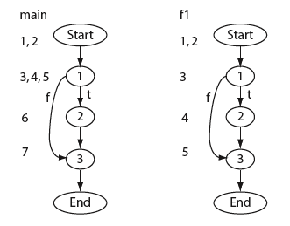
Test minimization: Example
Step 1: Let the basic block be the testable entity of interest.
The basic blocks for a sample program are shown here
for both main and function f1.
Step 2: Suppose the coverage of the basic blocks, when executed against three tests, is as follows:
t1: main: 1, 2, 3. f1: 1, 3
t2: main: 1, 3. f1: 1, 3
t3: main: 1, 3. f1: 1, 2, 3
Step3: A minimal test set for regression testing is {t1, t3}.
© Aditya P. Mathur 2007

Slide 38
Test minimization: Questions
Is the minimal test set unique? Why or why not?
Is test minimization NP hard? How is the traditional set cover problem in mathematics related to the test minimization problem?
What criteria should be used to decide the kind of testable entity to be used for minimization?
© Aditya P. Mathur 2007

Slide 39
Test selection using test prioritization

Slide 40
Test prioritization
Test minimization will likely discard test cases.
There is a small chance that, if P’ were executed against a discarded test case, it would reveal an error in the modification made.
When very high quality software is desired, it might not be wise to discard test cases as in test minimization.
In such cases one uses test prioritization.
Tests are prioritized based on some criteria. For example, tests that cover the maximum number of a selected testable entity could be given the highest priority, the one with the next highest coverage the next higher priority, and so on.
© Aditya P. Mathur 2007

Slide 41
A procedure for test prioritization
Step 1: Identify the type of testable entity to be used for test minimization. Let e1, e2, …, ek be the k testable entities of type TE present in P.
In our previous example TE is “function”.
Step 2: Execute P against all elements of test set T and for each test t in T. For each t in T, compute the number of distinct testable entities covered.
Step 3: Arrange the tests in T in order of their respective coverage.
Test with the maximum coverage gets the highest priority and so on.
© Aditya P. Mathur 2007

Slide 42
Using test prioritization
Once the tests are prioritized, one has the option of using all tests for regression testing or a subset of them. The choice is guided by several factors, such as the resources available for regression testing and the desired product quality.
In any case, tests are discarded only after careful consideration that does not depend only on the coverage criteria used.
© Aditya P. Mathur 2007

Slide 43
Tools for regression testing
Methods for test selection described here require the use of an automated tool for all but trivial programs.
xSuds from Telcordia Technologies can be used for C programs to minimize and prioritize tests.
Many commercial tools for regression testing simply run the tests automatically, they do not use any of the algorithms described here for test selection. Instead they rely on the tester for test selection. Such tools are especially useful when all tests are to be rerun.
© Aditya P. Mathur 2007

Slide 44
Summary
Regression testing is an essential phase of software product development.
In a situation where test resources are limited and deadlines are to be met, execution of all tests might not be feasible.
In such situations, one can use sophisticated technique for selecting a subset of all tests and reduce the time for regression testing.
© Aditya P. Mathur 2007

Slide 45
Summary
Test selection for regression testing can be done using any of the following methods:
Select only the modification traversing tests [based on CFGs].
Select tests using dynamic slices [based on execution traces and dynamic slices].
Select tests using code coverage [based on the coverage of testable entities].
© Aditya P. Mathur 2007

Slide 46
Summary
Select tests using a combination of code coverage and human judgment [based on the amount of coverage of testable entities].
Use of any of the techniques mentioned here requires access to sophisticated tools. Most commercially available tools are best in situations where test selection is done manually and do not use the techniques described in this chapter.
© Aditya P. Mathur 2007

