Slide 1
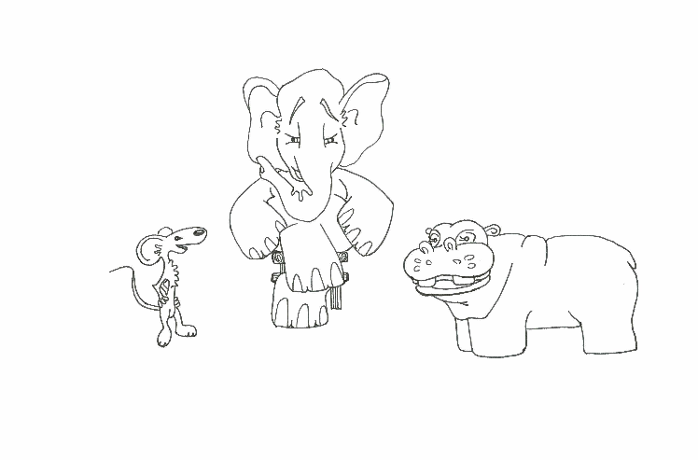
Foundations of Software Testing
Chapter 6: Test Adequacy Measurement and Enhancement:
Control and Data flow
Aditya P. Mathur
Purdue University
These slides are copyrighted. They are for use with the Foundations of Software Testing book by Aditya Mathur. Please use the slides but do not remove the copyright notice.
Last update: September 3, 2007

Slide 2
Learning Objectives
What is test adequacy? What is test enhancement? How to measure test adequacy and use it to enhance tests?
Control flow based test adequacy -- statement, decision, condition, multiple condition, LCSAJ, and MC/DC coverage
Data flow coverage
The “subsumes” relation amongst coverage criteria
© Aditya P. Mathur 2007

Slide 3
Test adequacy
© Aditya P. Mathur 2007

Slide 4
What is adequacy?
Given a program P written to meet a set of functional requirements R = {R1, R2, …, Rn}.
Let T contain k tests for determining whether or not P
meets all requirements in R.
Assume that P produces correct behavior for all tests in T.
We now ask: Is T good enough?
or: Has P been tested thoroughly? or: Is T adequate?
In software testing, the terms “thorough”, “good enough”, and “adequate” have the same meaning.
© Aditya P. Mathur 2007

Slide 5
Measurement of adequacy
Adequacy is measured for a given test set and a given criterion.
A test set is considered adequate wrt criterion C when it satisfies C.
© Aditya P. Mathur 2007

Slide 6
Example
Program sumProduct must meet the following requirements:
R1 Input two integers, x and y, from standard input.
R2.1 Print to standard output the sum of x and y if x<y.
R2.2 Print to standard output the product of x and y if x≥ y.
© Aditya P. Mathur 2007

Slide 7
Example (contd.)
Suppose now that the test adequacy criterion C is specified as:
C : A test set T for program (P, R) is considered adequate if,
for each r in R there is a test case in T that tests the correctness of P with respect to r.
T={t: <x=2, y=3> is inadequate with respect to C for program sumProduct.
The lone test case t in T tests R1 and R2.1, but not R2.2.
© Aditya P. Mathur 2007

Slide 8
Black-box and white-box criteria
Given an adequacy criterion C, we derive a finite set Ce known as the coverage domain.
A criterion C is a white-box test adequacy criterion if the corresponding Ce depends solely on the program P under test.
A criterion C is a black-box test adequacy criterion if the corresponding Ce depends solely on the requirements R for the program P under test.
© Aditya P. Mathur 2007

Slide 9
Coverage
Measuring adequacy of T:
T covers Ce if, for each e' in Ce, there is a test case in T that tests e'. T is adequate wrt C if it covers all elements i.
T is inadequate with respect to C if it covers k<n elements of Ce.
k/n is the coverage of T wrt C.
© Aditya P. Mathur 2007

Slide 10
Example
Consider criterion:
“A test T for (P, R) is adequate if , for each requirement r in R, there is at least one test case in T that tests the correctness of P with respect to r.”
The coverage domain is Ce={R1, R2.1, R2.2}.
T covers R1 and R2.1 but not R2.2.
Hence, T is inadequate with respect to C.
The coverage of T wrt C is 2/3=0.66.
© Aditya P. Mathur 2007

Slide 11
Another Example
Consider the following criterion:
“A test T for program (P, R) is considered adequate if each path in P is traversed at least once.”
Assume that P has exactly two paths, p1 and p2, corresponding to condition x<y and condition x≥ y, respectively.
For the given adequacy criterion C we obtain the coverage domain Ce to be the set {p1, p2}.
© Aditya P. Mathur 2007

Slide 12
Another Example (contd.)
To measure the adequacy of T of sumProduct against C,
we execute P against each test case in T .
As T contains only one test for which x<y, only path p1 is executed.
Thus, the coverage of T wrt C is 0.5. T is not adequate with respect to C.
We can also say that p1 is tested and p2 is not tested.
© Aditya P. Mathur 2007

Slide 13
Code-based coverage domain
In the previous example, we assumed that P contains two paths.
This assumption is based on knowledge of the requirements. However, when the coverage domain must contain elements from the code, these elements must be derived by analyzing the code.
Errors in the program and incomplete/incorrect requirements can cause the coverage domain to be different from the expected.
© Aditya P. Mathur 2007

Slide 14
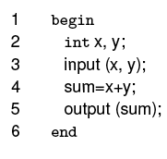
Example
sumProduct1
This program is incorrect as per the requirements of sumProduct.
There is only one path, p1, which traverses all the statements.
Using the path-based coverage criterion C, Ce={ p1}.
T={t: <x=2, y=3>}is adequate w.r.t. C but does not reveal the error.
© Aditya P. Mathur 2007

Slide 15
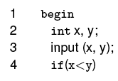
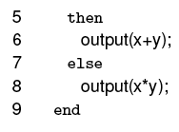
Example (contd.)
sumProduct2
This program is correct as per the requirements of sumProduct.
It has two paths, p1 and p2.
Ce={ p1, p2}.
T={t: <x=2, y=3>} is inadequate w.r.t. the path-based coverage criterion C.
© Aditya P. Mathur 2007

Slide 16
Lesson
An adequate test set might not reveal even the most obvious error in a program.
This does not diminish in any way the need for the measurement of test adequacy, as increasing coverage might reveal an error!
© Aditya P. Mathur 2007

Slide 17
Test enhancement
© Aditya P. Mathur 2007

Slide 18
Test Enhancement
While a test set adequate wrt some criterion does not guarantee an error-free program, an inadequate test set often implies deficiency.
Identifying deficiency helps in enhancing inadequate test set.
Enhancement in is likely to test the program in new ways – testing untested portions or testing the features in a sequence different from the one used previously.
Testing the program differently than before may discover any uncovered errors.
© Aditya P. Mathur 2007

Slide 19
Test Enhancement: Example
For sumProduct2, to make T adequate wrt the path coverage criterion we need to add a test that covers p2 --{<x=3>, y=1>}.
Adding this test to T, we obtain the expanded test set T’:
T’={t1: <x=3, y=4>, t2: <x=3, y=1>}
Executing sum-product-2 against the two tests in T’ causes paths p1 and p2 to be traversed.
Thus, T' is adequate with respect to the path coverage criterion.
© Aditya P. Mathur 2007

Slide 20
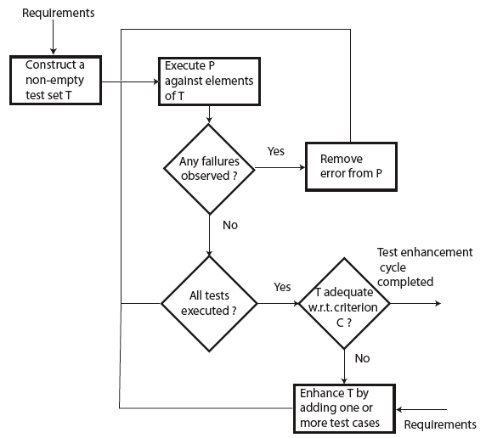
Test Enhancement: Procedure
© Aditya P. Mathur 2007

Slide 21
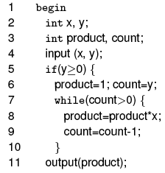

Test Enhancement: Example
Consider a program intended to compute x^{y} given integers x and y. For y<0 the program skips the computation and outputs an error message.
© Aditya P. Mathur 2007

Slide 22
Test Enhancement: Example (contd.)
Suppose that test T is considered adequate if it tests the exponentiation program for at least one zero and one non-zero value of each of the two inputs x and y.
Ce can be determined using C alone – no need to inspect program.
Ce={x=0, y=0, x≠0, y≠ 0}.
Again, we can derive an adequate test set for the program by examining Ce alone.
T={t1: <x=0, y=1>, t2: <x=1, y=0>}.
© Aditya P. Mathur 2007

Slide 23
Test Enhancement: Example: Path coverage
Criterion C of the previous example is a black-box coverage criterion as it does not require an examination of the program.
Let us now consider the path coverage criterion defined in an earlier example.
The exponentiation program has an indeterminate number of paths due to the while loop.
The number of paths depends on the value of y.
© Aditya P. Mathur 2007

Slide 24
Example: Path Coverage (contd.)
Given that y is any non-negative integer, the number of paths can be arbitrarily large.
Thus for the path coverage criterion, we cannot determine the coverage domain.
The usual approach in such cases is to simplify C and reformulate it as follows: A test T is considered adequate if it tests all paths. In case the program contains a loop, then it is adequate to traverse the loop body zero times and once.
© Aditya P. Mathur 2007

Slide 25
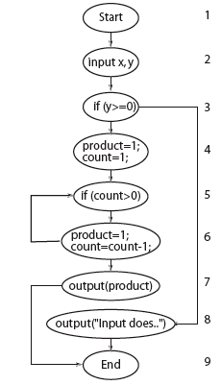
Example: Path coverage (contd.)
f
The modified path coverage criterion leads to Ce’={p1, p2, p3}.
t
y
f
t
5
7
product*x
© Aditya P. Mathur 2007

Slide 26
Example: Path coverage (contd.)
f
We measure the adequacy of T with respect to C'.
As T does not contain any test with y<0, p3 remains uncovered.
Thus, the coverage of T with respect to C' is 2/3=0.66.
t
y
f
t
product*x
5
7
© Aditya P. Mathur 2007

Slide 27
Example: Path coverage (contd.)
Any test with y<0 causes p3 to be traversed.
Let’s use t:<x=5, y=-1>.
Test t covers path p3 and P behaves correctly. We add t to T.
The loop in the enhancement terminates,
as we have covered all feasible elements of Ce’. The enhanced test set is:
T={<x=0, y=1>, <x=1, y=0>, <x=5, y=-1>}
f
t
y
f
t
product*x
© Aditya P. Mathur 2007

Slide 28
Infeasibility and test adequacy
An element of the coverage domain is infeasible if it cannot be covered by any test in the input domain of the program under test.
There is no algorithm that can analyze a given program and determine if a given element in the coverage domain is infeasible.
Usually the tester determines whether or not an element of the coverage domain is infeasible.
© Aditya P. Mathur 2007

Slide 29
Demonstrating feasibility
Feasibility can be demonstrated by executing the program on a test case that shows that the element under consideration is covered.
Infeasibility cannot be demonstrated by execution on a finite number of test cases. Determining infeasibility is difficult.
An attempt to enhance a test set by executing tests aimed at covering an infeasible element will fail.
© Aditya P. Mathur 2007

Slide 30
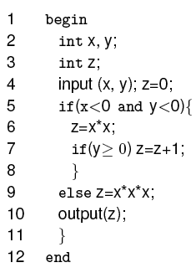
Infeasible path: Example
This program inputs two integers x and y and computes z.
© Aditya P. Mathur 2007

Slide 31
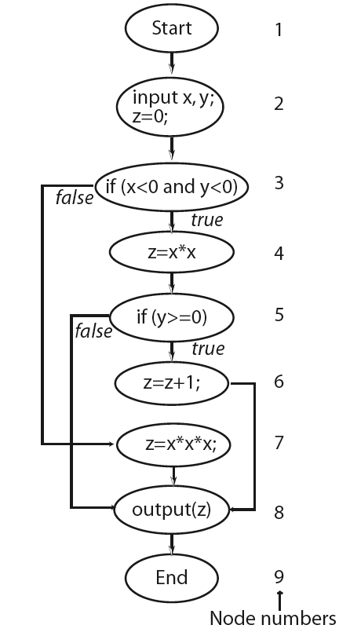
Example: Flow graph and paths
8
9]
p1 is infeasible because at node 5, y≥0 is false and control can never reach node 6.
Any test set adequate wrt path coverage criterion will only cover p2 and p3.
© Aditya P. Mathur 2007

Slide 32
Adequacy and infeasibility
A test is considered adequate when all feasible elements in the domain have been covered.
While programmers are not concerned with infeasible elements, testers attempting to obtain code coverage are.
Prior to test enhancement, a tester usually does not know which elements of a coverage domain are infeasible.
Only when attempting to find a test case that covers an element, one might realize the infeasibility of that element.
© Aditya P. Mathur 2007

Slide 33
Error detection and test enhancement
Goal of test enhancement: to add test cases that test the untested parts of a program or exercise the program using uncovered portions of the input domain.
The more complex the set of requirements, the more likely it is that a test set designed using requirements is inadequate with respect to even the simplest of various test adequacy criteria.
© Aditya P. Mathur 2007

Slide 34
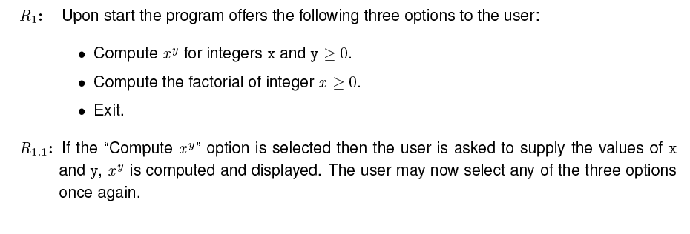
Example
A program to meet the following requirements is to be developed.
© Aditya P. Mathur 2007

Slide 35
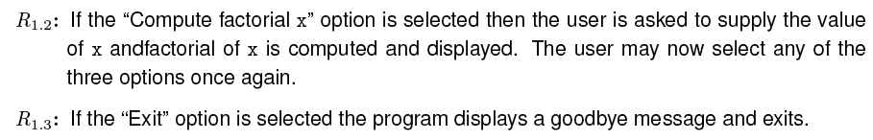
Example (contd.)
© Aditya P. Mathur 2007

Slide 36
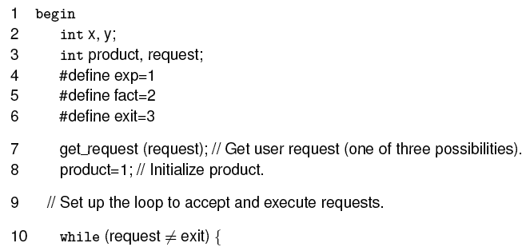
Example (contd.)
Consider this program written to meet the above requirements.
© Aditya P. Mathur 2007

Slide 37
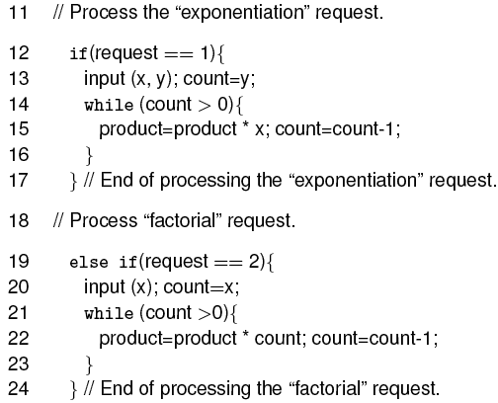
Example (contd.)
© Aditya P. Mathur 2007

Slide 38
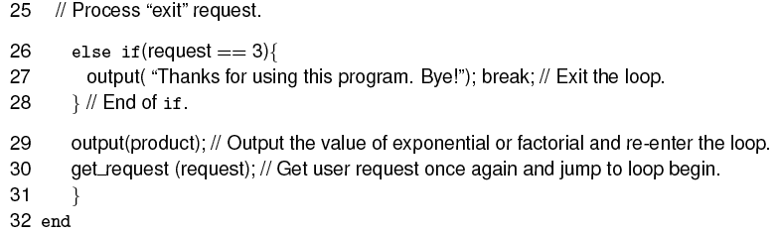
Example (contd.)
© Aditya P. Mathur 2007

Slide 39
Example (contd.)
Consider the following to test if program meets its requirements.
T={<request=1, x=2, y=3>, <request=2, x=4>, <request=3>}
For the first requests, the program correctly outputs 8 and 24.
The program exits when executed against the last request.
This program behavior is correct, hence one might conclude that the program is correct.
But this conclusion is incorrect.
© Aditya P. Mathur 2007

Slide 40
Example (contd.)
Let us now evaluate T against the path coverage criterion.
The coverage domain consists of all paths that traverse each of the three loops zero and once in the same or different executions of the program.
We consider one uncovered path that exposes error.
© Aditya P. Mathur 2007

Slide 41
Example (contd.)
Consider the path p that: begins execution at line 1; reaches the outermost while at line 10; then the first if at line 12; followed by the statements that compute the factorial starting at line 20; and then the code to compute the exponential starting at line 13.
p is traversed when the program is launched and the first request is to compute the factorial of a number, followed by a request to compute the exponential.
The sequence of requests in T does not exercise p.
T is inadequate with respect to the path coverage criterion.
© Aditya P. Mathur 2007

Slide 42
Example (contd.)
The following test covers p:
T’={<request=2, x=4>;<request=1, x=2, y=3>;<request=3>}
When the values in T’ are input, the program correctly outputs 24 as the factorial of 4, but incorrectly outputs 192 as the value of 2³ .
This happens because T’ traverses the path which makes the computation of the exponentiation begin without initializing product.
In fact the code at line 14 begins with the value of product set to 24.
© Aditya P. Mathur 2007

Slide 43
Example (contd.)
In an effort to increase path coverage we built T’.
T’ did cover a path that was not covered earlier and revealed an error in the program.
This example has illustrated a benefit of test enhancement based on code coverage.
© Aditya P. Mathur 2007

Slide 44
Multiple executions
In the previous example, we built two test sets, T and T’.
Both T and T’ contained three tests, one for each value of variable request.
Is T (or T’) a single test or a sequence of three tests?
T’={<request=2, x=4>;<request=1, x=2, y=3>;<request=3>}
We assumed that all three tests were input in a sequence during a single execution. Hence, T (or T’) is one test case.
© Aditya P. Mathur 2007

Slide 45
Statement and Block Coverage
© Aditya P. Mathur 2007

Slide 46
Statement Coverage
The statement coverage of T wrt program P is defined as
Sc/(Se-Si), where
Sc is the number of statements covered;
Si is the number of unreachable statements; and
Se is the total number of statements in the program.
T is considered adequate wrt the statement coverage criterion if the statement coverage of T is 1.
© Aditya P. Mathur 2007

Slide 47
Block Coverage
The block coverage of T wrt Program P is
Bc/(Be -Bi), where
Bc is the number of blocks covered;
Bi is the number of unreachable blocks; and
Be is the total number of blocks in the program.
T is considered adequate with respect to the block coverage criterion if the block coverage of T is 1.
© Aditya P. Mathur 2007

Slide 48
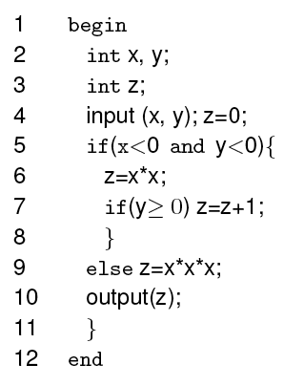
Example: Statement Coverage
Coverage domain: Se={2, 3, 4, 5, 6, 7, 7b, 9, 10}
Let T₁={t1:<x=-1, y=-1>, t2:<x=1, y=1>}
Statements covered:
t1: 2, 3, 4, 5, 6, 7, 10
t2: 2, 3, 4, 5, 9, 10.
(b)
Sc=6, Si=1, Se=7. The statement coverage for T is 6/(7-1)=1.
Hence, we conclude that T₁ is adequate for P with respect to the statement coverage criterion. Note: 7b is unreachable.
© Aditya P. Mathur 2007

Slide 49
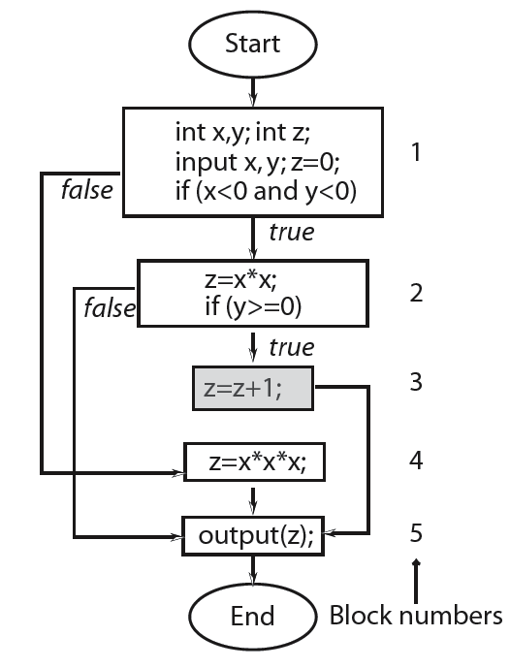
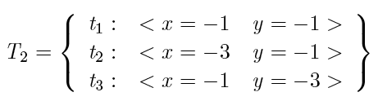
Example: Block Coverage
Coverage domain: Be={1, 2, 3, 4, 5}
Blocks covered:
t1: Blocks 1, 2, 5
t2, t3: same coverage as of t1.
Be=5, Bc=3, Bi=1.
Block coverage for T₂= 3/(5-1)=0.75.
Hence, T₂ is not adequate for P wrt the block coverage criterion.
© Aditya P. Mathur 2007

Slide 50
Example: Block Coverage (contd.)
T1 is adequate wrt block coverage criterion.
Also, if test t2 in T1 is added to T2, we obtain a test set adequate with respect to the block coverage criterion for the program under consideration.
© Aditya P. Mathur 2007

Slide 51
Condition and Decision Coverage
© Aditya P. Mathur 2007

Slide 52
Simple and Compound Conditions
A simple condition does not use any boolean operators except for the not operator.
It is made up of variables and at most one relational operator from the set {<, ≤ >, ≥, ==, ≠ }.
A compound condition is made up of two or more simple conditions joined by one or more boolean operators.
© Aditya P. Mathur 2007

Slide 53
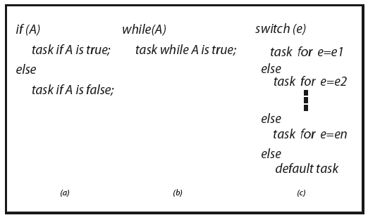
Conditions as Decisions
Conditions serve as a decision in context of if, while, and switch statements.
© Aditya P. Mathur 2007

Slide 54
Outcomes of a Decision
When the condition corresponding to a decision to take one or the other path is taken, a decision can have three possible outcomes:
true, false, and undefined.
In some cases the evaluation of a condition might fail in which case the corresponding decision outcome is undefined.
© Aditya P. Mathur 2007

Slide 55
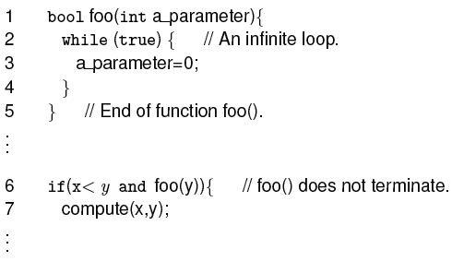
Undefined Condition
The condition inside the if statement at line 6 will remain undefined because the loop at lines 2-4 will never terminate.
Thus the decision at line 6 evaluates to undefined.
© Aditya P. Mathur 2007

Slide 56
Decision Coverage
A decision is considered covered if all outcomes of the decision have been taken.
For example, the expression in an if or a while statement has evaluated to true in some execution of the program under test and to false in the same or another execution.
© Aditya P. Mathur 2007

Slide 57
Decision Coverage: switch statement
A decision implied by the switch statement is considered covered if, during one or more executions of the program under test, the flow of control has been diverted to all possible destinations.
Covering a decision within a program might reveal an error that is not revealed by covering all statements and all blocks.
© Aditya P. Mathur 2007

Slide 58
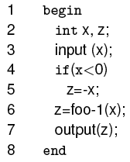
Decision Coverage: Example
This program inputs an integer x and, if necessary, transforms it into a positive value before invoking foo-1 to compute the output z.
The program has an error: it should compute z using foo-2 when x≥0.
© Aditya P. Mathur 2007

Slide 59
Decision Coverage: Example (contd.)
Consider the test set T={t1:<x=-5>}.
It is adequate with respect to statement and block coverage criteria, but does not reveal the error.
Another test set T'={t1:<x=-5>, t2:<x=3>} does reveal the error.
It covers the decision whereas T does not.
© Aditya P. Mathur 2007

Slide 60
Decision Coverage: Computation
The decision coverage of T for P is
Dc/(De -Di), where
Dc is the number of decisions covered;
Di is the number of infeasible decisions; and
De is the total number of decisions in the program.
T is considered adequate with respect to the decisions coverage criterion if the decision coverage of T wrt P is 1.
© Aditya P. Mathur 2007

Slide 61
Decision Coverage
The domain of decision coverage consists of all decisions in the program under test.
Note that each if and each while contribute to one decision whereas a switch contribute to more than one.
© Aditya P. Mathur 2007

Slide 62
Condition Coverage
A decision can be composed of a simple condition such as x<0, or of a more complex condition, such as ((x<0 AND y<0 ) OR (p≥q )).
AND, OR, XOR are the logical operators that connect two or more simple conditions to form a compound condition.
A simple condition is considered covered if it evaluates to true and false in one or more executions of the program in which it occurs.
A compound condition is considered covered if each simple condition it contains is also covered.
© Aditya P. Mathur 2007

Slide 63

Decision and Condition Coverage
Decision coverage is concerned with the coverage of decisions regardless of whether or not a decision corresponds to a simple or a compound condition. Thus, in the statement
there is only one decision that leads control to line 2 if the compound condition inside the if evaluates to true.
However, a compound condition might evaluate to true or false in one of several ways.
© Aditya P. Mathur 2007

Slide 64
Decision and condition coverage (contd)
The condition at line 1 evaluates to false when x≥0 regardless of the value of y. Another condition, such as x<0 OR y<0, evaluates to true regardless of the value of y, when x<0.
With this evaluation characteristic in view, compilers often generate code that uses short circuit evaluation of compound conditions.
© Aditya P. Mathur 2007

Slide 65
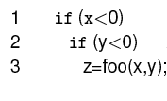
Decision and Condition coverage (contd)
Here is a possible translation:
We now see two decisions, one corresponding to each simple condition in the if statement.
© Aditya P. Mathur 2007

Slide 66
Condition Coverage
The condition coverage of T wrt P is
Cc/(Ce -Ci), where
Cc is the number of simple conditions covered;
Ci is the number of infeasible simple conditions; and
Ce is the number of simple conditions in the program.
T is considered adequate wrt the condition coverage criterion if the condition coverage of T wrt P is 1.
© Aditya P. Mathur 2007

Slide 67

Condition Coverage: alternate formula
An alternate formula where each simple condition contributes 2, 1, or 0 to Cc depending on whether it is covered, partially covered, or not covered, respectively, is:
© Aditya P. Mathur 2007

Slide 68
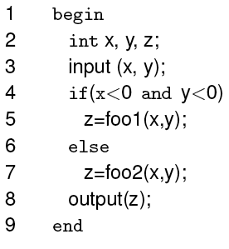
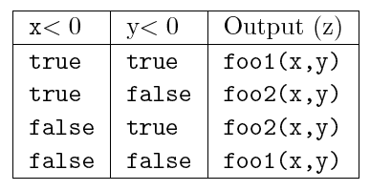
Condition Coverage: Example
Partial specifications for computing z:
Error
© Aditya P. Mathur 2007

Slide 69
Condition Coverage: Example (contd.)
Consider the test set:
+2
T and T
T and F
T is adequate wrt the statement, block, and decision coverage criteria and the program behaves correctly for t1 and t2.
Cc=1, Ce=2, Ci=0.
Hence, the condition coverage for T is 0.5.
© Aditya P. Mathur 2007

Slide 70
Condition Coverage: Example (contd.)
Add the following test case to T:
t3: <x=3, y=4>
F and F
The enhanced test set T is adequate wrt the condition coverage criterion and can possibly reveal an error.
Under what conditions will a possible error at line 7 be revealed by t3?
foo2(3,4) != foo1(3,4)
© Aditya P. Mathur 2007

Slide 71
Condition/Decision Coverage
When a decision is composed of a compound condition, decision coverage does not imply that each simple condition within a compound condition has taken both values true and false.
Condition coverage ensures that each component simple condition within a condition has taken both values true and false.
However, condition coverage does not require each decision to have taken both outcomes.
Condition/Decision coverage, also known as branch condition coverage, requires coverage of conditions and decisions.
© Aditya P. Mathur 2007

Slide 72
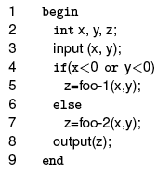
Condition/Decision Coverage: Example
T or F
F or F
T1={t1:<x=-3, y=2>, t2:<x=4, y=2>}
T2={t1:<x=-3, y=2>, t2:<x=4, y =-2>}
T or F
F or T
T1 is adequate wrt decision coverage but not condition coverage.
T2 is adequate wrt condition coverage but not decision coverage.
© Aditya P. Mathur 2007

Slide 73
Condition/Decision Coverage: Definition
The condition/decision coverage of T wrt P is
(Cc+Dc)/((Ce -Ci) +(De-Di)), where
Cc is the number of simple conditions covered;
Dc is the number of decisions covered;
Ce and De are the numbers of simple conditions and decisions respectively; and
Ci and Di are the numbers of infeasible simple conditions and decisions, respectively.
T is considered adequate wrt condition/decision coverage criterion if the condition/decision coverage of T wrt P is 1.
© Aditya P. Mathur 2007

Slide 74

Condition/Decision Coverage: Example
The following test set is adequate with respect to the condition/decision coverage criterion.
T or T
F or F
© Aditya P. Mathur 2007

Slide 75
Multiple Condition Coverage
© Aditya P. Mathur 2007

Slide 76
Multiple Condition Coverage
Consider a compound condition with two or more simple conditions.
Using condition coverage on some compound condition C implies that each simple condition within C has been evaluated to true and false.
However, this does not imply that all combinations of the values of the individual simple conditions in C have been exercised.
© Aditya P. Mathur 2007

Slide 77

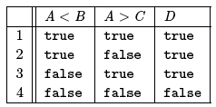
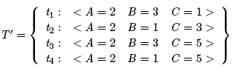
Multiple Condition Coverage: Example
Consider D=(A<B) OR (A>C) composed of two simple conditions A< B and A> C --- there are four possible combinations of the outcomes of these two simple.
T or T
1
F or T
Does T cover all four combinations? No
Does T’ cover all four combinations? Yes
T or T
1
F or T
T or F
© Aditya P. Mathur 2007
F or F

Slide 78
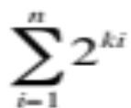
Multiple Condition Coverage: Definition
Suppose that the program under test contains a total of n decisions and that each decision contains k1, k2, …, kn simple conditions.
Decision i will have a total of 2^{ki} combinations.
The total number of combinations to be covered is
© Aditya P. Mathur 2007

Slide 79
Multiple Condition Coverage: Definition (contd.)
The multiple condition coverage of T wrt P is
Cc/(Ce -Ci), where
Cc is the number of combinations covered;
Ci is the number of infeasible simple combinations; and
Ce is the total number of combinations in the program.
T is considered adequate wrt the multiple condition coverage criterion if the condition coverage of T wrt P is 1.
© Aditya P. Mathur 2007

Slide 80

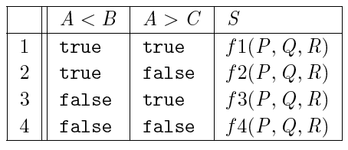

Multiple Condition Coverage: Example
Consider the following program with specifications in the table.
Error! the computation of S for line 3 in the table has been left out.
© Aditya P. Mathur 2007

Slide 81

Multiple Condition Coverage: Example (contd.)
T covers all simple conditions but not decisions.
Does it reveal the error? No.
T and T -> f1
T and T -> f4
t1: T T; T F; F F
t2: F F; F T; T T
© Aditya P. Mathur 2007

Slide 82
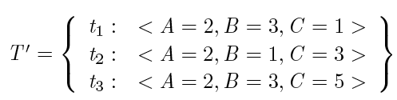
Multiple Condition Coverage: Example (contd.)
Adding t3 gives T’that covers all decisions.
Does it reveal the error? No.
f1
f4
f2
© Aditya P. Mathur 2007

Slide 83
Multiple Condition Coverage: Example (contd.)
Adding t4 to T‘covers all combinations.
Does it reveal the error? Yes.
f1
f4
f2
t₄ : < A = 2, B = 1, C = 1 >
f3 should have been executed
But is not. If this effect is visible
in the output, error is revealed.
© Aditya P. Mathur 2007

Slide 84
LCSAJ coverage
© Aditya P. Mathur 2007

Slide 85
Linear Code Sequence and Jump (LCSAJ)
Execution of sequential programs that contain conditions proceeds in pairs consisting of: a sequence of statements executed one after the other and its termination by a jump to the next such pair.
A Linear Code Sequence and Jump is a program unit composed of a textual code sequence that terminates in a jump to the beginning of another code sequence and jump.
An LCSAJ is represented as a triple (X, Y, Z) where X and Y are, respectively, the locations of the first and the last statements and Z is the location to which the statement at Y jumps.
© Aditya P. Mathur 2007

Slide 86
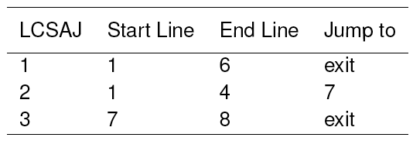
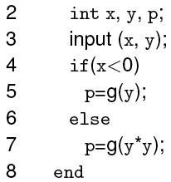
Linear Code Sequence and Jump (LCSAJ)
Consider this program.
The last statement in an LCSAJ (X, Y, Z) is a jump and Z may be program exit.
When control arrives at statement X, follows through to statement Y, and then jumps to statement Z, we say that the LCSAJ (X, Y, Z) is traversed or covered or exercised.
© Aditya P. Mathur 2007

Slide 87
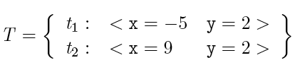
LCSAJ coverage: Example 1
t2 covers (1,4,7) and (7, 8, exit).
t1 covers (1, 6, exit).
T covers all three LCSAJs.
© Aditya P. Mathur 2007

Slide 88
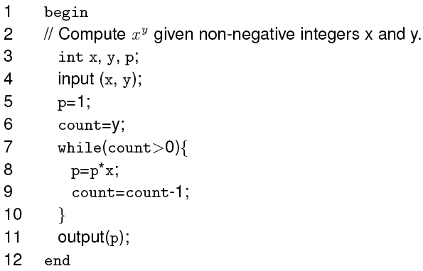
LCSAJ coverage: Example 2
LCSAJs:
(1,10,7)
(7,10,7)
(1,7,11)
(11,12,exit)
(7,7,11)
© Aditya P. Mathur 2007

Slide 89
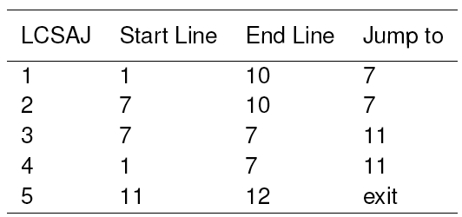

LCSAJ coverage: Example 2 (contd.)
This set covers all LCSAJs.
© Aditya P. Mathur 2007

Slide 90

LCSAJ Coverage: Definition
The LCSAJ coverage of a test set T wrt P is:
T is considered adequate wrt the LCSAJ coverage criterion if the LCSAJ coverage of T wrt P is 1.
© Aditya P. Mathur 2007

Slide 91
MC/DC coverage
© Aditya P. Mathur 2007

Slide 92
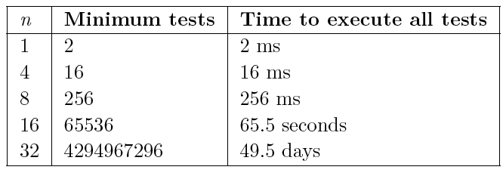
Modified Condition/Decision (MC/DC) Coverage
Obtaining multiple condition coverage might become expensive when there are many embedded simple conditions.
If a compound condition C contains n simple conditions, the maximum number of tests required to cover C is 2^{n} .
© Aditya P. Mathur 2007

Slide 93
Compound conditions and MC/DC
MC/DC coverage requires that every compound condition in a program must be tested by demonstrating that each simple condition within the compound condition has an independent effect on its outcome.
Thus, MC/DC coverage is a weaker criterion than the multiple condition coverage criterion.
© Aditya P. Mathur 2007

Slide 94
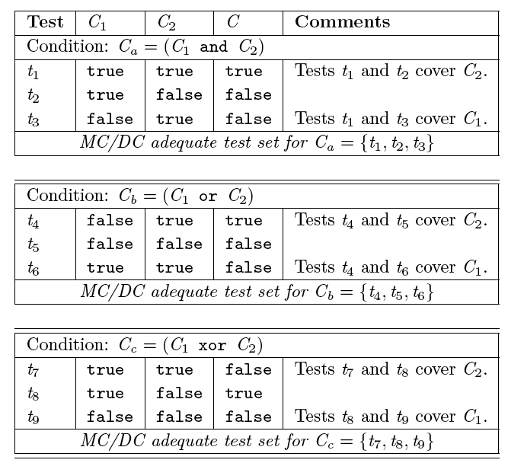
MC/DC coverage: Simple conditions
false
true
t₅
© Aditya P. Mathur 2007

Slide 95
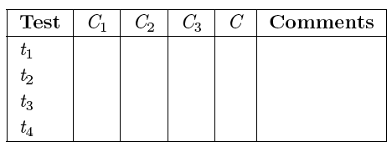
MC/DC coverage: Generating tests for compound conditions
If C=C1 AND C2 AND C3, create a table with five columns and four rows. Label the columns as Test, C1, C2, C3, and C, from left to right. An optional column “Comments” may be added.
The column labeled Test contains rows labeled by test case numbers t1 through t4 . The remaining entries are empty.
© Aditya P. Mathur 2007

Slide 96
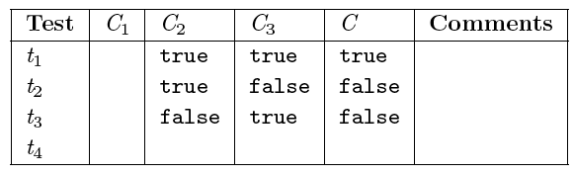
MC/DC coverage: Generating tests for compound conditions (contd.)
Copy all entries in columns C1, C2, and C from the table for simple conditions into columns C2, C3, and C of the empty table.
© Aditya P. Mathur 2007

Slide 97
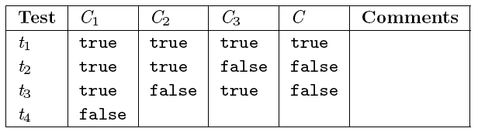
MC/DC coverage: Generating tests for compound conditions (contd.)
Fill the first three rows in the column marked C1 with true and the last row with false.
© Aditya P. Mathur 2007

Slide 98
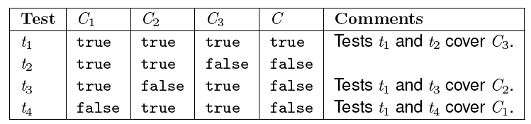
MC/DC coverage: Generating tests for compound conditions (contd.)
Fill the last row under columns labeled C2, C3, and C with
true, true, and false, respectively.
We now have a table containing MC/DC adequate tests for
C=(C1 AND C2 AND C3) derived from tests for C=(C1 AND C2) .
© Aditya P. Mathur 2007

Slide 99
MC/DC coverage: Generating tests for compound conditions (contd.)
The procedure illustrated above can be extended to derive tests for any compound condition using tests for a simpler compound condition.
© Aditya P. Mathur 2007

Slide 100
MC/DC coverage: Definition
A test set T for program P written to meet requirements R is considered adequate with respect to the MC/DC coverage criterion if, upon the execution of P on each test in T, the following requirements are met:
Each block in P has been covered.
Each simple condition in P has taken both true and false values.
Each decision in P has taken all possible outcomes.
Each simple condition within a compound condition C in P has been shown to independently affect the outcome of C.
This is the MC part of the coverage we discussed.
© Aditya P. Mathur 2007

Slide 101
MC/DC coverage: Analysis
The first three requirements above correspond to block, condition, and decision coverage, respectively.
The fourth requirement corresponds to “MC” coverage.
Thus, the MC/DC coverage criterion is a mix of four coverage criteria based on the flow of control.
With regard to the second requirement, it should be noted that conditions that are not part of a decision, such as the one in statement A= (p<q) OR (x>y), are also included in the set of conditions to be covered.
© Aditya P. Mathur 2007

Slide 102
MC/DC coverage: Analysis (contd.)
With regard to the fourth requirement, a condition such as
(A AND B) OR (C AND A)
poses a problem. It is not possible to keep the first occurrence of A fixed while varying the value of its second occurrence.
The first occurrence of A is coupled to its second occurrence.
In such cases, an adequate test set only has to demonstrate the independent effect of any one occurrence of the coupled condition
© Aditya P. Mathur 2007

Slide 103

MC/DC coverage: Adequacy
Let C1, C2, .., CN be the conditions in P,
let ni be the number of simple conditions in Ci,
Let ei be the number of simple conditions shown to have independent affect on the outcome of Ci, and
Let fi be the number of infeasible simple conditions in Ci .
The MC coverage of T for program P subject to requirements R, denoted by MC_{c}, is:
n_{i}
Test set T is considered adequate with respect to the MC coverage if MC_{c} = 1.
© Aditya P. Mathur 2007

Slide 104
MC/DC coverage: Example
Consider the following requirements:
R1.1: Invoke fire-1 when
(x<y) AND (z * z > y) AND (prev=``East").
R1.2: Invoke fire-2 when
(x<y) AND (z * z ≤ y) OR (current=``South").
R1.3: Invoke fire-3 when none of the two conditions above holds.
R2: The invocation described above must continue until an input boolean variable becomes true.
© Aditya P. Mathur 2007

Slide 105
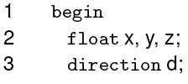
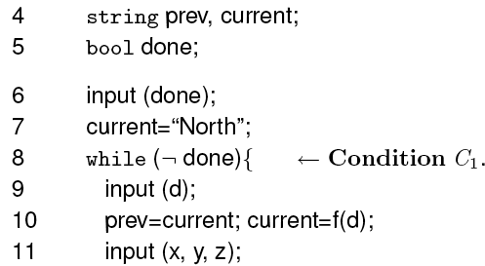
MC/DC coverage: Example (contd.)
© Aditya P. Mathur 2007

Slide 106
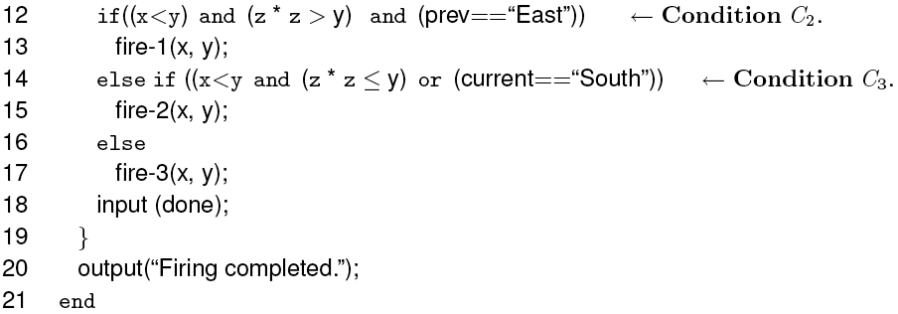
MC/DC coverage: Example (contd.)
© Aditya P. Mathur 2007

Slide 107
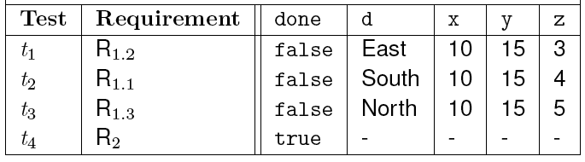
MC/DC coverage: Example (contd.)
Verify that the following set T1 of four tests, executed in the given order, is adequate with respect to statement, block, and decision coverage criteria, but not with respect to the condition coverage criterion.
© Aditya P. Mathur 2007

Slide 108
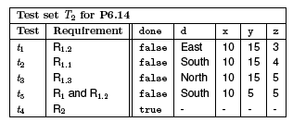
MC/DC coverage: Example (contd.)
Verify that the following set T2, obtained by adding t5 to T1, is adequate with respect to the condition coverage but not with respect to the multiple condition coverage criterion.
Note that sequencing of tests is important in this case!
© Aditya P. Mathur 2007

Slide 109
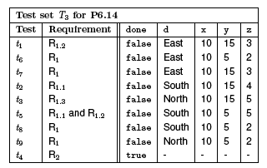
MC/DC coverage: Example (contd.)
Verify that the following set T3, obtained by adding t6, t7, t8, and t9 to T2 is adequate with respect to MC/DC coverage criterion.
Note again that sequencing of tests is important in this case
(especially for t1 and t7)!
© Aditya P. Mathur 2007

Slide 110
MC/DC adequacy and error detection
We consider the following three types of errors.
Missing condition: One or more simple conditions is missing from a compound condition. For example, the correct condition should be (x<y AND done) but the condition coded is (done).
Incorrect Boolean operator: One or more boolean operators is incorrect. For example, the correct condition is (x<y AND done) but it has been coded as
(x<y OR done).
Mixed: One or more simple conditions are missing and one or more boolean operators are incorrect. For example, the correct condition should be
(x<y AND z*x ≥ y AND d=``South") but it been coded as (x<y OR z*x ≥ y).
© Aditya P. Mathur 2007

Slide 111
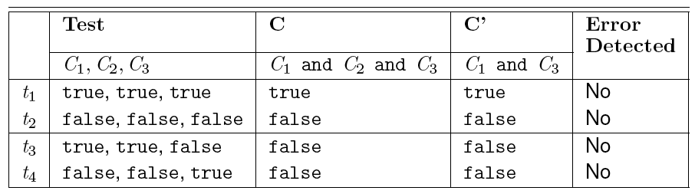
MC/DC adequacy and error detection: Example
Suppose that condition C=C1 AND C2 AND C3 has been coded as C'=C1 AND C2. Four tests that form an MC/DC adequate set are in the following table. The following set of four tests is MC/DC adequate but does not reveal the error.
© Aditya P. Mathur 2007

Slide 112
MC/DC and condition coverage
Several examples in the book show that satisfying the MC/DC adequacy criteria does not necessarily imply that errors made while coding conditions will be revealed.
However, the examples do favor MC/DC over condition coverage.
The examples also show that an MC/DC adequate test will likely reveal more errors than a decision or condition-coverage adequate test.
© Aditya P. Mathur 2007

Slide 113
MC/DC and short circuit evaluation
Consider C=C1 AND C2.
The outcome of the above condition does not depend on C2 when C1 is false. When using short-circuit evaluation, condition C2 is not evaluated if C1 evaluates to false.
Thus the combination C1=false and C2=true, or the combination C1=false and C2=false may be infeasible if the programming language allows or requires, as in C, short circuit evaluation.
© Aditya P. Mathur 2007

Slide 114

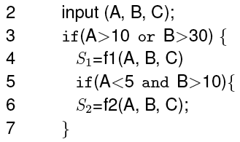
MC/DC and decision dependence
Dependence of one decision on another might also lead to an infeasible combination.
Consider, for example, the following sequence of statements.
Infeasible condition A<5
© Aditya P. Mathur 2007

Slide 115
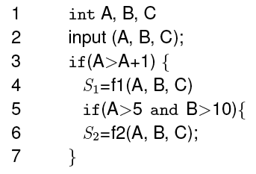
Infeasibility and reachability
Note that infeasibility is different from reachability.
A decision might be reachable but not feasible and vice versa.
In the sequence above, both decisions are reachable but the second decision is not feasible. Consider the following sequence.
In this case the second decision is not reachable due an error at line 3. It may, however, be feasible.
© Aditya P. Mathur 2007

Slide 116
Test trace-back
When enhancing a test set to satisfy a given coverage criterion, it is desirable to ask the following question: What portions of the requirements are tested when the program under test is executed against the newly added test case? The task of relating the new test case to the requirements is known as test trace-back.
Trace-back assists us in determining whether the new test case is redundant.
© Aditya P. Mathur 2007

Slide 117
Data flow coverage
© Aditya P. Mathur 2007

Slide 118
Basic concepts
We will now examine some test adequacy criteria based on the flow of “data” in a program. This is in contrast to criteria based on “flow of control” that we have examined so far.
Test adequacy criteria based on the flow of data are useful in improving tests that are adequate with respect to control-flow based criteria. Let us look at an example.
© Aditya P. Mathur 2007

Slide 119
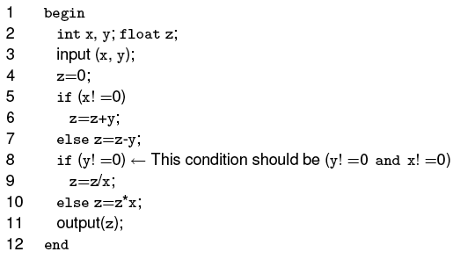

Example: Test enhancement using data flow
Here is an MC/DC adequate test set that does not reveal the error.
© Aditya P. Mathur 2007

Slide 120
Example (contd.)
Neither of the two tests force the use of z defined on line 6, at line 9. To do so one requires a test that causes conditions at lines 5 and 8 to be true.
7,
An MC/DC adequate test does not force the execution of this path, hence the divide by zero error is not revealed.
© Aditya P. Mathur 2007

Slide 121

Example (contd.)
Verify that the following test set covers all def-use pairs of z and reveals the error.
© Aditya P. Mathur 2007

Slide 122
Definitions and uses
A program written in a procedural language, such as C or Java, contains variables. Variables are defined by assigning values to them and are used in expressions.
Statement x=y+z; defines variable x and uses variables y and z.
Declaration int x, y, A[10]; defines three variables.
Statement scanf(``%d %d", &x, &y); defines variables x and y.
Statement printf(``Output: %d \n", x+y); uses variables x and y.
© Aditya P. Mathur 2007

Slide 123
Definitions and uses (contd.)
A parameter x passed as call-by-value to a function, is considered as a use of, or a reference to, x.
A parameter x passed as call-by-reference serves as a definition and use of x
© Aditya P. Mathur 2007

Slide 124

Definitions and uses: Pointers
Consider the following sequence of statements that use pointers.
The first of the above statements defines a pointer variable z.
The second defines y and uses z.
The third defines x through the pointer variable z.
The fourth defines y and uses x accessed through the pointer variable z.
© Aditya P. Mathur 2007

Slide 125

Definitions and uses: Arrays
Arrays are also tricky.
Consider the following declaration and two statements in C:
The first statement defines variable A.
The second statement defines A and uses i, x, and y.
OR: The second statement defines A[i] but not the entire array A. The choice of whether to consider the entire array A as defined or just the specific element depends upon how stringent is the requirement for coverage analysis.
© Aditya P. Mathur 2007

Slide 126

C-use
Uses of a variable that occurs within an expression as part of an assignment statement, in an output statement, as a parameter within a function call, and in subscript expressions, are classified as c-use, where the “c” in c-use stands for computational.
How many c-uses of x can you find in the following statements?
Answer: 5
© Aditya P. Mathur 2007

Slide 127

p-use
The occurrence of a variable in an expression used as a condition in a branch statement, such as an if or a while, is considered a p-use.
The “p” in p-use stands for predicate.
How many p-uses of z and x can you find in the following statements?
Answer: 3 (2 of z and 1 of x)
© Aditya P. Mathur 2007

Slide 128

p-use: possible confusion
Consider the statement:
The use of A is clearly a p-use.
The use of x? either p-use or c-use.
© Aditya P. Mathur 2007

Slide 129

C-uses within a basic block
Consider the basic block
While there are two definitions of p in this block, only the second definition will propagate to the next block.
The first definition of p is considered local to the block while the second definition is global.
We are concerned with global definitions and uses.
Note that y and z are global uses.
Their definitions flow into this block from some other block.
© Aditya P. Mathur 2007

Slide 130
Data flow graph
A data-flow graph of a program, also known as def-use graph, captures the flow of definitions (also known as defs) across basic blocks in a program.
It is similar to a control flow graph of a program in that the nodes, edges, and all paths through the control flow graph are preserved in the data flow graph.
An example follows.
© Aditya P. Mathur 2007

Slide 131
Data flow graph: Example
Given a program, find its basic blocks, compute defs, c-uses and p-uses in each block.
Each block becomes a node in the def-use graph
(this is similar to the control flow graph).
Attach defs, c-use and p-use to each node in the graph.
Label each edge with the condition which, when true, causes the edge to be taken.
d_{i}(x) refers to the definition of variable x at node i.
u_{i}(x) refers to the use of variable x at node i.
© Aditya P. Mathur 2007

Slide 132



Data flow graph: Example (contd.)
© Aditya P. Mathur 2007
Unreachable node

Slide 133
Def-clear path
Any path starting from a node at which variable x is defined and ending at a node at which x is used, without redefining x anywhere else along the path, is a def-clear path for x.
Path 2-5 is def-clear for variable z defined at node 2 and used at node 5.
Path 1-2-5 is NOT def-clear for variable z defined at node 1 and used at node 5.
Thus definition of z at node 2 is live at node 5 while that at node 1 is not live at node 5.
© Aditya P. Mathur 2007

Slide 134
Def-use pairs
Def of a variable at line l₁ and its use at line l₂ constitute a def-use pair. l₁ and l₂ can be the same.
dcu (di(x)) denotes the set of all nodes where di(x) is live and used.
dpu (di(x)) denotes the set of all edges (k, l) such that there is a def-clear path from node i to edge (k, l) and x is used at node k.
We say that a def-use pair (d_{i}(x), u_{j}(x)) is covered when a def-clear path that includes nodes i to node j is executed.
If u_{j}(x) is a p-use, then all edges of the kind (j, k) must also be taken during some executions.
© Aditya P. Mathur 2007

Slide 135


Def-use pairs (example)
© Aditya P. Mathur 2007

Slide 136
Def-use pairs: Minimal set
Def-use pairs are items to be covered during testing.
However, in some cases, coverage of a def-use pair implies coverage of another def-use pair.
Analysis of the data flow graph can reveal a minimal set of def-use pairs whose coverage implies coverage of all def-use pairs.
© Aditya P. Mathur 2007

Slide 137

Data flow based adequacy
CU: total number of c-uses in a program.
PU: total number of p-uses.
Given a total of n variables v₁, v₂, …, v_{n} each defined at d_{i} nodes.
© Aditya P. Mathur 2007

Slide 138

C-use coverage
© Aditya P. Mathur 2007

Slide 139

C-use coverage: path traversed
Path (Start, …, q, k, ..., z, …, End) covers the c-use at node z of x defined at node q given that (k, …, z) is def clear with respect to x
c-use of x
© Aditya P. Mathur 2007

Slide 140

p-use coverage
© Aditya P. Mathur 2007

Slide 141

p-use coverage: paths traversed
© Aditya P. Mathur 2007

Slide 142

All-uses coverage
© Aditya P. Mathur 2007

Slide 143
Infeasible p- and c-uses
Coverage of a c-use or a p-use requires a path to be traversed through the program.
However, if this path is infeasible, then some c-uses and p-uses that require this path to be traversed might also be infeasible.
Infeasible uses are often difficult to determine without some hint from a test tool.
© Aditya P. Mathur 2007

Slide 144
Infeasible c-use: Example
Consider the c-use at node 4 of z defined at node 5.
This c-use is infeasible.
© Aditya P. Mathur 2007

Slide 145
Other data-flow based criteria
There exist several other adequacy criteria based on data flows. Some of these are more powerful in their error-detection effectiveness than the c-use, p-use, and all-use criteria.
Examples:
(a) def-use chain or k-dr chain coverage.
These are alternating sequences of def-use for one or more variables.
(b) Data context and ordered data context coverage.
© Aditya P. Mathur 2007

Slide 146
Subsumes relation
Subsumes: Given a test set T that is adequate with respect to criterion C1, what can we conclude about the adequacy of T with respect to another criterion C2?
Effectiveness: Given a test set T that is adequate with respect to criterion C, what can we expect regarding its effectiveness in revealing errors?
© Aditya P. Mathur 2007

Slide 147

Subsumes relationship
© Aditya P. Mathur 2007

Slide 148
Summary
© Aditya P. Mathur 2007

Slide 149
Summary
We have introduced the notion of test adequacy and enhancement.
Two types of adequacy criteria considered: one based on control flow and the other based on data flow.
Control flow based: statement, decision, condition, multiple condition, MC/DC, and LCSAJ coverage.
Data flow based: c-uses, p-uses, all-uses, k-dr chain, data context, elementary data context.
© Aditya P. Mathur 2007

