Slide 1

2.8 Error Detection and Correction
It is physically impossible for any data recording or transmission medium to be 100% perfect 100% of the time over its entire expected useful life.
As more bits are packed onto a square centimeter of disk storage, as communications transmission speeds increase, the likelihood of error increases-- sometimes geometrically.
Thus, error detection and correction is critical to accurate data transmission, storage and retrieval.

Slide 2
2.8 Error Detection and Correction
Check digits, appended to the end of a long number can provide some protection against data input errors.
  The last character of UPC barcodes and ISBNs are check digits.
Longer data streams require more economical and sophisticated error detection mechanisms.
Cyclic redundancy checking (CRC) codes provide error detection for large blocks of data.

Slide 3
2.8 Error Detection and Correction
Checksums and CRCs are examples of systematic error detection.
In systematic error detection a group of error control bits is appended to the end of the block of transmitted data.
  This group of bits is called a syndrome.
CRCs are polynomials over the modulo 2 arithmetic field.
The mathematical theory behind modulo 2 polynomials is beyond our scope. However, we can easily work with it without knowing its theoretical underpinnings.

Slide 4
2.8 Error Detection and Correction
Modulo 2 arithmetic works like clock arithmetic.
In clock arithmetic, if we add 2 hours to 11:00, we get 1:00.
In modulo 2 arithmetic if we add 1 to 1, we get 0. The addition rules couldn’t be simpler:
⁰ ⁺ ⁰ ⁼ ⁰ ⁰ ⁺ ¹ ⁼ ¹
¹ ⁺ ⁰ ⁼ ¹ ¹ ⁺ ¹ ⁼ ⁰
You will fully understand why modulo 2 arithmetic is so handy after you study digital circuits in Chapter 3.

Slide 5
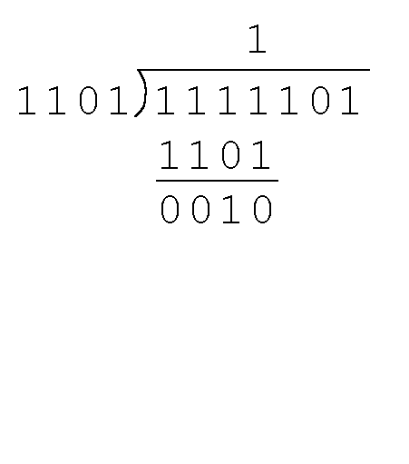
2.8 Error Detection and Correction
Find the quotient and remainder when 1111101 is divided by 1101 in modulo 2 arithmetic.
  As with traditional division, we note that the dividend is divisible once by the divisor.
  We place the divisor under the dividend and perform modulo 2 subtraction.

Slide 6
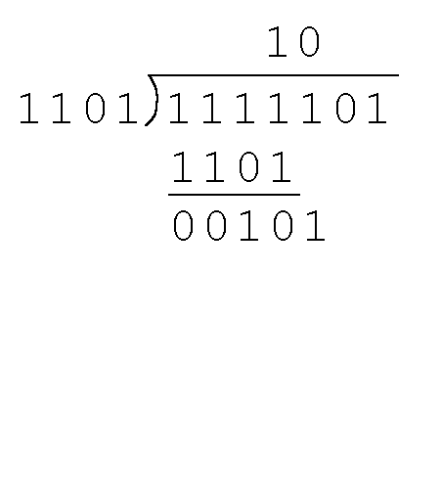
2.8 Error Detection and Correction
Find the quotient and remainder when 1111101 is divided by 1101 in modulo 2 arithmetic…
  Now we bring down the next bit of the dividend.
  We see that 00101 is not divisible by 1101. So we place a zero in the quotient.

Slide 7
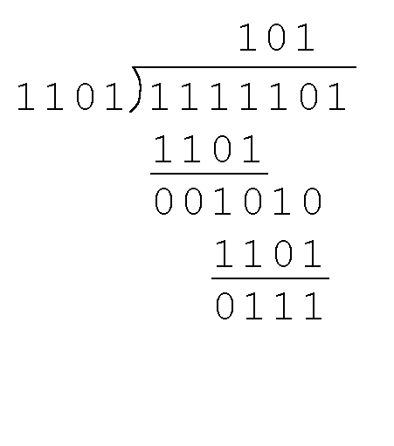
2.8 Error Detection and Correction
Find the quotient and remainder when 1111101 is divided by 1101 in modulo 2 arithmetic…
  1010 is divisible by 1101 in modulo 2.
  We perform the modulo 2 subtraction.

Slide 8
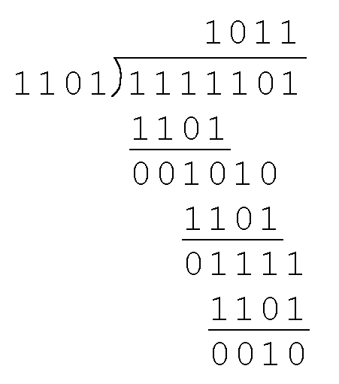
2.8 Error Detection and Correction
Find the quotient and remainder when 1111101 is divided by 1101 in modulo 2 arithmetic…
  We find the quotient is 1011, and the remainder is 0010.
This procedure is very useful to us in calculating CRC syndromes.
Note: The divisor in this example corresponds to a modulo 2 polynomial: X ³ + X ² + 1.

Slide 9
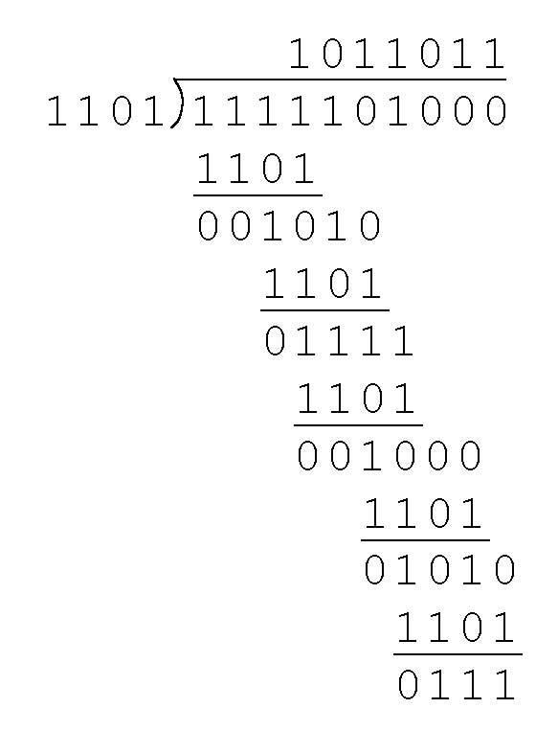
2.8 Error Detection and Correction
Suppose we want to transmit the information string: 1111101.
The receiver and sender decide to use the (arbitrary) polynomial pattern, 1101.
The information string is shifted left by one position less than the number of positions in the divisor.
The remainder is found through modulo 2 division (at right) and added to the information string: 1111101000 + 111 = 1111101111.

Slide 10
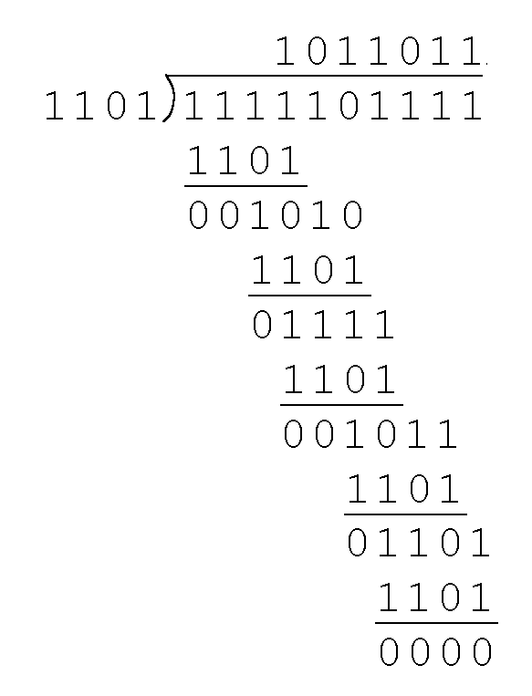
2.8 Error Detection and Correction
If no bits are lost or corrupted, dividing the received information string by the agreed upon pattern will give a remainder of zero.
We see this is so in the calculation at the right.
Real applications use longer polynomials to cover larger information strings.
  Some of the standard poly-nomials are listed in the text.

Slide 11
2.8 Error Detection and Correction
Data transmission errors are easy to fix once an error is detected.
  Just ask the sender to transmit the data again.
In computer memory and data storage, however, this cannot be done.
  Too often the only copy of something important is in memory or on disk.
Thus, to provide data integrity over the long term, error correcting codes are required.

Slide 12
2.8 Error Detection and Correction
Hamming codes and Reed-Soloman codes are two important error correcting codes.
Reed-Soloman codes are particularly useful in correcting burst errors that occur when a series of adjacent bits are damaged.
  Because CD-ROMs are easily scratched, they employ a type of Reed-Soloman error correction.
Because the mathematics of Hamming codes is much simpler than Reed-Soloman, we discuss Hamming codes in detail.

Slide 13
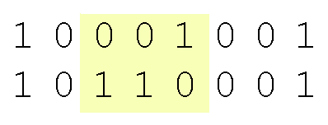
2.8 Error Detection and Correction
Hamming codes are code words formed by adding redundant check bits, or parity bits, to a data word.
The Hamming distance between two code words is the number of bits in which two code words differ.
The minimum Hamming distance for a code is the smallest Hamming distance between all pairs of words in the code.
This pair of bytes has a Hamming distance of 3:

Slide 14
2.8 Error Detection and Correction
The minimum Hamming distance for a code, D(min), determines its error detecting and error correcting capability.
For any code word, X, to be interpreted as a different valid code word, Y, at least D(min) single-bit errors must occur in X.
Thus, to detect k (or fewer) single-bit errors, the code must have a Hamming distance of D(min) = k + 1.

Slide 15
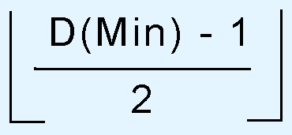
2.8 Error Detection and Correction
Hamming codes can detect D(min) - 1 errors and correct errors
Thus, a Hamming distance of 2k + 1 is required to be able to correct k errors in any data word.
Hamming distance is provided by adding a suitable number of parity bits to a data word.

Slide 16
2.8 Error Detection and Correction
Suppose we have a set of n-bit code words consisting of m data bits and r (redundant) parity bits.
An error could occur in any of the n bits, so each code word can be associated with n erroneous words at a Hamming distance of 1.
Therefore,we have n + 1 bit patterns for each code word: one valid code word, and n erroneous words.

Slide 17
2.8 Error Detection and Correction
With n-bit code words, we have 2 ^{n} possible code words consisting of 2 ^{m} data bits (where n = m + r).
This gives us the inequality:
(n + 1) × 2 ^{m} ≤ 2 ^{n}
Because n = m + r, we can rewrite the inequality as:
(m + r + 1) × 2 ^{m} ≤ 2 ^{m + r} or (m + r + 1) ≤ 2 ^{r}
  This inequality gives us a lower limit on the number of check bits that we need in our code words.

Slide 18
2.8 Error Detection and Correction
Suppose we have data words of length m = 4. Then:
(4 + r + 1) ≤ 2 ^{r}
implies that r must be greater than or equal to 3.
This means to build a code with 4-bit data words that will correct single-bit errors, we must add 3 check bits.
Finding the number of check bits is the hard part. The rest is easy.

Slide 19
2.8 Error Detection and Correction
Suppose we have data words of length m = 8. Then:
(8 + r + 1) ≤ 2 ^{r}
implies that r must be greater than or equal to 4.
This means to build a code with 8-bit data words that will correct single-bit errors, we must add 4 check bits, creating code words of length 12.
So how do we assign values to these check bits?

Slide 20
2.8 Error Detection and Correction
With code words of length 12, we observe that each of the digits, 1 though 12, can be expressed in powers of 2. Thus:
1 = 2 ⁰ 5 = 2 ² + 2 ⁰ 9 = 2 ³ + 2 ⁰
2 = 2 ¹ 6 = 2 ² + 2 ¹ 10 = 2 ³ + 2 ¹
3 = 2 ¹ + 2 ⁰ 7 = 2 ² + 2 ¹ + 2 ⁰ 11 = 2 ³ + 2 ¹ + 2 ⁰
4 = 2 ² 8 = 2 ³ 12 = 2 ³ + 2 ²
  1 (= 2⁰) contributes to all of the odd-numbered digits.
  2 (= 2¹) contributes to the digits, 2, 3, 6, 7, 10, and 11.
  . . . And so forth . . .
We can use this idea in the creation of our check bits.

Slide 21
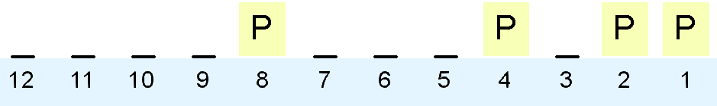
2.8 Error Detection and Correction
Using our code words of length 12, number each bit position starting with 1 in the low-order bit.
Each bit position corresponding to an even power of 2 will be occupied by a check bit.
These check bits contain the parity of each bit position for which it participates in the sum.

Slide 22
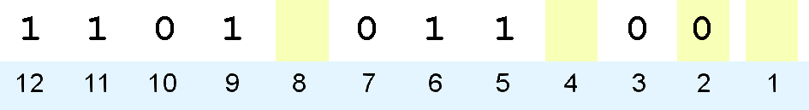
2.8 Error Detection and Correction
Since 2 (= 2¹) contributes to the digits, 2, 3, 6, 7, 10, and 11. Position 2 will contain the parity for bits 3, 6, 7, 10, and 11.
When we use even parity, this is the modulo 2 sum of the participating bit values.
For the bit values shown, we have a parity value of 0 in the second bit position.
What are the values for the other parity bits?

Slide 23
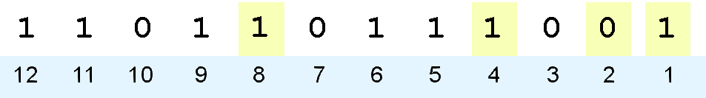
2.8 Error Detection and Correction
The completed code word is shown above.
  Bit 1checks the digits, 3, 5, 7, 9, and 11, so its value is 1.
  Bit 4 checks the digits, 5, 6, 7, and 12, so its value is 1.
  Bit 8 checks the digits, 9, 10, 11, and 12, so its value is also 1.
Using the Hamming algorithm, we can not only detect single bit errors in this code word, but also correct them!

Slide 24
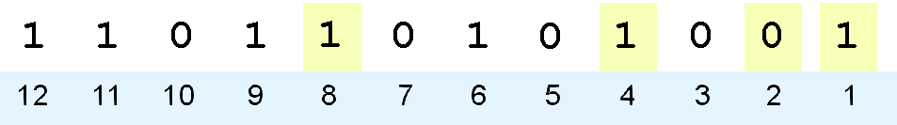
2.8 Error Detection and Correction
Suppose an error occurs in bit 5, as shown above. Our parity bit values are:
  Bit 1 checks digits, 3, 5, 7, 9, and 11. Its value is 1, but should be zero.
  Bit 2 checks digits 2, 3, 6, 7, 10, and 11. The zero is correct.
  Bit 4 checks digits, 5, 6, 7, and 12. Its value is 1, but should be zero.
  Bit 8 checks digits, 9, 10, 11, and 12. This bit is correct.

Slide 25
2.8 Error Detection and Correction
We have erroneous bits in positions 1 and 4.
With two parity bits that don’t check, we know that the error is in the data, and not in a parity bit.
Which data bits are in error? We find out by adding the bit positions of the erroneous bits.
Simply, 1 + 4 = 5. This tells us that the error is in bit 5. If we change bit 5 to a 1, all parity bits check and our data is restored.

