Slide 1
Overview Of J2EE & JBoss

Slide 2
Past History
Initially two tier architecture (client server applications)
Client is responsible for data access applying business logic and presentation of data
Only service provided by Server was that of database server.

Slide 3
Two Tier Application Architecture
Client Server

Slide 4
Two Tier Application Architecture
Drawbacks
Easy to deploy but difficult to enchance or upgrade.
It makes reuse of business and presentation logic difficult
Not scalable and not suited for internet

Slide 5
Java 2 Platform Enterprise Edition(J2EE)
J2EE is an architecture for implementing enterprise class applications using Java and Internet Technology
- Solves problems of two tier architecture

Slide 6
J2EE
To develop n tier application
It supports the development of a variety of application types
  small client server systems
  Systems running on Intranets
  Systems on large scale internet e-commerce site

Slide 7
J2EE Features
Sapana Mehta (CS-6V81)
Component based model
Container provided services
Highly Scaleable
Simplified Architecture
Flexible security model

Slide 8
Java: Foundation for J2EE
J2EE is an application of java
Write once and deploy the code into any platform

Slide 9
J2EE Components & Services
Primary technologies
  Servlets
  JavaServer Pages (JSP)
  Enterprise JavaBeans (EJB)
Standard services & supporting technologies
  Java database connectivity(JDBC) data access API
  Remote Method Invocations (RMI)
  Extensible Markup Languages(XML)
  JavaIDL
  JavaMail

Slide 10
J2EE Tiers
Client Presentation
  HTML or Java applets deployed in Browser
  XML documentations transmitted through HTTP
  Java clients running in Client Java Virtual Machine (JVM)
Presentation Logic
  Servlets or JavaServer Pages running in web server
Application Logic
  Enterprise JavaBeans running in Server

Slide 11
J2EE Application Model
Browser is able to process HTML and applets pages.
It forwards requests to the web server, which has JSPs and Servlets
Servlets and JSPs may access EJB server.
Java Standalone runs on java client, which access EJB server using RMI.

Slide 12
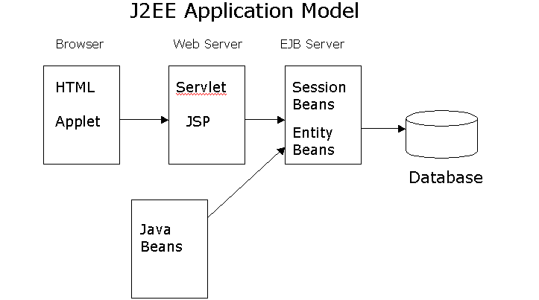
J2EE Application Model

Slide 13
Enterprise Java Beans (EJBs)
Enterprise Java beans architecture is a component model for development and deployment of distributed business application.
Entity Beans
  Represent persistent business Entity
  Persisted in storage system ( usually Database)
  Might contain Application logic intrinsic to entity
Session Beans
  Perform work for individual clients on the server
  Encapsulate complex business logic
  Can coordinate transactional work on multiple entity beans

Slide 14
States and Persistence
Sapana Mehta (CS-6V81)
Session beans can be
  Stateless- belong to client for duration of a method call
  Stateful- belong to client for duration of client conversation
Entity beans can have
  Bean-managed persistence- The developer writes SQL code to retrieve,store and update database
  Container managed persistence- The developer provide database mapping information that allows the container to manage persistence

Slide 15
Example of EJB Application
It consists of number of clients accessing session beans and entity beans
Each Session bean provides specialized processing on behalf of client
e.g. Travel Agent session bean makes travel reservations while Flight Scheduler bean schedules planes to fly on various routes.
Each Entity Bean represent different type of business entity.
e.g.Passengers, seats, planes, flights are entity beans

Slide 16
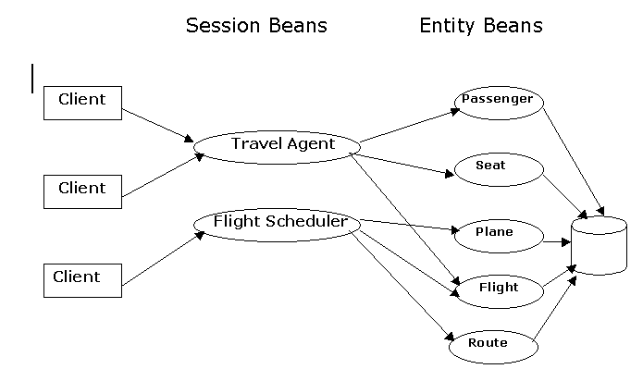
Example EJB Application

Slide 17
Overview of Servlets
Are container managed web components
Replace Common Gateway Interface(CGI) or Active Server Pages (ASP)
Generate dynamic response to requests from web based clients
Synchronize multiple concurrent client request
Serve as client proxies

Slide 18
Servlet Operation
Sapana Mehta (CS-6V81)
Server is Java program that runs as separate thread inside servlet container.
Servlet container is part of web server
It interact with web client using response request paradigm

Slide 19
JavaServer Pages (JSP)
Text based documents describe how to process a request and create a response
Contains HTML or XML and other JSP elements defined by JSP specification.
Are Installed on web server
are web components that sits on top of java servlet mode.

Slide 20
JSP Advantages
Performance
  Runtime characteristics of servlets
  Automatic recompilation of modified pages
  Server side processing
Programming
  Emphasize use of reusable components
  Write Once , Run Anywhere properties
  Extensible through custom tag libraries
Provides front end access mechanism to EJBs

Slide 21
Parts of JSP Pages
Directive
<%@ pageimport=“java.util.”, MVCApp.Cart, MVCApp.CartItem” %>
Declaration
<%! Iterator it = null; CartItem ci = null; Vector cpi = null;%>
Raw HTML
<html><head><title>Shopping Cart</title></head></html>
Action
<jsp:usebean id =“Cart” scope = “session” class = “MVCApp.Cart”/>
Scriplets
%
Cpi = cart.getCartItems ( );
it = cpi.iterator();
While (it.hasNext()){ci= (Cart Item)it.next();
%>

Slide 22
Parts of JSP Pages
Expression
<td<% = ci.getTitle() %></td>
<td align =“right”><%=ci.getQuantity()%></td>
Implicit Objects
<% string action = request.getParameter(“action”) ; %>

Slide 23
JBoss- J2EE Product
FIND OUT MORE ABOUT
TODAY’S MOST SUCCESSFUL OPEN
SOURCE- DEVELOPED APPLICATION
SERVER

Slide 24
What is JBoss
Created in 1999, JBoss is the product of an OpenSource developer community dedicated to developing the best J2EE-compliant application server in the market
With 1000 developers worldwide and a steadily growing number of downloads per month, reaching 72,000 for October ’01 (per independent www.sourceforge.net), JBoss is arguably the most downloaded application server in the world today
Distributed under an LGPL license, JBoss is absolutely FREE for use. No cost. Period.

Slide 25
What is Application Server
  Application servers enable the development of multi-tiered distributed applications. They are also called “middleware”
  An application server acts as the interface between the database(s), the web servers and the client browsers

Slide 26
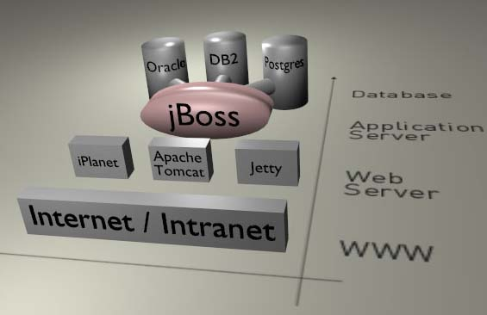
JBoss- Application Server

Slide 27
Conclusion
“First they ignore you
Then they laugh at you
Then they fight you
Then you win”
-- Mahatma Gandhi

