Slide 1
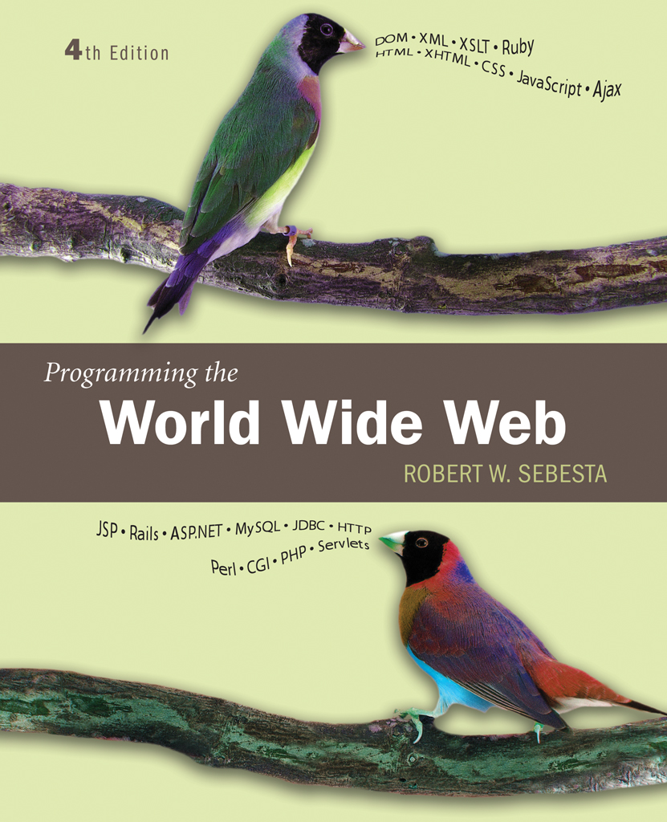
Chapter 1
Fundamentals

Slide 2
1.1 A Brief Introduction to the Internet
Internet History
Internet Protocols

Slide 3
1.1 Internet History
Origins
In 1960s department of defense (DOD) where interested in developing network for communication,program sharing etc
a)ARPAnet(advanced research project agencies) - late 1960s and early 1970s
    Network reliability
    The use was simple text based communication through email.
    Was available for ARPA-funded research organizations
b)BITnet(because its time network), Csnet(computer science network) - late 1970s & early 1980s
BITNET was began at university of newyork.
CSNET connected the university of Delaware,purdue university ,wisconsin,RAND corporation,& bolt,beranek,& newmann.
email and file transfer for other institutions

Slide 4
c)NSFnet (national science foundation)- 1986
Originally for non-DOD funded places
Initially connected five supercomputer centers
By 1990, it had replaced ARPAnet for non-military uses
Soon became the network for all (by the early 1990s)
NSFnet eventually became known as the Internet

Slide 5
1.1 Internet History
What the Internet is:
    A world-wide network of computer networks
    At the lowest level, since 1982, all connections use TCP/IP
    TCP/IP hides the differences among devices connected to the Internet

Slide 6
1.1 Internet Protocols
Internet Protocol (IP) Addresses
  Every node has a unique numeric address
  Form: 32-bit binary number
    New standard, IPv6, has 128 bits (1998)
Organizations are assigned groups of IPs for their computers
Problem: By the mid-1980s, several different protocols had been invented and were being used on the Internet, all with different user interfaces (Telnet, FTP, Usenet, mailto

Slide 7
1.1 Internet Protocol addresses
internet nodes are identified by names for people,for computers they are numeric addresses.
The ip-address is a unique 32-bit number(divided into 4 parts)
For small organization it is 256 ip-address
Range from 191.57.126.0 to 191.57.126.255
For large organizations 16 million ip-address 12.0.0.0 to 12.255.255.255
In late 1998 a new ip standard IPv6 was approved but has not yet been widely implemented. (change is to exchange 32bits to 128 bits)

Slide 8
Domain names
m/c on the internet have names begin with the name of the host m/c followed by larger enclosing collections of machines called domains.
There are 2,3, or more domain names
Form: host-name.domain-names
First domain is the smallest; last is the largest
Last domain specifies the type of organization
In united states edu is education ,gov is government,com is company etc,,(for last domain name)
In other country it is name of the country. Eg: se for sweden
Fully qualified domain name - the host name and all of the domain names
Eg: movies.comedy.marxbros.com

Slide 9
Client and Server
Clients and Servers are programs that communicate with each other over the Internet
A Server runs continuously, waiting to be contacted by a Client
  Each Server provides certain services
  Services include providing web pages
A Client will send a message to a Server requesting the service provided by that server
  The client will usually provide some information, parameters, with the request

Slide 10
Domain name conversion
DNS servers are s/w systems which - convert fully qualified domain names to Ips
Name server serves the collection of machines on the internet.
All document requests from browsers are routed to the nearest name server.
If the name server can do the conversion it does
If it cannot it sends it to another name server
The most common protocol to allow user on one computer on the internet to logon to use another computer is telnet
File transfer protocol(ftp) which was developed to transfer files.
Usenet to serve as an electronic bulletin board.
mailto to allow messages f rom one user of one computer to others on another computer

Slide 11
1.2 The World-Wide Web
Origins
  Tim Berners-Lee at CERN proposed the Web in 1989
    Purpose: to allow scientists to have access to many databases of scientific work through their own computers
    The proposed new system was designed to allow a user anywhere on the internet to search for and retreive documents from the databases on any number of different document serving computers.
  Document form: uses hypertext,which is text with embedded links to text in other documents to allow nonsequential browsing of textual material.
  The idea of hypertext had been developed earlier and had appeared in Xerox’s notecards and Apple’s HyperCard in the mid 1980’s

Slide 12
The units of information on the web have been referred to by several different names;among them the most common are pages,documents and resources
Best of the three is documents which imply only text
Pages is widely used
Calling it as resources because that covers the possibility of non textual information
Documents are sometimes text,with embedded links to other documents,but they often also include images,sound recordings,or other kind of media
When a document contains nontextual information ,it is called hypermedia

Slide 13
1.2 The World-Wide Web
Web or Internet?
The internet is a collection of computers and other devices connected by equipment that allows them to communicate with each other.
The web is a collection of software & protocols that has been installed on most
Of the computers on the internet.

Slide 14
1.3 Web Browsers
Documents provided by servers on the web are requested by browsers ,which are programs running on client machines.
They are called browsers because they allow the user to browse the resources available on servers.
The first browser was text basedit does not have GUI
In early 1993 ,Mosaic was released the first GUI browser
Mosaic was developed at the national center for supercomputer applications(NCSA) at the university of Illinois.
The first release of Mosaic ran on UNIX systems using X window system
By late 1993 ,versions of Mosaic for Apple Macintosh and Microsoft windows system had been released.
A browser is a client on the web ,it initiates the communication with the server,which waits for a request from a client before doing anything.
In simple browser request a static document from the server

Slide 15
The server locates the document and sends it to the browser,which displays it for the user.
Web supports a variety of protocols , the most common one is the Hyper text Transfer protocol(HTTP)
HTTP provides a standard form of communications between the browsers and web servers.
The most commonly used browsers are Microsoft Internet Explorer(IE) which runs only on PCs that use one of the Microsoft Windows operating systems.
The Firefox which is available in versions for different computing platforms,including windows,Mac OS,and linux
There are other browsers relative to Firefox ,they are Mozilla suite,and netscape navigator,Opera and Apple’s Safari

Slide 16
1.4 Web Servers
Web servers are program that Provide documents to requesting browsers
Servers are slave programs:they act only when requests are made to them by browsers running on other computers on the internet.
The most commonly used web servers are apache,which has been implemented for a variety of computer platforms,and Microsoft’s Internet Information Server(IIS),which runs under windows operating systems.

Slide 17
1.4 Web Server Operation
Web browsers initiate network communications with servers by sending them URLs
A URL can specify one of the two different things
The address of a data file stored on the server that is to be sent to the client
A program stored on the server that the client wants executed.
All the communications between the web client and a web server use the standard web protocol HTTP
When a web server begins execution,it informs the operating system that it is ready to accept incoming network connections through a specific port on the machine
While in this running state server runs as a background process in the operating system environment.
The web client or browser opens a network connection to the web server,sends information requests and possibly data to the server,receives information from the server,closes the connection.

Slide 18
Other machines exist between browsers and servers on the network are network routers and domain name servers
In simple the primary task of a web server is to monitor a communications port on its host machines,accept HTTP commands through that port,and perform the operations specified by the commands.
All HTTP commands include a URL,which include the specification of the host machine.
When the URL is received it is either translated to file name or program name
All current Web servers came from either
    The original from CERN in Europe
    The second one, from NCSA at the university of illinois.

Slide 19
1.4 general Server Characteristics
Most available servers share common characteristics,regardless of their origin or the platform on which they run
A file structure of the Web servers have two main directories:
    The root of one of these is called the Document root
    The file hierarchy that grows from the document root stores the web documents to which the server has direct access and normally serves to clients.
    2. The root of the other directory is called the Server root :
this directory along with the descendants directories,stores the server and its support software.
The files stored directly in the document root are those available to clients through top level URL’s
Client donot access the document root directly in URL’s,rather the server maps requested URL’s to the document root,whose location is not known to clients.

Slide 20
Many servers allow part of the servable document collection to be stored outside the directory at the document root.the secondary areas from which documents can be served is called Virtual document trees
Many servers can support more than one site on a computer,reducing the cost of each site and making their maintenance more convenient.such secondary hosts are called Virtual hosts
Some servers can serve documents that are in the document root of other machines on the web;such servers are called Proxy servers
Web servers now support other Internet protocols like ftp,Gopher,news and mail.

Slide 21
1.4 Web Server :Apache
Apache began as the NCSA server,httpd,with some additional features.
Apache came from the nature of its first version,which was a patchyversion of the httpd server.
The primary reasons for using widely the Apache server are
It is an excellent server because it is fast & reliable
It is a open source software: it is free and is managed by a large team of volunteers,a process that efficiently & effectively maintains the system.
It is one of the best available servers for unix based systems.
When apache begins execution,it reads its configuration information from a file and sets its parameters to operate accordingly
A new copy of Apache includes default configuration information for “typical”operation.
The site manager modifies this configuration information to fit his or her particular needs & tastes.

Slide 22
There are three configuration files in an Apache
Httpd.conf: actually stores the directives that control an Apache server’s behavior.
& 3. Srm.conf & access.conf these points to httpd.conf.This file contains a list of directives that specify the server operation.
These directives are described at http://httpd.apache.org/docs/2.2/mod/quickreference.html

Slide 23
1.4 Web Server : IIS
Most windows based servers use IIS
Difference b/w apache & Iis
Apache is controlled by a configuration file that is edited by the manager to change apache’s behavior
In IIS,server behavior is modified using windows-based management program named IIS snap-in.this program allows the site manager to set parameters for the server

Slide 24
1.5 URLsuniform resource locators
URL’s are used to identify documents on the internet.
URL format
General form:
  scheme:object-address
  The scheme is often a communications protocol, such as telnet ,http, ftp,mailto,file.
  Different schemes use object address of different forms.
For the http protocol, the object-address is:/ fully qualified domain name/document path
For the file protocol the document resides on the machine running the browser.this is useful to test the document without making it visible to other browsers.
the URL form as only the doc ument path

Slide 25
1.5 URLs
Host name is the name of the server computer that stores the document
Messages to a host machine is directed through port numbers .
The default port number of web server is 80.it is necessary to attach the port number to the host name in URL
URLs cannot include spaces or any of a collection of other special characters (semicolons, colons, ...).to include these it must start with % followed by 2 digit hexadecimal ASCII code .eg: san jose is a domain name,it must be typed as san%20jose.
URL paths
The path of the document for the HTTP protocol is similar to a path to a file or directory.(sequence of directory names & file names seperated by seperator)
For unix server,the path is forward slashes.for windows server it is backward slashes.

Slide 26
Path in a URL can differ from the path to a file because a URL need not include all directories on the path.the path that include all directories along the way is called complete path.
Path of the document is relative path that is specified in the configuration files of the server.such paths are called partial paths.
Complete path: http://www.gumboco.com/files/f99/storefront.html
Partial path: http://www.gumboco.com/storefront.html when the servers configuration specifies the root directory for files it can serve is files/f99.
If the specified document is a directory rather than a single document, the directory name is followed immediately by a slash
http://www.gumboco.com/departments/

Slide 27
1.6 Multipurpose Internet Mail Extensions (MIME)
The browser needs a way for determining the format of a document it receives from a web server which is done through MIME.
Type specification
Originally developed for email
Used to specify to the browser the form of a file returned by the server (attached by the server to the beginning of the document)eg: text,video data, or sound data.
Type specifications
  Form:
    type/subtype
  The most common MIME types are text, image and video
  The most common image subtype are plain and html
  Examples: text/plain, text/html
  The most common image subtype are gif & jpeg
  The most commom video subtypes are mpeg and quicktime.

Slide 28
1.6 Multipurpose Internet Mail Extensions (MIME)
A list of MIME specification is stored in the configuration files of every web server.
Browsers also maintain a conversion table for looking up the type of a document by its filename extension,this is used only when the server does not specify the MIME type,which is the case in old servers.
Experimental document types
The name of an experimental subtype begins with x-,as in /x-msvideo.
A web provider can add an experimental subtype by having its name added to the list of MIME specifications stored in the web server
There are some document types which are widely used but cannot be handle d with the browser,which is done in the same way as experimental subtypes.

Slide 29
1.7 The HyperText Transfer Protocol
The protocol used by ALL Web communications is HTTP
The current version is HTTP1.1,it is formally defined as RFC2616,which was approved in june 1999
HTTP consists of 2 phases, the request and the response
Each HTTP communication between the browser and server consists of 2 parts,a header & a body
The header contains the information about the communication ;the body contains the data of the communication
Request Phase
  General Form:
  HTTP method domain part of URL HTTP version.
  Header fields
  blank line
  Message body

Slide 30
1.7 The HyperText Transfer Protocol: Methods
  an example of the first line of a HTTP request:
    GET /degrees.html HTTP/1.1
Only few methods are defined by HTTP, and even a smaller number of these are typically used.
GET – returns the contents of the specified document
POST - Execute the document, using the data in body
HEAD – returns the headerinformation for the specified document
PUT – replaces the specified document with the enclosed data
DELETE – deletes the specified document.
The most commonly used method are get & post
Following the first line of an HTTP communication is any number of header fields,most of which are optional.
The format of the header is field name followed by a colon and the value of the field.

Slide 31
1.7 HTTP Headers
Four categories of header fields:
  General : for general information such as date
  Request : included in request header
  response : for response headers
  Entity : used in both response & request header.
One common request field is ACCEPT field,which specifies a preference of the browser for the MIME type of the requested document
More than one ACCEPT field can be used if the browser is willing to accept document in more than one format
  Accept: text/plain
  Accept:text/html
  Accept:image/gif
  A wildcard character,the asterisk(*)can be used to specify that part of a MIME type can be anything
  Accept: text/*

Slide 32
  The host: hostname request field gives the name of the host,this is required for HTTP1.1.
  If –modified-since: date request field specifies therequested file should be sent only if it has been modified since the given date.
  Content-length gives the length of the request body
  The header of the request must be followed with blank line,which is used to separate the header from the body of the requests
  Requests that use the GET,HEAD,and DELETE methods do not have bodies
  The browser is not necessary to communicate with the server;telnet is used
  > telnet blanca.uccs.edu http → this command creates a connection to the http port on the blanca.uccs.edu server

Slide 33
  The server responds with the following
  Trying 128.198.162.60 …
  Connected to blanca
  Escape character is ‘^ j’.
  The connection to the server is now complete,and HTTP commands can be given.
  For example
  GET /respond.html HTTP/1.1
  Host: blanca.uccs.edu

Slide 34
1.7 HTTP Response
General Form:
  Status line
  Response header fields
  blank line
  Response body
Status line format:
  HTTP version status code short textual explanation of the status code
Most responses begin with the following
HTTP/1.1 200 OK
Status code is a three-digit number; first digit specifies the general status
  1 => Informational
  2 => Success
  3 => Redirection
  4 => Client error
  5 => Server error
The header field, Content-type, is required

Slide 35
One of the more common status codes is one users never want to see:404 Not Found
200 OK is what the users want to see ,

Slide 36
1.7 HTTP Response Example
HTTP/1.1 200 OK
Date: Tues, 18 May 2004 16:45:13 GMT
Server: Apache (Red-Hat/Linux)
Last-modified: Tues, 18 May 2004 16:38:38 GMT
Etag: "841fb-4b-3d1a0179"
Accept-ranges: bytes
Content-length: 364
Connection: close
Content-type: text/html, charset=ISO-8859-1
Both request headers and response headers must be followed by a blank line

Slide 37
1.8 The Web Programmer’s Toolbox
Document languages and programming languages that are the building blocks of the web and web programming
The tools are
XHTML→a markup language
XML→is a meta markup language
Javascript ,Java, Perl, Ruby, PHP →are programming languages
AJAX→ is a web technology that uses javascript & xml
Rails →is a development framework for web based database access systems
Web programs are divided into 2 categories,client side & server side according to there execution
Xhtml & xml are client side languages
Perl,php,& ruby are server side languages
Java script is often a client side language,although it can be used for both
Java is used for both

Slide 38
1.8 XHTML
Xhtml is not a programming language
It cannot describe computations
It describes the general form and layout of documents to be displayed by the browser
Xhtml is not the first markup language
TeX & LaTeX are older markup languages used
An XHTML document is a mix of content and controls
Controls are specified by the tags of xhtml
The name of the tag specifies the category of its content
Most xhtml tags consists of pair of syntactic markers that are used to delimit particular kinds of content
The pair of tags with contents are called as element
Some tags

Slide 39
Creating XHTML documents
XHTML editors - make document creation easier
  Shortcuts to typing tag names, spell-checker,
WYSIWYG XHTML editors
    Need not know XHTML to create XHTML documents

Slide 40
1.8 Plugins and Filters
Plug ins
  Integrated into tools like word processors, effectively converting them to WYSIWYG XHTML editors
Filters
  Convert documents in other formats to XHTML

Slide 41
1.8 Plugins and Filters: Advantages and Disadvantages
Advantages of both filters and plug-ins:
  Existing documents produced with other tools can be converted to XHTML documents
  Use a tool you already know to produce XHTML
Disadvantages of both filters and plug-ins:
  XHTML output of both is not perfect - must be fine tuned
  XHTML may be non-standard
  You have two versions of the document, which are difficult to synchronize

Slide 42
1.8 XML
A meta-markup language
Used to create a new markup language for a particular purpose or area
Because the tags are designed for a specific area, they can be meaningful
No presentation details
A simple and universal way of representing data of any textual kind

Slide 43
1.8 JavaScript
A client-side HTML-embedded scripting language
Only related to Java through syntax
Dynamically typed and not object-oriented
Java script is usually embedded in XHTML documents
The XHTML documents are downloaded when they are requested by the browser
Application of javascript is to dynamically create & modify documents

Slide 44
1.8 Java
General purpose object-oriented programming language
Based on C++, but simpler and safer
Java was designed by sun microsystems
It was originally developed to program household appliances where time is very important
Java is very powerful way to provide a computational capability for XHTML documents
Instead of java programs running on the web server to provide a computational capability ,a special kind of java pgm called applet can be resident on server,but the compiled version of applet is downloaded to the browser when requested by the XHTML document
Our focus is on applets, servlets, and JSP
Java can be used as a server side scripting language

Slide 45
1.8 Perl
Before applets & embedded scripts server-side computation for XHTML documents, was through CGI (common gateway interface)
CGI programs can be written in any programming language that is supported by server machine
The most commonly used language for CGI is perl
Perl is good for CGI programming because:
  Direct access to operating systems functions
  Powerful character string pattern-matching operations
  Access to database systems
Perl is highly platform independent, and has been ported to all common platforms
Perl is not just for CGI
Perl syntax is similar to that of C. perl code is not compiled into the machine language and executed,as in c.instead it is compiled to an intermediate language and interpreted.

Slide 46
1.8 PHP
A server-side scripting languagespecially designed for web applications
PHP code is embedded in XHTML document like JS
An alternative to CGI
Similar to JavaScript ,both in terms of its syntactic appearance and in terms of dynamic nature of its strings and arrays
PHP arrays are the combination of perl arrays & perl hashes(associative arrays).
Great for form processing and database access through the Web

Slide 47
ruby
Ruby is an object oriented scripting language in the early 1990s & released in 1996
The original motivation for ruby was dissatisfaction of its designer with the earlier languages perl & python
The feature of ruby is it is pure object oriented language just like small talk
Every data value is an object and all operations are via method calls
Both classes & objects in ruby are dynamic ,that methods can be dynamically addedto either
The syntax of ruby is related to ada
There is no need to declare variables because of dynamic typing
Rails was designed for use with ruby

Slide 48
rails
Rails is a development framework for web based applications that access databases
The framework is a system in which much of the more or less standard software parts are furnished by the framework,so they need not be written by the application developer
ASP.NET is also a development framework for web based applications
Since rails as connection with ruby it is called as ruby on rails or RoR.
Rails applications are tightly bound to relational databases
Rails can & often is used in conjunction with Ajax

Slide 49
Ajax
Asynchronous javascript+xml
The idea of ajax is simple,but results in different way of viewing & building web interaction
In traditional web application, the client sents a request & waits until server responses
In ajax web application
1.The communication from the browser to the server is asynchronous:the browser need not wait for the server to respond,the browser user can continue with what he is doing until the new document is searched & rendered
2. The document provided by the server is relatively small part of displayed document ,it takes less time to be transmitted & rendered
These 2 changes can result in much faster interaction between browser & server
X in ajax is xml

Slide 50
Ajax has some advantages over ASP.NET & JSP
1. the technologies that support ajax are already resident in nearly all web browsers & servers
2.Ajax does not require the learning of a new tool or language rather ,it requires only a new way of thinking about web interactions

