Slide 1

Chapter 2
Introduction to
XHTML

Slide 2
2.1 Origins and Evolution of HTML(extensible hypertext markup language)
HTML was defined with SGML(standard generalized markup language),which is an ISO standard notation for describing text formatting languges.
Original intent of HTML: General layout of documents that could be displayed by a wide variety of computers
Addition of style sheets to HTML in the late 1990 advanced the capabilities closer to those of other text formatting languages.
Versions of HTML & XHTML
The original version of HTML was designed ,with the structure of web & the first browser at european laboratory or CERN( conseil European la Recherce Nucleaire)

Slide 3
MOSAIC is the first graphical web browser release in 1993,it was commercialized & marketed by netscape
Microsoft began developing its own browser IE(internet explorer)
In late 1994 Berners-Lee started the worldwide web consortium(W3C) purpose is to develop standards for web technologies starting with HTML.
The first HTML standard,HTML 2.0 was released in 1995.
It was followed byHTML 3.2 in early 1997.
Recent versions:
HTML 4.0 – 1997
Introduced many new features and deprecated many older features
HTML 4.01 – 1999-approved by W3C – A cleanup of 4.0

Slide 4
XHTML 1.0 – approved in early 2000
XHTML 1.0 is a redefinition of HTML4.01 using XML.
XHTML 1.1 was recommended by W3C in may 2001
XHTML 1.1 Modularized 1.0, and drops frames
We’ll stick to 1.1, except for frames
XHTML 2.0 is getting close to release.
The latest versions of the most popular browsers,microsoft internet explorer 7(IE7) and firefox 2(FX2).

Slide 5
2.1 Origins and Evolution of HTML (continued)
Reasons to use HTML, rather than XHTML:
  HTML has lax syntax rules, leading to sloppy and sometime ambiguous documents
  – XHTML syntax is much more strict, leading to clean and clear documents in a standard form
  HTML is easier to write
  Because a huge number of HTML documents available on the web ,browsers supports it.
  Why to use XHTML
  1.Quality & consistency is high
  2.Enforces strict syntax rules
  3.The syntactic correctness of XHTML documents can be validated ie can be checked by xml browser

Slide 6
2.2 Basic Syntax
The fundamental syntactic units of html are called tags.
Tags are used to specify categories of content.
Elements are defined by tags (markers)
Tag format: must be written in lower case letters
Opening tag: <name>
Closing tag: </name>
The opening tag and its closing tag together specify a container for the content they enclose
Not all tags have content
  If a tag has no content, its form is <name />

Slide 7
The container and ,its content together are called an element
Eg: <p> this is simple </p>
If a tag has attributes(specifies alternative meanings of the tag), they appear between its name and the right bracket of the opening tag
Attributes are specified in keyword form
Attribute-name=attribute-value
Comment form: <!-- … -->
Eg: <!-- This is program 1 -- >
Browsers ignore comments, unrecognizable tags, line breaks, multiple spaces, and tabs
Tags are suggestions to the browser, even if they are recognized by the browser

Slide 8
2.3 standard XHTML Document Structure
Every XHTML document must begin with an xml declaration element which identifies the document as being one based on XML.
This includes attributes like version number & encoding which is unicode encoding “utf-8”
Every XHTML document must begin with:
  <?xml version = ″1.0″ encoding = “utf-8”?> ( this must start with first character position).
  Following xml declaration element is an SGML DOCTYPE command which specifies the particular SGML document –type definition(DTD) with which the document compiles ,among other things
  <!DOCTYPE html PUBLIC ″-//w3c//DTD XHTML 1.1//EN″
  http://www.w3.org/TR/xhtml11/DTD/xhtml11.dtd>

Slide 9
<html>, <head>, <title>, and <body> tags are required in every XHTML document
The whole document must have <html> as its root
html must have the xmlns attribute which specifies the XHTML namespaces:
<html xmlns = ″http://www.w3.org/1999/xhtml″
The xmlns value looks like a URL ,but it is a name.
A document consists of a head and a body
The <title> tag is used to give the document a title, which is normally displayed in the browser’s window title bar (at the top of the display)
Prior to XHTML 1.1, a document could have either a body or a frameset

Slide 10
2.4 Basic Text Markup
1. paragraphs
Text is normally placed in paragraph elements
Paragraph Elements
  The <p> tag breaks the current line and inserts a blank line - the new line gets the beginning of the content of the paragraph
  The browser puts as many words of the paragraph’s content as will fit in each line
  <?xml version = ″1.0″?>
  <!DOCTYPE html PUBLIC ″-//w3c//DTD XHTML 1.1//EN″
  http://www.w3.org/TR/xhtml11/DTD/xhtml11.dtd>
  <!-- greet.hmtl
  A trivial document
  -->
  <html xmlns = ″http://www.w3.org/1999/xhtml″>
  <head> <title> Our first document </title>
  </head>
  <body>
  <p>
  Greetings from your Webmaster!
  </p>
  </body>
  </html>

Slide 11
2.4 Basic Text Markup (continued)
2.Line breaks
  The effect of the <br /> tag is the same as that of <p>, except for the blank line
    No closing tag! / indicates both beginning and closing
Example of paragraphs and line breaks
  On the plains of hesitation <p> bleach the
  bones of countless millions </p> <br />
  who, at the dawn of victory <br /> sat down
  to wait, and waiting, died.
Typical display of this text:
  On the plains of hesitation
  bleach the bones of countless millions
  who, at the dawn of victory
  sat down to wait, and waiting, died.

Slide 12
3. Preserving white spaces
Some cases it is desirable to preserve whitespaces in text,which is done using pre tag.
Eg:
<p><pre>
mary
had a
pretty
</pre></p>
Output:
mary
had a
pretty

Slide 13
2.4 Basic Text Markup (continued)
4.Headings
  Six levelsof headings, 1 - 6, specified with <h1> to <h6>
  1, 2, and 3 use font sizes that are larger than the default font size
  4 uses the default size
  5 and 6 use smaller font sizes
  Heading tags always break current line so there content always appear on new line,browser usually insert some vertical spaces before and after all headings.
<!-- headings.html
An example to illustrate headings
-->
<html xmlns = ″http://www.w3.org/1999/xhtml″>
<head> <title> Headings </title>
</head>
<body>
<h1> Aidan’s Airplanes (h1) </h1>
<h2> The best in used airplanes (h2) </h2>
<h3> "We’ve got them by the hangarful" (h3)
</h3>
<h4> We’re the guys to see for a good used
airplane (h4) </h4>
<h5> We offer great prices on great planes
(h5) </h5>
<h6> No returns, no guarantees, no refunds,
all sales are final (h6) </h6>
</body>
</html>

Slide 14
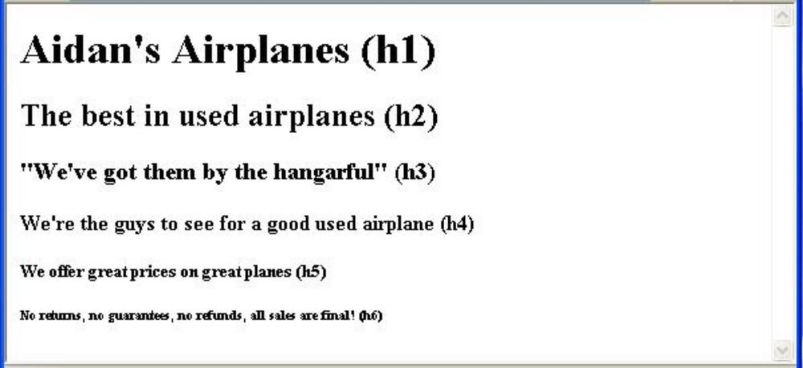
2.4 Basic Text Markup (continued)
5.Blockquotations
  Content of <blockquote>
  To set a block of text off from the normal flow in a document
  Browsers often indent, and sometimes italicize
6.Font Styles and Sizes (can be nested)
  Boldface - <b>
  Italics - <i>

Slide 15
2.4 Basic Text Markup (continued)
    There are few tags called content based tags.
    Emphasis tag, <em>,-specifies the content is special.(specifies it in italic
    Strong tag <strong> species the strong element bold
    <code> tag is used to specify the monospace font usually used for program code.
  Superscripts and subscripts
    Subscripts with <sub>
    Superscripts with <sup>
  Example: x<sub>2</sub><sup>3</sup>
  Display: x₂³
Inline versus block elements
The content of the inline tag appears on the current line except br which is an inline tag eg: <em>,<strong>
The block tag breaks the current line and appears on newline.eg:heading & <blockquote>
Inline tags cannot be nested in the body ,block tags can be nested.

Slide 16
2.4 Basic Text Markup (continued)
7. Character entities
Char. Entity Meaning
& &amp; Ampersand
< &lt; Less than
> &gt; Greater than
” &quot; Double quote
’ &apos; Single quote
¼ &frac14; One quarter
½ &frac12; One half
¾ &frac34; Three quarters
° &deg; Degree
(space) &nbsp; Non-breaking space
8. Horizontal rules
  <hr /> draws a line across the display, after a line break
  9.The meta element.
The meta element Used to provide additional information about a document, with attributes, not content.
The 2 attributes that are used are name & conent.commonly used name attribute is keywords
<meta name =“keywords” content=“binary trees,lists,stacks” />

Slide 17
2.5 Images
1. Image formats
GIF (Graphic Interchange Format)
  8-bit color representations for pixels(allowing a pixel to have 256 different colors)
  It uses .gif extension
  Gif images are made to appear transparent.
JPEG (Joint Photographic Experts Group)
  24-bit color (16 million different colors)
  .jpg extension
  The compression algorithm used for jpeg is better than gif
  The images are small
  It is not transparent
PNG(portable network graphics)
PNG was designed in 1996 as a free replacement for GIF
It is transparent and as large number of colors
images need more space than JPEG
it is also called as ping

Slide 18
2. The <img /> tag
It is an inline tag
Images are inserted into a document with the <img /> tag with 2 attributes
src attribute –specifies the file containing the image
The alt attribute –specifies text to be displayed if image is not displayed
<img src = "comets.jpg"
alt = "Picture of comets" />
The <img> tag has 30 different attributes, including width and height (in pixels)

Slide 19
2.5 Images (continued)
<!-- image.html
An example to illustrate an image
-->
<html xmlns = ″http://www.w3.org/1999/xhtml″>
<head> <title> Images </title>
</head>
<body>
<h1> Aidan's Airplanes </h1>
<h2> The best in used airplanes </h2>
<h3> "We've got them by the hangarful"
</h3>
<h2> Special of the month </h2>
<p>
1960 Cessna 210 <br />
577 hours since major engine overhaul
<br />
1022 hours since prop overhaul
<br /><br />
<img src = "c210new.jpg"
alt = "Picture of a Cessna 210"/>
<br />
Buy this fine airplane today at a
remarkably low price <br />
Call 999-555-1111 today!
</p>
</body>
</html>

Slide 20
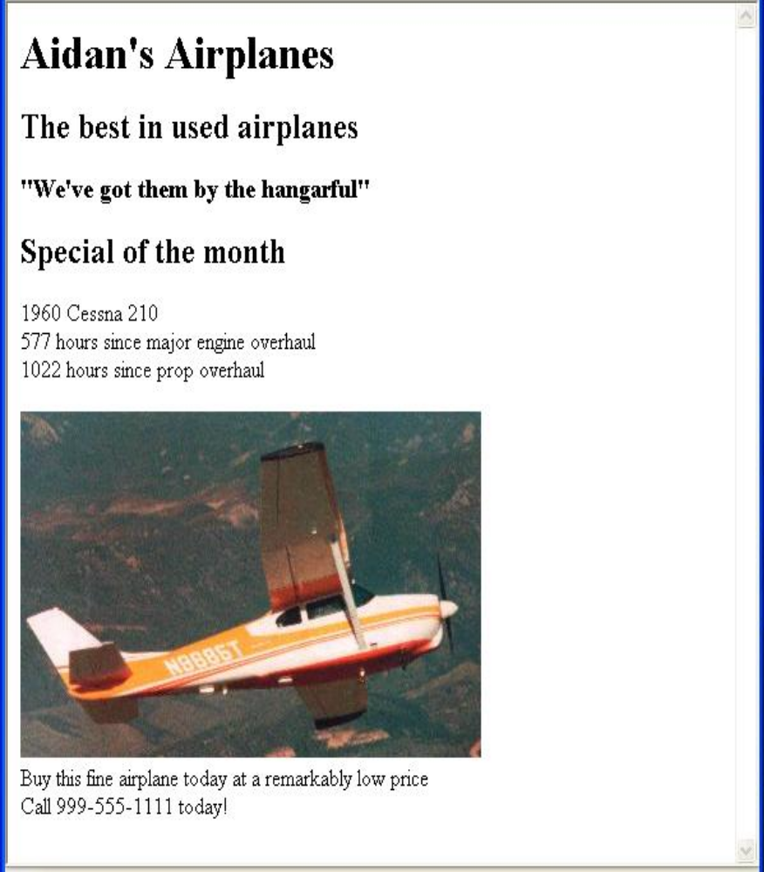
2.5 Images (continued)

Slide 21
2.6 Hypertext Links
Hypertext link in an XHTML document simply called as link acts as a pointer to some resource.
1. Links
A link that points to a different document specifies the address of that document,such an address can be a filename,path or a complete URL.
A link is specified with the href (hypertext reference) attribute of <a> (the
anchor tag)
Anchor tag is a inline tag
  The content of <a> is the visual link in the document
  Links are usually implicitly rendered in different color with underline.

Slide 22
2.6 Hypertext Links (continued)
<!-- link.html
An example to illustrate a link
-->
<html xmlns = ″http://www.w3.org/1999/xhtml″>
<head> <title> Links </title>
</head>
<body>
<h1> Aidan's Airplanes </h1>
<h2> The best in used airplanes </h2>
<h3> "We've got them by the hangarful"
</h3>
<h2> Special of the month </h2>
<p>
1960 Cessna 210 <br />
<a href = "C210data.html">
Information on the Cessna 210 </a>
</p>
</body>
</html>

Slide 23
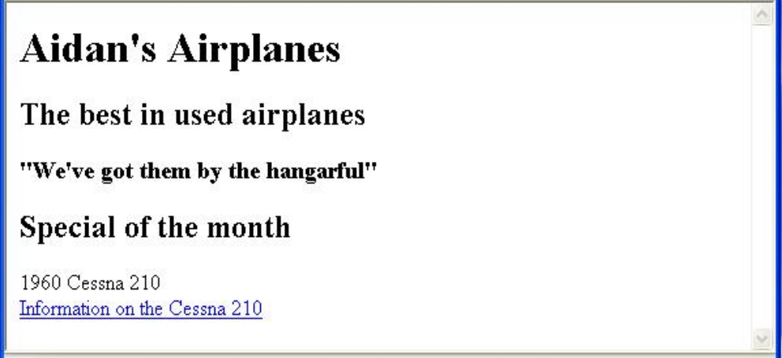
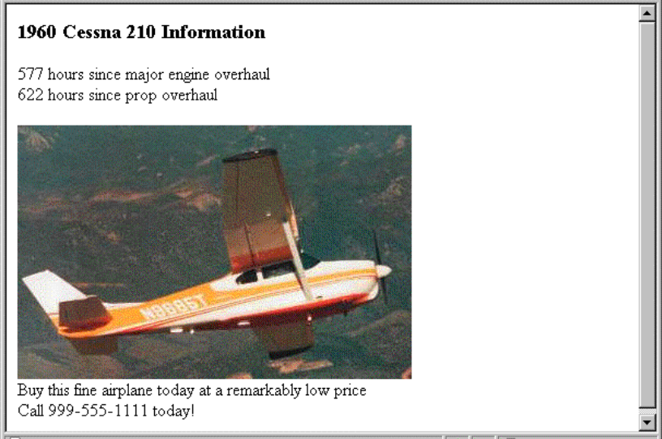
2.6 Hypertext Links (continued)

Slide 24
2.6 Hypertext Links (continued)
2.Targets within documents
If the target is not at the beginning of the document, the target spot must be marked
Target labels can be defined in many different tags with the id attribute, as in
  <h1 id = "baskets"> Baskets </h1>
The link to an id must be preceded by a pound sign (#); If the id is in the same document, this target could be
  <a href = "#baskets">
What about baskets? </a>
If the target is in a different document, the document reference must be included
  <a href = "myAd.html#baskets”> Baskets </a>
Style note: a link should blend in with the surrounding text, so reading it without taking the link should not be made less pleasant
Links can have images:
<a href = "c210data.html“>
<img src = "smallplane.jpg"
alt = "Small picture of an airplane " />
Info on C210 </a>

Slide 25
3.Using links
Use of links to parts of same document is to provide a table of contents in which each entry has a link.

Slide 26
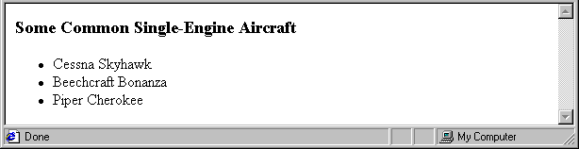
2.7 Lists
1.Unordered lists
The list is the content of the <ul> tag
<ul> is a block tag
List elements are the content of the <li> tag
<h3> Some Common Single-Engine Aircraft </h3>
<ul>
<li> Cessna Skyhawk </li>
<li> Beechcraft Bonanza </li>
<li> Piper Cherokee </li>
</ul>
2.Ordered lists
  The list is the content of the <ol> tag
  Each item in the display is preceded by a sequence value
  It is a block tag,the default sequential values are arabic numerals beginning with 1,

Slide 27
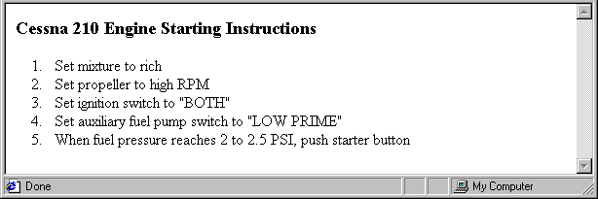
2.7 Lists (continued)
<h3> Cessna 210 Engine Starting Instructions
</h3>
<ol>
<li> Set mixture to rich </li>
<li> Set propeller to high RPM </li>
<li> Set ignition switch to "BOTH" </li>
<li> Set auxiliary fuel pump switch to
"LOW PRIME" </li>
<li> When fuel pressure reaches 2 to 2.5
PSI, push starter button </li>
</ol>
Nested lists
  Any type list can be nested inside any type list
  The nested list must be in a list item

Slide 28
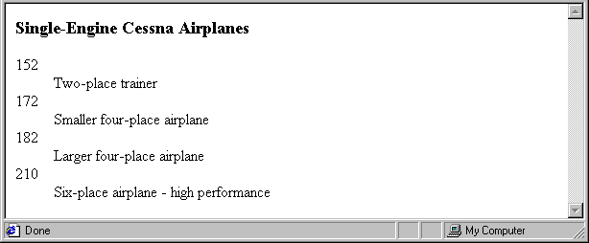
2.7 Lists (continued)
3.Definition lists (for glossaries, etc.)
  List is the content of the <dl> tag, which is a block tag
  Each Terms being defined are the content of the <dt> tag
  The definitions themselves are the content of the <dd> tag
<h3> Single-Engine Cessna Airplanes </h3>
<dl >
<dt> 152 </dt>
<dd> Two-place trainer </dd>
<dt> 172 </dt>
<dd> Smaller four-place airplane </dd>
<dt> 182 </dt>
<dd> Larger four-place airplane </dd>
<dt> 210 </dt>
<dd> Six-place airplane - high performance
</dd>
</dl>

Slide 29
2.8 Tables
A table is a matrix of cells, each possibly having content
The cells can include almost any element
Some cells have row or column labels and some have data
1. Basic table tags
A table is specified as the content of a <table> tag
The line around the outside of the whole table is called a border
The lines that separate the cells is called rules.
A border attribute in the <table> tag specifies a border between the cells
If border is set to "border", the browser’s default width border is used
The border attribute can be set to a number, which will be the border width
Without the border attribute, the table will have no lines!
Tables are given titles with the <caption> tag, which can immediately follow <table>

Slide 30
2.8 Tables (continued)
Each row of a table is specified as the content of a <tr> tag
The row headings are specified as the content of a <th> tag
The contents of a data cell is specified as the content of a <td> tag
<table border = "border">
<caption> Fruit Juice Drinks </caption>
<tr>
<th> </th>
<th> Apple </th>
<th> Orange </th>
<th> Screwdriver </th>
</tr>
<tr>
<th> Breakfast </th>
<td> 0 </td>
<td> 1 </td>
<td> 0 </td>
</tr>
<tr>
<th> Lunch </th>
<td> 1 </td>
<td> 0 </td>
<td> 0 </td>
</tr>
</table>

Slide 31
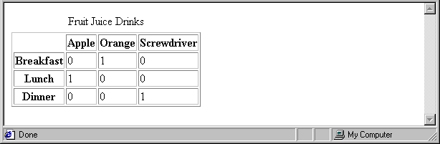
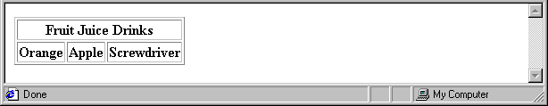
2.8 Tables (continued)
2. The rowspan and colspan attributes
A table can have two levels of column labels
  If so, the colspan attribute must be set in the <th> tag to specify that the label must span some number of columns
<tr>
<th colspan = "3"> Fruit Juice Drinks </th>
</tr>
<tr>
<th> Orange </th>
<th> Apple </th>
<th> Screwdriver </th>
</tr>

Slide 32
2.8 Tables (continued)
If the rows have labels and there is a spanning column label, the upper left corner must be made larger, using rowspan
<table border = "border">
<tr>
<td rowspan = "2"> </td>
<th colspan = "3"> Fruit Juice Drinks
</th>
</tr>
<tr>
<th> Apple </th>
<th> Orange </th>
<th> Screwdriver </th>
</tr>
…
</table>

Slide 33
2.8 Tables (continued)
3. The align & valign attributes
The align attribute controls the horizontal placement of the contents in a table cell
  Values are left, right, and center (default)
  align is an attribute of <tr>, <th>, and <td> elements
The valign attribute controls the vertical placement of the contents of a table cell
  Values are top, bottom, and center (default)
  valign is an attribute of <th> and <td> elements
  SHOW cell_align.html and display it
  4. The cellpadding and cell spacing
The cellspacing attribute of <table> is used to specify the distance between cells in a table
The cellpadding attribute of <table> is used to specify the spacing between the content of a cell and the inner walls of the cell

Slide 34
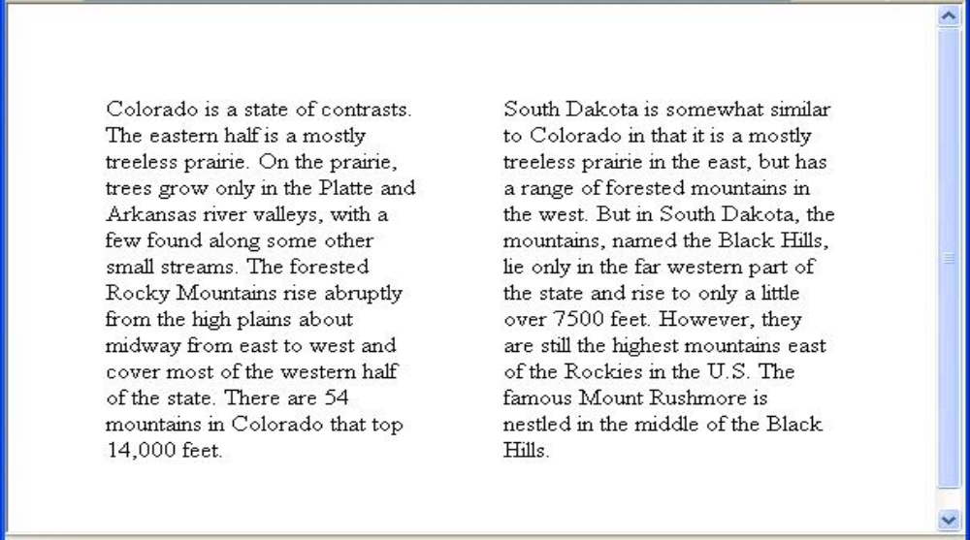
2.8 Tables (continued)
<table cellspacing = "50">
<tr>
<td> Colorado is a state of …
</td>
<td> South Dakota is somewhat…
</td>
</tr>
</table>

Slide 35
5.Table Sections:
Tables occur in 2 and sometimes 3 parts:header,body ,footer
Header, body, and footer, which are the elements: thead, tbody, and tfoot
The header contains the column labels,regardless of number of levels in those labels
The body includes the data of the table including the row labels
The footer when it appears, sometimes has the column labels repeated after the body.in some tables, it contains the totals for the columns of data above.
If a document has multiple tbody elements, they are separated by thicker horizontal lines

Slide 36
2.9 Forms
A form is the usual way information is gotten from a browser to a server
HTML has tags to create a collection of objects that implement this information gathering
  The objects are called widgets (e.g., radio buttons and checkboxes)
When the Submit button of a form is clicked, the form’s values are sent to the server
1. The <form> tag
All of the widgets, or components of a form are defined in the content of a <form> tag
  The only required attribute of <form> is action, which specifies the URL of the application that is to be called when the Submit button is clicked
  action =
  "http://www.cs.ucp.edu/cgi-bin/survey.pl"
    If the form has no action, the value of action is the empty string

Slide 37
2.9 Forms (continued)
The method attribute of <form> specifies one of the two possible techniques of transferring the form data to the server, get and post
  get and post are discussed in Chapter 10
  2. The <input> tag
  It is an inline tag
  Many of the commonly used controls are created with the <input> tag which is used for text,passwords,checkboxes,radiobuttons, & the action buttons reset ,submit,and plain
    The type attribute of <input> specifies the kind of control being created
    Text
      Creates a horizontal box for text input
      Default size is 20; it can be changed with the size attribute
      If more characters are entered than will fit, the box is scrolled (shifted) left

Slide 38
2.9 Forms (continued)
  If you don’t want to allow the user to type more characters than will fit, set maxlength, which causes excess input to be ignored
    <input type = "text" name = "Phone"
    size = "12" >
    If the contents of a text box should not be displayed when it is entered by the user, a password control can be used
    Eg: <input type = “password” name = “mypassword” size = “10” maxlength = “10” />
    Text boxes as well as other control signals must be labeled
    Eg: <label> phone:<input type = “text” name = “phone” />
    </label>

Slide 39
2. Checkboxes - to collect multiple choice input
Every checkbox requires a value attribute, which is the widget’s value in the form data when the checkbox is ‘checked’
Name identifies the button
A checkbox that is not ‘checked’ contributes no value to the form data
By default, no checkbox is initially ‘checked’
To initialize a checkbox to ‘checked’, the checked attribute must be set to "checked"

Slide 40
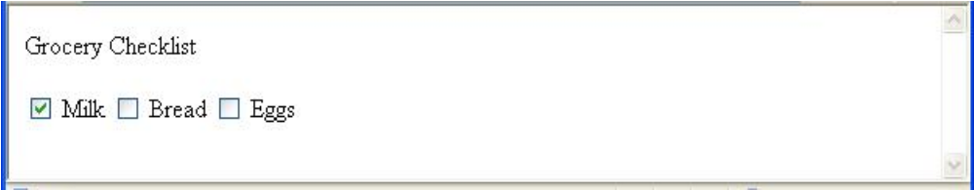
2.9 Forms (continued)
Widgets (continued)
Grocery Checklist
<form action = "">
<p>
<input type = "checkbox" name ="groceries"
value = "milk" checked = "checked">
Milk
<input type = "checkbox" name ="groceries"
value = "bread">
Bread
<input type = "checkbox" name = "groceries"
value= "eggs">
Eggs
</p>
</form>
3. Radio Buttons - collections of checkboxes in which only one button can be ‘checked’ at a time
    Every button in a radio button group MUST have the same name

Slide 41
2.9 Forms (continued)
Widgets (continued)
3. Radio Buttons (continued)
  If no button in a radio button group is ‘pressed’, the browser often ‘presses’ the first one
Age Category
<form action = "">
<p>
<input type = "radio" name = "age"
value = "under20" checked = "checked"> 0-19
<input type = "radio" name = "age"
value = "20-35"> 20-35
<input type = "radio" name = "age"
value = "36-50"> 36-50
<input type = "radio" name = "age"
value = "over50"> Over 50
</p>
</form>

Slide 42
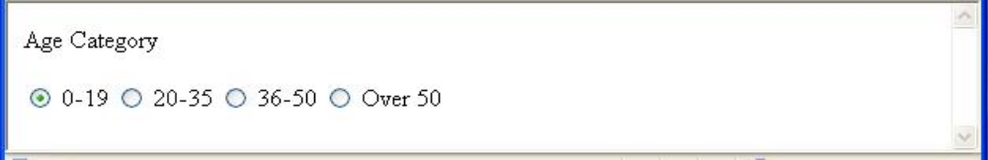
2.9 Forms (continued)
4. Menus - created with <select> tags
There are two kinds of menus, those that behave like checkboxes and those that behave like radio buttons (the default)
  Menus that behave like checkboxes are specified by including the multiple attribute, which must be set to "multiple"
The name attribute of <select> is required
The size attribute of <select> can be included to specify the number of menu items to be displayed (the default is 1)
  If size is set to > 1 or if multiple is specified, the menu is displayed as a pop-up menu

Slide 43
2.9 Forms (continued)
Widgets (continued)
3. Menus (continued)
  Each item of a menu is specified with an <option> tag, whose pure text content (no tags) is the value of the item
  An <option> tag can include the selected attribute, which when assigned "selected” specifies that the item is preselected
Grocery Menu - milk, bread, eggs, cheese
<form action = "">
<p>
With size = 1 (the default)
<select name = "groceries">
<option> milk </option>
<option> bread </option>
<option> eggs </option>
<option> cheese </option>
</select>
</p>
</form>

Slide 44
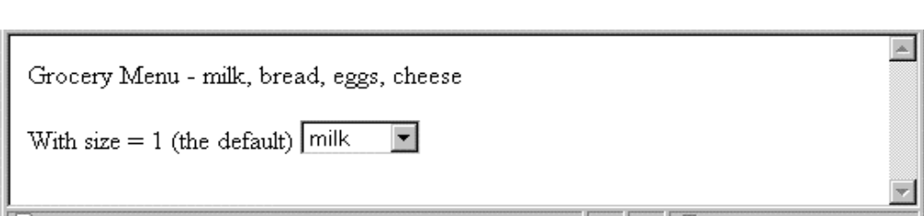
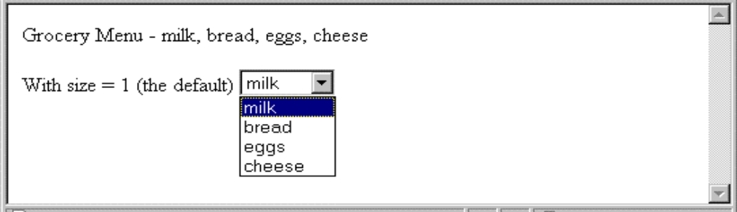
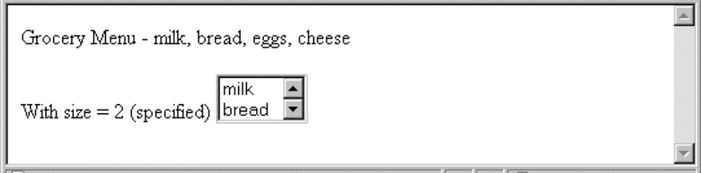
2.9 Forms (continued)
Widgets (continued)
After clicking the menu:
After changing size to 2:

Slide 45
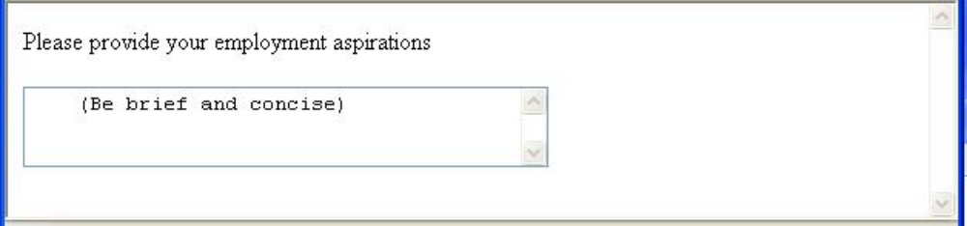
2.9 Forms (continued)
Widgets (continued)
4. Text areas - created with <textarea>
  Usually include the rows and cols attributes to specify the size of the text area
  Default text can be included as the content of <textarea>
  Scrolling is implicit if the area is overfilled
Please provide your employment aspirations
<form action = "">
<p>
<textarea name = "aspirations" rows = "3”
cols = "40">
(Be brief and concise)
</textarea>
</p>
</form>

Slide 46
2.9 Forms (continued)
Widgets (continued)
5. The action buttons
The reset button clears all of the controls in the form to their initial states
The submit button has 2 actions
The form data is encoded & sent to the server
The server is requested to execute the server resident program specified in the action attribute of the <form> tag.
  Both are created with <input>
<input type = "reset" value = "Reset Form">
<input type = "submit” value = "Submit Form">
A plain button has the type button. Plain buttons are used to choose an action.

Slide 47
2.10 Frames
The browser display window can be used to display more than one document at a time.
Frames are rectangular sections of the display window, each of which can display a different document
Because frames are no longer part of XHTML, you cannot validate a document that includes frames
1.framesetsThe <frameset> tag specifies the number of frames and their layout in the window
  <frameset> takes the place of <body>
  Cannot have both!
  <frameset> must have either a rows attribute or a cols attribute, or both (usually the case)
  Default is 1
  The possible values for rows and cols are numbers, percentages, and asterisks
    A number value specifies the row height in pixels - Not terribly useful!
    A percentage specifies the percentage of total window height for the row - Very useful!

Slide 48
2.10 Frames (continued)
  An asterisk after some other specification gives the remainder of the height of the window
  Examples:
  <frameset rows = "150, 200, 300">
  <frameset rows = "25%, 50%, 25%">
  <frameset rows = "50%, 20%, *" >
  <frameset rows = "50%, 25%, 25%"
  cols = "40%, *">
2.Frames
The <frame> tag specifies the content of a frame
The first <frame> tag in a <frameset> specifies the content of the first frame, etc.
  Row-major order is used
  Frame content is specified with the src attribute
  Without a src attribute, the frame will be empty (such a frame CANNOT be filled later)
If <frameset> has fewer <frame> tags than frames, the extra frames are empty

Slide 49
2.10 Frames (continued)
Scrollbars are implicitly included if needed (they are needed if the specified document will not fit)
If a name attribute is included, the content of the frame can be changed later (by selection of a link in some other frame)
→SHOW frames.html
Note: the Frameset standard must be specified in the DOCTYPE declaration

Slide 50
2.10 Frames (continued)
<!-- contents.html
The contents of the first frame of
frames.html, which is the table of
contents for the second frame
-->
<html xmlns = ″http://www.w3.org/1999/xhtml″>
<head> <title> Table of Contents Frame
</title>
</head>
<body>
<h4> Fruits </h4>
<ul>
<li> <a href = "apples.html"
target = "descriptions">
apples </a>
<li> <a href = "bananas.html"
target = "descriptions">
bananas </a>
<li> <a href = "oranges.html"
target = "descriptions">
oranges </a>
</ul>
</body>
</html>

Slide 51
2.10 Frames (continued)
Nested frames - to divide the screen in more interesting ways
→ SHOW nested_frames.html
2.11 Syntactic Differences between HTML & XHTML
Case sensitivity-in HTML the tag & attribute names are case insensitive.
Closing tags-in HTML the closing tags can be ommitted if the browser can infer its presence.
Eg <p>
during
<p>
show
Quoted attribute values-in HTML attribute values must be quoted only if there are embedded special character or whitespace character.in XHTML all attribute values are double quoted.

Slide 52
Explicit attribute values-in HTML some attribute values are implicit .eg: <table border>
In XHTML <table border=“border”>
Other such attributes are checked,multiple & selected.
id and name attributes- html supports name & id attributes but xhtml use only id for form elements.
Element nesting-HTML has rules against improper nesting of elements,xhtml the nesting rules are strictly enforced.
Rules are
Anchor element cannot contain another anchor element,and a form element cannot contain another form element.
If an element appears inside another element,the closing tag of the inner element must appear before the closing tag of the outer element
Block elements cannot be nested in inline elements
Text cannot be directly in body or form elements
List elements cannot be directly nested in list elements

