Slide 1

Chapter 3
Cascading
Style Sheets

Slide 2
3.1 Introduction To impose particular style on documents
The CSS1 specification was developed in 1996 by W3C for use in XHTML documents
CSS2 was released in 1998 .it was also extended presentation control to media,other than web browsers such as printers.
CSS3 is on its way
But not all of CSS1 has been implemented by internet explorer 7 & fireFox 2,but support for CSS2 is far from complete,especially in IE7.as a result of incomplete implementation of CSS2 ,W3C has decided for a new standard CSS2.1
CSS2.1 is at a “working draft “stage
CSSs provide the means to control and change presentation of HTML documents
CSS is not technically HTML, but can be embedded in HTML documents
Style sheets allow you to impose a standard style on a whole document, or even a whole collection of documents
Style is specified for a documents by the values of its properties

Slide 3
XHTML style sheets are called cascading style sheets because they can be defined at three different levels to specify the style of the document.
Lower level style sheets can override the higher level style sheets.

Slide 4
3.2 Levels of Style Sheets
There are three levels of style sheets
  Inline - specified for a specific occurrence of a tag and apply only to that tag
  – This is fine-grain style, which defeats the purpose of style sheets - uniform style
  Document-level style sheets - apply to the whole document in which they appear
  External style sheets - can be applied to any number of documents. Stored separately and referenced by all documents.
When more than one style sheet applies to a specific tag in a document, the lowest level style sheet has precedence

Slide 5
3.2 Levels of Style Sheets (continued)
Inline style sheets appear in the tag itself
Document-level style sheets appear in the head of the document
External style sheets are in separate files, potentially on any server on the Internet
  Written as text files with the MIME type text/css
  Disadvantage of inline
  This style defeats one of the advantage of style sheet i.e. imposing a uniform style on the tags of at least one whole document

Slide 6
Linking an External Stylesheet
A <link> tag is used to specify that the browser is to fetch and use an external style sheet file
<link rel = "stylesheet" type = "text/css"
href = "http://www.wherever.org/termpaper.css">
</link>
The link to an external style sheet must appear in the head of the document.
External style sheets can be validated with the service provided at
  http://jigsaw.w3.org/css-validator/
  validator-upload.html

Slide 7
3.3 Style Specification Formats
Format depends on the level of the style sheet
  Inline:
    Style sheet appears as the value of the style attribute
    General form:
    style = "property_1: value_1;
    property_2: value_2;
    …
    property_n: value_n;"

Slide 8
Format for Document-level
Style sheet appears as a list of rules that are the content of a <style> tag
The <style> tag must include the type attribute, set to "text/css“
Comments in the rule list must have a different form - use C comments (/*…*/)

Slide 9
General form:
<style type = "text/css">
rule list
</style>
Each style rule in the rule-list has two parts
A selector : which indicates the tag or tags affected by the rule
A list of property/value pairs
Form of the rules:
selector {list of property/values}
Each property/value pair has the form:
property: value
Pairs are separated by semicolons, just as in the value of a <style> tag

Slide 10
General Form, External style sheets
Form is a list of style rules, as in the content of a <style> tag for document-level style sheets

Slide 11
3.4 Selector Forms
1.Simple selector forms
It is a single element name
The selector is a tag name or a list of tag names, separated by commas
  h1, h3{font-size:22pt};
  P

Slide 12
2. Class Selectors
Used to allow different occurrences of the same tag to use different style specifications
A style class has a name, which is attached to a tag name with a period
  p.narrow {property/value list}
  p.warning {property/value list}
The class you want on a particular occurrence of a tag is specified with the class attribute of the tag
For example,
  <p class = "narrow">
  ...
  </p>
  ...
  <p class = "warning">
  ...
  </p>

Slide 13
3. Generic Selectors
A generic class can be defined if you want a style to apply to more than one kind of tag
A generic class must be named, and the name must begin with a period
Example,
  .really-big { property-value list }
Use it as if it were a normal style class
  <h1 class = "really-big"> … </h1>
  ...
  <p class = "really-big"> … </p>

Slide 14
4.id Selectors
An id selector allow the application of a style to one specific element
General form:
  #specific-id {property-value list}
Example:
  #section14 {font-size: 20}
  <h2 id= “section14”> Hello </h2>

Slide 15
5. Universal selectors
The universal selector,denoted by an asterisk(*),applies its style to all elements in the document.
Eg:
* {color: red;}

Slide 16
6. Pseudo Classes
Pseudo classes are styles that apply when something happens, rather than because the target element simply exists
Pseudo classes Names begin with colons
hover classes apply when the mouse cursor is over the element.this supports both IE7 & FX2
focus classes apply when an element has focus. This is supported only by FX2.

Slide 17
3.4 Pseudo Class Example
<!-- pseudo.html -->
<html xmlns = "http://www.w3.org/1999/xhtml">
<head> <title> Checkboxes </title>
<style type = "text/css">
input:hover {color: red;}
input:focus {color: green;}
</style>
</head>
<body>
<form action = "">
<p>
Your name:
<input type = "text" />
</p>
</form>
</body>
</html>

Slide 18
3.5 Properties
CSS1 includes 60 different properties in 7 categories:
  Fonts
  Lists
  Alignment of text
  Margins
  Colors
  Backgrounds
  Borders

Slide 19
3.5 Property Values
Keyword property values are used when there are only few possible values and they are predefined large,medium, small, …
  Not case sensitive Small small are all same
Length values are specified as numbers, that are followed immediately by a two-character abbreviation of a unit name
Units: number followed by units
  px – pixels
  in - inches
  cm - centimeters
  mm - millimeters
  pt - points
  pc - picas (12 points)
  em - height of the letter ‘m’
  ex-height - height of the letter ‘x’
  No space is allowed between the number and the unit specification e.g., 1.5 in is illegal!

Slide 20
3.5 Property Value Forms (continued)
Number values is either can be integer or a sequence of integers with a decimal point & can be precede with + or -.
Percentage - just a number followed immediately by a percent sign .this is used to provide a measure
URL values-URL is placed in paranthesis which can be either relative or absolute.
  url(protocol://server/pathname)
  There is no space b/w url & left paranthesis
Colors: can be specified as color names, as 6 –digit hexadecimal numbers or in RGB form
  Color name: powderblue
  rgb(n1, n2, n3) ; rgb(176,224,230)
    Numbers can be decimal(0 to 255) or percentages
  Hex form: #XXXXXX :#B0E0E6
Property values are inherited by all nested tags, unless overridden

Slide 21
3.6 Font Properties
1.font-families
  is used to specify a list of font names - browser uses the first in the list it has
  Eg:
  font-family: Arial, Helvetica, Courier( if the browser does not support any one specified,it will use the alternative of its choosing.
  Generic fonts: can be specified as a font-family value
  serif, Times New Roman,garamond
  sans-serif, Ms Arial,helvetica
  cursive, calfisch script,zapf-chancery
  fantasy, critter,cottonwood
  monospace courier,prestige
  Browser has a specific font for each of these generic names
  If a font has more than one word,it must be specified within single quotes
  Eg: font-family: ‘Times New Roman’

Slide 22
3.6 Font Properties (continued)
2.font-size
  Possible values: a length number or a name, such as xx-small,x-small,small,medium,large,x-large,xx-large etc.in addition smaller or larger can be specified.
  Eg: font-size: 10pt
3.font-variants
The default value of font-variant property is normal which specifies the usual character font
This property can be set to small-caps to specify small capital letters
4.font-style:
it is used to specify italic
An alternate to italic is oblique,but when displayed,the two are nearly identical.

Slide 23
5.font-weight
– is used to specify the degrees of boldness
bolder, lighter, bold, normal(default)
Eg: font-weight:bold
6. Font shorthands
For specifying a list of font properties
Eg:font: bolder 14pt Arial Helvetica
Order must be:weight,variant,style,size,name
> SHOW fonts.html and display
> SHOW fonts2.html and display
7.Text decoration
The text-decoration property to specify some special features of text
line-through, overline, underline, none
letter-spacing property controls the amount of space between characters in text–
Values of letter spacing is any length property value

Slide 24
3.7 list Properties
list-style-type:value
Unordered lists
  Bullet can be a disc (default), a square, or a circle or none
  Set it on either the <ul> or <li> tag
    On <ul>, it applies to list items
<h3> Some Common Single-Engine Aircraft </h3>
<ul style = "list-style-type: square">
<li> Cessna Skyhawk </li>
<li> Beechcraft Bonanza </li>
<li> Piper Cherokee </li>
</ul>

Slide 25
3.7 List properties (continued)
On <li>, list-style-type applies to just that item
<h3> Some Common Single-Engine Aircraft </h3>
<ul>
<li style = "list-style-type: disc">
Cessna Skyhawk </li>
<li style = "list-style-type: square">
Beechcraft Bonanza </li>
<li style = "list-style-type: circle">
Piper Cherokee </li>
</ul>

Slide 26
3.7 List properties (continued)
  Could use an image for the bullets in an unordered list
    Example:
  <style type = “text/css”>
  li.image {list-style-image:url(small_airplane.gif)}
  </style>
  ..
  <li class=“image”>beechcraft bonanza </li>
  On ordered lists - list-style-type can be used to change the sequence values
Property value Sequence type First four
Decimal Arabic numerals 1, 2, 3, 4
upper-alpha Uc letters A, B, C, D
lower-alpha Lc letters a, b, c, d
upper-roman Uc Roman I, II, III, IV
lower-roman Lc Roman i, ii, iii, iv
→ SHOW sequence_types.html and display

Slide 27
3.8 Colors
Color is a problem for the Web for two reasons:
  Monitors vary widely
  Browsers vary widely
1.Color groups
There are three levels of color collections
  There is a set of 16 colors that are guaranteed to be displayable by all graphical browsers on all color monitors
  black 000000 green 008000
  silver C0C0C0 lime 00FF00
  gray 808080 olive 808000
  white FFFFFF yellow FFFF00
  maroon 800000 navy 000080
  red FF0000 blue 0000FF
  purple 800080 teal 008080
  fuchia FF00FF aqua 00FFFF
  2. There is a much larger set, the Web Palette
  216 colors
  Use hex color values of 00, 33, 66, 99, CC, and FF

Slide 28
3.8 Colors (continued)
3. 24 bit number is used to specify Any one of 16 million different colors
___________________________________________
2. Color properties
The color property specifies the foreground color of elements
<style type = “text/css”>
th.red {color: red}
th.orange {color: orange}
</style>
…
<table border = "5">
<tr>
<th class = "red"> Apple </th>
<th class = "orange"> Orange </th>
<th class = "orange"> Screwdriver </th>
</tr>
</table>
The background-color property specifies the background color of elements
Eg: <styletype = “text/css”>
p.Standout {font-size:24pt;color: blue;background-color:red”>
</style>
…
<p class =“standout”>
To really
</p>

Slide 29
3.9 Alignment of Text
The text-indent property allows indentation
  Takes either a length or a % value
The text-align property has the possible values, left (the default), center, right, or justifyis used to arrange the text horizontally.
Eg: p {text-align: right}
Sometimes we want text to flow around another element - the float property
The float property which is often set for images & tables ,is used to specify that the text should flow around some element.
  The float property has the possible values, left, right, and none (the default)
  If we have an element we want on the right, with text flowing on its left, we use the default text-align value (left) for the text and the right value for float on the element we want on the right

Slide 30
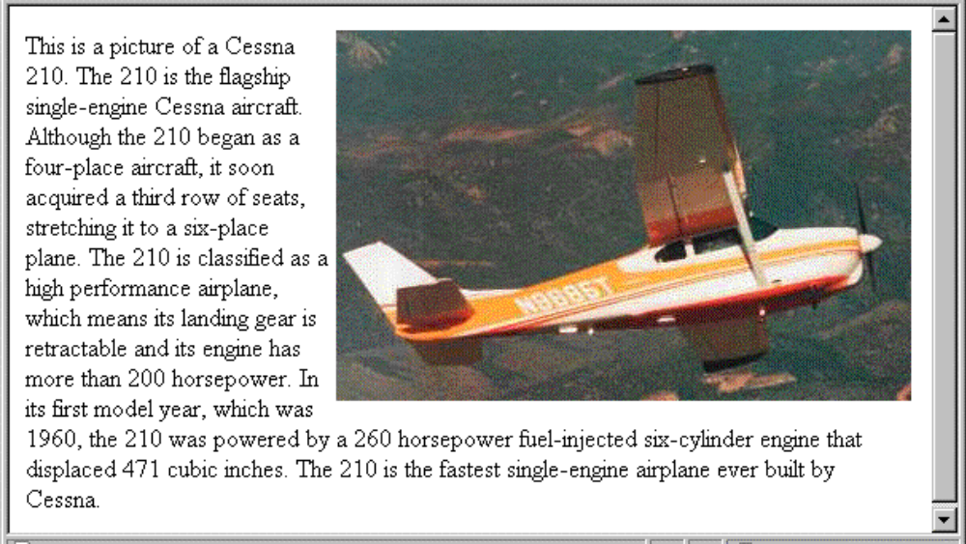
3.9 Alignment of Text (continued)
<img src = "c210.jpg"
style = "float: right" />
  Some text with the default alignment - left

Slide 31
3.10 The Box Model
All document elements can have borders
These borders have various styles such as color and width
Padding: amount of space between the content of an element and its border
Margin: space between the border & adjacent element.
1.Borders –
every element has a border-style property
  Controls whether the element has a border and if so, the style of the border
  border-style values: none, dotted, dashed, and double
  The styles of one of the four sides border-top-style,border-bottom-style,border-left-style,border-right-style
  border-width property used to specify thickness– thin, medium (default), thick, or a length value in pixels
  Border width can be specified for any of the four borders (e.g., border-top-width,border-bottom-width,border-left-width,border-right-width)
  border-color – any color
  Border color can be specified for any of the four borders (e.g., border-top-color)
  → SHOW borders.html and display

Slide 32
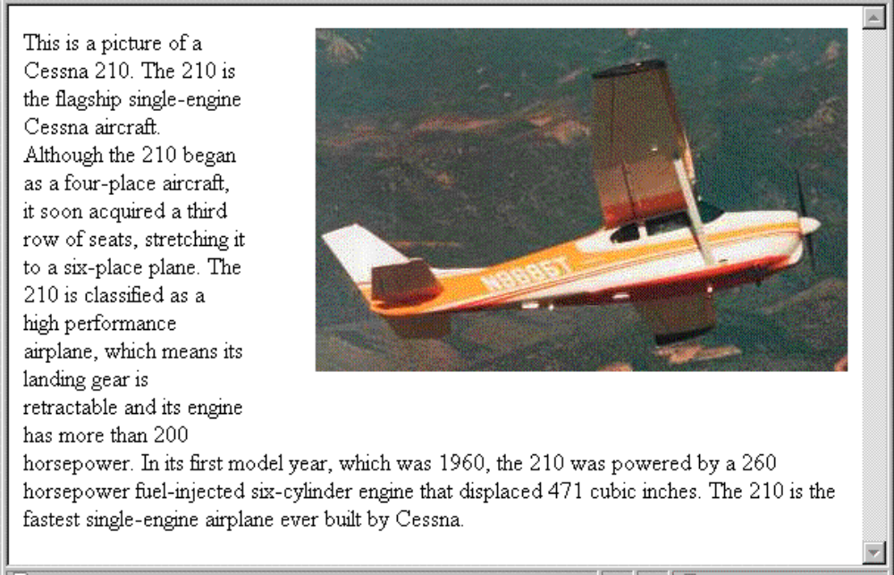
3.10 The Box Model (continued)
2.Margins & paddings
Margin – the space between the border of an element and its neighbor element
The margins around an element can be set with margin-left, margin-right,margin-top,margin-bottom - just assign them a length value
<img src = "c210.jpg " style = "float: right;
margin-left: 0.35in;
margin-bottom: 0.35in" />

Slide 33
3.10 The Box Model (continued)
Padding – the distance between the content of an element and its border
  Controlled by padding, padding-left,padding-right,padding-top,padding-bottom.
SHOW marpads.html and display
3.11 Background Images
The background-image property is used to place an image in the background of an element
SHOW back_image.html and display
Background image is replicated as necessary to fill the area of the element this replication is calle tiling.tiling can be controlled using
  background-repeat property
  Possible values: repeat (default), no-repeat, repeat-x, or repeat-y
  background-position property
    Possible values: top, center, bottom, left, or right

Slide 34
3.12 The <span> and <div> tags
One problem with the font properties is that they apply to whole elements, which are often too large
  Solution: a new tag to define an element in the content of a larger element - <span>
  The default meaning of <span> is to leave the content as it is
    <p>
    Now is the <span> best time </span> ever!
    </p>
  Use <span> to apply a document style sheet to its content
    <style type = "text/css">?
  bigred {font-size: 24pt;
  font-family: Ariel; color: red}
  </style>
  <p>
  Now is the
  <span class = "bigred">
  best time </span> ever!
  </p>

Slide 35
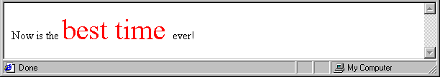
3.12 The <span> and <div> tags (continued)
The <span> tag is similar to other HTML tags, they can be nested and they have id and class attributes
Another tag that is useful for style specifications: <div>
  Used to create document sections (or divisions) for which style can be specified
    e.g., A section of five paragraphs for which you want some particular style
    <div class=“primary”>
    <p>
    …
    </p>
    <p>
    …
    </p></div>

Slide 36
3.13 Conflict Resolution
When style sheets at two or more levels specifydifferent values for the same property on the same element.this is resolved by the precedence of the levels
Inheritance is another source of potential property value conflicts.these can occur if a property on aparticular element has a property value assigned by some style sheet and also inherits a value for that same property.therefore there must be a method to resolve the conflict
When two or more rules apply to the same tag there are rules for deciding which rule applies
Document level
  In-line style sheets have precedence over document style sheets
  Document style sheets have precedence over external style sheets
Within the same level there can be conflicts
  A tag may be used twice as a selector
  A tag may inherit a property and also be used as a selector

Slide 37
3.13 Precedence Rules
Style sheets can have different sources
The author of a document may specify styles
The user, through browser settings, may specify styles
1.Conflict resolution is a multistage process.collecting all the style specifications from the three possible levels of style sheets .this is done based on the rules given below
From highest to lowest
Important declarations with user origin
Important declarations with author origin
Normal declarations with author origin
Normal declarations with user origin
Any declarations with browser (or other user agent) origin

Slide 38
2.If there are conflicts after sorting is sorting based on specificity. First as a highest precedence
Specificity
  id selectors
  Class and pseudo-class selectors
  Contextual selectors
  General selectors
  3.If there are still conflicts they are resolved by giving precedence to the most recently seen specification.

