Slide 1
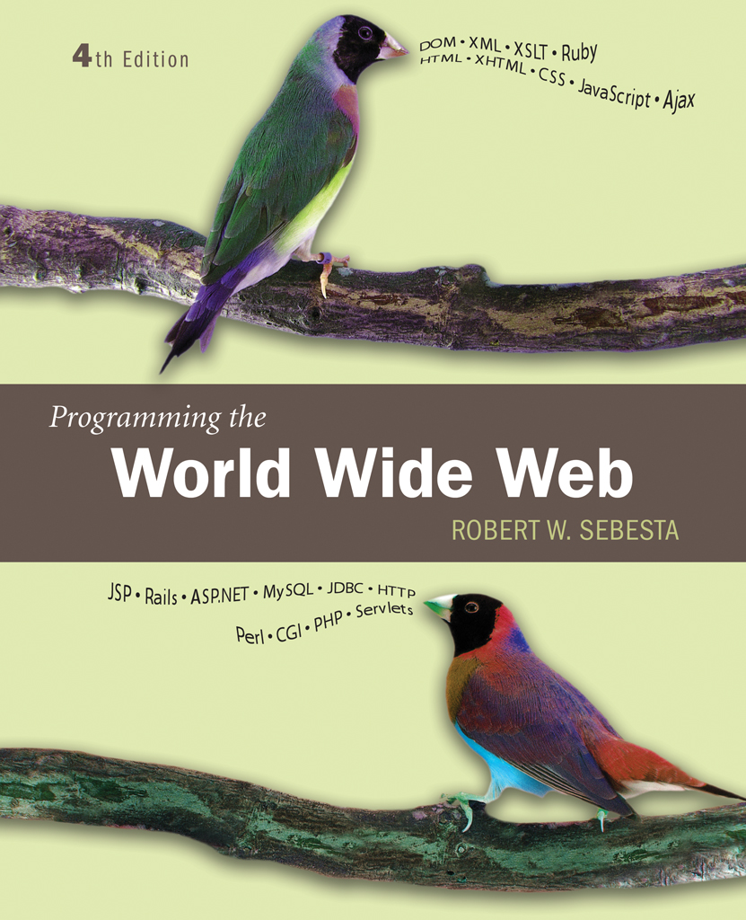
Chapter 4
Basics of
JavaScript

Slide 2
JavaScript/EcmaScript References
The official EcmaScript, third edition, specification
  http://www.ecma-international.org/publications/files/ECMA-ST/Ecma-262.pdf
A working version of the 4th edition of the EcmaScript language specification
  http://www.carsoncheng.com/Ecma/tc39-tg1-2006-001.pdf
JavaScript as implemented in Mozilla products
  http://developer.mozilla.org/en/docs/JavaScript

Slide 3
4.1 Overview of JavaScript:
1. Origins
Javascript Originally named livescript developed by Netscape
Livescript made a Joint Development with Sun Microsystems & ntescape in 1995 and a name changed to javascript
Netscape’s javasript have versions from 1.0 to 1.5
The language standard for javascript was developed in late 1990’s by European Computer Manufacturers Association as EC-262.this standard is approved by ISO as ISO-16262.
ECMA-262 edition 3 is the current standard
  Edition 4 is under development
ECMA-262 Supported by Netscape, Mozilla, Internet Explorer
The official name of the standard language is ECMAscript.

Slide 4
JavaScript Components
The javascript is divided into 3 parts core,client-side & server side.
Core
  The heart of the language including its operators, expressions,
  statements and subprograms
Client-side
  Library of objects supporting browser control and user interaction
Server-side
  Library of objects that support use in web servers
  Server-side javascript is used far less frequently than client-side javascript
  Client-side java script is an XHTML-embedded scripting language

Slide 5
2. Java and JavaScript
Differences
  JavaScript support object oriented programming
  JavaScript is not strongly typed,types areall known at compile time,and the operand types are checked for compatibility
  Java script objects are dynamic -number of data members and methods of an object can change during execution
  Similarity:
  The syntax of their expressions,assignment statements,and control statements.

Slide 6
3. Uses of JavaScript
The original goal of javascript was to provide programming capability at both the server and the clients end of the web connection
Javascript has grown into the full fledged programming language that can be used for a variety of application areas
Client-side JS is embedded in XHTML documents and is interpreted by the browser.client-side JS cannot replace all server-side JS.
Provide alternative to server-side programming
  Servers are often overloaded
  Client processing has quicker reaction time
JavaScript can work with form elements such as buttons & menus
JS can be used alternative to java applets.JS has an advantage of being easier to learn and use than java.
JavaScript can interact with the internal model of the web page (Document Object Model) ,which allows JS to access & modify the CSS properties and content of any element of a displayed XHTML documents,making formally static document highly dynamic

Slide 7
4.1 Event-Driven Computation
Users actions, such as mouse clicks and key presses, are referred to as events
The main task of most JavaScript programs is to respond to events
For example, a JavaScript program could validate data in a form before it is submitted to a server
  Caution: It is important that crucial validation be done by the server. It is relatively easy to bypass client-side controls

Slide 8
4.1 XHTML/JavaScript Documents
When JavaScript is embedded in an XHTML document, the browser must interpret it
Two locations for JavaScript serve for different purposes
  JavaScript in the head element will react to user input and be called from other locations
  JavaScript in the body element will be executed once as the page is loaded

Slide 9
4.2 Object Orientation and JavaScript
Java sript is not an object oriented programming language.JS does not have classes,its object serve as both as objects & as models of objects.
JavaScript is object-based
  JavaScript defines objects that encapsulate both data and processing
  However, JavaScript does not have true inheritance nor sub typing
JavaScript provides prototype-based inheritance
JS cannot support polymorphism
Client side javascript deals in larger part with the document & document elements, which are modeled with objects.

Slide 10
4.2 JavaScript Objects
Objects are collections of properties ,which corresponds to members of classes in java & c++
Properties are either data properties and method properties
Data properties are either primitive values and references to other objects
JS use nonobject types for some of its simplest datatypes,these types are called primitives
Primitive values are often implemented directly in hardware,resulting in faster operation on their values
All objects are indirectly accessed through variables. These are also called as value types.
The property of an object are referenced by attaching the name of the property to the variable that references the object
Eg: mycar.engine
The Object is the root object in JS.object is the ancestor of all objects in a JavaScript program
  Object has no data properties, but several method properties

Slide 11
4.3 JavaScript in XHTML
JS Directly embedded in XHTML
  <script type=“text/javascript”>
  <!--
  …Javascript here…
  -->
  </script>
Indirect reference of JS in XHTML using the src attribute of the script tag
  <script type=“text/javascript” src=“tst_number.js”/>
  This is the preferred approach

Slide 12
4.3 JavaScript in XHTML:
  The indirect method of embedding javascript in XHTML documents has the advantage of hiding the sript from the browser user.
  There are many situation when a small amount of javascript code is embedded in a XHTML document and some documents have a large number of places where the javascript code is embedde. Therfore it is inconvenient and cumbersome to place all the JS code in a separate file.
  In JS identifiers or names begin with a letter ,an (_),or a dollar sign.subsequent characters may be letters,underscore,$ or digit.
  There is no length limitation & characters are case sensitive
  Programmer defined variable names cannot include uppercase letters
  JS has 25 reserve words
  Break delete function return typeof case do if switch var catch else in this void continue finally instanceof throw while default for new try with.
  In addition JS has a large collection of predefined words alert,open,java & self.

Slide 13
4.3 General Syntactic Characteristics
Comments
  //
  /* … */
  There are 2 issues regarding embedding JS in XHTML documents
  There are browsers which recognize <script> tag but do not have JS interpreters.these just ignore the contents of the script elements & cause no problems.
  Few browsers which donot recognize <script> tag ,it just displays the content as text.
  The XHTML comment(<!--) works as a hiding prelude to javascript code,but the syntax for closing the comment is special
  Eg: <!- -
  -- javascript script - -
  // - - >
  This hides the enclosed script from browsers that do not have javascript interpreters,but makes it visible to browsers that donot support javascript.

Slide 14
4.3 Statement Syntax
Statements can be terminated with a semicolon
However, the interpreter will insert the semicolon if missing at the end of a line and the statement seems to be complete
Can be a problem:
  return
  x;
If a statement must be continued to a new line, make sure that the first line does not make a complete statement by itself
Example hello.html

Slide 15
4.4 Primitive Types
Five primitive types
  Number
  String
  Boolean
  Undefined
  Null
There are five classes(objects) corresponding to the five primitive types eg: String,Number,Boolean etc:
These objects are called wrapper objects
These wrapper objects contains a property that stores a value of the corresponding primitive type
The purpose of wrapper object is to provide properties and methods that are convenient for use with values of the primitive types.

Slide 16
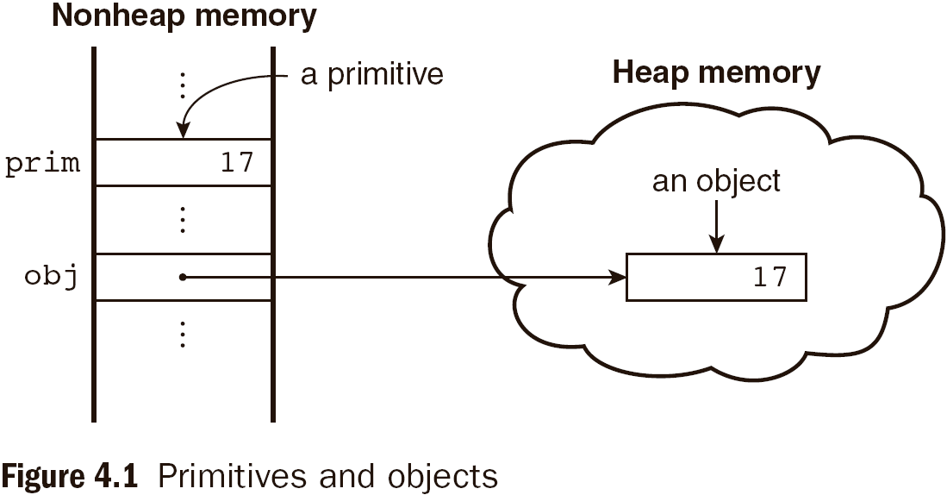
4.4 Primitive and Object Storage

Slide 17
4.4 Numeric and String Literals
All numeric literals are values of type Number.
Number values are represented internally as double-precision floating-point values
  Number literals can be either integer or float
  Float values may have a decimal and/or and exponent,exponents can be specified with uppercase or lowercase e & can have a sign.
  Eg: 72 7.2 .72 72. 7E2 7e2 .7e2 7.e2 7.2 E-2
  Integer literal can be written in a hexadecimal form by preceding their first digit with either 0x or 0X.
A String literal can be sequence of zero or more characters is delimited by either single or double quotes
  There is no difference between single and double quotes
  Certain characters may be escaped in strings
    \’ or \” to use a quote in a string delimited by the same quotes
    \\ to use a literal backspace
  The empty string ‘ ’ or “ ” has no characters

Slide 18
4.4 Other Primitive Types
Null
  A single value, null
  null is a reserved word
  A variable that is used but has not been declared nor been assigned a value has a null value
  Using a null value usually causes an error
Undefined
  A single value, undefined
  However, undefined is not, itself, a reserved word
  The value of a variable that is declared but not assigned a value
Boolean
  Two values: true and false

Slide 19
4.4 Declaring Variables
JavaScript is dynamically typed, that is, variables do not have declared types
A variable can have a value of any primitive type or it can be a reference to any object
  A variable can hold different types of values at different times during program execution
A variable is declared using the keyword var
A variable that has been declared ,but not assigned a value,has the value undefined.
  var counter,
  index,
  pi = 3.14159265,
  quarterback = "Elway",
  stop_flag = true;

Slide 20
4.4 Numeric Operators
Standard arithmetic
  + * - / %
Increment and decrement
  -- ++
  Increment and decrement differ in effect when used before and after a variable
  Assume that a has the value 3, initially
  (++a) * 3 has the value 24
  (a++) * 3 has the value 27
  a has the final value 8 in either case
  All numeric operations are done in double-precision floating point.
  The precedence rules specify which operator is evaluated first when 2 operators with different precedence are adjacent in an expression.
  The associativity rules specify which operator is evaluated first when two operators with the same precedence are adjacent in an expression.

Slide 21
4.4 Precedence of Operators
Operators | Associativity
++, --, unary - | Right
*, /, % | Left
+, - | Left
>, <, >= ,<= | Left
==, != | Left
===,!== | Left
&& | Left
|| | Left
=, +=, -=, *=, /=, &&=, ||=, %= | Right

Slide 22
4.4 Example of Precedence
var a = 2,
b = 4,
c,
d;
c = 3 + a * b;
// * is first, so c is now 11
d = b / a / 2;
// / associates left, so d is now 1

Slide 23
4.4 The Math Object
Provides a collection of properties and methods useful for Number values
This includes the trigonometric functions such as sin and cos
Floor is used to truncate a number
Round; to round a number
Max, to return the largest of 2 given numbers.
When used, the methods must be qualified, as in Math.sin(x)

Slide 24
4.4 The Number Object
The Number object include the collection of useful properties that have a constant values
Properties
  MAX_VALUE(largest representable value)
  MIN_VALUE(smallest representable value)
  NaN(not a number)
  POSITIVE_INFINITY(special value to represent infinity)
  NEGATIVE_INFINITY( special value to represent negative infinity)
  PI(value of PI 3.14)
Operations resulting in errors return NaN
  To determine whether a variable has the NaN value,the predefined predicate function isNaN(a) is used
  toString method converts a number to string
  Eg: var price =427,
  str_price;
  Str_price = price.tostring();

Slide 25
4.4 String Catenation
The operation + is the string catenation operation
In many cases, other types are automatically converted to string
Eg:the value of first is “Freddie”
First + “ Freeloader”
Result: “Freddie Freeloader”

Slide 26
4.4 Implicit Type Conversion
JS interpreter performs several different implicit type conversions.such conversions are called coercions.
JavaScript attempts to convert values in order to be able to perform operations
“August “ + 1977 causes the number to be converted to string and a concatenation to be performed
7 * “3” causes the string to be converted to a number and a multiplication to be performed
null is converted to 0 in a numeric context, undefined to NaN
0 is interpreted as a Boolean false, all other numbers are interpreted a true
The empty string is interpreted as a Boolean false, all other strings (including “0”!) as Boolean true
undefined, Nan and null are all interpreted as Boolean false

Slide 27
4.4 Explicit Type Conversion
Strings that contain numbers can be converted to numbers with the string constructor
Eg: var str_value = String(value)
The same conversion can be done with toString method
Var num = 6;
Var str_value = num.toString(); [ “6” ]
Var str_value_binary = num.tostring(2); [ “110” ]
Explicit conversion of string to number
  Number(aString)
  aString – 0
  Both of the above conversion have the following restriction:the number in the string cannot be followed by any character except a space
parseInt function searches the string for an integer literal.if one is found at the beginning of the string,it is converted to a number and returned.if the string does not begin with a valid integer literal,NaN is returned

Slide 28
parseInt function searches the string for an integer literal.if one is found at the beginning of the string,it is converted to a number and returned.if the string does not begin with a valid integer literal,NaN is returned
Parsefloat function is similar to parseint,but it searches for a floating point literal.

Slide 29
4.4 String Properties and Methods
String methods can always be used through string primitive values,as if the values were objects.
The String object includes one property,length and a large collection of methods
The number of characters in a string is stored in the length property
Eg: var str = “George”;
Var len=str,length;
< len =6>
The string methods starts the character position from 0
Eg: var str = “George”;
Str.charAt(2) is ‘o’
Str.indexOf(‘r’) is 3
Str.substring(2,4) is’org’
Str.toLowerCase() is ‘george’

Slide 30
4.4.String Methods
Method | Parameters | Result
charAt | A number | Returns the character in the String object that is at the specified position
indexOf | One-character string | Returns the position in the String object of the parameter
substring | Two numbers | Returns the substring of the String object from the first parameter position to the second
toLowerCase | None | Converts any uppercase letters in the string to lowercase
toUpperCase | None | Converts any lowercase letters in the string to uppercase

Slide 31
4.4 The typeof Operator-returns type of its single operand
Returns “number” or “string” or “boolean” for primitive types
Returns “object” for an object or null,where objects donot have types
If the operand is a variable that has not been assigned a value typeOf evaluates to “undefined”
Two syntactic forms
  typeof x
  typeof(x)

Slide 32
4.4 Assignment Statements
Plain assignment indicated by =
Compound assignment with
  += -= /= *= %= …
a += 7 means the same as
a = a + 7

Slide 33
4.4 The Date Object
A Date object represents a time stamp, that is, a point in time
A Date object is created with the new operator
  var now= new Date();
  This creates a Date object for the time at which it was created
  The date & time properties of the Date object are in 2 forms, local and Coordinated universal time (UTC)
  We deal with local time

Slide 34
4.4 The Date Object: Methods
toLocaleString | A string of the Date information
getDate | The day of the month
getMonth | The month of the year, as a number in the range of 0 to 11
getDay | The day of the week, as a number in the range of 0 to 6
getFullYear | The year
getTime | The number of milliseconds since January 1, 1970
getHours | The number of the hour, as a number in the range of 0 to 23
getMinutes | The number of the minute, as a number in the range of 0 to 59
getSeconds | The number of the second, as a number in the range of 0 to 59
getMilliseconds | The number of the millisecond, as a number in the range of 0 to 999

Slide 35
4.5Screen output & keyboard input
JS models the XHTML document with the Document object.
The window in which the browser displays an XHTML document is modeled using Window object
Window has two properties
  window refers to the Window object itself
  document refers to the Document object
The Window object is the default object for JavaScript, so properties and methods of the Window object may be used without qualifying with the class name
The Document object has several properties and methods. Let us consider write,which is used to create script output.
Eg: document.write(“the result is: “,result,”<br />”); the parameter to write is <br />,it can include any html tags or contents.
The window object uses three methods
Prompt,alert,confirm
roots.html
r

Slide 36
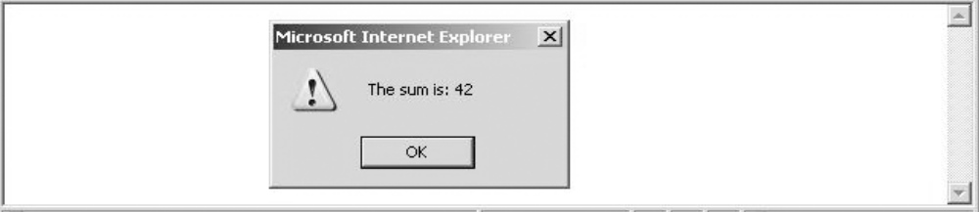
4.5 The alert Method
The alert method opens a dialog window & displays its parameter in the window ,it also displays a OK button
The parameter string to alert is not XHTML,it is plain text, so use new lines rather than <br/>
alert("The sum is:" + sum + "\n");

Slide 37
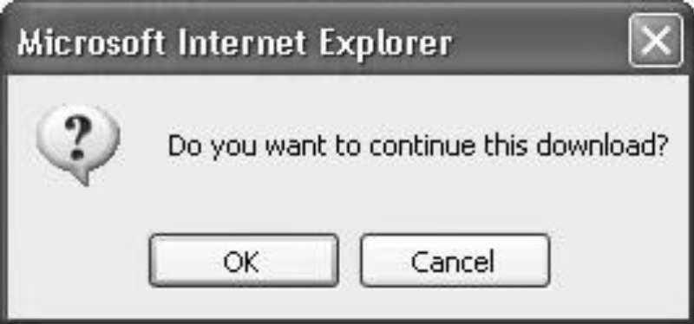
4.5 The confirm Method
The confirm methods displays a message provided as a parameter
  The confirm dialog has two buttons: OK and Cancel
If the user presses OK, true is returned by the method
If the user presses Cancel, false is returned
var question =
confirm("Do you want to continue this download?");

Slide 38
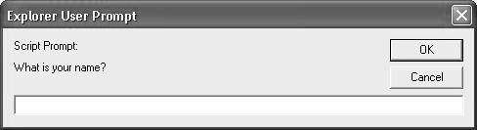
4.5 The prompt Method
This method displays its string argument in a dialog box
  A second argument provides a default content for the user entry area
The dialog box has an area for the user to enter text,it also consists of 2 buttons OK & Cancel.
The method returns a String with the text entered by the user
name = prompt("What is your name?", "");

Slide 39
4.5 Example of Input and Output
roots.html

Slide 40
4.6 Control Statements
A compound statement in JavaScript is a sequence of 0 or more statements enclosed in curly braces
  Compound statements can be used as components of control statements allowing multiple statements to be used where, syntactically, a single statement is specified
A control construct is a control statement including the statements or compound statements that it contains

Slide 41
4.6 Control Expressions
The control expressions upon which statement flow control can be based include primitive values,relational expressions and compound expressions.
A control expression has a Boolean value
  An expression with a non-Boolean value used in a control statement will have its value converted to Boolean automatically
Comparison(relational) operators
  == != < <= > >=
  a == b is true if a and b reference the same object
  === compares identity of values or objects(strictly equals to)
  3 == ‘3’ is true due to automatic conversion
  3 === ‘3’ is false
Boolean operators
  && || !
Warning! A Boolean object evaluates as true
  Unless the object is null or undefined

Slide 42
Operator precedence & associativity
Operators associativity
++,--,unary - right
*,/,% left
+, - left
>,<,>=,<= left
==,!= left
===,!== left
&& left
|| left
=,+=,-=,/=,*=,&&=,||=,%= right

Slide 43
4.6 Selection Statements
The if-then and if-then-else are similar to that in other programming languages, especially C/C++/Java
Eg:
If (a>b)
Document.write(“a is greater than b <br />”);
Else{
a=b;
Document.write(“a was not greater than b <br />”,”now they are equal <br />”);
}

Slide 44
4.6 switch Statement Syntax
switch (expression) {
case value_1:
// statement(s)
case value_2:
// statement(s)
...
[default:
// statement(s)]
}

Slide 45
4.6 switch Statement Semantics
The expression is evaluated
The value of the expressions is compared to the value in each case in turn
If no case matches, execution begins at the default case
Otherwise, execution continues with the statement following the case
Execution continues until either the end of the switch is encountered or a break statement is executed

Slide 46
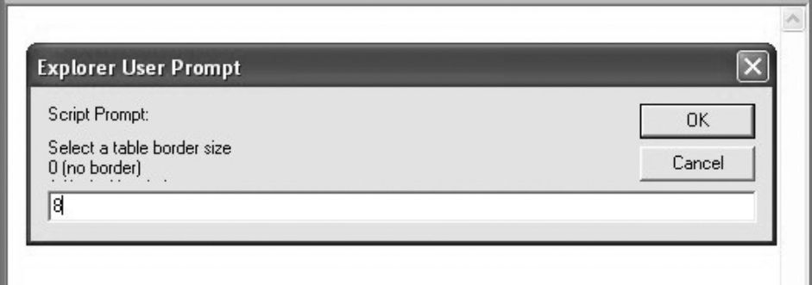
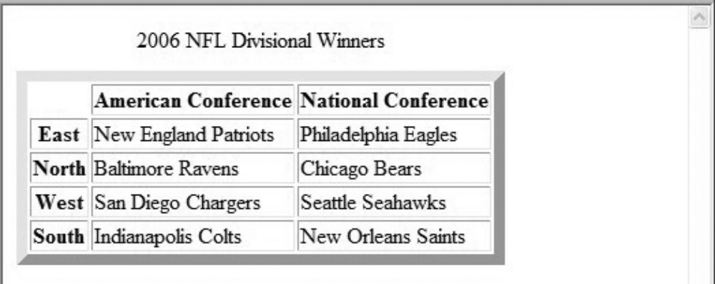
4.6 Example borders2.js
User Input Prompt
Results

Slide 47
4.6 Loop Statements
Loop statements in JavaScript are similar to those in C/C++/Java
While
  while (control expression)
  statement or compound statement
For
  for (initial expression; control expression; increment expression)
  statement or compound statement
do/while
  do statement or compound statement
  while (control expression)

Slide 48
4.6 date.js Example
Uses Date objects to time a calculation
Displays the components of a Date object
Illustrates a for loop

Slide 49
4.6 while Statement Semantics
The control expression is evaluated
If the control expression is true, then the statement is executed
These two steps are repeated until the control expression becomes false
At that point the while statement is finished

Slide 50
4.6 for Statement Semantics
The initial expression is evaluated
The control expression is evaluated
If the control expression is true, the statement is executed
Then the increment expression is evaluated
The previous three steps are repeated as long as the control expression remains true
When the control expression becomes false, the statement is finished executing

Slide 51
4.6 do/while Statement Semantics
The statement is executed
The control expression is evaluated
If the control expression is true, the previous steps are repeated
This continues until the control expression becomes false
At that point, the statement execution is finished

Slide 52
4.7 Object Creation and Modification
The new expression is used to create an object
  This includes a call to a constructor
  The new operator creates a blank object, the constructor creates and initializes all properties of the object
Properties of an object are accessed using a dot notation: object.property
Properties are not variables, so they are not declared
  An object may be thought of as a Map/Dictionary/Associative-Storage
The number of properties of an object may vary dynamically in JavaScript
Eg: var my_object = new object();

Slide 53
4.7 Dynamic Properties
The number of properties in a JS object is dynamic.at any time during interpretation,properties can be added to or deleted from an object.
Create my_car and add properties like make & model
  // Create an Object object
  var my_car = new Object();
  // Create and initialize the make property
  my_car.make = "Ford";
  // Create and initialize model
  my_car.model = "Contour SVT";
  There is an abbreviated way to create an object and its properties
  Var my_car ={ make:”ford”,model: “Contour SVT”};
  Because objects can be nested ,create a new object that is a property of my_car with properties of its own as follows.
  Eg: my_car.engine=new Object();
  My_car.engine.config=“v6”;
The delete operator can be used to delete a property from an object
  delete my_car.model

Slide 54
4.7 The for-in Loop
Properties can be accessed in 2 ways.
Using object dot property eg: var prop1 =my_car.make;
can be accessed as if they were elements of an array eg: var prop2=my_car[“make”];
Syntax: for-in is used for listing the properties of an object
  for (identifier in object)
  statement or compound statement
The loop lets the identifier take on each property in turn in the object
Printing the properties in my_car:
  for (var prop in my_car)
  document.write("Name: ", prop, "; Value: ",
  my_car[prop], "<br />");
Result:
  Name: make; Value: Ford
  Name: model; Value: Contour SVT

Slide 55
4.8 Arrays
Array elements can be primitive or reference to other objects
Arrays are lists of elements indexed by a numerical value
Array indexes in JavaScript begin at 0
Arrays can be modified in size even after they have been created

Slide 56
4.8 Array Object Creation
2 ways
Arrays can be created using the new Array method
  new Array with one parameter creates an empty array of the specified number of elements
    new Array(10)
  new Array with two or more parameters creates an array with the specified parameters as elements
    new Array(10, 20)
    Eg: var my_list=new Array(1,2,”three”,”four”);
Literal arrays can be specified using square brackets to include a list of elements
  var alist = [1, “ii”, “gamma”, “4”];
Elements of an array do not have to be of the same type

Slide 57
4.8 Characteristics of Array Objects
The lowest index of every JS array is zero
The length of an array is one more than the highest index to which a value has been assigned or the initial size (using Array with one argument), whichever is larger
Eg: my_list[47]=2222; [length=48]
The length of an array is both read and write acessible through the length property
Assignment to an index greater than or equal to the current length simply increases the length of the array
Only assigned elements of an array occupy space
  Suppose an array were created using new Array(200)
  Suppose only elements 150 through 174 were assigned values
  Only the 25 assigned elements would be allocated storage, the other 175 would not be allocated storage

Slide 58
4.8 Example insert_names.js
This example shows the dynamic nature of arrays in JavaScript

Slide 59
4.8 Array Methods
Join method converts all the elements of the array to strings and catenates them into a single string.
If no parameter provided to join, the values in the new string are seperated by commas.
Eg: var names=new Array[“Mary”,”Max”];
Var name_string=names.join(“:”);
“Mary : Max”
Reverse method reverses the order of the elements of an array.
Sort method arrays to strings and sorts them alphabetically
Eg: names.sort();
Concat method catenates its actual parameters to the end of the Array object on which it is called.
Eg: var new_names=names.concat(“Moo”);
“Mary,Max,Moo”

Slide 60
Slice method returns part of the array object
The returned array has the elements of the array object through which it is called from the first parameter up to,but not include the second parameter
Eg: var list =[2,4,6,8,10];
Var list2=list.slice(1,3);
[4,6]
If the slice is given only one parameter, the returned array has all of the elements of the object,starting with the specified index.
Eg: var list1=list.slice(2);
[6,8,10]

Slide 61
4.8 Dynamic List Operations
Push method
  Add to the high end of the array
pop
  Remove from the high end of the array
  Eg: var list=[“Dasher”,”Dancer”,”donner”,”blitzen”];
  Var deer=list.pop(); // deer is “blitzen”
  List.push(“blitzen”);//this puts back “blitzen” back on list
shift
  Remove from the beginning of the array
unshift
  Add to the beginning of the array
  Eg: var deer=list.shift();//deer is now “dasher”
  List.unshift(“Dasher”);//this put “dasher” back to the list

Slide 62
4.8 Two-dimensional Arrays
A two-dimensional array in JavaScript is an array of arrays
  This need not even be rectangular shaped: different rows could have different length
Example nested_arrays.js illustrates two-dimensional arrays

Slide 63
4.9 Functions

Slide 64
4.9 Function Fundamentals
Function definition syntax
  A function definition consist of a header followed by a compound statement that describes actions.
  A function header:
    function function-name(optional-formal-parameters) the paranthesis are required even if there are no parameters.
return statements return contrl from the function
  A return statement causes a function to cease execution and control to pass to the caller
  A return statement may include a value which is sent back to the caller
    This value may be used in an expression by the caller
  A return statement without a value implicitly returns undefined
Function call syntax
  Function name followed by parentheses and any actual parameters
  Function call may be used as an expression or part of an expression
Functions must defined before use in the page header

Slide 65
4.9 Functions are Objects
Functions are objects in JavaScript
Functions may, therefore, be assigned to variables and to object properties
  Object properties that have function values are methods of the object
Example
  function fun() {
  document.write( "This surely is fun! <br/>");
  }
  ref_fun = fun; // Now, ref_fun refers to the fun object
  fun(); // A call to fun
  ref_fun(); // Also a call to fun

Slide 66
4.9 Local Variables
“The scope of a variable is the range of statements over which it is visible”
A variable not declared using var has global scope, visible throughout the page, even if used inside a function definition
A variable declared with var outside a function definition has global scope
A variable declared with var inside a function definition has local scope, visible only inside the function definition
  If a global variable has the same name, it is hidden inside the function definition
  If a variable that is defined both as a local variable and as a global variable appears in a function,the local variable has precedence,effectively hiding the global variable with the same name.this is the advantage of local variables.

Slide 67
4.9 Parameters
Parameters named in a function header are called formal parameters
Parameters used in a function call are called actual parameters
Parameters are passed by value
  For an object parameter, the reference is passed, so the function body can actually change the object
  However, an assignment to the formal parameter will not change the actual parameter

Slide 68
4.9 Parameter Passing Example
function fun1(my_list) {
var list2 = new Array(1, 3, 5);
my_list[3] = 14;
...
my_list = list2;
...
}
...
var list = new Array(2, 4, 6, 8)
fun1(list);
The first assignment changes the object to which my_list refers,which was created in the calling code.
The second assignment has no effect on the list object in the caller
Pass by reference can be simulated by passing an array containing the value

Slide 69
4.9 Parameter Checking
JavaScript checks neither the type nor number of parameters in a function call
  Formal parameters have no type specified
  Extra actual parameters are ignored (however, see below)
  If there are fewer actual parameters than formal parameters, the extra formal parameters remain undefined
This is typical of scripting languages
A property array named arguments holds all of the actual parameters, whether or not there are more of them than there are formal parameters
  Example params.js illustrates this

Slide 70
4.9 The sort Method, Revisited
A parameter can be passed to the sort method to specify how to sort elements in an array
  The parameter is a function that takes two parameters
  The function returns a negative value to indicate the first parameter should come before the second
  The function returns a positive value to indicate the first parameter should come after the second
  The function returns 0 to indicate the first parameter and the second parameter are equivalent as far as the ordering is concerned
  Function num_order(a,b){return b-a;}
  Num_list.sort(num_order);
Example median.js illustrates the sort method

Slide 71
4.11 Constructors
Constructors are functions that create an initialize properties for new objects
Every new expression must include a call to a constructor,whose name is the same as the object being created.
A constructor uses the keyword this in the body to reference the object being initialized
Eg: function car(new_make,new_model,new_year){
this.make = new_make;
this.model=new_model;
this.year=new_year;}
My_car = new car(“ford”,”contour SVT”,”2000”);

Slide 72
If a method is to be included in the object,it is initialized the same way as if it were a data property
Eg: function display_car(){
Document.write(“car make: “,this.make,”<br />”);
Document.write(“car model: “,this.model,”<br />”);
Document.write(“car year: “,this.year,”<br />”);
}
The following line must be added to the car constructor
This.display =display_car;
Now my_car.display();
Car make:ford
Car model:contour SVT
Car year:2000
Example car_constructor.html

Slide 73
4.12 pattern matching Using Regular Expressions
JS has powerful pattern matching capabilities based on regular expressions
Regular expressions are used to specify patterns in strings
JavaScript provides two methods to use regular expressions in pattern matching
  String methods
  RegExp objects (not covered in the text)
  Patterns are specified in a form that is based on regular expressions
A literal regular expression pattern is indicated by enclosing the pattern in slashes
The simplest pattern matching method is search,which takes a pattern as a parameter.
The search method returns the position of a match, if found, or -1 if no match was found

Slide 74
4.12 Example Using search
var str = "Rabbits are furry";
var position = str.search(/bits/);
if (position > 0)
document.write("'bits' appears in position",
position, "<br />");
else
document.write(
"'bits' does not appear in str <br />");
This uses a pattern that matches the string ‘bits’
The output of this code is as follows:
  'bits' appears in position 3

Slide 75
4.12 Characters and Character-Classes
Metacharacters have special meaning in regular expressions
  \ | ( ) [ ] { } ^ $ * + ? .
  These characters may be used literally by escaping them with \
Other characters represent themselves
A period matches any single character except newline
  /f.r/ matches for and far and fir but not fr
A character class matches one of a specified set of characters
  [character set]
  List characters individually: [abcdef]
  Give a range of characters: [a-z]
  Beware of [A-z]
  ^ at the beginning negates the class

Slide 76
4.12 Predefined character classes
Name | Equivalent Pattern | Matches
\d | [0-9] | A digit
\D | [^0-9] | Not a digit
\w | [A-Za-z_0-9] | A word character (alphanumeric)
\W | [^A-Za-z_0-9] | Not a word character
\s | [ \r\t\n\f] | A whitespace character
\S | [^ \r\t\n\f] | Not a whitespace character
Eg: /\d\.\d\/ //matches a digit ,followed by a period,followed by 2 digits
/\D\d\D/ //matches a single digit
/\w\w\w/ //matches 3 adjacent word characters

Slide 77
4.12 Repeated Matches
A pattern can be repeated a fixed number of times by following it with a pair of curly braces enclosing a count
A pattern can be repeated by following it with one of the following special characters
  * indicates zero or more repetitions of the previous pattern
  + indicates one or more of the previous pattern
  ? indicates zero or one of the previous pattern
Examples
  /\(\d{3}\)\d{3}-\d{4}/ might represent a telephone number
  /[$_a-zA-Z][$_a-zA-Z0-9]*/ matches identifiers

Slide 78
4.12 Anchors
Anchors in regular expressions match positions rather than characters
  Anchors are 0 width and may not take multiplicity modifiers
Anchoring to the end of a string
  ^ at the beginning of a pattern matches the beginning of a string
  $ at the end of a pattern matches the end of a string
    The $ in /a$b/ matches a $ character
Anchoring at a word boundary
  \b matches the position between a word character and a non-word character or the beginning or the end of a string
  /\bthe\b/ will match ‘the’ but not ‘theatre’ and will also match ‘the’ in the string ‘one of the best’

Slide 79
4.12 Pattern Modifiers
Pattern modifiers are specified by characters that follow the closing / of a pattern
Modifiers modify the way a pattern is interpreted or used
The I modifier makes the letters in the pattern match either uppercase or lowercase letters in the string.
Eg: /Apple/I matches ‘APPLE’,’apple’,’APPle’
The x modifier causes whitespace in the pattern to be ignored
  This allows better formatting of the pattern
  \s still retains its meaning
Eg: /\d+ the street number
\s the space before the street name
[A-Z][a-z]+ the street name
/x
The above pattern is equivalent to /\d+\s[A-Z][a-z]+/

Slide 80
4.12 Other Pattern Matching Methods
The replace method takes a pattern parameter and a replacement string parameter
  The method replaces a match of the pattern in the target string with the second parameter
  A g modifier can be attatched to the pattern if the replacement is to be global in the string,in which case the replacement is done for every match in the string.
  The matched substrings of the strings are made available through a predefined variables $1,$2 and so on.
  Eg: var str=“fred,freddie,and frederica were siblings”;
  Str.replace(/fre/g,”boy”);
  Str is “boyd,boyddie,and boyderica were siblings”,and $1,$2,and $3 are all set to “fre”
Parentheses can be used in patterns to mark sub-patterns
  The pattern matching machinery will remember the parts of a matched string that correspond to sub-patterns

Slide 81
The match method takes one pattern parameter
Without a g modifier, the return is an array of the match and parameterized sub-matches
With a g modifier, the return is an array of all matches
Eg: var str=“having 4 apples is better than having 3 oranges”;
Var matches =str.match(/\d/g);
Matches is set to [4,3]
The split method splits the object string using the pattern to specify the split points
Eg: var str=“grapes:apples:oranges”;
Var fruit = str.split(“:”);
Fruit is set to [grapes,apples,oranges]

Slide 82
4.13 An Example
forms_check.js
Using javascript to check the validity of input data
Note, a server program may need to check the data sent to it since the validation can be bypassed in a number of ways

Slide 83
4.14 Errors in Scripts
JS interpreter is capable of detecting various errors in scripts.
These are primarily syntax errors
Script errors cause the browser to not display the document and do not produce an error message.without a diagnostic message to find the problem is difficult
There are ways
The default settings for IE7 no debugging help for JS.
Select internet options from the tools menu and choose the advanced tab there.this opens a window with a long list of checkboxes.uncheck the disable script debugging box and check the display a notification about every script error box. Then press the apply button in this window.starting then and continuing until the browser is closed,JS errors will cause the browser to open and display a small window with an explanation of problem
2.The FX2 browser has a special console window that displays script error. Select tools and error console to open this window.when using this browser to display documents that include JS,this window should be kept open.after the error message has appeared and has been used to fix a script,press the clear button on the console

