Slide 1
Process Management

Slide 2
Process Management
Key concepts
  Introduction
  Process migration
  Threads

Slide 3
Process Management
Introduction
  In DOS, main goal of process management is to make best use of the processing resources of entire system by sharing them among all processes
  Important concepts to achieve this goal are
    Processor allocation
    Process migration
    Threads

Slide 4
Process Migration
Relocation of a process from its current location to another
A process may be migrated either before it starts executing (known as non-preemptive process migration) or during the course of execution (known as preemptive process migration)
Process migration involves:
  Selection of process that should be migrated
  Selection of the destination node to which the selected process should be migrated
  Actual transfer of the selected process to the destination node

Slide 5
Process Migration
Source
Destination
Time
node
node
Process P
1
in
execution
Execution
suspended
Freezing
Transfer of control
time
Execution
resumed
Process P
in
execution
1
Flow of execution of a migrating process

Slide 6
Desirable features of a good process migration mechanism
A good process migration must possess
  Transparency
    Object access level
      Access to object such as files and devices can be done in location independent Manner
    System call and IPC level
      Migrated process does not depend on its originating Node after Migration
      System calls including IPC are location Independent

Slide 7
Desirable features of a good process migration mechanism
  Minimal interference
    Migration should cause minimal Interference to the process and the system
    One Method: Minimizing the freezing time: Time period for which the execution is stopped for transfer of Information during Migration
  Minimal residual dependencies
    Migrated process should not depend on the previous Node once it has started executing on its New Node

Slide 8
Desirable features of a good process migration mechanism
  Efficiency
    Time required for Migration should be kept MINIMUM
    Cost of locating on object should be kept MINIMUM
    Cost of supporting Remote Execution after Migration should be kept MINIMUM
  Robustness
    Failure of intermediate Nodes except the current Node should not cause any problem to the execution or Accessibility
  Communication between coprocesses of a job
    Co-processors must be able to directly communicate with each other irrespectively of their locations

Slide 9
Process migration mechanisms
Major sub activities in Process Migration
  Freezing the process on source Node and reinstating it on its target Node
  Transferring Processing Address space from source Node to Target Node
  Forwarding messages meant for Migrated Process
  Handling communication between cooperating process of the Migrated process

Slide 10
Process migration mechanisms
Freezing the process on source Node and reinstating it on its target Node
  Take a “snapshot” of the process state on its source Node during Execution
  Freeze the process
  Transfer the state Information to the target Node
  Reinstate the process on target Node
Issues:
  Before process can be frozen, its execution must be blocked
  Immediate or Delayed Blocking

Slide 11
Process migration mechanisms
  Depending on the current state of the process, it can be blocked immediately or delayed
  If process is not executing a system call, it can be blocked immediately
  If the process is executing a system call but sleeping at an Interruptible priority (priority at which any received signal would awaken the process) waiting for a Kernel event to happen, can be immediately blocked
  If the process executing a system call and is sleeping at NON-INTERRUPTIBLE priority waiting for a KERNAL event to occur, it cannot be blocked immediately. It is delayed until the system call is complete

Slide 12
Process migration mechanisms
  Fast and slow I/O operations:
  After blocking the process, it is desirable to wait for the completion of all fast I/O operations (Ex Disk I/O) associated with the process
  However it is not feasible to wait for slow I/O operations to complete
  Proper mechanisms are necessary for continuing slow I/O operations correctly after process migration
  Information about open files
  Files opened by the process are included in the process’s state information

Slide 13
Process migration mechanisms
  File state information collected at the source node should be modified properly on the process’s destination node in order to ensure that, whenever possible, local file operation are performed instead of remote file operation
  Reinstating the process on its destination Node:
  An empty process state is created during the process migration on the destination node
  Two copies; the old and the new copy exist and are accessible during the process migration
  The state of the migrating process is transferred from the old copy to the new one
  After copying all the state information of migrating process the new copy is unfrozen and the old copy is deleted

Slide 14
Process migration mechanisms
Transferring the process’s address space and state from its source node to the destination node
Information transferred during migration is the process’s state and the process’s address space
Process’s state:
  Execution state of the process(contents of registers)
  Memory being used by the process
  I/O states (I/O queue, I/O buffers etc.)
  Process’s identifier
  Process’s user & group identifiers
  List of objects to which the process has a right to access
  List of files opened by the process

Slide 15
Process migration mechanisms
Process’s address space:
  Code, data and stack of the program
  The size of the address space is larger than the size of the process’s state information
  Transferring of the process’s state requires complete stopping the execution of the migrant process, but in some systems it is possible to transfer process’s address space without stopping its execution

Slide 16
Process migration mechanisms
  Address space transfer methods
        Total freezing
        Pretransferring
        Transfer on reference

Slide 17
Process migration mechanisms
Total freezing
  Process execution is stopped while its address space is being transferred
Source node
Destination node
Time
Execution suspended
Migration decision made
Freezing Time
Transfer of Address space
Execution resumed

Slide 18
Process migration mechanisms
Total Freezing
  Advantages : Simple and easy to implement
  Disadvantages: Process is suspended for a long time during Migration, so timeouts may occur
  If the process is Interactive, the delay is noticed by the user
Pretransferring
  Address space is transferred while process is still running on source node
  Pre transfer operation is executed at highest priority

Slide 19
Process migration mechanisms
Pretransferring
  Ist transfer takes longest time which involves transfer of entire address space
  IInd transfer moves only pages modified during the Ist transfer, so takes less time
  Subsequent transfer operations have to move fewer and fewer pages
  Finally zero pages or few pages which are transferred after the process is frozen
  Advantages : Reduced Freezing time
  Disadvantages : It may increase the MIGRATION time due to the possibility of redundant pages (Dirty Pages during Transfer)

Slide 20
Process migration mechanisms
Pretransferring
Source node
Destination node
Time
Migration decision made
Execution suspended
Transfer of Address space
Freezing Time
Execution resumed

Slide 21
Process migration mechanisms
Transfer on reference
  Assumption: Process tend to use relatively small part of their address space while executing
  Address space is left behind on its source Node
  As the relocated process executes on its destination node, desired (when referenced) blocks are copied from the remote source node
  Advantages : Switching time of the process from its source node to its destination node is very short and it is virtually independent of the size of the address space
  Disadvantages : Continued load on source Node Process fails if Source Node fails or reboots.

Slide 22
Process migration mechanisms
Transfer on reference
Source node
Destination node
Time
Execution suspended
Migration decision made
Freezing Time
Execution resumed
On-demand transfer of Address space

Slide 23
Process migration mechanisms
Message forwarding mechanisms
  All pending, en-route and future messages should arrive at the process’s new location
  The process is moved to the destination node, but processes communicating with the migrating process are not informed about the migration
  Processes communicating with the migrating process will still send messages to the source node
  Thus, when a process is suspended and migrating, all messages addressed to it are saved
  After the process is resumed on the destination node, these buffered messages are forwarded to its new location

Slide 24
Process migration mechanisms
Types of messages to be forwarded to the new location:
  Type 1: messages received at the source node after the process’s execution has been stopped on its source node and the process’s execution has not yet started on its destination node
  Type 2 : messages received at the source node after the process’s execution has started on its destination node
  Type 3 : messages that are sent to the migrant process from any other node after it has started executing on the destination node

Slide 25
Process migration mechanisms
Message forwarding (redirection) methods:
        Mechanism of Resending the message
        Origin site mechanism
        Link traversal mechanism
        Link update mechanism

Slide 26
Process migration mechanisms
Message forwarding (redirection) methods:
Mechanism of Resending the message
  Messages of type 1 and type 2 are returned to the sender as not deliverable or simply dropped assuming that the sender of the message is storing a copy of the data and is prepared to retransmit it
  Sender does a locate operation to find the new whereabouts of the process and communication is re-established
  Messages of type3 are sent directly to the process’s destination node
  Drawback is, message forwarding is non-transparent to the processes interacting with the migrant process

Slide 27
Process migration mechanisms
Origin node mechanism
  Each node keeps information about the current locations of all the processes created on it
  Messages for a process are always sent to the node where the process was created
  The origin node forwards the message to the process’s current node
Drawbacks
  Not reliable, failure of origin site will disrupt message forwarding
  Continuous load on origin node even after migration

Slide 28
Process migration mechanisms
Link traversal
  Message queue is created on its source node and all messages of type1 are placed in this message queue
  After receiving the notification of the process start on the destination station node all messages in the queue are sent to the current node as part of the migration procedure
  To redirect messages of type 2 and type 3, a link is left at the source node pointing to the destination node of the migrant process

Slide 29
Process migration mechanisms
  The link contains two components; the first one is the identifier of the node where the process was created and the unique local identifier generated by that node, the second one is the identifier of the last known node of the process
  To forward a message, the location of a migrant process is located through series of links
  Second component of the link is updated when the corresponding process is accessed from a node
Drawbacks
  Poor efficiency and reliability
    Several links may have to be traversed to locate the process
    If any node in the chain of links fails, the process cannot be located

Slide 30
Process migration mechanisms
Link update
  Processes communicate via location-independent links
  During migration, the source node sends link-update messages to the kernel controlling communication of migrant processes
  These link-update messages contain the new address of each link held by the migrant process
  Messages sent to the migrant process on any of its links will be directly forwarded to the migrant process’s current node
  Messages of type1 and type 2 are forwarded to the destination node by the source node and type 3 are directly sent to destination node

Slide 31
Process Migration in Heterogeneous Systems
Problem:
  Different data representation at different nodes
Solution:
  In these systems all data must be translated from the source processor format to the destination processor format (external data representation)
  A standard representation is used for the transport of data,
  Each processor should convert data to and from the standard format

Slide 32
Advantages of Process Migration
Reducing average response time of processes
  Process migration may reduce the average response time of the processes of overloaded nodes
Speeding up individual tasks
  Migrating processes to different nodes and executing them concurrently
  Migrating a process to a faster processor
Gaining higher throughput
  Capabilities of processors are better used as a result of load balancing among processors

Slide 33
Advantages of Process Migration
Utilising resources effectively
  Processes can be migrated to the most suitable node to utilise the system resources in the most efficient manner
  There are some resources that cannot be accessed remotely, process migration facilitates the use of such resources
Reducing communication load
  Migrating a process closer to the resources, it requires, may reduce communication load
Improving system security
  A process may be migrated and run on a node that is not directly accessible to general users

Slide 34
Advantages of Process Migration
Improving system reliability
  Migration of a process to a node whose reliability is higher
  Migration of a copy of a critical process to some other node and to execute both the original and copied processes concurrently on different nodes
  After the detection of a fault in a node, a process running on it, can be migrated to another node to continue the execution before the node completely fails

Slide 35
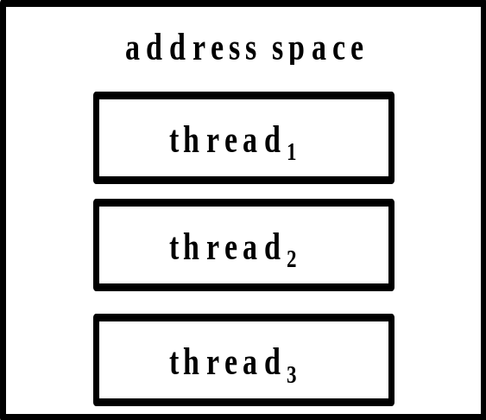
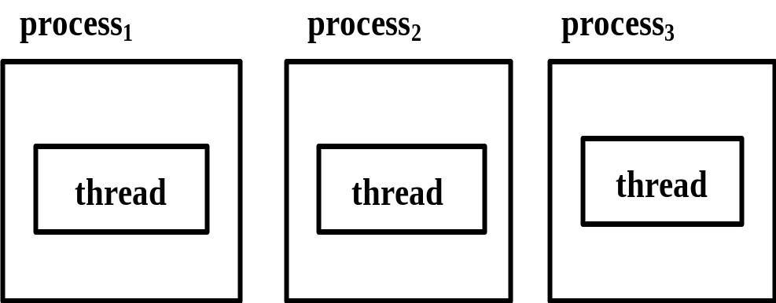
Threads
Popular way to improve application performance through parallelism
In traditional OS each process has its own program counter, its own register states, its own stack, and its own address space
In OS with threads facility, a process consists of an address space and one or more threads of control
Single thread
One multithreaded process with 3 threads

Slide 36
Threads
Thread share all resources accessible within the execution environment of a process to decrease costs of process management, thus threads share the same global variables and the same set of OS resources
Data and other resources within an execution environment are inaccessible to threads of other execution environments
Threads maximise the concurrent execution between closely-related operations
Threads can create and terminate child threads
Threads can block for system calls to complete and can change their states during their execution

Slide 37
Motivation for using threads
  The overheads involved in creating a new process are in general considerably > those of creating a new thread
  Switching between threads sharing the same address space is considerably cheaper than switching between processes that have their own address spaces
  Threads allows parallelism to be combined with sequential execution and blocking system calls
  Resource sharing can be achieved more efficiently

Slide 38
Models for Organizing Threads
3 commonly used ways to organize threads of process are:
  Dispatcher-workers model
  Team model
  Pipeline model

Slide 39
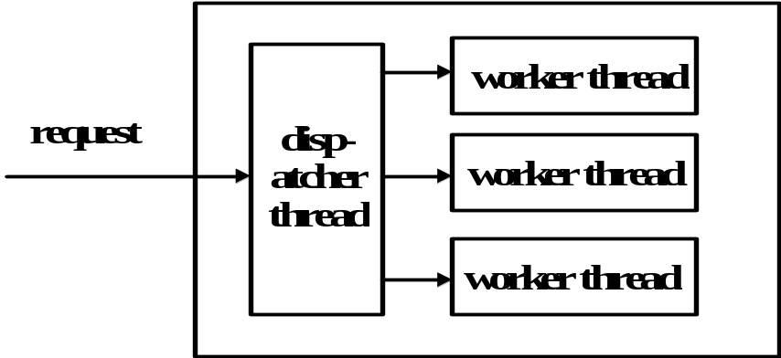
Models for Organizing Threads
Dispatcher-workers model
  Process with a single dispatcher thread and multiple worker threads
  The dispatcher thread accepts request from clients and dispatches the request to one of the free worker threads for further processing of the request
  It records the state of the current request and then gets the next message
  Each worker thread works on different request
Fig: dispatcher workers model

Slide 40
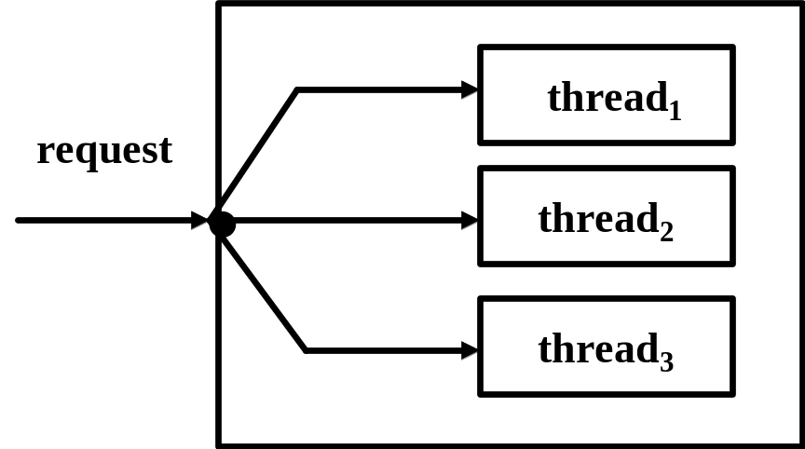
Models for Organizing Threads
Team-model
  Client’s requests are not dispatched among threads
  Each thread gets and processes client’s request on its own, but threads may service special requests of clients
  It may have a job queue to store pending requests in order to sort out special requests and distribute them among threads
Fig: team-model

Slide 41
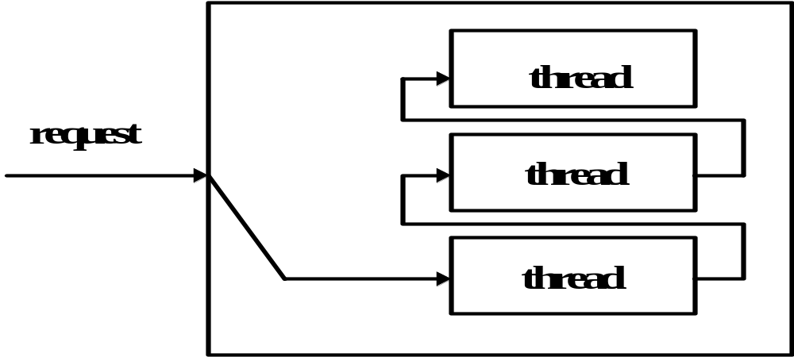
Models for Organizing Threads
Pipeline model (producer consumer model)
  Threads are organised as a pipeline so that output of a thread is used as input by an another thread
  Processing of data continue from thread to thread
Fig: pipeline model

Slide 42
Issues in Designing a Threads Package
Important issues in designing a threads package are:
  Threads creation
  Threads termination
  Threads synchronization
  Threads scheduling
  Signal handling

Slide 43
Issues in Designing a Threads Package
Thread creation
  a. static creation: the number of threads remains fixed for entire lifetime of a process and each thread has a fixed stack
  b. dynamic creation: a process is started with a single thread, new threads are created when needed during the execution of the process
Thread termination
  there are two methods to terminate threads:
    a thread may destroy itself when it finishes its job by making an exit call,
    a thread may be killed by using the kill command from outside

Slide 44
Issues in Designing a Threads Package
Thread synchronization
  problem: multiple threads should be prevented from trying to access the same data simultaneously
  solution: critical region + mutual exclusion
  a. mutex variables - binary semaphore with locked and unlocked states, which is used for short-term locking,
    operations on mutex variables:
    Lock: unlock → lock state change to disable access to the critical region,
    Unlock: lock → unlock state change to enable access to critical region after finishing a particular execution

Slide 45
Issues in Designing a Threads Package
Thread synchronization (Contd…)
  b. condition variables - mutex variable + its Boolean state, used for long-term locking
  operations on condition variables:
    Wait: unlock → lock state change and the thread is blocked until a signal operation is performed by some other thread on the condition variable,
    Signal: unlock → lock state change the thread that was blocked waiting for the condition variable starts executing in the critical region

Slide 46
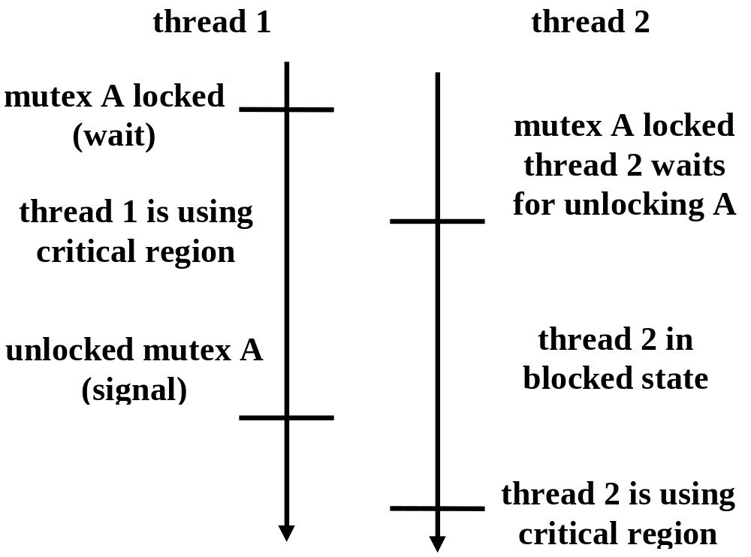
Issues in Designing a Threads Package
  Mutex_A is a mutex variable for exclusive use of shared resource A
  A_free is a condition variable for resource A to become free
Fig: use of mutex variable for synchronizing threads

Slide 47
Issues in Designing a Threads Package
Threads scheduling
  Threads package supports the following scheduling features:
    a. priority assignment
      To assign priorities to threads in order to ensure that important threads run frequently than others
    b. dynamic scheduling
      The size of time slots may be changed taking into account the total number of threads in the system
    c. hand-off scheduling
      To name successor of a thread in order to bypass the queue of runnable threads and directly switch the processor to the thread given by the currently running thread
    d. affinity scheduling
      A thread is scheduled on the processor it last ran supposing that part of its address space is still in that processor cache

Slide 48
Issues in Designing a Threads Package
Signal handling
  Signals provide software generated interrupts and exceptions
  Threads package supports the following exception and interrupt handling features:
    a. exception & interrupt signal must be handled properly
      There is a separate exception handler thread in each process that handles all exception conditions occurring in any thread of the process
      When a thread receives a signal for an exception condition, it sends an exception occurrence message to the exception handler thread and waits until the exception is handled

Slide 49
Issues in Designing a Threads Package
Signal handling (Contd…)
  b. exception & interrupt signal must be prevented from getting lost
    Each thread has its own private global variables for signalling exception conditions, so that conflicts between threads over the of such global variables never occur,

Slide 50
Implementing threads package
Key implementation issues of threads package are the following:
  Handling blocking system calls from threads,
  Scheduling threads for execution in a process
User-level threads package
  The user space consists of run-time systems that is a collection of threads management routines
  Threads run in the user space on top of the run-time system which is a set of procedures that manages threads

Slide 51
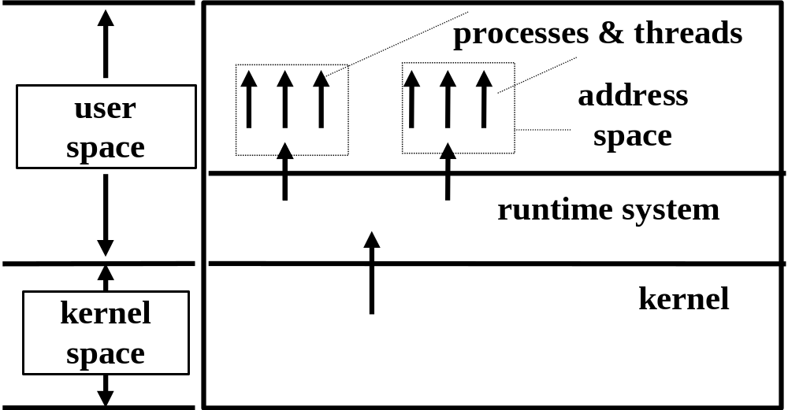
Implementing threads package
User-level threads (Contd…)
  The kernel knows nothing about threads and manages them as
  single-thread processes
  All calls are implemented as calls to the run-time system procedures that perform the functions corresponding to the calls, the run-time system maintains a status information table of threads

Slide 52
Implementing threads package
User-level threads (Contd…)
  A blocking system call from a running thread is not trapped by the OS but is routed to the run-time procedure,
  When a thread performs a system call, it calls a run-time system procedure, this procedure checks whether the running thread must be suspended, if so a thread is suspended and thread switching is executed
  In this case only the thread is blocked, it is put into a queue maintained by a run-time support, and the execution of the process continues with other threads,
  Two-level scheduling is performed; the scheduler in the kernel allocates processes, and the scheduler of the run-time system manages threads

Slide 53
Implementing threads package
Advantages of user-level approach
  Thread package can be implemented on top of an existing OS that does not support threads
  The most suitable scheduling policy may be selected because it runs with its own run-time library
  Switching the context from one thread to another is faster in the user level approach because it is performed by the run-time system and there is no call to the kernel

Slide 54
Implementing threads package
Disadvantage of user level approach
  Difficult to manage time slicing, when the timer interrupt occurs because control returns to a procedure in the thread library which can decide whether the thread is out of time
  Blocking system calls are not allowed directly because all threads of the process will be stopped and the kernel will schedule another process to run, but there is a solution to this problem:
    If the system call returns the result, it can be passed to the calling thread which may continue
    Blocking systems calls may be replaced by non-blocking system calls, if the call returns with a suspended state, the calling thread is blocked and another thread is scheduled
  When the non-blocking call completes the calling thread may be runnable again and the results made available to it in the usual way
  Threads within a process cannot take advantage of a multiprocessor architecture

Slide 55
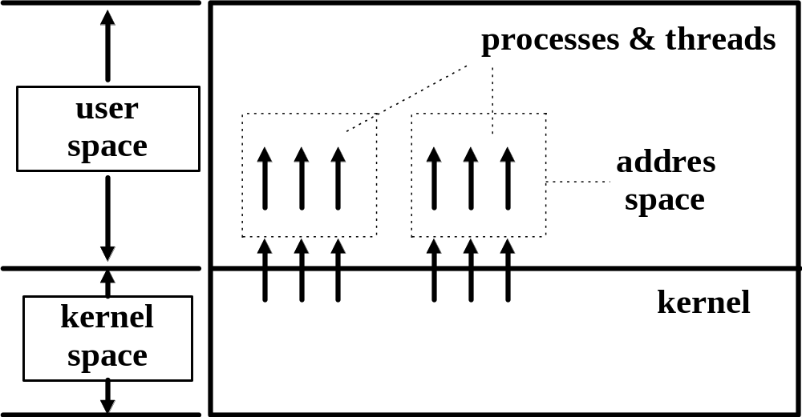
Implementing threads package
Kernel-level approach
  No run-time system is used and the threads are managed by the kernel, thus status information table of threads is maintained within the kernel, where the kernel has one table per process with one entry per thread
Fig: kernel level user threads package

Slide 56
Implementing threads package (Contd…)
Kernel level threads package (Contd…)
  Kernel thread is created for each user-level thread and all scheduling is carried out by the kernel
  All calls that might block a thread are implemented as system calls that trap to the kernel, i.e. blocking and non-blocking of threads is carried by the kernel
  A thread issuing a system call can be blocked without blocking all other threads in the same process, and each thread can compete for processor
  When a thread blocks, the kernel either selects another thread from the same process or from a different process to be run,
  To decrease costs of creating and destroying of threads some systems recycle their threads

Slide 57
Implementing threads package (Contd…)
Advantages of kernel-level approach
  the kernel can keep track of the amount of processor time consumed by a thread, when a thread finishes its time-slot, it can be interrupted by the kernel
  blocking calls are used by this approach because after a blocking call, it traps to the kernel, where it is suspended and the kernel starts a new thread

Slide 58
Implementing threads package (Contd…)
Disadvantage of kernel level approach
  The concepts of threads must be incorporated in the design of the kernel of OS
  Context switching overhead is greater than at the user-level approach because switching is carried out by the kernel
  Users can select scheduling algorithm and assign priorities to threads through the system call parameters as a result of the single level schedule
  Poor scalability because the status information table for threads is maintained in the kernel

Slide 59
Implementing threads package (Contd…)
Kernel-user level thread package
  Combination of kernel-level and user-level approach to achieve flexibility and maximum potential performance,
  User threads are assigned to kernel threads taking into account:
  How many processors are available, and which threads should run parallel on separate processors,
  Which threads will make blocking calls,

Slide 60
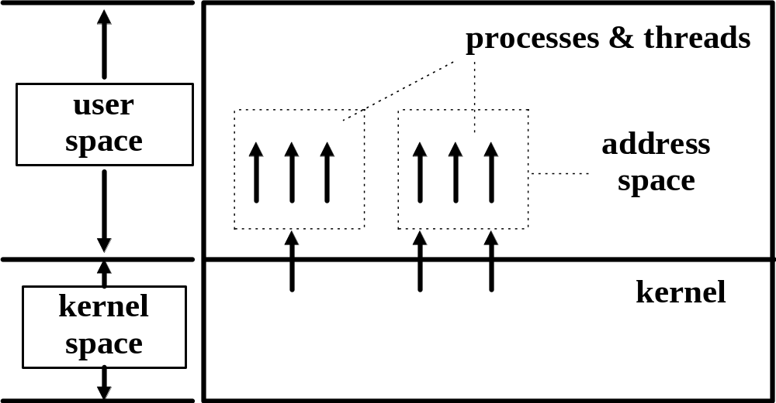
Implementing threads package (Contd…)
Kernel-user level thread package (Contd…)
Fig: kernel user thread package

Slide 61
End of chapter

