Slide 1
Distributed File Systems

Slide 2
Distributed File Systems
  Introduction
  Features of distributed file system
  File models
  File accessing models
  File sharing semantics
  File caching schemes
  File replication

Slide 3
Introduction
A file is a named object that comes into existence by explicit creation, and persists until explicitly destroyed
Two main purposes of using file are:
  Permanent storage of information
  Sharing of information
A file system is a subsystem of an O.S. that performs file management activities
  Organization, storing, retrieval, naming, sharing and protection of files

Slide 4
Introduction
Distributed file system supports:
  Remote information sharing
  User mobility
  Availability
  Diskless workstations
Three types of services provide by distributed file systems:
  Storage service
  True file service
  Name service
The design and implementation of storage service of distributed file system is similar to that of storage of centralized file system

Slide 5
Desirable features of a good distributed file system
A good distributed file system should have:
  Transparency
    Four types of transparency that are desirable are
      Structure transparency
      Access transparency
      Naming transparency
      Replication transparency
  User mobility
  Performance
  Simplicity and ease of use

Slide 6
Desirable features of a good distributed file system
  Scalability
  High availability
  High reliability
  Data integrity
  Security
  Heterogeneity

Slide 7
File Models
Two most commonly used criteria for file modeling are:
  Structure
  Modifiability
Unstructured and structured files:
  In an unstructured model there is no substructure known to the file server and the contents of each file of the file system appears to the file server as an uninterpreted sequence of bytes
  In an structured model, a file appears to the file server as an ordered sequence of records

Slide 8
File Models
  2 types of structured files
    Files with non indexed records
    Files with indexed records
Mutable and immutable files:
  In mutable model, an update performed on a file overwrites on its old contents to produce the new contents
  In immutable model, a file cannot be modified once it has been created except to be deleted
  A new version of the file is created each time a change is made

Slide 9
File Accessing Models
The file accessing model of a distributed file system mainly depends on two factors:
  Accessing remote files
  Unit of data access
Accessing remote files:
  When the accessed file is a remote file one of the following models can be used
  Remote service model :
  The client request for file access is delivered to the server, the server performs the access request and the result is forwarded to the client

Slide 10
File Accessing Models
    Data-caching model
    If the data needed is not present locally, it is copied from the server’s node to the client’s node and is cached there.
    Client’s request is processed on the client’s node itself by using the cached data.
    Recently accessed data are retained in the cache for sometime so that repeated accesses to the same data can be handled locally.
    Replacement policy such as the LRU is used to keep cache size bounded

Slide 11
File Accessing Models
Unit of data transfer:
  Unit of data transfer refers to the fraction (or its multiples) of a file data that is transferred to and from clients as a result of a single read or write operation
  4 commonly used data transfer models are:
    File-level transfer model
    Block-level transfer model
    Byte-level transfer model
    Record-level transfer model

Slide 12
File-Sharing Semantics
When a shared file is simultaneously accessed by multiple users, when to make the modifications of file data made by a user observable by other users ?
The File sharing semantics defines this.
  UNIX semantics
    Total ordering of R/W events
    Easy to achieve in a non-distributed system
    In a distributed system with one server and multiple clients with no caching at client, total ordering is also easily achieved since Reads and Writes are immediately performed at server strictly sequentially

Slide 13
File-Sharing Semantics
    Performance of a distributed system which uses Unix like is semantics is frequently poor
  Session semantics
  Writes are guaranteed to become visible only when the file is closed
  Allow caching at client with lazy updating for better performance
  If two or more clients simultaneously write one file, last one (or non-deterministically) replaces the other

Slide 14
File-Sharing
  Immutable shared-files semantics
    Immutable files cannot be modified once it has been created
    Once the file is declared as sharable, the file is treated as immutable, so that it cannot be modified anymore
    Changes to file are made by creating new updated version of file
    Each version is treated as entirely new file
    Files are shared only in the read mode

Slide 15
File-Sharing Semantics
Transaction like semantics
  High-level mechanism for controlling concurrent access to shared, mutable data
  Transaction is a set of operations enclosed in between a pair of begin_transaction- and end_transaction-like operations
  Partial modification made to the shared data by a transaction will not be visible to other transactions until the transaction ends
  If multiple concurrent transactions operating on a file, the system ensures that the final file content will be same as if all the transactions were run in some sequential order

Slide 16
File Caching Schemes
File caching improves I/O performance
The idea is to retain recently accessed file data in main memory, so that repeated access to the same information can be handled without additional disk transfers
In Centralized systems design of file caching should address
  Granularity of cached data ( large vs. small )
  Cache size (large vs. small ,fixed vs. dynamically changing)
  Replacement policy
In addition, File caching scheme for DFS should address
  Cache location
  Modification propagation
  Cache validation

Slide 17
File Caching Schemes
In addition, File caching scheme for DFS should address
  Cache location
  Modification propagation
  Cache validation
Cache location
  Refers to the place where cached data is stored
  3 possible locations in a DFS
      Server’s main memory
      Client’s disk
      Client’s main memory

Slide 18
File Caching Schemes
Node boundary
Client’s
Main memory
Server’s
Main memory
4
2
1
No caching
2
Cache located in server’s main memory
Client’s
Disk
Server’s
Disk
3
Cache located in client’s disk
4
Cache located in client’s main memory
3
1
Not available in diskless workstations
Original file location
Possible cache locations in a file caching scheme for a DFS

Slide 19
File caching schemes
Advantages of three cache location policies
Cache location | Access cost on cache hit | Advantages
Server’s main memory | One network access | Easy to implement Totally transparent to clients Easy to keep the original file and cached data consistent Easy to support UNIX-like file sharing semantics

Slide 20
File caching schemes
Cache location | Access cost on cache hit | Advantages
Client’s disk | One disk access | Reliability against crashes Large storage capacity Suitable for supporting disconnected operation Contributes to scalability and reliability

Slide 21
File caching schemes
Cache location | Access cost on cache hit | Advantages
Client’s main memory |  | Maximum performance gain Permits workstations to be diskless Contributes to scalability and reliability

Slide 22
Modification Propagation
Keeping file data cached at multiple client nodes consistent is an important design issue in DFS that use client caching
When to propagate modifications made to a cached data to the corresponding file server?
How to verify the validity of cached data?
Modification propagation schemes
  Write-through scheme
  Delayed-write scheme

Slide 23
Modification Propagation
Write-through scheme
  When cache entry is modified, the new value is immediately sent to server for updating the master copy of the file
  2 main advantages
    High degree of reliability
    Suitability for UNIX-like semantics
  Drawbacks
    Poor write performance
      Each write has to wait until information is written to the master copy of the server

Slide 24
Modification Propagation
Delayed-write scheme
  When cache entry is modified, the new value is written only to the cache and the client just makes a note that the cache entry has been updated
  Later, all updated cache entries corresponding to a file are gathered together and sent to the file server at a time
  Depending on when modifications are sent to file server, delayed-write policies are of 3 different types
    Write on ejection from cache
    Periodic write
    Write on close

Slide 25
Modification propagation
Delayed-write scheme
  Helps in performance improvement due to
    Write access complete more quickly because the new value is written only in the cache of the client performing the write
    Modified data may be deleted before it is time to send them to the server
    Gathering all of file updates and sending them together to server is more efficient than sending separately

Slide 26
Modification propagation
Drawbacks of Delayed-write scheme
  Suffers from reliability problems
    Modifications that are not sent to the server from client’s cache will be lost if client crashes
  Delaying the propagation of modifications to the server results in fuzzier file sharing semantics, because when another process reads the file, what is gets depends on the timing

Slide 27
Modification propagation
Cache validation schemes
  2 approaches to verify the validity of cached data
    Client initiated approach
    Server-initiated approach
  Client initiated approach
    Client contacts the server and checks whether its locally cached data is consistent with the master copy
    File sharing semantics depends on the frequency of the validity check

Slide 28
Modification propagation
File sharing semantics depends on the frequency of the validity check
  Checking before every access
  Periodic checking
  Check on file open
Server initiated approach
  Client informs the file server when opening a file, indicating whether the file is being opened for reading, writing, or both
  File server keeps a record of which client has which file open in what mode
  A potential for inconsistency occurs when two or more clients try to open a file in conflicting modes

Slide 29
Modification propagation
Problems with Server initiated approach
  Violates the traditional client-server model
  Requires file servers be stateful
  A check-on-open, client initiated cache validation approach must still be used along with the server initiated approach

Slide 30
File Replication
A replicated file is a file that has multiple copies, with each copy located on separate file server
Difference between replication and caching
  A replica is associated with a server, where as a cached copy is normally associated with a client
  Existence of a cached copy is primarily dependent on the locality in file access patterns, whereas the existence of replica normally depends on availability and performance requirements
  As compared to cached copy, replica is more persistent, widely known, secure, available, complete , and accurate
  A cached copy is dependent upon a replica

Slide 31
File Replication
Advantages of replication
  Increased availability
  Increased reliability
  Improved response time
  Reduced network traffic
  Improved system throughput
  Better scalability
  Autonomous operation

Slide 32
Replication Transparency
Replication of files should be designed to be transparent to the users so that multiple copies of a replicated file appear a single logical file to its users
2 important issues related to replication transparency are
  Naming of replicas
  Replication control
    Explicit replication : Users are given the flexibility to control the entire replication process
    Implicit/lazy replication : Entire replication process is automatically controlled by the system without users knowledge

Slide 33
Multicopy Update Problem
How to keep multiple copies of the same file which exists on different servers mutually consistent?
Maintaining consistency is the major design issue
Commonly used approaches to keep multiple copies consistent are
  Read-only replication
  Read-any-write-all protocol
  Available-copies protocol
  Primary-copy protocol
  Quorum-based protocol

Slide 34
Multicopy Update Problem
Read-only replication
  It supports replication of immutable files which are frequently read and non-frequently modified
    example: system programs
Read-Any-Write-All Protocol
  A read operation on a replicated file is performed by reading any copy of the file and a write operation by writing to all copies of the file
  Before updating any copy, all copies are locked. Then they are updated and next the locks are released
  The write operation cannot be performed if any of the server having a copy of the replicated file is down at the time of the write operation

Slide 35
Multicopy Update Problem
Read-Any-Write-All Protocol
server 1
file1, file2, file4,
locking file2
file6, file9
file server
server 4
server 2
file2, file3, file5,
file2, file3, file5,
locking file2
file6
file6
file server
writing file2
server 3
file server
file5, file6, file7

Slide 36
Multicopy Update Problem
Available copies protocol
  A read operation is performed by reading any available copies, but a write operations are executed by writing to all available copies excluding servers that are down
  When a server recovers after a failure, it brings itself up-to-date by copying files from other servers before accepting any user read or write request

Slide 37
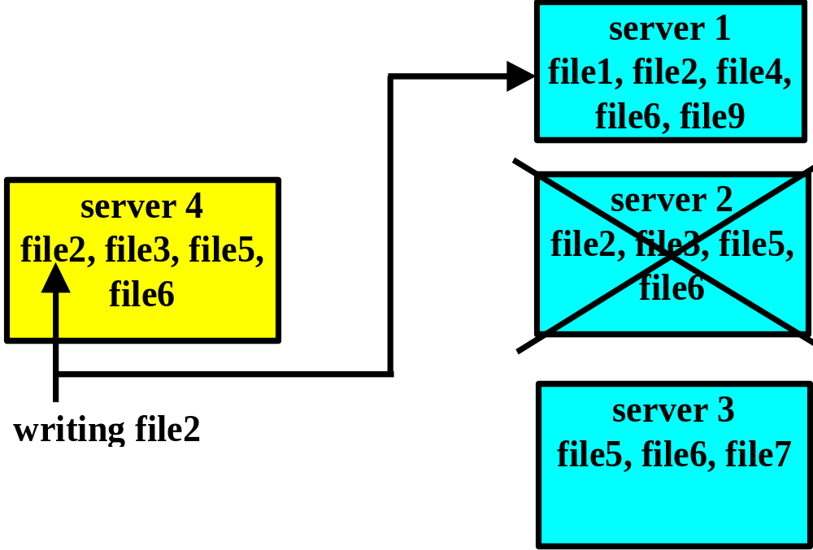
Multicopy Update Problem
Available copies protocol does not prevent inconsistencies in the presence of communication failures

Slide 38
Multicopy Update Problem
Primary copy replication
  One copy is assigned to each replicated file as the primary copy, all others are secondary copies
  Read operations can be performed using any copy, but all write operations are directly performed only on the primary copy
  Each server having the secondary copy updates its copy either by receiving notification of changes from the server having the primary copy or by requesting the updated copy from it

Slide 39
Multicopy Update Problem
Primary-copy protocol
server 1
primary copy
file1, file2, file4,
of file2
file6, file9
file server
server 4
server 2
file2, file3, file5,
file2, file3, file5,
file6
updating
file6
secondary
writing file2
copies of file2
server 3
file server
file server
file5, file6, file7

Slide 40
Multicopy Update Problem
Quorum-based protocol
  If there are “n” copies of a replicated file, to read the file a minimum “r” copies of the file have to be consulted (“r” copies = set of read quorum)
  To perform write operation on the file, minimum of “w” copies of the file have to be written (“w” copies = set of write quorum)
  To achieve consistency, “r+w” should be greater than “n”, i.e. there is at least one common copy of the file between any read/write quorum

Slide 41
Multicopy Update Problem
Quorum-based protocol
  Up-to-date copies in a quorum are identified by version numbers, where the copy with the largest version number in a quorum is current (or up-to-date)
  Operations in this approach are not executed on all copies, therefore it becomes necessary to identify a current copy in a quorum using version number of copies
  Version number of a copy is updated every time the copy is modified
  New version number assigned to each copy is one more than the version number associated with the current copy

Slide 42
Multicopy Update Problem
Quorum-based protocol
  Read operation:
    Retrieve a read quorum (any “r” copies) of a file
    Select the copy with the largest version number
    Perform the read operation on the selected copy
  Write operation:
    Retrieve write quorum (any “w” copies) of a file
    Get the version number of the copy with the largest version number
    Increment the version number
    Write the new value and the new version number to all “w” copies of the write quorum

Slide 43
Multicopy Update Problem
file 2 n = 4
  Write quorum w = 2 writes files on server 1 & 6, these files receive the new values and version number
  Read quorum r = 3 has to select among files on server 1, 2, 4 & 6, the read quorum has to include a copy on server either No.1 or No.6,
  Read operation is performed using the copy of the file2 on server No.1,
server 1
server 4
file1, file2, file4,
file2, file4,
file6, file9
file5, file8
server 2
server 5
file2, file3, file5,
file3, file5,
file6
file6, file7
server 3
server 6
file5, file6, file7
file2,
file4, file7

Slide 44
End of Chapter 7

