Slide 1
Naming in Distributed Systems

Slide 2
Naming in Distributed System
Key concepts
  Introduction
  Desirable features of a good naming system
  Fundamental terminologies and concepts
  System oriented names
  Object locating mechanisms
  Human oriented names
  Name caches
  Naming and security

Slide 3
Naming in Distributed System
Introduction
  Naming facility of DOS enables users and programs to assign character-string names to objects and subsequently use these names to refer to those objects
  Locating facility is an integral part of naming facility, maps an object’s name to the object’s location in a DS
  Naming and Locating facility jointly form a naming system that provides the users with an abstraction of an object that hides the details of how and where an object is actually located in network

Slide 4
Desirable Features of a Good Naming System
Location transparency : Name of an object should not reveal any hint about the physical location of the object
Location independency : Name of an object need not be changed when the object’s location changes
  2 features
    An object at a node can be accessed without the knowledge of its physical location
    An object at any node can issue an access request without the knowledge of its own physical location( user mobility )
Scalability

Slide 5
Desirable Features of a Good Naming System
    Uniform naming convention
    Multiple user-defined names for the same object
    Group naming
    Meaningful names
    Performance
    Fault tolerance
    Replication transparency
    Locating the nearest replica
    Locating all replicas

Slide 6
Desirable Features of a Good Naming System
Locating the nearest replica
Locating all replicas
Client node
Object
Object
Object
N1
N2
N3
N4
If the object locating mechanism maps to node N4 instead of N2?
Client node
Object
N1
N2
N3
N4
N5
Object

Slide 7
Fundamental Terminologies and Concepts
Name
  Name is a string composed of a set of symbols chosen from a finite alphabet
  Name is an identifier or logical object that identifies a physical object
  Names are used to designate or refer to objects at all levels of system architecture
  Access to an object or a resource involves mapping its user name onto a resource identifier, mapping this to a port identifier and a service-specific identifier, and mapping the port identifier to a network address, and the service-specific identifier onto the resource in the server concerned

Slide 8
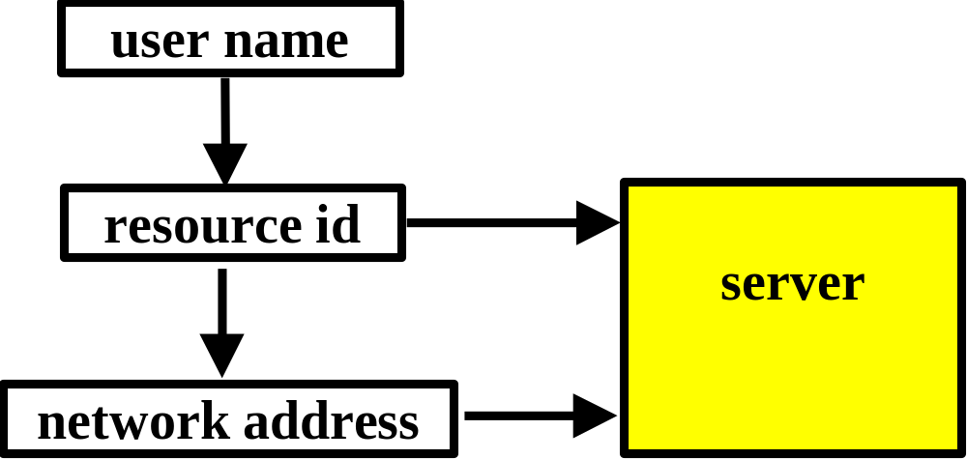
Fundamental Terminologies and Concepts
Names
  They have various purposes, forms, and properties depending on the levels at which they are defined
  The correspondence between names and objects is provided by binding logical and physical objects for the purpose of object identification

Slide 9
Fundamental Terminologies and Concepts
Human oriented and system oriented names
  Human oriented name is generally a character string that is meaningful to its users i.e., defined by the users
    E.g.: /nitk/cse/anp/Sur-Quiz1
  For shared object, different users of the object must have the flexibility to define their own human oriented names
  For transparency, human oriented names should be independent of the physical location or structure of objects
  Human oriented names cannot be easily manipulated, stored and used by the machines for identification purpose

Slide 10
Fundamental Terminologies and Concepts
  System oriented names are bit patterns of fixed size that can be easily manipulated and stored by machines
  Automatically generated by the system
  Should be generated in a distributed manner to avoid the problems of efficiency and reliability of a centralized unique identifier generator
  Also known as unique identifiers and low-level names
  Human oriented name is first mapped (translated) to a system-oriented name
  system-oriented name is then mapped to the physical locations of the corresponding object’s replica

Slide 11
Fundamental Terminologies and Concepts
Physical addresses of the named object
Replica
Human oriented
name
System oriented
name
Replica
Replica
First-level mapping
Second-level mapping
Simple naming model based on human oriented and system oriented names

Slide 12
Fundamental Terminologies and Concepts
Name space
  Name space is a set of names complying with a given naming convention
  The syntactic representation and semantic interpretation of a name depends on the naming convention used for the name
  Names are associated with some context where a context is an environment in which a name is valid
  In a distributed system context represents a partitioning of the name space

Slide 13
Fundamental Terminologies and Concepts
Flat (primitive) Name Space
  Flat names are character strings having no structure
  Names in the flat (primitive) name space that does not have internal structure but identifies unambiguously a particular object
  Since flat names do not have any structure, it is difficult to assign unambiguous meaningful names to a large set of objects
  Therefore flat names are suitable for use either for small name spaces having names for only a few objects or for system-oriented names that need not be meaningful to the users

Slide 14
Fundamental Terminologies and Concepts
Partitioned name space
  A naming convention that partitions the name space into disjoint classes
  A partitioned name is structured name that identifies an object as a series of primitive names. For example: a domain, a subdomain, a sub-subdomain
  Each partition of a partitioned name space is called a domain of the name space
  Each domain of a partitioned name space may be viewed as a flat name space by itself, and the names defined in a domain must be unique within that domain. However, two different domains may have a common name defined within them

Slide 15
Fundamental Terminologies and Concepts
  A name defined in a domain is called a simple name
  In a partitioned name space, all objects cannot be uniquely identified by simple names, and hence compound names are used for the purpose of unique identification
  A compound name is composed of one or more simple names that are separated by a special delimiter
    For example: /a/b/c
  A commonly used partitioned type name space is the hierarchical name space, in which the name space is partitioned into multiple levels and is structured as an inverted tree
  Each node of the name space tree corresponds to a domain of the name space.
  In this type of name space, the number of levels may be either fixed or arbitrary

Slide 16
Fundamental Terminologies and Concepts
Name server
  Name server is a process that maintains information about named objects and provides facilities that enable users to access that information
  It maps names specified by clients to objects.
    For example files and directories using name resolution
  It binds an object's name to some of its properties, including the object's location
  Several name servers are normally used for managing the name space of object names in a distributed system
  Each name server normally has information about only a small subset of the set of objects in the distributed system

Slide 17
Fundamental Terminologies and Concepts
  Each server is responsible for mapping objects stored in different domains
  Name servers that store the information about an object are called the authoritative name servers of that object
  To determine the authoritative name servers for every named object, the name service maintains authority attributes that contain a list of the authoritative name servers for each object
  In a hierarchical name space, it is sufficient that each name server store information to locate the authoritative name servers for the root domain of the name tree

Slide 18
Fundamental Terminologies and Concepts
  The authoritative name servers of the root domain should know the locations of the authoritative name servers of the domains that branch out from the root domain
  The amount of configuration data that must be maintained by name servers at the various levels of the hierarchy is proportional to the degree of branching of the name space tree
  For this reason, hierarchical naming conventions with several levels are often better suited for naming large number of objects

Slide 19
Fundamental Terminologies and Concepts
Name Agent
  Location of name servers should be transparent to clients of the name service
  Transparency can be achieved through name agents which act between name servers and their clients
  Name agents maintains a detailed knowledge of the name space and of existing name servers
  Name agents may be of 2 types
    Private → work for single client
    Shared → works for several clients

Slide 20
Fundamental Terminologies and Concepts
Name Context
  Names are always associated with some context.
  A context is the environment in which a name is valid
  Name contexts provide a means of partitioning the naming information database so that it may be distributed among multiple name servers
  A context/name pair forms a qualified name that can be used for uniquely identifying an object

Slide 21
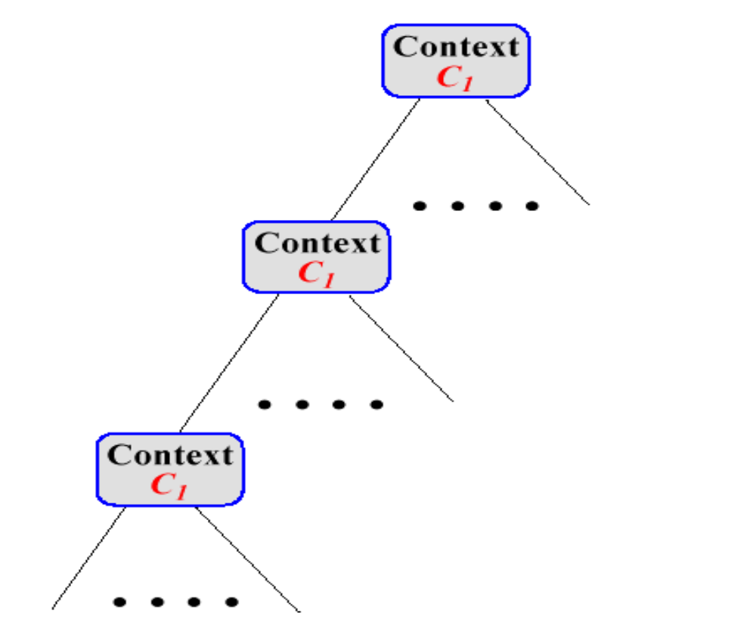
Fundamental Terminologies and Concepts
  A naming context is partially described by the distinguished name of its root entry. It is called the context prefix because it is a prefix to the distinguished names of each entry in the naming context

Slide 22
Fundamental Terminologies and Concepts
  Contexts represent a division of the name space along natural geographical, organizational, or functional boundaries
  In a partitioned name space, each domain corresponds to a context of the name space. Names in a context can be generated independently of what names exist in any other context, therefore, a name may occur in more than one context
  Contexts may also be nested, as in the case of hierarchical name spaces
  In nested contexts, a qualified name consists of a series of names identifying, respectively, a context, a subcontext, a sub-subcontext followed by a name inside the last sub-subcontext

Slide 23
Fundamental Terminologies and Concepts
Name resolution
  Locates the attributes of a specific object given by its name i.e. selection of name server for the object
  The resolution process involves two stages:
    Name resolution and Address resolution
    Name resolution
      Names are application-oriented denotations of objects, and addresses are object representations with some structural information
      The name resolution maps names to logical addresses
      It is performed by the distributed operating system

Slide 24
Fundamental Terminologies and Concepts
  Address resolution
    Addresses resolution maps addresses to routes that show how an object can be physically located where the route is the lowest level of location information and cannot be reduced any further
    Address resolution is a function of the computer network
    Name resolution is the process of mapping an object's name to the object's properties, such as its location
    Since an object's properties are stored and maintained by the authoritative name servers of that object, name resolution is basically the process of mapping an object's name to the authoritative name servers of that object

Slide 25
Fundamental Terminologies and Concepts
  Once an authoritative name server of the object has been located, operations can be invoked to read or update the object's properties
  Each name agent in a distributed system knows about at least one name server a priori
  To get a name resolved, a client first contacts its name agent, which in turn contacts a known name server, which may in turn contact other name servers

Slide 26
Fundamental Terminologies and Concepts
Types of name resolution:
  1. Structure-oriented name resolution
    Locates the set of name servers for a named object based on the structure of the name space
  2. Structure-free name resolution
    Locates the set of name server for a given object without relying on the structure of the name space

Slide 27
Fundamental Terminologies and Concepts
Abbreviation/Alias
  In case of partitioned name spaces, a qualified name may consist of several simple names and may be too long
  It may be inconvenient for a user to specify the qualified name of an object every time they use it
  Users are allowed to specify and use their own short-form substitutes called abbreviations/aliases
  All abbreviations defined by a user form a private context of that user
  Ex. Symbolic links in UNIX

Slide 28
Fundamental Terminologies and Concepts
Absolute and Relative names
  Using the concept of current working context there is no need to specify the full name of an object in tree-structured name spaces
  A user is always associated with a context.
  A user can change his or her current context whenever required
  An absolute name begins at the root context of the name space tree and follows a path down to the specified object, giving the names on the path

Slide 29
Fundamental Terminologies and Concepts
  A relative name defines a path from the current context to the specified object.
  It is called a relative name because it is "relative to” (start from) the user's current context
  A user may specify an object in any of the following ways using either the absolute or relative names:
    a. using the full (absolute) name
    b. using a relative name
    c. changing the current context first and then using a relative name

Slide 30
Fundamental Terminologies and Concepts
  Example:
  relative address:
    user's current context: root-context/context-l/context-3,
    the relative name: context-5/object-1
  absolute address:
    root-context/context-1/context-3/context-5/object-1

Slide 31
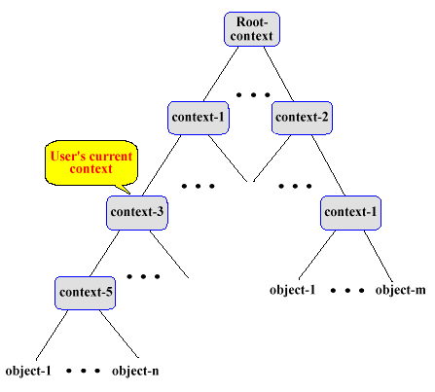
Fundamental Terminologies and Concepts
Absolute and Relative names

Slide 32
Fundamental Terminologies and Concepts
Generic and Multicast Names
  The use of generic and multicast names requires the naming system to support one-to-many bindings,
  i.e. the naming system must allow a simple name to be bound to a set of names
  In a generic naming facility, a name is mapped to any one of the set of objects to which it is bound.
  This type of facility is useful in situations such as when a user wants a request to be serviced by any of the servers capable of servicing that request and the user is not concerned with which server services the request

Slide 33
Fundamental Terminologies and Concepts
Descriptive/Attribute based name
  Allows an object to be identified by a set of attributes or properties that describe the object and uniquely identify it among the group of objects in the name space
Source-Routing name
  Structure of a name space has the same form as underlying physical network of DS
  Identifies a path through the network of DS
  E.g.: UNIX-to-UNIX Copy (UUCP)

Slide 34
System-Oriented Names
Characteristics
  They are large integers or bit strings
  They are also referred to as unique identifiers
  Unlike human oriented names that are variable in length, all system oriented names are of same size irrespective of type or location
  Manipulations like hashing, sorting, can be easily performed as they are normally shorter than human oriented names
  They are hard to guess and hence are sometimes also used for security related purposes
  They are automatically generated by the system

Slide 35
System-Oriented Names
System oriented names can be
  Structured or unstructured
A single field of large integers or bit strings
unstructured system oriented names
Node identifier Local unique identifier
structured system oriented names

Slide 36
System-Oriented Names
Centralized approach for generating System oriented Names
  Mainly used by a naming system that uses unstructured names
  A standard, uniform global identifier is generated for each object in the system by a centralized global unique identifier generator
  Each node either directly binds these global identifiers to the locally created objects or it maps its local identifiers for the locally created objects to these global identifiers
  Advantage : Simple and easy to implement and is only method for generating unstructured global unique identifiers
  Drawbacks : Poor efficiency and poor reliability

Slide 37
System-Oriented Names
Distributed approach for generating System Oriented Names
  Distributed generation forces the naming system to use structured object identifiers
  The hierarchical concatenation strategy is used to create global unique identifiers
  Each identification domain is assigned a unique identifier
  Global unique identifier for an object is created by concatenating the unique identifier of a domain with an identifier used within this domain
  Global unique identifiers consists of 2 components
    The domain identifier and an identifier within this domain

Slide 38
System-Oriented Names
How to generate unique identifiers within an domain in an efficient manner ?
2 methods
  1) Treat each node of the system as a domain of name space and treat reading from the real-time clock (timestamp) of a node as a unique identifier within the node
    Global identifier takes form → (node-ID, timestamp)
  2) Treat each server as a domain and then to allow a server to generate object identifiers for the objects it serves in a server-specific manner
    Global identifier takes the from → (server-ID, server-specific-unique-identifier)

Slide 39
System-Oriented Names
Distributed approach for generating System Oriented Names
  Advantage : Better efficiency and reliability
  Drawbacks
    The form and length of identifiers may be different for different computers, in a heterogeneous environment, resulting in nonuniform global unique identifiers
    Node boundaries or servers are explicitly visible in this scheme

Slide 40
System-Oriented Names
How to generate Unique Identifiers in the event of Crashes?
  A crash may lead to loss of the state information of unique identifier generator
  Upon recovery, the unique identifier generator may not function correctly, which may result in generation of nonunique identifiers
  2 basic approaches to overcome these are
  Using a clock that operates across failures
    Clock is guaranteed to operate across failures and it will not recycle during the period within which the needed identifiers must be unique
  Using two or more levels of storage

Slide 41
System-oriented Names
Using two or more levels of storage:
  Two or more levels of storage are used
  Unique identifiers are structured in a hierarchical fashion with one field for each level
  A counter associated with each level contains the highest value of the corresponding field assigned.
  Current values of these fields are cached in memory
  When a lower level field is about to cycle or associated storage device crashes, the next higher level counter in incremented and lower level counter is reset

Slide 42
Object Locating Mechanisms
Object locating is the process of mapping an object’s system oriented unique identifier to the replica locations of the object
Object locating operation is different and independent of the object-accessing operation
Object locating mechanisms used by various D.O.S. are
  Broadcasting
  Expanding ring broadcast
  Encoding location of object within its UID
  Searching creator node first and then broadcasting
  Using forward location pointers
  Using hint cache and broadcasting

Slide 43
Object Locating Mechanisms
Broadcasting
  An object is located by broadcasting a request for the object from a client node
  Request is processed by all nodes and then the nodes currently having the object reply back to the client node
  Simple and enjoys a high degree of reliability
  Suffers from poor efficiency and scalability
    The amount of network traffic generated for each request is directly proportional to the number of nodes in the system and is prohibitive for large networks

Slide 44
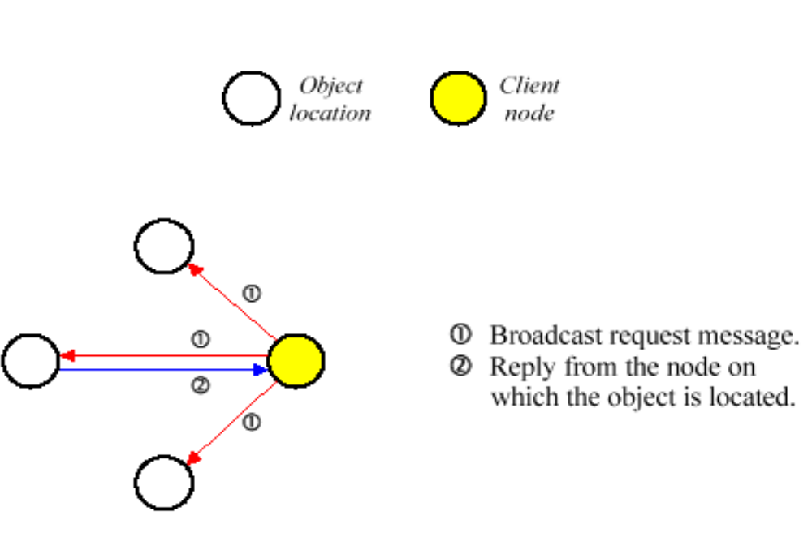
Object Locating Mechanisms
Broadcasting

Slide 45
Object Locating Mechanisms
Expanding Ring Broadcast
  Pure broadcasting is expensive for large networks
  Modified form of broadcasting, called expanding ring broadcast (ERB), is normally employed in an internetwork that consists of LAN’s connected by gateways
  Here, increasingly distant LANs are systematically searched until the object is found or until every LAN has been searched unsuccessfully
  Distance metric used is hop
  A ring is the set of LANs a certain distance away from a processor

Slide 46
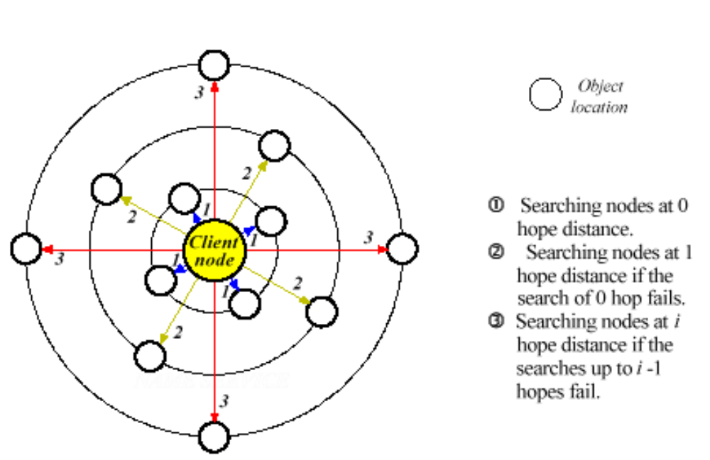
Object Locating Mechanisms
Expanding ring broadcast

Slide 47
Object Locating Mechanisms
Expanding ring broadcast
  Processor A needs to locate object X
  Beginning with i=0, a request message is broadcast to all LANs in Ring_{i}[A]
  If a response is received, the search ends successfully
  Otherwise, after timeout period has elapsed, i is incremented by 1 and the request is repeated
  Ring size i is bounded by the diameter of internetwork

Slide 48
Object Locating Mechanisms
Expanding ring broadcast
  This method does not necessarily supply all the replica locations of an object simultaneously, although it does supply the nearest replica location
  Efficiency of an object locating operation is directly proportional to the distance of the object from client node at the time of locating it

Slide 49
Object Locating Mechanisms
Encoding locating of object within its UID
  Uses structured object identifiers
  One field of structured UID is the location of the object
  Given the UID, the system simply extracts the corresponding objects location from its UID by examining the appropriate field of the structured UID
  Straightforward and efficient scheme
  Restriction is that an object is not permitted to move once it is assigned to a node
  Limitation is that it is not clear how to support multiple replicas of an object

Slide 50
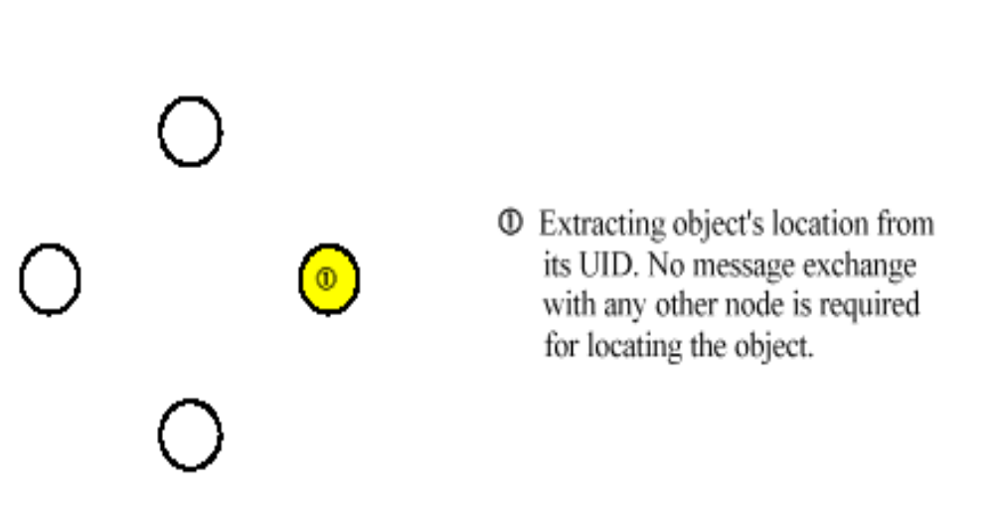
Object Locating Mechanisms
Encoding locating of object within its UID
Do not support object migration and object replication

Slide 51
Object Locating Mechanisms
Searching Creator Node First and then Broadcasting
  Extension of encoding locating of object within its UID scheme
  The extension is meant for supporting object migration facility
  Method is based on assumption that it is very likely for an object to remain at the node where it was created
  Location field of the structured UID contains the identifier of the node on which the object was created
  Helps in reducing network traffic to a great extent
  More flexible for object migration

Slide 52
Object Locating Mechanisms
Forward location pointers
  Goal is to avoid the use of broadcast protocol
  A forward location pointer is a reference used at a node to indicate the new location of an object
  Whenever object is migrated from one node to another, forward location pointer is left at its previous node
  Advantage
    Totally avoids the use of broadcast protocol
    Supports object migration

Slide 53
Object Locating Mechanisms
Forward location pointers
  Major drawbacks
    Object locating cost is directly proportional to the length of the chain of pointers to be traversed and grows considerably as the chain becomes longer
    Poor reliability, It is difficult to locate an object if an intermediate pointer has been lost
    The method introduces additional system overhead for upkeep

Slide 54
Object Locating Mechanisms
Hint cache and broadcasting
  Cache is maintained on each node that contains the (UID, last known location) pairs of a number of recently referenced remote objects
  Local cache is searched for the UID
  If the UID is found the corresponding location information is extracted from the cache
  Request is forwarded to that node
  If the object is not found in that node, it returns a negative reply, indicating that the location information extracted from the cache was outdated

Slide 55
Object Locating Mechanisms
Hint cache and broadcasting
  If the UID is not found in the local cache or if the information found to be outdated, a message is broadcast throughout the network requesting the current location of the object
  Each node performs an internal search for the object
  A reply message is sent to the requester from the node on which the object is found
  Location information is cached at the client node
  Cache entry is only a hint, it may be wrong because of migration

Slide 56
Object Locating Mechanisms
Hint cache and broadcasting
  Very efficient if high degree of locality is exhibited in locating objects from a node
  Flexible since it can support object migration facility
  Problem is,
    Broadcast requests will clutter up the network, disturbing all the nodes even though only a single node is directly involved with each object locating operation

Slide 57
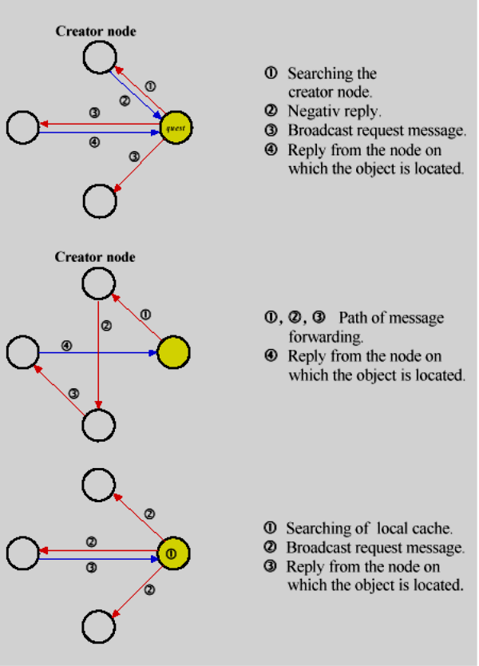
Object Locating Mechanisms
Searching the creator node first and then broadcasting
Forward location pointers
Hint cache and broadcasting

Slide 58
Human Oriented Names
Characteristics
  They are character strings that are meaningful to their users
  They are defined and used by the users
  Different users can define and use their own suitable names for a object. Facility of aliasing is provided to the users
  They are variable in length not only in names for different objects but even in different names for the same object
  Due to aliasing same name may be used by different users at the same time to refer to different objects. Human oriented names are not unique in either space or time

Slide 59
Human Oriented Names
Major issues with human oriented names are
  Selecting a proper scheme for global object naming
  Selecting a proper scheme for partitioning a name space into contexts
  Selecting a proper scheme for implementing context bindings
  Selecting a proper scheme for name resolution

Slide 60
Human Oriented Hierarchical Naming Schemes
Combining an object’s local name with its host name
  Uses a name space that is comprised of several isolated name spaces
  Each isolated name space corresponds to a node of DS, and name in this name space uniquely identifies an object of the node
  Simple and easy to implement
  Drawback is that it is neither location transparent nor location independent
  It is inflexible

Slide 61
Human Oriented Hierarchical Naming Schemes
Interlinking isolated name spaces into a single name space
  Global name is comprised of several isolated name spaces
  Isolated name spaces are joined together to form a single naming structure
  Position of these component name spaces in the naming hierarchy is arbitrary
  There is no notion of absolute pathname
  Each pathname is relative to some context, either to the current working context or to the current component name space
  Advantage : simple to join existing name spaces into a single global name space

Slide 62
Human Oriented Hierarchical Naming Schemes
Sharing remote name spaces on explicit request
  Based on the idea of attaching the isolated name spaces of various nodes to create a new name space
  Users are given the flexibility to attach a context of remote name space to one of the contexts of their local name spaces
  Once a remote context is attached locally, its objects can be named in a location-transparent manner
  Goal is to allow some degree of sharing among the name spaces of various nodes in a transparent manner on explicit request by users

Slide 63
Human Oriented Hierarchical Naming Schemes
Sharing remote name spaces on explicit request
  In NFS, the mount protocol is used to attach a remote name space directory to a local name space
  Node that performs mount operation is client node
  Node whose name space directory is mounted is server node
  NFS allows all nodes to be client and server at the same time
  The list of directories to be exported by the server is maintained in the /etc/exports file
  Semantics of mount operation are that a server’s file system directory exported by the server is mounted over a directory of client’s file system

Slide 64
Human Oriented Hierarchical Naming Schemes
Sharing remote name spaces on explicit request
  A client can mount a directory in one of the following ways
    Manual mounting
      mount and umount command are used explicitly
    Static mounting
      Automatically mount the directories during mounting
    Automounting
      Directories are mounted an unmounted only when client needs it

Slide 65
Human Oriented Hierarchical Naming Schemes
File mounting mechanism of NFS naming scheme
N1
N2
User1
dir3
User2
dir1
dir2
Part of the name tree of node N1
Part of the name tree of node N2

Slide 66
Human Oriented Hierarchical Naming Schemes
file mounting mechanism of NFS naming scheme
N1
N2
User1
dir3
User2
dir1
dir1
dir2
dir2
structure of name tree of node N1 after mounting dir2 of node N2 over dir1
structure of name tree of node N2 after mounting dir1 of node N1 over dir3

Slide 67
A Single Global Name Space
A single global name structure spans all the objects of all nodes in the system
Same name space is visible to all users
An object’s absolute name is always the same irrespective of the location of the object or user accessing it
Its one of the most common approach used by modern DOS due to its properties of complete location transparency and location independency

Slide 68
Partitioning a Name Space into Contexts
Name space management involves storage and maintenance of naming information which consists of object names, object attributes, and the bindings between the two
The notion of context is used for partitioning a name space into smaller components.
Contexts represent indivisible units of storage and replication of information regarding named objects
Name space is partitioned into contexts using clustering condition
A clustering condition is an expression that, when applied to a name, returns either a true or false value, depending on whether give name exists in the context designated by the clustering condition

Slide 69
Partitioning a Name Space into Contexts
      Three basic clustering methods
        Algorithmic clustering
        Syntactic clustering
        Attribute clustering

Slide 70
Partitioning a Name Space into Contexts
Algorithmic clustering
  Names are clustered according to the value that results from applying a function to them
  The clustering condition is a predicate of the form function (name)=value
  Advantage: supports structure-free name distribution
  Structure-free name distribution is one that places no restriction on the administrative control over parts of a name space
  Drawback: difficulty in devising proper clustering function

Slide 71
Algorithmic clustering
Delhi Imphal Kolkatha
Madras Mumbai Pune vasi surat
cochin bangalore puri Indore nagpur
gwalior nasik jammu haryana
simla bhatinda trichy calicut
Jaipur anand kota
func-1(name):
if (total characters (name) =
even) return(0)
else return (1);
func-1(name)=0
func-1(name)=1
Kolkatha nagpur
Mumbai Pune vasi
cochin bangalore Indore
Puri kota bhatinda trichy Jaipur
Delhi nasik haryana
Madras surat simla
gwalior jammu
Calicut anand
func-2(name)=1
func-2(name)=0
Nagpur cochin Vasi Imphal
Bangalore Simla Pune nasik
Puri kota
Bhatinda Kolkatha Mumbai
Indore haryana trichy Jaipur
func-2(name):
if (total vowels (name) = even) return(0)
else return (1);

Slide 72
Partitioning a Name Space into Contexts
Syntactic clustering
  Performed using pattern-matching techniques
  Patterns are templates against which a name is compared
  They range from names that may simply contain wildcards, which are denoted by asterisks and match any sequence of characters, to regular expressions
  All names that match a particular pattern, such as names with a common prefix prefix*, are considered part of the same context.

Slide 73
Partitioning a Name Space into Contexts
Attribute clustering
  Used by attribute naming conventions
  Names are grouped on the attributes possessed by the names
  An attribute has both a type and a value, where the type indicates the format and meaning of the value field
  All names having the same attribute (type, value) pair are placed in the same partition in the attribute clustering mechanism
  Several attributes may be matched in a single step as attribute conditions are not restricted

Slide 74
Context Binding
The contexts of name space are distributed among the various name servers managing that name space
A name server normally stores only a small subset of the set of context of the name space
When presented with a name to be resolved, Server first looks in local contexts for an authority attribute for the named object
If authority attribute for the named object is not found in a local context, additional configuration data, called context bindings, must exist locally for the name resolution to proceed
2 main strategy used to implement are:
  Table-based strategy
  Procedure-based strategy

Slide 75
Context Binding
Table-based context binding
  Commonly used approach for implementing context bindings in hierarchical tree-structured name spaces
  Each context is a table having 2 fields
    First field stores a component name of the named object
    Second field either stores context binding information or authority attribute information
  An entry corresponding to the last component of a name contains the authority attribute information while other entries contain context bindings
  The contexts of a table-based strategy are also known as directories

Slide 76
Context Binding
Procedure-based context binding
  Context binding takes the form of a procedure, which, when executed, supplies information about the next context to be consulted for the named object
  This scheme is less flexible than table-based strategy because, if required, the context bindings cannot be changed dynamically and independently for each object
  Changing of context bindings requires changes in clustering procedures

Slide 77
Name Resolution Mechanisms
Name resolution is a process of mapping an object’s name to the authoritative name servers of the object
Name resolution mechanism of a naming system depends on the policy used for distributing the contexts of the name space of naming system
Name resolution mechanisms:
  Centralized approach
  Fully replicated approach
  Distribution based on physical structure of name space
  Structure free distribution of contexts

Slide 78
Name Resolution Mechanisms
Centralized approach
  A single name server in the entire DS is located at a centralized node
  Location of centralized name server is known to all other nodes
  The name server resolves a name by traversing the complete resolution chain of contexts locally and finally returns the attributes of the named object to the client node
  Example: DARPA domain name system
  Advantage : simple and easy to implement

Slide 79
Name Resolution Mechanisms
  Drawbacks:
    Does not scale well for large systems
    Reliability is very poor
Fully Replicated Approach
Name server is located on each node of the distributed system and all contexts are replicated at every node.
All name resolution requests of any node are serviced locally by the local name server
Pup name service and the DDCLN (Distributed Double-Loop Computer Network) system uses this approach
Simple and efficient in name resolution

Slide 80
Name Resolution Mechanisms
  Large overhead in maintaining consistency of naming information in all servers and hence not suitable for large name spaces
Distribution Based on Physical Structure of Name Space
  Used for hierarchal tree-structured name spaces.
  Name space tree is divided into several subtrees called zones ( also referred as domains or file groups )
  There are several name servers in the distributed system, with each server providing storage for one or more zones

Slide 81
Name Resolution Mechanisms
Advantages:
  Matching on a name prefix rather than on the one full name allows a small number of table entries to cover a large number of names, resulting in good performance
  As compared to global directory lookup, the name prefix table helps in bypassing part of the directory lookup mechanism
    The directory bypass has advantages in performance and reliability
  The on-use consistency checking of a name prefix table entry results in considerable saving of consistency control overheads

Slide 82
Name Resolution Mechanisms
Structure-Free Distribution of Contexts
  Name services should be able to be reconfigured if the present servers become overworked with data or if the system scale changes due to addition or removal of nodes
  Reconfiguration often requires changing an object’s authoritative name server
  In zone-based context distribution approach, changing an object’s authoritative name server requires changing its names, storing all contexts in the zone and creating a new zone

Slide 83
Name Resolution Mechanisms
  A new zone will be a subzone of the zone that corresponds to the object and is managed by the object’s old authoritative name server
  There may be duplication of some of the contexts in the old as well as the new zones
  Zone-based scheme has limited flexibility in the assignment/changing of an object’s authoritative name server
  This limitation is overcome by using the structure-free name distribution scheme
  Structure free name distribution is one that places no restriction on the administrative control over parts of a name space

Slide 84
Name Resolution Mechanisms
  A name service based on this approach permits maximum flexibility
  Simplifies name management because name servers need not agree on what zones make up the name space
  The name resolution operation for a given object name is carried out by traversing the complete chain of contexts on a context-by-context basis until the names object’s authoritative name server is encountered

Slide 85
Name Resolution Mechanisms
Since each context can be freely placed at any server, so a name operation may migrate from server to server, possibly hopping from one node to another if the servers involved are located on different nodes
2 important questions to be addressed:
  How should context objects be located?
  How should one interact with name servers while resolving a name?

Slide 86
Locating Context Objects during Name Resolution
Qualified name consists of a context/name pair
When user specifies a name to be resolved, its resolution should start in the context to which it is associated
First step in the resolution process is to locate the context
Locating context involves resolving its name
Thus, an infinite recursion must be solved using some special technique
2 commonly used methods to tackle this problem:
  Using a metacontext
  Always starting the resolution from the root context

Slide 87
Locating Context Objects during Name Resolution
Using a metacontext
  A special context called metacontext is used that contains the name and authority attribute pairs for all context objects in the name space
  Size of metacontext depends on the number of contexts in the name space
  If it is small, it can be stored at all name server nodes
  If it is large, it is stored only at some name server nodes, and other name servers only store pointers to the servers that store metacontext

Slide 88
Locating Context Objects during Name Resolution
Always starting the resolution from the root context
  Used in naming systems in which the name space is structured as a single global hierarchical name tree
  The root context is replicated at all name server nodes
  Given a name to be resolved in the context, we say that the name is relative to that context
  A relative name can be converted to an absolute name by prepending the context name to it

Slide 89
Interaction with Name Servers During Name Resolution
During name resolution, a name agent may interact with name servers in one of the following ways:
  Recursive
  Iterative
  Transitive

Slide 90
Interaction with Name Servers During Name Resolution
Recursive
  The name agent forwards the name resolution request to the name server that stores the first context required to start the resolution of the given name
  Name servers that store the contexts of the given pathname are recursively activated one after another until the authority attribute of the named object is extracted from the context corresponding to the last component name of the pathname
  The last name server returns the authority attribute to its previous name server, which then returns it to its own previous name server and so on along the original path (recursive chaining)

Slide 91
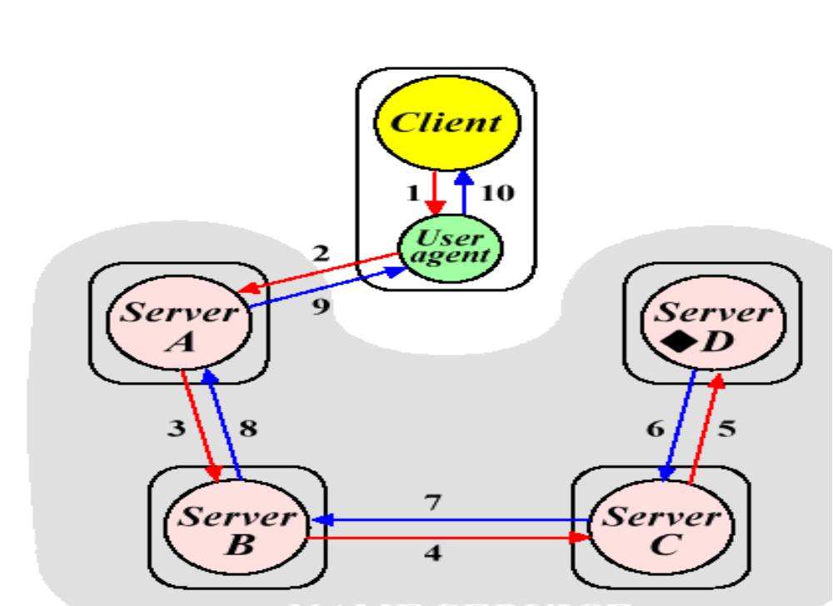
Interaction with Name Servers During Name Resolution
Recursive

Slide 92
Interaction with Name Servers During Name Resolution
Iterative
  Name servers do not call each other
  Name agent controls the resolution process
  Name agent calls each of the name servers involved in the resolution one by one
  The name agent first sends the name to be resolved to the name server that stores the first context required to start the resolution of the given name

Slide 93
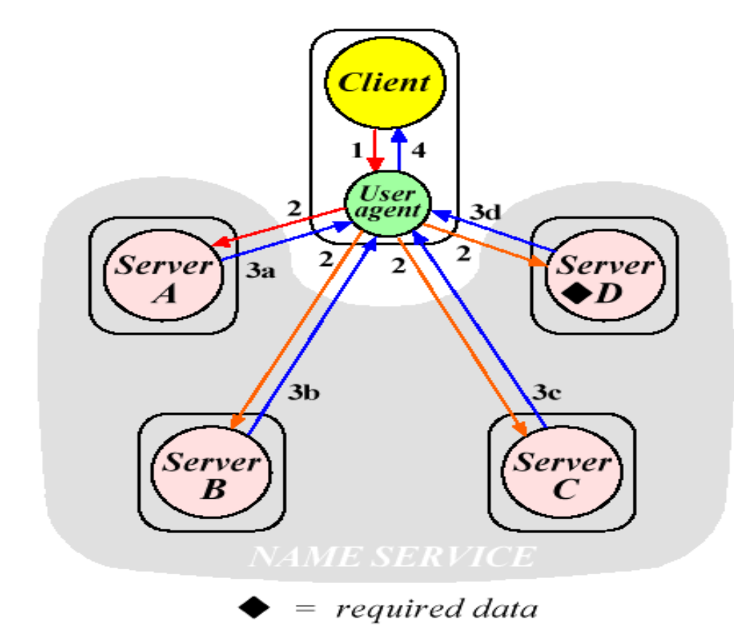
Interaction with Name Servers During Name Resolution
Iterative

Slide 94
Interaction with Name Servers During Name Resolution
Transitive
  The name agent first sends the resolution request to the name server that stores the first context needed to start the resolution process
  The server resolves as many components of the name as possible.
  It then passes on the unresolved portion of the name to the name server that stores the next context needed to proceed with the resolution process

Slide 95
Interaction with Name Servers During Name Resolution
Transitive
  This name server resolves as many components of the name as possible and then passes on the unresolved portion of the name to the next name server
  The process continues and the name server that encounters the authority attribute of the named object returns it directly to the name agent

Slide 96
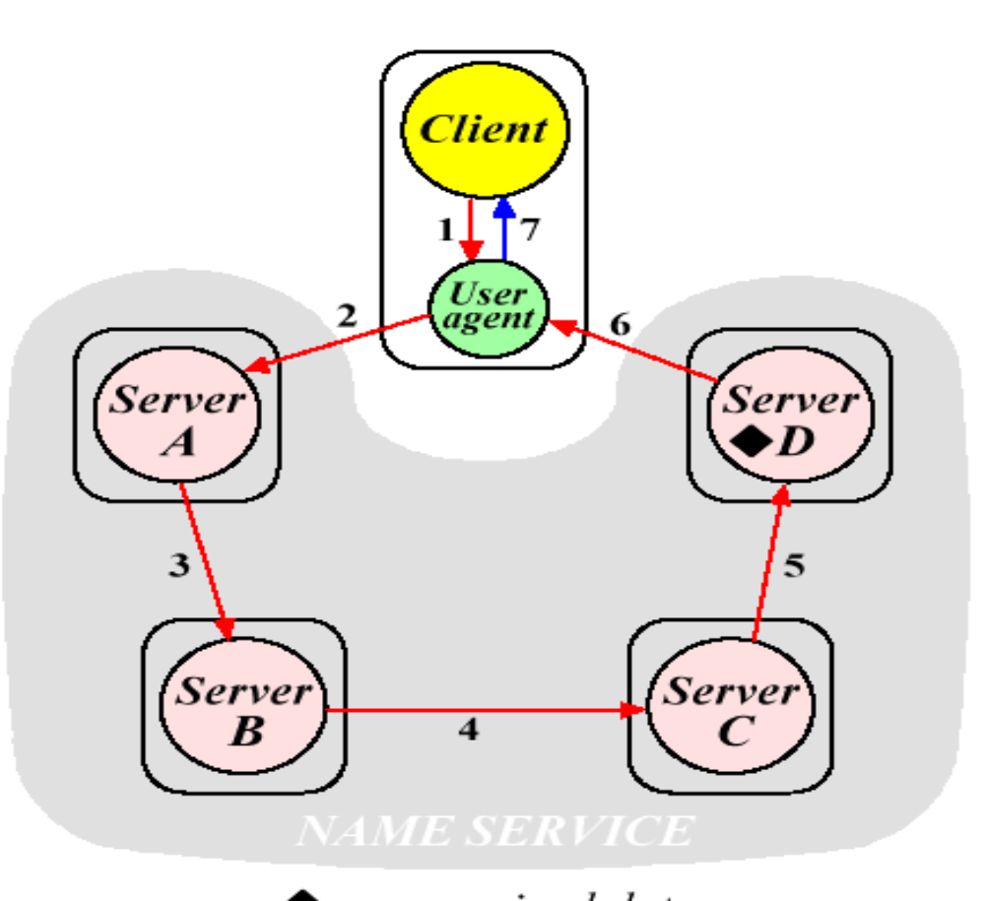
Interaction with Name Servers During Name Resolution
Transitive

Slide 97
Name Caches
Caching is an important technique for building responsive, scalable distributed systems
Recently used names and their addresses can be kept in a cache to reduce the need for name resolution
Caching is successful because naming data are changed relatively rarely
Caching provides high performance of the name service and assists in maintaining the availability of the name service after name server crashes

Slide 98
Name Caches
Characteristics of name service
  High degree of locality of name lookup
  Slow update of name information database
  On-use consistency of cached information is possible
Types of name caches
  Directory cache : Each entry consists of a directory page. All recently used directory pages that are brought to the client node are cached. Normally used in iterative method of name resolution
  Prefix cache : Each entry consists of name prefix and zone identifier. Used in zone based context distribution mechanism

Slide 99
Name Caches
  Full-name cache : Each entry consists of an object’s full path name and the identifier and location of its authoritative name server. Can be used with any naming mechanism
Approaches for name cache implementation
  2 commonly used approaches are:
    A cache per process
      A separate name cache is maintained for each process
    A single cache for all process of a node
      A single name cache is maintained at each node for all the processes of that node

Slide 100
Multicache Consistency
When a naming data update occurs, related name cache entries become stale and must be invalidated or updated properly
2 commonly used methods for multicast consistency of name caches are
  Immediate Invalidate
  On-use update

Slide 101
Multicache Consistency
Immediate Invalidate
  All related name cache entries are immediately invalidated when a naming data update occurs
  2 ways of doing this
    Whenever a naming data update operation is performed, an invalidate message identifying the data to be invalidated is broadcast to all nodes in the system
    The storage node of naming data keeps a list of nodes against each data that corresponds to the nodes on which the data is cached.
      Only the nodes in the corresponding list are notified to invalidate their corresponding cache entry
      Avoid use of broadcast protocol

Slide 102
Multicache Consistency
On-use Update
  Commonly used method for maintaining name cache consistency
  No attempt is made to invalidate all related cache entries when a naming data update occurs
  When a client uses a stale cached data, it is informed by the naming system that the data being used is either incorrectly specified or stale
  On receiving a negative reply, necessary steps are taken (broadcasting or multicasting) to obtain the updated data

Slide 103
Naming and Security
3 basic naming-related access control mechanisms are:
  Objects names as protection keys
  Capabilities
  Associating protection with name resolution path
Objects names as protection keys
  An object’s name acts as a protection key for the object
  User who knows the name of the object can access the object by using its name
  Any keys can be used to access the objects with multiple names
  In systems using this method, users are not allowed by the system to define a name for an object that they are not authorized to access

Slide 104
Naming and Security
Objects names as protection keys
  This scheme is based on the assumption that, there is no way for a user to obtain the names of other user objects and the names cannot be guessed easily
  Drawbacks :
    Doest not guarantee a reliable access control mechanism
      Since in practice object names are generally picked to be mnemonic, they may be guessed easily
    Doest not provide the flexibility of specifying the modes of access control
      User having name for an object has all types of possible access rights for that object

Slide 105
Naming and Security
Capabilities
  Extension of Object names and protection keys scheme that overcomes its limitations
  Capability is a special type of object identifier that contains additional information redundancy for protection
  May be considered as unforgeable ticket that allows its holders to access the object in one or more permission modes
Object identifier Rights information
Two basic parts of capability

Slide 106
Naming and Security
Capabilities
  Capabilities are object names having following properties:
    A capability is a system-oriented name that uniquely identifies an object
    It is also used to protect the object it references by defining operations that may be performed on the object it identifies
    A client that possesses a capability can access the objects by it in the modes allowed by it
    There are several capabilities for each object
    All clients that have capabilities to a given object can share this object

Slide 107
Naming and Security
Associating protection with name resolution path
  Protection can be associated either with an object or with name resolution path of the name to identify the object
  The more common scheme provides protection on the name resolution path
  Systems using this approach, employs access control list (ACL) based protection, which controls access dependent on the identity of the user
  In addition to object identifier, another trusted identifier representing the accessing principal (entity with which access rights are associated) is needed for ACL

Slide 108
Naming and Security
Associating protection with name resolution path
  ACL is associated with an object and specifies the user name and types of access allowed for each user of that object.
  When user requests to an object, the OS checks the ACL associated with that object
  If that user is listed for the requested access, the access is allowed else protection violation occurs and user job is denied access to the object
  Associating ACL with each context of the name space, access can be controlled to both the named objects and the information in the naming database

Slide 109
End of Chapter

