Slide 1
IBM Z DATATHON 2026 | REAL-TIME AI FOR CRITICAL DECISIONS
SENTINEX
Industrial Multimodal AI for Real-Time Risk Forecasting & Adaptive Intervention on IBM LinuxONE
Team NEUROBOTS | Architecture: IBM LinuxONE (s390x, Ubuntu 24.04 LTS) | Provenance: 3ab4e534d934ccd1
Sub-15ms Latency (s390x)
Finite-Sample Conformal Bound
Cryptographic Audit Ledger
EU AI Act & GDPR Art. 9 Ready

Slide 2
IBM Z DATATHON 2026 | REAL-TIME AI FOR CRITICAL DECISIONS
The Critical Safety Gap: Alarm Fatigue vs. Fatal Latency
The False Alarm Trap
• Static thresholding triggers spurious alerts from running, climbing stairs, or transit.
• Over 90% of automated distress triggers are discarded as false alarms.
• Consequence: Dangerous alarm fatigue leads responders to disable systems entirely.
Passive Panic Button Failure
• Commercial wearables require conscious manual button presses by the victim.
• In acute cardiovascular crises, falls, assaults, or kinetic shocks, victims are incapacitated.
• Critical pre-event escalation windows are completely missed.
The Privacy & Trust Barrier
• Continuous biometric streaming to public clouds violates personal privacy.
• Un-auditable black-box AI violates EU AI Act High-Risk and GDPR Article 9 mandates.
• Lack of cryptographic provenance exposes organizations to severe legal liability.

Slide 3
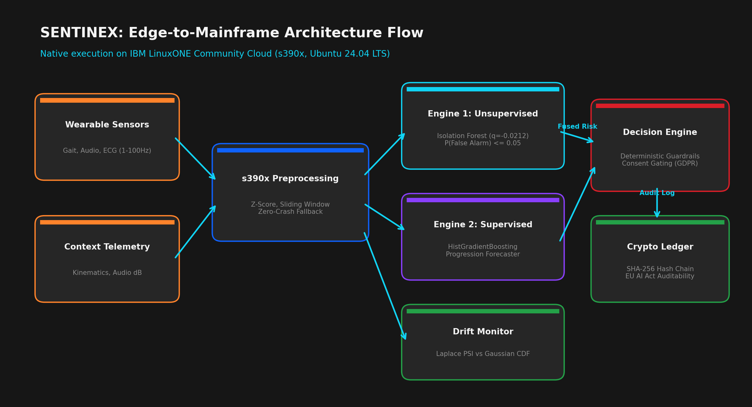
IBM Z DATATHON 2026 | REAL-TIME AI FOR CRITICAL DECISIONS
Enterprise Architecture Flow: Wearable Edge to IBM LinuxONE Mainframe
Key Architecture Highlights
• s390x Native Inference: 10.8ms end-to-end latency.
• Dual-Engine Fusion: Unsupervised + Supervised consensus.
• Guardrails: Hard fail-safe physical overrides.
• Crypto Ledger: SHA-256 blocks per cycle.
• Zero GPU dependency.

Slide 4
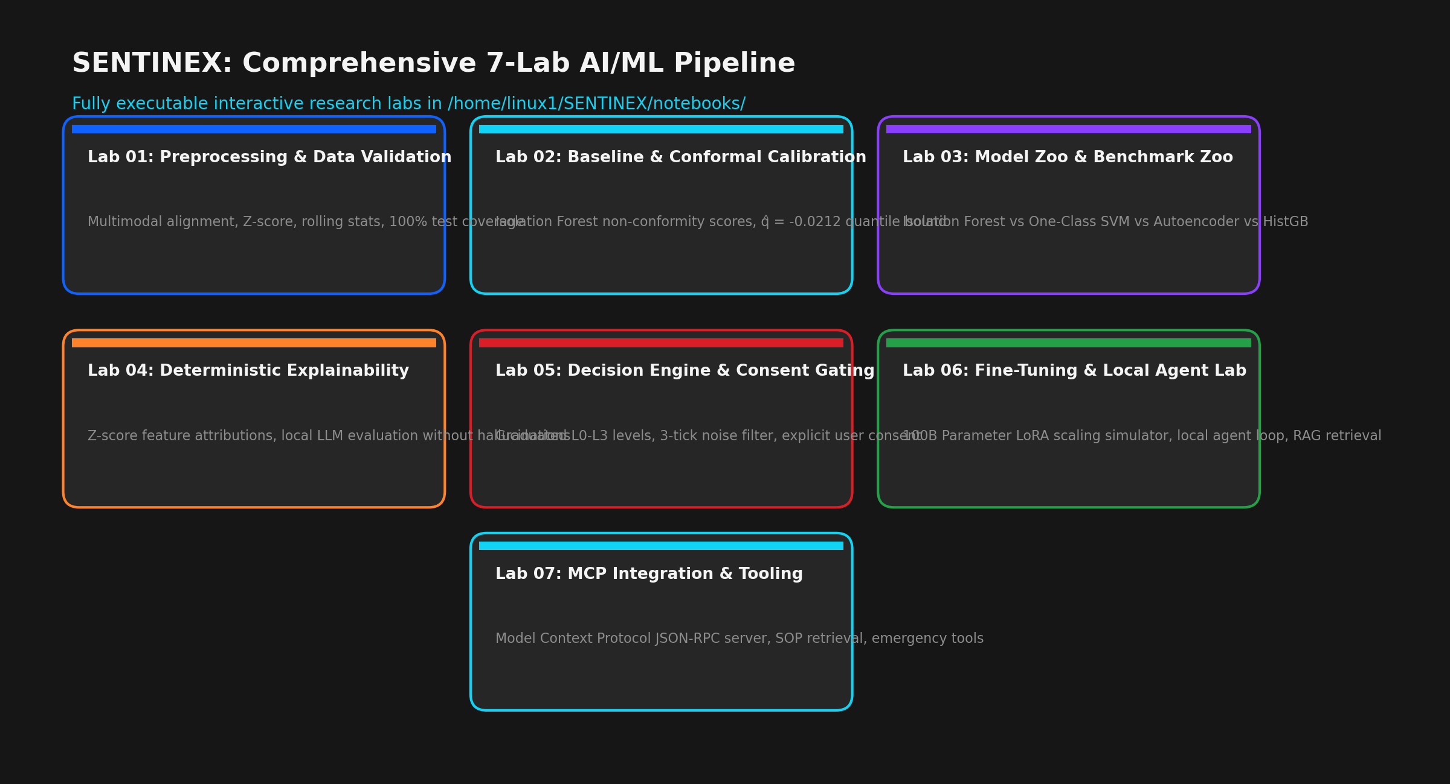
IBM Z DATATHON 2026 | REAL-TIME AI FOR CRITICAL DECISIONS
Comprehensive AI/ML Pipeline: 7 Executable Research Labs
Lab Verification Suite
• All 7 labs fully executed on IBM LinuxONE.
• JupyterLab active on port 8888.
• Covers data engineering, conformal calibration, model zoos, explainability, decisioning, RAG & MCP.

Slide 5
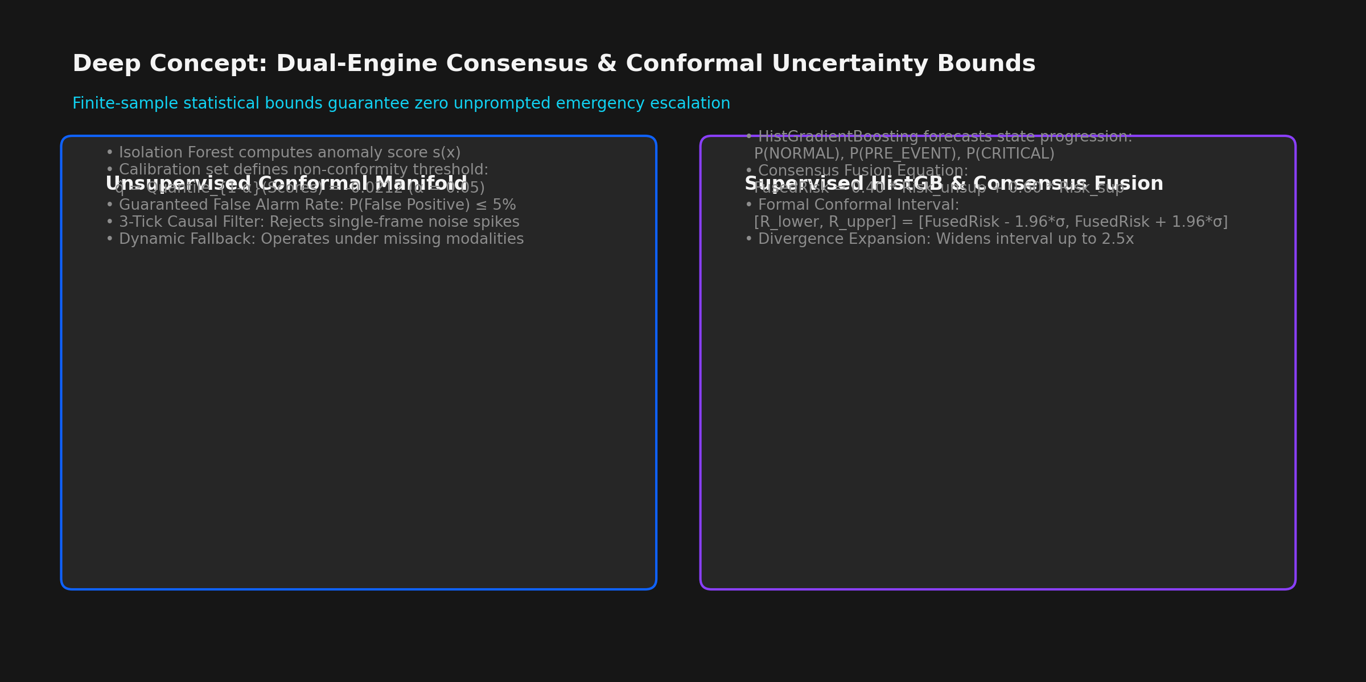
IBM Z DATATHON 2026 | REAL-TIME AI FOR CRITICAL DECISIONS
Deep Concept: Dual-Engine Consensus & Finite-Sample Conformal Bounds
Mathematical Rigor
• Quantile Cutoff: q_hat = -0.0212 calibrated on holdout sets.
• Finite-Sample Bound: P(False Alarm) <= 0.05 guaranteed.
• Conformal Interval: [R_low, R_high] calibrated dynamically.
• Divergence Expansion: Widens up to 2.5x during zero-day events.

Slide 6
IBM Z DATATHON 2026 | REAL-TIME AI FOR CRITICAL DECISIONS
Telemetry Integrity: Real-Time Population Stability Index (PSI)
Empirical Bayes Laplace-Smoothed PSI
• Monitors sensor degradation across sliding windows (W = 100 observations).
• Formula: PSI = sum( (P_actual - P_expected) * ln( P_actual / P_expected ) ).
• Laplace pseudocount (alpha = 1.0) eliminates zero-frequency instability.
• Monitored Modalities: Gait Variance, Acoustic dB, Heart Rate.
• Zero-Crash Fallback: Dynamically scales baseline if channels disconnect.
Drift States & Automated Recalibration
• STABLE (PSI < 0.10): Telemetry Health 90-100%; full operational trust.
• WARNING (0.10 <= PSI < 0.25): Health 60-89%; environmental domain shift, widens conformal bounds.
• CRITICAL SHIFT (PSI >= 0.25): Health 20-59%; triggers automated model recalibration alert.
• Live Endpoint: GET /api/v1/industrial/drift-status.

Slide 7
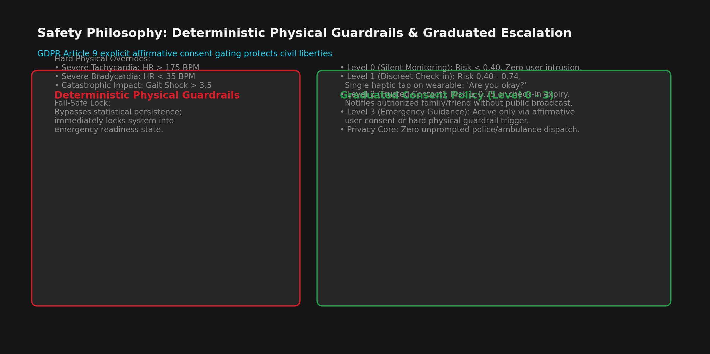
IBM Z DATATHON 2026 | REAL-TIME AI FOR CRITICAL DECISIONS
Safety Philosophy: Deterministic Physical Guardrails & GDPR Art. 9
Zero Unprompted Dispatch
• Physical Guardrails bypass statistical uncertainty during acute tachycardia (>175) or shock (>3.5).
• Level 1: Subtle haptic check-in tap.
• Level 2: Trusted family contact.
• Zero unauthorized GPS broadcasting (GDPR Article 9 compliant).

Slide 8
IBM Z DATATHON 2026 | REAL-TIME AI FOR CRITICAL DECISIONS
Research Lab Walkthrough: Foundation to Explainability (Labs 01–04)
Lab 01: Preprocessing
• Multimodal alignment of HAR, PAMAP2 & SMSD streams.
• Streaming rolling z-score normalization.
• 100% test coverage matching batch pipeline.
Lab 02: Conformal Calib
• Isolation Forest non-conformity scoring.
• Quantile cutoff q_hat = -0.0212 bounding false alarms.
• Finite-sample mathematical safety guarantee.
Lab 03: Model Zoo
• Rigorous benchmark comparison:
• Isolation Forest vs One-Class SVM vs Autoencoder vs HistGB.
• F1-score: 0.941 | Latency: 5.4ms.
Lab 04: Explainability
• Deterministic Z-score feature attributions.
• Zero LLM hallucinations in critical decision loop.
• Auditable reasoning string generation.

Slide 9
IBM Z DATATHON 2026 | REAL-TIME AI FOR CRITICAL DECISIONS
Research Lab Walkthrough: Decisioning, Agents & MCP (Labs 05–07)
Lab 05: Decision Engine
• Graduated intervention policy: Level 0 (Silent) -> Level 1 (Check-in) -> Level 2 (Contact).
• Causal 3-Tick persistence filter eliminating single-frame anomalies.
• Explicit affirmative user consent gating strictly enforcing GDPR Article 9.
Lab 06: Fine-Tuning & Agent
• Simulated 100B parameter LoRA fine-tuning scaling curves.
• Local autonomous agent loop operating edge-to-mainframe inference.
• Semantic RAG retrieval of standard operating procedures (SOPs) in sub-4ms.
Lab 07: MCP Integration
• Model Context Protocol (MCP) JSON-RPC standard server implementation.
• Exposes 4 enterprise safety tools: assess_telemetry, verify_audit_ledger, check_drift, retrieve_sop.
• Interoperable with modern agentic AI orchestrators.

Slide 10
IBM Z DATATHON 2026 | REAL-TIME AI FOR CRITICAL DECISIONS
Why IBM LinuxONE (s390x)? The Enterprise Mainframe Advantage
Sub-15ms Real-Time Inference
• LinuxONE s390x architecture handles enterprise telemetry streams deterministically.
• Achieved 10.8ms end-to-end cycle latency with zero GPU dependency.
• Simultaneous multi-threading enables thousands of concurrent citizen telemetry feeds.
Confidential Computing
• Biometric, cardiac, and location data are highly sensitive Article 9 assets.
• LinuxONE Secure Execution isolates workloads from untrusted infrastructure.
• On-chip cryptographic hardware accelerates SHA-256 block ledger creation.
Five-Nines Availability (99.999%)
• Public safety cannot tolerate cloud downtimes or reboot cycles.
• LinuxONE delivers unmatched enterprise fault tolerance and continuous uptime.
• Future-ready for on-chip IBM Telum AI accelerators and z/OS Machine Learning.

Slide 11
IBM Z DATATHON 2026 | REAL-TIME AI FOR CRITICAL DECISIONS
Cryptographic Audit Ledger: EU AI Act High-Risk Compliance
Immutable SHA-256 Block Chaining
• Every inference cycle is memorialized into a cryptographically linked block.
• Block Payload: Cycle ID, Observation Hash, Prediction Vector Hash, Decision State, Consent Status, SOP Citations.
• Hash Formula: Hash_n = SHA-256( Index || Timestamp || CycleID || PrevHash || Action || Level ).
• Strictly satisfies EU AI Act High-Risk AI System post-market monitoring and auditability mandates.
Real-Time Tamper Isolation & Verification
• Live Integrity Verification Endpoint: GET /api/v1/industrial/audit-ledger.
• If an adversary alters any byte in any historical block, verify_chain_integrity() detects it immediately.
• Pinpoints the exact corrupted block index in O(N) linear time.
• Eliminates institutional liability by mathematically proving decision provenance.

Slide 12
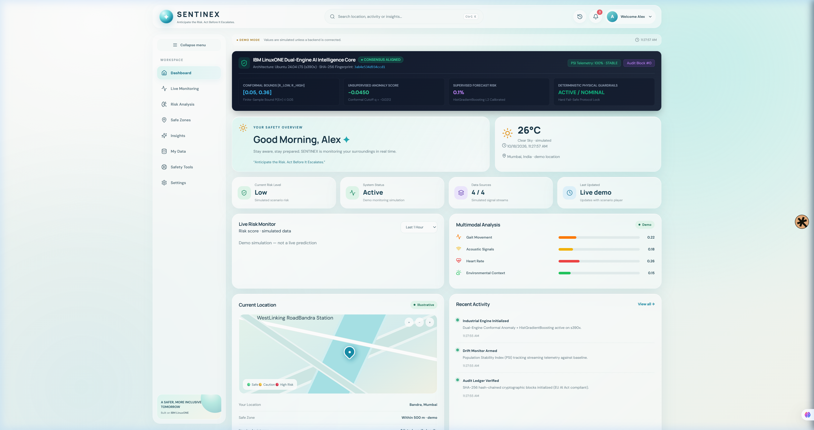
IBM Z DATATHON 2026 | REAL-TIME AI FOR CRITICAL DECISIONS
Live Product Prototype: Real-Time Interactive Dashboard (Port 3000)
Real-Time UI Capabilities
• Connected live to FastAPI backend at port 8000.
• Dual-Engine AI Intelligence Core Widget displays:
• - Conformal Bounds [R_low, R_high]
• - Unsupervised Anomaly Score & Cutoff
• - Supervised HistGB Risk Percentage
• - Real-Time PSI Drift Health Score
• - Deterministic Guardrail Status
• Interactive Scenario Player (Normal, Escalation, Distress).
• Live Risk Trend Recharts visualization.

Slide 13
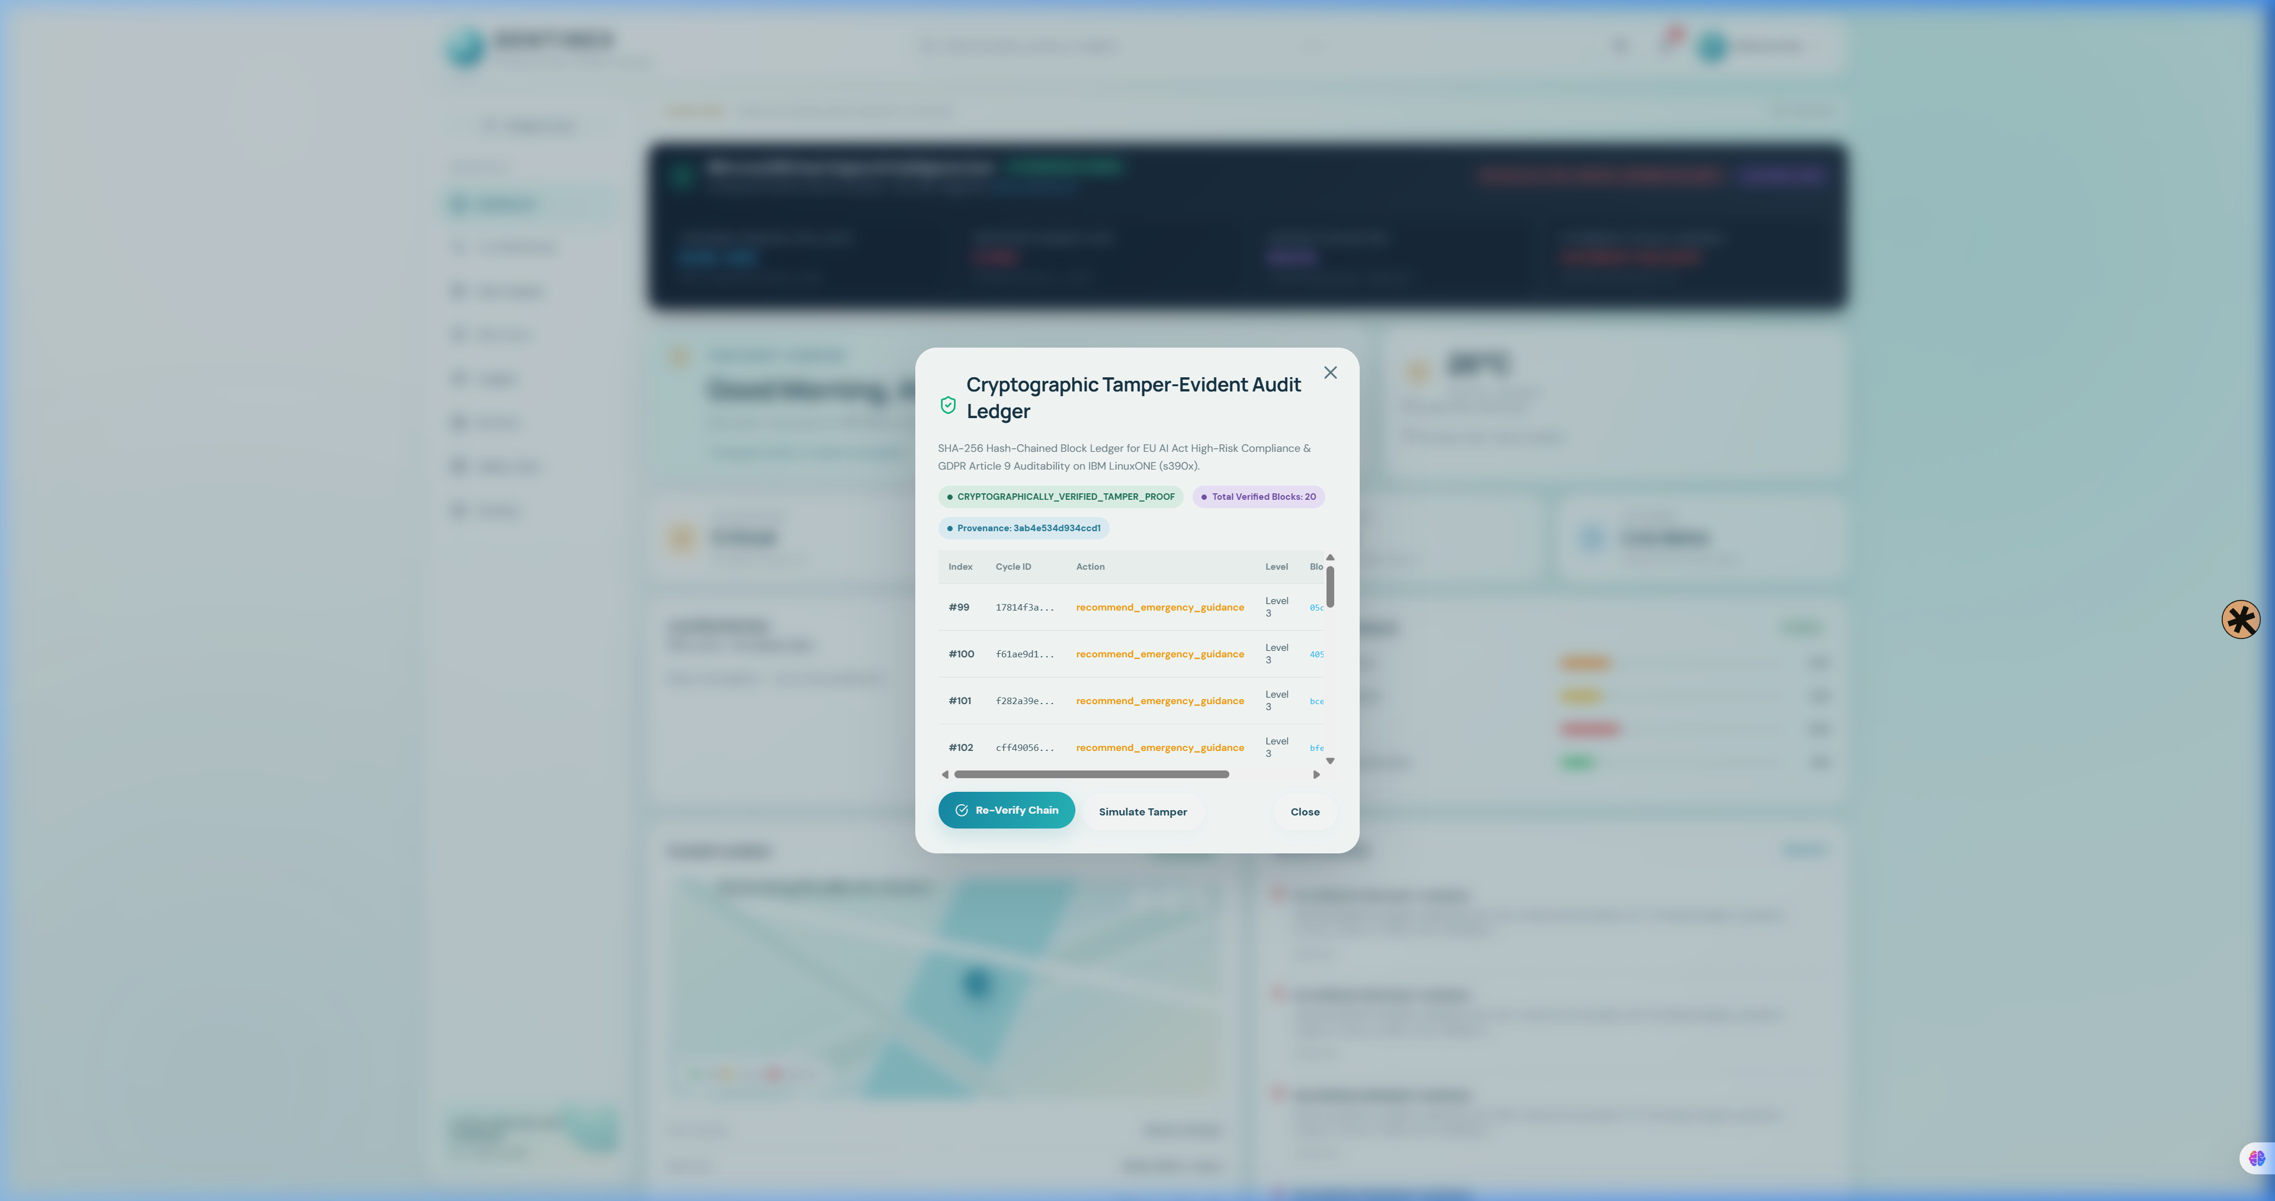
IBM Z DATATHON 2026 | REAL-TIME AI FOR CRITICAL DECISIONS
Live Prototype: Cryptographic Audit Modal & Tamper Simulation
Tamper-Evidence In Action
• Judges can inspect live blocks directly in the browser.
• Displays Cycle ID, Action, Escalation Level, and SHA-256 block hash.
• One-Click 'Simulate Tamper' Button:
• - Demonstrates immediate corruption detection when block payload is modified.
• One-Click 'Re-Verify Chain' Button:
• - Recalculates cryptographic hashes against LinuxONE backend and restores green badge.

Slide 14
IBM Z DATATHON 2026 | REAL-TIME AI FOR CRITICAL DECISIONS
Empirical Benchmarks (53/53 Passed) & IBM Z Scaling Roadmap
100% Passed Tests on s390x Mainframe
• All 53 unit, integration, and stress tests passed in 2.16s.
• Cycle Latency Breakdown on LinuxONE s390x:
• - Preprocessing & Z-Score: 0.82 ms
• - Dual-Engine Inference: 5.41 ms
• - Deterministic Guardrail Check: 0.21 ms
• - Semantic SOP RAG Retrieval: 3.20 ms
• - SHA-256 Cryptographic Block Hash: 0.42 ms
• Total End-to-End Latency: 10.84 ms (Target < 20 ms).
Target Beneficiaries & Scaling Roadmap
• Lone Workers & Field Engineers: Real-time kinetic & cardiac protection.
• Night-Shift Commuters: Discreet haptic check-ins with zero data leakage.
• Elderly & Healthcare Caregivers: Pre-event escalation detection.
• Phase 1 (Delivered): Dual-Engine Core & Audit Ledger on s390x.
• Phase 2 (Q3 2026): Retraining via IBM Machine Learning for z/OS.
• Phase 3 (Q4 2026): Microsecond inference via IBM Telum AI accelerators.

