Slide 1
Capstone Project
BANK MARKETING EFFECTIVENESS PREDICTION
SHREYAS HINGMIRE

Slide 2
INDEX
Problem Statement
Data Summary
Exploratory Data Analysis
Outlier Detection
Data- Preprocessing
Applying and comparing accuracy of different Machine Learning Models
Applying Xgboost and increasing its accuracy
Conclusion

Slide 3
PROBLEM STATEMENT
A Portuguese banking institution does direct marketing campaigns via phone calls.
They may call a particular customer more then once to check if they have subscribed to bank term deposit or not.
Our job was to predict if the customer will subscribe to term deposit or not based on customer information.

Slide 4
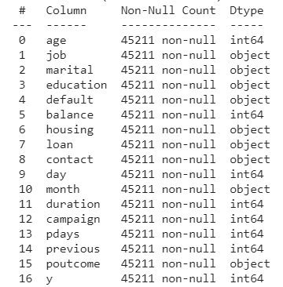
DATA SUMMARY
Dataset consists of 17 columns
and 45211 rows.
Dataset dosen’t consist of any null values.
Imbalance dataset.
11.7% took term deposit.
88.3% didn’t took

Slide 5
EXPLORATORY DATA ANALYSIS

Slide 6
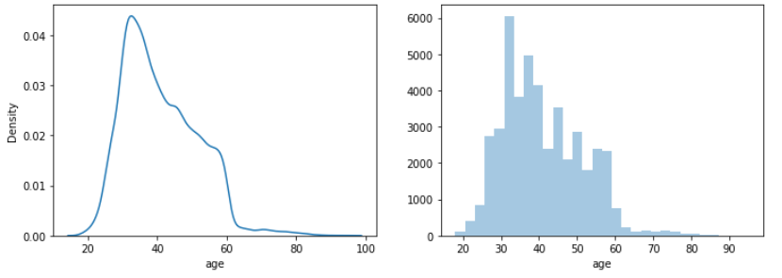
Distribution of Age of Customers

Slide 7
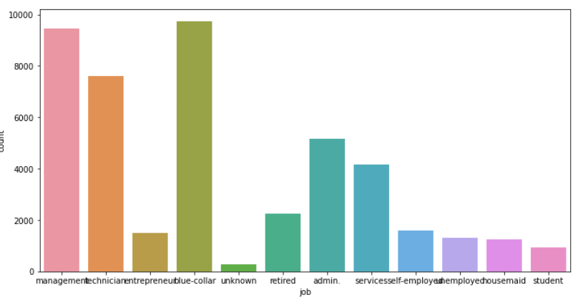
Analysis based on job-type

Slide 8
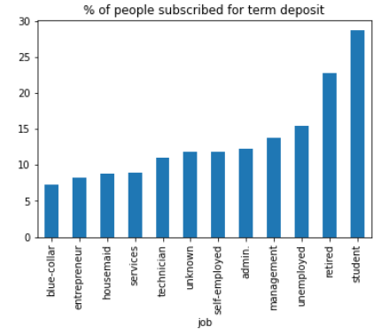
Analysis based on job-type

Slide 9
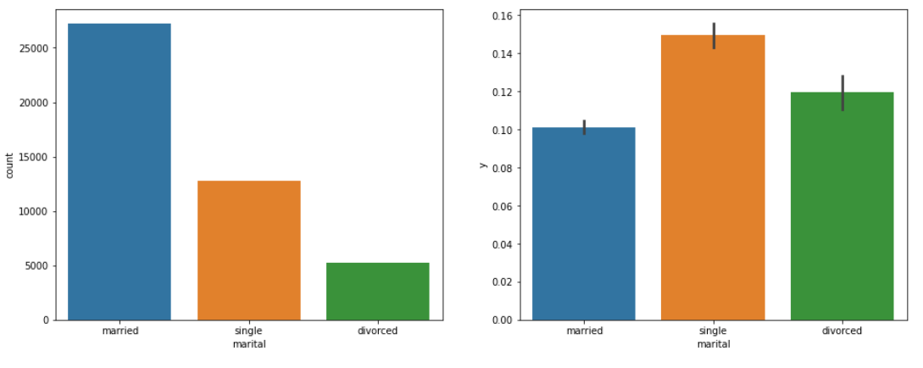
Analysis based on Marital

Slide 10
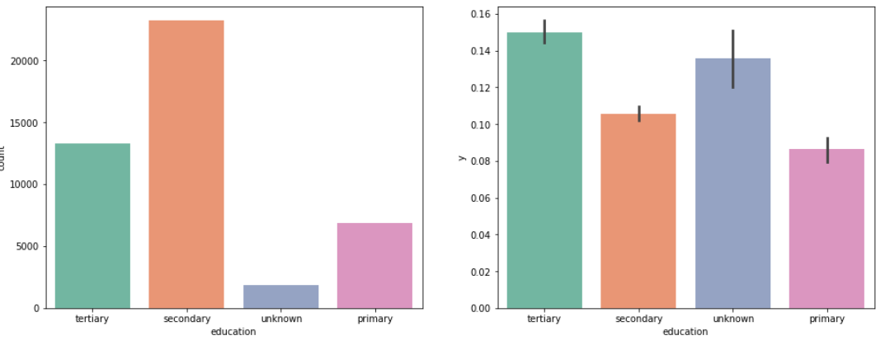
Analysis based on Education

Slide 11
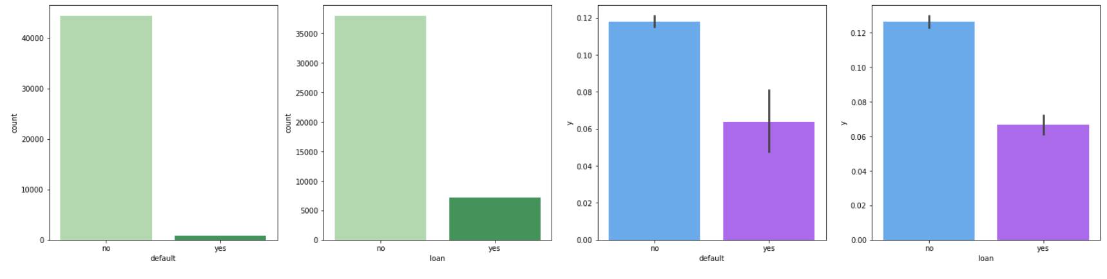
Analysis based on Credit default, Personal Loan

Slide 12
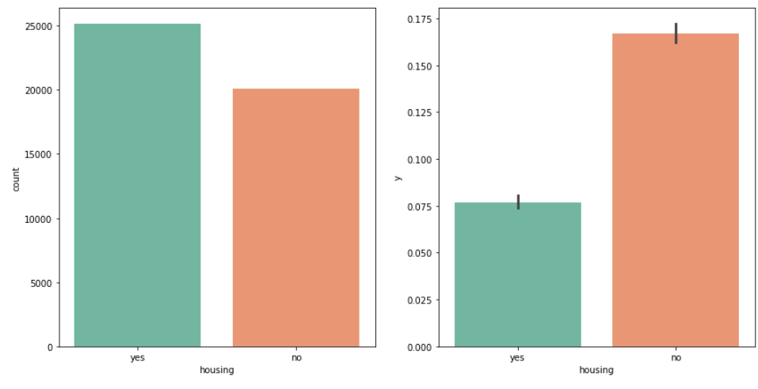
Analysis based on Housing Loan

Slide 13
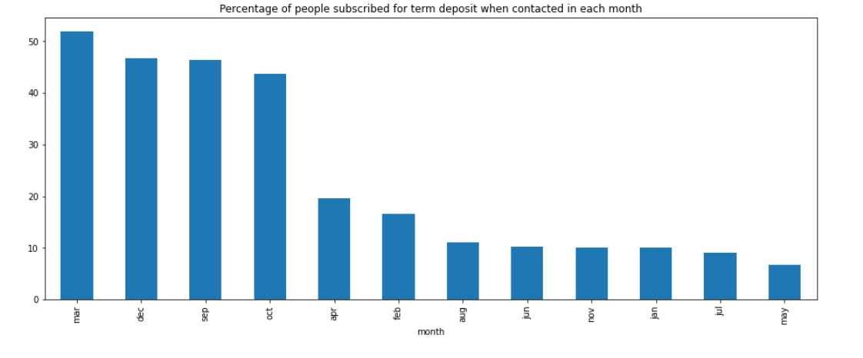
Analysis based on month

Slide 14
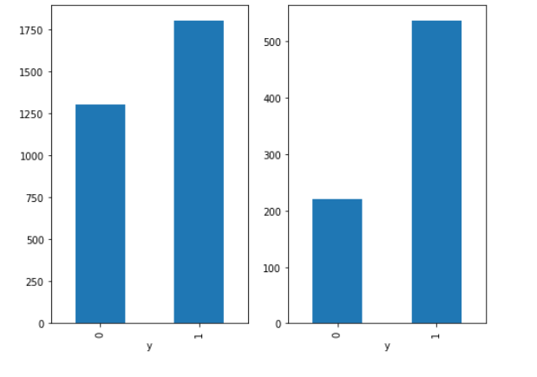
Analysis based on Balance and Duration

Slide 15
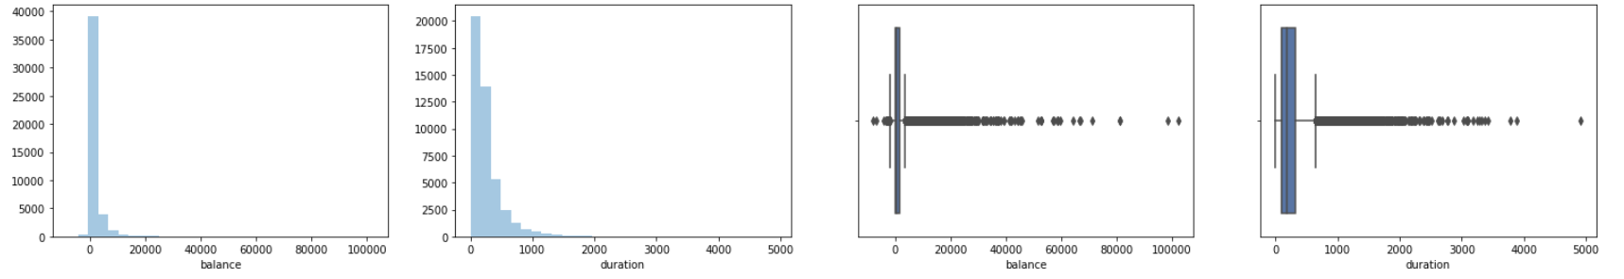
Outlier Detection
We remove outlier for
balance and duration
with the help of IQR.

Slide 16
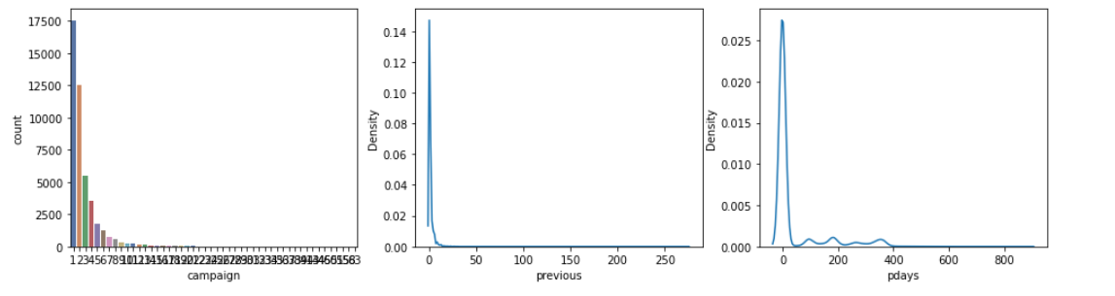
Outlier Detection

Slide 17
Data Preprocessing
There was no multi-collinearity between numerical variables and all of them had VIF of less then 10.
Onehotencoding and labelencoding was applied on categorical variables.
Standard Scaler was applied on dataset.
Month column was removed as it didn’t contributed much in prediction.

Slide 18
APPLYING MACHINE LEARNING MODEL TO PREDICT WEATHER CUSTOMER WILL TAKE TERM DEPOSIT OR NOT.

Slide 19
Comparing Accuracy of different Algorithms
Algorithm | Training Score | Test Score | Roc-Auc Score
Decision Tree | 90.5% | 90.9% | 86.1%
Xgboost | 91.5% | 91.5% | 91%
Random Forest | 91.3% | 91.3% | 90.3%
Logistic Reg | 91% | 91.5% | 89.6%
KNN | 91.7% | 90.8% | 79.5%
Naive Bayes | 91.7% | 90.8% | 80.4%
SVM | 91.7% | 90.8% | 80.4%

Slide 20
Applying Xgboost and increasing accuracy
Xgboost was selected as it gave maximum test accuracy and maximum roc-auc score.
But its F1 score was just 41% since the dataset is imbalance.
To tackle this problem we apply SMOTE to dataset to balance it and then apply Xgboost algorithm.
After that we apply hyperparameter tuning to find optimal set of parameters which could further increase the accuracy.

Slide 21
 | Xgboost | Xgboost after applying SMOTE | Xgboost after SMOTE, hyperparameter tuning
Training Score | 91.5% | 94.5% | 96.1%
Test Score | 91.5% | 94.2% | 94.9%
Roc- Auc Score | 91% | 98.7% | 98.9%
F1 Score | 41% | 94% | 95%

Slide 22
CONCLUSION
XGBOOST Model gave the best roc-auc score of 98.9% and F1 score of 95%.
Ideal parameters for the model were - 'alpha': 8, 'learning_rate': 0.5, 'max_depth': 7, 'n_estimators': 20.

Slide 23
THANKYOU

