Slide 1
Capstone Project
CUSTOMER SEGMANTATION
SHREYAS HINGMIRE

Slide 2
INDEX
Problem Statement
Data Summary
Handling Missing values
Exploratory Data Analysis
RFM Model
Analysis and Relationship of RFM Model
K-Means CLustering- (Silhouette and Elbow method)
K= 2 & k=4
Conclusion

Slide 3
PROBLEM STATEMENT
In this project we had to identify major customer segments on a transnational data set which contains all the transactions occurring between 01/12/2010 and 09/12/2011 for a UK-based and registered non-store online retail.
The company mainly sells unique all-occasion gifts. Many customers of the company are wholesalers.
Customer segments or cluster will be useful for company to find out which customers are profitable , which customers need marketing or which customers need to be given offers etc so that their sales or orders can increase in future.

Slide 4
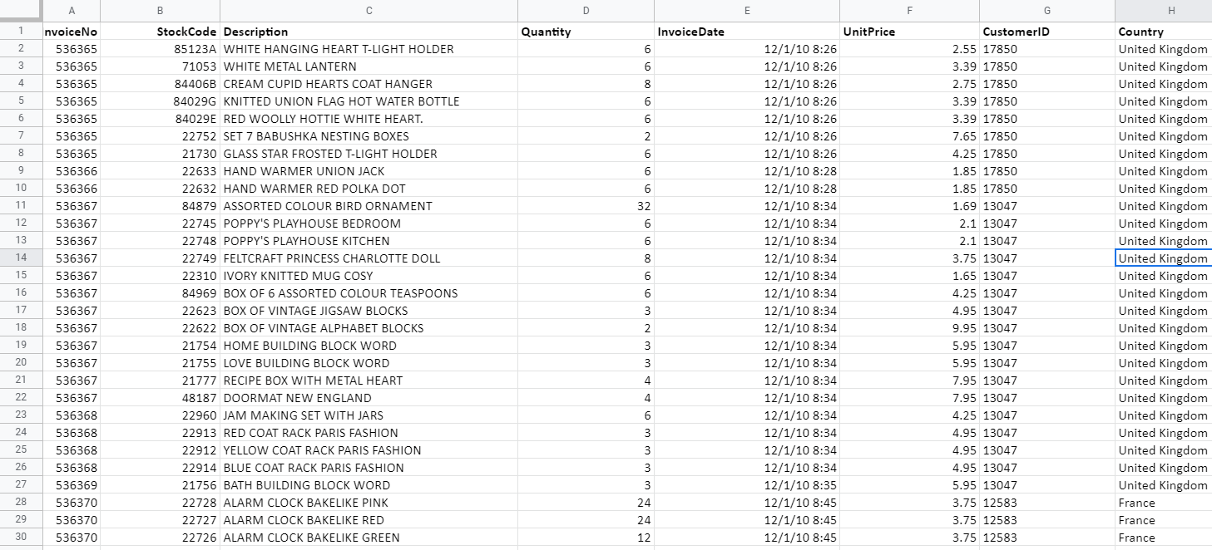
DATA SUMMARY
541909 rows
8 columns

Slide 5
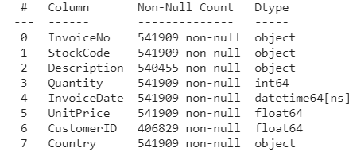
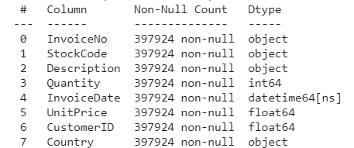
HANDLING MISSING VALUES
All null values were removed.
All cancelled orders were removed.

Slide 6
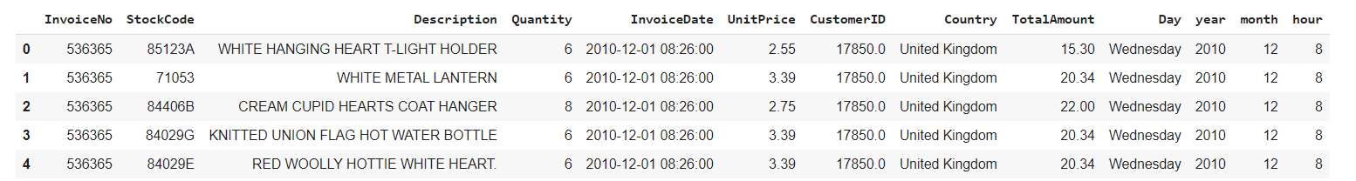
ADDING NEW COLUMNS
From the invoice column : day of week , month , year and hour of purchase was derived
Total amount for an order was derived by multiplying Quantity with Unit price.

Slide 7
EXPLORATORY DATA ANALYSIS

Slide 8
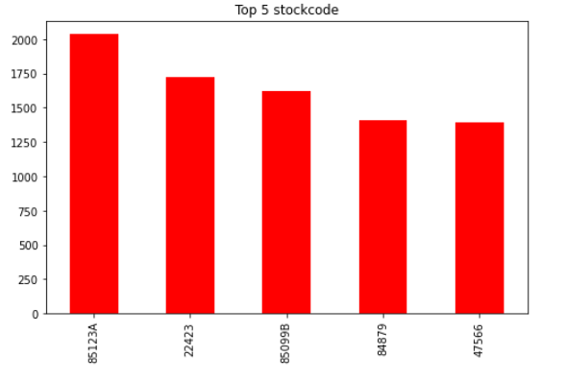
ANALYSIS BASED ON STOCKCODE

Slide 9
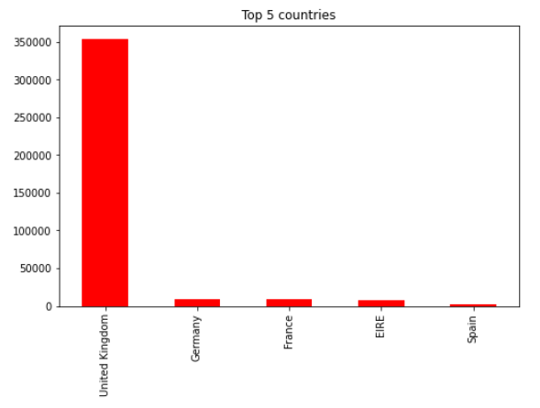
ANALYSIS BASED ON COUNTRY
88% of the rows are from UK.

Slide 10
ANALYSIS BASED ON COUNTRY
88% of the rows are from UK.

Slide 11
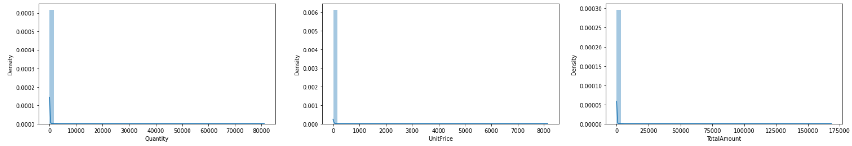
Analysis based on Quantity ,Unitprice & TotalAmount

Slide 12
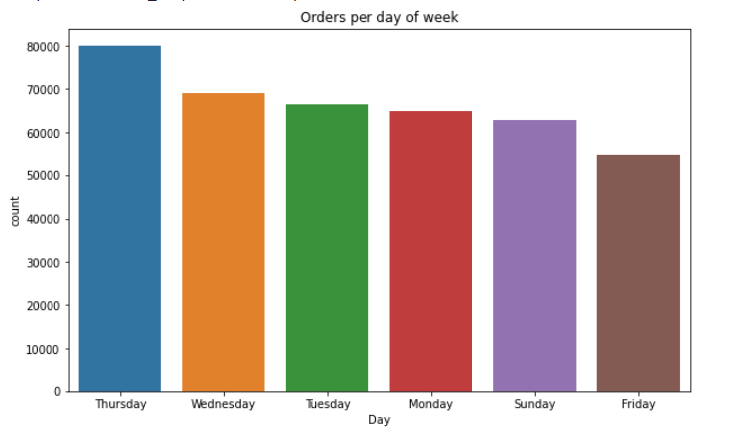
ANALYSIS BASED ON DAY

Slide 13
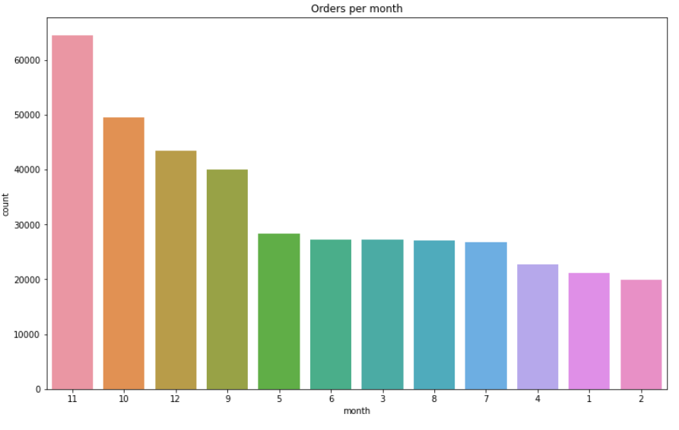
ANALYSIS BASED ON MONTH

Slide 14
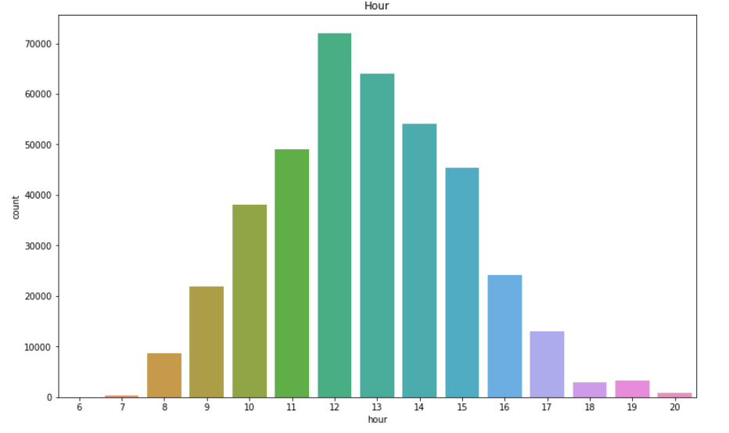
ANALYSIS BASED ON HOUR

Slide 15
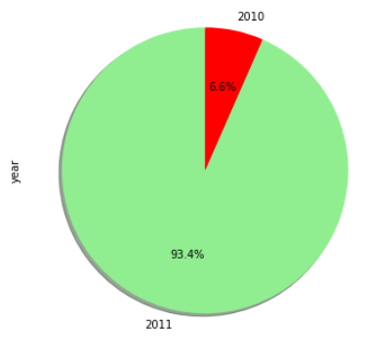
ANALYSIS BASED ON YEAR

Slide 16
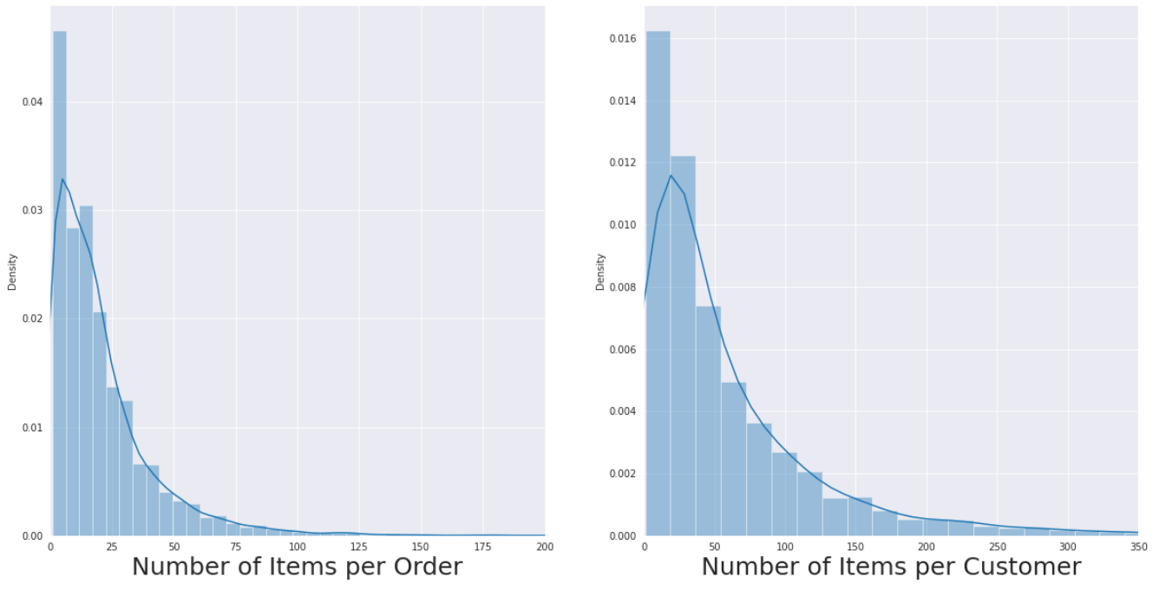

Slide 17
RFM MODEL
Recency, frequency, monetary value is a marketing analysis tool used to identify a company's or an organization's best customers by using certain measures.
Recency - calculated as the difference between the most recent transaction carried out by customer and the most recent transaction date in dataset.
Frequency - frequency of transactions for each customer.
Monetary - total money a customer pays in all the orders he has placed.

Slide 18
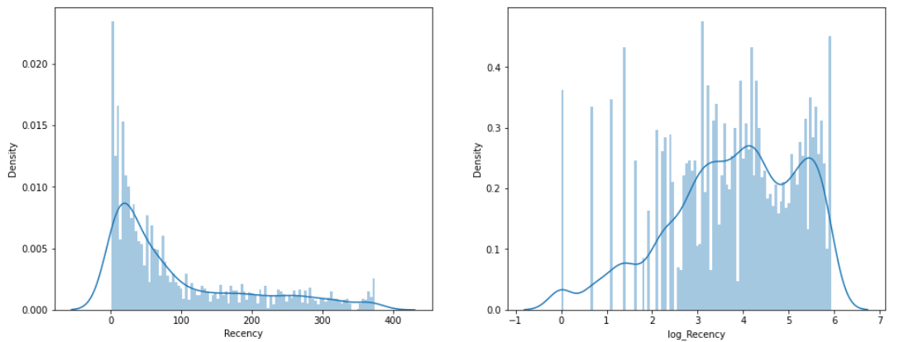
ANALYSIS OF RECENCY
Log transformation was applied on RFM values so that they are scaled.

Slide 19
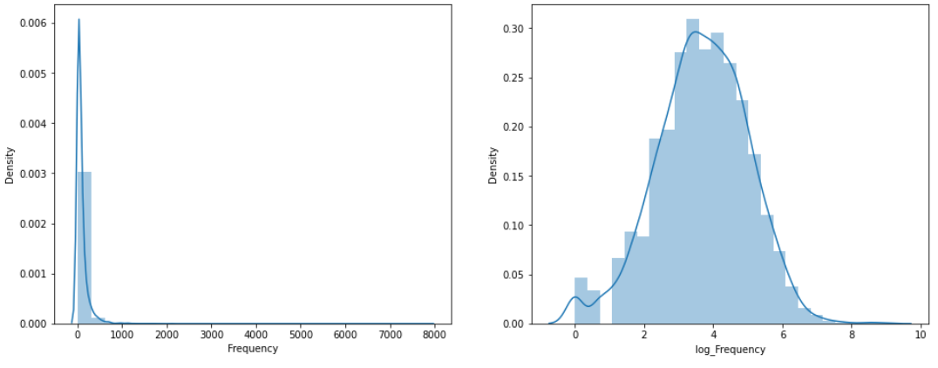
ANALYSIS OF FREQUENCY

Slide 20
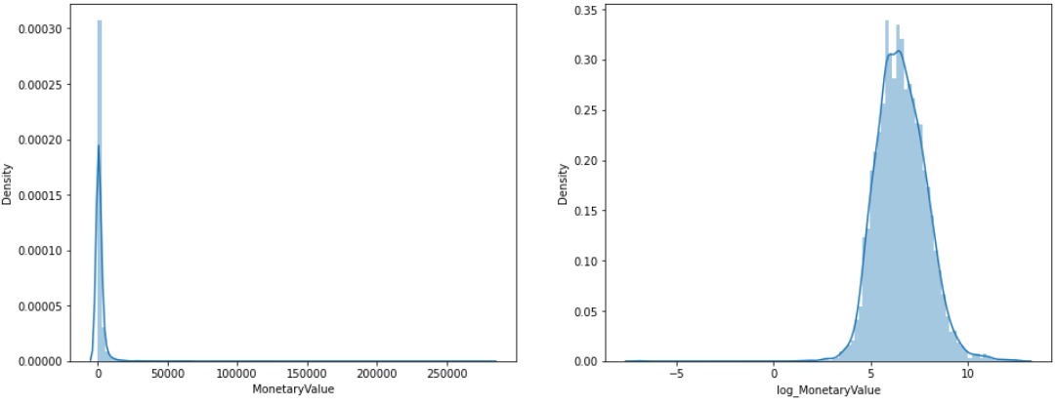
ANALYSIS OF MONETARY VALUE

Slide 21
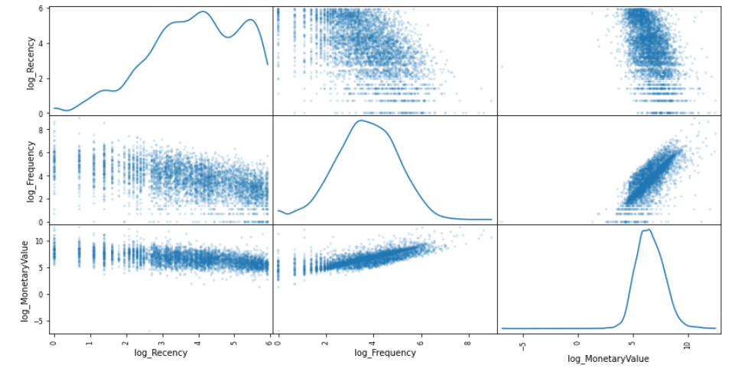
RELATIONSHIP BETWEEN R,F,M

Slide 22
K-MEANS IMPLEMENTATION
We use the K-means clustering algorithm to determine the ideal segments of customers.
We will try different cluster numbers and check their silhouette coefficient.
Silhouette score is used to evaluate the quality of clusters created using K-Means clustering algorithms .

Slide 23
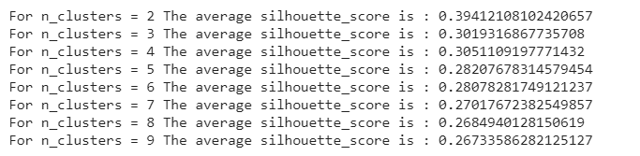
SILHOUETTE SCORE

Slide 24
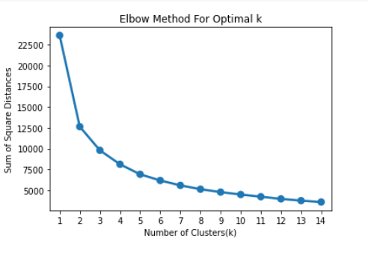
ELBOW METHOD

Slide 25
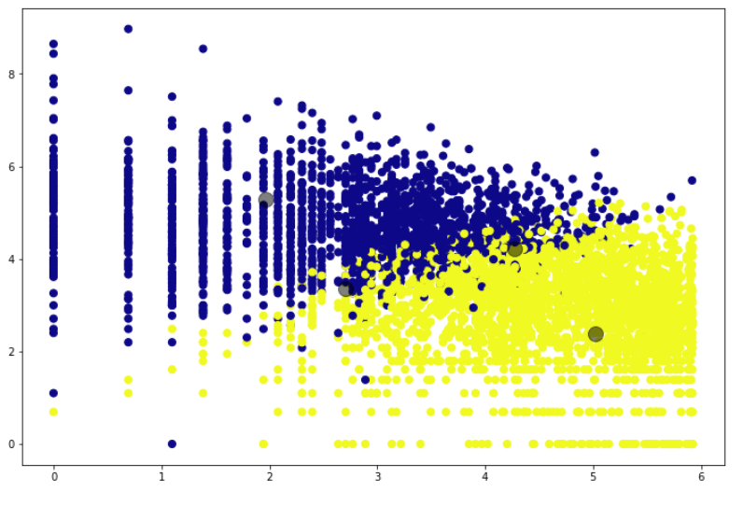
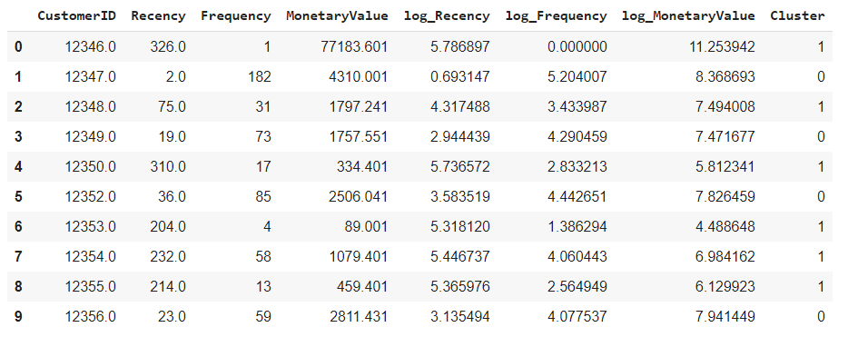
K = 2

Slide 26
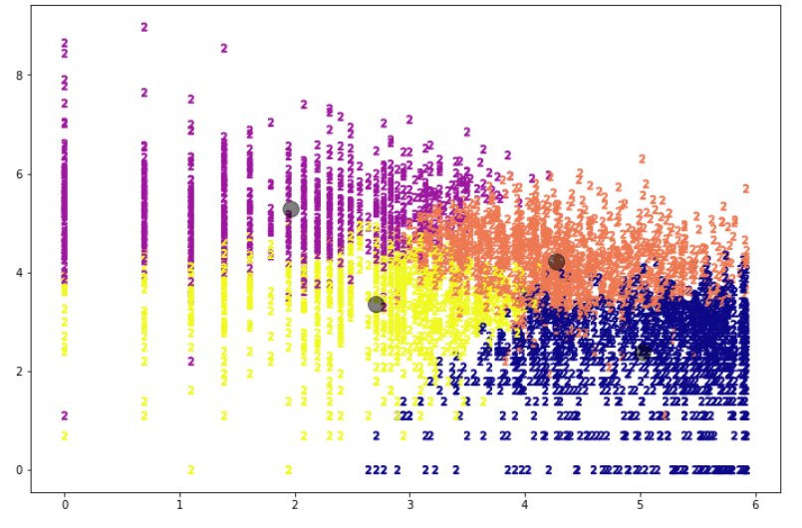
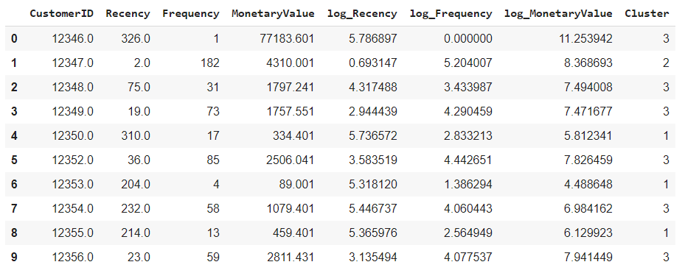
K = 4

Slide 27
CONCLUSIONS
Customers were clustered with the help of RFM model.
The customers were clustered into 2 and 4 clusters as they gave maximum silhouette score.
Major problem faced was optimal number of clusters and factors on which k-Means clustering should be applied.

Slide 28
THANK YOU

