Slide 1


Employee Management System

Slide 2
Introduction
The Employee Management System (EMS) is designed to make it easier for organizations to manage employee information in one place. It stores details such as personal data, job roles, salaries, qualifications, leaves, and payroll records. By using relational tables with foreign keys and cascading actions, the system ensures data accuracy and consistency.
This system helps HR teams handle tasks like payroll calculation, leave tracking, and department-wise job role management more efficiently. It reduces manual errors, saves time, and provides useful insights for decision-making. Overall, EMS improves the organization’s workflow and ensures employee data is secure, updated, and easy to access

Slide 3
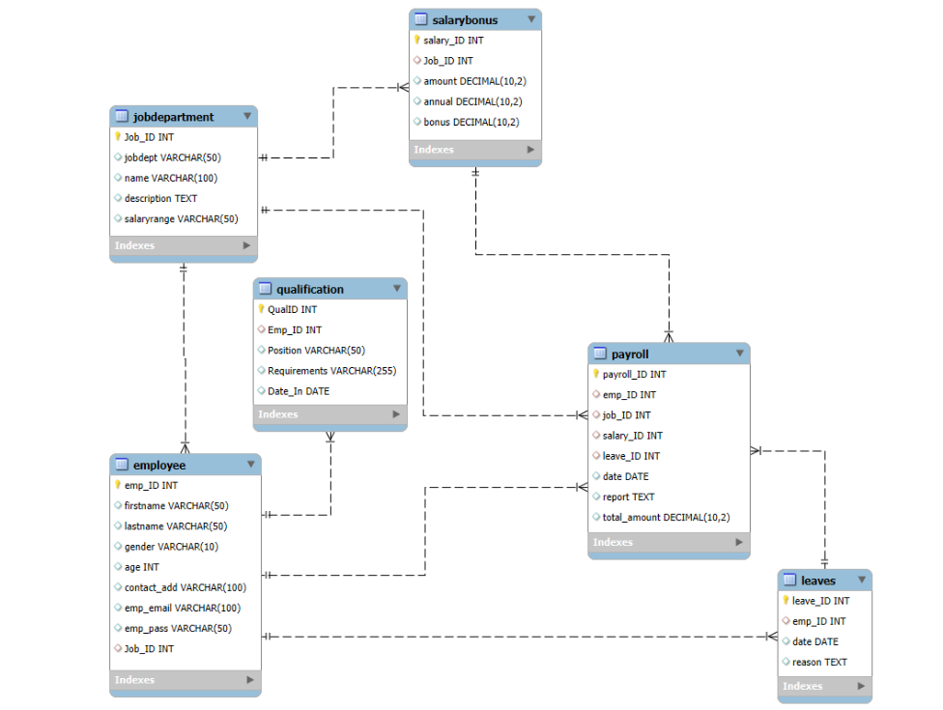
ER Diagram
Employees Table

Slide 4




Job Department Table
Leaves Table
Qualifications Table
Payroll Table
Salary Bonus Table

Slide 5
PROBLEM STATEMENT
Managing employee information manually is slow, confusing, and often leads to mistakes. It becomes difficult to keep records updated, calculate salaries correctly, and track leaves or qualifications across departments. Without a centralized system, data can get duplicated or lost, causing delays, errors, and inefficiency in HR operations. This also makes it hard for management to get accurate insights for decision-making. A digital Employee Management System helps overcome these challenges by organizing all employee data in one place, improving accuracy, saving time, and making overall HR management more efficient. It also enhances data security and ensures smooth communication between employees and the HR department.

Slide 6



How many unique employees are currently in the system?
Query Output

Slide 7

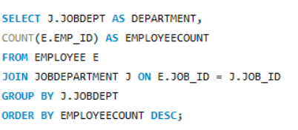
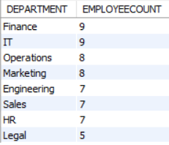
Which department have the highest number of employees ?
Query Output

Slide 8
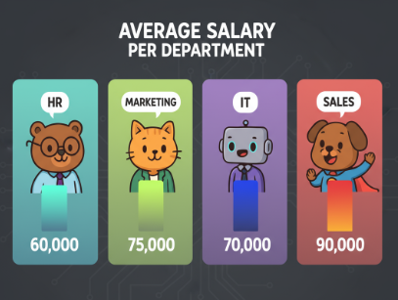
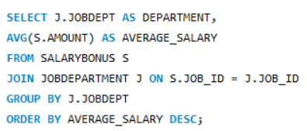
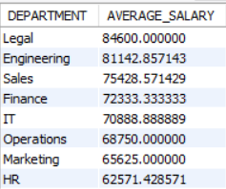
What is the average salary per department?
Query
Output

Slide 9

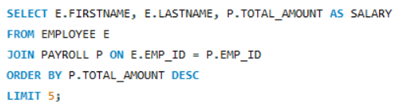
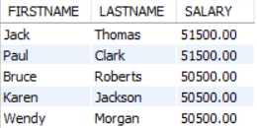
Who are the top 5 highest-paid employees?
Query
Output

Slide 10



What is the total salary expenditure across the company?
Query
Output

Slide 11

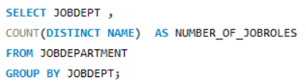
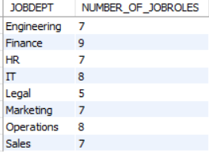
2.JOB ROLE AND DEPARTMENT ANALYSIS
How many different job roles exist in each department?
Query
Output

Slide 12

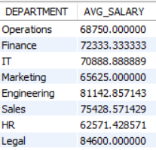
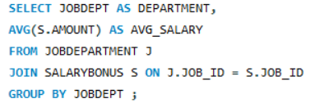
What is the average salary range per department?
Query Output

Slide 13

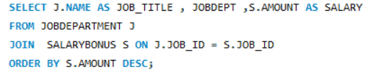
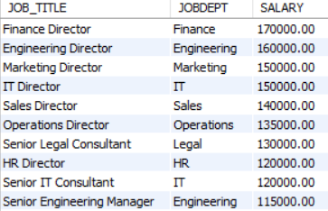
Which job roles offer the highest salary?
Query
Output

Slide 14

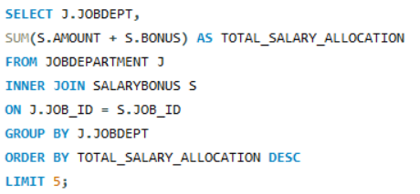
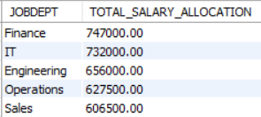
Which departments have the highest total salary allocation?
Query
Output

Slide 15


3.QUALIFICATION AND SKILLS ANALYSIS
How many employees have at least one qualification listed?
Query
Output

Slide 16

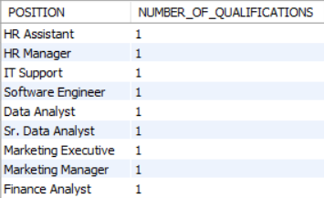
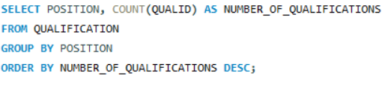
Which positions require the most qualifications?
Query Output

Slide 17

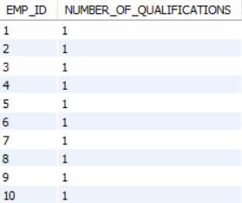
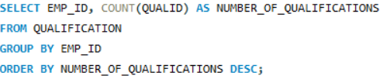
Which employees have the highest number of qualifications?
Query Output

Slide 18

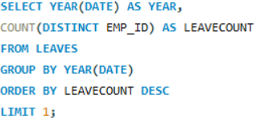

4.LEAVE AND ABSENCE PATTERNS
Which year had the most employees taking leaves?
Query Output

Slide 19

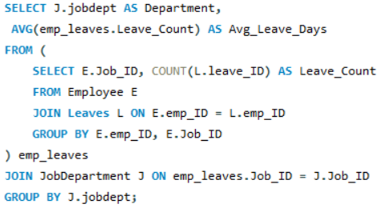
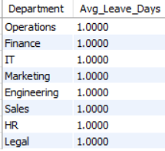
What is the average number of leave days taken by its employees per department?
Query Output

Slide 20

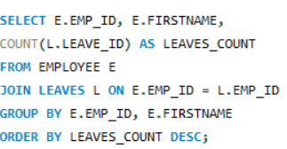
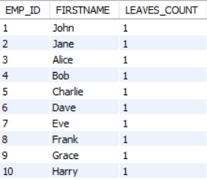
Which employees have taken the most leaves?
Query Output

Slide 21



What is the total number of leave days taken company-wide?
Query Output

Slide 22

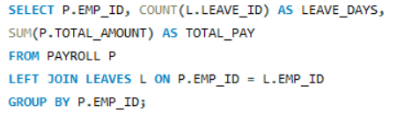
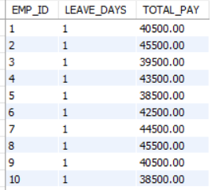
How do leave days correlate with payroll amounts?
Query
Output

Slide 23

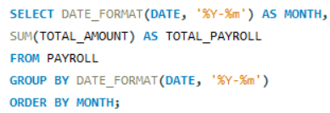

5. PAYROLL AND COMPENSATION ANALYSIS
What is the total monthly payroll processed?
Query
Output

Slide 24

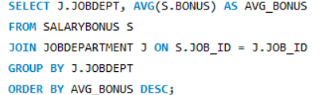
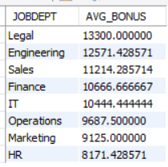
What is the average bonus given per department?
Query Output

Slide 25

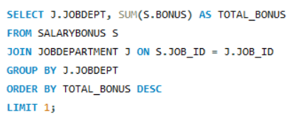

Which department receives the highest total bonuses?
Query Output

Slide 26



What is the average value of total amount after considering leave deductions?
Query Output

Slide 27
INSIGHTS
The Employee Management System (EMS) brings all employee and HR data together in one place, making it more accurate and easier to access.
The system automatically manages things like salary calculations (payroll), employee leave requests and approvals, and storing or updating employee records.
By analyzing departments and job roles, it shows that skilled positions usually get higher salaries and bonuses.
The system also helps identify training needs and supports promotions based on employee qualifications.
Overall, EMS improves efficiency, helps in better decision-making, and makes HR work smoother and smarter

Slide 28

THANK YOU
Presented By
Nishwitha A
Shreya S

