Slide 1
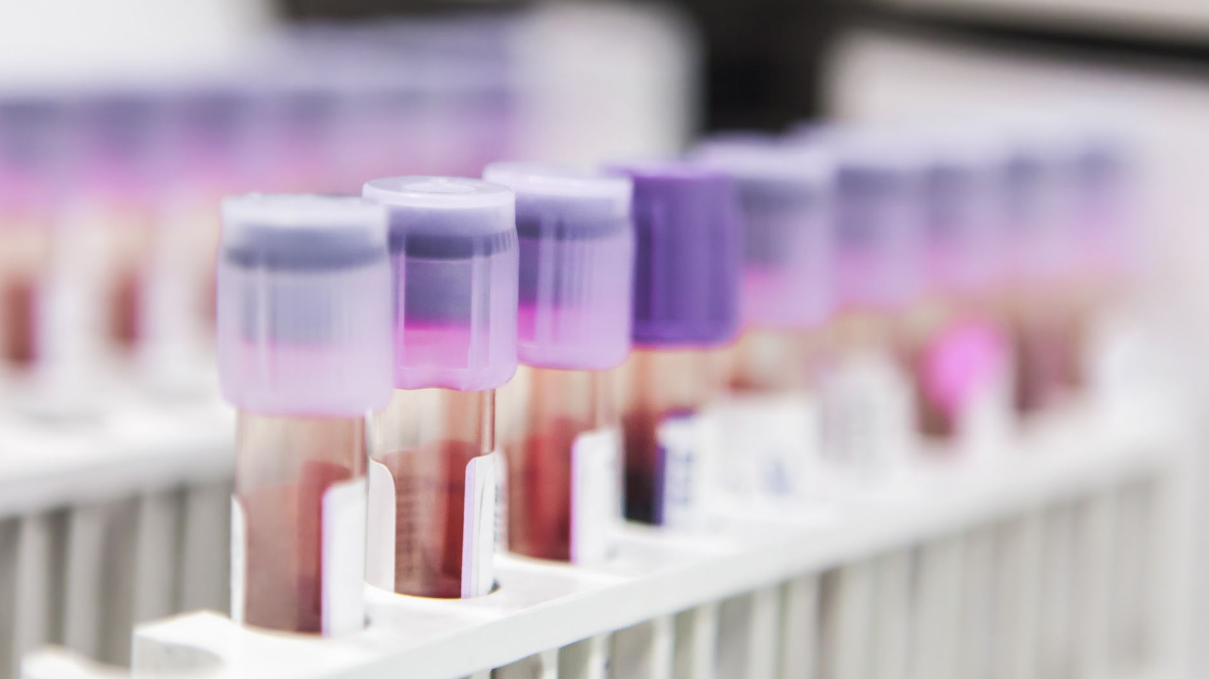
Patient Drug Event Analysis
Group No.: 5
Uma Viraja Dasaraju
Shreya Saraf

Slide 2

Problem Statement:
Adverse Drug Events (ADEs) are a growing public health concern that can lead to severe outcomes such as hospitalization, disability, and death.
Our goal is to leverage machine learning on large-scale adverse drug event data to proactively flag life-threatening reactions early especially death outcomes.
Predicting whether a reported drug reaction is serious enough to result in death.

Slide 3

Objectives:
Understand temporal and demographic trends in adverse drug events.
Perform extensive feature engineering on drug-reaction reports.
Build and compare multiple ML models.
Visualize insights using clear and informative plots.

Slide 4

Dataset Overview:
Source: OpenFDA
Volume: Over 1 million drug events reported
Components
  drug (brand & active substance)
  reaction (e.g., nausea, dermatitis)
  patient info (age, gender, weight)
  seriousness indicators (hospitalization, death, disability)

Slide 5
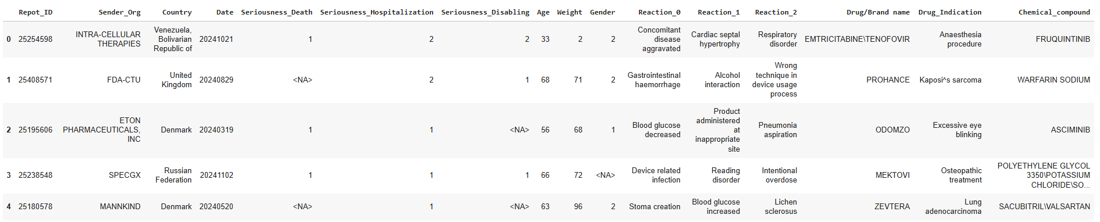
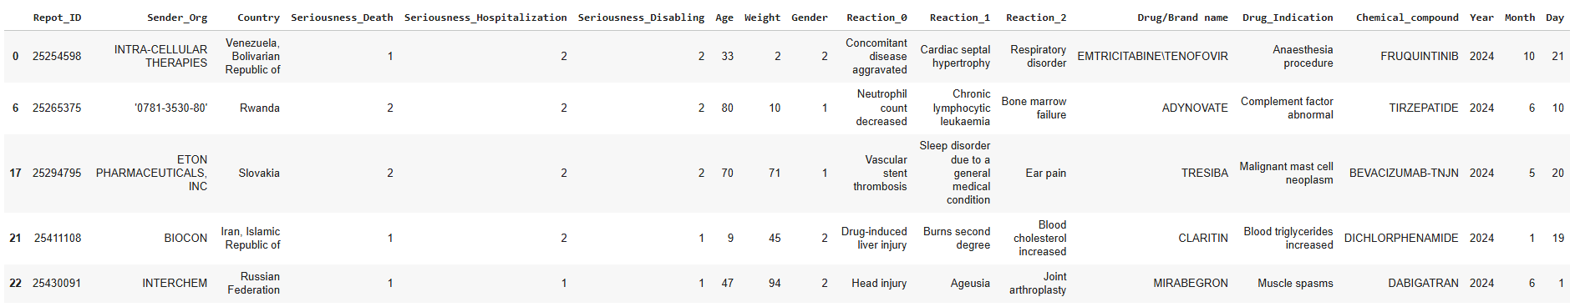
Raw Dataset:
Cleaned Dataset:

Slide 6
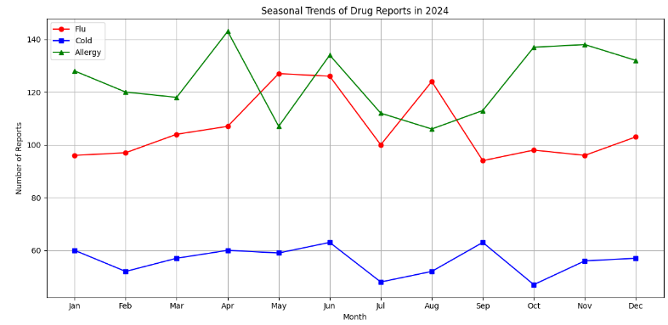
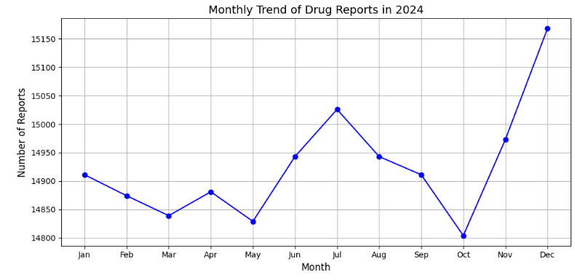
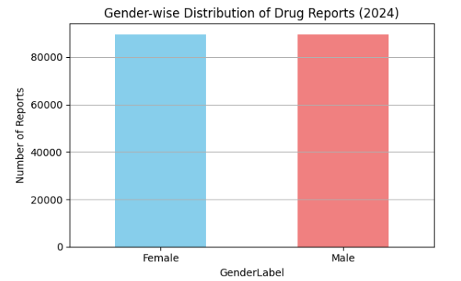
EDA Analysis:

Slide 7
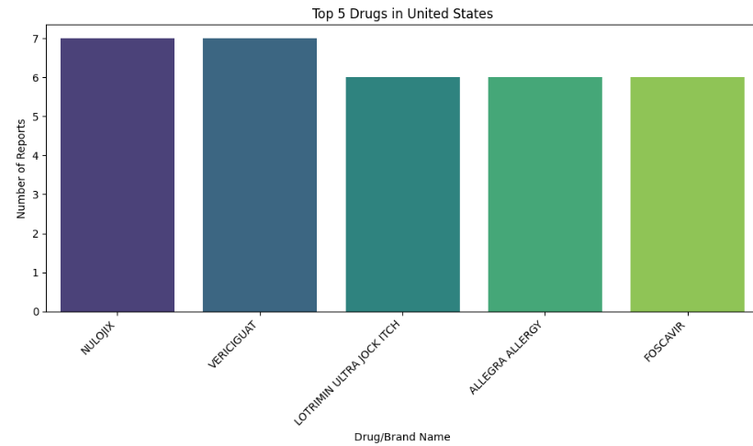
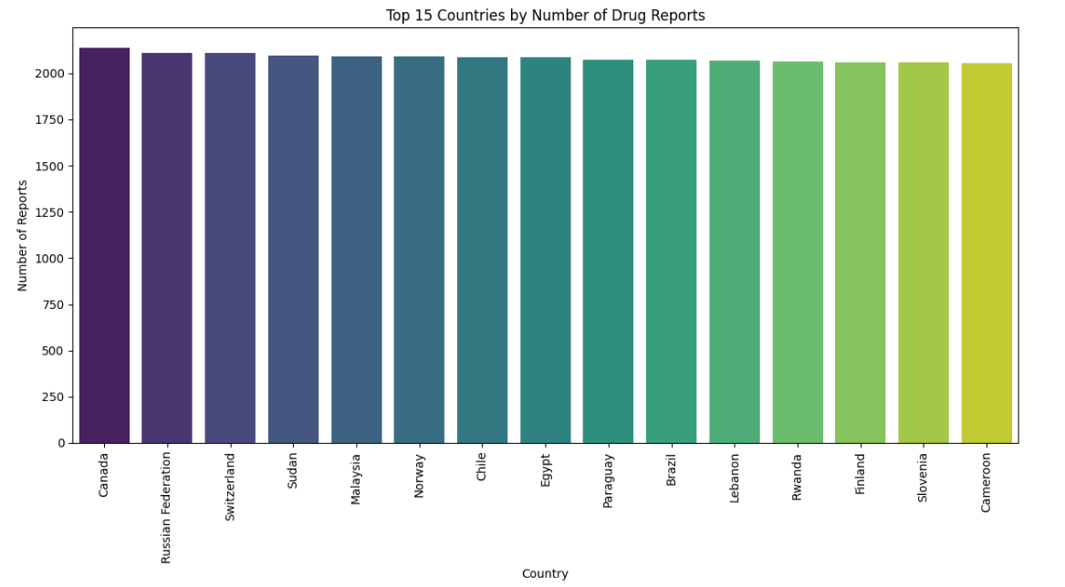
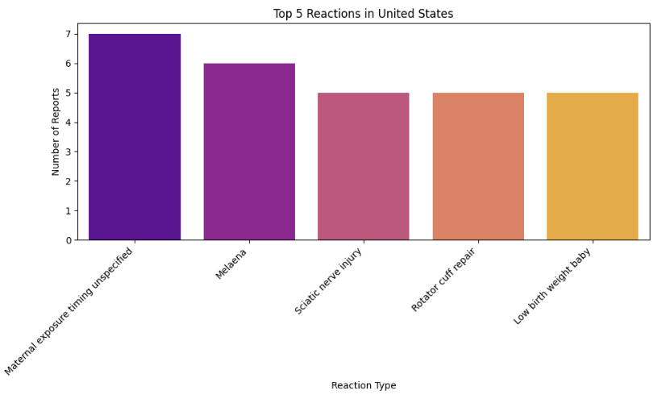
Countrywide EDA

Slide 8
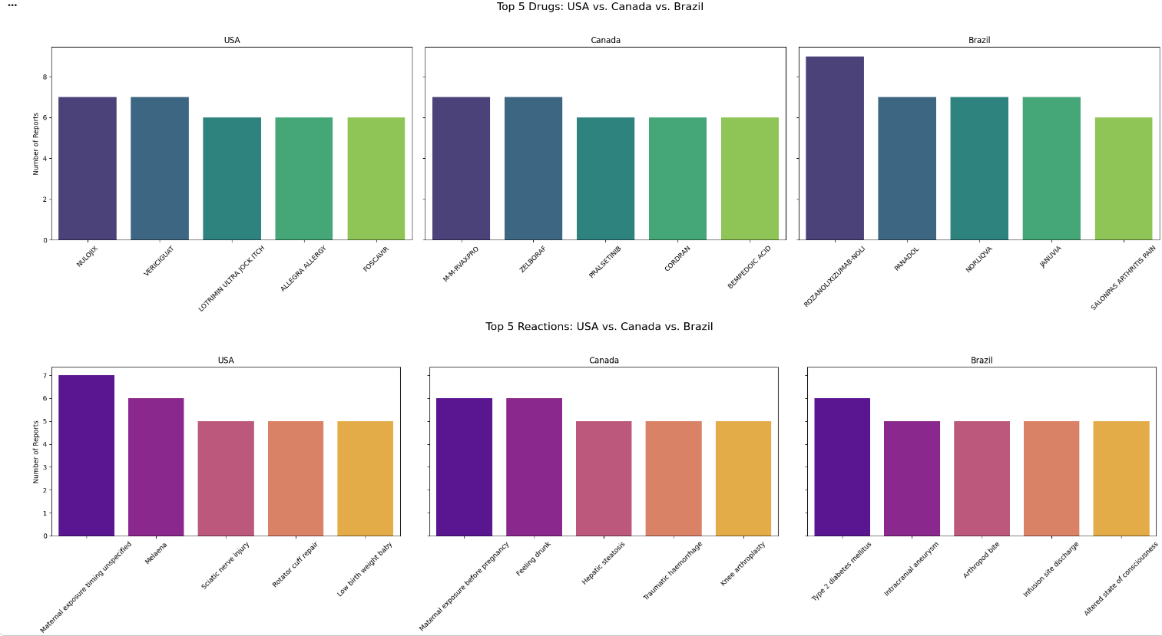
Top Drugs: USA vs. Canada vs. Brazil

Slide 9
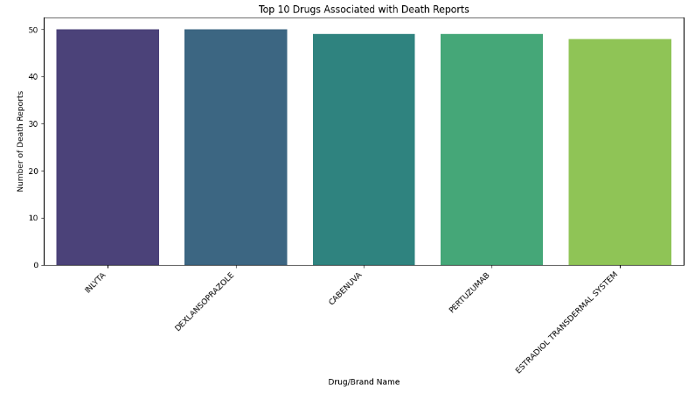
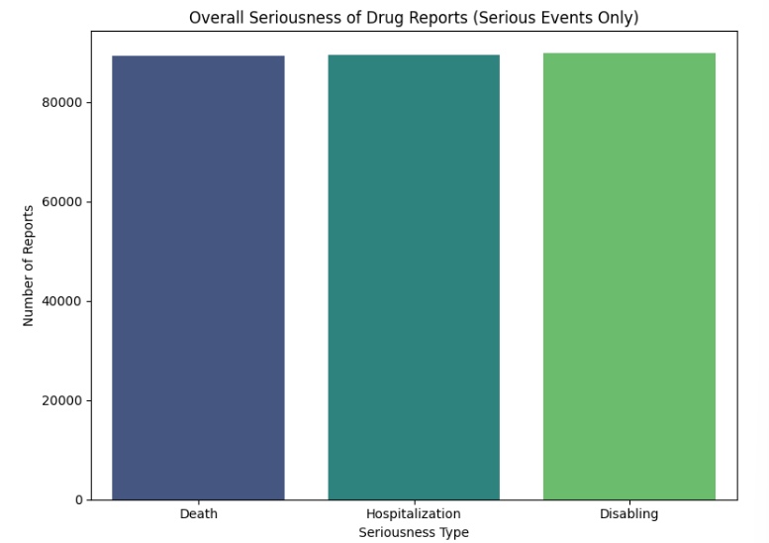
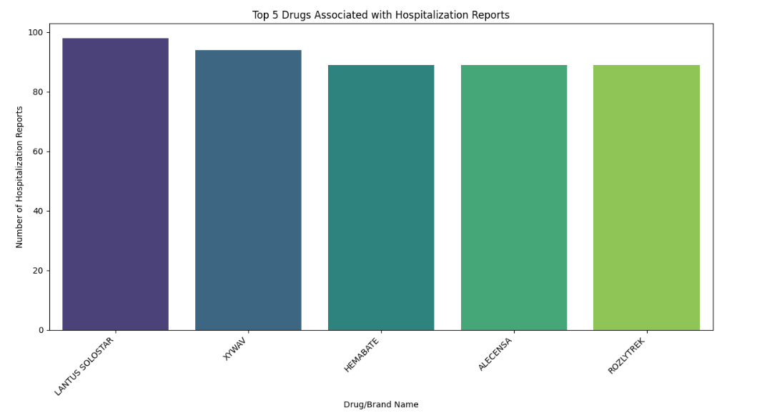
Seriousness EDA

Slide 10
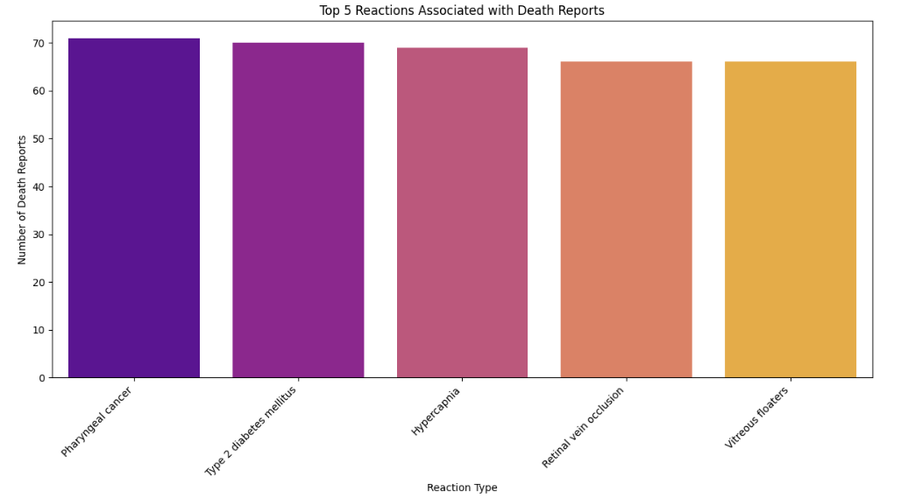
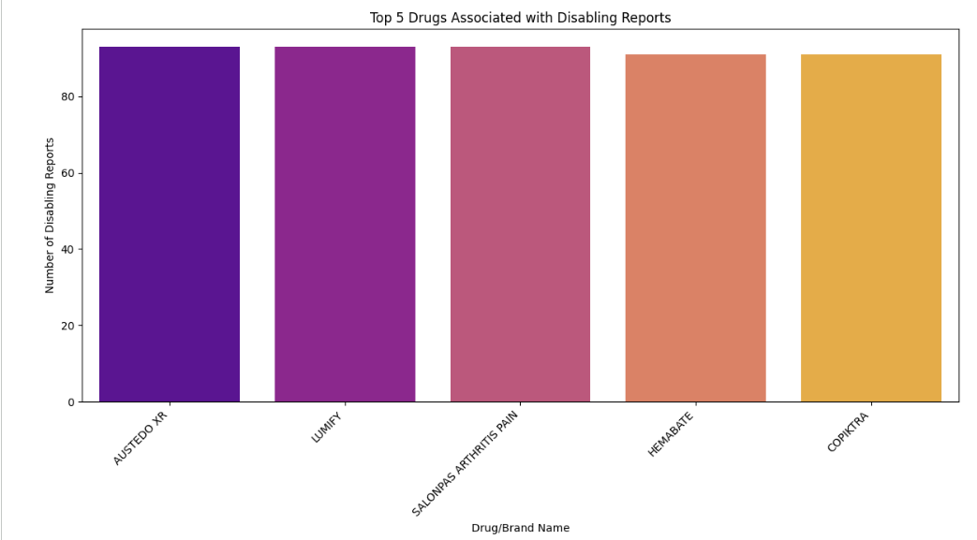
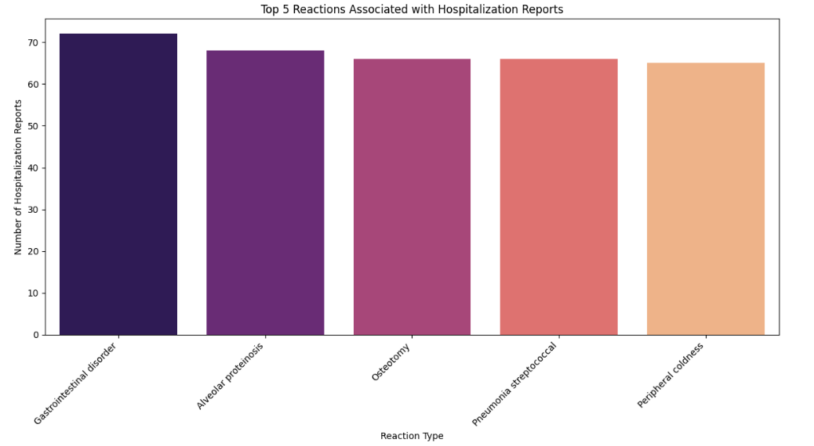
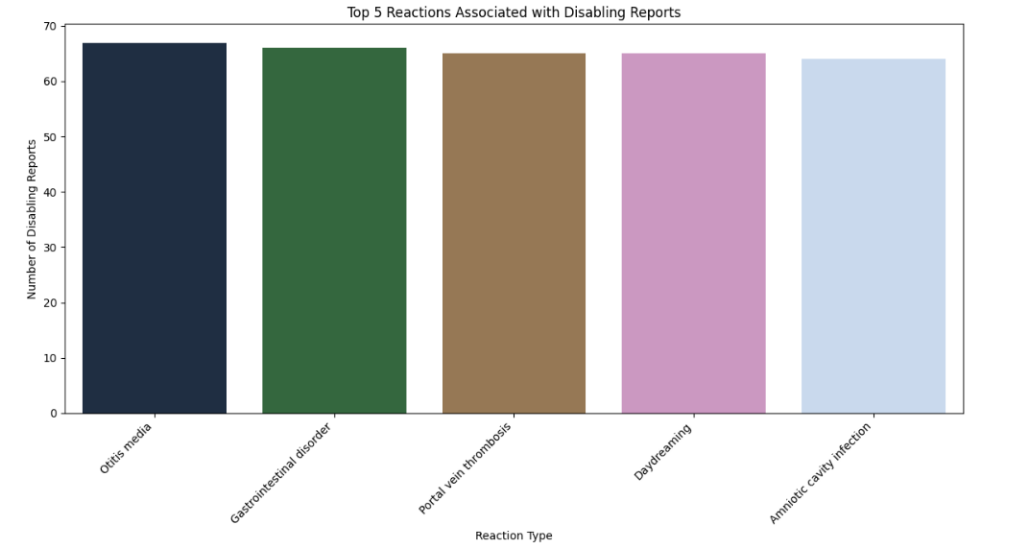
Seriousness by Drug and Reaction

Slide 11
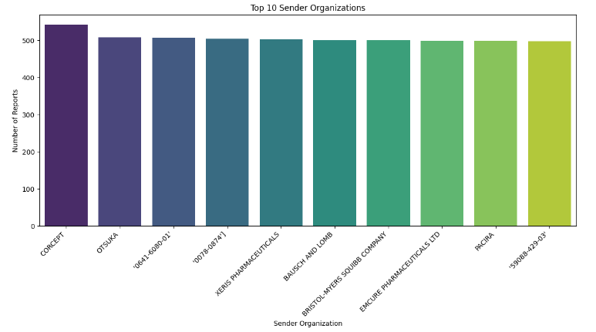
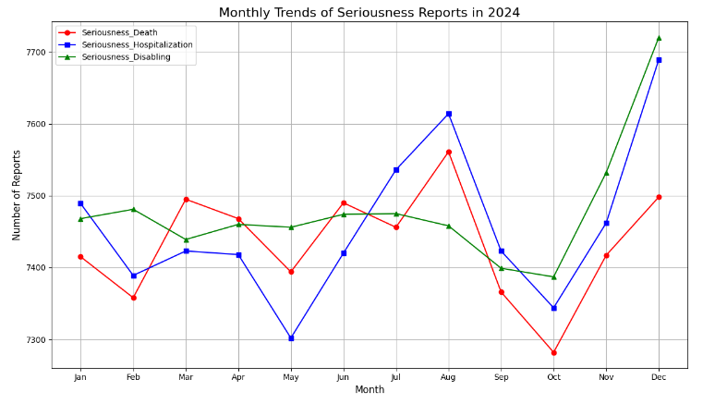
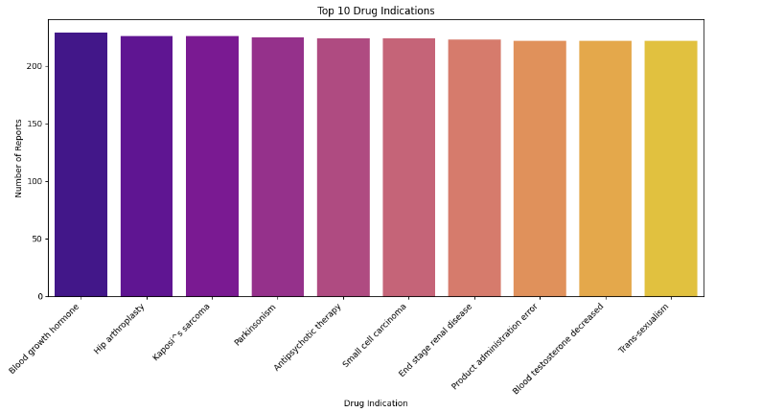
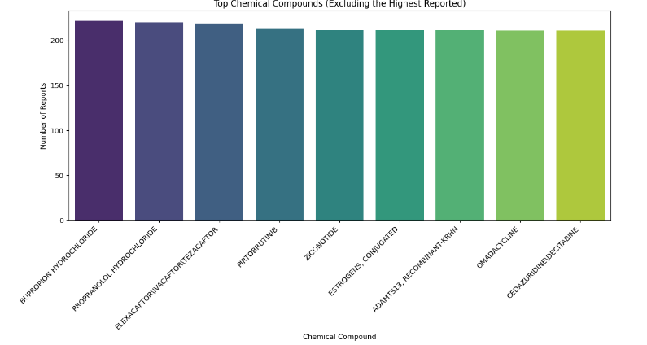
Other Trends:

Slide 12
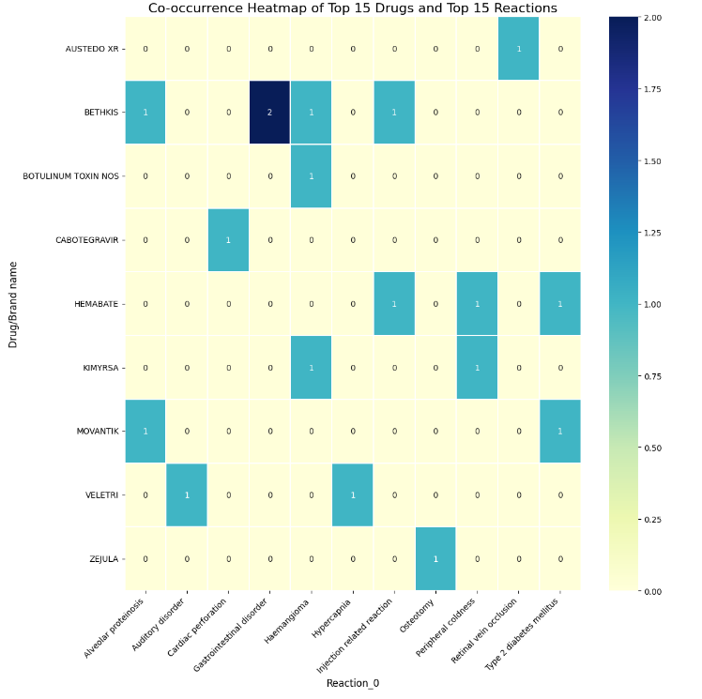
Correlation HeatMap

Slide 13
Analysis & Modeling:
We evaluated multiple models to study performance across learning strategies.
  Logistic Regression
  Random Forest
  SVM
  KNN
Each model was evaluated based on:
Metrics Used:
  Accuracy — overall correctness
  Precision — correctness of predicted deaths
  Recall — how many real deaths were detected
  F1‑Score — balance between precision and recall
  Confusion Matrix — error visualization
  Training Time — efficiency

Slide 14
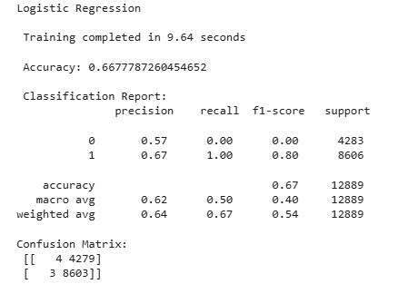
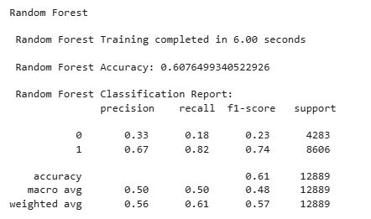
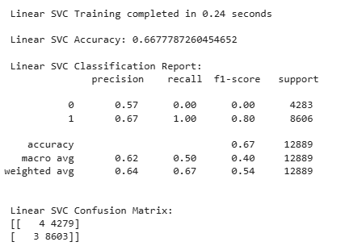
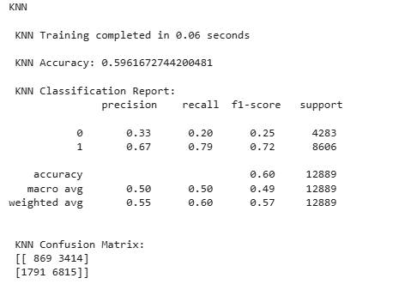
Evaluation Metrics:

Slide 15
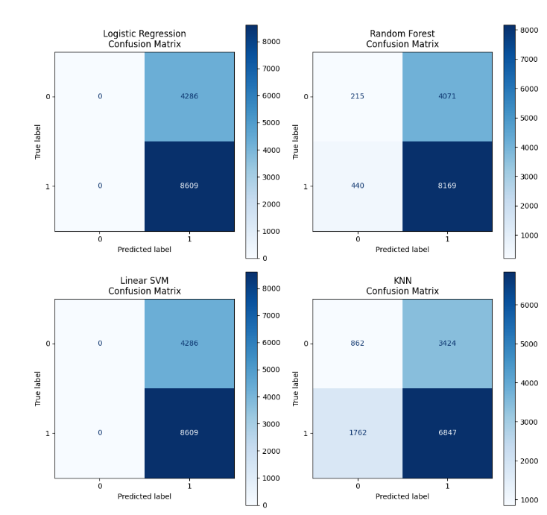
Confusion matrix:

Slide 16
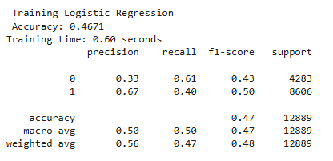
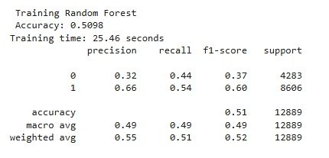
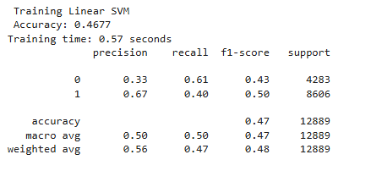
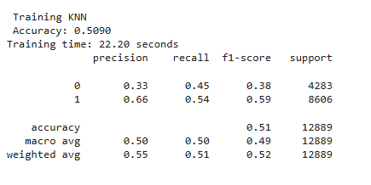
With SMOTENC – Synthetic Minority Oversampling

Slide 17
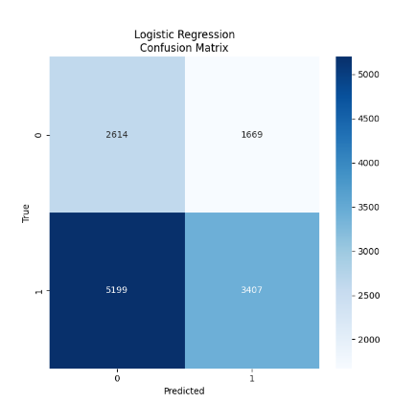
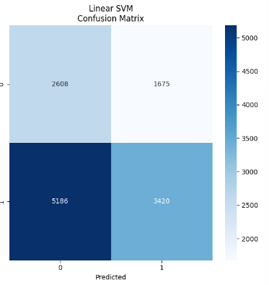
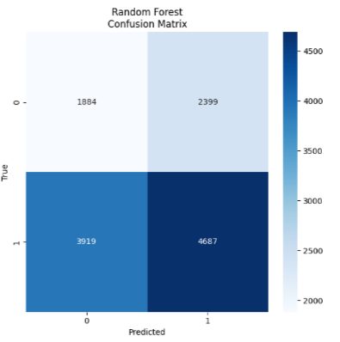
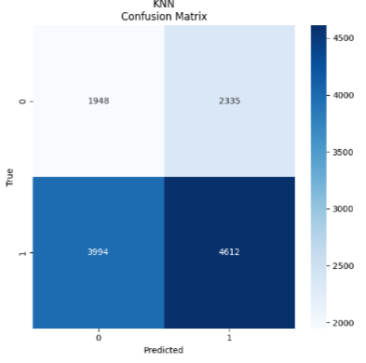
Matrix with SMOTENC

Slide 18
Best Performing Results
Accuracy ranged between 64–67%
Logistic Regression and Linear SVM performed best
Confusion matrix showed good balance between precision and recall
With SMOTENC
  Accuracy dropped to 47–51%
  Models trained on smaller data (post-filtering)
  Confusion matrices still showed meaningful class separation
  Accuracy dropped slightly, but our model became fairer and more sensitive to real deaths.

Slide 19
Challenges & Future Work
Challenges Faced:
  Unstructured data in original JSON format
  High-cardinality features (e.g., 5000+ drug names)
  Balancing categorical and numerical features
  Interpretability of medical terms (e.g., reactions)
Future Enhancements:
  Use embeddings or transformers for drug/reaction text
  Add external knowledge graphs for drug interaction context
  Try deep learning with more balanced dataset
  Deploy model on real-time streaming pipeline using Spark/Kafka

Slide 20
Conclusion:
Processed and cleaned over 1 million drug reaction reports
Reduced complexity by grouping rare reactions and filtering top drugs
Tackled imbalance using SMOTENC to fairly represent fatal cases
Evaluated multiple ML models — best accuracy of 67% (imbalanced), and 50% (balanced)
Gained valuable insights into how age, gender, country, and drug type relate to serious drug reactions

Slide 21
Thank you

