Slide 1
SHREYA SARVAN MASANAM
THE FINAL PROJECT : KEYLOGGER

Slide 2
PROJECT NAME : KEYLOGGER
This presentation will delve into the Keylogger Project, exploring its role in monitoring and providing security insight. We will discuss its applications, implications, and potential benefits for organizations and individuals.
Keyloggers are stealthy tools designed to capture keystrokes on a computer or mobile device. They can record sensitive information such as passwords, usernames, and financial data. Understanding their operation is crucial for security measures.

Slide 3
AGENDA
INTRODUCTION
PROBLEM STATEMENT ABOUT KEYLOGGER
PROJECT OVERVIEW
END USERS
SOLUTIONS AND ITS VALUE PROPOSITIONS
THE WOW IN THE SOLUTIONS
MODELLING
CONCLUSION

Slide 4
INTRODUCTION
A keylogger, sometimes called a keystroke logger, is a type of surveillance technology used to monitor and record each keystroke on a specific device, such as a computer or smartphone.
It takes the information and sends to a hacker using command-and-control (C&C) server.
It can be either hardware or software based. Both types of keyloggers can be used for malicious purposes, including credential theft and identity theft.
They are often used without the user’s knowledge and can capture sensitive data like login credentials and credit card numbers.

Slide 5
PROBLEM STATEMENT ABOUT KEYLOGGER
MONITORING AND SECURITY INSIGHT
Keyloggers are malicious programs that record keystrokes to steal sensitive data like passwords and financial information. They pose a significant threat to organizational security, potentially leading to severe data breaches and financial losses. This project aims to develop and implement effective detection, prevention, and mitigation strategies against keylogger attacks.

Slide 6
PROJECT OVERVIEW
Develop a comprehensive understanding of keyloggers, their type , how to work , and effective security measures to prevent keylogging attacks.
Scope:
Development Phase:
Design and implement a basic keylogger using programming languages and libraries.
Testing Phase:
Test the keylogger in a controlled environment to evaluate its functionality.
Analysis Phase:
Analyze the captured data to understand the keylogger’s effectiveness

Slide 7
END USERS
End users are the individuals within an organization who interact with various digital platforms, applications, and devices daily. They are often the first line of defense against cyber threats

Slide 8
PROPOSED SOLUTION:
To effectively manage keylogger threats, we offer comprehensive security measures including detection, prevention and mitigation strategies. The system will include real-time monitoring and analysis of network traffic and system behavior to detect keyloggers. It will include comprehensive endpoint security solutions and enforce strict access management. In addition, regular employee training on cybersecurity best practices will be implemented.

Slide 9
THE WOW IN YOUR SOLUTION
Innovative Approach: Combining technical measures with user education for comprehensive protection.
Demonstration: Real-time demonstration of a simple keylogger to illustrate the threat and the effectiveness of security measures.
Impact: Significant reduction in the likelihood of keylogging attacks through proactive measures

Slide 10
MODELLING
INITIALIZATION:
Set up the main GUI window.
Initialize global variables for key logging.
EVENT CAPTURE:
Start capturing key events when the “start” button is pressed
Log key is pressed and release events.
DATA LOGGING:
Continuously update text and Json log files with captured key events.
STOP LOGGING:
Stop capturing key events when the “Stop” button is pressed.
Update the GUI status to indicate the keylogger is stopped.

Slide 11

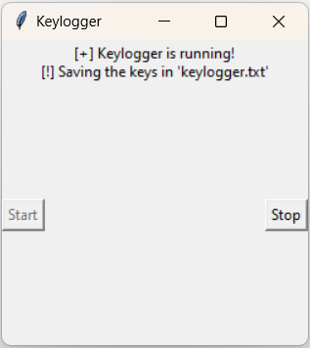
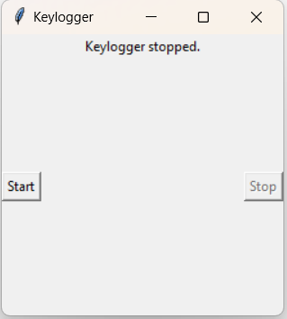

IMAGES
11

Slide 12
CONCLUSION :
In the face of increasing keylogger threats, our proposed framework provides a complete solution to enhance organizational cybersecurity. By combining real-time analytics, robust prevention strategies, and effective mitigation strategies, we can significantly reduce the risk of keylogger attacks and create critical information protect Use advanced technologies such as network traffic analysis, machine learning modeling and endpoint security solutions.
Ultimately, this integrated security strategy will provide robust security, ensuring the integrity and confidentiality of the organization’s data and strengthening overall network security.

Slide 13
PROJECT LINK:
https://github.com/shreyasarvan/keylogger.git

Slide 14
THANK
YOU

