Slide 1
DBMS Project Report Phase 4

Slide 2
CropKart An Online Auction System for Agricultural Products

Slide 3
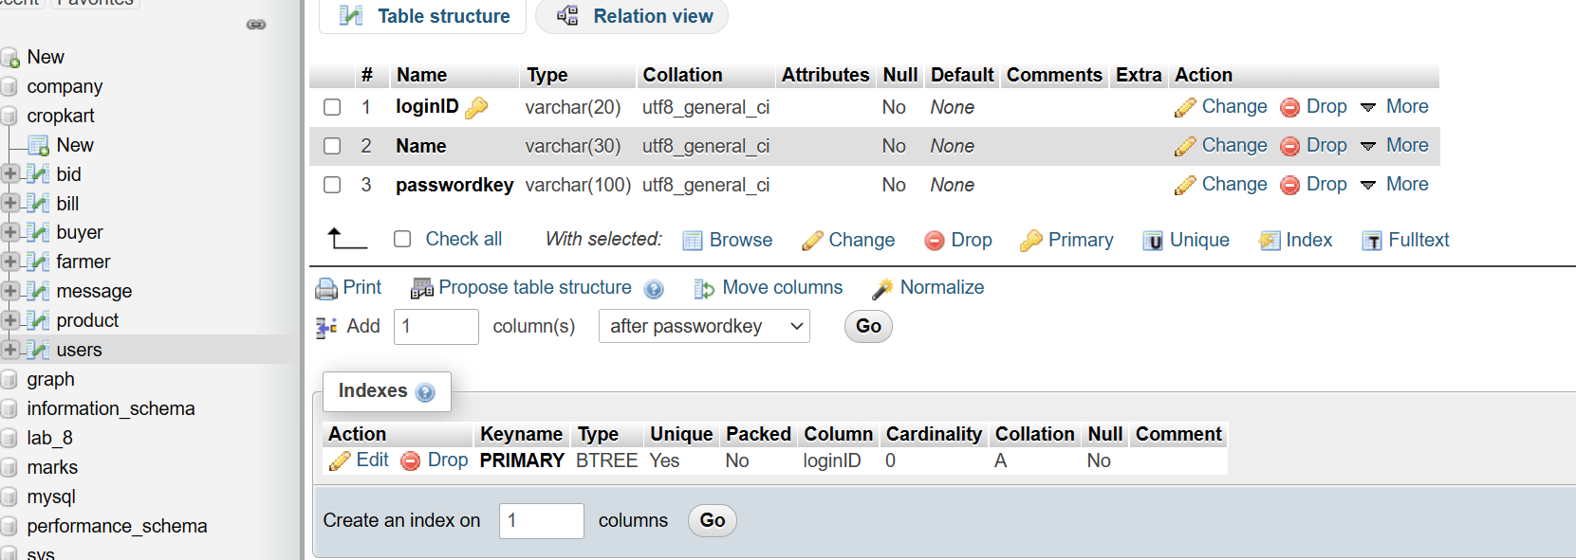
{loginID}->{Name, passwordkey}
It is in BCNF

Slide 4
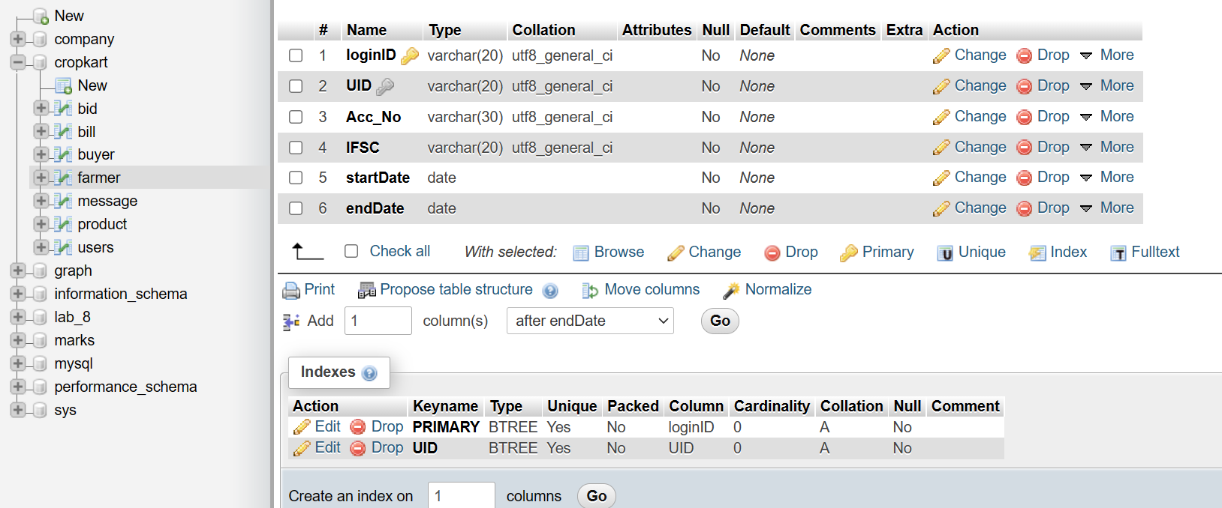
{loginID}->{startDate, endDate, Acc_No, IFSC,UID}
{UID}->{Acc_No, IFSC,startDate, endDate,loginID}
UID is unique.
It is BCNF.

Slide 5
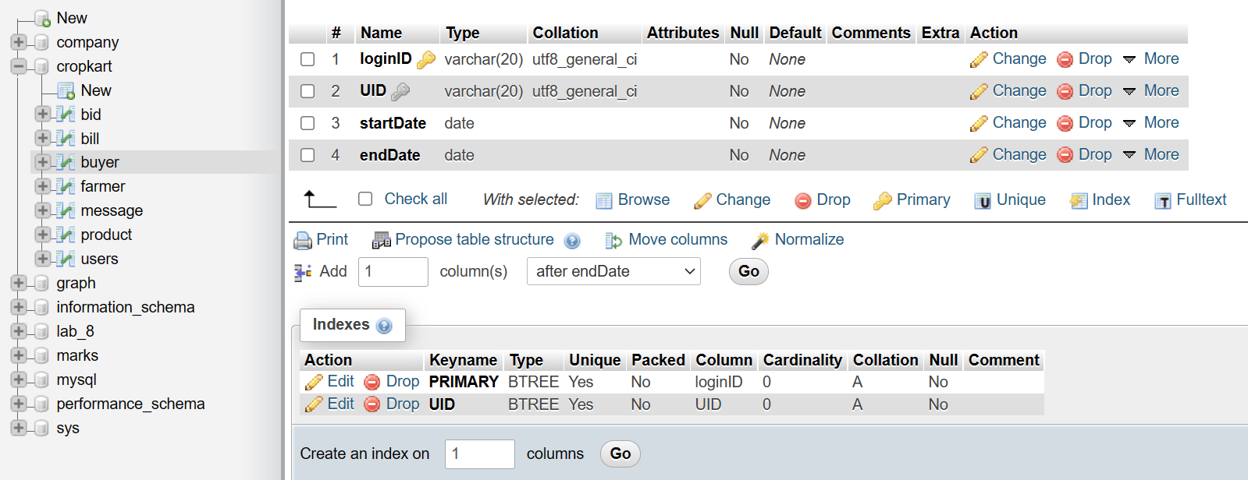
{loginID}->{startDate, endDate, UID}
{UID}->{startDate, endDate,loginID}
UID is unique.
It is BCNF.

Slide 6
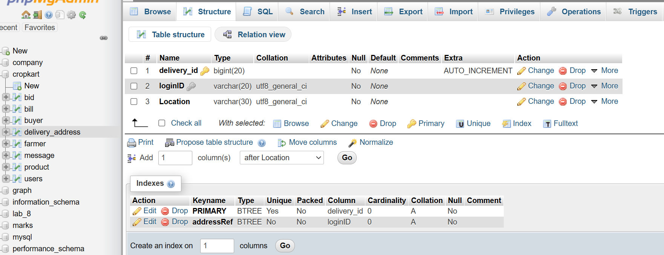
{delivery_id}->{loginID, Location}
BCNF

Slide 7
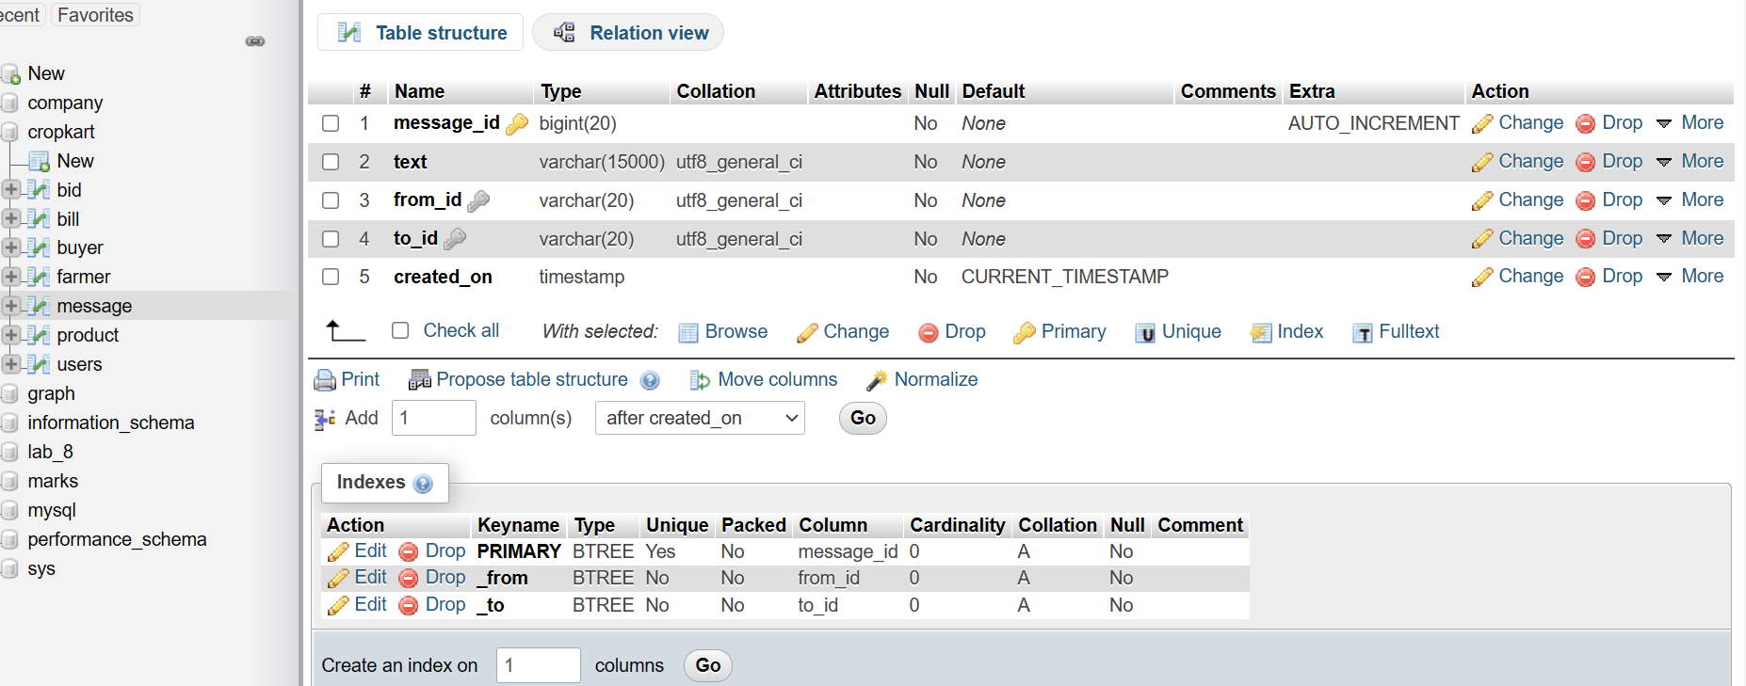
{message_id}->{text,from_id,to_id,created_on}
BCNF

Slide 8
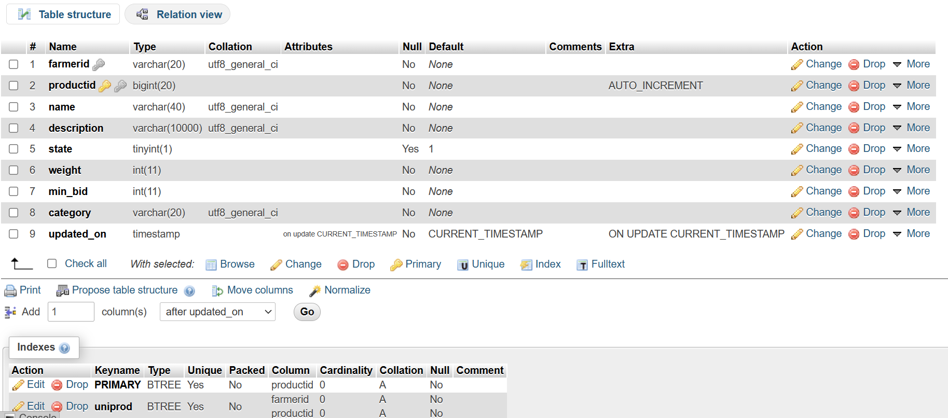
BCNF

Slide 9
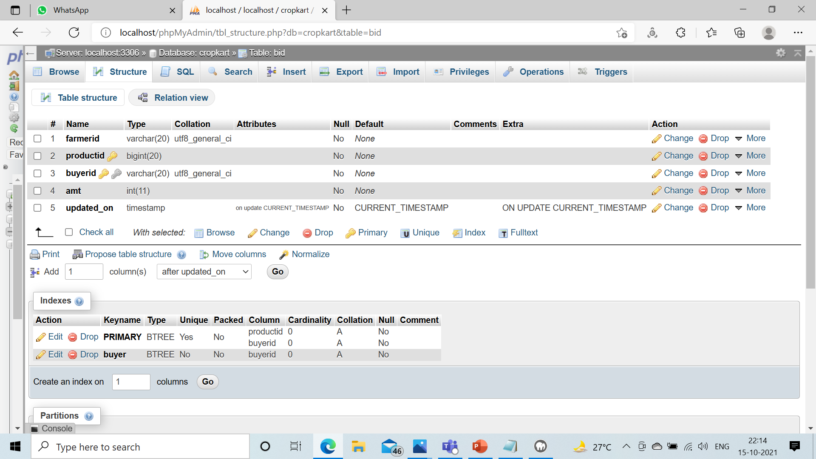
BCNF

Slide 10
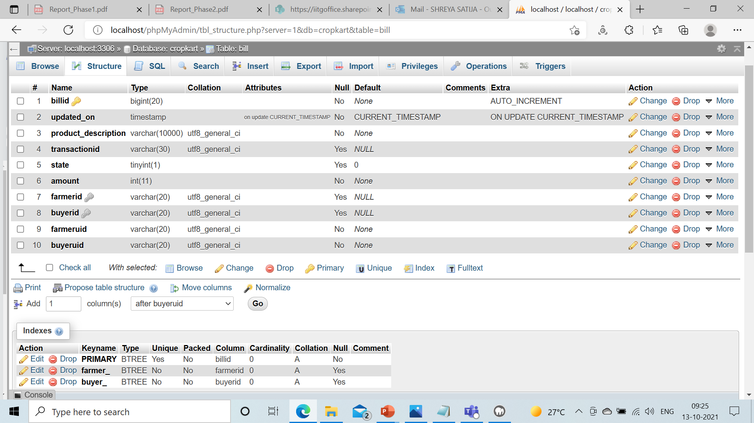
BAD FD.
{farmeruid}->{farmerid}
{buyeruid}->{ buyerid}
NOT IN BCNF

Slide 11
THANK YOU

