Slide 1

Traffic Monitoring System
Kush Patel
Tejas Ravi
Jeffrey Gillen
Shreyas Bhandare
Kisholoy Vinayak Ghosh
Aaditya Shukla

Slide 2
Traffic Monitoring System
Who?
The product is designed for anyone traveling in a vehicle, whether they are a daily commuter, or someone going out for lunch.
Why?
This application will give them traffic information along a specific route so the user can plan accordingly.
How?
Application stores live and historic traffic information to be displayed on the route.

Slide 3
Traffic Monitoring System
Current Features:
Users are able to view live traffic for a certain area designated by a zip code or city name.
Users can view incidents by traffic, construction, and other special events.
Users can also obtain navigation by entering a starting location and destination.
Users can view congestion, that is the traffic delays along the routes by severity levels 1,2,3

Slide 4
Traffic Monitoring System
Users can also view these traffic incidents along this navigated route.
Users will be able to view for cops on the route and slow down.
Users can view for traffic trends in a particular area, by selecting a particular day and hour.
Users can download an android application to access all the features on the go.

Slide 5


Data Collection Module
MySQL Database
JSON Traffic Data
-Waze
-Yelp
-Parkwhiz
Parse JSON & Write to Database
Response
HTTP Servlet
Request
PHP Script
Flow chart describes database
Webpage queries database and plots data points using Latitude and Longitude of the reported traffic incident or police and shows description
Android app

Slide 6
Prediction
Streets with same names | Delay
6th Ave | 80
6th Ave | 74
-The Bayesian Prediction is of order M=4
Street | Delay
Street | Delay
6th Ave | 80
Bennetts Ln | 123
6th Ave | 74
Bennetts Ln | 101
Bayesian Prediction
Check for the particular Day and time (ex. Thursday 11AM – 1PM)
MySQL Database
Streets with same names | Delay
Bennetts L | 123
Bennetts L | 101
Predicted table :
Streets with different names | Predicted delay
6th Ave | 79
Bennetts L | 115

Slide 7
Website
Project is based on visual outputs and hence Website is equally important.
The website is easy to navigate and use.
The website is built using HTML, CSS, Javascript and PHP.
The website links to the MySQL Database to plot the stored data.

Slide 8
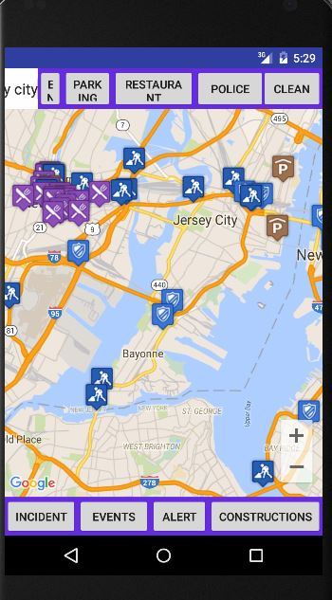
Android Application
The app was built using Android Studio 4.0.
The app is compatible with Android Version 5.0 and above.
The app gives a user experience that is simple to understand and similar to the webpage.

Slide 9
Features of Android Application
The app has the following features:
User can enter an address and the app will zoom to that address
User can plot and clear the following information on the app:
Construction work, Incidents & Special Events.
Live alerts and user reported Police information.
Restaurant information around the area.

Slide 10
Traffic Monitoring System
FINAL DEMO
Timeline:
DEMO 1
Traffic Trends based on prediction
Police Data &
Alerts
Use Case Definitions
Design Website
Add Navigation
Android App
Project Assigned
Data Collection
Traffic
Integrate Database + Website
Prediction Algorithm
Parking Lot & Restaurants

