Slide 1
Project Objective
- To build a model which will predict whether customers will default on their loan or not
- model should be able to identify key factors that contribute to creditworthiness and use these factors to make informed predictions
- model should be efficient and scalable, allowing it to be applied to many customers and updated regularly as new data becomes available

Slide 2
Background
- Classifying bank customers to determine their creditworthiness is essential for ensuring the financial stability, profitability, and regulatory compliance of banks.
- It also contributes to enhanced customer satisfaction, improved resource allocation, and a competitive advantage in the banking industry.

Slide 3
Project Stakeholders
Bank Management
Data Team
Interested in accuracy and effectiveness
Data Scientists and
Finance Analysts
Loan Officers
Customers
Evaluating loan applications and making lending decisions
Individuals and businesses seeking loans

Slide 4


Project Development
Exploratory Data Analysis
Performance Evaluation
Data Preparation
Model Building
Process of visually and statistically summarizing, interpreting, and understanding the main characteristics, patterns, and relationships in a dataset.
Process of cleaning, transforming, and organizing raw data into a structured and suitable format for analysis or machine learning.
Process of creating and training a machine learning algorithm on a dataset to make predictions or infer patterns.
Assessment of how well a machine learning model generalizes to new, unseen data based on predefined metrics such as accuracy, precision, recall, and F1-score.
Step 01
Step 02
Step 03
Step 04

Slide 5
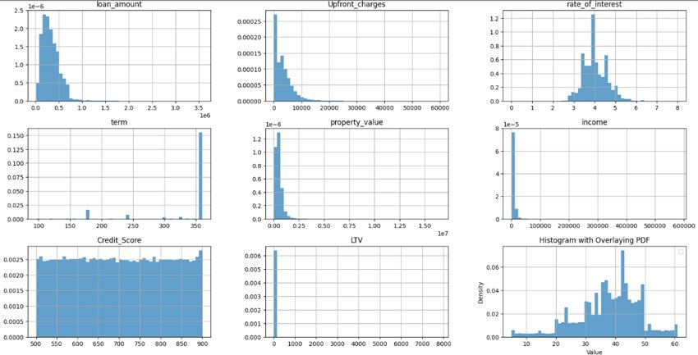
Exploratory Data Analysis
The loan amount has a right skewed distribution, indicating that most of the loan amount taken is between USD 200K to USD 400K.
Most people do not tend to pay the upfront charges and the people who do they at pay around USD 3000.
The rate of interest is slightly close to normal distribution with majority of interest rates between 3.5% to 4.5%
Most people have taken a loan for a period of 350 months.
The income of most of the people is around USD7500
The distributions of Credit score, LTV, are not uniform and do not provide much information.

Slide 6

Data Preparation
The columns that doesn’t add value to the model is been dropped. - 'ID', 'year’, 'co-applicant_credit_type', 'Interest_rate_spread' and 'submission_of_application’ .
Dataset contains many number of missing values in more than 7 columns, the rows with more than 3 missing values from the dataset are dropped, as it adds a bias to our model.
The columns with missing value that are important for the model performance is imputed with most relevant values using KNN imputer to fill.
Data Preparation

Slide 7
Model Building
01
02
03
04
K- Nearest Neighbors
Decision Trees Classifier
Logistic Regression
Random Forest Classifier

Slide 8
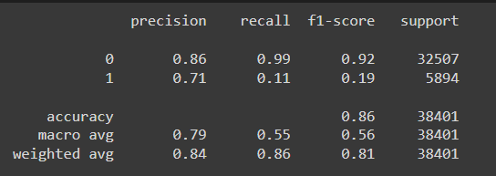
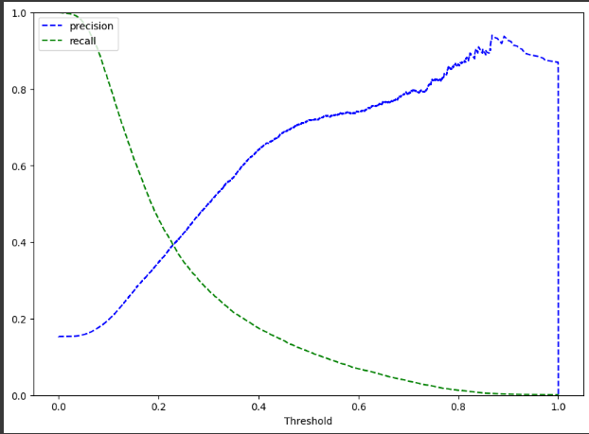
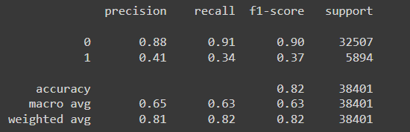
Logistic Regression
Accuracy of 86% on both our train and test datasets
The recall for class 0 is good but the recall for class 1 is too low, only 11% on both of our datasets.
To conclude, this model failed to identify most employees who will default on their loan.
The precision and the recall are balanced for a threshold of about ~ 0.25
By specifying the threshold as 0.25 the model performance is improved for class 1 on both train and test data by
The average recall and precision for the model are good.

Slide 9
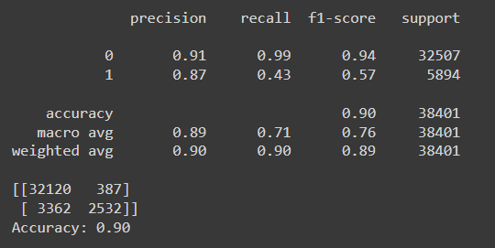
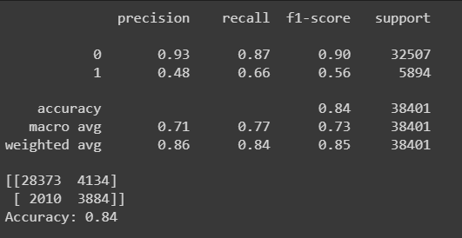
Random Forest Classifier
The recall values are not that good from the previous model.
We have low recall for class 1, so we will have to optimize our model.
By Performing Hyperparameters model performance has improved
The recall for class 1 has increased significantly and recall of 66% indicates a good improvement over previous models.

Slide 10
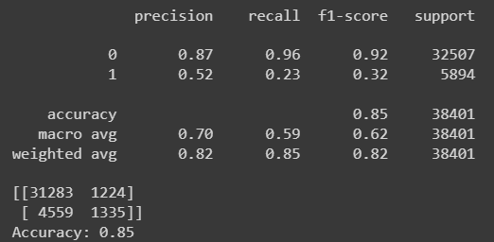

K-Nearest Neighbors
Accuracy is 85%.
The recall for class 0 is good but the recall for class 1 is too low, only 23%
To conclude, this model failed to identify most employees who will default on their loan.
Since, The recall for class 1 is significantly low, recall value for different number of K value is performed.
The recall value for the class 1 decreases as we increase out K value. This suggests that the KNN model works best when the K value is 2.

Slide 11
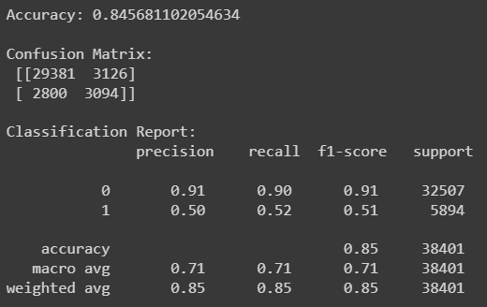
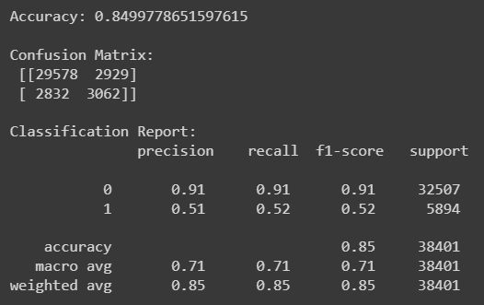
Decision Trees Classifier
Accuracy of 84% by using the Decision tree classifier which is almost the same as other models
The recall is higher than the logistic regression model for the class 1
By tuning the hyperparameters, though the accuracy is increased slightly, the recall for class 1 is same as before.
To conclude, this model will only give 50% recall for class 1 and won't perform well in differentiating the customers who have a high chance of defaulting on the loan.

Slide 12
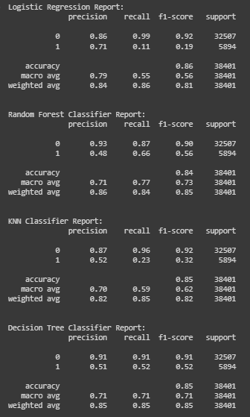
Model Comparison
- All the models gives us high accuracy and almost all gives us high precision as well
- Recall for class 1 is lower in all models as compared to class 0
- Except Random Forest classifier, all the models looks like they are struggling to perform well on class 1
-The f1 score, weighted average are high on almost all the models

Slide 13
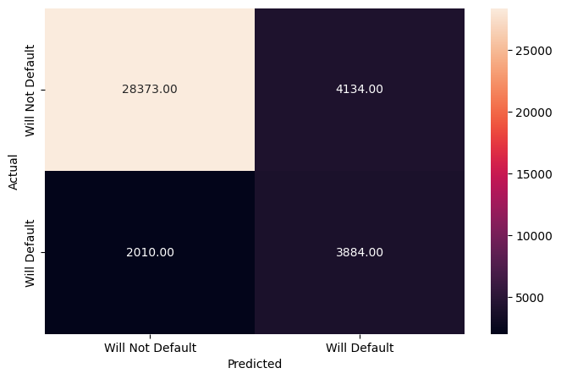
Model Selection
- The Random forest classifier has accuracy of 84%
- The recall is good for class 1 among all the models
- Even though the precision is low on class 1, the suggested model to go ahead is the modified ‘Random Forest Classifier’

Slide 14
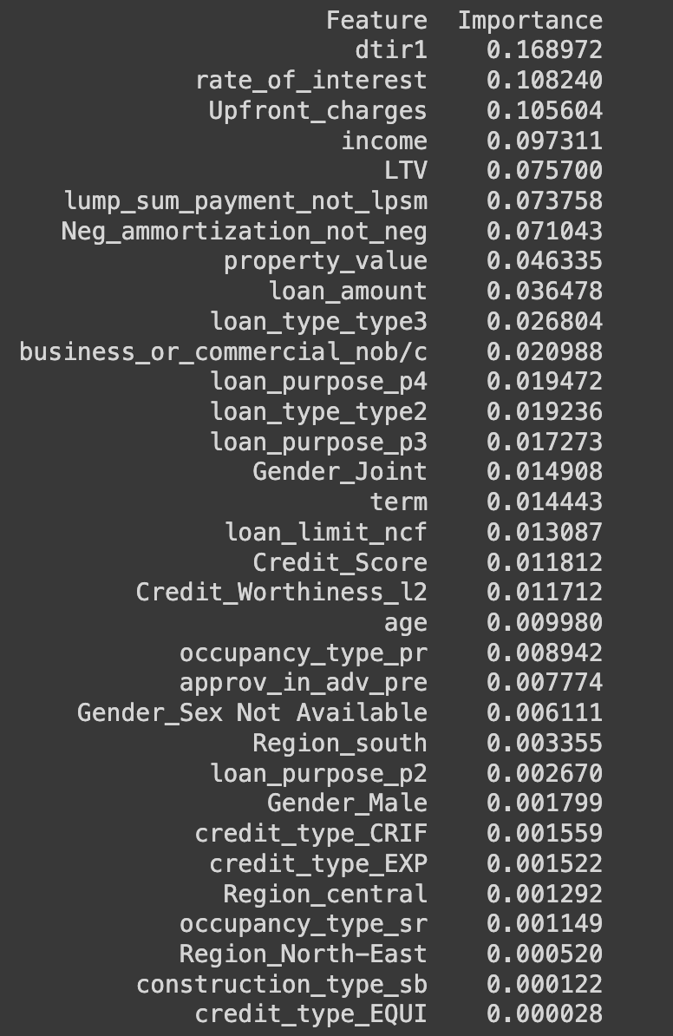
Results & Action Plan
A high debt-to-income ratio indicates that a significant portion of a person's income is already committed to servicing existing debts. So, to avoid this, the bank should perform a deeper analysis on DTIR.
Customers who choose to pay upfront charges may be doing so because they are in a financially strained situation. Financial strain can be an indicator of a higher risk of default. The banks can provide customers with flexible repayment options based on their financial situation. This could include customized repayment plans, grace periods, or options to adjust installment amounts during challenging periods.
Customers with a higher risk profile, such as a lower credit score or a history of late payments, may be offered loans with higher interest rates. And the bank can offer flexible repayment plans to customers facing financial difficulties. This may include options such as temporary payment reductions, deferment, or restructuring of the loan to make it more manageable.
The customers with Lower Income face greater financial challenges, making it more difficult for them to meet their loan obligations. To avoid this, the bank can provide targeted support services for customers with lower incomes, such as financial counseling, budgeting assistance, or access to resources that can help them manage their finances more effectively.
Customers with higher LTV ratio indicates a higher Defaultation of loans because high LTV ratios may be perceived as riskier borrowers, possibly due to creditworthiness, income limitations, or other financial challenges. Consider incorporating provisions for periodic reassessment or adjustments based on changes in the asset's value.

