Slide 1
Building Portfolio Websites and Landing Pages
K.S. Gaikwad

Slide 2
Definition of Portfolio Websites
A portfolio website is your own personal site, where you can present your creative or commercial work.
Importance for College Students
Examples of Portfolio Websites
https://diogotc.com/
http://www.johngreenbooks.com/

Slide 3


Slide 4
Landing Pages
A landing page is a standalone web page, created specifically for a marketing or advertising campaign.
It’s where a visitor “lands” after they click on a link in an email, or ads from Google, Bing, YouTube, Facebook, Instagram, Twitter, or similar places on the web.
Landing pages are designed with a single focus or goal, known as a call to action (or CTA, for short).

Slide 5

Landing Pages

Slide 6
Understanding Your Audience
Every website has a niche audience

Slide 7
Choosing the Right Platform
HTML, CSS, JS, Web frameworks etc
WordPress, Wix, etc
Markdown
Cost
Ease of use
Responsiveness

Slide 8
Demo : Setting Up a Portfolio Website

Slide 9
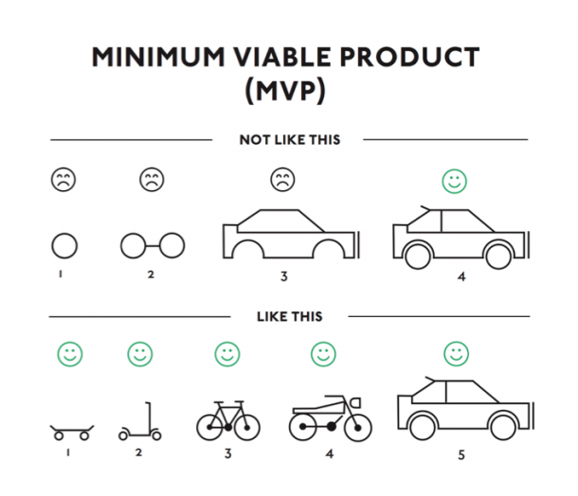
Delivering MVP – Minimum Viable Product

Slide 10

Design - UI
UI – User Interface
UX – User eXperience

Slide 11


Slide 12
Next Steps
Create an issue – GitHub Repository ( Scan Code Below)
Portfolio Link
10 clients – Documentation / Audio / Video Recording
First Call
Discovery
Deal
MVP
Version 1,2,3,….

