Slide 1






Dijkstra's Algorithm
Shreyas Gajbhiye
PRN: 25070521206 | Sec D
Shortest path in weighted graphs

Slide 2



Overview
Finds the shortest path from one source node to every other node in a weighted graph.
Proposed by Edsger W. Dijkstra in 1956. It is a greedy algorithm: at every step it settles the closest unvisited node, so a node's distance is final once it is picked. Works for graphs with non-negative edge weights.

Slide 3



The 4 Steps
1. Initialize
2. Pick
3. Relax
4. Repeat
Set the source distance to 0 and every other node to infinity. Mark all nodes unvisited.
Pick the unvisited node with the smallest known distance (a min-priority queue does this fast).
For each neighbour v of u: if dist[u] + w(u,v) < dist[v], update dist[v] and store u as its parent.
Mark the node as visited. Repeat until all nodes (or the target) are visited.

Slide 4
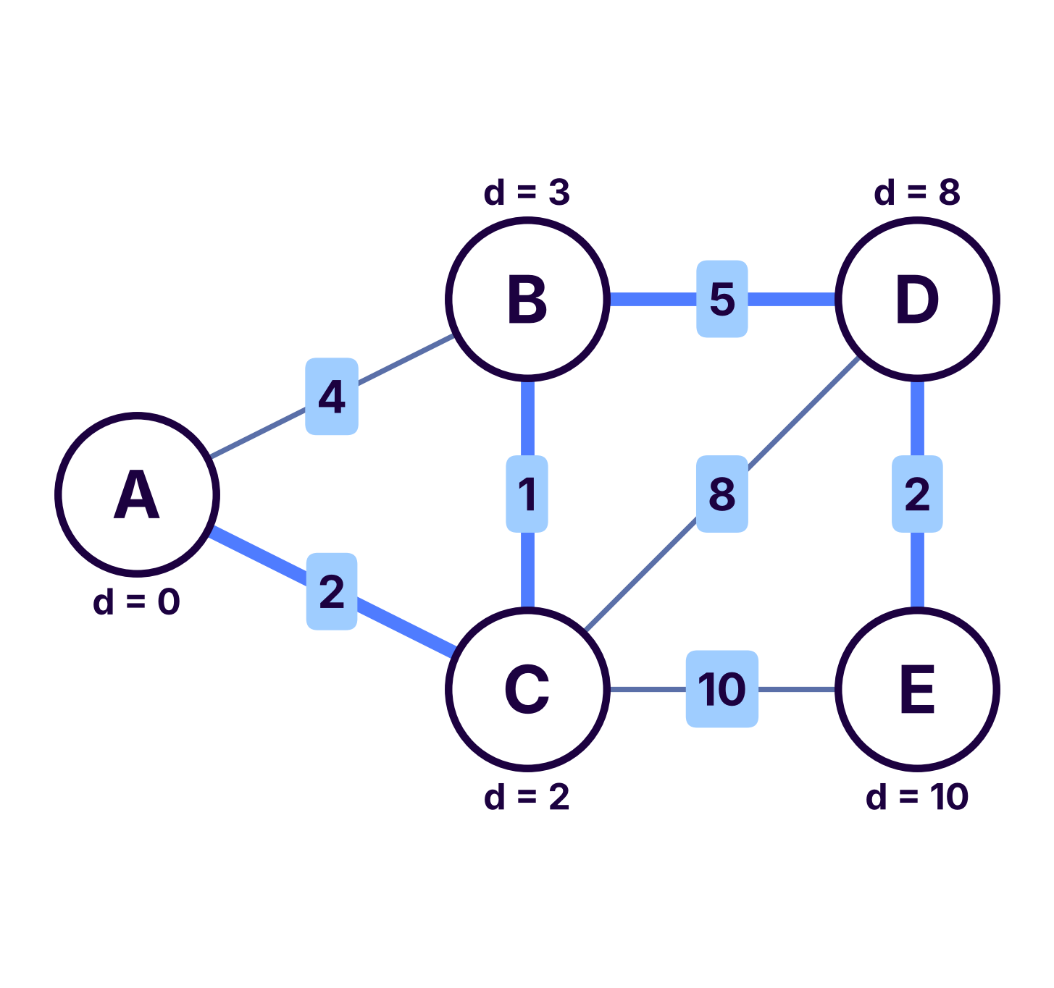
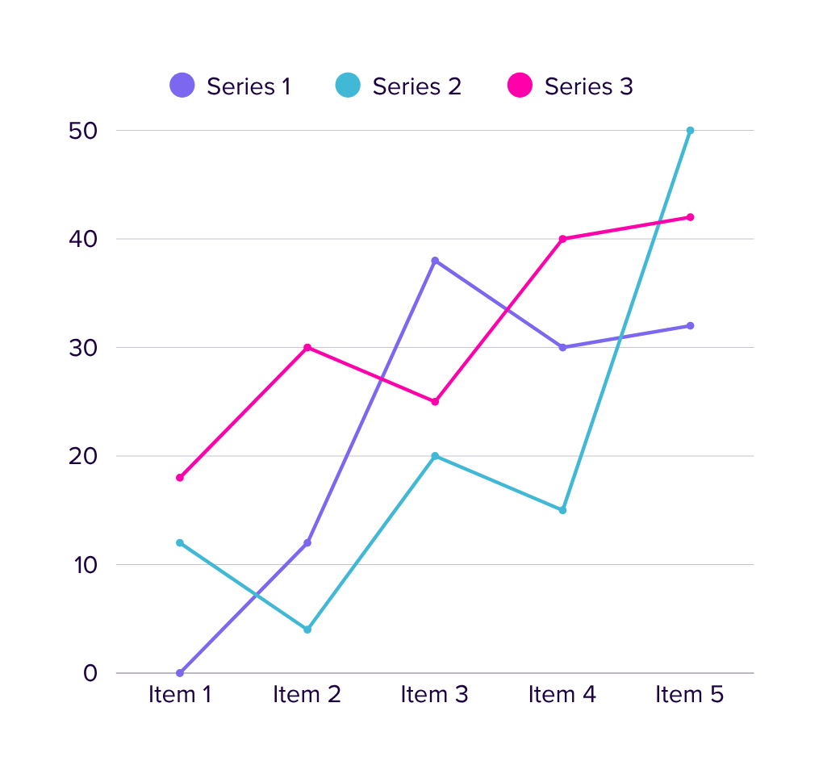
A graph with 5 nodes (A to E) and weighted edges. Source = A. Goal: shortest distance from A to every node. Bold blue edges show the final shortest paths.
Worked Example

Slide 5
Step-by-step
trace
Start: A = 0, all others = infinity
Visit A: B = 4, C = 2
Visit C: B = 3 (via C), D = 10, E = 12
Visit B: D = 8 (via B)
Visit D: E = 10 (via D)
Result: A = 0, B = 3, C = 2, D = 8, E = 10. Shortest path A to E: A -> C -> B -> D -> E (cost 10).

Slide 6
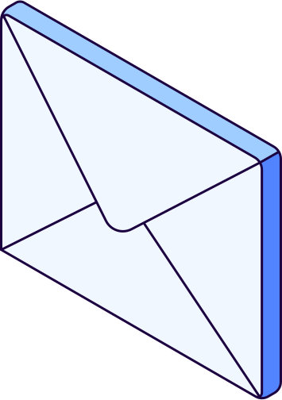

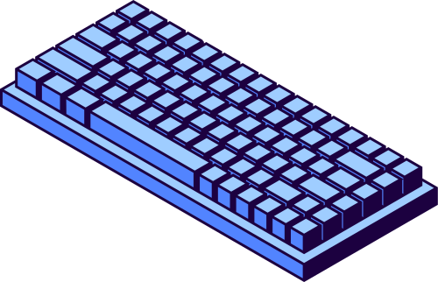
Time Complexity
1.
Simple array: O(V^2). Easy to code, good for dense graphs.
2.
Binary min-heap: O((V + E) log V). The most common choice.
3.
Fibonacci heap: O(E + V log V). Best theoretical bound.

Slide 7
Applications & Limits
1.
Maps & GPS: finds the fastest route between two places.
2.
Network routing: OSPF and IS-IS use it to pick shortest paths.
3.
Limitation: fails with negative edge weights (use Bellman-Ford).

Slide 8

Dijkstra's Algorithm
Shreyas Gajbhiye | PRN: 25070521206 | Sec D
Thank You

