Slide 1
Research Thinking in Mathematics
From problems to structures, conjectures, and proofs
A journey through one problem
1

Slide 2
When mathematicians encounter an unsolved problem,
what do they do?
Problems → Structures → Conjectures → Proofs
2

Slide 3
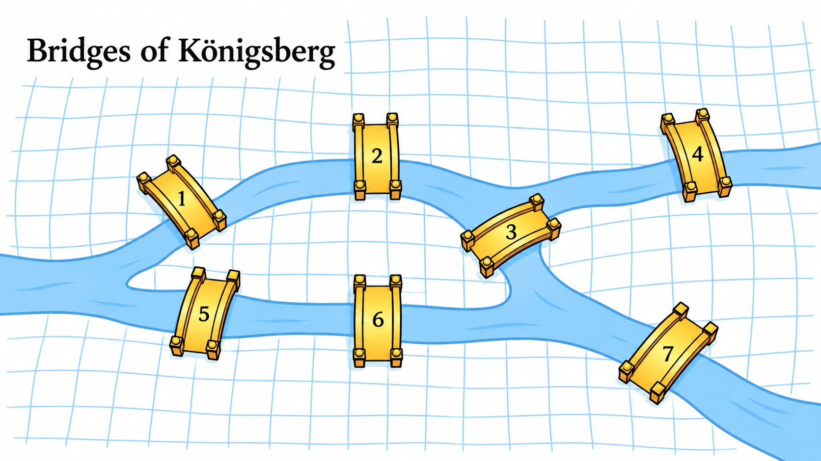
Can we cross every bridge exactly once?
Start anywhere. Cross every bridge exactly once.
You may finish anywhere.
3

Slide 4
Let's try it.
Experiment before theory
Try different starting points
and different routes.
We keep getting stuck.
4

Slide 5
What information actually matters?
Strip away the details
Does the exact shape of the land matter?
Does the length of a bridge matter?
What matters is only:
who is connected to whom.
5

Slide 6
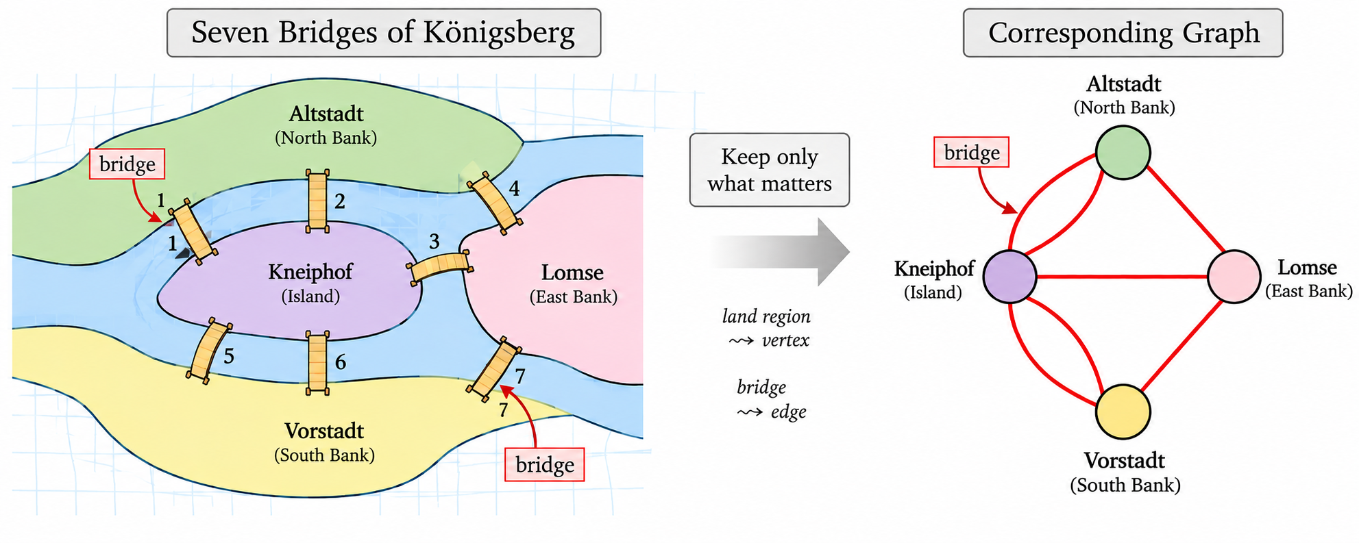
Can we represent the problem more simply?
A new object appears.
vertex = a location
edge = a connection
A geography problem → a graph problem
6

Slide 7
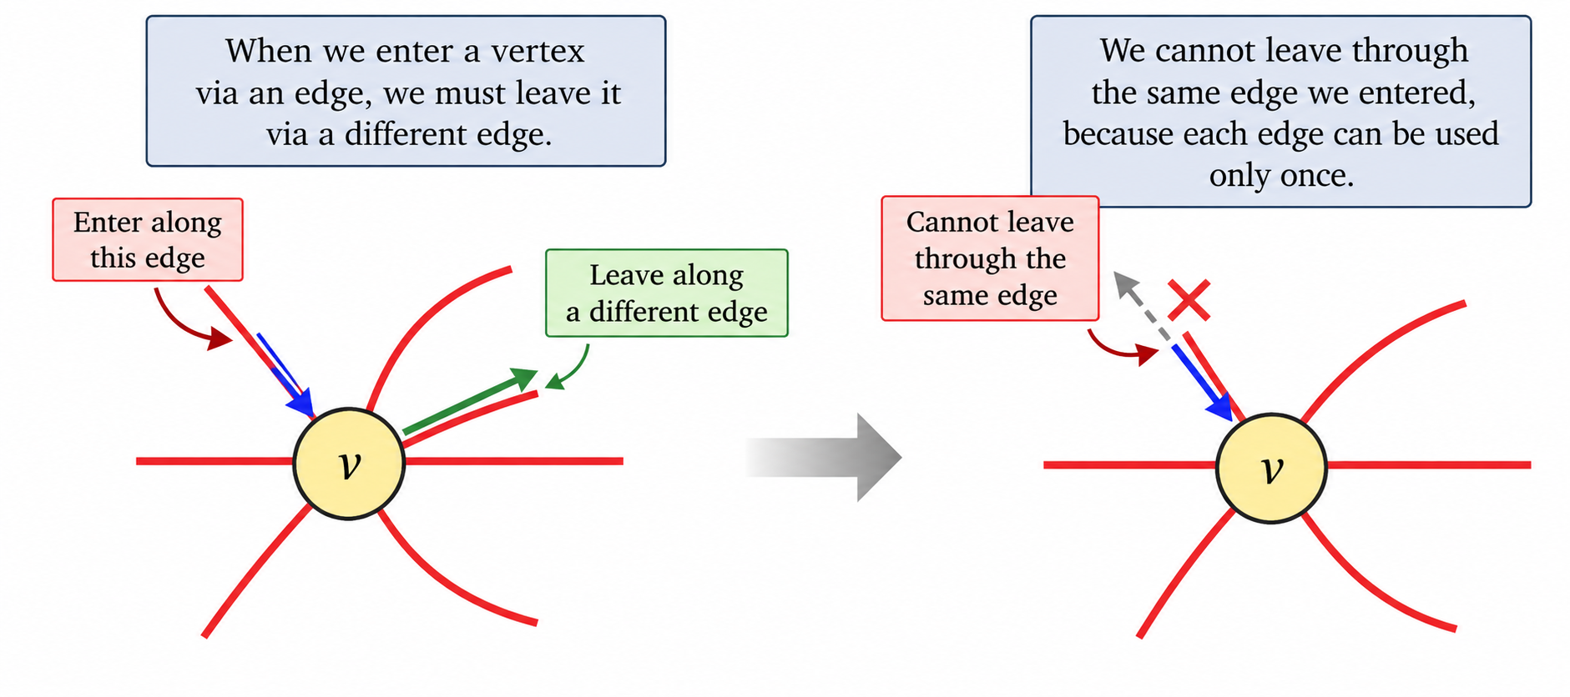
What happens when we enter a region?
Crossings come in pairs.
ENTER
LEAVE
7

Slide 8
What about the beginning and the end?
Only the start and end
can have an unmatched crossing.
Intermediate vertices → even degree
Therefore → at most 2 odd-degree vertices
8

Slide 9
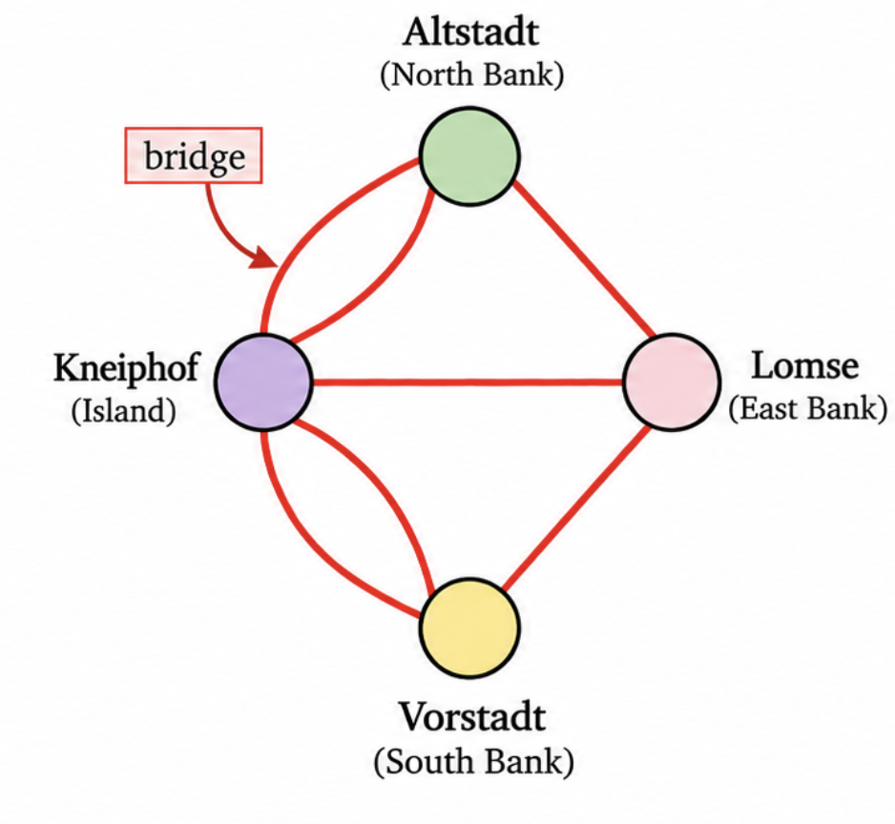
Does Königsberg satisfy our condition?
3
3
All four vertices are odd.
But a valid journey can have
at most two odd-degree vertices.
So the journey is impossible.
3
5
9

Slide 10
We solved more than one problem.
Generalize
The argument wasn't really about Königsberg.
0 odd
2 odd
0 odd
A general structural property emerges.
0 or 2 odd-degree vertices → Eulerian trail
10

Slide 11
What just happened?
Problem
Experiment
Abstraction
Object
Constraint
Generalize
We didn't know the solution at the beginning.
We changed the way we looked at the problem.
11

Slide 12
The bigger idea
• What is really going on here?
• What information is essential?
• What structure is hiding underneath?
• What object captures that structure?
• What must that object satisfy?
Problems → Structures → Conjectures → Proofs
12

