Slide 1
GROCERY MART SYSTEM
TEAM MEMBERS-
SIDDHARTH BHADAURIYA(1900970100114) SHIV CHANDRA YADAV(1900970100109)
SHREYASH (1900970100113)
TANISHK MEROTHIYA(1900970100120)

Slide 2
INTRODUCTION
The Grocery Management System is developed to facilitate the work of the grocery storekeeper and the customer who buys the products. This system consists of the methods which can relate the perpetual crisis while managing the rhetoric quandaries concerning the authoritarian source.
The Grocery Shopping System keeps track of all information about a product, including its manufacturer, type, customer, and stock. This system can also maintain track of the personal information of customers. The grocery shopping system is a PHP and SQL-based online application. It allows you to manage your grocery store, customer information, and assist in the online sale of your groceries

Slide 3
OBJECTIVE
This project's main purpose is to maintain track of all the information about the different stores, their selling products, customer information, and order information. This system also aids in the management of grocery inventory, restocking, sales, refunds, purchases, and other tasks. It increases the number of employment available and the number of opportunities to participate in earning activities.

Slide 4
SYSTEM REQUIREMENTS
Category
Minimum
OPERATING SYSTEM:
Windows 10 is used as it is stable and support features and is more user friendly
ENVIRONMENT:
Microsoft Visual Studio
.NET FRAMEWORK:
PHP
LANGUAGE:
CSS, HTML,PHP
BACKEND:
SQL

Slide 5
HARDWARE REQUIREMENTS
Category
Minimum
Maximum
Windows MAC OS X
Intel Core i5 and above ( Intel Core i7) OR AMD FX 4100 and above, or A6 and above
PROCESSOR:
Intel Pentium III
HARD DISK:
20GB
128
Gigabytes (GB)*
128GB+Solid State Disk(SSD) with at least 20 GB of free disk space
RAM:
1GB
8GB
PROCESSOR SPEED:
2.4 GHz
Wired Networking:
Ethernet LAN Port or USB
Ethernet LAN Port or USB Ethernet Adapter/Dongle
Intra server
Wireless Networking
802.09g
802.13ax

Slide 6
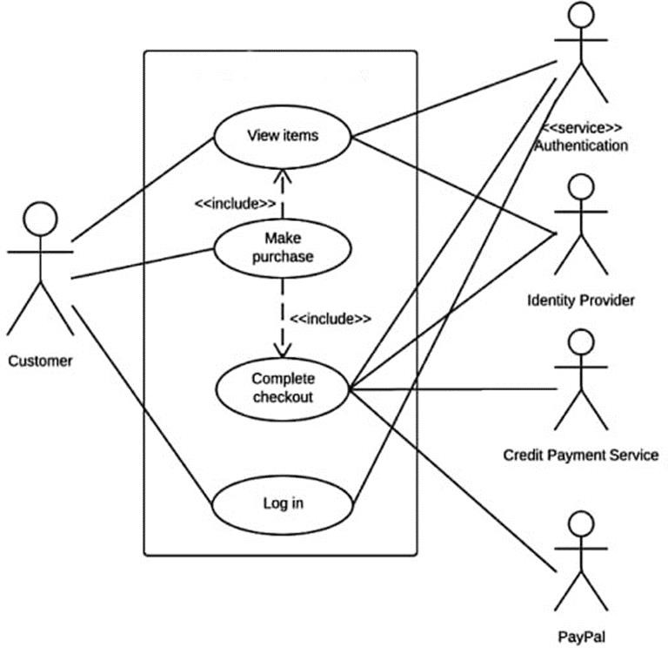
USE CASE DIAGRAM

Slide 7
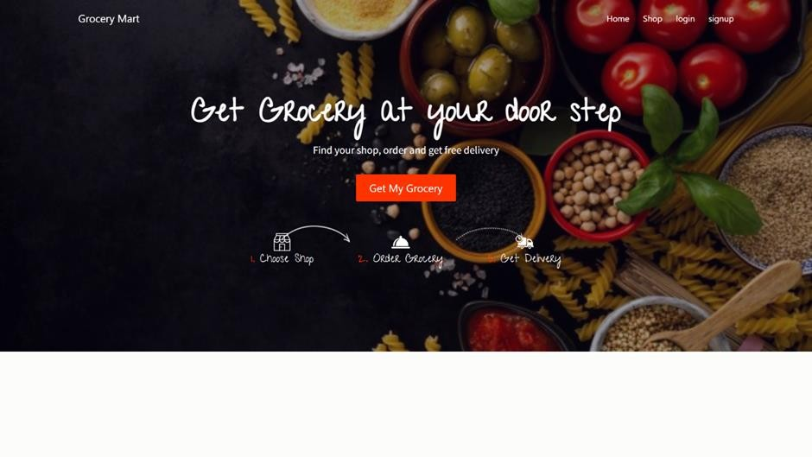
SCREEN LAYOUT

Slide 8
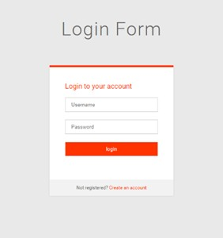
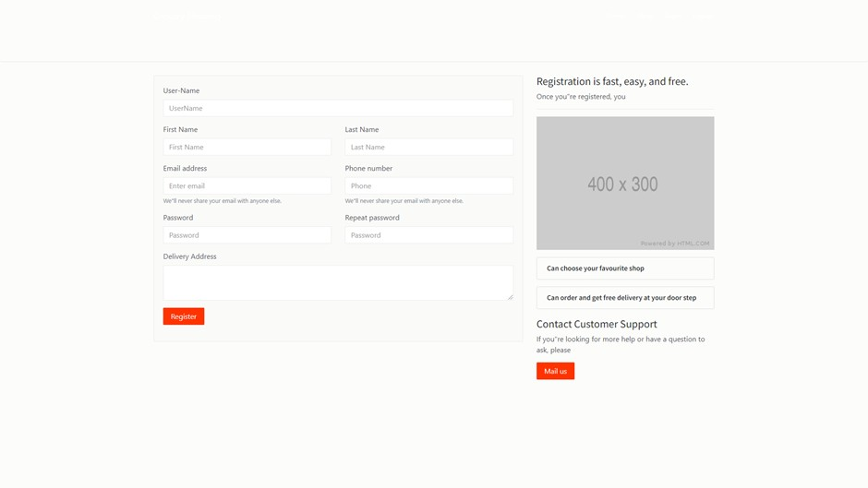
LOGIN PANEL

Slide 9
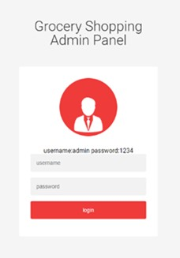
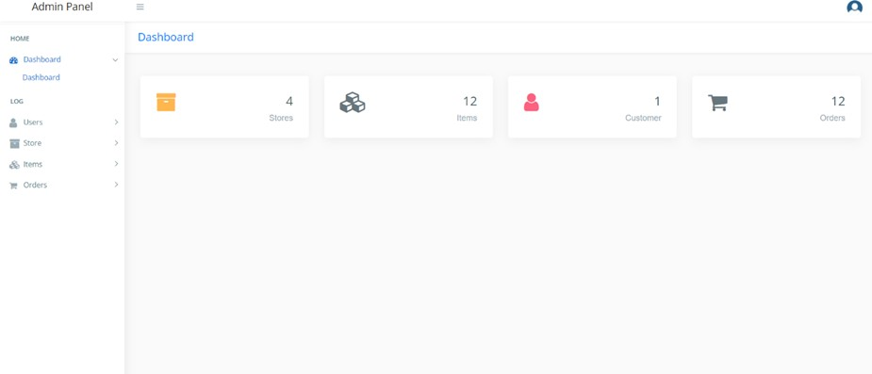
ADMIN PANEL

Slide 10
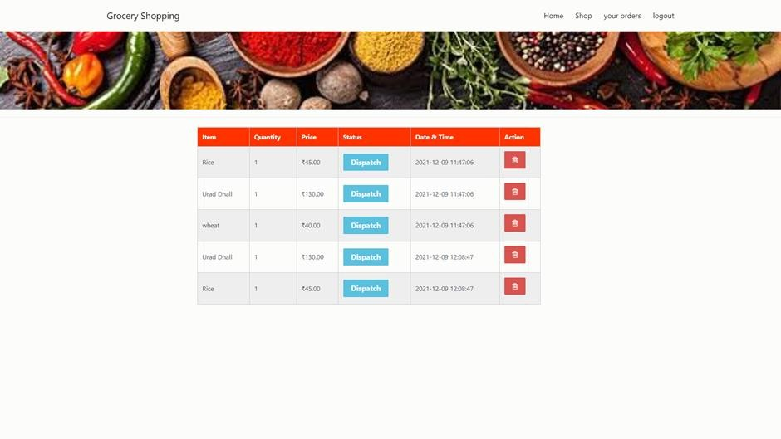
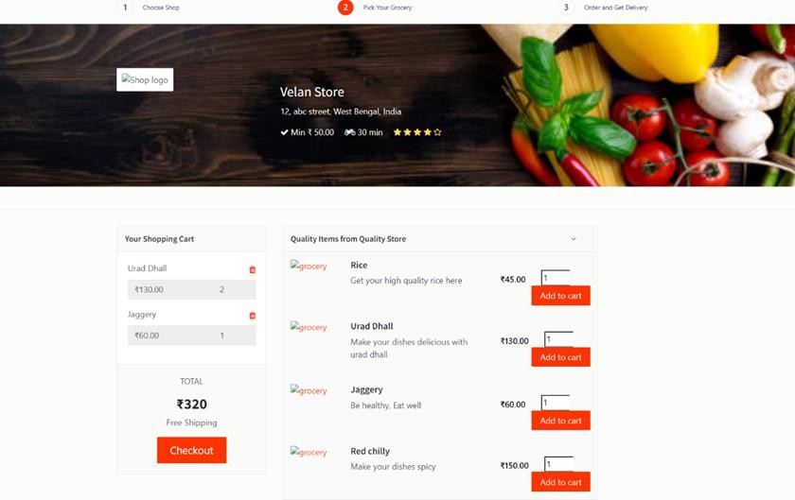
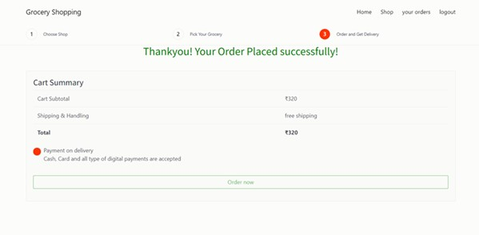

Slide 11
MODULE DESCRIPTION
Admin Panel
Admin has the official powers to control the flow of the data from one part of the system to the other. He can manipulate the access of the users to the data. The primary purpose of this account is to make the user data relevant and then giving the inputs to the other interface module and make it work optimistically and get the timetable according to the wish we want to create for a particular type of inputs.
Hence all the data will be reflected in clean and well data in the interfaces.
Dashboard
User Management
Add User
Update / Delete User
(iii) Store Management
Add Store
Update / Delete Store

Slide 12
MODULE DESCRIPTION
(iv) Item Management
Add Item to specific Store
Update/ Delete Item
(v) Order Management
Order Management
Get all Order Details
Take Action on Order
Dispatch – For new order
On the way – If the order ready for packing
Cancelled – If the ordered item is unavailable

Slide 13
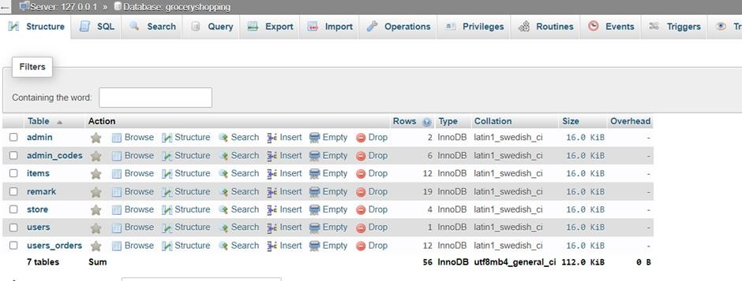
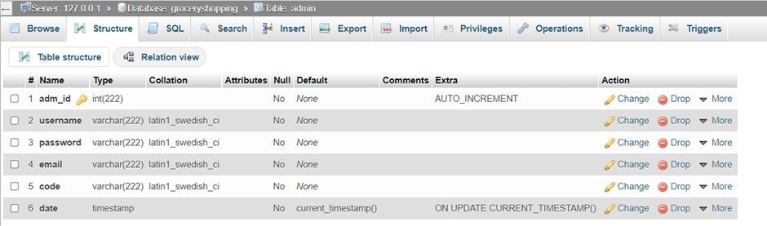
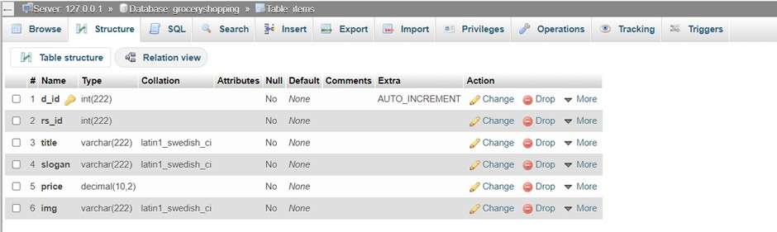
DATABASE TABLES

Slide 14
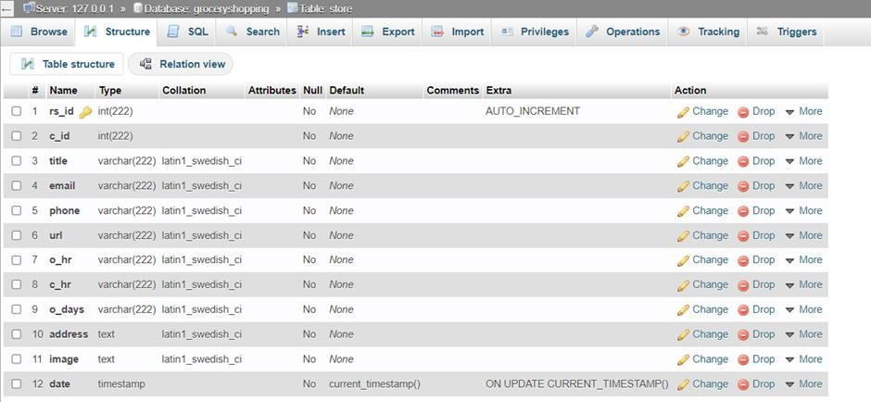
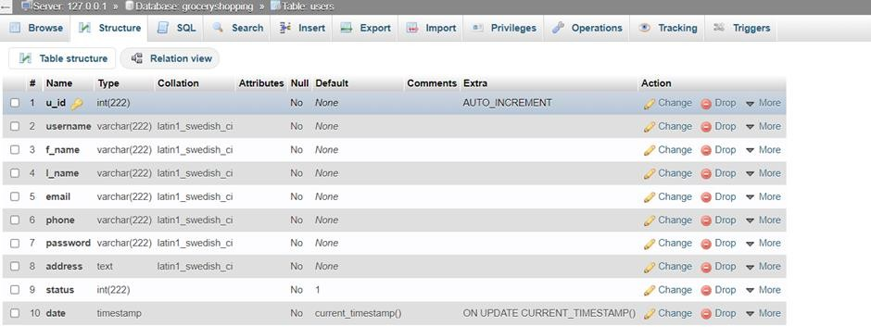
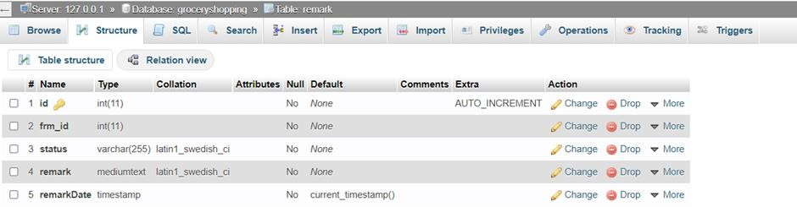
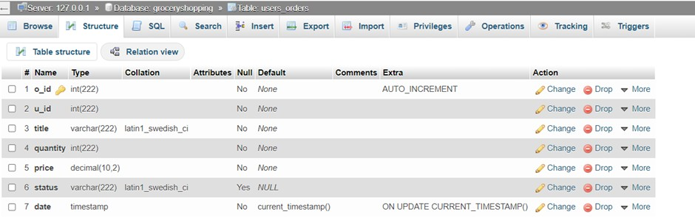
DATABASE TABLES

