Slide 1
Smart Brain
Presented By:
Shreyash Srivastava (191500787)

Slide 2
OUTLINE
About the Project
Objective
Requirements
Snapshots from the website

Slide 3
ABOUT THE PROJECT
We will be building a face detection application.
The application will have two buttons, one for picking an image and one for detecting the faces. The button for picking an image will ask the user to select a source. Once a photo is selected, the button for detecting faces becomes visible. Tapping this button will send a request to face detection API, which returns the data for the detected faces. Using the response of the API, little boxes are drawn around the detected faces.

Slide 4
OBJECTIVE
The face is one of the easiest ways to distinguish the individual identity of each other. Face recognition is a personal identification system that uses personal characteristics of a person to identify the person's identity. Our objective is to design an interactive User Interface which could be used as a face recognition system.

Slide 5
REQUIREMENTS
Software Specification Used:-
Technology Implemented: React.js, Node.js, APIs
Languages/Technologies Used: Front-End Technologies
IDE Used: Sublime Text
Web Browser: Google Chrome

Slide 6
Hardware Used:
Operating System: Windows 10
RAM: 2 GB
Hardware Devices: Computer System
Hard Disk: 256 GB

Slide 7
THIS IS HOW OUR PROJECT LOOKS
Hope you will like it :)

Slide 8
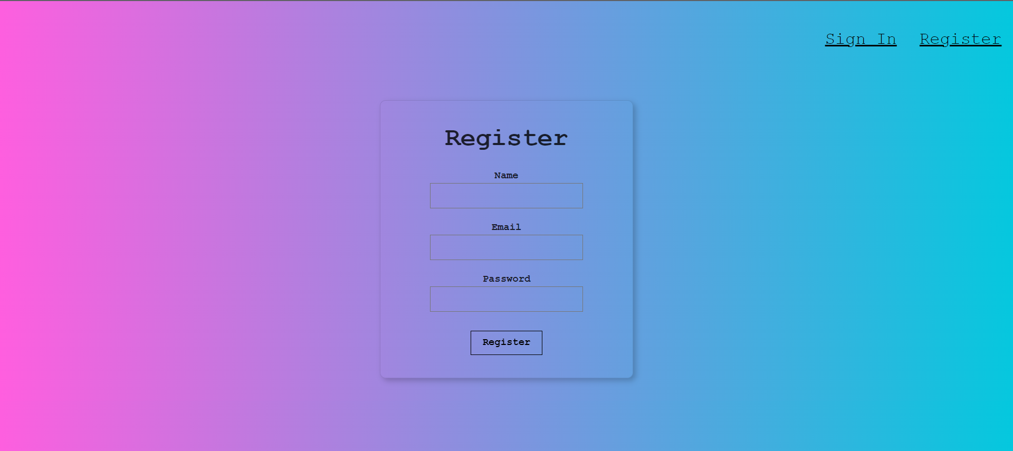
REGISTER PAGE

Slide 9
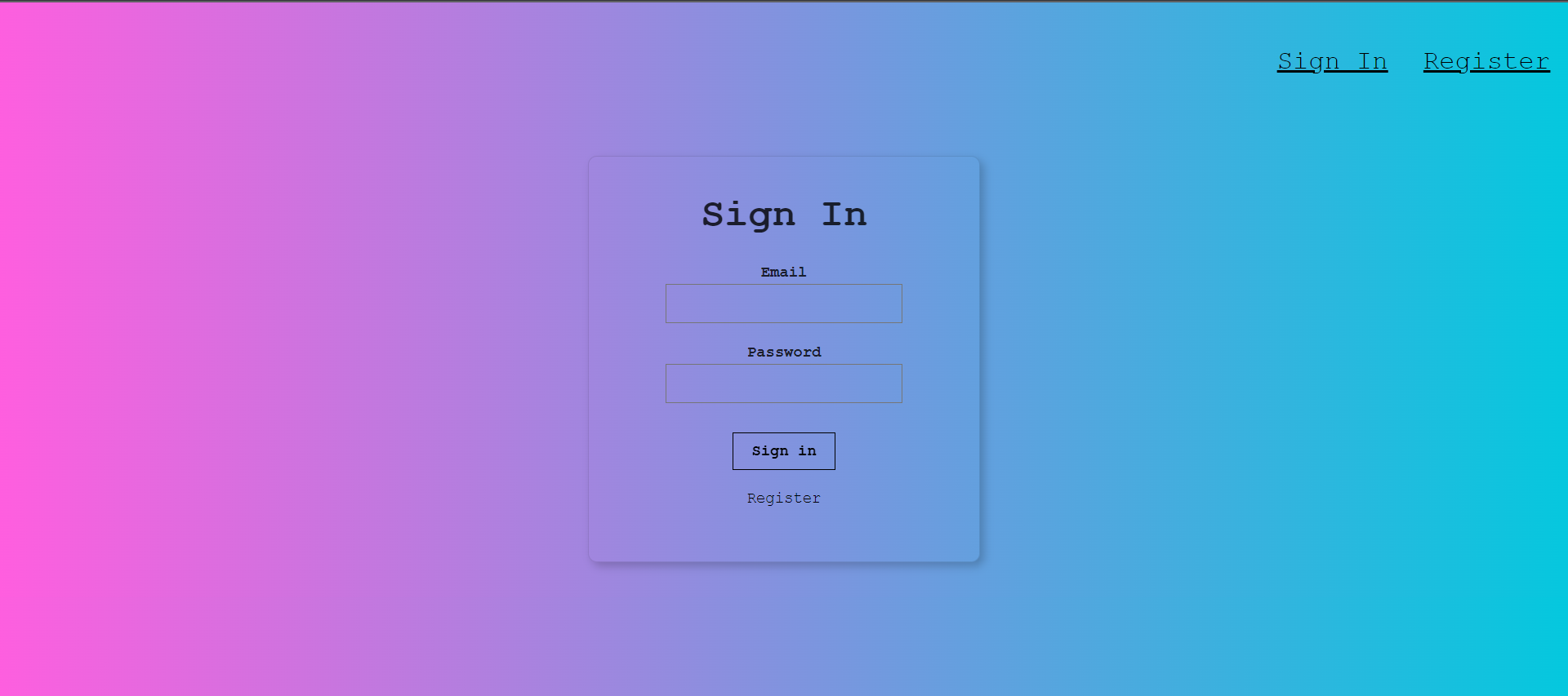
2. SIGN IN PAGE

Slide 10
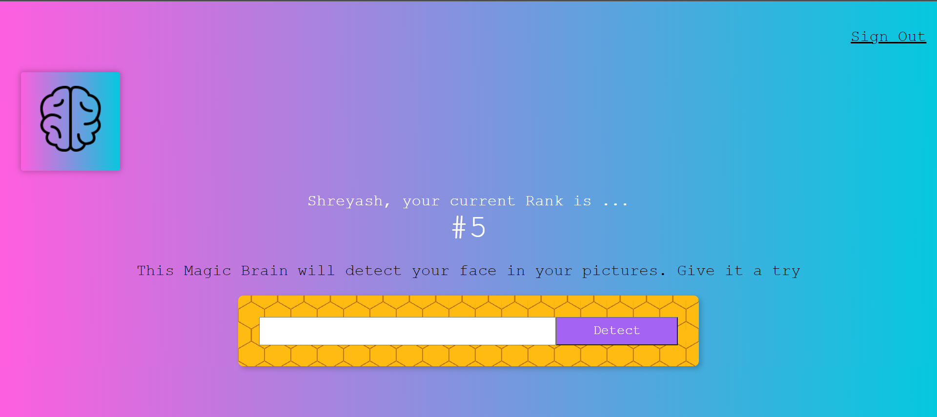
3. MAIN PAGE

Slide 11
Thank You!!!

