Slide 1

QuickServicing.Com
Presented By
Mayur Katarmal (210943120052)
Shreyash Abhang ( 210943120097)
Ashutosh Murumkar ( 210943120017)

Slide 2
Contents
Introduction
Modules
Use Case Diagram
Future Scope

Slide 3
Introduction
Due to the Pandemic people prefer to stay home and get their works done with a easy and effective way. Because of which the use of personal vehicle’s is more and need to service the vehicle is increasing rapidly. But people don’t want to come in contact with other persons in order to maintain social distance .So we came up with an idea to make a system through which people can simply log into the system and list their vehicle and just select a service centre according to their need and the service centre can come and collect their vehicle and can service them easily without coming in direct contact with each other.

Slide 4
With this system we made arrive each and every service station at each and everybody’s home. Our system will be also beneficial for all garage owners, tyre shop owners as well as the vehicle shipment owners because they are going to get more number of customers easily.

Slide 5
Modules
1. Customer Module
Customer Can register in this module and enter his details
Customer can enter his vehicles details and can look for the shop that he wants to get his bike services from.
Enter his location or we can say the pickup point from where his vehicle would be picked.
Give feedback about the garage &Raise any complaint.

Slide 6
2. Service Provider Module
Enlist their shop and show the costing and charges.
Can enter their details and specialization
Can check for service request of the customers and act upon it.

Slide 7
3. Admin Module
Admin will have all-over control on the functionality i.e.
He can add a garage or shop, he can check for payments and complainants and can act upon it.
He can view all the details of all the peoples and modules.

Slide 8
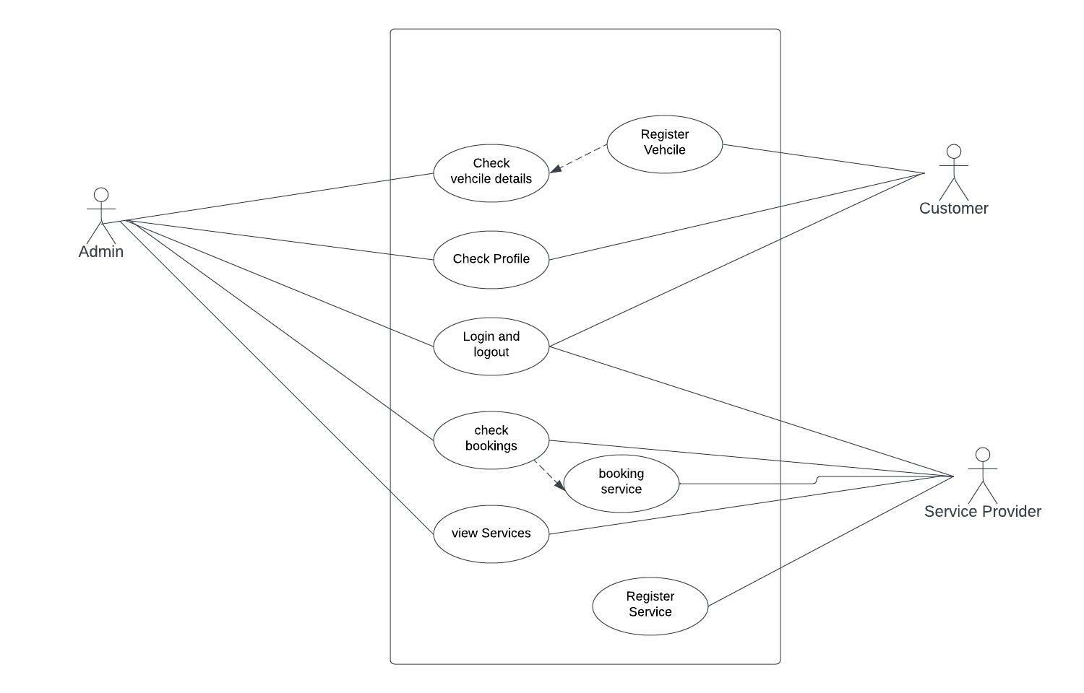
Use Case Diagram

Slide 9
Future Scope
We can add a Google Maps by which the location tracking can be made much easier
We can also add a UPI service in the future with which the payment system can be much easier

Slide 10
Thank You…..

