Slide 1

PRESENTATION On “SMART RESUME ANALYZER” Delivered By: Shreyash Ghogare Yash Wanjari Gaurav Sontakke Yash Dhomne Parimal Yawalkar Under Guidance of: Dr. Dhiraj Karwatkar
U.G. Program Computer Science and Engineering Department of Data Science Abha Gaikwad-Patil College of Engineering & Technology, Nagpur
Academic Year : 2024-2025

Slide 2
INDEX
Introduction
Literature Survey
Problem Statement
Objectives
Techniques
Proposed work
Conclusion
References

Slide 3
INTRODUCTION
Any recruiter will find it difficult to choose the best prospects from a vast pool of applicants for that employment vacancy. The chore of manually sorting through thousands of resumes to find the best candidates for the position is incredibly challenging for recruiters. Although the methods employed by job websites have produced some accuracy and precision, one of the main drawbacks is the intricacy of the time component. The time complexity for getting the results is very significant if every candidate resume is compared to every other job posting provided on the online recruitment site. In the last several years, more than 50,000 e-recruitment websites have been created.
These online recruitment services creators have employed a variety of strategies to find potential applicants for a specific job profile. Some of them have been successful in using approaches for categorizing resumes of applicants into different groups for each job posting provided by each employer. These methods attempt to match each applicant's resume with the specific job posting. To determine which resumes are closest to the specified job description, top candidates could be sorted using Content-based Recommendation, cosine similarity, and KNN.

Slide 4
LITERATURE SURVEY
British Broadcasting Corporation-BBC
AI hiring tools may be filtering out the best job applicants
Published on 16 February 2024 by Charlotte Lytton
In one high-profile case in 2020, UK-based make-up artist Anthea Mairoudhiou said her company told her to re-apply for her role after being furloughed during the pandemic. She was evaluated both based on past performance and via an AI-screening programme, HireVue. She says she ranked well in the skills evaluation – but after the AI tool scored her body language poorly, she was out of a job for good.
"The problem is no-one knows exactly where the harm is," she explains. And, given that companies have saved money by replacing human HR staff with AI–which can process piles of resumes in a fraction of the time – she believes firms may have little motivation to interrogate kinks in the machine.

Slide 5
PROBLEM STATEMENT
In the current competitive job market, recruiters receive thousands of resumes for a single position, making it difficult to efficiently screen and identify the most suitable candidates. Traditional methods of resume screening are time-consuming and prone to human error, leading to potential mismatches between candidates and job roles.
Additionally, applicants struggle to optimize their resumes to highlight relevant skills and experiences that align with specific job descriptions. The problem lies in the lack of an automated, intelligent system that can analyze resumes, extract key information, and evaluate them against job requirements with high accuracy. There is also a need for a tool that can provide feedback to job seekers on how to improve their resumes for better visibility and relevance in the job market.
The "Smart Resume Analyzer" aims to address these challenges by developing an AI-powered tool that can match resumes against specific job descriptions to rank candidates based on their suitability, provide actionable feedback to job seekers to enhance their resumes, save time for recruiters and improve the quality of the hiring process by reducing the risk of overlooking qualified candidates. This solution will help streamline the recruitment process, ensure a better match between job seekers and employers, and assist applicants in presenting their qualifications more effectively.

Slide 6
OBJECTIVES
Automated Resume Parsing: Develop an algorithm capable of automatically parsing resumes to extract key information such as contact details, education, work experience, skills, certifications, and other relevant sections.
Job Description Matching: Create a matching system that compares the extracted resume data with job descriptions to evaluate the compatibility between a candidate’s qualifications and the job requirements.
Skill and Experience Analysis: Implement a module to analyze the skills and experience listed in the resume, identifying strengths and gaps relative to the job market demands.
User-Friendly Interface: Build an intuitive and user-friendly interface for both recruiters and job seekers, ensuring easy navigation and interaction with the system. Allow users to upload resumes and receive instant analysis and feedback.
Data Privacy and Security: Ensure that the system complies with data privacy regulations by securing user data and maintaining confidentiality.
Performance Metrics: Develop performance metrics to evaluate the efficiency and effectiveness of the resume analyzer, such as accuracy of resume parsing, matching success rate, and user satisfaction.
Scalability: Design the system to be scalable, capable of handling a large volume of resumes and job descriptions without compromising performance. Ensure that the system can be easily updated with new algorithms or modules as technology and market needs evolve.

Slide 7
TECHNIQUES
Natural Language Processing: to extract and understand text from resumes.
Named Entity Recognition: to identify and classify entities like names, skills and experience.
Text Summarization: to generate concise summaries of resumes.
Recommendation Systems: to suggest relevant job roles and skills.
Python libraries: NLTK, SPACY, PANDAS, NUMPY, OPENPYX1, SCIKIT-LEARN, TENSORFLOW, PYTORCH, PYTESSERACT, PYPDF2, DOCX, MATPLOTLIB, SEABORN, PLOTLY
Algorithm: ADAMW (AKA ADAM OPTIMIZER WITH WEIGHT DECAY): used to manage larning rates adaptively resulting in better performance to fine tune models on specific NLP tasks involved in reusme analysis.

Slide 8
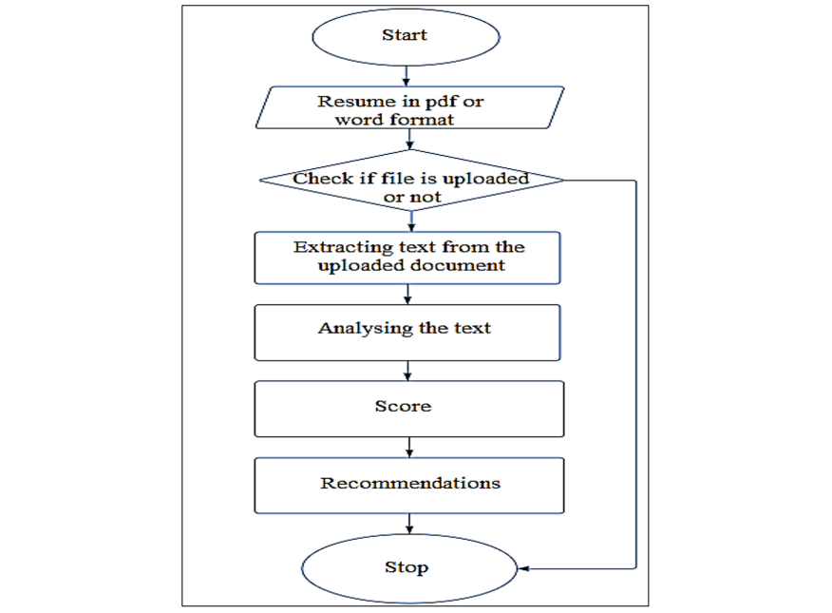
PROPOSED WORK

Slide 9
METHODOLOGY
The initial step of the interface of proposed method involves obtaining resumes from the participants in the form of either a PDF or Word document format. The participants were informed that the maximum allowable file size for submission is 200MB. Upon receipt of the submitted resumes, a prompt display of the uploaded file is provided, allowing participants to review their submission and edit it if necessary. The uploaded resumes are then securely stored in our system for subsequent phases of the interface of proposed method. The file that has been uploaded by the user is accepted by us.
Now we move into the second phase where we extract the data from the uploaded resume. To do the extraction of the data efficiently we take the help of the module pyresparser. We call the pyrespareser functions and store their return values in a variable. The pyresparser when called extracts the user’s name, the user’s email id, the user’s phone number, the user’s skills, The user’s total experience, and more from the uploaded file and returns it to the place where the function was called.

Slide 10
METHDOLOGY CONTINUED
The module pyresparser internally uses spacy and NLTK modules which can provide the pyresparser to do NLP operations. pyresparser takes the uploaded resume as the input and returns a list of dictionary objects, each key of this dictionary represents a medium to identify a person to elaborate this statement with an example the medium can be: name, email id, and phone number these are unique characteristics used to identify a person. The value for these keys can be: the name of the person, the phone number of a person, etc, and this information is extracted from the user's resume by this module. Finally, this model defines a dictionary in a list. The keys in the dictionary are a set of names that are the unique identifiers of any person like name, phone numbers and the values for these keys are the corresponding information in the user's resume.

Slide 11
CONCLUSION
Hiring new employees and analysing a large number of resumes and cv's is a challenge for the human resource department or employer. Therefore, this system will help the recruiters by using an automated intelligent system based on natural language processing. The project will lay out the quality of applicants for the companies.
The unfair and discriminatory malpractices in the process will be reduced. Based on the relevant data in the form of technical skills the resumes will be ranked in order. This Resume Parsing technique aims to be used for screening candidate profiles, to decrease an organization’s time-to-hire. The project can benefit the human resource department or recruiter in screening resumes before conducting interviews and finding the best candidate for a particular job position

Slide 12
REFERENCES
“Resume Screening using Machine Learning” by Dr. Sandeep Tayal, Shivansh Singhal, Taniya Sharma. In: April 2024 International Journal of Scientific Research in Computer Science Engineering and Information Technology 10(2):602-606 DOI:10.32628/CSEIT2410275 LicenseCC BY 4.0
“Applying BERT-Based NLP for Automated Resume Screening and Candidate Ranking” by Asmita Deshmukh, Anjali Raut. In: March 2024, Annals of Data Science. DOI:10.1007/s40745-024-00524-5
“Towards smarter hiring: resume parsing and ranking with YOLOv5 and DistilBERT” by Shakti Kinger, Shivam Thakkar, Devashish Bhake, Somaiya Vidyavihar. In: March 2024 Multimedia Tools and Applications DOI:10.1007/s11042-024-18778-9
“Resume Screening with Natural Language Processing in Python” by Shradha Pujari. In: September 2023 DOI:10.13140/RG.2.2.17882.11206
"Smart Resume Analyser: A Case Study using RNN-based Keyword Extraction" by Patlolla Sruthi1, P. N. V. K. G. Adithya, MD. Suleman, Pallerla Kunal, Surya Prakash, E3S Web of Conferences 430 , 01023 (2023), ICMPC 2023
“Smart Resume Analyzer” by Ms. Y. Sowjanya, Mareddy Keerthana, Pulluri Suneeksha, Dorgipati Sai Sri Harsha. In: International Journal of Research in Engineering and Science (IJRES), ISSN (Online): 2320-9364, ISSN (Print): 2320-9356, www.ijres.org Volume 11 Issue 3 March 2023 PP. 409-418
“Smart Resume Analyser: A Case Study using RNN-based Keyword Extraction” by Patlolla Sruthi, P.N.V.K.G. Adithya, M.D. Suleman. In: October 2023 E3S Web of Conferences 430 430 DOI:10.1051/e3sconf/202343001023 LicenseCC BY 4.0
“AUTOMATED SOLUTION FOR RESUME ANALYSIS USING MACHINE LEARNING” by R M K G K Rathnayake, Eranda Dhanushka, Chamod Rathnayake. In: March 2024 Conference: The 1st International Conference on University-Industry Collaborations for Sustainable DevelopmentAt: Colombo, Sri Lanka

Slide 13


