Slide 1
TIME SERIES & ANALYSIS PROJECT · MID-SEM EVALUATION
AQI Forecasting Driven Health Prediction System
Phase 2: forecasting daily AQI 30 days ahead with ARIMA, SARIMA and Holt-Winters, across six Indian cities
Delhi, monthly mean AQI, 2015–2020: the winter peaks we are trying to forecast
Shreyash Singh S24CSEU1290
Bhoomi Singh S24CSEU0886
CPCB daily data via Kaggle · 2015–2020
Notes:
Good morning. In Phase 1 we explored the data. In Phase 2 we built the first forecasting models: classical time-series models that predict daily AQI a month ahead for six cities. The line at the bottom is Delhi's monthly AQI; those winter peaks are what we are trying to forecast.

Slide 2
Every step we planned, built and tested
01 · FROM PLAN TO IMPLEMENTATION
The question for this phase: can a model forecast AQI a month ahead better than “tomorrow looks like today”? Six cities, 10,711 days of CPCB data, 2015–2020.
Planned | What we built | Code | Result (reports/)
Clean the data (gaps found in EDA) | Daily index, gaps ≤ 21 days interpolated, log(1 + AQI), Ahmedabad CO fixed | src/data_loader.py src/preprocessing.py | preprocessing.csv
Test stationarity | ADF and KPSS on the level and the first difference | src/preprocessing.py | stationarity.csv
Let decomposition guide the models | Decomposition and ACF / PACF of log AQI | src/phase2.py | decomposition, ACF plots
ARIMA / SARIMA for trend and season | ARIMA; SARIMA + annual Fourier terms; orders by AIC | src/models/statistical.py | parameters.csv, AIC grids
Holt-Winters for the yearly cycle | Damped trend; 7- vs 365-day season by AIC | src/models/statistical.py | parameters.csv
Check model assumptions | Ljung-Box and Jarque-Bera on the residuals | src/phase2.py | residual_diagnostics.csv
Score with RMSE, MAE, MAPE | 6 rolling 30-day windows against 3 naive baselines | src/run_forecasting.py | metrics.csv, forecast plots
Notes:
This slide links the plan to the build. Each step we proposed in the synopsis, plus the checks the Phase 2 brief asks for, has a method, the code file that implements it, and the saved result. The question running through it all: can a model forecast AQI a month ahead better than assuming tomorrow looks like today? Running python -m src.run_forecasting and then python -m src.phase2 reproduces every number in this deck.

Slide 3
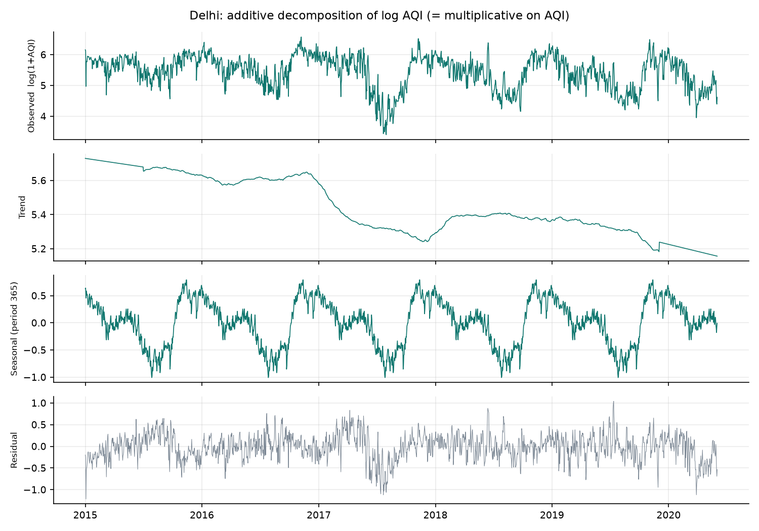
Stationary, but the level breathes with the seasons
02 · DATA AND STATIONARITY
WHAT WE DID TO THE DATA
Filled short gaps only. Gaps up to 21 days are interpolated (0.5–4% of days) and never used for scoring.
Took the log. AQI is skewed and swings harder when it is high; log(1 + AQI) evens that out.
Fixed Ahmedabad. A faulty CO sensor inflated its AQI, so we rebuilt it without CO.
WHAT THE TESTS SAID
ADF rejects a unit root in all 6 cities (p < 0.05). KPSS objects in 5, because the mean moves with the seasons. So no differencing (d = 0); the yearly cycle is modelled directly.
Notes:
We kept preprocessing light: fill only short gaps, take the log, and fix Ahmedabad's faulty CO readings. The ADF test says there is no unit root anywhere; KPSS disagrees in five cities because the level moves with the seasons, which the decomposition on the right shows clearly for Delhi. So we do not difference; we model the yearly cycle instead.

Slide 4
The autocorrelation chose our models for us
03 · READING THE STRUCTURE
Strong persistence
→ autoregressive terms
ARIMA
A yearly wave
→ annual Fourier terms
SARIMA
Level + season smoothing
→ exponential smoothing
Lag 1: 0.92
Lags 100–250: negative
Lag 365: back to 0.52
Holt-Winters
Yesterday predicts today
Summer vs winter, opposite seasons
The yearly cycle returns
Notes:
This is the autocorrelation of Delhi's log AQI. It starts around 0.9, so yesterday is a strong predictor of today. It turns negative for opposite seasons and climbs back near one year. Persistence points to AR terms, the yearly wave to Fourier terms in SARIMA, and Holt-Winters gives us a smoothing-based alternative. The weekly pattern turned out to be weak.

Slide 5
Three classical models, each tuned by AIC
04 · THE MODELS
ARIMA
SARIMA
Holt-Winters
Uses the last few days of AQI and the last few errors.
ARIMA plus a weekly term and three yearly sine/cosine waves.
Smooths level, trend and season separately.
p, q ≤ 3 searched by AIC; d = 0 from the ADF test.
A 365-day seasonal ARIMA is too slow on ~1,900 days, so Fourier terms carry the year.
Damped trend; season of 7 or 365 days chosen by AIC.
Chosen by AIC | Delhi | Bengaluru | Chennai | Hyderabad | Lucknow | Ahmedabad | White-noise residuals*
ARIMA | (2,0,2) | (2,0,1) | (2,0,2) | (3,0,1) | (2,0,2) | (2,0,2) | 4 / 6
SARIMA | (2,0,2)(0,0,1)₇ | (2,0,1)(0,0,1)₇ | (2,0,2)(0,0,1)₇ | (2,0,2)(0,0,1)₇ | (2,0,2)(0,0,1)₇ | (2,0,2)(0,0,1)₇ | 4 / 6
Holt-Winters | m 7 · α 0.94 | m 7 · α 0.46 | m 7 · α 0.73 | m 7 · α 0.70 | m 7 · α 0.70 | m 7 · α 0.67 | 0 / 6
Why these orders: in every city the runner-up ARIMA order is within 2 AIC points of the best, so the exact order matters little; but the best model without an AR term is 185–888 points worse, so the AR terms are essential.
*Ljung-Box at lag 14, by city. Residuals are heavy-tailed (kurtosis 4.5–13.0), and Holt-Winters, with no AR term, leaves day-to-day persistence in its errors.
Notes:
Three models. ARIMA uses recent days and errors. SARIMA adds a weekly term and yearly waves. Holt-Winters smooths level, trend and season. The table shows the orders AIC chose in each city. The AIC evidence: the second-best ARIMA order is always within about two points of the best, so the exact order is not critical, but dropping the AR terms costs hundreds of points. Then the assumption check: ARIMA and SARIMA leave white-noise residuals in four of six cities; Holt-Winters fails in all six because it has no autoregressive term.

Slide 6
Delhi, June 2020: a month-ahead forecast vs reality
05 · FORECASTING A MONTH AHEAD
HOW EVERY MODEL IS TESTED
Oct–Nov 18
Feb–Mar 19
Jun–Jul 19
Oct–Nov 19
Feb–Mar 20
Jun–Jul 20
Six 30-day windows, each trained only on earlier data. Scored with RMSE (main), MAE and MAPE on measured days.
ARIMA wins this month in Delhi, but June is calm; the late-June spike surprised every model. That is why one window is never enough.
Notes:
Here is a real forecast: made on 1 June 2020 for the next 30 days in Delhi. ARIMA has the lowest error this month, beating the naive guess. But no model saw the spike at the end of June. One month can mislead, so every model is tested on six windows spread across seasons, as shown on the right.

Slide 7
A classical model beats the naive forecast in every city
06 · RESULTS
City | Best model | RMSE | MAE | MAPE | Gain
Delhi | SARIMA | 69.2 | 55.9 | 26% | 30%
Bengaluru | SARIMA | 19.4 | 15.8 | 20% | 24%
Chennai | ARIMA | 37.5 | 27.5 | 25% | 13%
Hyderabad | Holt-Winters | 25.8 | 21.2 | 34% | 0.2%
Lucknow | SARIMA | 60.0 | 48.5 | 31% | 28%
Ahmedabad | Holt-Winters | 57.4 | 48.2 | 32% | 5%
SARIMA wins 3 cities, Holt-Winters 2, ARIMA 1. The gains are largest where winters are worst (Delhi 30%, Lucknow 28%). Hyderabad's AQI is so steady that the naive guess almost ties.
Notes:
Averaged over all six windows, the best classical model beats the best naive forecast in every city. SARIMA is the winner in three cities, and the gains are biggest in Delhi and Lucknow, where the yearly cycle is strongest. Hyderabad is the honest near-tie. Gain is the RMSE reduction against the best naive forecast.

Slide 8
07 · WHAT WE LEARNED
The season is the signal; the spikes are the noise
01
02
03
Model the year, don't difference it
Classical models earn their place
Spikes stay out of reach
Log AQI has no unit root but a strong yearly cycle. Fourier terms let SARIMA carry it without differencing.
The best one beats the naive forecast in all six cities, by up to 30% in Delhi.
Diwali and crop-burning spikes do not land on fixed dates, so history cannot time them. Delhi’s typical error (RMSE 69) is still under one AQI band.
Next, Phase 3: LSTM, XGBoost and Prophet on the same six windows, compared head to head with these results.
Live demo: python -m src.run_forecasting · python -m src.phase2 · notebooks/02_classical_models.ipynb
Notes:
Three takeaways. Model the yearly cycle rather than differencing it away. Classical models beat the naive forecast everywhere. And the remaining error comes from pollution episodes the history cannot predict. Next phase we bring in LSTM, XGBoost and Prophet on the same windows. I'll now show the code running.

