Slide 1

Credit Risk Project

Slide 2

Background
Overview of the project
This is a machine learning project to build a credit risk model for predicting customer defaults and designing credit assignment strategies. The project involves data processing, feature engineering, model selection, and strategy development.

Slide 3





🧠 Project Goal: To build an intelligent credit risk model using AI and machine learning that predicts the likelihood of customer default and helps the company make smarter lending decisions.
Why This Matters
What We Did
Default risk is a key challenge in credit business — every bad loan affects profitability.
By using AI models trained on 13 months of customer behavior, we can reduce losses and maximize revenue.
This project transforms raw transaction data into actionable insights for real-time credit decisioning.
Developed two powerful models: XGBoost and Neural Network.
Evaluated 72 XGBoost models and 16 Neural Net configurations using AUC and rank-ordering performance.
Designed two credit strategies: Conservative (safe but limited growth) and Aggressive (higher growth within acceptable risk).

Slide 4


Data Understanding
How many months worth data we have of our customers is showcased here.
Months of Data | # Obs | Default Rate (%)
1 | 1,031 | 32.01
2 | 1,250 | 31.76
3 | 1,113 | 36.75
4 | 875 | 43.54
5 | 951 | 40.17
6 | 1,118 | 39.00
7 | 1,039 | 42.64
8 | 1,260 | 44.44
9 | 1,250 | 45.60
10 | 1,301 | 44.97
11 | 1,192 | 43.88
12 | 2,025 | 38.47
13 | 77,378 | 23.11

Slide 5


Raw Features
Each row represents a monthly snapshot of a customer.
Numerical Features:
Spend (S_), Balance (B_), Delinquency (D_), Risk (R_)
Categorical/Binary Features:
Product type, revolving status, account status, etc.
Time-Indexed: Each variable has values across 13 months.
Feature Category | Prefix | Description | # of Features
Spend | S_ | Monthly spending activity | 21
Balance | B_ | Account balances | 48
Delinquency | D_ | Late payments, delinquencies | 117
Risk | R_ | Risk scores, ratios, credit factors | 28
Other | — | Product type, status, misc. binary | 6
Total |  |  | 220

Slide 6
Feature Engineering
Created statistical summaries (mean, max, min) over fixed time windows: Last 3, 6, and 12 months
Extracted March 2018 values for each feature to capture the most recent customer status
Calculated percent change features to reflect trends over time:
e.g., (Mar 2018 – Mar 2017) / Mar 2017
Applied aggregations to both:
Numerical features (e.g., balance, spend, risk scores)
Binary/categorical features (after one-hot encoding)
Resulting features represent a customer’s behavioral patterns across time, enabling better prediction of default risk
Feature Category | Prefix | Aggregations Created | # Engineered Features
Spend | S_ | Avg (6m, 12m), Min (6m), Max (9m), Apr '17/'18 | 126
Balance | B_ | Avg (6m, 12m), Min (6m), Max (9m), Apr '17/'18 | 252
Delinquency | D_ | Avg (6m, 12m), Min (6m), Max (9m), Apr '17/'18 | 594
Risk | R_ | Avg (6m, 12m), Min (6m), Max (9m), Apr '17/'18 | 168
Other | — | Similar aggregations or left unchanged | 25
Total |  |  | 1165
Feature | Mean | Std Dev | Min | Max | Missing %
P_2_Min_6 | 0.60 | 0.27 | -0.39 | 1.01 | 0.57%
P_2_Ave_6 | 0.64 | 0.25 | -0.35 | 1.01 | 0.57%
B_1_Ave_6 | 0.13 | 0.21 | -0.05 | 1.32 | 0.00%
B_2_Ave_6 | 0.61 | 0.37 | 0.00 | 1.01 | 0.01%
R_1_Ave_6 | 0.09 | 0.20 | 0.00 | 2.05 | 0.00%
Notes:
“Based on our SHAP analysis, these are the top 5 most influential features in predicting credit default. They capture important trends in payment behavior, balance patterns, and risk attributes over the past 6 months. These engineered features provide valuable insights into customer creditworthiness.”

Slide 7
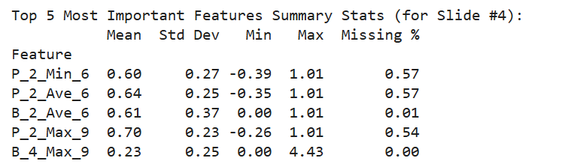
Top 5 features using SHAP Analysis

Slide 8

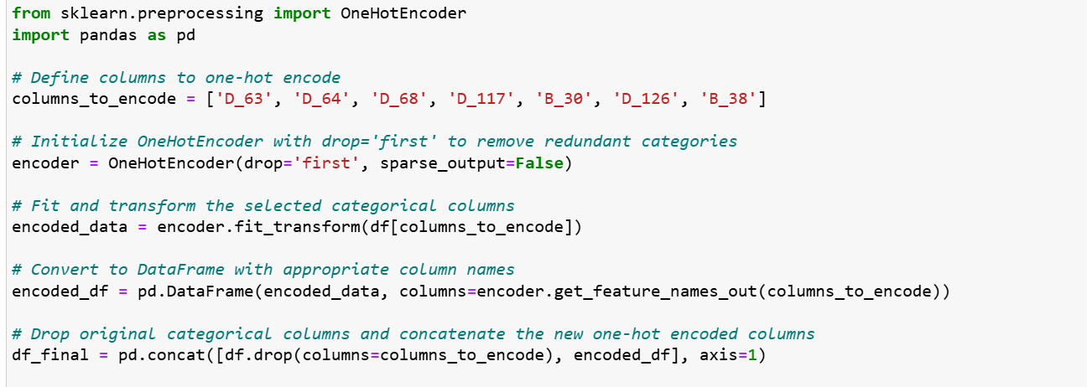
One-Hot Encoding
Categorical variables that were binary or nominal with few categories.
These were the columns, which were selected for One Hot Encoding operation.

Slide 9
One-Hot Encoding results:
D_63: D_63_CO, D_63_CR, D_63_XL, D_63_XM, D_63_XZ
D_64: D_64_O, D_64_R, D_64_U, D_64_nan
D_68: D_68_1.0, D_68_2.0, D_68_3.0, D_68_4.0, D_68_5.0, D_68_6.0, D_68_nan
D_117: D_117_1.0, D_117_2.0, D_117_3.0, D_117_4.0, D_117_5.0, D_117_6.0, D_117_nan
B_30: B_30_1.0, B_30_2.0, B_30_nan
D_126: D_126_0.0, D_126_1.0, D_126_nan
B_38: B_38_2.0, B_38_3.0, B_38_4.0, B_38_5.0, B_38_6.0, B_38_7.0, B_38_nan

Slide 10
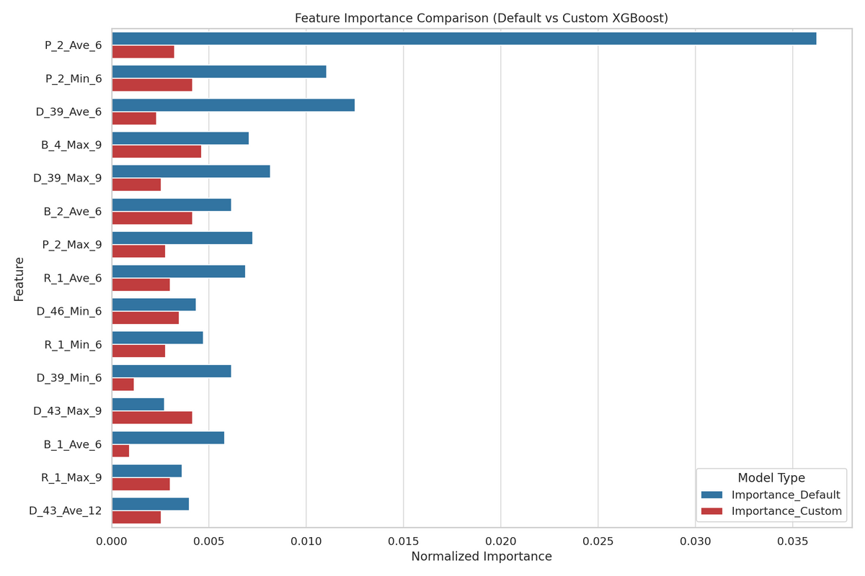
Feature Selection – XGBoost Importance
We trained two XGBoost models:
Model 1: Default parameters
Model 2: Custom parameters (300 trees, learning rate=0.5, max_depth=4, etc.)
Calculated feature importance using the Gain metric.
Selection Rule: Keep features with >0.5% importance in either model.
Final Set: 54 features retained for modeling.
Feature Category | # Engineered Features | # Selected for Model
Spend (S_) | 126 | 0
Balance (B_) | 252 | 3
Delinquency (D_) | 594 | 3
Risk (R_) | 168 | 1
Other | 25 | 3

Slide 11
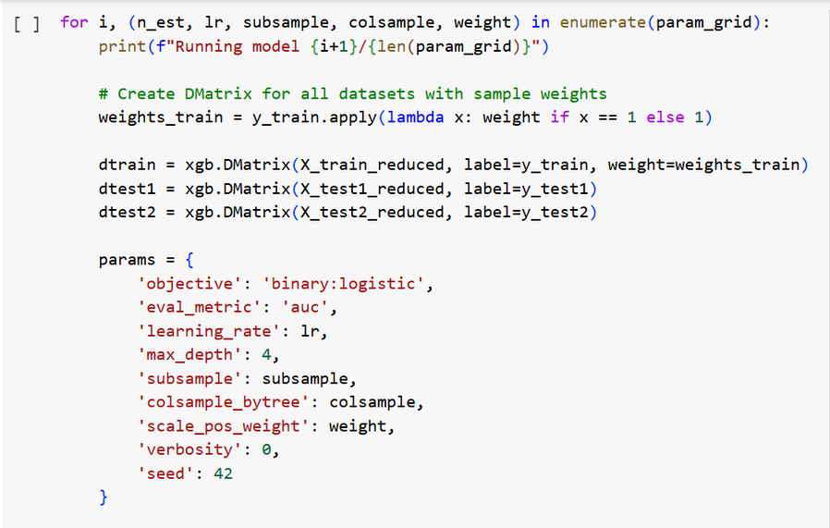
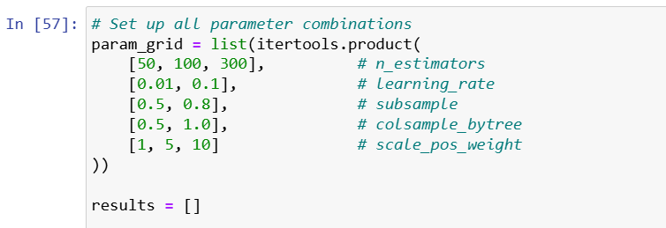
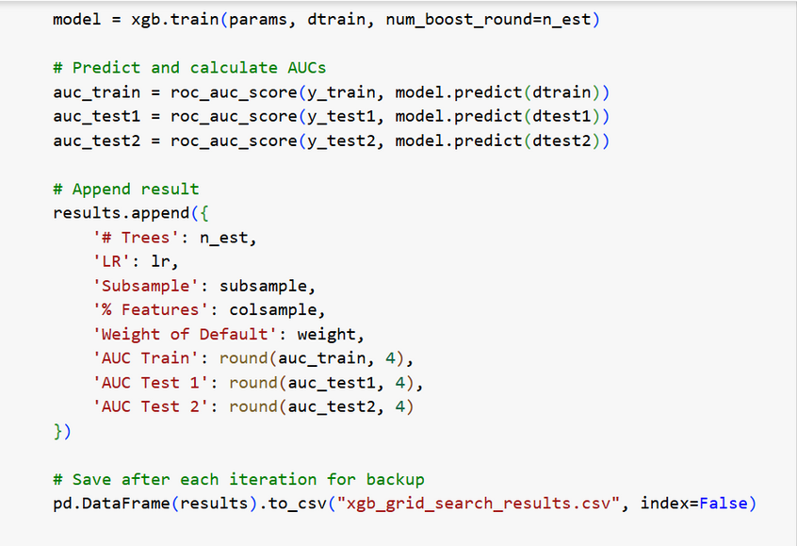
XGBoost – Grid Search code
We evaluated 72 models from the XGBoost grid search, using three datasets: Train, Test1, and Test2.

Slide 12
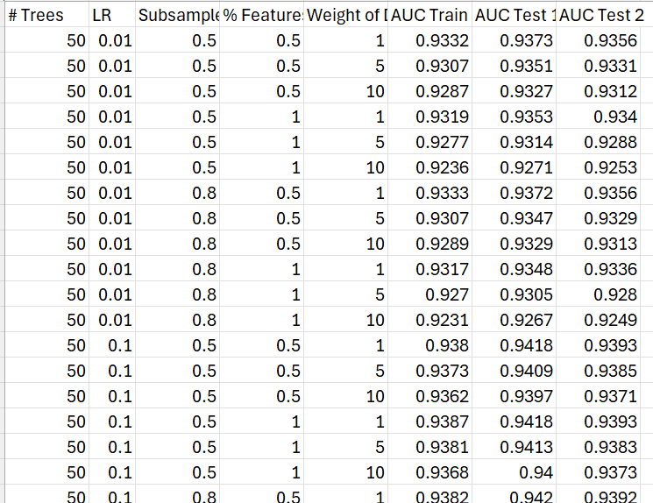
XGBoost – Grid Search result

Slide 13
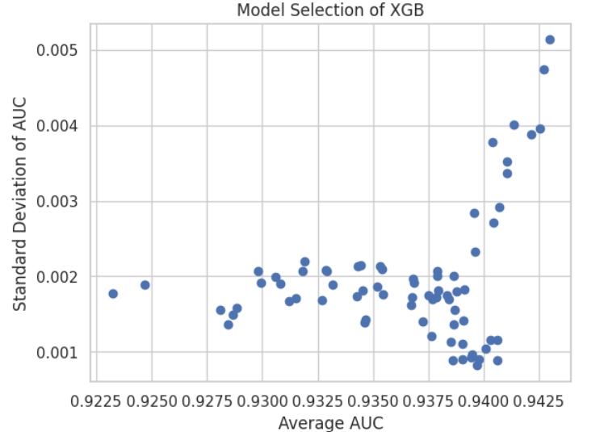
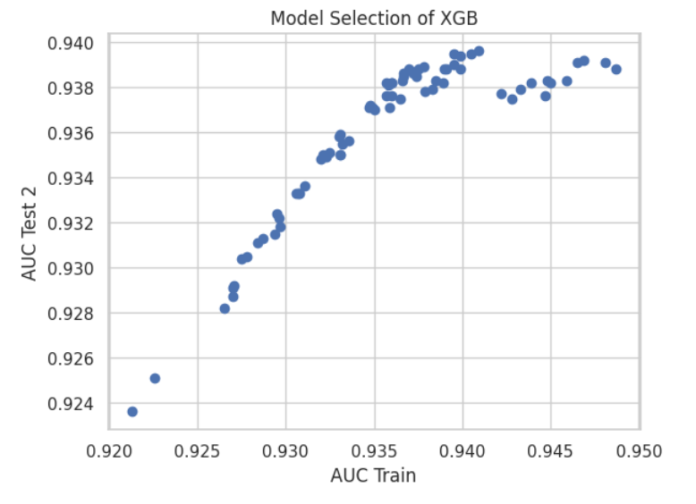
XGBoost – Grid Search plots
For each model:
Average AUC: to measure overall strength
AUC Standard Deviation: to assess model stability (lower = better generalization)

Slide 14

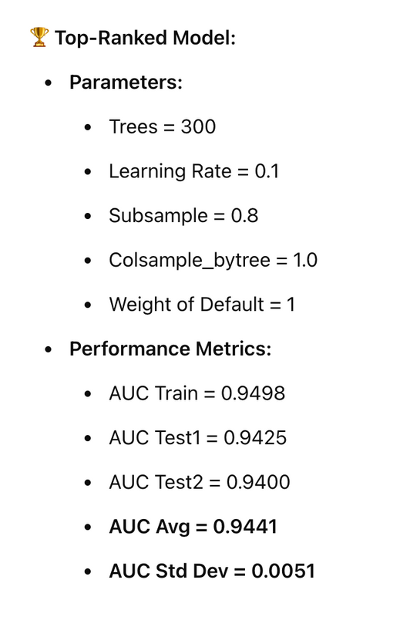
XGBoost – Model Selection (Bias vs Variance Trade-off)
Models were sorted by:
Highest Average AUC (to prioritize predictive strength)
Lowest AUC Std Dev (to prioritize stability)
Why This Model Was Selected:
It had the highest average AUC across all datasets.
Its Test2 AUC (0.9400) ranked among the top, indicating strong out-of-sample performance.
The model showed low variance, suggesting strong generalizability with minimal overfitting.

Slide 15
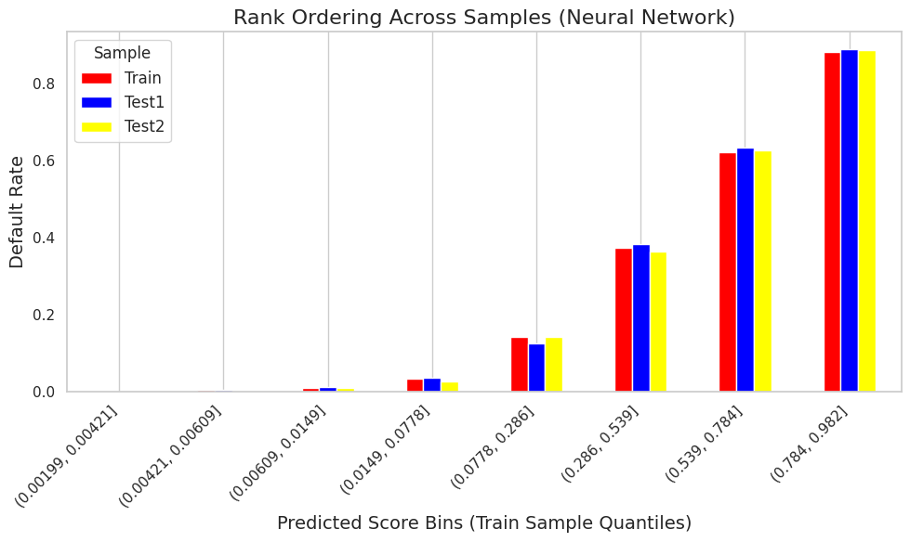

XGBoost Rank Ordering graph
Notes:
The rank ordering plot shows that the predicted scores successfully separate customers by risk across all datasets. As we move from lower to higher predicted score bins, the actual default rates consistently increase. The Train, Test1, and Test2 samples show similar patterns, indicating the model generalizes well and avoids overfitting. This rank ordering supports the effectiveness of the model for risk prediction.

Slide 16
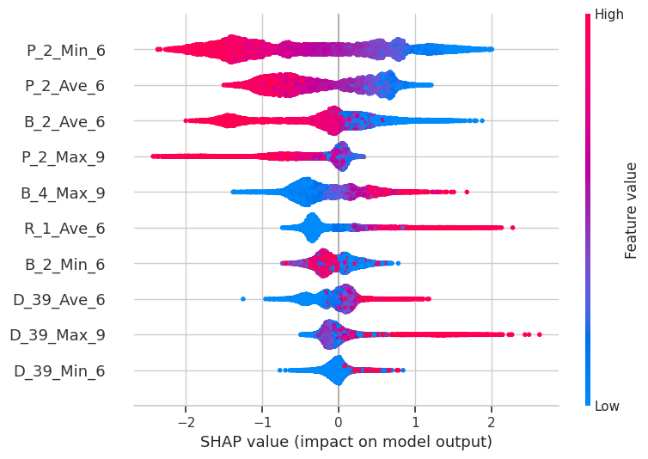
SHAP (SHapley Additive exPlanations) explains how much each feature contributed to a model’s prediction, making machine learning models more transparent and trustworthy.
SHAP Beeswarm Plot
Top features are listed by importance (most impactful at the top)
SHAP values are on the X-axis (impact on model output: default risk)
Color gradient shows feature value (red = high, blue = low)
Spread shows the distribution of feature impact across all customers
Notes:
The rank ordering plot shows that the predicted scores successfully separate customers by risk across all datasets. As we move from lower to higher predicted score bins, the actual default rates consistently increase. The Train, Test1, and Test2 samples show similar patterns, indicating the model generalizes well and avoids overfitting. This rank ordering supports the effectiveness of the model for risk prediction.

Slide 17
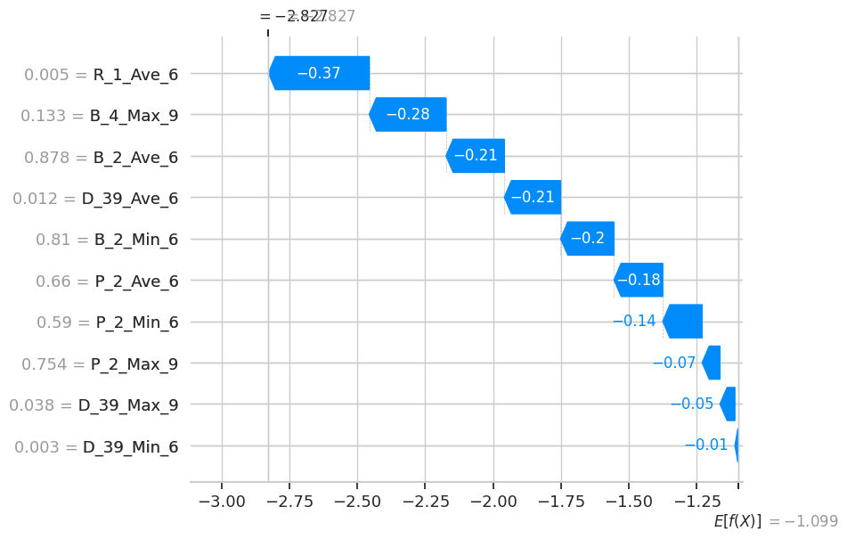
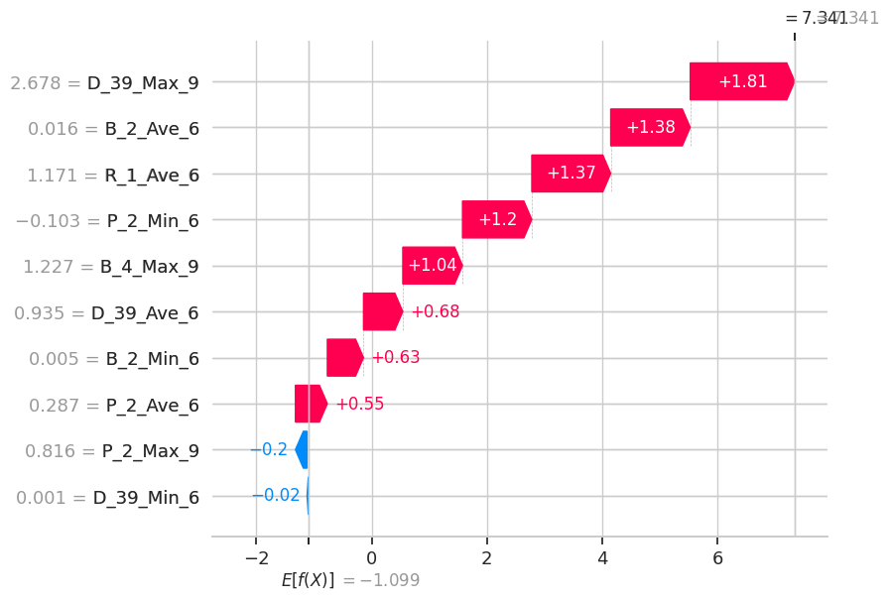
SHAP Waterfall Plot
Low risk customer:
Offer a higher credit limit to this customer confidently.
High risk customer:
Do not approve this customer's credit application without significant additional checks.
Possibly reject or offer a very low limit with strict monitoring.
Notes:
The rank ordering plot shows that the predicted scores successfully separate customers by risk across all datasets. As we move from lower to higher predicted score bins, the actual default rates consistently increase. The Train, Test1, and Test2 samples show similar patterns, indicating the model generalizes well and avoids overfitting. This rank ordering supports the effectiveness of the model for risk prediction.

Slide 18
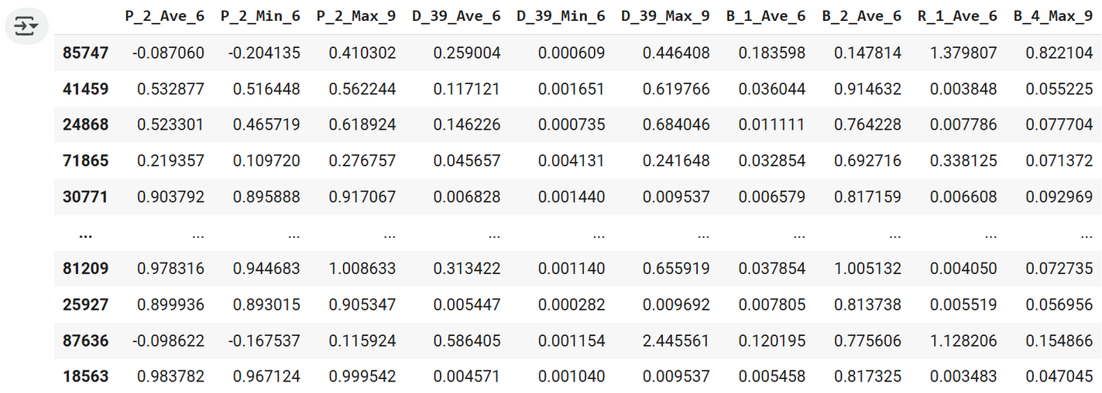
Missing Value Imputation:
Replaced all NaN values with 0.
Assumes missing = neutral value for neural net inputs.
Outlier Treatment:
Applied capping and flooring at the 1st and 99th percentiles.
Prevents extreme values from distorting learning.
Normalization:
Used StandardScaler to standardize all features (mean = 0, std = 1).
Ensures consistent scale for back propagation.
Neural Network Data Preprocessing
Selected only the features that passed XGBoost-based feature selection
Applied the following preprocessing steps:

Slide 19
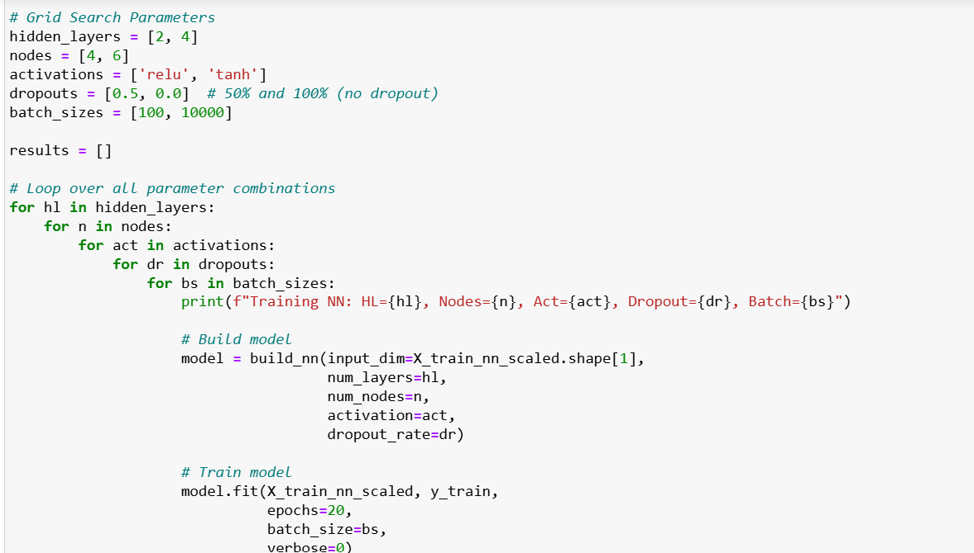
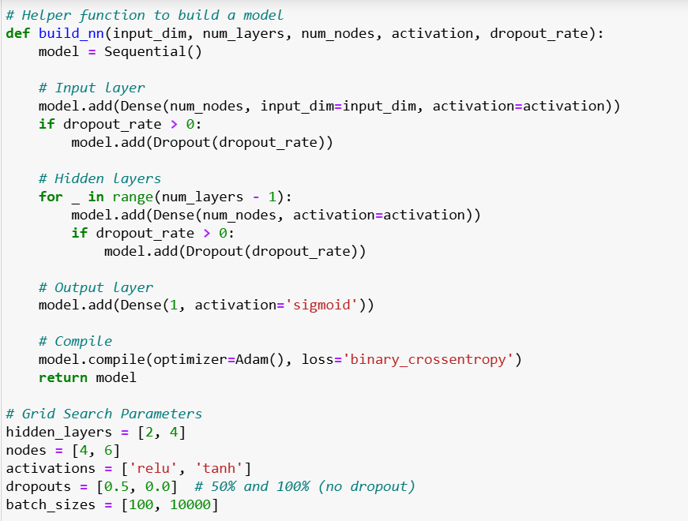
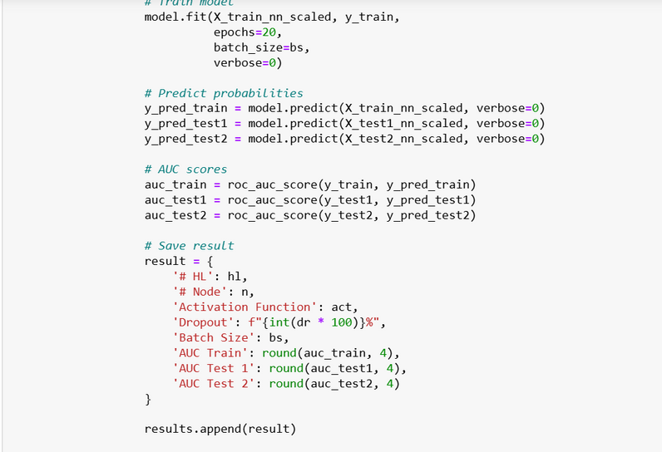
Neural Network Grid Search
Code

Slide 20
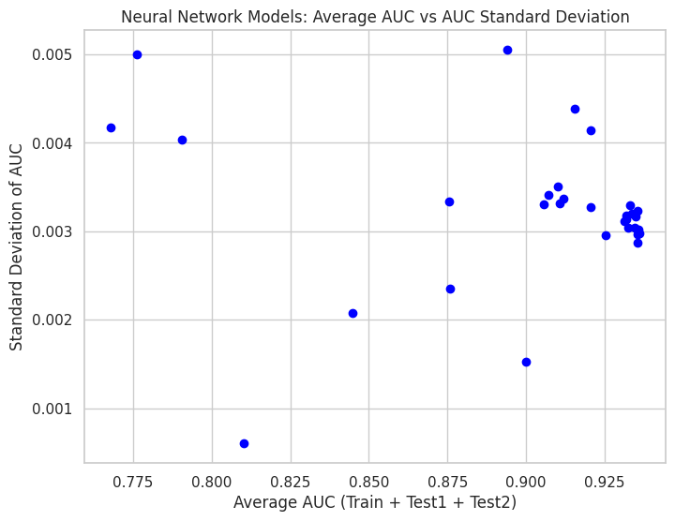
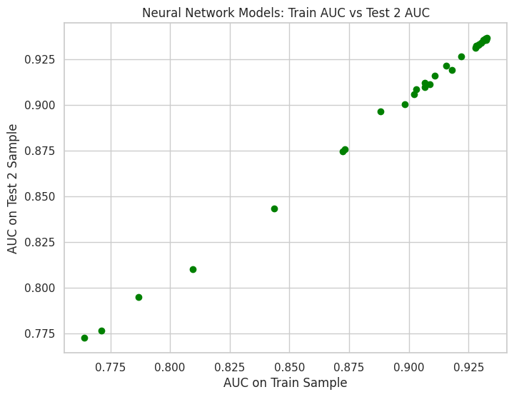


Neural Network Graphs

Slide 21
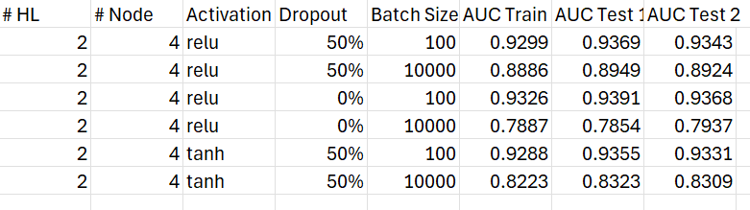
Neural Network – Grid Search
Output

Slide 22
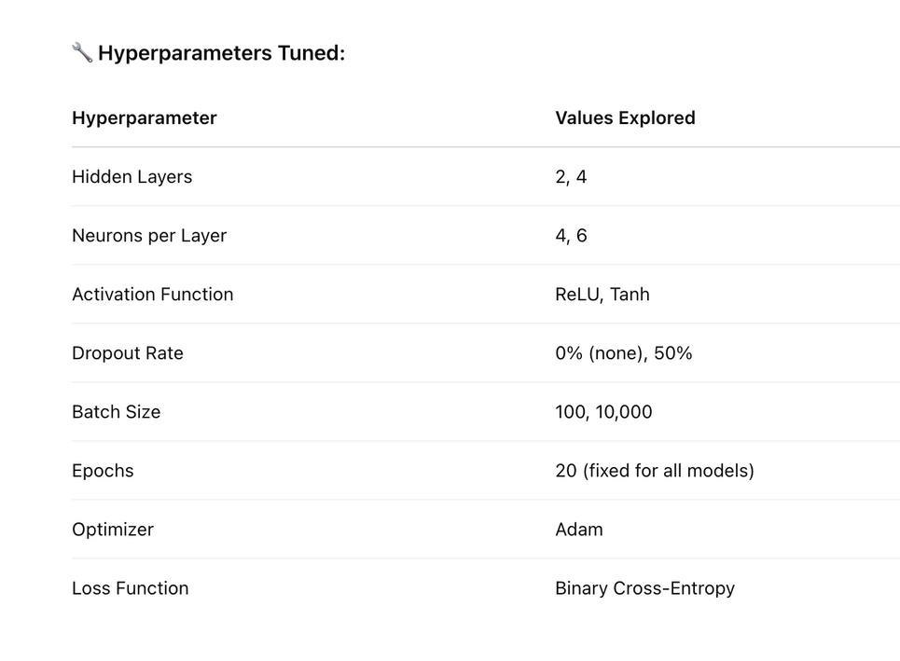
Neural Network – Grid Search Setup & Execution
Conducted a grid search over 16 neural network configurations.
Evaluated each model on Train, Test1, and Test2 using AUC as the performance metric.
The objective: find a model that balances high predictive power with low variance.
Observations from Grid Search:
ReLU activation generally outperformed Tanh.
Smaller batch size (100) led to more stable and generalizable models.
Models with dropout (50%) avoided overfitting better on deeper networks.
For each model configuration, we calculated:
Models were ranked by:
Highest AUC Average (strongest overall performance)
Lowest AUC Std Dev (lowest variance across datasets)
Why This Model Was Chosen:
Balanced strong predictive power with low variance.
Generalized well across all three samples (Train, Test1, Test2).
Served as a competitive alternative to the XGBoost model.

Slide 23
Neural Network – Final Model & Rank Ordering
Final Neural Network retrained using best hyperparameters:
2 Hidden Layers, 6 Neurons per Layer
ReLU activation, Dropout = 50%
Batch Size = 100, Epochs = 20
What It Shows:
Default rate increased consistently with predicted score.
Confirms that the neural network can effectively rank applicants by risk.
Supports its potential for real-world credit decisioning.

Slide 24
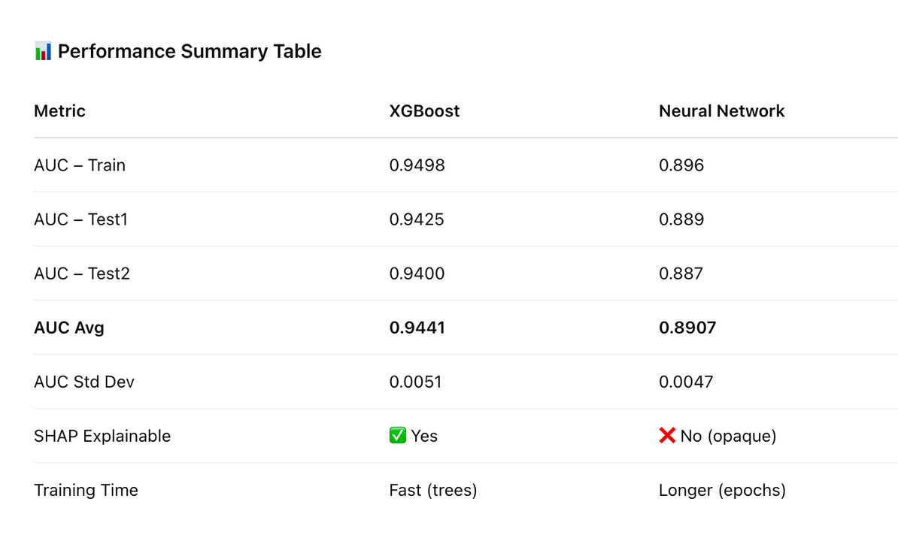
Final Model Comparison – XGBoost vs Neural Network
We trained and evaluated both models across three datasets: Train, Test1, Test2.
Used AUC to measure predictive performance and rank ordering plots to evaluate risk stratification.
Compared models on accuracy, stability, and interpretability.

Slide 25
Revenue per Month=(0.001×S_Ave)+(0.02×B_Ave)
Expected Revenue=12×Revenue per Month
Strategy Thresholds
 | Train | Train | Train | Test 1 | Test 1 | Test 1 | Test 2 | Test 2 | Test 2
Threshold | # Total | Default Rate | Revenue | # Total | Default Rate | Revenue | # Total | Default Rate | Revenue
0.1 | 27297 | 0.0122 | 498.09 | 5848 | 0.0147 | 105.13 | 5809 | 0.0143 | 104.18
0.2 | 30876 | 0.0257 | 641.07 | 6627 | 0.0296 | 140.52 | 6604 | 0.0318 | 135.12
0.3 | 33475 | 0.0424 | 754.59 | 7160 | 0.0478 | 162.54 | 7194 | 0.051 | 158.03
0.4 | 36031 | 0.0632 | 864.26 | 7695 | 0.0693 | 182.84 | 7759 | 0.0723 | 182.44
0.5 | 38809 | 0.0903 | 983.94 | 8313 | 0.0977 | 464.9 | 8360 | 0.1005 | 205.73
0.6 | 41766 | 0.1227 | 1096.33 | 8949 | 0.1313 | 486.05 | 8994 | 0.1313 | 228.18
0.7 | 44805 | 0.159 | 1189.31 | 9573 | 0.1652 | 505.52 | 9620 | 0.1655 | 247.3
0.8 | 47808 | 0.1981 | 1249.04 | 10206 | 0.2022 | 522.08 | 10279 | 0.2024 | 263.87
0.9 | 50642 | 0.2367 | 1280.57 | 10775 | 0.2369 | 530.21 | 10883 | 0.237 | 272.66
1 | 54622 | 0.2908 | 1288.2 | 11640 | 0.2904 | 534.75 | 11750 | 0.2905 | 276.62

Slide 26
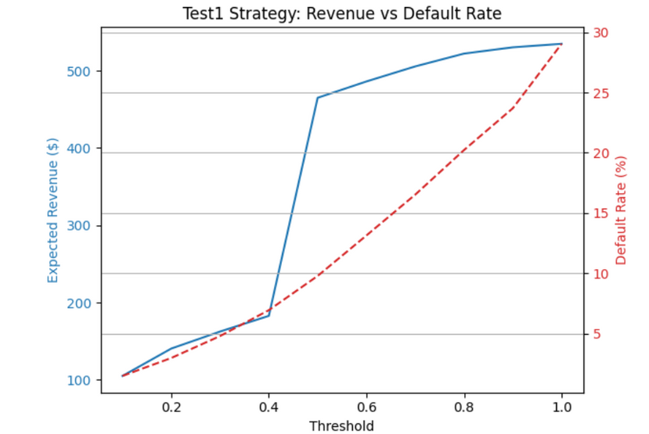
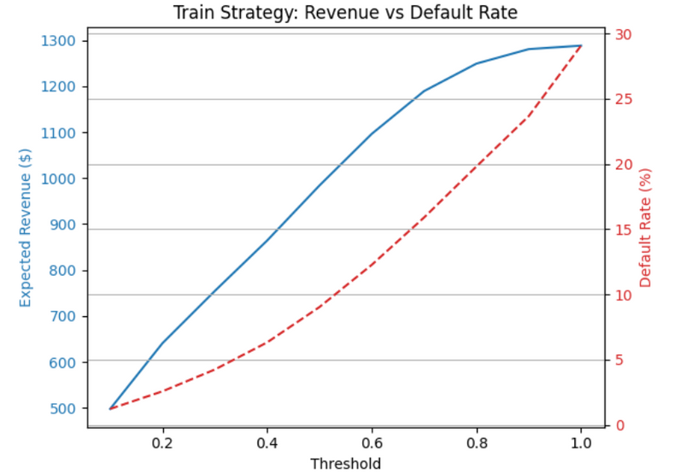
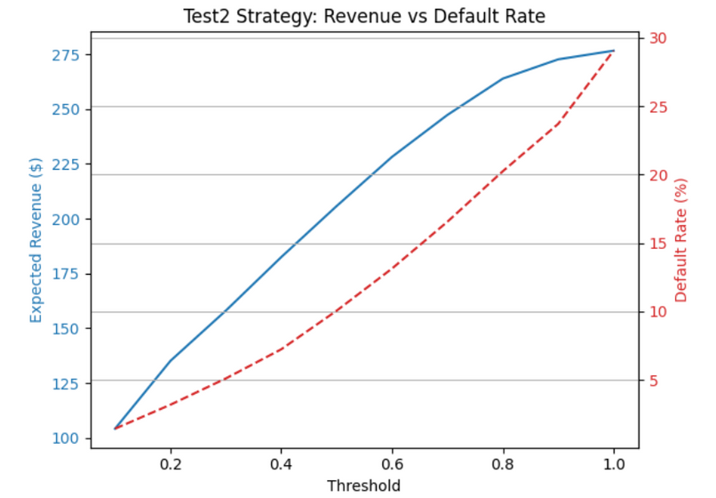
04

Slide 27
Credit Strategy – Threshold-Based Decisioning
We used the final model’s predicted probability of default (PD) to define two approval strategies:
Conservative: Lower risk tolerance, stricter approval threshold.
Aggressive: Higher acceptance rate, slightly increased risk.
Strategy evaluation was based on:
Portfolio Default Rate
Expected Revenue (from spend & balance)
Business constraint: Default rate must stay below 10%
Conservative Strategy | Aggressive Strategy
Threshold: 0.10 | Threshold: 0.50
Default Rate: ~1% across all sets | Default Rate: • Train: ~9.0% • Test1: ~9.1% • Test2: ~9.3%
Revenue: Modest but safe | Revenue: Highest while staying under 10% cap

Slide 28
Recommendation: Balanced Strategy (Threshold = 0.40)
Generates ~73% higher revenue compared to the conservative strategy.
Keeps default rate safely around 6–7%, well below the 10% business risk cap.
Backed by:
A robust, interpretable XGBoost model
Comprehensive rank ordering and SHAP-based feature analysis
Portfolio-level financial impact estimation, balancing risk and profitability
Final Recommendation to Management

