Slide 1

TOUR AND TRAVELS
Travel & World
Saurabh Agarwal:2115000923
Shreyash Kulshrestha:2115000973
Abhishek Sikarwar:2115000031
Gauri Pandey:2115000409
Sanskar Khare:2115000912

Slide 2
Introduction
Welcome to Tour World, your gateway to unforgettable journeys and seamless travel experiences! We understand that the thrill of exploration and the joy of discovery are essential elements of a well-lived life, and our mission is to make your travel dreams a reality.

Slide 3
Objective
We aspire to ignite the spirit of wanderlust in our audience by showcasing the beauty, diversity, and richness of destinations around the world. Through engaging content, stunning visuals, and immersive storytelling, we aim to inspire our visitors to explore new horizons and create lasting memories.

Slide 4
Problem Statement
Travel planning often involves sifting through a vast amount of information from various sources, leading to confusion and decision fatigue. Tour World aims to streamline this process by providing curated and reliable information, making it easier for users to plan their trips. Many travel platforms offer generic options that may not cater to individual preferences.

Slide 5
Literature Review
Established platforms like Expedia, Booking.com, and TripAdvisor continue to dominate the online travel market. These platforms offer comprehensive services, including flight and hotel bookings, activity recommendations, and reviews.

Slide 6
Methodology
The specific Algorithms, techniques, tools, languages used are-
HTML(Hypertext Markup Language)
CSS(Cascading Style Sheet)
JAVASCRIPT
NODEJS
MONGODB

Slide 7


System Architecture
Front-End:
User Interface (UI): The front-end includes the user interface elements that users interact with. This could be implemented using HTML, CSS for styling,and JavaScript for dynamic content and
interactions.
Responsive Design:
Ensure a responsive design to
provide an optimal user experience
across various devices.

Slide 8


Back-End: Server-Side Logic: The back-end consists of the server-side logic responsible for handling user requests, business logic, and data processing. Common back-end frameworks include Node.js, Django (Python), Ruby on Rails, or Express.js. APIs (Application Programming Interfaces): Develop APIs for communication between the front-end and back-end, allowing data exchange and functionality implementation. User Authentication: Implement user authentication mechanisms for secure access to user-specific features.

Slide 9


Database: Database Management System (DBMS): Use a suitable database management system like MySQL, PostgreSQL, or MongoDB, depending on your data requirements. Data Storage: Store information about tourist destinations, user profiles, reviews, and other relevant data in the database.

Slide 10
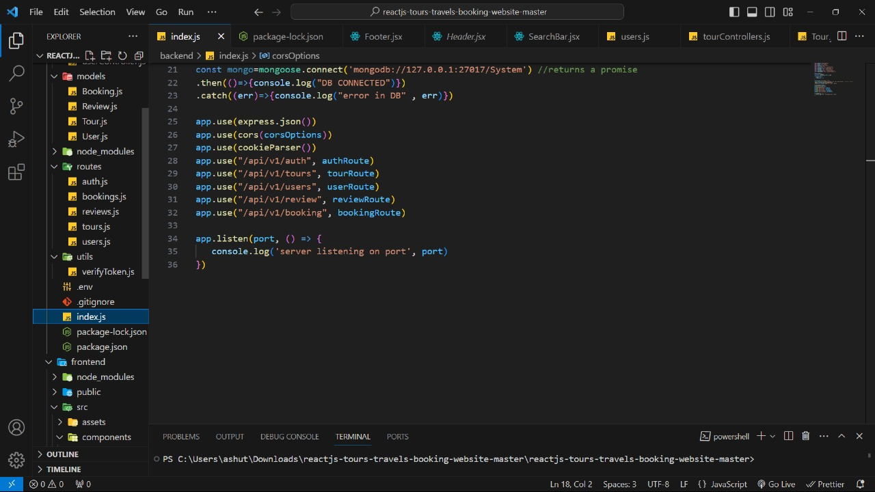
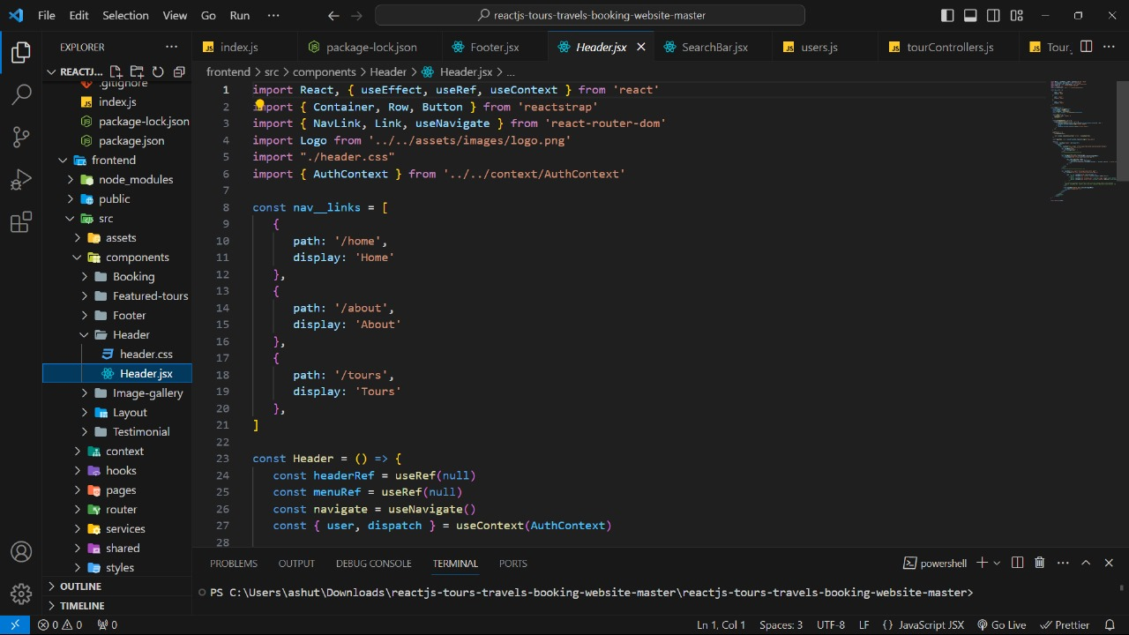
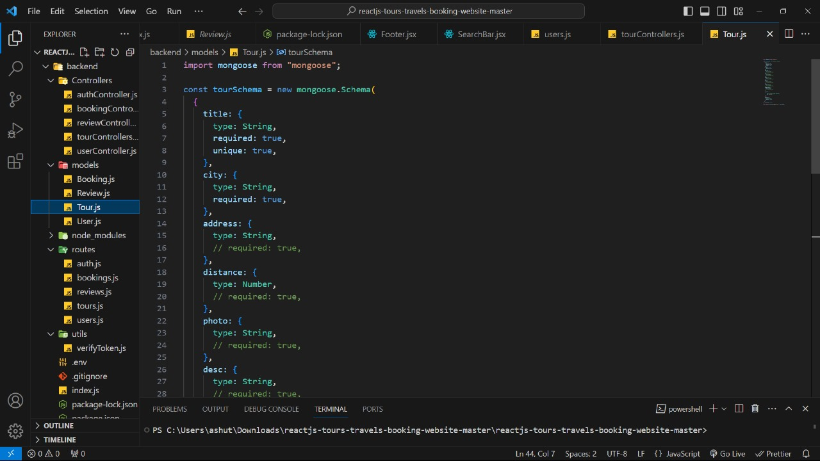

Slide 11
Implementation
Setup and Environment Configuration:
Set up the development environment with the chosen tools, frameworks, and libraries.
Configure version control systems (e.g., Git) for tracking changes.
Front-End Development:
Develop the user interface (UI) using HTML for structure, CSS for styling, and JavaScript for dynamic behavior.
Ensure the UI is responsive, providing a seamless experience across various devices and screen sizes.

Slide 12
Back-End Development: Choose a back-end technology stack (e.g., Node.js with Express, Django, Ruby on Rails). Implement server-side logic to handle user requests, business rules, and data processing. Develop RESTful APIs for communication between the front-end and back-end

Slide 13
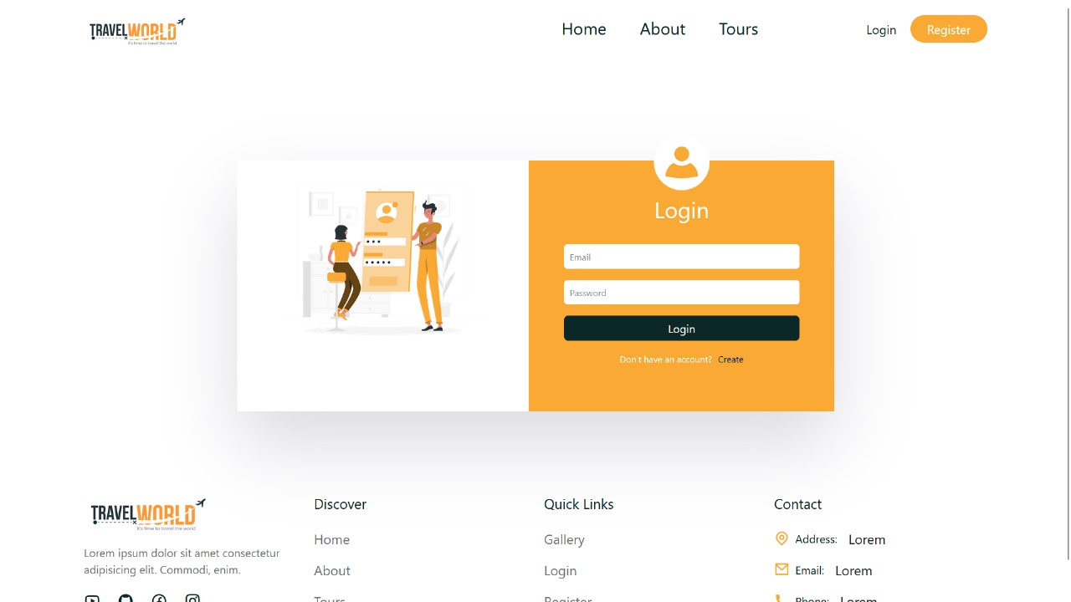
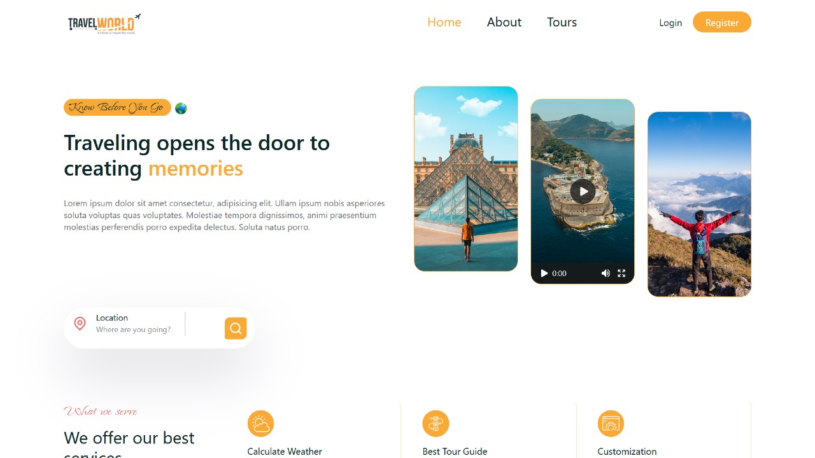
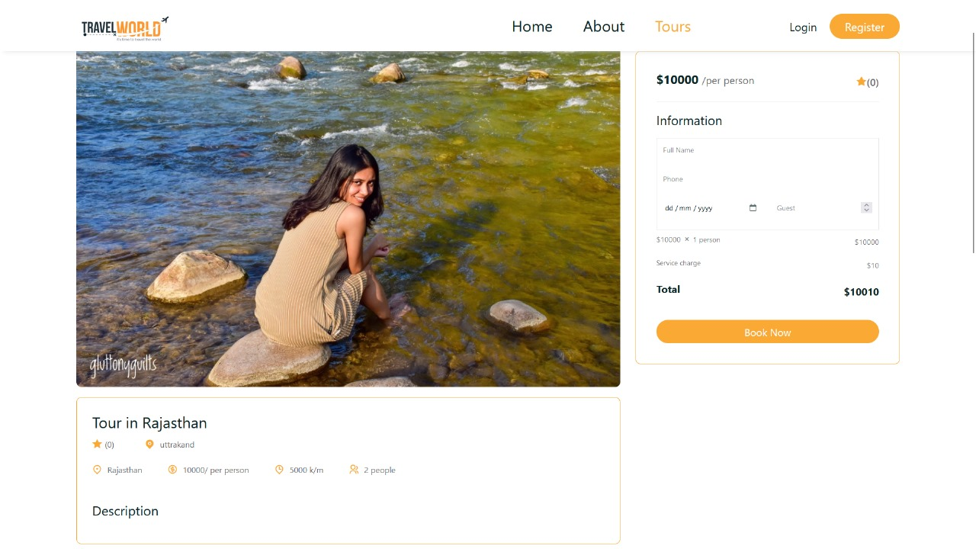

Slide 14
Features
Capability for users to leave reviews and ratings for destinations, accommodations, and attractions, providing valuable insights for others.
A user-friendly and responsive design ensuring a seamless experience across various devices and screen sizes.
A dashboard for administrators to manage user accounts, review user-generated content, and monitor system analytics.

Slide 15
Challenges Faced
Encouraging active user participation, including leaving reviews and contributing content.
Protecting user data and ensuring compliance with privacy regulations.

Slide 16
Future Works
Expand language support to cater to a broader international audience.
Localize content and user interfaces for different regions to enhance accessibility.
Integrate AI-driven chatbots for instant user assistance and guidance.

Slide 17
Conclusion
The tourist guide project is a web-based platform designed to provide comprehensive information and assistance to travelers and tourists.
The project aims to offer detailed destination information, user engagement features, travel planning assistance, and personalized recommendations.

Slide 18
