Slide 1
Great outdoors
- Ankush
- Madhuri
- Saurabh
- Sarthak
- Shreyash

Slide 2
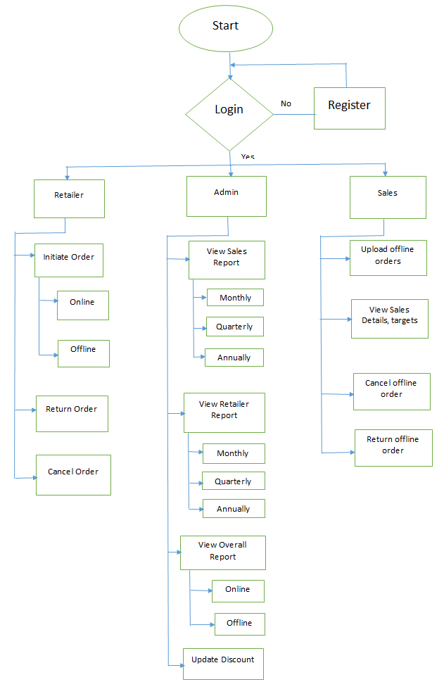
Flow Diagram

Slide 3
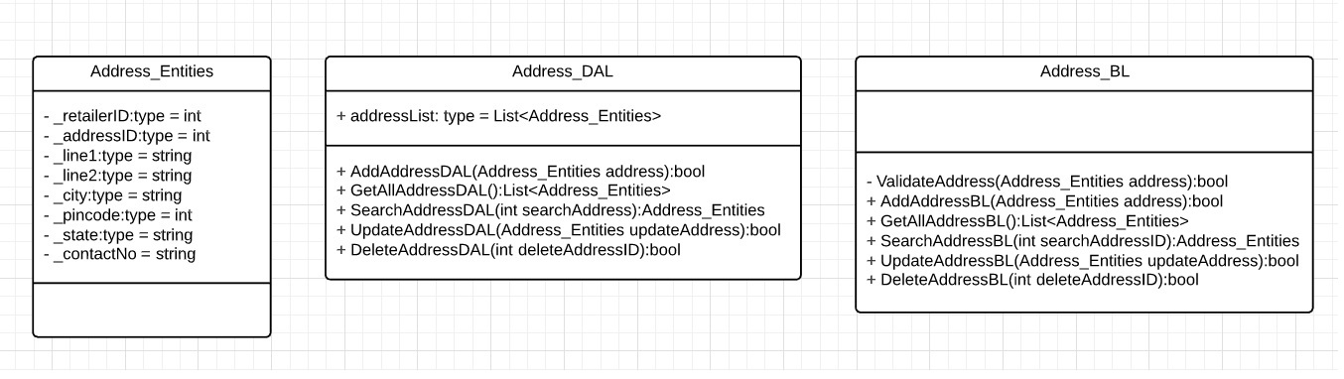
Address Class Diagram

Slide 4
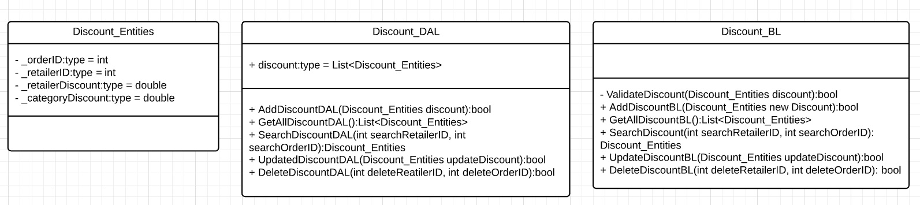
Discount Class Diagram

Slide 5
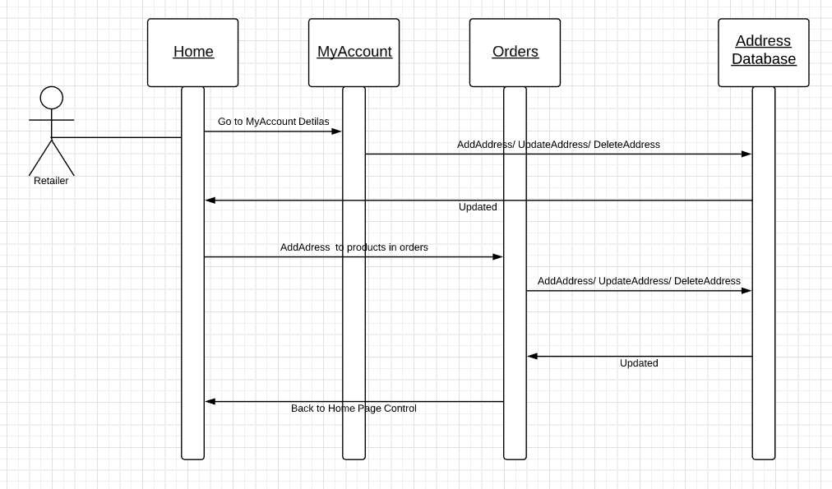
Address Sequence Diagram

Slide 6
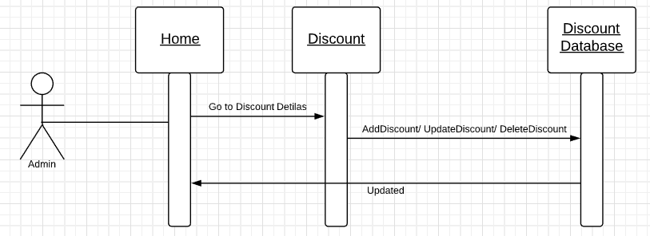
Discount Sequence Diagram

