Slide 1
GAGAN NETRA
City's Eye, People's Safety
Autonomous Aerial Monitoring for Urban Air Quality & Civic Safety
Team Members
Aditya Sharma (250840143003) | Pradhyuman Kumar (250840143009)
Pratik Mahule (250840143011) | Shreyash Jane (250840143012)
C-DAC ACTS, Pune | PG-DUASP

Slide 2

CONTENTS
Introduction
The Problem Statement
Motivation & Content
Aim & Objective
System Overview
System Architecture
Hardware: Flight Platform/Sensor Fusion
Software & AI Stack
System Workflow
AI Models & Detection
Key Features & Innovations
Dashboard & Visualization
Security & Resilience
Benefits & Impact
Future Scope
Conclusion

Slide 3
Introduction
Gagan Netra is an autonomous aerial monitoring system designed to assess and visualize city-wide air quality hotspots, while simultaneously detecting pollution-causing activities and civic hazards.
Traditional fixed AQI stations are limited in spatial coverage and responsiveness. The proposed system integrates onboard gas sensors, particulate matter sensors, and computer vision algorithms to monitor AQI, identify anomalous events, and geo-tag them in real time.
The solution enhances urban sustainability by enabling faster detection, localized intervention, and hotspot analysis.

Slide 4
The Problem Statement
Urban environments face increasing environmental degradation, but current monitoring systems have critical limitations:
Limited Coverage
Delayed Detection
Sparse static AQI stations miss localized pollution hotspots
Hours/days lag in identifying pollution sources and civic hazards
No Vertical Profiling
Reactive Response
Cannot measure air quality variation at different altitudes
Lack of real-time data prevents proactive intervention
There is a need for a dynamic, mobile, real-time, scalable sensing platform for urban monitoring.

Slide 5
Motivation & Context
7M+
91%
$8.1T
Deaths annually from
air pollution (WHO)
World population exposed
to poor air quality
Annual economic cost
of air pollution
Current Challenges in Indian Cities
Rapid urbanization increasing pollution sources
Limited AQI monitoring infrastructure (1 station per 500,000+ people)
Delayed response to pollution events and civic hazards
Lack of real-time, localized air quality data
Poor enforcement due to insufficient evidence

Slide 6
Aim & Objectives
AIM
To develop an autonomous drone-based system that maps city-wide air-quality hotspots and automatically detects pollution-causing activities and civic hazards, delivering geo-tagged, real-time intelligence to authorities.
Primary Objectives
Secondary Objectives
Build AI models (RGB + thermal) for anomaly detection
Generate pollution heatmaps and trend analysis
Integrate with municipal GIS and civic workflows via APIs
Map city-wide AQI hotspots dynamically
Detect pollution-causing activities (waste burning, emissions)
Identify civic hazards (potholes, garbage, blocked drains)
Geo-tag events and push real-time alerts to dashboard

Slide 7
System Overview
Key Characteristics
Operational Flow
Mobile Sensing: High spatial and vertical resolution compared with static stations
Edge Intelligence: Onboard models reduce bandwidth by sending events and summarized telemetry
Spatio-Temporal Fusion: Sensor readings and vision detections fused by timestamp and location
Actionable Outputs: Heatmaps, ranked hotspots, incident alerts, and downloadable reports
Autonomous aerial survey
Sensor data collection (PM, gases)
RGB + thermal image capture
Onboard AI processing
Event detection & classification
GPS/RTK geo-tagging
LTE/4G cloud transmission
Backend data fusion & analysis
Dashboard visualization
Alert generation & API integration

Slide 8
System Architecture
Edge Layer
Drone hardware + companion computer for sensing and inference
Transport Layer
Secure telemetry (MQTT/HTTP) and LTE/4G with buffering
Ingest Layer
Cloud API for authentication, validation, and queuing
Processing Layer
Microservices for fusion, AQI computation, correlation
Storage Layer
Time-series DB, spatial DB (PostGIS), object storage
Presentation Layer
Hotspot mapping engine and dashboard web app

Slide 9
Hardware: Flight Platform
Airframe & Propulsion
Flight Controller & Autopilot
Configuration: Hexacopter
Motors:
BLDC Motors: MN5008 KV 340(*6)
Power:
6S 22000mAh LiPo battery (40 min flight time)
ESC:
40 AMP
Hardware: Cube Orange
Firmware:
CUBE+(AURDOPILOT)
Features:
IMU, barometer, magnetometer, GPS
Capabilities:
Autonomous waypoint navigation, geofencing
Hardware: NVIDIA Jetson Nano / Xavier NX (GPU-accelerated AI inference) OS: Ubuntu 20.04/22.04
Middleware: ROS/ROS2 for sensor fusion and mission control
Edge AI:
TensorRT-optimized models for real-time inference (YOLO, thermal processing) Storage: 32GB+ for local buffering during connectivity loss

Slide 10
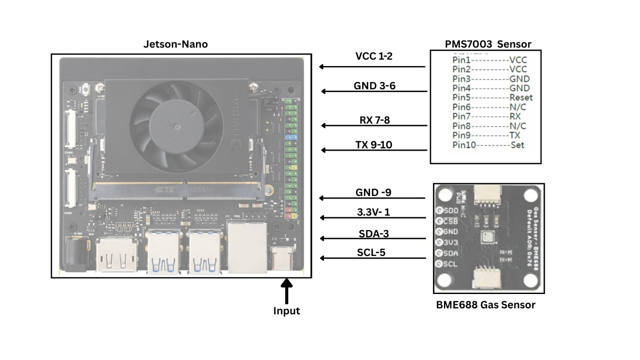
Hardware: Connection Diagram

Slide 11
Software & AI Stack
AI & Computer Vision
Backend & Communication
PyTorch / TensorFlow
YOLOv8/v11
NVIDIA TensorRT (edge)
OpenCV preprocessing
C, Python Flask / FastAPI
Python
UART/ I2C
MQTT/HTTP
Geospatial & Mapping
Database & Dashboard
QGIS for analysis
GeoPandas, Folium
RTK + IMU fusion
Pandas, NumPy, Matplotlib, Seaborn
StreamLit,
AWS – DynamoDB, S3Bucket

Slide 12
System Workflow
1
Data Acquisition
Drone-mounted sensors collect PM, gas, temp, humidity at multiple altitudes
2
Vision Processing
GoPro Hero 9 camera detect fire, smoke, waste, potholes using AI models
3
Edge Inference
Onboard AI classifies events, assigns severity, reduces bandwidth
4
Geo-Tagging
GPS/RTK provides precise coordinates, data timestamped
5
Cloud Upload
Events + telemetry transmitted via LTE/4G to cloud backend
6
Processing & Fusion
Microservices compute AQI, correlate sensors+vision, rank anomalies
7
Visualization
Dashboard displays heatmaps, alerts, trends, APIs for integration

Slide 13
AI Models & Detection
Models: YOLOv8
Detection Targets:
• Waste accumulation
• Potholes and road damage
• Blocked drains
• Vehicle accidents
• Smoke plumes
Accuracy:
85-95% detection accuracy on field data
Techniques: Custom YOLO algorithms
Detection Targets:
Fire hotspots
Waste burning events
Industrial heat sources
Biomass combustion
Fusion:
Thermal + RGB correlation for validation
Multi-Modal Sensor-Vision Correlation
Spatio-Temporal Matching: Link sensor spikes with visual detections (±50m, ±30s) Confidence Scoring: Higher confidence for multi-modal confirmations
Example:
Waste burning = Thermal hotspot + PM spike + CO increase + RGB smoke detection

Slide 14
Key Features & Innovations
📍
Mobile Sensing
🧠
Edge Intelligence
High spatial & vertical resolution vs static stations
Onboard AI reduces bandwidth, enables real-time alerts
🔗
Multi-Modal Fusion
📊
Actionable Outputs
Combines sensor + vision data for validated detections
Heatmaps, alerts, reports for rapid municipal response
Transforms environmental monitoring from static snapshots to dynamic, continuous intelligence

Slide 15
Dashboard & Visualization
Dashboard Components
Live Monitoring: Real-time fleet status, battery, mission progress
Interactive Map:
AQI heatmap overlays, detection markers, drone positions
Alert Feed:
Scrolling list of detections with severity badges
Analytics:
Time-series charts, trend graphs, comparison tools
Evidence Viewer:
RGB/thermal imagery, sensor data, timestamps

Slide 16
Security & Resilience
Resilience & Fault Tolerance
Local Buffering:
• 2-4 hours data storage on drone
• Automatic sync when connectivity restored
Retry Logic:
• Exponential backoff for failed uploads
• Priority queuing (alerts first)
High Availability:
• Multi-zone cloud deployment
• Database replication
• Automatic failover

Slide 17
Benefits & Impact
For Cities & Authorities
For Citizens & Environment
Faster detection: Minutes vs hours/days
Localized intervention at pollution sources
Evidence for enforcement & compliance
Strategic planning with historical trends
Proactive public health advisories
Improved air quality through rapid response
Safer civic infrastructure (potholes, drains)
Transparent environmental data access
Reduced health risks from pollution exposure
Data-driven urban sustainability
10x
Real-Time
360°
Spatial Resolution
Detection & Alerts
Vertical Profiling

Slide 18
Future Scope
Advanced Sensors
Fleet Orchestration
Acoustic monitoring for noise pollution
Chemical speciation (mass spec, FTIR)
Heavy metal detection
Bioaerosol & allergen sensors
Multi-drone swarm coordination
24/7 continuous coverage
Automated mission planning
Collaborative plume tracking
Predictive Analytics
Integration & Scale
6–48-hour AQI forecasting
Source attribution maodeling
Trend analysis & seasonality
Policy impact simulation
Emergency response systems
Municipal workflow automation
Public alert systems
Federated learning across cities
Long-term Vision
Transform from a monitoring tool into a comprehensive environmental intelligence system driving healthier, more sustainable, and equitable urban environments through the convergence of continuous model learning, regulatory validation, and multi-stakeholder collaboration.

Slide 19
Conclusion
Gagan Netra represents a pattern shift in urban environmental monitoring.
By delivering faster detection, finer resolution, and actionable evidence, it empowers cities to respond effectively to pollution challenges while building the data infrastructure necessary for sustainable urban development.
From reactive crisis response to proactive, predictive governance.
Building Next-Generation Environmental Intelligence

Slide 20
THANK YOU
Questions & Discussion
Team Gagan Netra
C-DAC ACTS, Pune | PG-DUASP
Guide: Dr. Adarsh Kodhanda

