Slide 1
Bank Customer Churn Prediction

Slide 2
Objective
The primary objective of this project is to develop a robust churn prediction model that can accurately identify potential churners among bank customers. Ultimately, the development of an accurate churn prediction model can significantly contribute to the reduction of customer churn rates and improve overall customer retention for banks.

Slide 3
Recap
Data preparation: checking for data duplication
Checking for missing values
Encoding, converting categorical data into numerical
EDA: understanding data deeply and gaining valuable knowledge through data visualization

Slide 4
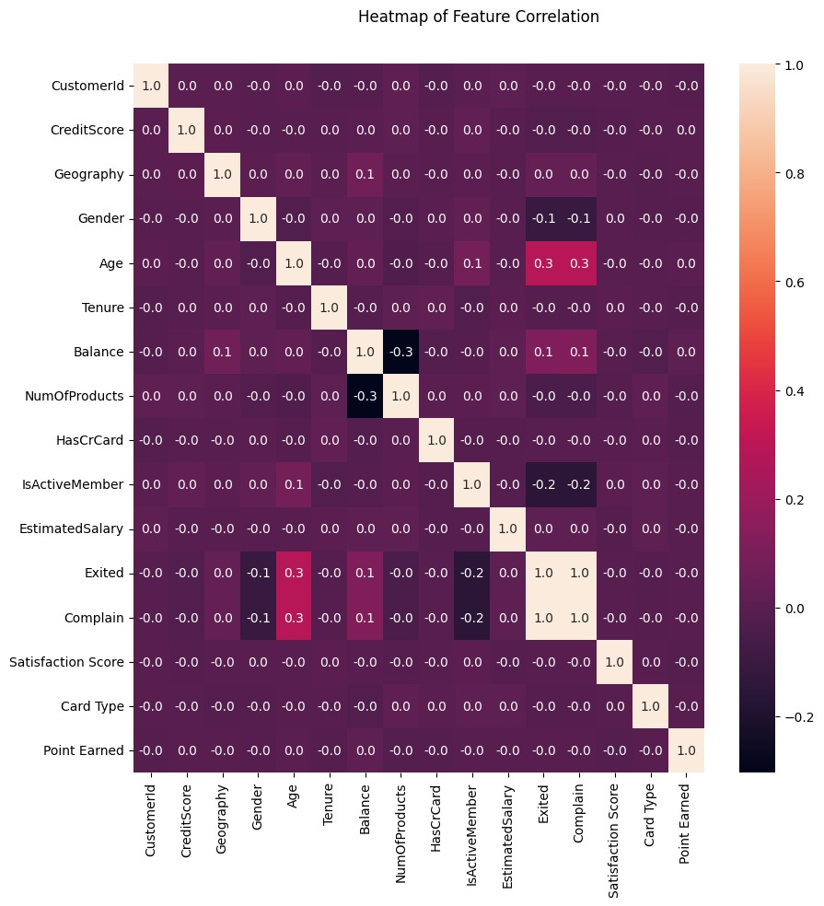
Correlation

Slide 5
Model Selection
Based on prior knowledge of the correlation between features, the model developed is one that work well on dataset that have many non-linear correlations between features.
Naive Bayes
Decision Tree
AdaBoost

Slide 6
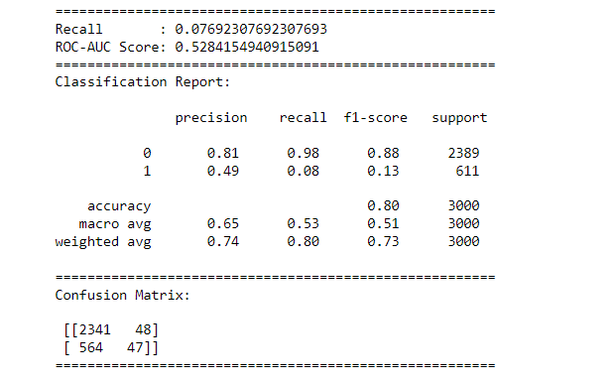


Naive Bayes
Intro to NB
Classification Report
Cross-Validation

Slide 7
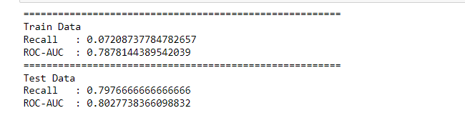
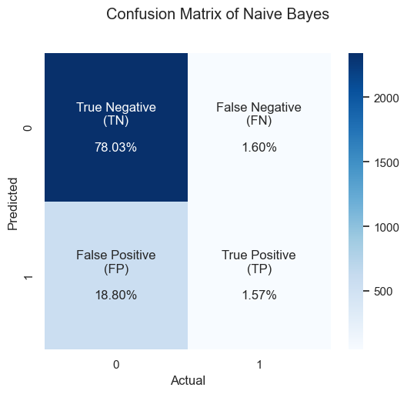
Hyperparameter Tuning
Confusion Matrix

Slide 8
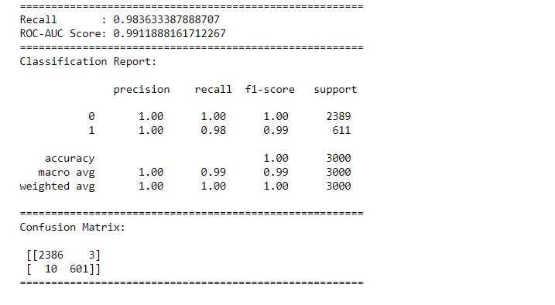
Decision Tree
Intro to DT
Classification Report
Cross-Validation

Slide 9
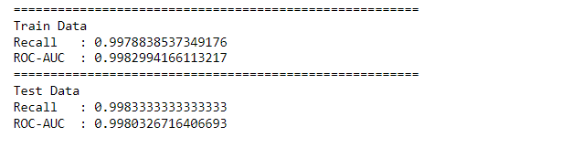
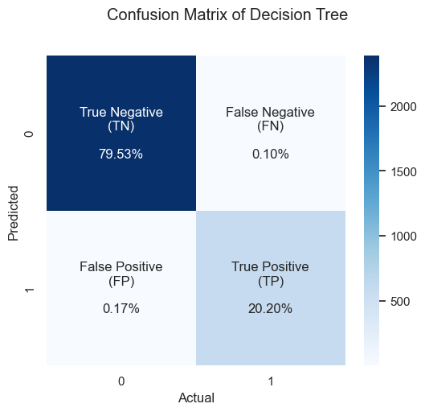
Hyperparameter Tuning
Confusion Matrix

Slide 10
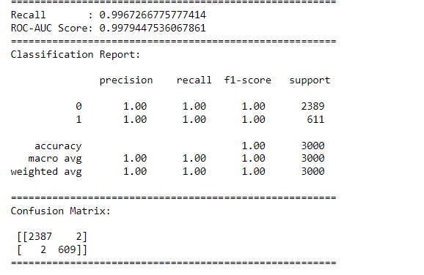
AdaBoost
Intro to AdaBoost
Classification Report
Cross-Validation

Slide 11
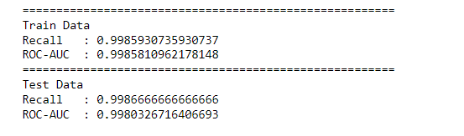
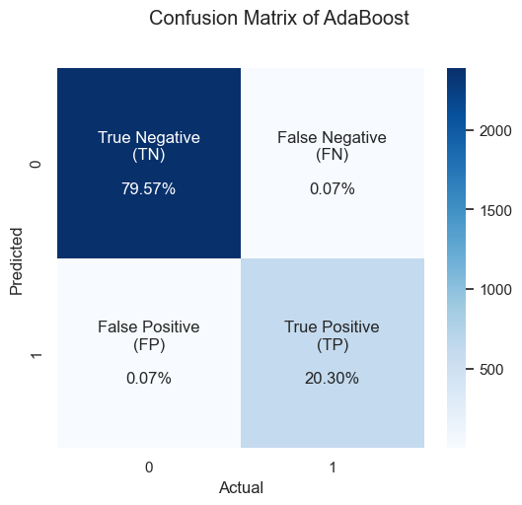
Hyperparameter Tuning
Confusion Matrix

Slide 12
Model Evaluation
Model Selection Criteria:
In churn analysis, the percentage of False Negative(FN) is important. A FN predicts a customer will not churn when they actually do.
Based on that, the percentage of FN should be minimized. So, most suitable evaluation metric is Recall because it takes into account False Negative.
ROC-AUC score provides a comprehensive measure of the model’s performance across various classification thresholds and allows for a more balanced evaluation and selection of models.

Slide 13
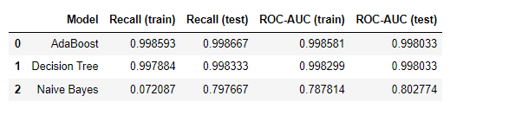
Best Model
The best model is selected from the model that produces the highest average recall value for the test data and does not indicate overfitting and underfitting. Based on the table above, the selected model is AdaBoost with an average recall for the testing data of 0.998667

Slide 14

Confusion matrix of the best model after the tuning process. Resulting in True Negative (TN) 79.57%, True Positive (TP) 20.30%, False Negative (FN) 0.07%, False Positive (FP) 0.07% which means the model is good enough in predicting churn.
Class 0: Retain Class 1: Churn

Slide 15
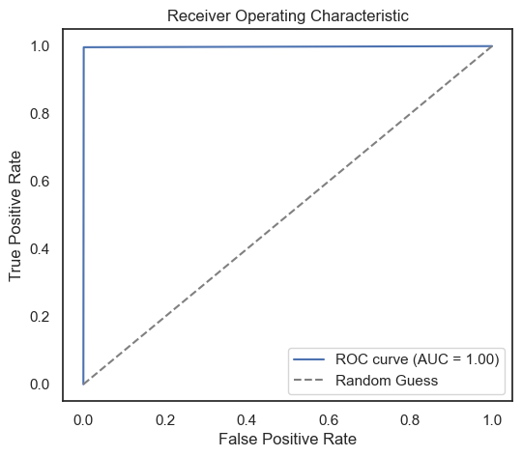
The graph shows the ROC AUC curve with an almost perfect score of 0.999998. This means that the model works well in predicting each class.

Slide 16
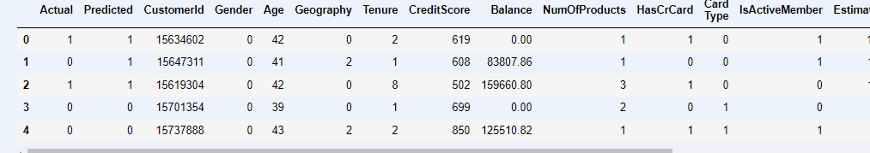
Prediction

Slide 17
Result
Based on the whole process from data preparation, analysis of data exploration results, and modeling, the following are the results:
The most suitable model evaluation metrics, in this case, are recall and ROC-AUC, using recall because it needs to take into account the percentage of False Negative (FN) that must be minimized. While ROC-AUC is to measure how well (balanced) the model predicts each class.
The best model obtained is AdaBoost which produces recall and ROC-AUC scores of 0.998667 and 0.998033 in test data, respectively.

Slide 18
Thank you

