Slide 1
Regional Round
10-12 April 2019
Maroon Berets
Shreyash Nadage, PerformAI
12-April-2019

Slide 2
Problem Statement
To help FIS improve operational efficiency using state of the art tools available today
To develop a platform for effective management of employee and project performance
EMPOWER

Slide 3
Proposed Solution
We are leveraging state of the art machine learning algorithms to develop a recommendation engine.
This is a similar concept to one used by ecommerce firms and streaming services, but optimized for employee performance management.
INNOVATE

Slide 4

Implementation
The algorithm feeds on the interaction matrix generated by employees and issues.
The users(employees) and items(issues) can be characterised futher by their respective relevent features.
The recommendation engine learns the latent features of each employees and issues.
The recommendation engine can generate recommendation even for new issues and users.

Slide 5
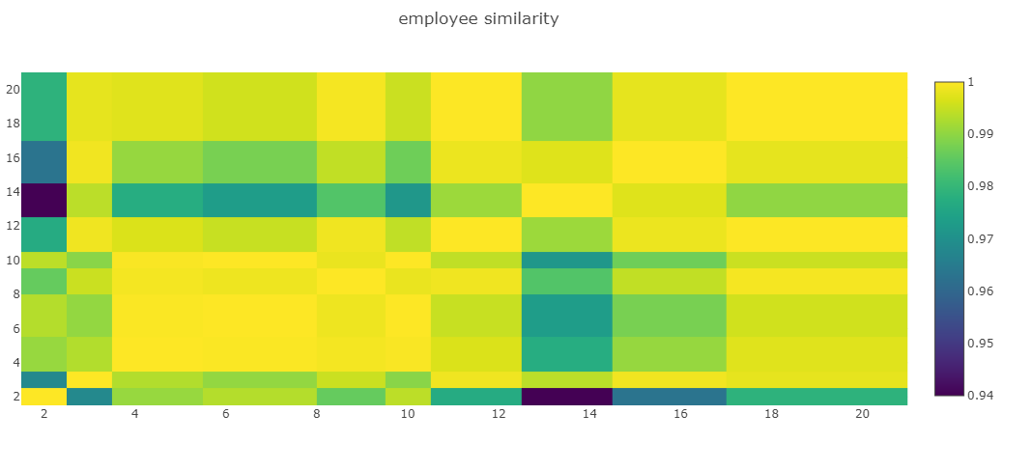
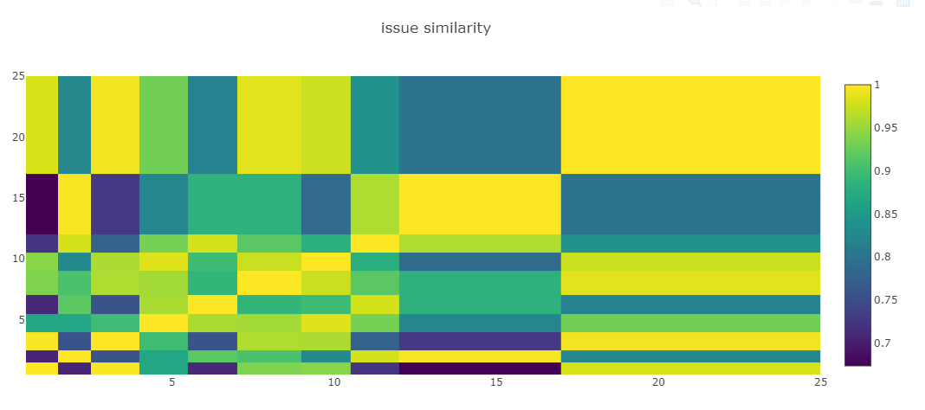
Metric Visualization

Slide 6
Applications
PerformAI increases operational efficiency by assigning issues using AI to find the best possible fit.
Helps in project management by helping managers to figure out individual employee’s strength and areas where skill development needs to be targeted.
It can also be used by employees to monitor their own progress over a period of time and showcase improvement in performance using metrics from PerformAI.

Slide 7

Future Scope
PerformAI can be seamlessly integrated with Performance360 to give real time employee and operational metrics
A GenZ idea like Performace360 needs a GenZ tool “PerformAI”.

Slide 8

Thank You!

Slide 9

Q & A

