Slide 1
Predictive Model for Customer Booking
Building prediction model using Machine Learning for booking completion

Slide 2
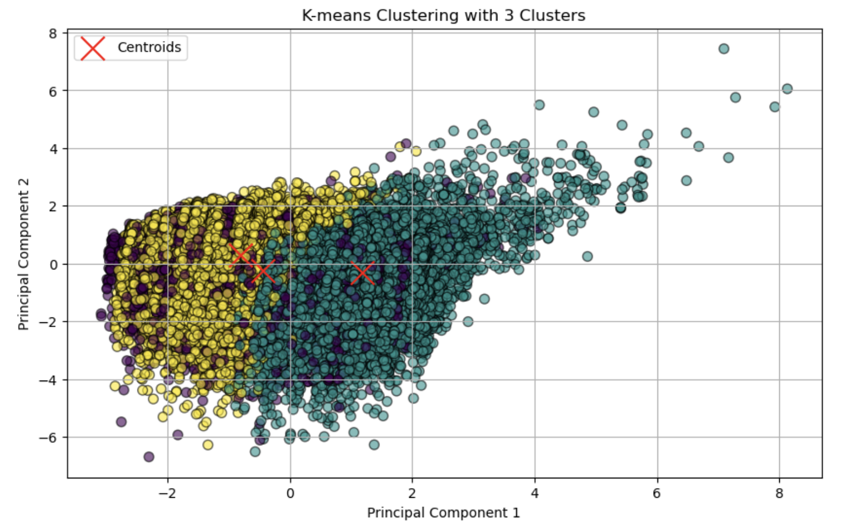
Customer Segmentation using Clustering Analysis
Predictive Model Analysis
Logistic Regression and Decision Trees Algorithm were used for building the model.
To enhance the Performance hyperparameter tuning was used.
Decision Trees outperformed Logistic Regression with 78% accuracy to 64%.
The confusion matrix indicated the model correctly identified 6377 non-bookers and 6948 bookers out of 16981 instances.
Precision (76.63%): Accuracy of positive predictions; 76.63% of predicted "booking completed" cases were correct. Helps minimize false positives.
Recall (81.89%): Ability to identify actual positive cases; 81.89% of true "booking completed" cases were correctly identified. Ensures most potential bookers are captured.
F1-Score (79.17%): Balances precision and recall, indicating overall model performance. Guides effective customer targeting strategies.
Purpose: Can help in identifying distinct groups within customers
Benefits: Tailored marketing strategies for each segment.
Enhancing customer experience as per the review of similar reviews of customers.

